Slide 1
PRESS methodology Modernization
April 2025

Slide 2
Content
Current Methodology
CRS Data
Methodological requirements
Methodology proposal

Slide 3
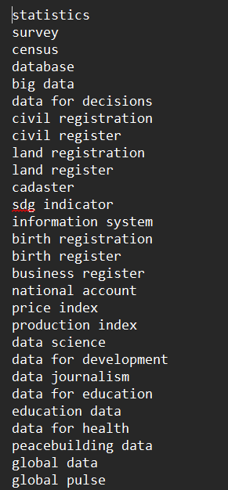
Preparation: CRS & keywords
CRS data
Statistical
keywords
…
projecttitle
shortdescription
longdescription
purposecode

Slide 4
Current Methodology
All steps
Preparation
  Downloading CRS datasets: 1 year, 1 dataset
  Create ID: hashed string based on projectnumber, crsid, year, purposecode, usd_disbursement, recipientcode
  Clean text: remove punctuation from titles, short description, long description
  Identify long descriptions for text mining: if it’s different from title and short description
Identifying statistics projects
  Language detection
  Detecting keywords in titles: keyword matching for statistics & gender from keyword lists
  Marking projects with statistics purpose codes
Frequency-based text mining
  Calculation of odds ratio for every term in statistical project’s long description compared to non-statistical project (no ppcode)
  Using odds ratio to filter projects without statistics purpose code and statistics title

Slide 5
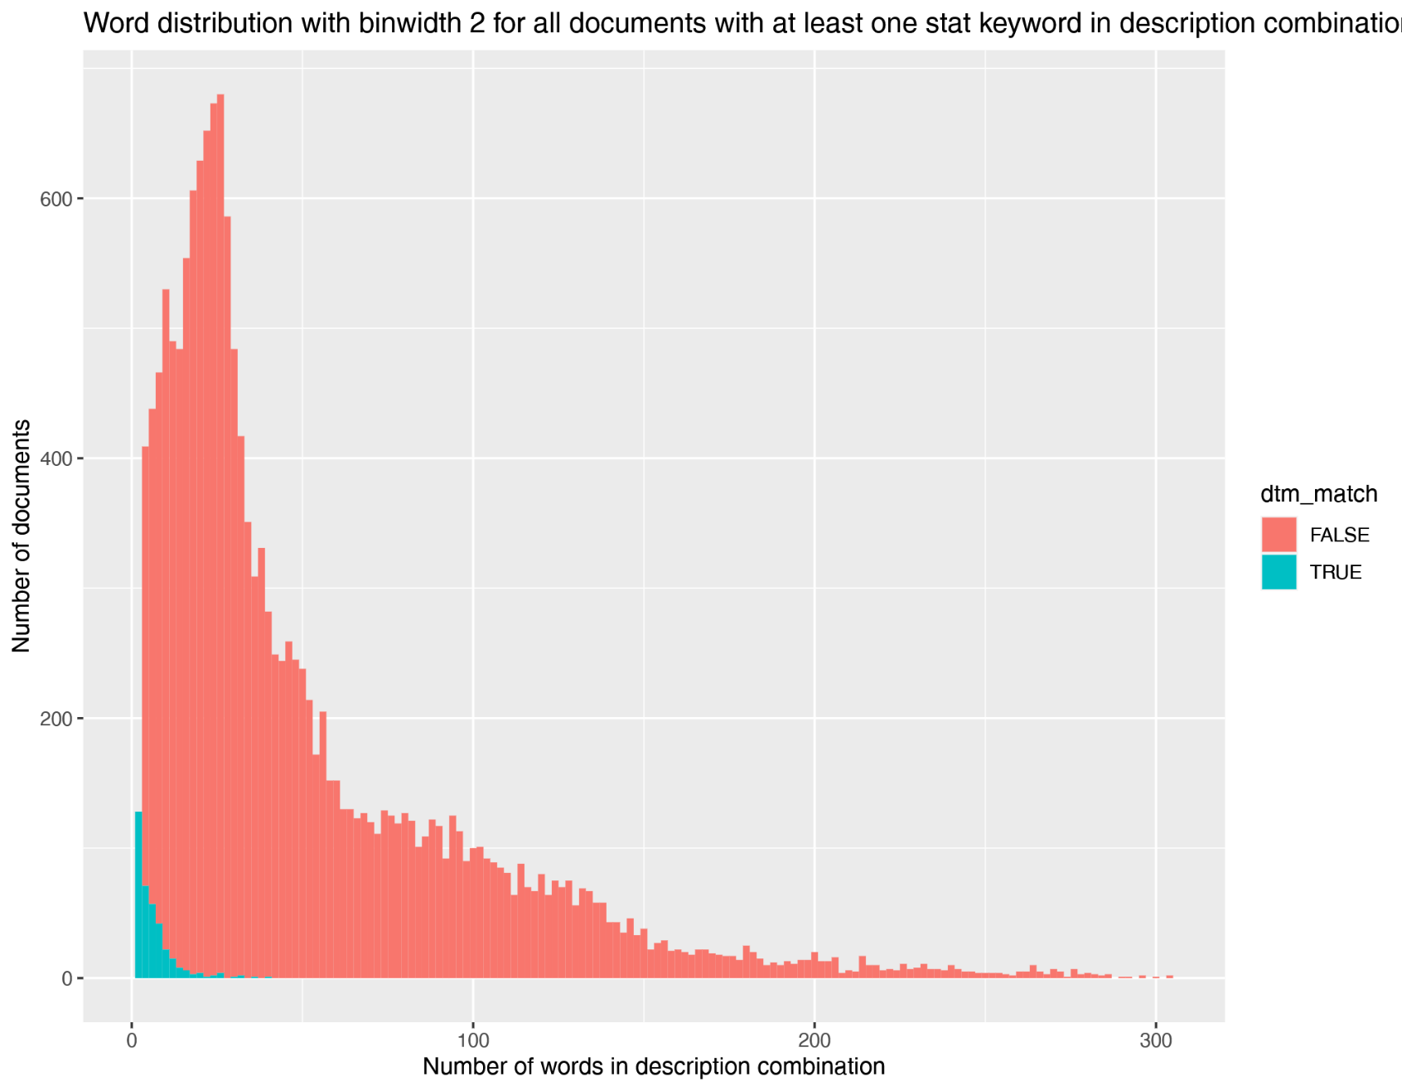

Former Frequency-based approach
Former methodology:
-> project marked as stat
$$\frac{{words}_{stat}}{{words}_{total}}>threshold$$

Slide 6
Data Science approach: XGBoost
Precondition:
Available training set available as projects that have been marked as statistical by reporters by purpose codes
statistical projects
?
Robust positively marked set
Rest combination non-stat & ?
statistical projects
non-stat projects
?

Slide 7

Data Science approach: XGBoost
Precondition:
Available training set available as projects that have been marked as statistical by reporters by purpose codes
statistical projects
?
Robust training
and validation set
Test set
statistical projects
non-stat projects
non-stat projects
?

Slide 8
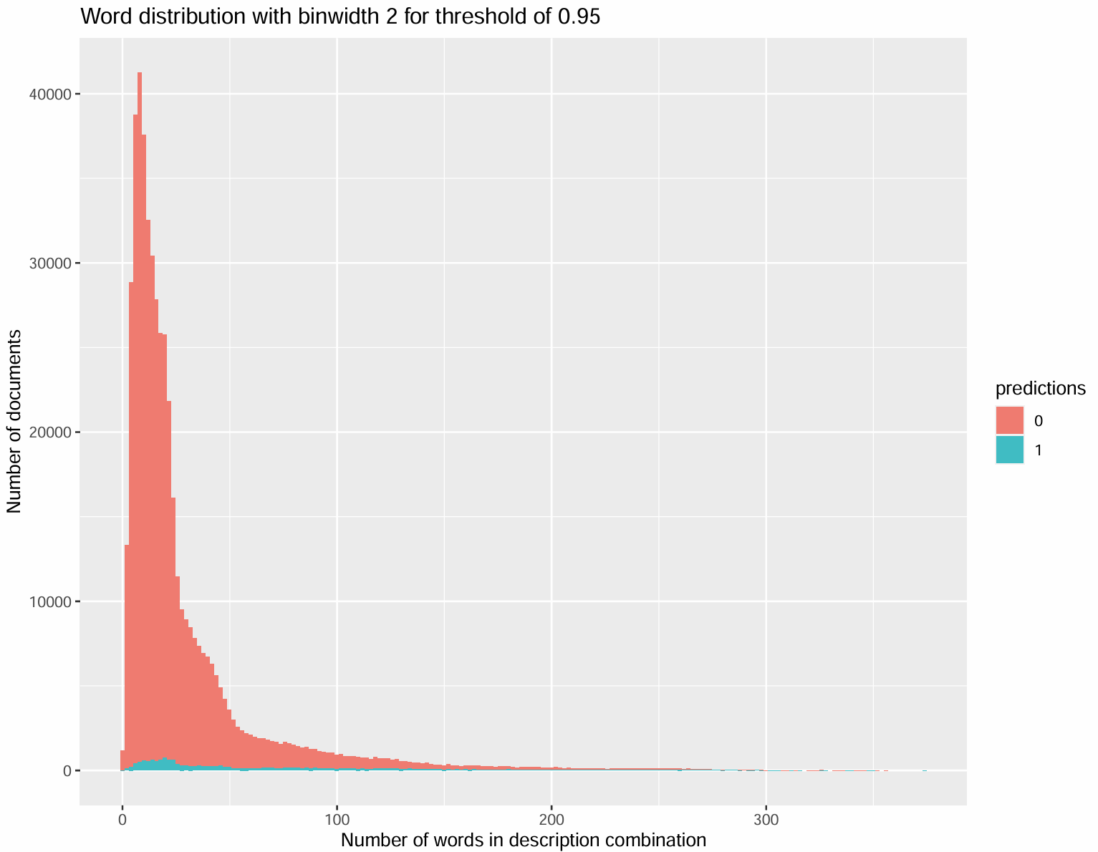
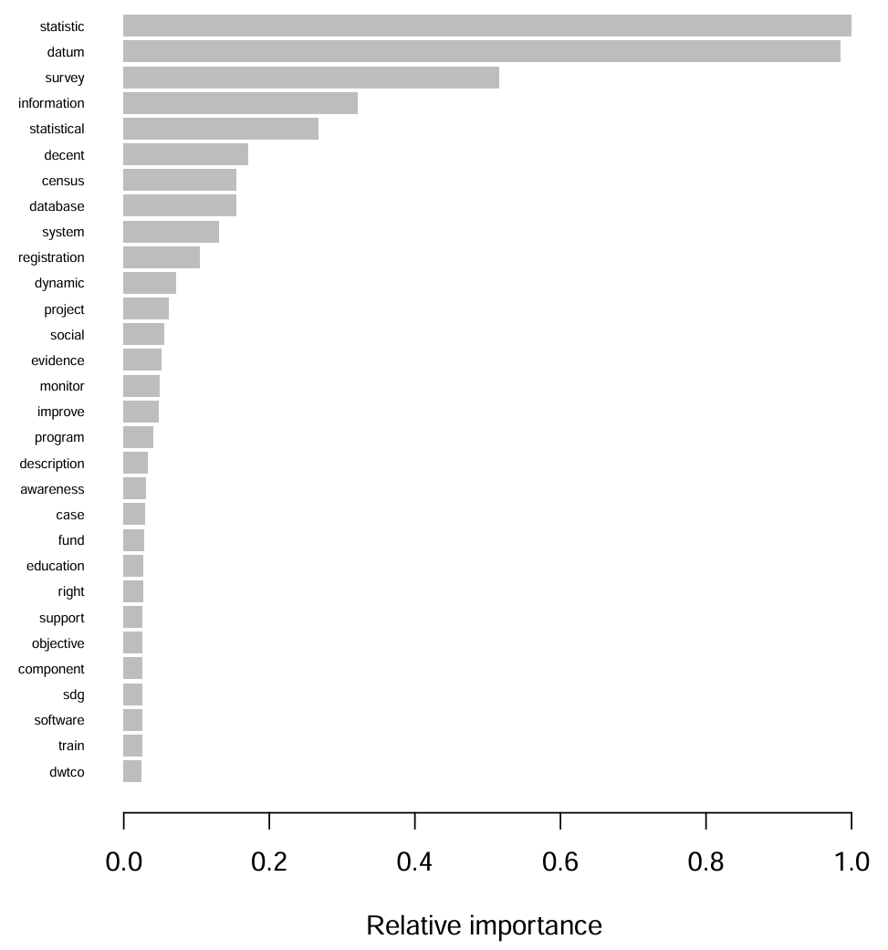
Data Science approach: XGBoost

Slide 9
Open questions
Open questions:
  Frequency based vs data science approach
  R vs Python
  CSA classification update (5 -> 7 categories)
  Methodology note currently showing XGBoost
  No mentions of methodology in PRESS 2024 report
  (Variance estimation: single figure in report e.g. 799 Billion USD)

