Slide 1


International Conference on Computational Technologies for Research in Data Analytics (ICCTRDA 2025)
21st -22nd November 2025
Causal Explainable AI Using Quantum Inspired Embeddings for Financial Risk Modeling
Authors
Parth Bramhecha*, Shubham Chandratre, Rajdeep Thakur, Parth Manekar and Dr.Emmanuel Mark
Affiliation of Presenting Author
Dept. of Information Technology, Pune Institute of Computer Technology, Pune, India
Paper ID 619

Slide 2
International Conference on Computational Technologies for Research in Data Analytics (ICCTRDA 2025)
21st -22nd November 2025
INDEX:
Abstract
Introduction
Literature Review
Research Gaps
Proposed Methodology
Results & Discussions
Comparative Analysis
Conclusion & Future Work
References

Slide 3
International Conference on Computational Technologies for Research in Data Analytics (ICCTRDA 2025)
21st -22nd November 2025
2. ABSTRACT:
Counterparty Credit Risk (CCR) in networked financial systems requires solutions that balance predictive accuracy with interpretability. Standard machine learning models, though effective in prediction, often lack transparency and fail to capture causal relationships. We propose a Quantum Inspired Causal Explainable AI (XAI) framework integrating random Fourier based quantum embeddings, causal graph learning, and concept level explainability via Testing with Concept Activation Vectors (TCAV). A Random Forest classifier, trained on a SMOTE resampled subset of the Home Credit Default Risk dataset, is evaluated under simulated macroeconomic stress conditions. The approach yields fine grained insights into CCR dynamics and reveals interpretable risk transmission channels. Compared to SHAP and counterfactual based methods, the framework preserves predictive robustness while enhancing interpretability, addressing known shortcomings of prior XAI approaches in finance. This methodology provides regulators and financial institutions with causally grounded, actionable insights, enabling a more informed trade off between model accuracy and explanatory clarity.

Slide 4
International Conference on Computational Technologies for Research in Data Analytics (ICCTRDA 2025)
21st -22nd November 2025
3. INTRODUCTION:
The Problem: CCR is the risk that a financial counterparty (bank, institution, borrower) fails to repay or defaults on a contract such as a loan or derivative.
In global financial systems, many institutions are interconnected — so a single default can cause chain reactions.
Limitations of Current Methods:
  Black-box ML models: High accuracy but poor interpretability and limited regulatory trust.
  Post-hoc explainers (SHAP, LIME): Fail to capture true causal dependencies.
  Quantum models: Offer theoretical benefits but lack integration with practical explainability.
Our Proposed Solution: We propose a Quantum-Inspired Causal Explainable AI (XAI) framework that combines lightweight quantum-inspired embeddings with causal graph learning and concept-based interpretability (TCAV). Trained on the Home Credit dataset, the model provides interpretable, causally grounded insights into credit risk propagation while maintaining predictive stability under stress conditions.

Slide 5
International Conference on Computational Technologies for Research in Data Analytics (ICCTRDA 2025)
21st -22nd November 2025
4. LITERATURE REVIEW :
Table 1. Literature Summary
Author(s) | Work Done | ML Algorithm | Methodology / Features Used
Ileberi et al. [2] | Stacked ensemble for credit risk prediction | Random Forest + Gradient Boosting + XGBoost | Feature selection with filter methods; high AUC (0.91) but limited interpretability
Zolotukhin et al. [12] | Comparative study of interpretable ML models | Decision Trees, Rule Learners, GAM | Focus on transparent credit scoring and regulatory trust
Schmid et al. [19] | Neural fuzzy modeling for bank credit risk | Neural Fuzzy Network | Combines neural learning with rule-based interpretability
Sonani et al. [6] | Hybrid XAI system with compliance metric | SHAP + Counterfactual + “What-if” Analysis | Integrates multiple explainability tools with a Regulatory Alignment Metric (RAM)
Schetakis et al. [7] | Quantum ML for credit scoring | Quantum Neural Network | Post-hoc SHAP explanations on quantum-enhanced embeddings
Mironowicz et al. [8] | Quantum ML applications in finance | QML Framework | Fraud detection, portfolio optimization, CCR modeling (conceptual only)
Proposed Work (Bramhecha et al.) | Quantum-Inspired Causal XAI for Counterparty Credit Risk | Random Forest (on quantum embeddings) | Random Fourier-based quantum feature embedding, causal graph learning, and concept-level TCAV explainability with stress testing

Slide 6
International Conference on Computational Technologies for Research in Data Analytics (ICCTRDA 2025)
21st -22nd November 2025
5. RESEARCH GAPS :
Our work addresses the following gaps identified in the literature:
Lack of Causal Transparency: Existing credit risk models focus on accuracy but fail to reveal causal relationships among financial factors.
Poor Explainability of ML Models: Ensemble and deep learning models act as black boxes, limiting trust and regulatory compliance.
Limited Use of Quantum-Inspired Techniques: Quantum approaches in finance are mostly theoretical and not integrated with interpretable AI.
Absence of Stress-Aware Insights: Current frameworks rarely assess model behavior under macroeconomic shocks, reducing real-world reliability.

Slide 7
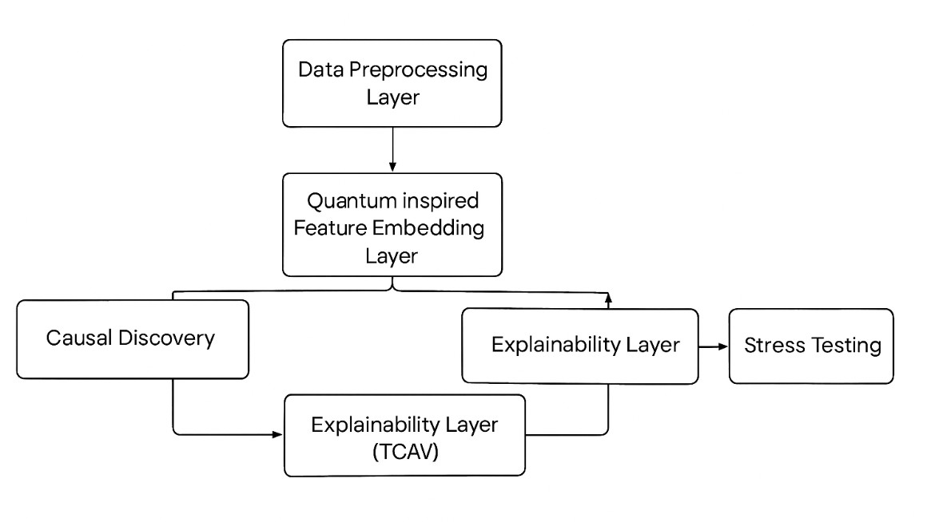
International Conference on Computational Technologies for Research in Data Analytics (ICCTRDA 2025)
21st -22nd November 2025
Proposed Methodology:
Fig. 1. Proposed Block Diagram

Slide 8
International Conference on Computational Technologies for Research in Data Analytics (ICCTRDA 2025)
21st -22nd November 2025
Layers Description
Data Preprocessing Layer: A stratified subset of 5,000 samples is selected, six core features are retained, and missing values are imputed using median replacement.
Quantum-Inspired Feature Embedding Layer: The selected features are transformed into a 21-dimensional space using normalization, sinusoidal functions, and Random Fourier Feature embeddings.
Causal Discovery Layer: Causal relationships are computed using Pearson correlation and mutual information to construct a causal graph showing directional influence among variables. 30 causal relationships are discovered.
Risk Prediction & Explainability Layer: A Random Forest model is trained on the embedded features with SMOTE balancing, and TCAV tells how much each concept(Liquidity, Credit Exposure, Credit Score) influence the prediction.
Stress Testing & Visualization Layer: Evaluate how the model behaves under: Interest Rate Shocks, Liquidity Crisis, Credit Crunch.

Slide 9
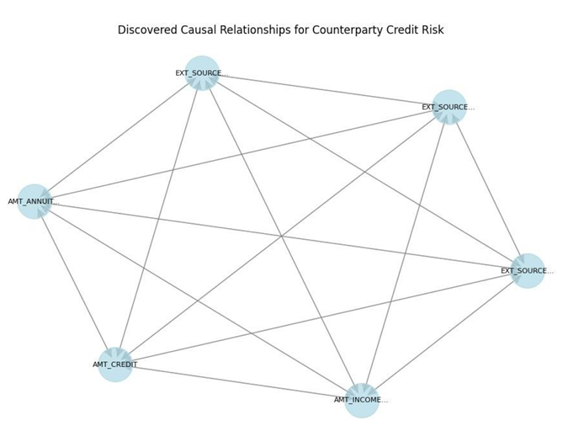
International Conference on Computational Technologies for Research in Data Analytics (ICCTRDA 2025)
21st -22nd November 2025
Fig 2. Causal Graph of Quantum Enhanced Features

Slide 10
International Conference on Computational Technologies for Research in Data Analytics (ICCTRDA 2025)
21st -22nd November 2025
7. RESULTS & DISCUSSION:
Performance
Accuracy: 85%
AUC-ROC: 0.559 (moderate because the default class is very rare)
Default recall: 0.03 (a known issue due to SMOTE and imbalance)
Explainability Insights
TCAV scores show the relative importance:
Credit Score — 0.024 (most important & influential)
Liquidity — 0.018
Credit Exposure — 0.016
Stress Testing Results
The model remains stable under shocks:
Only small increases in default risk on average
But high-risk clients show significant spikes (up to 0.20)
This indicates realistic financial behavior.

Slide 11
International Conference on Computational Technologies for Research in Data Analytics (ICCTRDA 2025)
21st -22nd November 2025
Table 2. Performance Metrics of Risk Model
Table 3. TCAV Scores Across Stress Scenarios
Class | Precision | Recall | F1 score | Support
0 (Non default) 1 (Default) | 0.90 0.05 | 0.93 0.03 | 0.92 0.04 | 902 98
Accuracy Weighted Avg | 0.82 | 0.85 | 0.85 0.83 | 1000 1000
Concept | Interest Rate Shock | Liquidity Crisis | Credit Crunch
Liquidity | 0.012 | 0.026 | 0.011
Credit Exposure | 0.018 | 0.013 | 0.020
Credit Score | 0.022 | 0.017 | 0.019

Slide 12
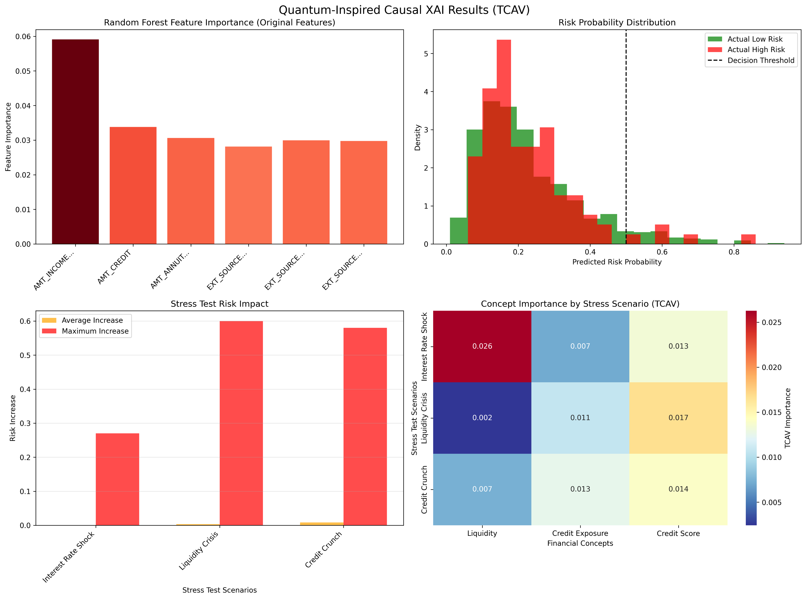
International Conference on Computational Technologies for Research in Data Analytics (ICCTRDA 2025)
21st -22nd November 2025
🔹 Top-Left: Random Forest Feature Importance
AMT_INCOME_TOTAL is the most influential feature for risk prediction.
Other key contributors: AMT_CREDIT, AMT_ANNUITY, and EXT_SOURCE_1–3.
Indicates that income and external credit sources heavily drive model decisions.
🔹 Top-Right: Risk Probability Distribution
Green = Actual Low Risk, Red = Actual High Risk.
Most predictions lie below 0.4 probability, showing a conservative model bias.
The decision threshold (≈0.5) effectively separates low and high-risk borrowers.
🔹 Bottom-Left: Stress Test Risk Impact
Stress scenarios tested: Interest Rate Shock, Liquidity Crisis, Credit Crunch.
Liquidity Crisis and Credit Crunch cause the highest risk increase (≈0.6).
Average risk rise is minimal, showing resilience under mild stress, but sharp spikes under severe shocks.
🔹 Bottom-Right: TCAV Concept Importance Heatmap
Measures causal importance of financial concepts across stress tests.
Liquidity concept most sensitive during Interest Rate Shock (TCAV ≈ 0.026).
Credit Exposure and Credit Score gain influence in Liquidity Crisis and Credit Crunch respectively.
Highlights that concept-level importance shifts dynamically under stress — useful for causal interpretability.
Fig. 3. Composite view of model outputs: Feature Importance (Top-Left), Risk Distri- bution (Top-Right), Stress Test Summary (Bottom-Left), TCAV Concept Importance Heatmap (Bottom-Right).

Slide 13
International Conference on Computational Technologies for Research in Data Analytics (ICCTRDA 2025)
21st -22nd November 2025
8. COMPARATIVE ANALYSIS:
Table 4. Traditional vs Proposed Comparison
Feature | Traditional ML Model | Quantum-Inspired Causal XAI (Proposed)
Core Logic | Utilized standard feature inputs with purely statistical learning. | Employs Random Fourier-based quantum embeddings and causal graph learning for deeper relationship discovery.
Interpretability | Relied on post-hoc methods like SHAP or LIME, offering limited causal insight. | Integrates TCAV concept-level explainability, mapping model behavior to liquidity, credit exposure, and credit score.
Robustness Under Stress | Performance degraded under macroeconomic shocks due to lack of causal reasoning. | Maintains interpretability and consistency through stress-aware causal modeling and adaptive TCAV scoring.
Overall Performance | High predictive accuracy but poor transparency and regulatory alignment. | Provides a balanced trade-off between accuracy and explainability, suitable for financial risk monitoring and compliance.

Slide 14
International Conference on Computational Technologies for Research in Data Analytics (ICCTRDA 2025)
21st -22nd November 2025
9. CONCLUSION & FUTURE WORK :
Conclusion
  This work presents a Quantum-Inspired Causal Explainable AI (XAI) framework for Counterparty Credit Risk (CCR) analysis, integrating quantum-inspired embeddings, causal graph learning, and concept-level TCAV explainability.
  The framework achieves a strong balance between predictive performance and interpretability, offering transparent insights into financial risk propagation.
  While the model demonstrates robustness under stress testing, limitations include low recall for default cases and the computational overhead of quantum embeddings.
Future Work
  Quantum Integration: Implement real quantum hardware for feature embedding and computation.
  Enhanced Causal Discovery: Apply advanced causal inference methods such as Granger Causality for deeper dependency modeling.
  Domain-Guided Constraints: Incorporate financial domain knowledge to refine causal structure accuracy.
  Multimodal Explainability: Extend the framework by fusing tabular data with financial news sentiment for richer, context-aware risk interpretation.

Slide 15
International Conference on Computational Technologies for Research in Data Analytics (ICCTRDA 2025)
21st -22nd November 2025
10. REFERENCES :
De Santis, A., Campi, R., Bianchi, M., Brambilla, M.: Visual TCAV: Concept based Attribution and Saliency Maps for Post hoc Explainability in Image Classification. arXiv preprint arXiv:2411.05698 (2024). https://arxiv.org/abs/2411.05698
Ileberi, E., Sun, Y., Wang, Z.: A machine learning based credit risk prediction engine system using a stacked classifier and a filter based feature selection method. J. Big Data 11(23), 2024. https://doi.org/10.1186/s40537-024-00882-0
Quan, J., Sun, X.: Credit risk assessment using the factorization machine model with feature interactions. Humanit. Soc. Sci. Commun. 11, 234 (2024). https://doi.org/10.1057/s41599-024-02700-7
Bowden, J., Cummins, M., Dao, D., Jain, K.: Explainable AI for Financial Risk Management. University of Strathclyde (2024). https://strathprints.strath.ac.uk/89573/
Černevičiene˙, J., Kabašinskas, A.: Explainable artificial intelligence in fi- nance: a systematic literature review. Artif. Intell. Rev. 57, 216 (2024). https://doi.org/10.1007/s10462-024-10854-8
Sonani, R.: Hybrid XAI Framework with Regulatory Alignment Metric for Adap- tive Compliance Enforcement by Government in Financial Systems. (2024). https://orcid.org/0009-0009-4072-0479
Schetakis, N., Kottas, D., Branagan, S.R.K., Papandreou, A.: Quantum Machine Learning for Credit Scoring. Mathematics 12(9), 1391 (2024). https://www.mdpi.com/2227-7390/12/9/1391
Mironowicz, P., Lee, T.C.M., Lim, M.H., Shapiro, J.K.: Applications of Quan- tum Machine Learning for Quantitative Finance. arXiv preprint arXiv:2405.10119 (2024). https://doi.org/10.48550/arXiv.2405.10119
Wilkens, S., Moorhouse, J.: Quantum Computing for Financial Risk Measurement. Quantum Inf. Process. 22, 51 (2023). https://dx.doi.org/10.2139/ssrn.4022463

Slide 16
International Conference on Computational Technologies for Research in Data Analytics (ICCTRDA 2025)
21st -22nd November 2025
Herman, D., Googin, C., Liu, X., Yang, S.T.: Quantum computing for finance. Nat. Rev. Phys. 5, 450–465 (2023). https://doi.org/10.1038/s42254-023-00603-1
Černevičiene˙, J., Kabašinskas, A.: Explainable artificial intelligence in finance: a systematic literature review. Artif. Intell. Rev. (2024)
Zolotukhin, Z., Ivanov, S., Ablayev, A.: Interpretable Machine Learning Models for Credit Scoring: A Comparative Study. Financ. Innov. 9, 121 (2023)
Lee, C., Hsu Shih, W., Turing, A.: Feature Relevance Methods for Financial AI Explained. J. Financ. Data Sci. (2023)
Santos, M., Kim, D., Cooper, R.: Simplification Techniques for XAI Models in Banking Sector. Int. J. Bank. Financ. (2022)
Petrenko, O., Makarov, I.: Local Explainability in Credit Default Predictions. Ex- pert Syst. Appl. (2023)
Kumar, V., Al Hassan, F., Carter, J.: Visual Explanation Approaches for Fraud Detection in Finance. IEEE Trans. Neural Netw. Learn. Syst. (2024)
Rodriguez, A., Liu, P., Desai, S.: Transparent Models for Loan Approval Processes. In: Artificial Intelligence in Finance (2023)
Nowak, T., Wojcik, K.: XAI Frameworks and their Applications in Finance: Cur- rent State and Challenges. Comput. Econ. (2024)
Schmid, M., Becker, L., Weber, H.: Neural Fuzzy Modeling for Bank Credit Risk Management. J. Risk Financ. (2022)
Silva, F., Martinez, R., Yildirim, E.: Value at Risk Methodology Enhanced by Fuzzy Programming for Credit Risk. Quant. Financ. (2023)

