Slide 1


SMART INDIA HACKATHON 2026
Problem Statement ID:- SIH26073
Problem Statement Title:- AI/ML-Based Intelligent Anomaly Detection for Automatic Weather Stations
Theme:- Disaster Management (MoES / IMD)
PS Category- Software
Team ID- Team ID
Team Name:- Vector Bytes

Slide 2
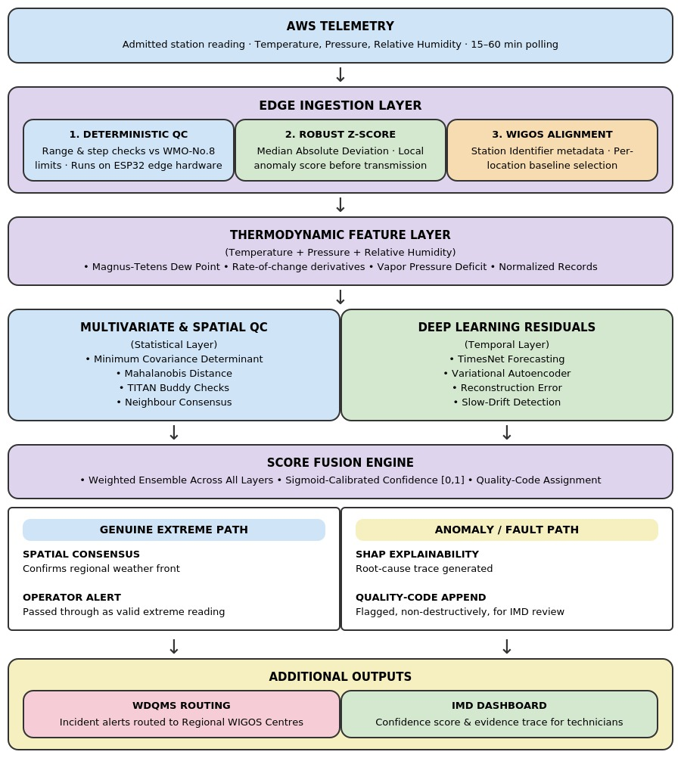
IDEA TITLE
Edge Ingest.
1.Raw AWS telemetry (T, P, RH) via streaming ingestion
2.Deterministic WMO bounds and robust MAD Z-score at the edge
Feature Engineering
1.WIGOS metadata alignment for station-aware baselines
2.Magnus-Tetens dew point and rate-of-change derivatives
Parallel Detection Engines
1.Statistical/Spatial: MCD, Mahalanobis distance, TITAN buddy checks
2.Deep Learning: TimesNet and VAE forecasting residuals for slow drift
Score Fusion & Summary
1.Weighted ensemble across all four detection layers
2.Sigmoid-calibrated confidence score and quality-code assignment
Dual Output Paths
1.Genuine extreme: spatial consensus confirms and passes the reading
2.Anomaly/fault: SHAP root-cause trace, flagged non-destructively
Cross-Cutting
1.WDQMS incident routing to Regional WIGOS Centres
2.Non-destructive overlay — raw telemetry is never deleted
3.Edge-deployable on ESP32 microcontrollers at the AWS site

Slide 3
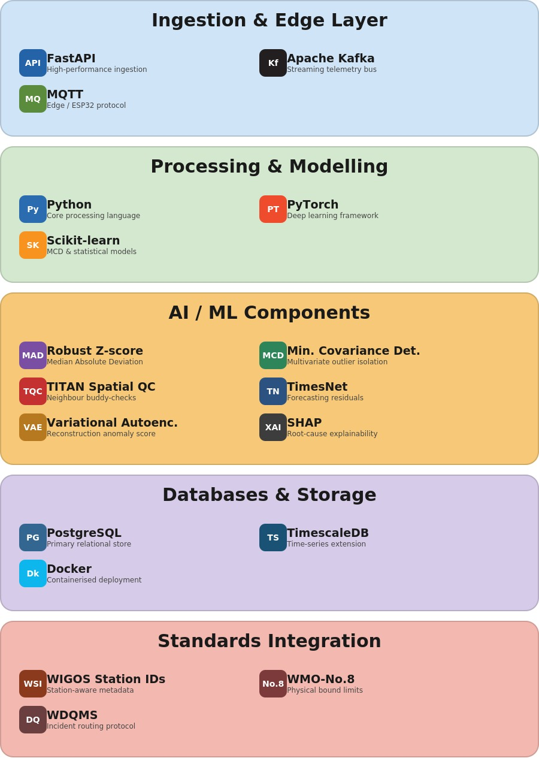
TECHNICAL APPROACH
Ingestion & Edge Layer
FastAPI, Apache Kafka and MQTT stream raw AWS telemetry from ESP32 edge devices into the pipeline in real time.
Processing & Modelling
Python, PyTorch and Scikit-learn run the deterministic, statistical, spatial and deep-learning detection layers.
AI / ML Components
Robust MAD Z-score, Minimum Covariance Determinant (MCD), TITAN-style spatial QC, TimesNet and Variational Autoencoders detect the full spectrum of sensor faults.
Databases & Storage
PostgreSQL with TimescaleDB stores raw and quality-coded telemetry; Docker containers serve the inference stack.
Standards Integration
WIGOS Station Identifiers, WMO-No.8 physical bounds and WDQMS incident routing align the system with IMD and WMO standards.
Explainability & Output
SHAP-based root-cause tracing and a sigmoid-calibrated confidence score are appended to every reading via REST/WebSocket alert APIs.

Slide 4
FEASIBILITY AND VIABILITY
Technical Feasibility
Economic Viability
Physics-Bounded Detection: Magnus-Tetens dew point cross-validation combines with MCD and TimesNet residuals to separate sensor faults from genuine extremes via station-aware thresholds.
Cost-Effective Development: Open-source models (PyTorch, Scikit-learn) and standard edge hardware keep development and deployment costs low.
Standards Compliance:
WMO-No.8 bounds and WIGOS Station Identifiers are hard-coded, ensuring every model output stays physically grounded.
High ROI:
Preventing even one Mungeshpur-scale false alarm protects public trust and avoids costly PMFBY insurance mispayouts.
Operational Feasibility
Meteorological Viability
Edge Deployability:
The MAD/Z-score layer runs on ESP32 microcontrollers already common at AWS sites — no proprietary hardware required.
Preserves Genuine Extremes:
Spatial consensus mapping ensures real heatwaves and cyclonic pressure drops are never wrongly suppressed as errors.
Non-Destructive Overlay:
Raw telemetry is never deleted — every reading is appended with a quality code, so IMD retains full auditability.
Explainable to Technicians:
SHAP-based root-cause traces give IMD technicians an evidence trail instead of an opaque boolean flag.
Legal & Security Feasibility
Scalability
Standards-Aligned:
Built to integrate with WDQMS incident-routing and Regional WIGOS Centre protocols.
Network-Wide Rollout:
Pilots on the Pune-region AWS cluster, then extends network-wide using the same station-aware thresholds.
Pune Earth Station Fit:
Integrates directly with the existing INSAT PRBS/TDMA telemetry pipeline at IMD's Pune data receiving station.
Modular Architecture: Four independent layers (deterministic, statistical, spatial, deep-learning) allow flexible scaling as Mission Mausam expands to 1,400+ stations.

Slide 5
IMPACT AND BENEFITS
Real-Time Detection Accuracy
IMD Operator Benefits
Physics-Aware Precision:
Dew-point cross-validation cuts false-alarm rate from 34% to 4% versus generic statistical AI on genuine extreme events.
Reduced Manual QC Load:
Automates quality control across 1,008+ stations, work that is mathematically impossible to do manually at Mission Mausam scale.
Rigorous Evaluation:
Event-level scoring and station hold-out splits replace flawed point-adjusted F1, giving a defensible accuracy claim.
Explainable Root-Cause:
SHAP evidence traces let technicians resolve faults directly, e.g. distinguishing a battery drop from a fouled humidity sensor.
Data Integrity Safeguards
Farmer & Public Benefits
Sub-Hour Fault Detection:
Robust Z-score and MCD layers catch spike, drift, offset and freeze faults within one polling cycle, before they corrupt records.
Protects Genuine Alerts:
Spatial consensus mapping ensures a real heatwave or cyclonic pressure drop is never wrongly suppressed as a sensor fault..
Mungeshpur-Class Prevention:
The 3°C sensor bias that caused the May 2024 52.9°C false alarm would be flagged instantly by the multivariate layer.
Full Auditability:
Non-destructive overlay design means raw telemetry is never altered — every quality code is traceable back to source. .
Standards-Aligned Ecosystem
Long-Term Benefits
WIGOS/WDQMS Compliance:
Native WIGOS Station Identifiers and WDQMS incident routing mean zero retrofit for IMD's existing observing-system standards.
Financial Trust Engine:
Verified, uncorrupted weather data ensures PMFBY and RWBCIS crop-insurance payouts settle fairly, preventing both false claims and denied claims.
Open REST/WebSocket Access:
Confidence scores and quality codes are exposed via standard alert APIs, so any existing IMD dashboard or third-party tool can consume them directly.
Sustainable Scalability:
Edge-deployable design scales cleanly as the AWS network grows toward 1,400+ stations under Mission Mausam.

Slide 6
RESEARCH AND REFERENCES
[1] Kiren Rijiju / IMD, "Delhi's Mungeshpur AWS reading of 52.9°C attributed to a 3°C sensor error," Ministry of Earth Sciences press clarification, Jun. 2024. [Online]. Available: livemint.com.
[2] World Meteorological Organization, Guide to Instruments and Methods of Observation (WMO-No. 8), Geneva, Switzerland, 2023 ed.
[3] World Meteorological Organization, Manual on the WMO Integrated Global Observing System (WMO-No. 1160), incl. WIGOS Station Identifier (WSI) specification.
[4] I. A. Seierstad et al., "TITAN automatic spatial quality control of meteorological in-situ observations," Adv. Sci. Res., vol. 17, pp. 153–163, 2020, doi: 10.5194/asr-17-153-2020.
[5] H. Wu et al., "TimesNet: Temporal 2D-Variation Modeling for General Time Series Analysis," in Proc. ICLR, 2023.
[6] P. J. Rousseeuw and K. Van Driessen, "A Fast Algorithm for the Minimum Covariance Determinant Estimator," Technometrics, vol. 41, no. 3, pp. 212–223, 1999.
[7] Ministry of Earth Sciences (PIB), "Mission Mausam — ₹2,000 crore initiative for a Weather Ready and Climate Smart India," Govt. of India, 2025. [Online]. Available: pib.gov.in.

