Slide 1
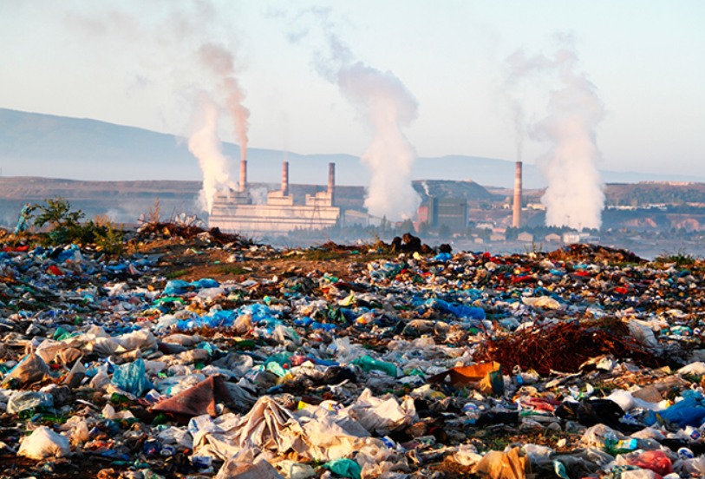
WASTE management system
Harshit Shukla (1080358)
Parth Soni (1087468)

Slide 2
Problem statement
We see huge amount of waste generation and accumulation around us like recyclable, non-recyclable, toxic, soiled waste etc. If such waste is not properly dumped and managed then it can cause unwanted consequences such as –
Spreading of different type of pollutions, i.e., air pollution, soil pollution, water pollution etc.
Spreading of infectious diseases
Polluting all our environmental resources, including forest, minerals water etc.
Many of the countries in the world have seen life threatening epidemics in the past inefficient waste disposal and management systems. This, addressing this issue at the earliest become inevitable.

Slide 3
Solution
Coordinated efforts of society and government can help to tackle this problem efficiently.
Society should also consider it as their prime responsibility to make government aware about surrounding waste in term of segregating at primary stage and informing collection centers.
Proper waste management system must include following functions –
Collection
Planning and segregation
Dumping
Recycling
Disposing

Slide 4
Approach
Our approach to the solution is to create a platform, which can provide facility to the requestors (civilians, industrialists, scrap stores etc.) to report any request for government for waste collection so that it can come to attention and is efficiently managed in later stages like planning, transportation, recycling and disposal.
Requestors can also see the status of the request created and whether it got recycled or and what is the produced product from the waste.
Whole waste management process is distributed among different enterprises and their organizations functioning independently and interacting with each other as well.
Each organization can see requests under their work area and take actions and assign to sub sequent organization and enterprise.

Slide 5
workflow
Government
Transportation
Recycler
Planning
T-Service
Quality Analysis
Collection
Recycler Plant
Requester
Production Unit

Slide 6
Use Case

Slide 7

Waste Management System
Request created
Collection Unit
Waste collected
Planning Unit
Requestor
Waste checked, planned and request assign to Government
Final product estimation & savings
Government
Product reached
Ready to transport
Transportation
Product Ready for transport
Transported to recycling site
Recycler
Waste sent to QA for quality check
Products from waste
If quality check fails
Production
Product sent for quality check
Quality Assurance
Ready for best from waste
Recycle Plant
Ready to recycle if quality check passes

Slide 8
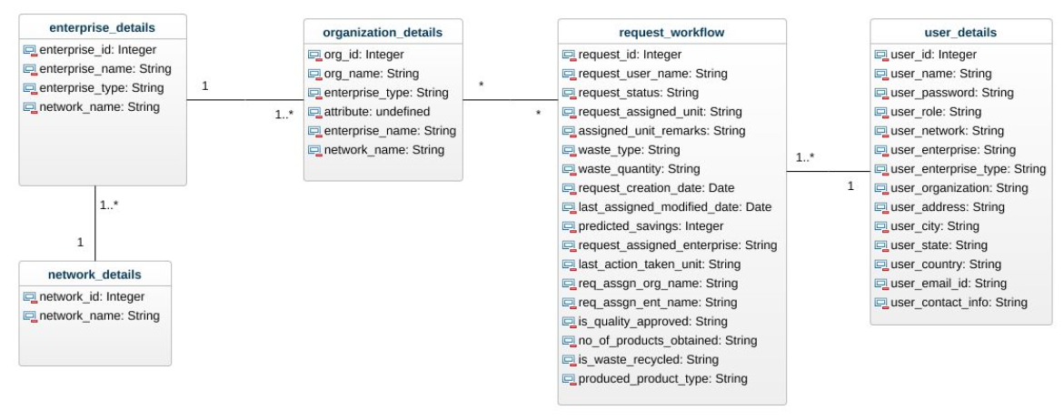
Object model diagram

Slide 9
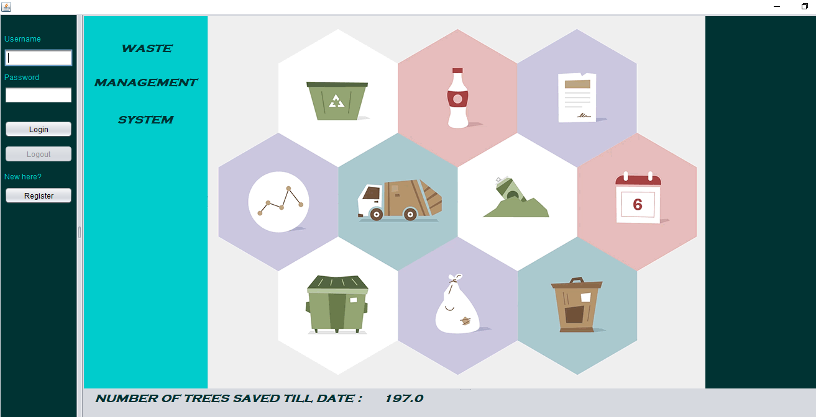
USER INTERFACE DESIGN

Slide 10
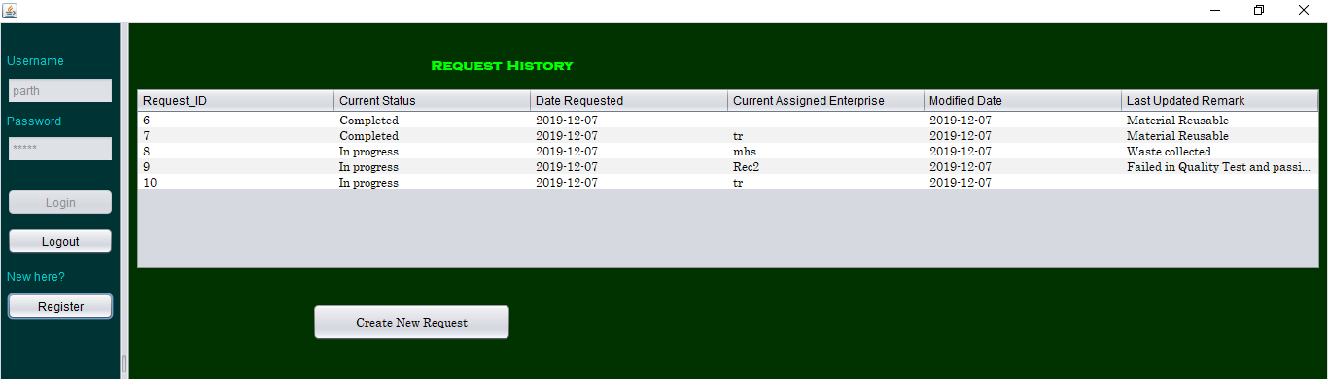
After cycle completes

Slide 11
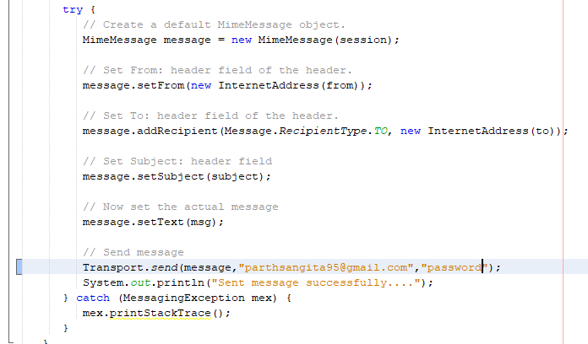
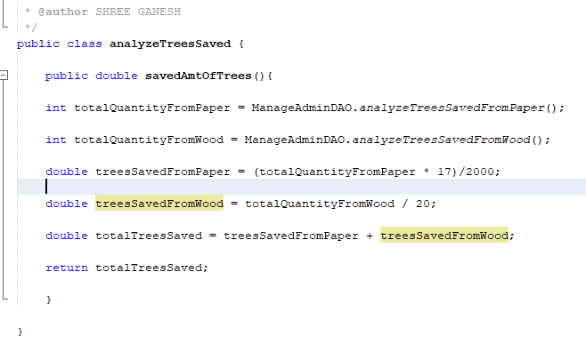
Code snippets

Slide 12
Future scope
This project can be scaled at very high level, adding many other components which can interact with each other efficiently. Future scope points are as below
Application can be implemented with other in-depth parameters related to organizational units.
All organizations across all enterprises can interact with each other, incurring time saving and efficient process for waste management.
We can add critical finance saving algorithm which can save money by efficient recycling process and some percent of saving can be awarded to requestors so that they get involved and encouraged actively in managing waste handling and recycling process.
Produced products from the waste can be distributed to target entities in need.

Slide 13
Thank You!!
Questions?

