Slide 1

Medical diagnosis using heart prediction systems in ai – a presentation slide by – b – 18 - Rutuja joshi. B – 29 - sagar Waghmare. B – 58 - parth tilay. B – 61 - Himanshu dhore.

Slide 2
Contents: 1 . Introduction. 2. heart and its functioning. 3. why heart diagnosis are important 4. medical diagnosis using ai 5. working of model. A. Dataset. B. Modelling and prediction. C. models used. 6. Summary.

Slide 3
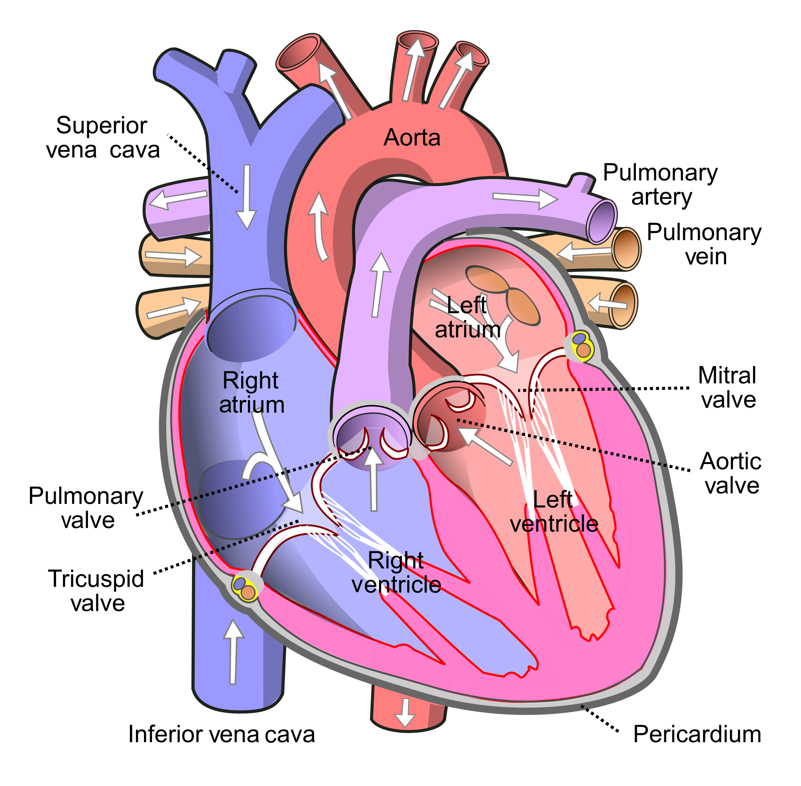
Heart and its functioning -
The heart is divided into four chambers and has valves that allow the blood to flow in one direction only. ~ The upper two chambers with relatively thin walls are called atria. ~ The two lower chambers with thick muscular walls are called ventricles.~ The figure shows the complete circulatory system in the body. ~ The right atrium receives carbon dioxide-rich blood from the various parts of the body and is then moved into the right ventricle.~ The right ventricle pumps the blood to the lungs, where carbon dioxide is removed and oxygen is absorbed.~ The left atrium receives oxygen-rich blood as it comes back to the heart from the lungs and is pushed into the left ventricle.~ The left ventricle pumps this blood to the rest of the body. The right side of the heart is completely separated from the left side with the help of a partition called the septum. ~ This prevents the mixing of oxygenated and de-oxygenated blood

Slide 4

Heart Diagnosis and its importance –
Today’s World is a never stopping and a rigorous changing model. Stress, anxiety, excitement is heavily bulging inside the body. Thus, having an annual check up for the heart and the body is important. As heart is a very delicate and the most important part we have to keep it healthy and happy all the time.

Slide 5
Medical diagnosis using ai we are creating a model that is used for the prediction of heart diseases on the basis of the previous medical history. Asserted by the patients. This prediction is done by using the supervised machine learning model tied with logistic regression to predict the outcomes of the datasets(medical history). On the basis of the data history(datasets) , we create our model that helps the model for prediction of outcomes. There are several real-time examples that come under this modelling such as Detecting lung cancer or strokes based on CT scans, Assessing the risk of sudden cardiac death or other heart diseases based on electrocardiograms and cardiac MRI images etc.

Slide 6
Working of diagnosis Model – heart prediction needs to be a very careful task , because all our health and life is dependant over it. Thus when we dive deep into the prediction, data is the most important asset that is required to make model think on its own. Using the dataset the model gets train into several machine learning models and thus makes predictions on the basis of the accuracy. Thus, the highest accuracy defines heart disease’s presence. Here we train our model using certain machine learning models so that actually it can define the presence of the heart disease inside a machine.

Slide 7
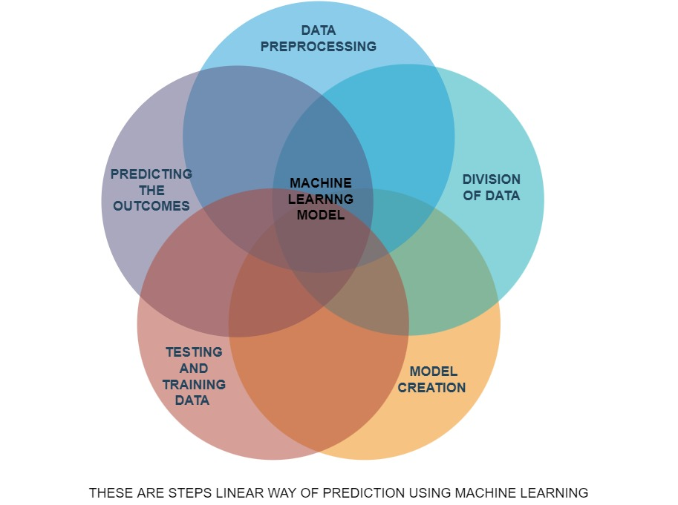
Linear way of prediction

Slide 8
dataset The dataset consists of 1026 individuals data. There are 14 columns in the dataset, which are described below:- Age: Displays the age of the individual. Sex: Displays the gender of the individual using the following format : 1 = male 0 = female Chest-pain type: displays the type of chest-pain experienced by the individual using the following format : 1 = typical angina 2 = atypical angina 3 = non — anginal pain 4 = asymptotic Resting Blood Pressure: displays the resting blood pressure value of an individual in mmHg (unit)

Slide 9
SERUM CHOLESTROL: DISPLAYS THE SERUM CHOLESTEROL IN MG/DL (UNIT) FASTING BLOOD SUGAR: COMPARES THE FASTING BLOOD SUGAR VALUE OF AN INDIVIDUAL WITH 120MG/DL. IF FASTING BLOOD SUGAR > 120MG/DL THEN : 1 (TRUE) ELSE : 0 (FALSE)
RESTING ECG : DISPLAYS RESTING ELECTROCARDIOGRAPHIC RESULTS 0 = NORMAL 1 = HAVING ST-T WAVE ABNORMALITY 2 = LEFT VENTRICULAR HYPERTHROPHY. MAX HEART RATE ACHIEVED : DISPLAYS THE MAX HEART RATE ACHIEVED BY AN INDIVIDUAL. EXERCISE INDUCED ANGINA : 1 = YES 0 = NO ST DEPRESSION INDUCED BY EXERCISE RELATIVE TO REST: DISPLAYS THE VALUE WHICH IS AN INTEGER OR FLOAT. PEAK EXERCISE ST SEGMENT : 1 = UPSLOPING 2 = FLAT 3 = DOWNSLOPING. NUMBER OF MAJOR VESSELS (0–3) COLORED BY FLOUROSOPY : DISPLAYS THE VALUE AS INTEGER OR FLOAT. THAL : DISPLAYS THE THALASSEMIA : 3 = NORMAL 6 = FIXED DEFECT 7 = REVERSIBLE DEFECT
DIAGNOSIS OF HEART DISEASE : DISPLAYS WHETHER THE INDIVIDUAL IS SUFFERING FROM HEART DISEASE OR NOT : 0 = ABSENCE 1, 2, 3, 4 = PRESENT.

Slide 10
3. Modelling and prediction - machine learning is happening is on the rise of the phase 1. Continuous evaluation and tremendous development is happening day by day. However, for our medical diagnosis we have use supervised learning in machine learning. In this way we are directing a machine with all of its input labels and, we can predict its outcomes. We have chosen several models such as – 1. Simple vector machines. 2. naïve bayes. 3. logistic regression. 4. random forest. We can predict the heart disease using such models in order to ensure the highest accurate outcome possible available.

Slide 11
Models used in prediction
There are altogether 4 models used in the Predicting the Heart Disease –
SIMPLE VECTOR MACHINES – Support vector machines (SVMs) are a set of supervised learning methods used for classification, regression and outliers detection. The advantages of support vector machines are: Effective in high dimensional spaces. Still effective in cases where number of dimensions is greater than the number of samples. Well SVM it capable of doing both classification and regression. In this post I'll focus on using SVM for classification. In particular I'll be focusing on non-linear SVM, or SVM using a non-linear kernel. Non-linear SVM means that the boundary that the algorithm calculates doesn't have to be a straight line. The benefit is that you can capture much more complex relationships between your datapoints without having to perform difficult transformations on your own. The downside is that the training time is much longer as it's much more computationally intensive.

Slide 12
2 . Naïve Bayes – Naïve Bayes algorithm is a supervised learning algorithm, which is based on Bayes theorem and used for solving classification problems. It is mainly used in text classification that includes a high-dimensional training dataset. Naïve Bayes Classifier is one of the simple and most effective Classification algorithms which helps in building the fast machine learning models that can make quick predictions. It is a probabilistic classifier, which means it predicts on the basis of the probability of an object. Some popular examples of Naïve Bayes Algorithm are spam filtration, Sentimental analysis, and classifying articles. The Reason for Naïve Bayes is –
Naïve: It is called Naïve because it assumes that the occurrence of a certain feature is independent of the occurrence of other features. Such as if the fruit is identified on the bases of color, shape, and taste, then red, spherical, and sweet fruit is recognized as an apple. Hence each feature individually contributes to identify that it is an apple without depending on each other.
Bayes: It is called Bayes because it depends on the principle of Bayes' Theorem

Slide 13
3. Logistic Regression – Logistic regression is one of the most popular Machine Learning algorithms, which comes under the Supervised Learning technique. It is used for predicting the categorical dependent variable using a given set of independent variables. Logistic regression predicts the output of a categorical dependent variable. Therefore the outcome must be a categorical or discrete value. It can be either Yes or No, 0 or 1, true or False, etc. but instead of giving the exact value as 0 and 1, it gives the probabilistic values which lie between 0 and 1. Logistic Regression is much similar to the Linear Regression except that how they are used. Linear Regression is used for solving Regression problems, whereas Logistic regression is used for solving the classification problems. In Logistic regression, instead of fitting a regression line, we fit an "S" shaped logistic function, which predicts two maximum values (0 or 1).

Slide 14
4. Random forest – A random forest is a machine learning technique that's used to solve regression and classification problems. It utilizes ensemble learning, which is a technique that combines many classifiers to provide solutions to complex problems. A random forest algorithm consists of many decision trees. The ‘forest’ generated by the random forest algorithm is trained through bagging or bootstrap aggregating. Bagging is an ensemble meta-algorithm that improves the accuracy of machine learning algorithms.
Random Forest helps in two essemble the two types -
Bagging– It creates a different training subset from sample training data with replacement & the final output is based on majority voting. For example, Random Forest.
Boosting– It combines weak learners into strong learners by creating sequential models such that the final model has the highest accuracy. For example, ADA BOOST, XG BOOST

Slide 15
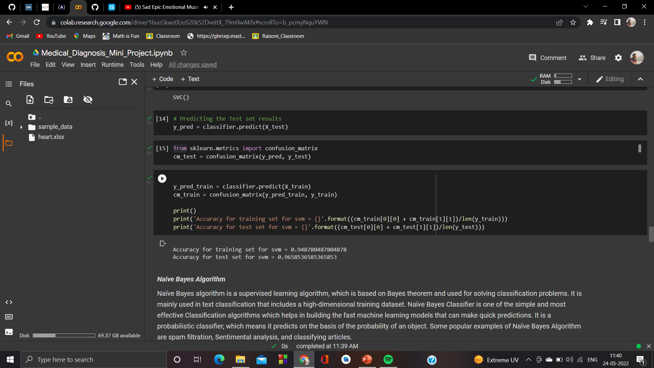
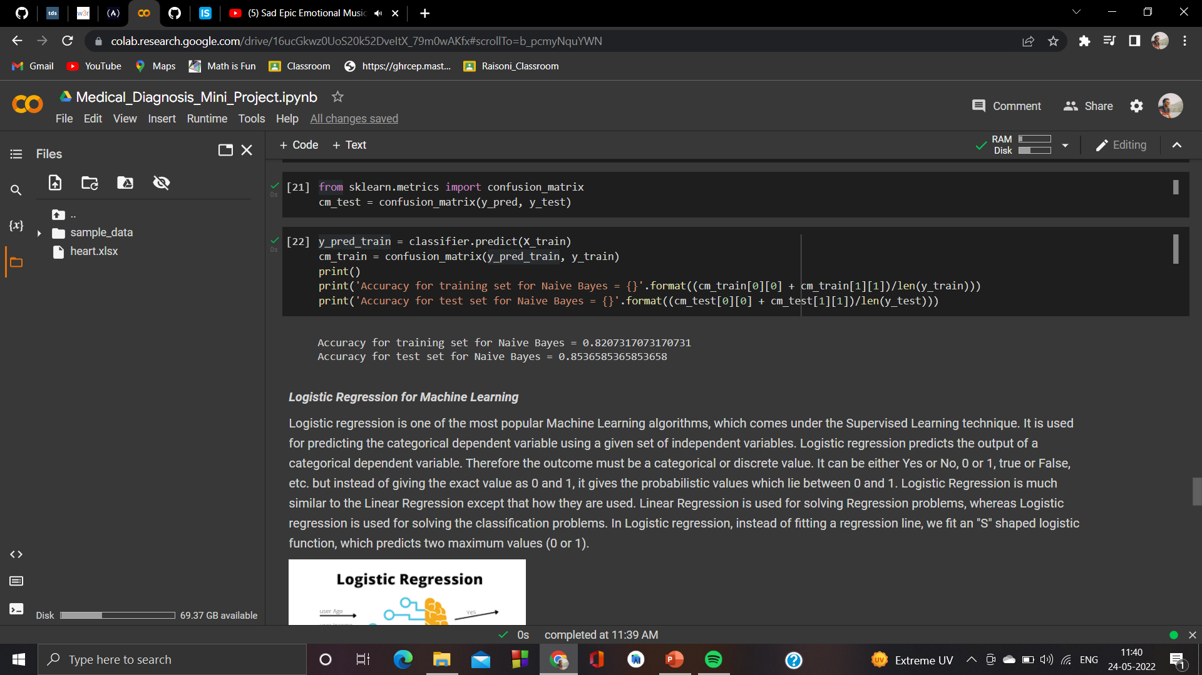
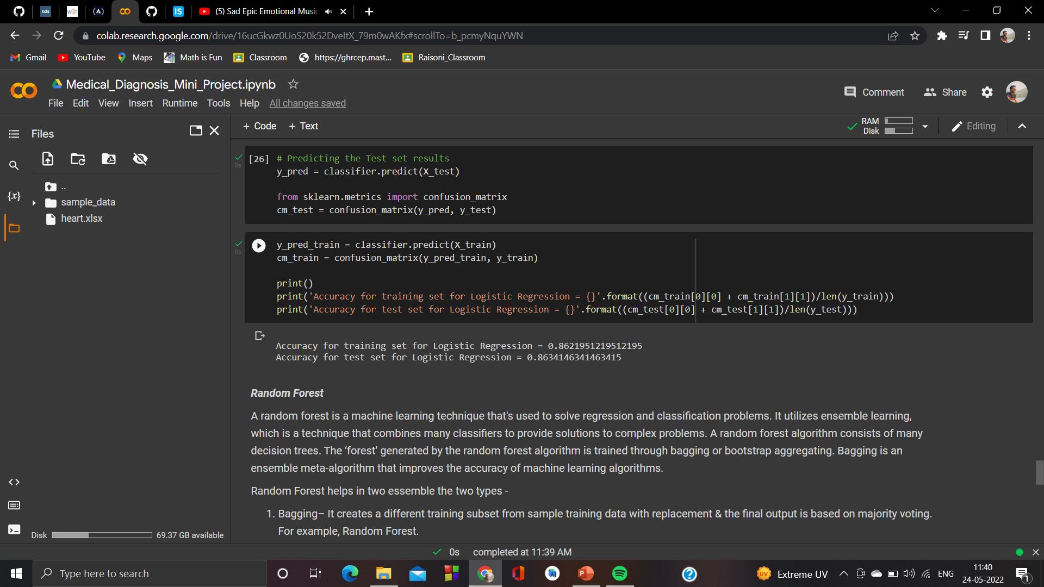
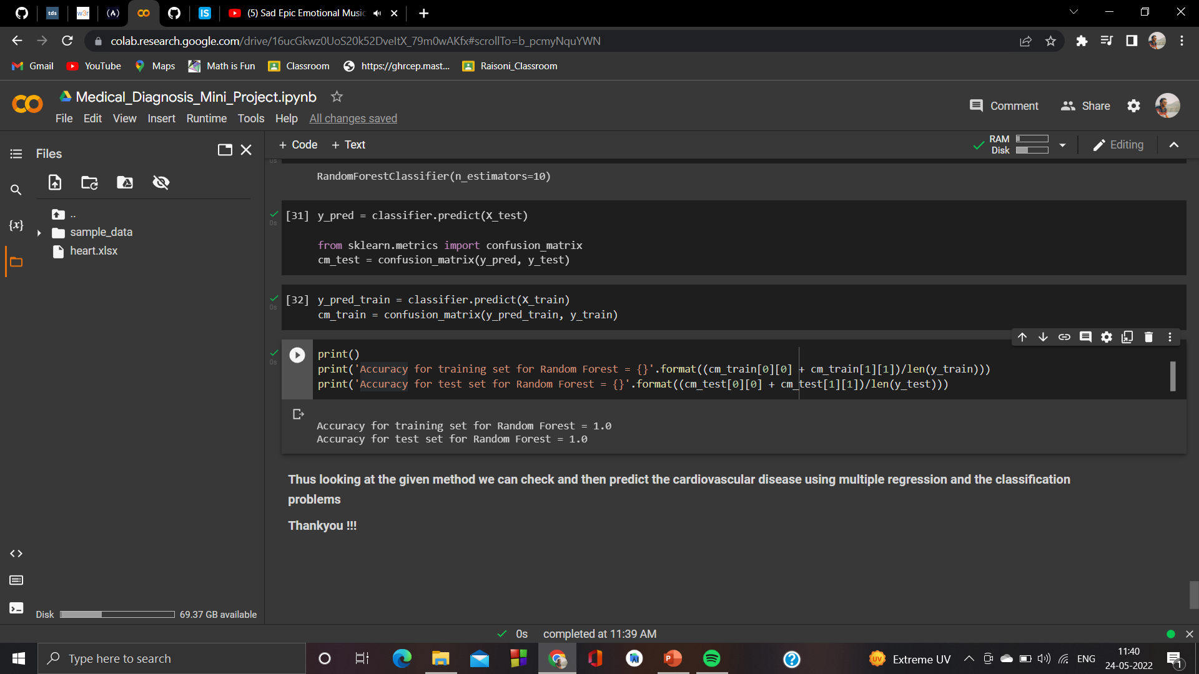
Output and Predictions

Slide 16
Summary
Thus, we have created a successfully predicting model using machine learning
This is slight sign for phase 1 in creating a self learning model that works conveniently without any extra resources
It saves time and helps to just feed and then predict heart diseases when emergency occurs

