Slide 1
INVESTMENT
RECOMMENDATION SYSTEM
Dashboard
Interactive Streamlit analytics
Finance Capstone Project Presentation
Core Analysis
Return • Risk • Trend
Presented by: PARUCHURI SAI MADAN KUMAR
Roll No.: 25914050399
MBA Finance | K. L University
Academic Year 2026
Outputs
Recommendation • Portfolio
Investment Recommendation System • MBA Finance Capstone • 1

Slide 2
Project Overview
01
A practical finance analytics application for structured investment analysis
• Analyzes historical market data for selected stocks.
• Measures return, volatility, maximum drawdown and moving-average trends.
• Combines return, trend and normalized risk into a project-defined investment score.
• Supports stock comparison, risk–return visualization and portfolio analysis.
• Presents results through an interactive Streamlit dashboard.
Data Source
Yahoo Finance historical market data
Analysis Period
1 year shown in the dashboard
Selected Example
TCS (TCS.NS)
Investment Recommendation System • MBA Finance Capstone • 2

Slide 3
Problem Statement & Objectives
02
Why the system was developed
Problem Statement
Objectives
Investors need a structured way to evaluate historical return, risk and trend across multiple stocks. Manual comparison of several indicators can be time-consuming and may make it difficult to form a consistent analytical view.
• Collect and process historical stock data
• Calculate financial risk/return metrics
• Analyze moving-average trends
• Compare selected stocks
• Generate a project-defined BUY/HOLD/SELL score
• Analyze portfolio performance
• Present results interactively
Investment Recommendation System • MBA Finance Capstone • 3

Slide 4
Technology Stack
03
Tools used to build the application
Python
Pandas
Core development
Data processing
NumPy
yfinance
Numerical calculations
Historical market data
Plotly
Streamlit
Interactive charts
Dashboard UI
VS Code
Development environment
The application is designed for academic and analytical use; it does not execute trades.
Investment Recommendation System • MBA Finance Capstone • 4

Slide 5
System Architecture
04
End-to-end workflow from data collection to decision output
Yahoo Finance
Data Processing
Financial Analysis
1
2
3
Scoring
Dashboard
Output
4
5
6
Workflow: Data Collection → Cleaning & Analysis → Risk/Return → Recommendation → Dashboard → Report
Investment Recommendation System • MBA Finance Capstone • 5

Slide 6
Project Modules
05
Functional components implemented in the dashboard
Module 1
Module 2
Financial Data Collection
Data Cleaning & Processing
Module 3
Module 4
Investment Analysis
Risk Analysis
Module 5
Module 6
Recommendation System
Stock Comparison
Module 7
Module 8
Portfolio Analysis
Dashboard & Report
Investment Recommendation System • MBA Finance Capstone • 6

Slide 7
Financial Methodology
06
Metrics used to evaluate historical investment behaviour
Total Return
Daily Return
Annualized Volatility
(Ending Price − Starting Price) / Starting Price
Percentage change in price from one trading day to the next
Standard deviation of daily returns × √252
Maximum Drawdown
Moving Averages
Portfolio Metrics
Largest decline from a historical peak to a subsequent trough
MA20 and MA50 used to evaluate price trend
Weighted daily returns used for portfolio performance
These metrics describe historical behaviour; they are not guarantees of future market performance.
Investment Recommendation System • MBA Finance Capstone • 7

Slide 8
Recommendation Methodology
07
Project-defined scoring framework
Return Score
Volatility Score
Drawdown Score
> +10% → +1
< −10% → −1
Otherwise → 0
< 15% → +1
15–25% → 0
> 25% → −1
> −20% → +1
−20% to −30% → 0
< −30% → −1
Investment Score
Recommendation
40% Return Score + 30% Trend Score + 30% Normalized Risk Score
Score ≥ 0.50 → BUY
−0.50 < Score < 0.50 → HOLD
Score ≤ −0.50 → SELL
Important: the weights and thresholds above are defined for this academic project; they are not presented as universal investment rules.
Investment Recommendation System • MBA Finance Capstone • 8

Slide 9
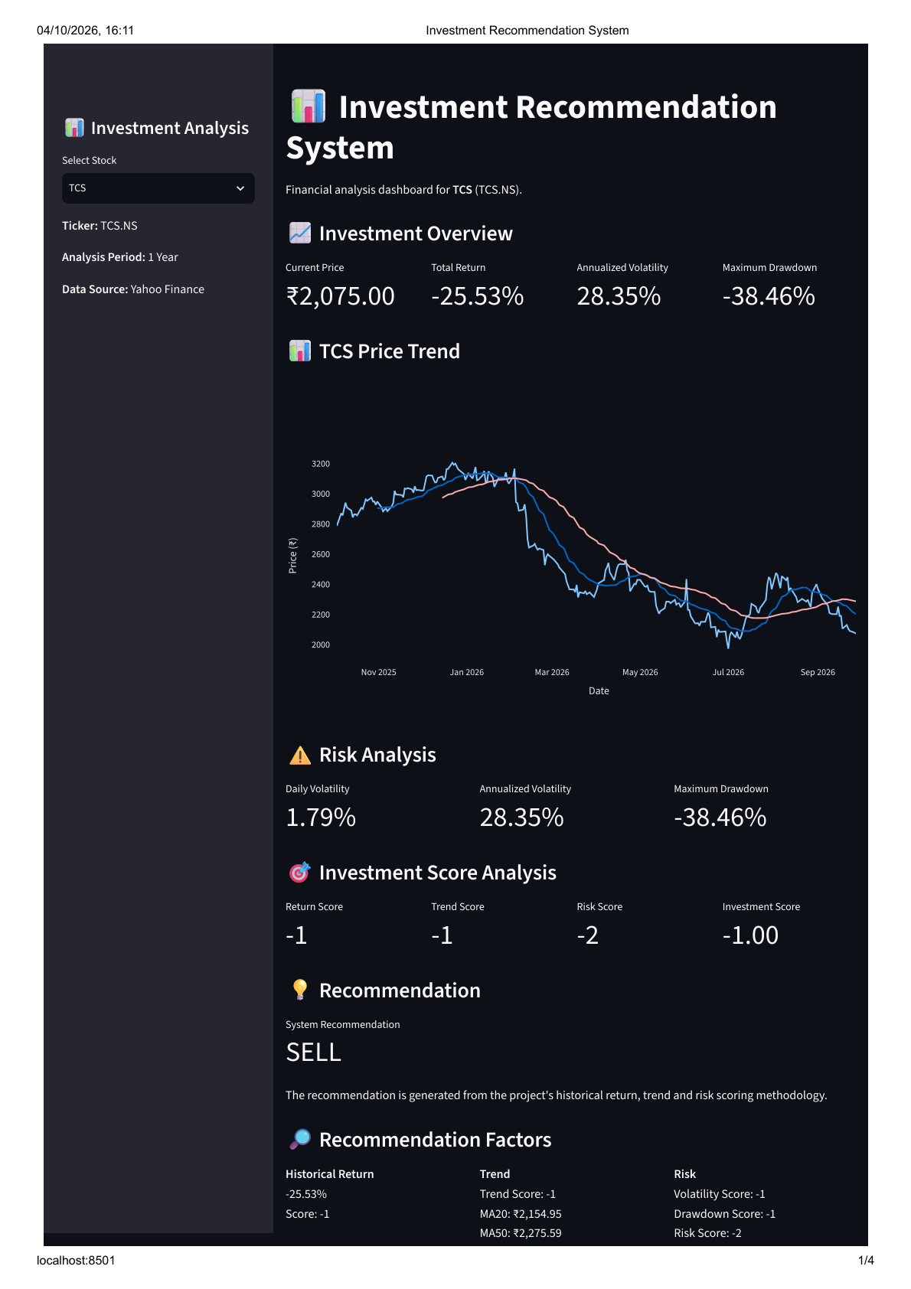
Dashboard — Investment Overview
08
Actual screenshot from the submitted dashboard PDF
Current Price
₹2,075.00
Total Return
−25.53%
Annualized Volatility
28.35%
Maximum Drawdown
−38.46%
Investment Recommendation System • MBA Finance Capstone • 9

Slide 10
Dashboard — Recommendation
09
TCS example shown in the dashboard
Return Score
−1
Trend Score
−1
Risk Score
−2
System Recommendation
SELL
Investment Recommendation System • MBA Finance Capstone • 10

Slide 11
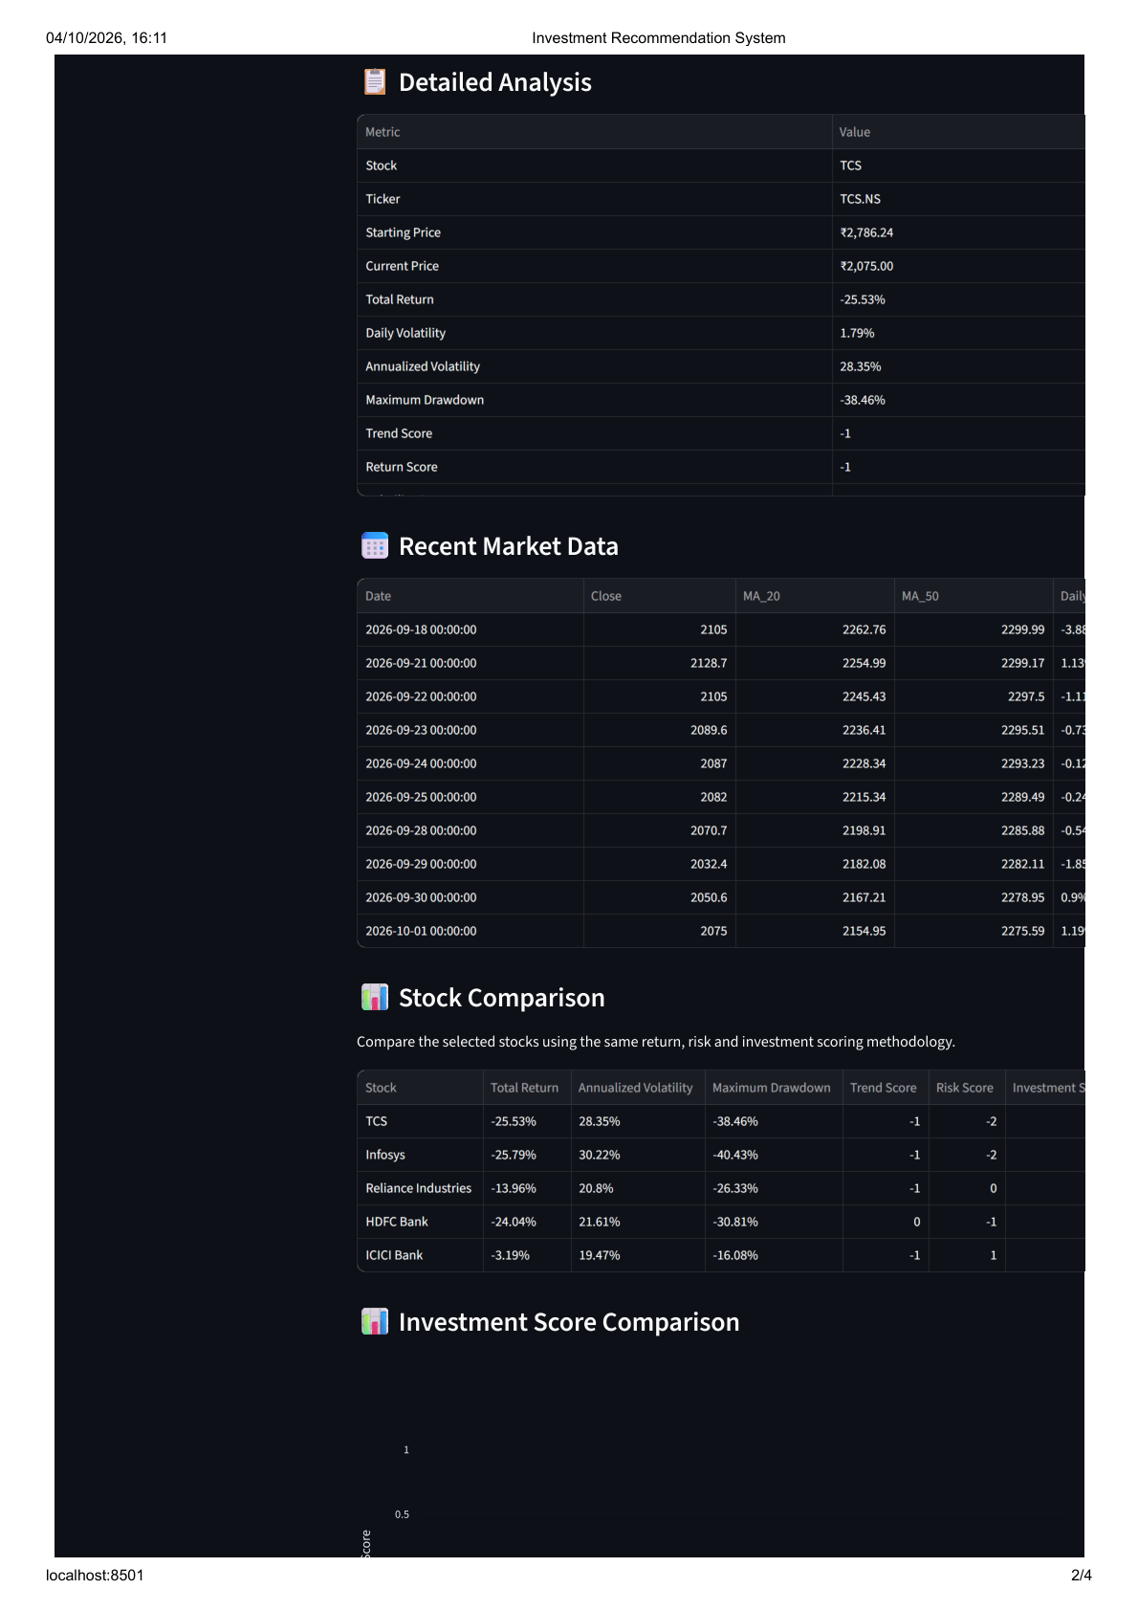
Dashboard — Detailed Analysis & Comparison
10
Actual screenshot from dashboard page 2
Detailed Analysis
Stock, ticker, starting/current price, return and risk metrics
Recent Market Data
Recent close, MA20, MA50 and daily-return information
Stock Comparison
Same return, risk and investment-scoring methodology
The dashboard compares TCS, Infosys, Reliance Industries, HDFC Bank and ICICI Bank.
Investment Recommendation System • MBA Finance Capstone • 11

Slide 12
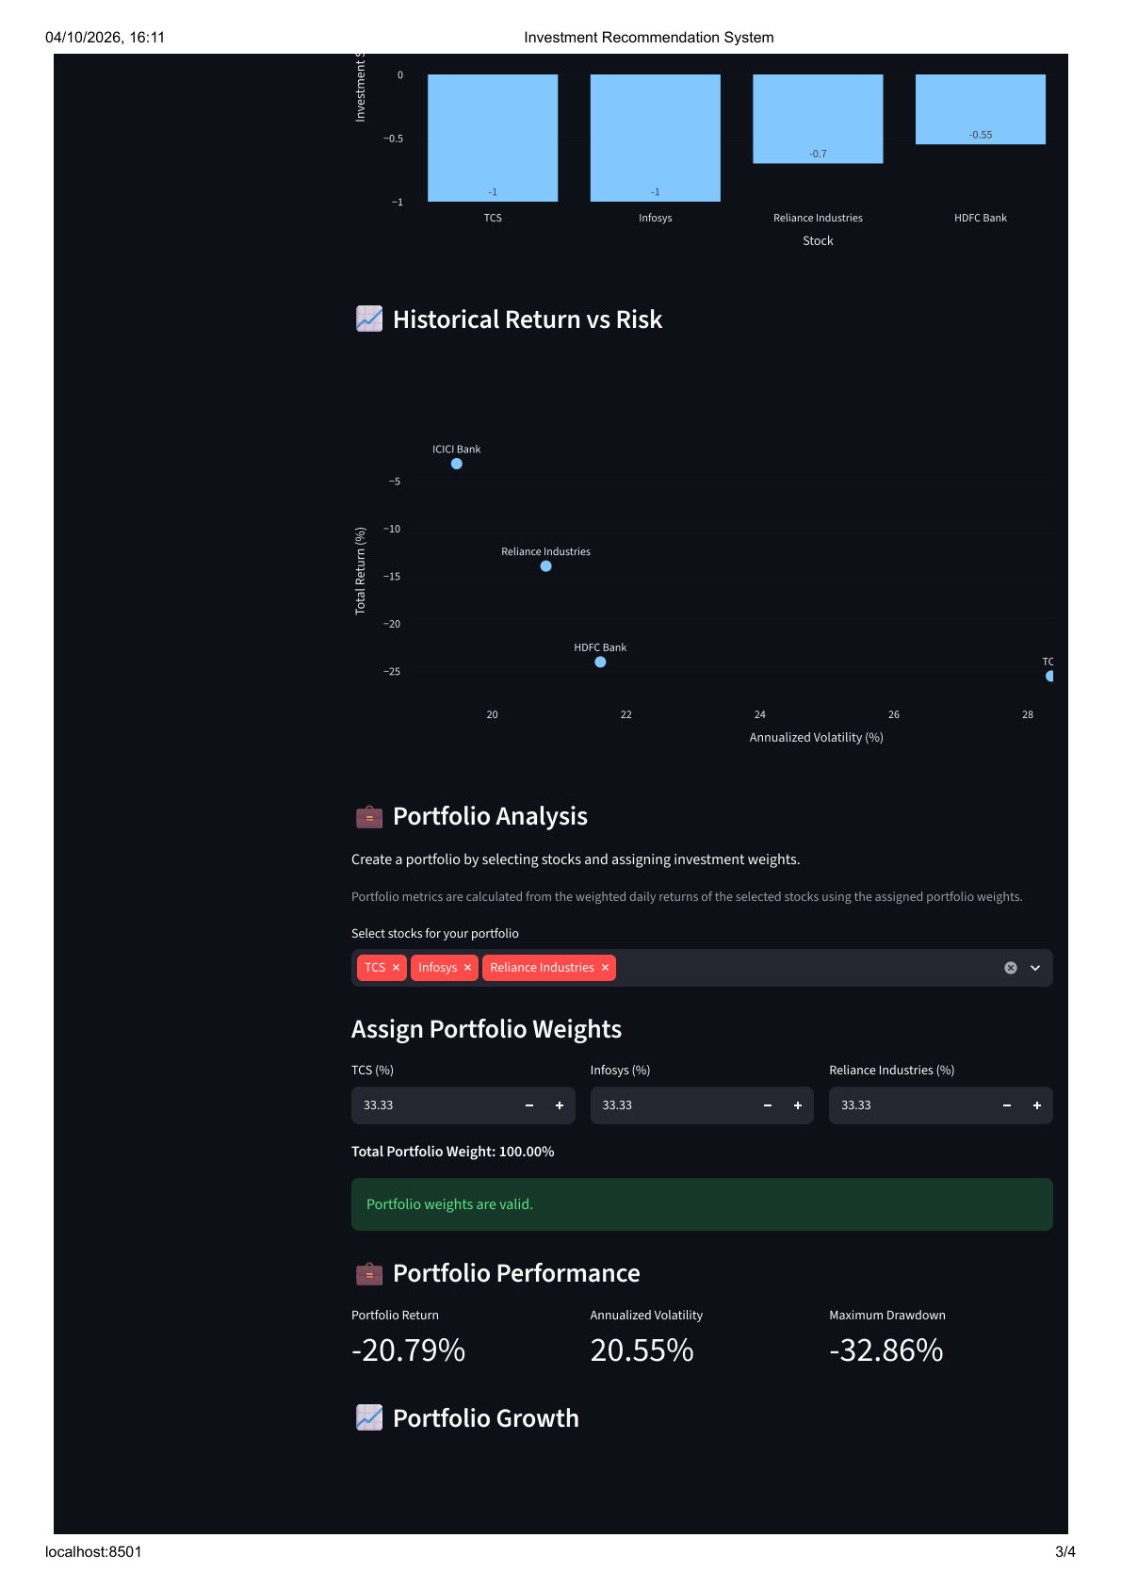
Dashboard — Risk–Return & Portfolio
11
Actual screenshot from dashboard page 3
Portfolio Stocks
TCS • Infosys • Reliance Industries
Portfolio Weights
33.33% each • Total 100%
Portfolio Return
−20.79%
Volatility
Drawdown
20.55%
−32.86%
Investment Recommendation System • MBA Finance Capstone • 12

Slide 13
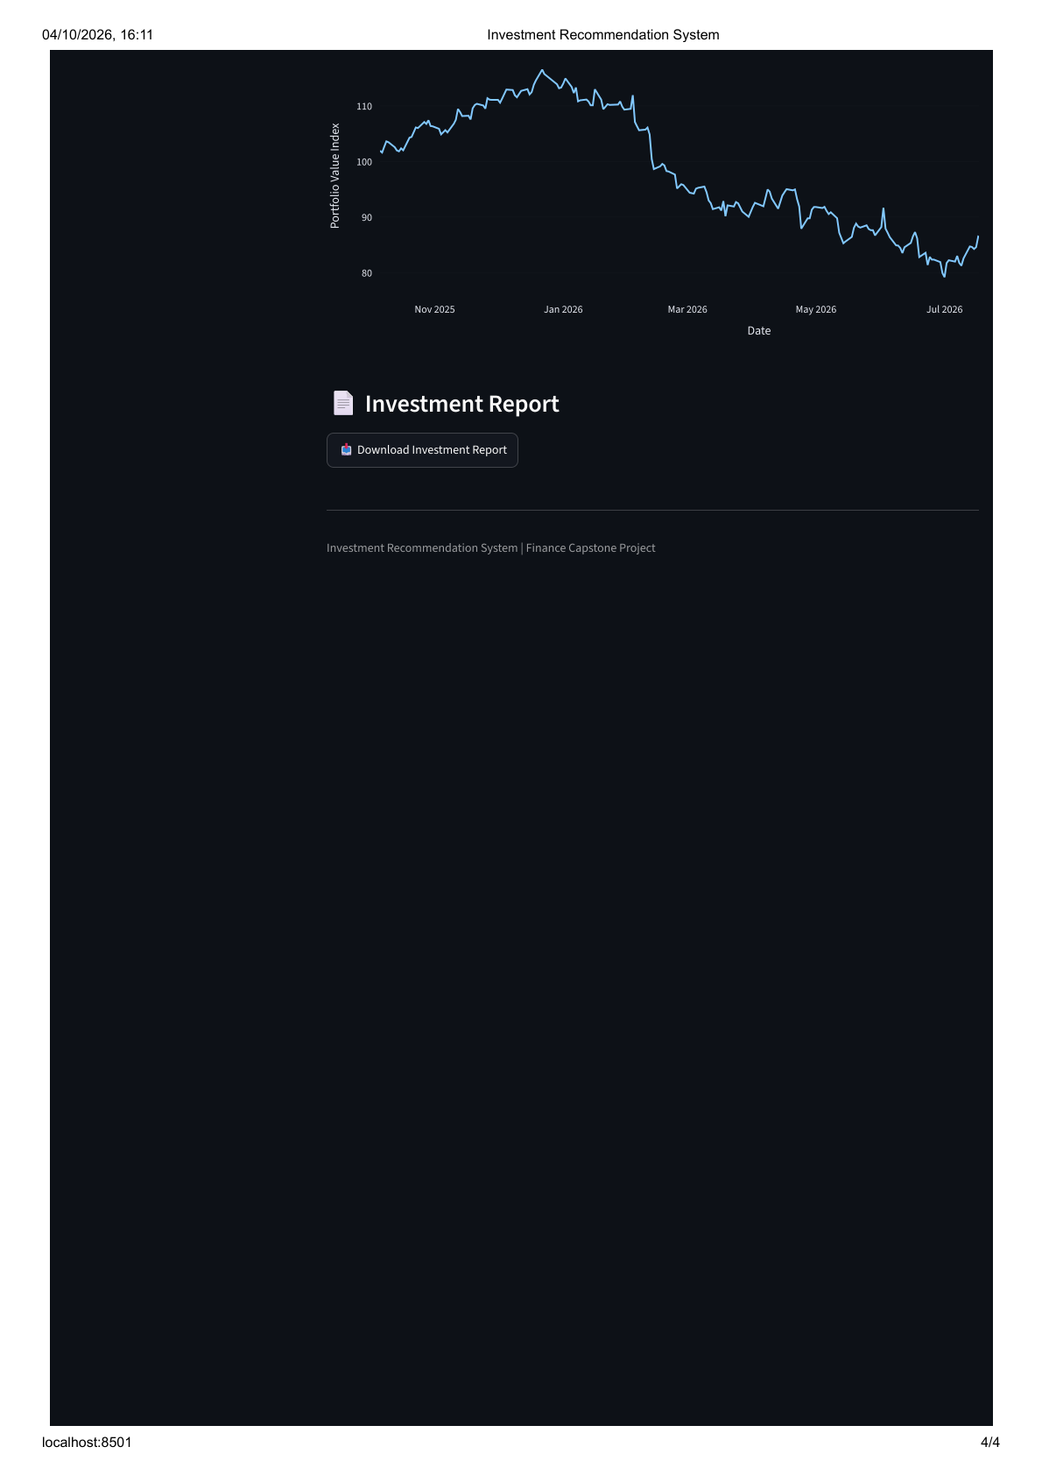
Dashboard — Portfolio Growth & Report
12
Actual screenshot from dashboard page 4
Portfolio Growth
Indexed portfolio value shown over the analysis period
Investment Report
Dashboard provides a downloadable investment report
Academic Use
Structured analytical output; no trade execution
Investment Recommendation System • MBA Finance Capstone • 13

Slide 14
Results — Stock Comparison
13
Historical results captured from the dashboard
Stock | Total Return | Ann. Volatility | Max Drawdown | Trend | Risk
TCS | −25.53% | 28.35% | −38.46% | −1 | −2
Infosys | −25.79% | 30.22% | −40.43% | −1 | −2
Reliance Industries | −13.96% | 20.80% | −26.33% | −1 | 0
HDFC Bank | −24.04% | 21.61% | −30.81% | 0 | −1
ICICI Bank | −3.19% | 19.47% | −16.08% | −1 | 1
The comparison shows that ICICI Bank had the least negative historical return among the five stocks and the lowest annualized volatility in the displayed results.
Investment Recommendation System • MBA Finance Capstone • 14

Slide 15
Testing & Validation
14
Functional checks performed on the application
Test Area | Expected Result | Status
Data loading | Historical stock data loads successfully | PASS
Data cleaning | Missing values handled before analysis | PASS
Financial metrics | Return, volatility and drawdown calculated | PASS
Recommendation | Score maps to BUY/HOLD/SELL rule | PASS
Stock comparison | Selected stocks displayed using same methodology | PASS
Portfolio | Weights validated to 100% | PASS
Report | Investment report download available | PASS
Testing is based on the implemented dashboard functions and the displayed successful outputs in the submitted dashboard.
Investment Recommendation System • MBA Finance Capstone • 15

Slide 16
Limitations & Future Scope
15
Current boundaries and possible enhancements
Limitations
Future Scope
• Uses historical market data
• Does not execute trades
• Does not guarantee future returns
• Scoring rules are project-defined
• Advanced quantitative models are outside the present scope
• Analysis is intended for academic purposes
• Expand the asset universe
• Add machine-learning models
• Add real-time alerts
• Add portfolio optimization techniques
• Add online deployment and user authentication
• Extend reporting and visualization capabilities
Investment Recommendation System • MBA Finance Capstone • 16

Slide 17
Conclusion
16
Key takeaway from the capstone project
• The project integrates finance concepts with Python-based data analytics.
• The dashboard provides a structured view of historical return, risk and trend.
• The system compares stocks using a consistent project-defined methodology.
• Portfolio analysis extends the system from single-stock analysis to combined investments.
• The result is an interactive academic tool for investment analysis and visualization.
Data → Analysis → Risk & Return → Recommendation → Portfolio Insights
Investment Recommendation System • MBA Finance Capstone • 17

Slide 18
THANK YOU
Questions & Answers
Investment Recommendation System
MBA Finance Capstone Project

