Slide 1
Understanding and Fine-Tuning BERT for NLP Tasks
By: PARVATHY VIJAYAN

Slide 2
Introduction to BERT
Capabilities of BERT
Why Fine-Tuning BERT?
About the Dataset
Training BERT
Fine-Tuning Process
Evaluation
Results and Insights
Code Implementation
Table of Contents
Points for discussion

Slide 3
What is BERT?
BERT (Bidirectional Encoder Representations from Transformers):
Developed by Google in late 2018.
Pretrained language representation model.
Capable of extracting high-quality language features or fine-tuning for specific tasks.
Key Feature:
Bidirectional training, allowing understanding of context from both directions in a sentence.
Transformer Architecture:
Utilizes self-attention mechanisms.
Handles long-range dependencies efficiently.
Pretraining Objectives:
Masked Language Model (MLM): Predicts masked tokens in a sentence.
Next Sentence Prediction (NSP): Predicts if two sentences are consecutive.

Slide 4
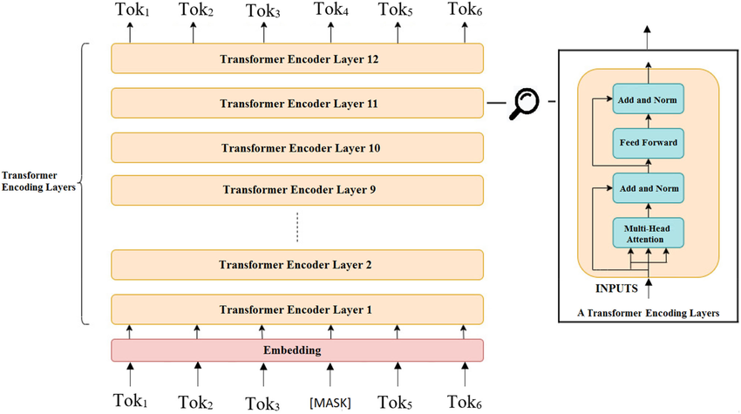
Architecture diagram of BERT

Slide 5
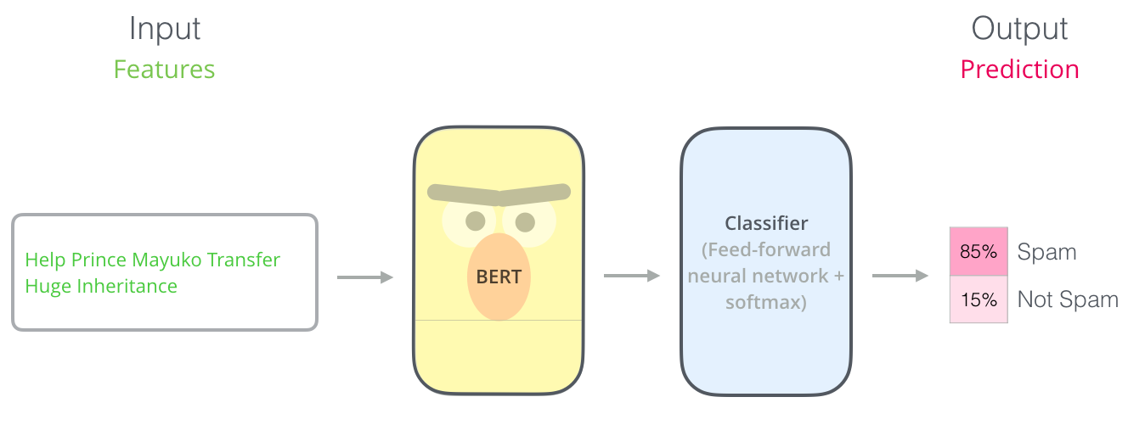
What Can BERT Do For Us?
Applications of BERT:
Text classification (e.g., sentiment analysis).
Named entity recognition (NER).
Question answering systems.
Text summarization.
Fine-Tuning BERT:
Adding an untrained layer and fine-tuning on a specific task.
Quick and effective way to achieve state-of-the-art results.
Multi-Task Learning:
Ability to adapt to various tasks with minimal changes.
Added untrained layer and fine-tune on a specific task
Input the sentence
0
1

Slide 6
Advantages of Fine-Tuning Over Building from Scratch
Easy Training:
Pretrained weights encode extensive language information.
Requires fewer training epochs (2-4 epochs recommended).
Less Data Required:
Can train on smaller datasets due to pretrained weights.
Good Results:
Achieves state-of-the-art results with minimal task-specific adjustments.
Cost and Time Efficiency:
Saves computational resources and time compared to training from scratch.
Adaptability:
Fine-tuning allows the model to specialize in specific tasks without extensive modifications.

Slide 7
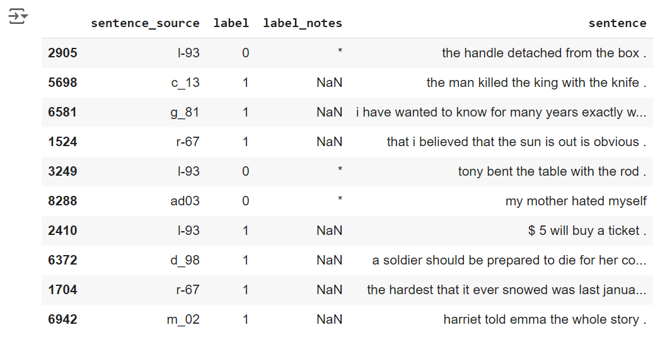
About the Dataset Structure
CoLA (Corpus of Linguistic Acceptability)Purpose: To classify sentences as grammatical (acceptable) or ungrammatical (unacceptable).
Size: 10,657 sentences
Source: Drawn from linguistic publications
The dataset contains sentences labeled for grammatical correctness.
It has four columns:
Column 1: A code representing the source of the sentence
Column 2: An acceptability judgment label (0 for unacceptable, 1 for acceptable)
Column 3: The acceptability judgment as originally notated by the author
Column 4: The sentence itself

Slide 8
Training BERT for Text Classification
STEP 1
STEP 2
STEP 3
Install and Import Libraries
Load and Prepare Dataset
Create Attention Masks
TensorFlow, PyTorch, and Hugging Face’s Transformers library
Use the CoLA dataset for single sentence classification.
Tokenize and format inputs for BERT.
from transformers import BertTokenizer
tokenizer = BertTokenizer.from_pretrained('bert-base-uncased')
inputs = tokenizer(sentences, return_tensors='pt', padding=True, truncation=True)
Handle padding and truncation for uniform input length.
Example code snippet for creating attention masks:
attention_masks = [[float(i != 0.0) for i in seq] for seq in inputs['input_ids']]

Slide 9
Fine-Tuning BERT Model
Model Preparation:
Load BertForSequenceClassification
Add a linear classification layer on top.
Training Loop:
Forward pass, compute loss, backward pass, and optimizer step.
Track loss and accuracy.

Slide 10
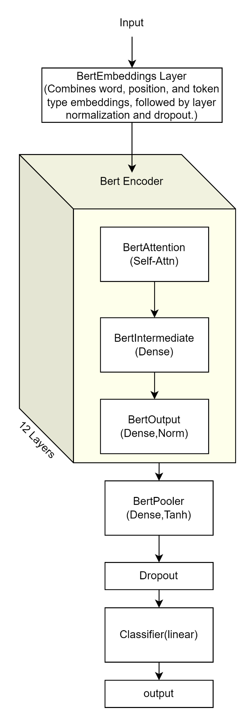
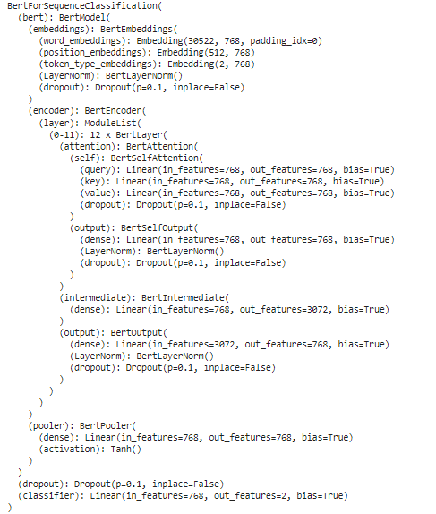

Slide 11
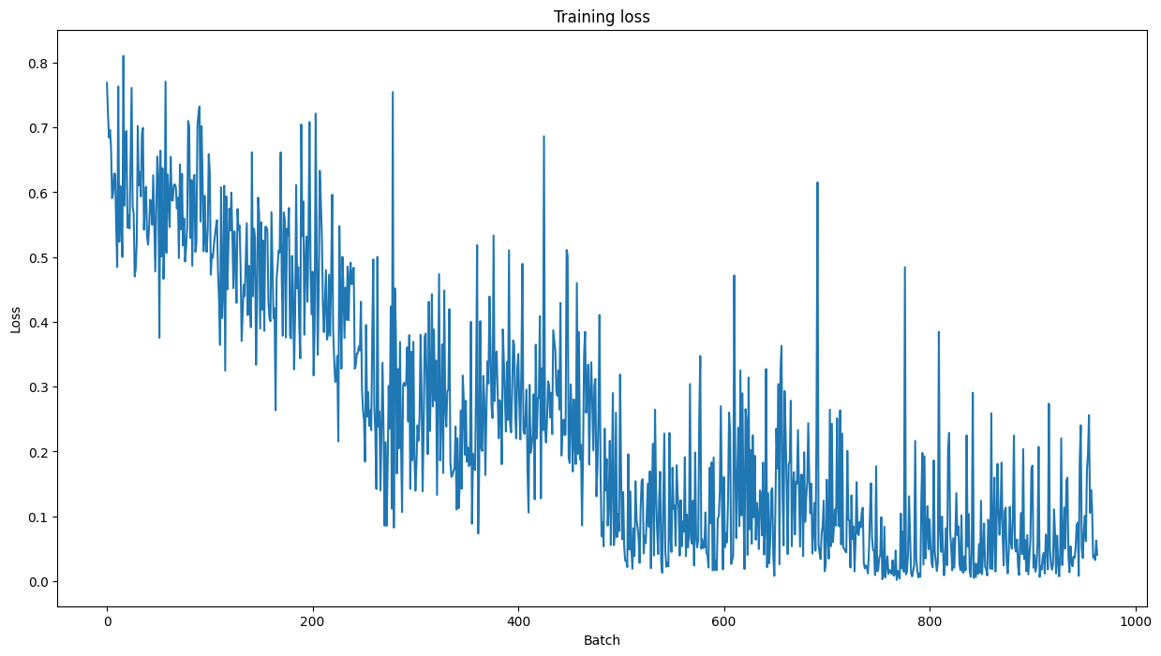
Evaluating BERT's Performance
Validation Accuracy: Measure accuracy on validation set during training. Training Loss: Plot training loss over batches to monitor progress. Use **Matthew’s correlation coefficient for performance evaluation. MCC value = 0.49
** Here’s how to interpret it:
Range: MCC values range from -1 to +1.
Positive Correlation: A value close to +1 indicates a strong positive correlation, meaning the predictions strongly agree with the true labels.
Negative Correlation: A value close to -1 indicates a strong negative correlation, meaning the predictions are in strong disagreement with the true labels.
Zero Correlation: A value close to 0 means no correlation, indicating random predictions.

Slide 12
Results and Insights
Training Results:
Consistent decrease in training loss.
Validation accuracy shows model’s generalization capability.
Observed:
Quick training with fewer epochs.
High accuracy with smaller datasets.
Achieved 82% accuracy with just 4 epochs of training.

Slide 13
Practical Implementation https://colab.research.google.com/drive/provide_your_link_here

Slide 14



Do you have any questions?

Slide 15
THANK YOU

