Slide 1
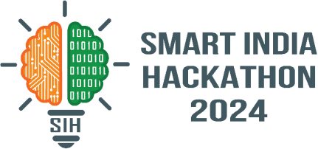

SMART INDIA HACKATHON 2024
Problem Statement ID – 1757
Problem Statement Title - India Post Indian Diaspora to access things Indian
Theme - Transportation & Logistics
PS Category - Software
Team ID - 4326
Team Name - The Deciders
A Bridge for

Slide 2




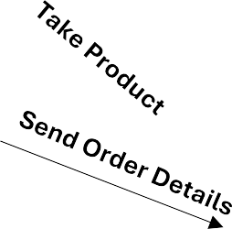

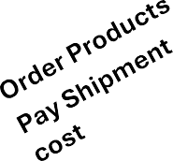




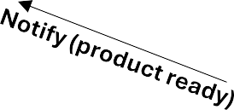

IDEA TITLE
Proposed Solution (Describe your Idea/Solution/Prototype)
Idea/Solution :-
A web application that provides access of authentic Indian products from MSMEs to the global Indian diaspora & international buyers at a reasonable price, meanwhile promoting and preserving traditional craftmanship and local artisans. The platform will:
Analyze data of around 73% diaspora people & foreigners buy Indian products online, with the help of AI and ML algorithms to provide results and offers based on their needs and preferences, enhancing user satisfaction.
Provide exclusive collection during festivals and seasonal events ( as demand rises by 40% ). User will also be provided with the option to order customizable product with real time enviorrment according to their own choice.
Provide “DoP Certified” badge to trusted sellers after proper checks.
Use DoP’s (Department of post’s) global network across 219 countries for affordable & reliable shipping (30-50% cheaper than private courier services).
Ensure secure payment processing and product verification to guarantee authenticity with advance N L P model and quality, addressing concerns of over 60% of Indian diaspora buyers who demand trusted & certified sources.
Notify Order
Platform
Request Customization
Customer
Artist
Unique Selling Proposition (USP) :-
AIcustomize products according to preferences, increasing personalized experience.
Implementation of AR visual of the product
A direct contact with post office for easy of artist referral(scheme by the post office for the artist)
Product offering according to seasonal recommdation
Chat feature allows sellers and artisans to communicate directly ensuring transparency.
Dynamic logistic for the DOP + AI future analytics
@SIH Idea submission- Template
2

Slide 3

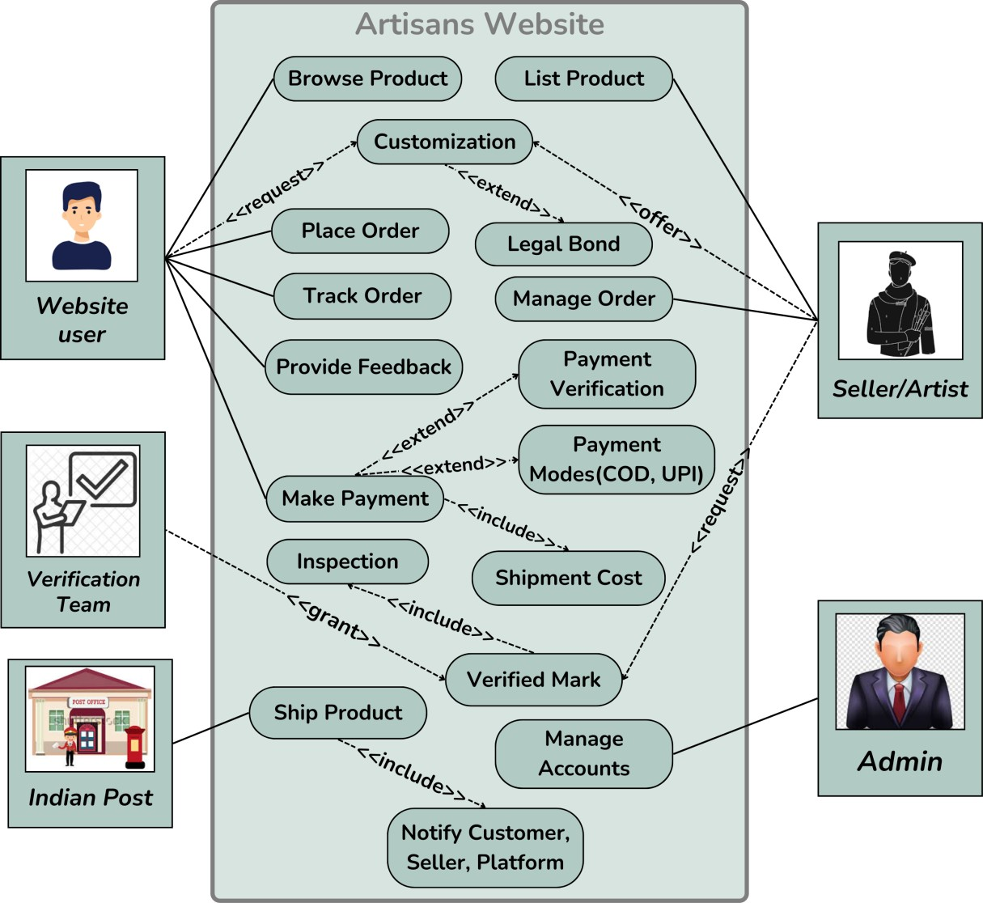
TECHNICAL APPROACH
Use Case Diagram
Technology Stack :-
Frontend Development :-
React JS, Tailwind CSS, Next JS
Backend Development :-
Node.js, Express.js, MongoDB, REST API
AI & Data Analysis :-
Apache Hadoop to analyze user data, track sales trends etc. for personalized recommendations.
Google BigǪuery and NLP(Natural Language Processing) for predictive analysis enabling data- driven decisions and demand forecasting.
Power BI to extract market insights for optimized product offerings, categorization and improve overall user engagement.
Blockchain Ledger be used to record
product’s journey at each step (creation, quality
checks, shipping etc.)

Slide 4
FEASIBILITY AND VIABILITY
Feasibility :-
Potential challenges and solution :-
Technical Feasibility: All the technologies required in this are
well established and their services can streamline different
aspects like payment, shipping, authentication etc.
Resource Availability: Their is a huge pool of suppliers in India (about 7 million artisans) and also the department of posts is a reliable and cost efficient logistics network spread across 219 countries.
Challenge : Product Ǫuality Control
Solution: Implement a strict seller verification and review system, along with quality checks for all products before shipment to guarantee authenticity and reliability.
Challenge : Conflict Resolution in Product Customization
Solution: Use a legal written bond that contains all
customization details. If the product doesn’t meet the agreed terms, the buyer gets a refund otherwise no refund.
Challenge : Limited Digital Literacy Among Artisans Solution: Provide training and support to artisans on using the platform, including easy-to-use interfaces and multilingual support to simplify the experience and adaptive process.
Challenge : Supply Chain Management
Solution: Implement real-time tracking and inventory management features to help artisans manage demand efficiently and ensure timely deliveries.
Viability :-
Market Demand: There is a strong demand of authentic Indian products with assured quality by 73% of the Indian diaspora which is over 32 million.
Economic Viability: Indian artisans market is experiencing a significant growth (expected to reach $5.8 trillion by 2027), utilizing it to cover development and operational cost through transaction cuts, advertisement etc. along with efficient logistics through DoP.
Regulatory compliance: Involves FDI regulations, GST registration and IT Act data protection. Security measures include encryption, multi-factor authentication and quality assurance ensuring data privacy and build trust.

Slide 5
IMPACT AND BENEFITS
Benefits :-
Impact :-
Direct Access to Authentic Products : Platform offer Indian diaspora and international buyers easy access to authentic products directly from local artisans and MSMEs in India.
Support for Local Artisans : Empowering small-scale artisans by providing them access to the global market, increasing the annual income of artisans by 25-50%
Standardized Shipping and Ǫuality Control : Guarantees fair, cheaper (30-40% less) & transparent shipping costs. Thorough quality check ensuring every product meets high standards and customer satisfaction.
Seamless User Experience : Simple and convenient way for users to browse, purchase and receive traditional products globally, building a strong emotional connection with India.
Enhanced Trust and Transparency: More than 60% of Indian diaspora buyers report concerns about product authenticity and quality when purchasing Indian goods. The platform fosters trust through a transparent system of seller verification, product quality checks, and reliable buyer feedback.
Economic Impact: Increases annual income of local artisans and MSMEs by 25-50% and decreasing price to the customers by 30-50% with the help of DOP.
Cultural Impact: Preserves traditional crafts and heritage while elevating global awareness of Indian craftsmanship.
Technological Impact: Revolutionizes e-commerce with AI and ML for personalized experiences, while delivering data-driven insights that empower sellers to optimize their products..
Global Impact : Indian handicrafts exports are growing, with an rate of 25.7% year-over-year. Through our platform we will be Promoting India’s cultural products globally
improving the country’s reputation for quality, diversity, and heritage, enhancing “Brand India” on the world stage.
Environmental Impact: Promotes sustainable, handcrafted products. & Reduces reliance on mass- produced goods also reducing the usage of non ecofriendly materials.

Slide 6
REFERENCES AND RESEARCH
Shipping cost comparison between DOP and private organization: Indian Post VS FedEx
Indian Post: https://www.indiapost.gov.in/VAS/Pages/calculatePostage.aspx
FedEx: https://www.fedex.com/en-us/shipping/international/understanding-international-shipping-cost.html
Challenges faced by artisans: The Challenges Faced By Artisans In Developing Countries | Vceela - Online marketplace for handicrafts by artisans and artists
Challenges and benefits of overseas shipping: The Benefits And Challenges Of Exporting Handmade Products Overseas || Rural
Handmade-Redefine Supply to Build Sustainable Brands
Artisans data analysis: Artisans in India and their quest for growth: Understanding the current set of capabilities among Indian artisans to adopt digital technology solutions – Catalyst Atal Incubation Centre (catalystaic.org)
Diaspora Problem: Problem NRIs Face While Shopping from Indian Online Websites and How Forward Parcel Can Help -
International Shipping from INDIA
Handicrafts market size: Indian Handicrafts Market Size, Share, Analysis, Report 2024-2032 (imarcgroup.com)
Global Data about diaspora: https://www.weforum.org/agenda/2019/09/indian-diaspora-largest-in-world-numbers/
Indian handicrafts data: https://indian.handicrafts.gov.in/en
Competitor analysis: https://ruralhandmade.com/ and https://www.directcreate.com/shop

