Slide 1

Dataverse Integration
26 november 2024 I jithu murugan

Slide 2
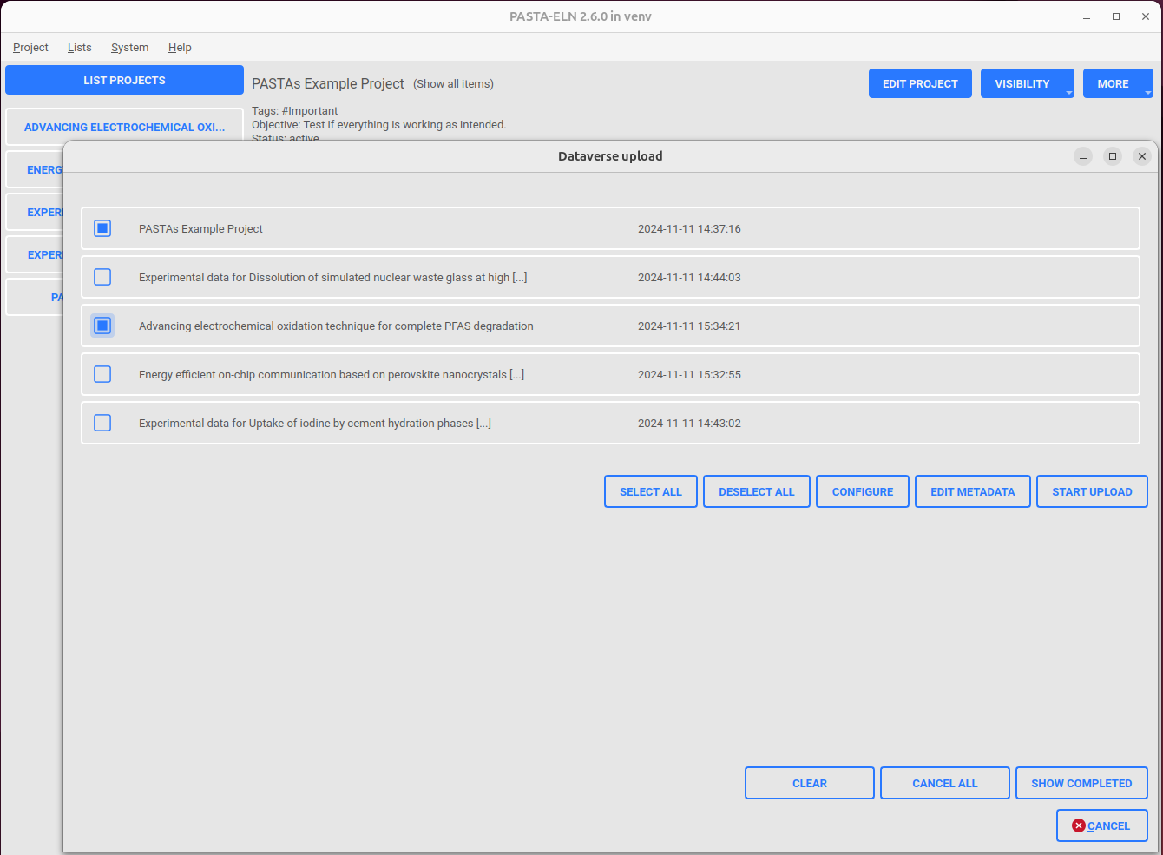
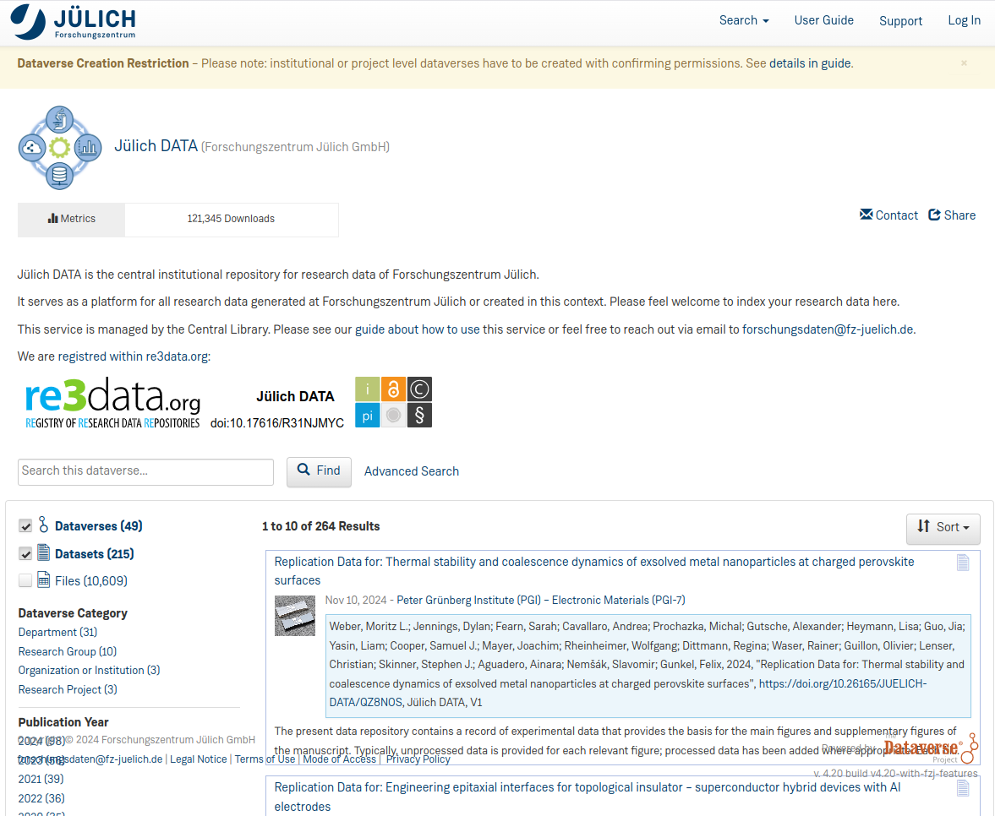
Dataverse integration
PASTA project upload to dataverse
Data-verse configuration (Auth Rest API Token)
Dataset creation with metadata population
ELN File generation
ELN File upload
HTTP REST API
PASTA Application
Dataverse server

Slide 3
Dataverse integration
PASTA project upload to dataverse
Data-verse configuration (Auth Rest API Token)
Dataset creation with metadata population
ELN File generation
ELN File upload
HTTP REST API
PASTA Application
Dataverse server
Features
Dataverse Login Configuration Dialog
Metadata editor dialog
Project upload configuration dialog
Upload Queue: Parallel upload of multiple project
Upload history dialog

Slide 4
Dataverse integration
Click “Show Completed” button to see the data upload history
The upload history will be shown in a sorted order (descending: finished time)
Enter search term to filter the upload by any field displayed in UI
How to use dataverse upload feature?
Open “Dataverse Configuration” dialog
Enter server URL & API Token combination
Click on “Verify and load” button to verify the given combination and load the available dataverse
Select the needed dataverse ID
Click Save button
4
1
1
Select the projects to be uploaded to the dataverse.
Click “Start Upload” button to enqueue the projects to upload queue.
Click on “Show log” for each project in the queue to see individual upload log
Click “Cancel” of individual projects to cancel the ongoing upload
Click “Cancel” all to cancel all the ongoing upload in the queue
Click “Clear” button to clear all the finished uploads from the queue
Open “Upload to dataverse” dialog
Click “Configure” button to edit the upload configuration
Save the configuration.
Click on “Edit Metadata” button to enter the metadata needed for dataverse. Make sure to at the least enter the minimal set.
Click save to see the summary and save the metadata successfully.
2
3

Slide 5
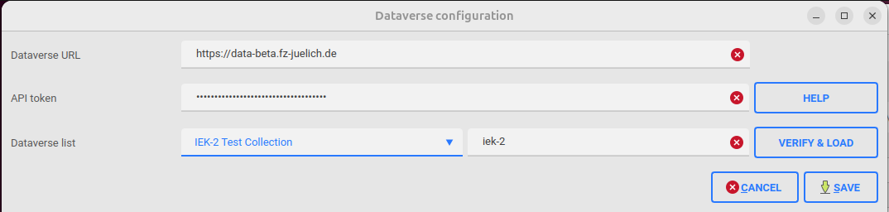
Dataverse integration
Dataverse Configuration
Run Pasta Application
Go to “Project group | Dataverse Configuration” or press F10
Navigate to dataverse help guide
Verify URL+API token combination and load the dataverse list
Data-verse server URL
Save the configuration
User REST API Token
Cancel the save operation
Selected data-verse from the list
Data-verse lists retrieved from the server

Slide 6
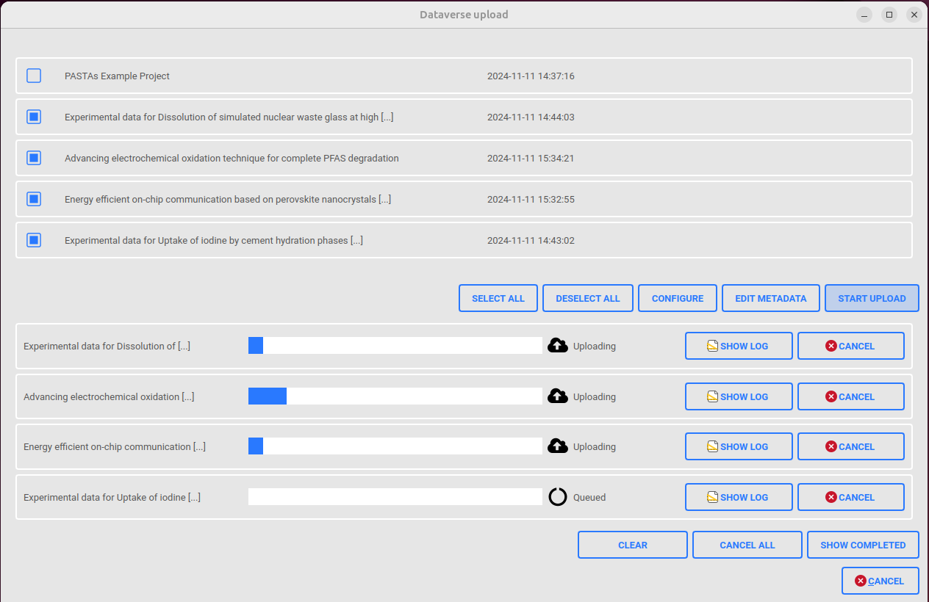

Dataverse integration
Dataverse Upload Page: UI Elements
Run Pasta Application
Go to “Project group | Upload to Dataverse” or press F11
Note: Make sure that the Configuration exists, otherwise will be taken to configuration page
Projects Queue: List of PASTA Projects
Select all projects in projects queue for upload
De-select all projects in projects queue for upload
Opens dialog to configure the project upload properties
Opens dialog to edit the metadata for the dataset.
Start upload of the selected projects in project queue
Upload Queue: List of PASTA Projects being uploaded

Slide 7
Dataverse integration
Dataverse Upload Page: UI Elements
Run Pasta Application
Go to “Project group | Upload to Dataverse” or press F11
Select the projects from the “project queue” and click “Start Upload” to begin the upload.
Project Name
Project Created time
Upload Project Name
Upload Project progress
Upload Project status (uploading/finished/error)
Click to expand/collapse upload project log information
Cancel project upload
Clear all finished items in the upload queue
Cancel all running items in the upload queue
Cancel all and close window

Slide 8
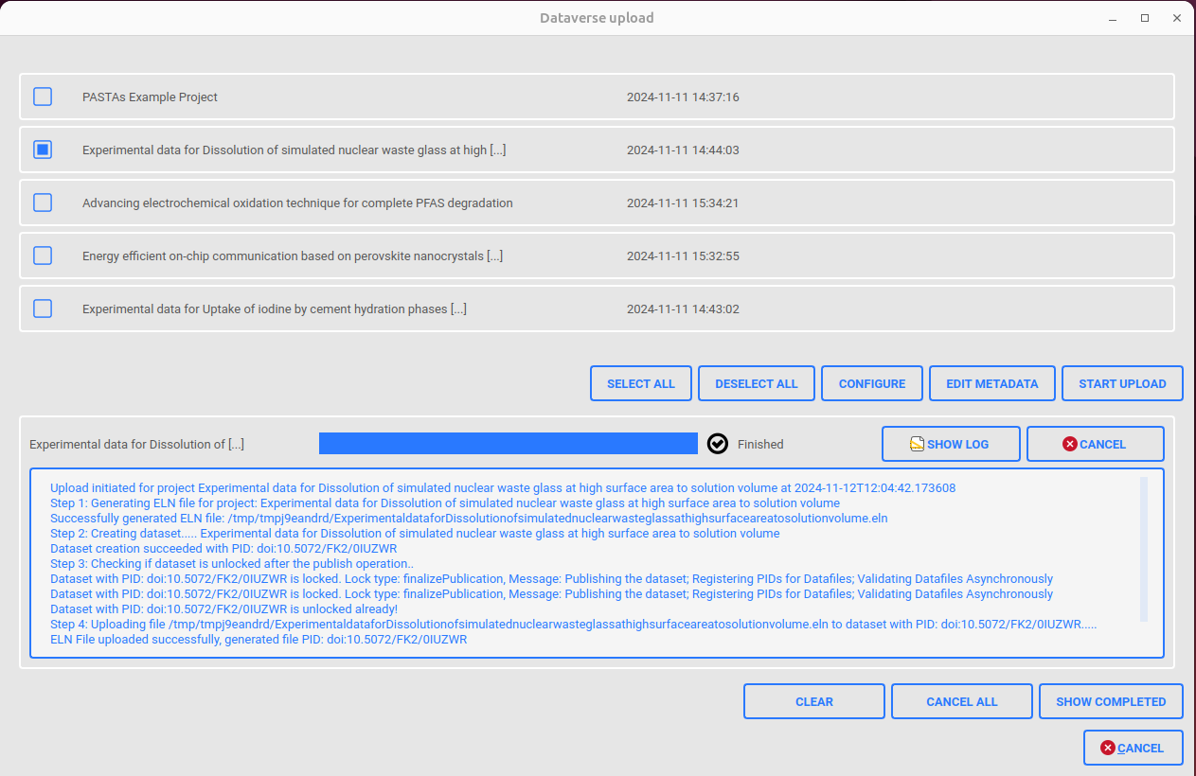
Dataverse integration
Dataverse Upload Page: UI Elements
Run Pasta Application
Go to “Project group | Upload to Dataverse” or press F11
Click on SHOW LOG button to expand or collapse the log window
Click to see the upload history

Slide 9
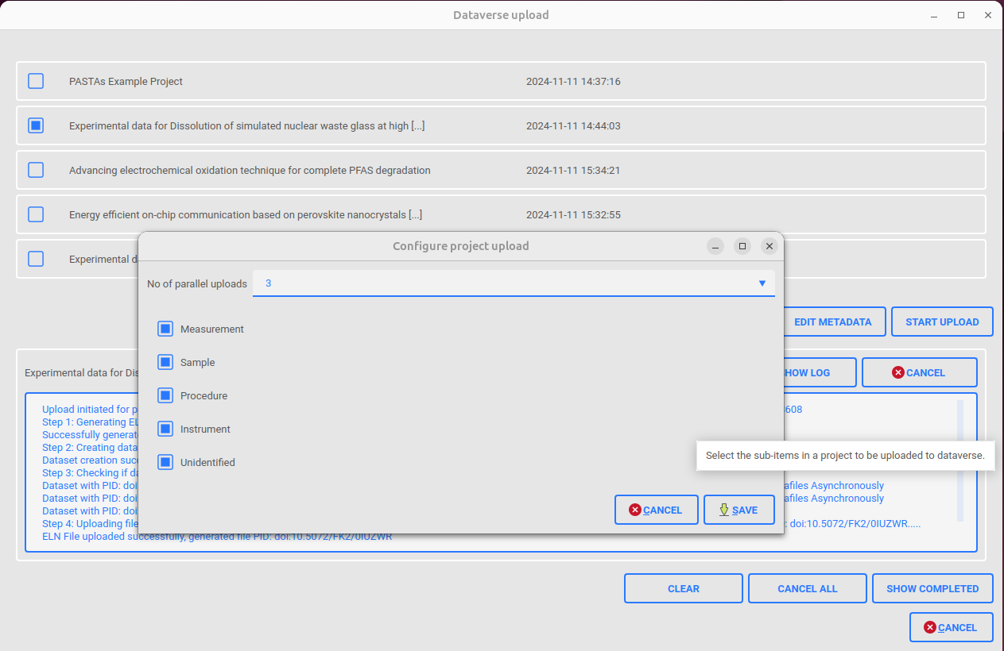
Dataverse integration
Dataverse: Configure Project Upload Dialog
Run Pasta Application
Go to “Project group | Upload to Dataverse” or press F11
Configure project upload dialog helps in saving the upload properties
Click on “Configure” button to open this window
Select the number of parallel uploads from the list.
2 to 5 parallel uploads possible and default value is 3.
Select the items to be zipped during the ELN generation. When a new type is added via data hierarchy tool, the item will be added here too, but will be de-selected by default.
Save the upload configuration
Cancel the changes made by the user and exit

Slide 10
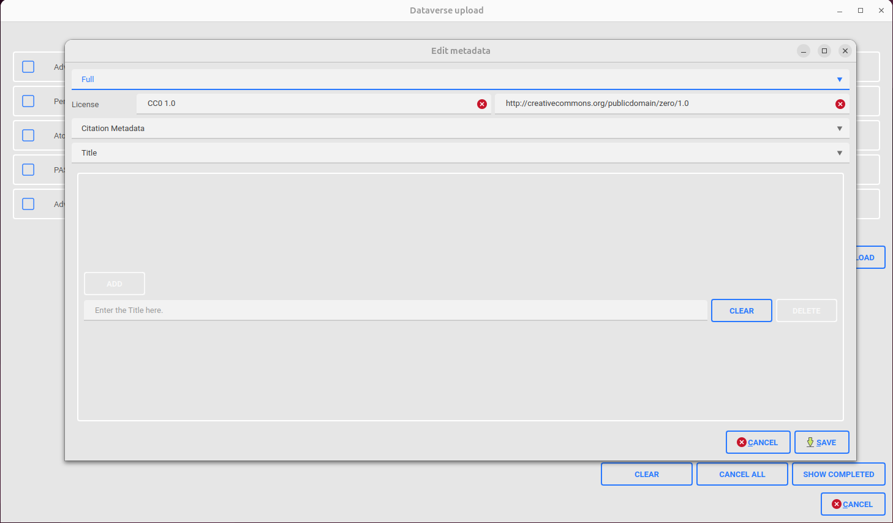
Dataverse integration
Dataverse: Edit Metadata Dialog
Run Pasta Application
Go to “Project group | Upload to Dataverse” or press F11
Edit metadata dialog helps in the modification of metadata needed to create the datasets.
Click on “EDIT METADATA” button to open this dialog
Select “Full” or “Minimal” to display the whole metadata or the minimally required to do the upload
Set the License URL
Set the license name, e.g. CC0 1.0, See help guide to get the supported license list.
Select the main metadata block from this list
Select the properties within the selected main metadata block from this list
Save the modified metadata
Cancel the changes made by the user and exit

Slide 11
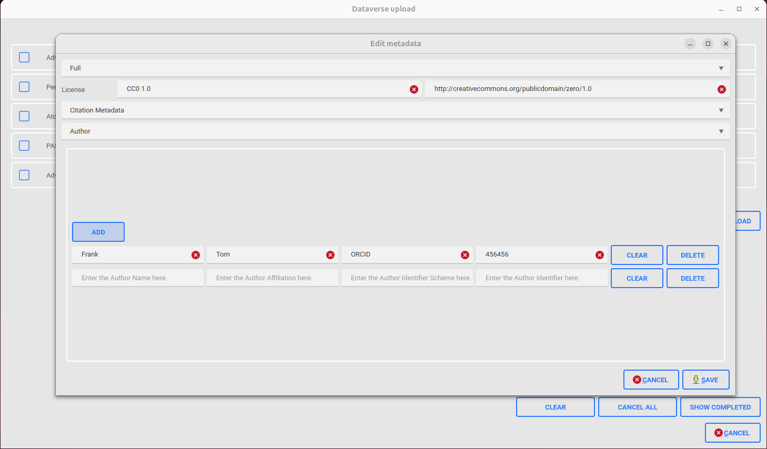
Dataverse integration
Dataverse: Edit Metadata Dialog
Run Pasta Application
Go to “Project group | Upload to Dataverse” or press F11
The first combo-box allows the user to see only the minimal or the full metadata list during edits.
Modified the selected property of the metadata block here
Add new entry for the Author
Delete the full entry to the left
Clear the full entry to the left
Fields for the metadata property

Slide 12
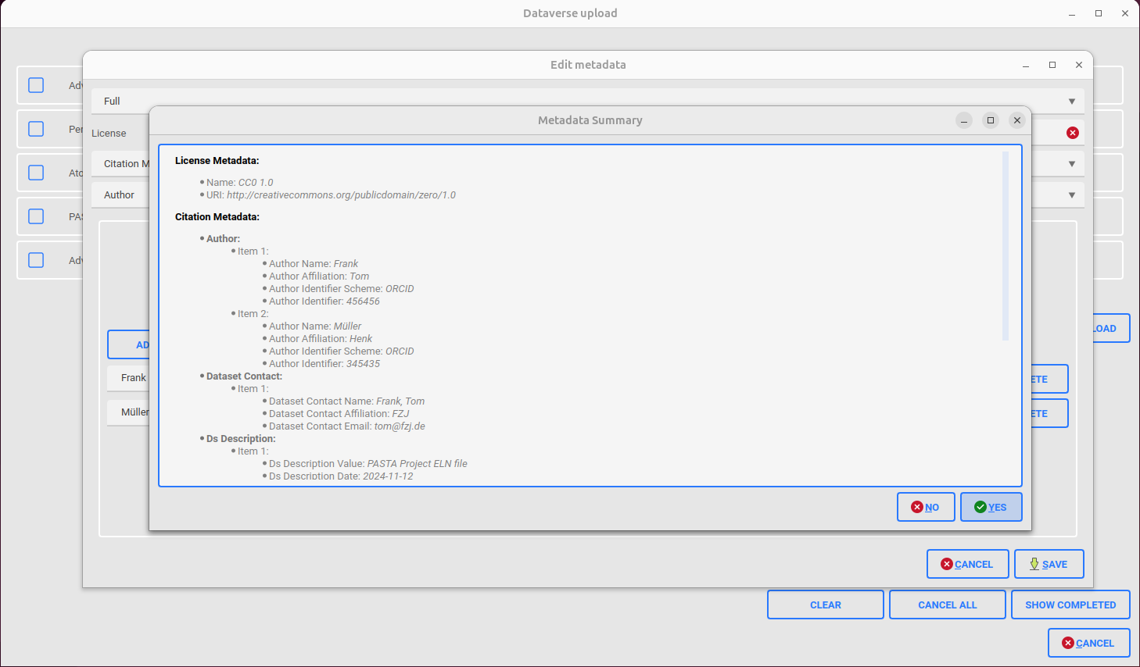
Dataverse integration
Dataverse: Edit Metadata Dialog
Run Pasta Application
Go to “Project group | Upload to Dataverse” or press F11
After making the edits and upon clicking “Save” button, the summarized list is displayed to the user.
After the edits, once when the user clicks “SAVE” button the summarized metadata is displayed. User can accept the changes by clicking “YES” or go back to the edit page by clicking “NO”

Slide 13
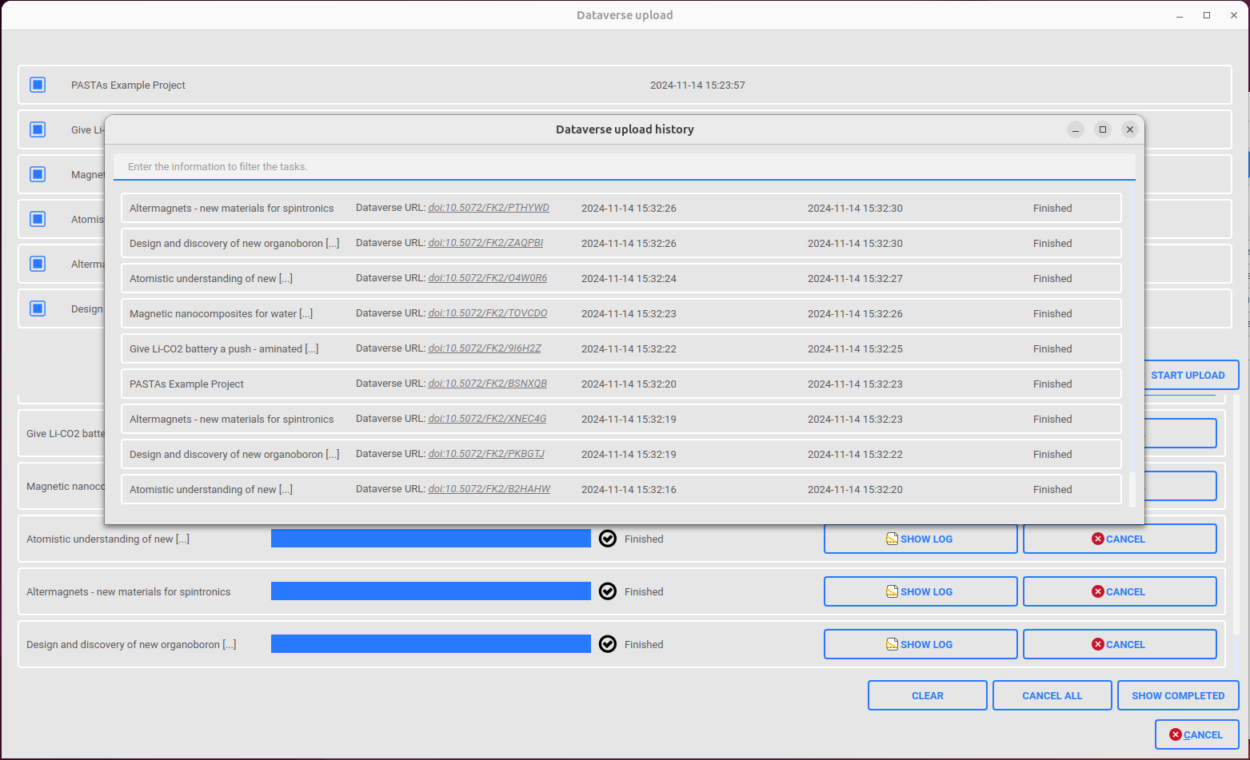
Dataverse integration
Dataverse: Upload History
Run Pasta Application
Go to “Project group | Upload to Dataverse” or press F11
Click “SHOW COMPLETED” button to open Dataverse Upload History Dialog
After the uploads, click “SHOW COMPLETED” button to open “Data-verse upload history” dialog which lists all the upload tasks done in the past in a descending order for the finished time.
Search bar for the finished uploads, filtering will be done instantaneously and the search term will be applied on all properties (project name, upload url, start/finished time and status)
Uploaded project name
Clickable Dataverse URL for the uploaded project
Upload start time
Upload finished time
Upload status (Finished / Error / Canceled)

Slide 14
Dataverse integration
Dataverse Module in Github repository
GUI module (~pasta_eln/GUI/dataverse)
  ~pasta_eln/GUI/dataverse/main_dialog.py (Main UI Dialog)
  ~pasta_eln/GUI/dataverse/config_dialog.py (Dataverse Configuration Dialog)
  ~pasta_eln/GUI/dataverse/edit_metadata_dialog.py (Metadata editor Dialog)
  ~pasta_eln/GUI/dataverse/upload_config_dialog.py (Upload Configuration Dialog)
Core Module (~pasta_eln/dataverse)
  ~pasta_eln/dataverse/database_api.py (Database abstraction layer)
  ~pasta_eln/dataverse/data_upload_task.py (Contains upload & publish logic)
  ~pasta_eln/dataverse/pasta_config_reader_factory.py (Configuration singleton)
  ~pasta_eln/dataverse/progress_updater_thread.py (Thread updating progress for the upload)
  ~pasta_eln/dataverse/upload_queue_manager.py (Queue manager for the upload tasks)

Slide 15
Thanks
jithu murugan

