Slide 1

Ontology Configuration
Ontology editor tool
20 September 2023 I jithu murugan

Slide 2
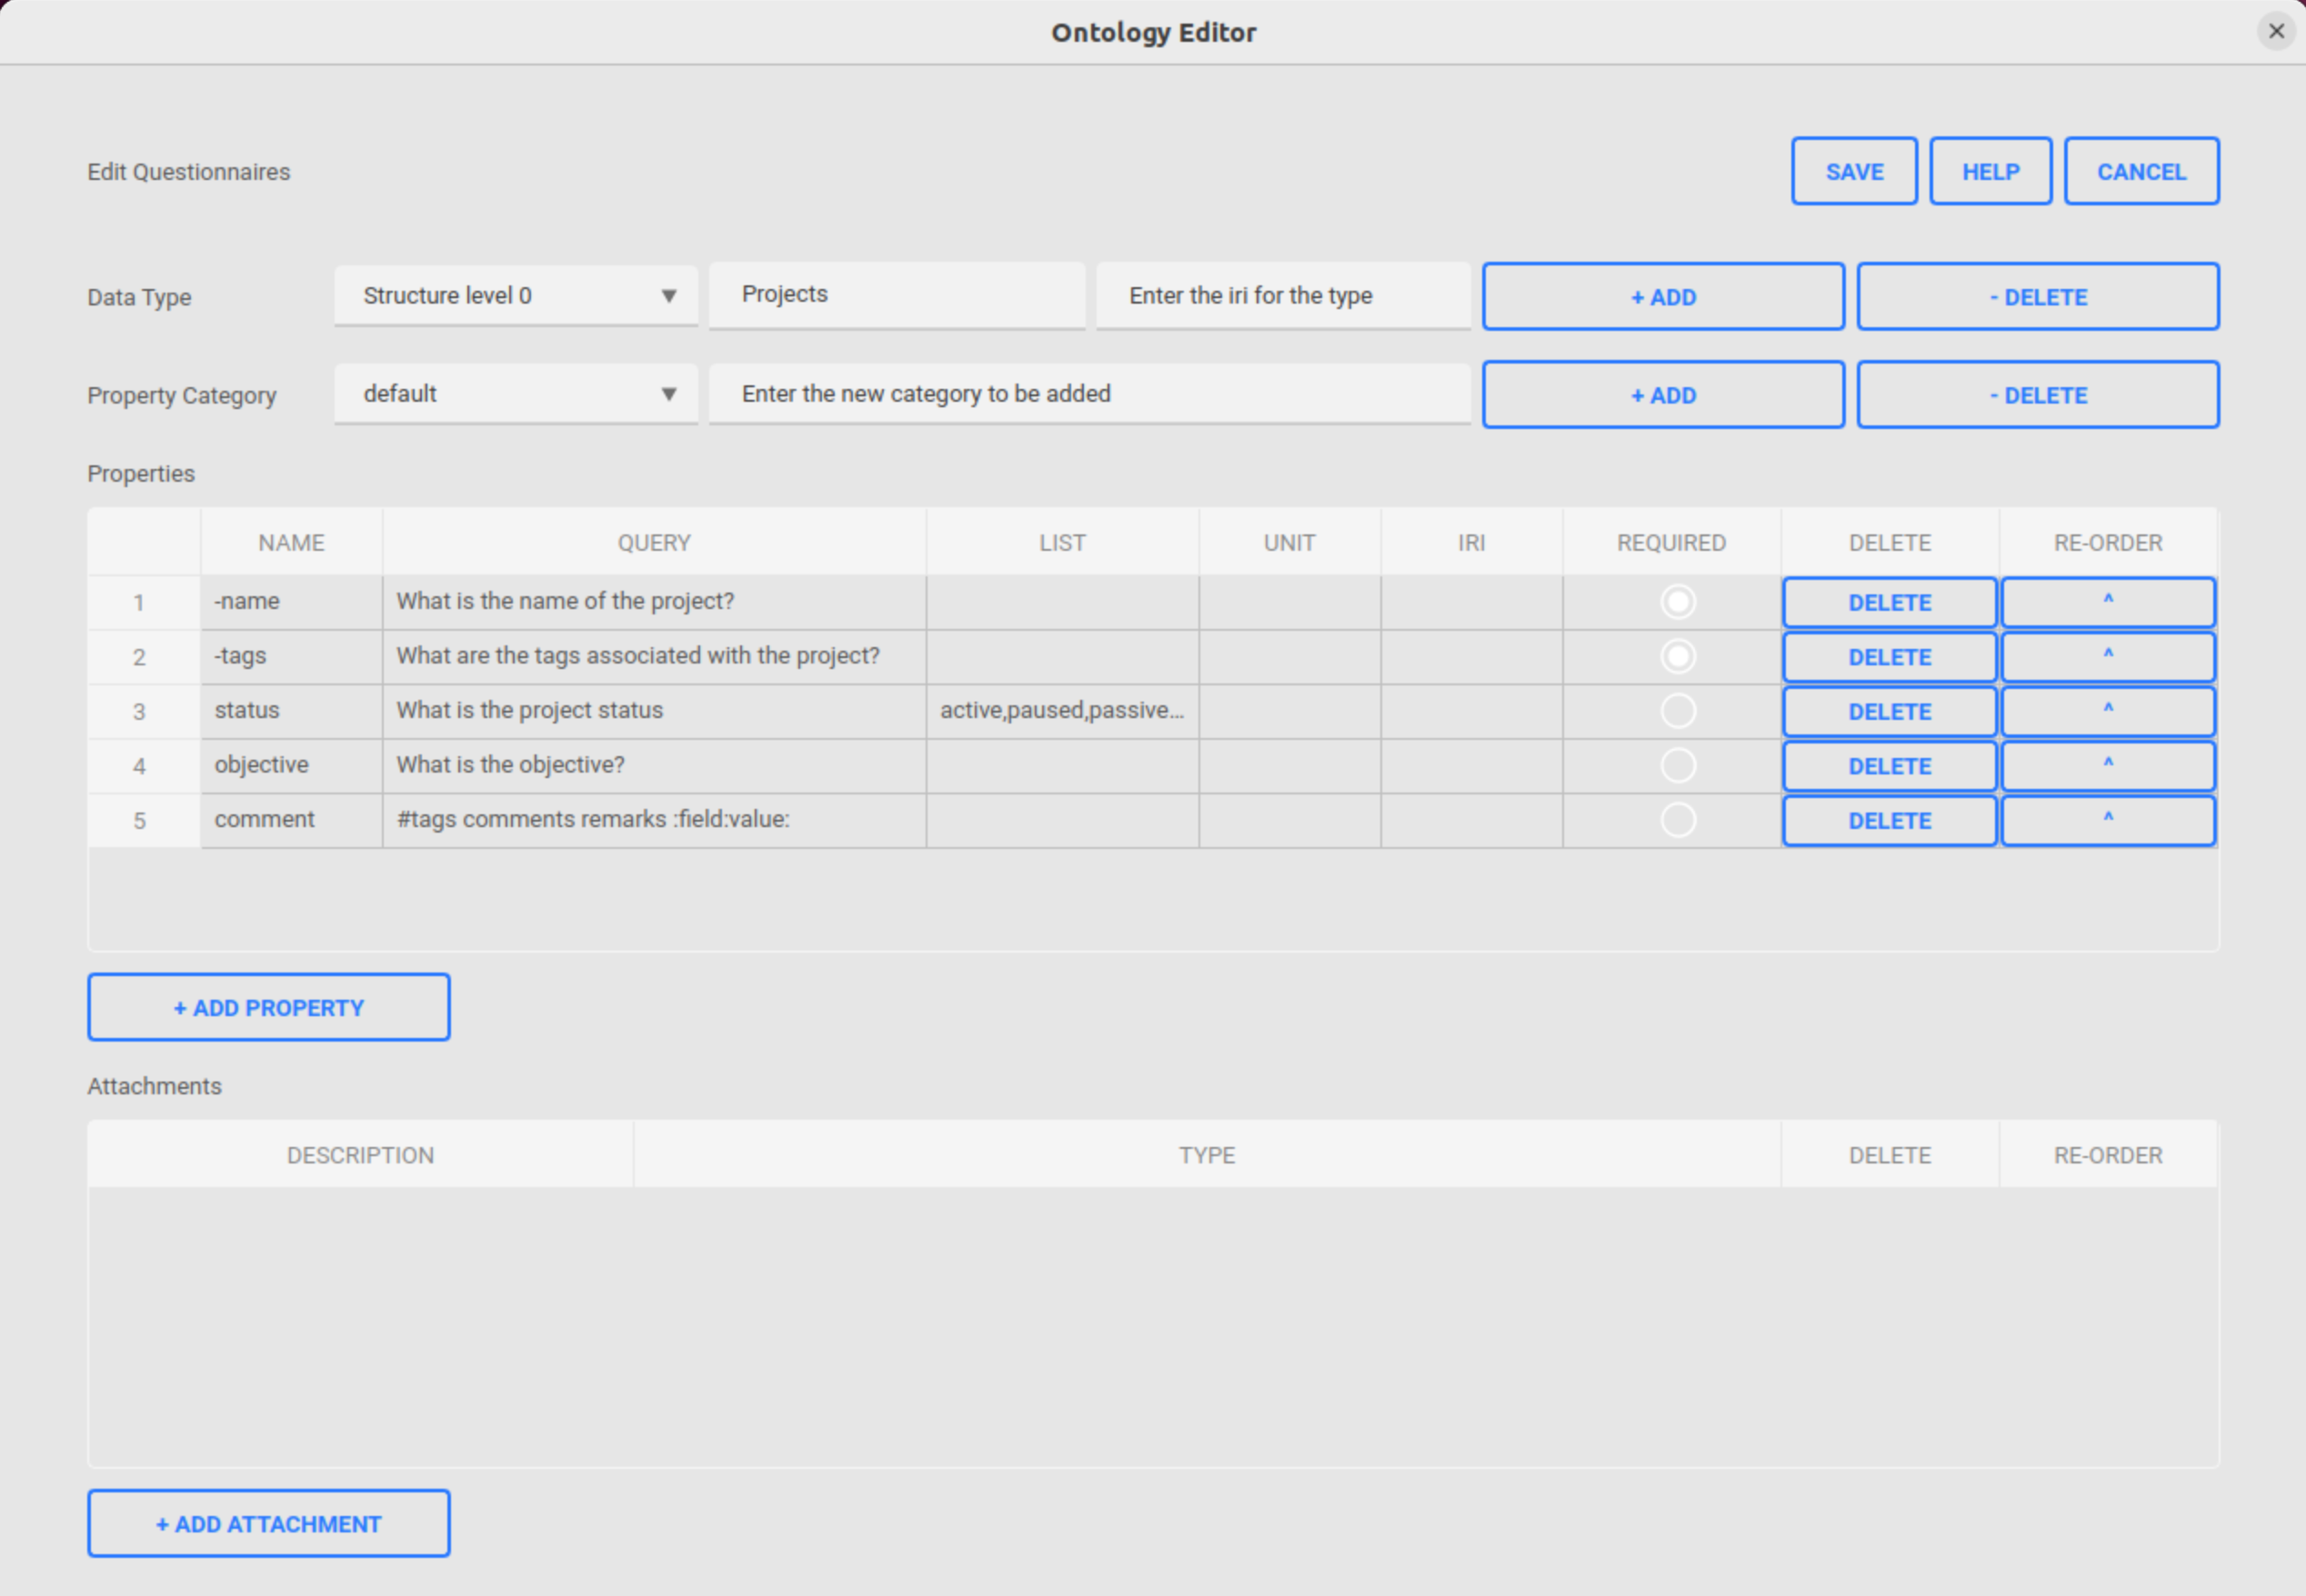
Usage
How to launch the tool
Follow the below given steps to open the tool
Open PASTA Application
Go to System | Questionnaires or press F8
Ontology editor will be opened with the loaded data from the database as shown in the picture

Slide 3
Ontology Editor
Data type tools
1
2
3
4
5
Select the data type to be edited from the combo-box list
Edit the label of the selected type
Edit the Internationalized Resource Identifier (IRI) associated with the selected type
Add a new type to the list
Delete the selected type from the list

Slide 4
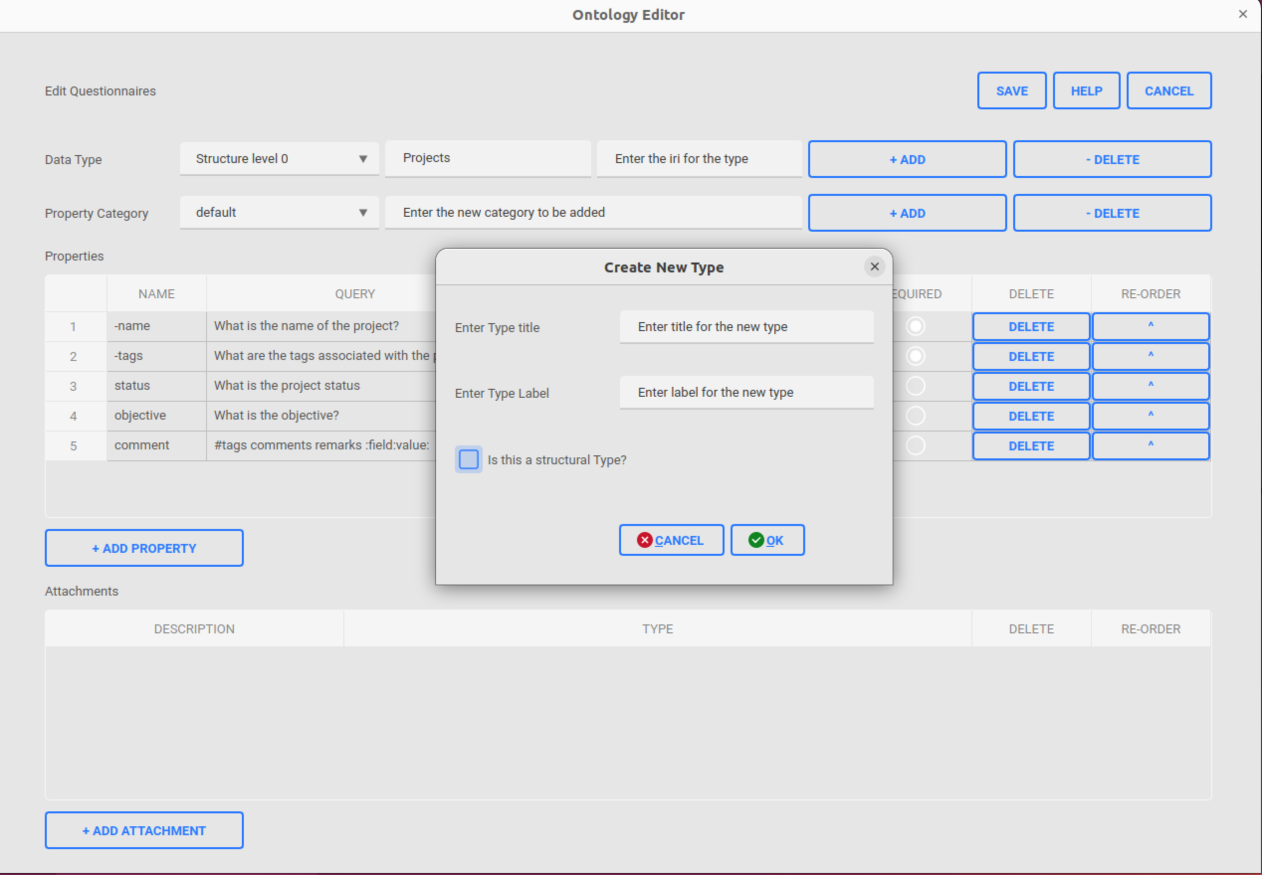
Ontology Editor
Data type tools: Add new type
Click “+ Add” button to open the “Create New Type” window
Enter the title for the type
Enter the label to be associated with the type
Select the check-box if you need to add a structure level type (x0, x1,...xn)
  If checked, the title will be auto-populated
1
2
3
4

Slide 5
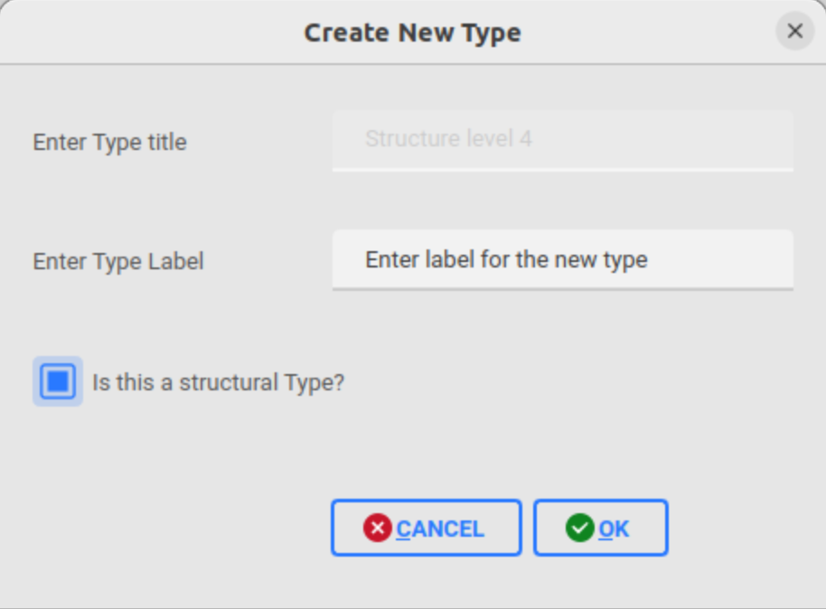
Ontology Editor
Data type tools: Add new type
1
2
3
Auto-populated title field
4

Slide 6
Ontology Editor
Data type properties list with categories
1
2
5
3
4
Select the property list category from the combo-box associated with the selected type
Enter the new property list category name to be added
Add the new property list category
  When a new category is added, the property list table will be cleared and default properties (-name & -tags) will be added automatically
Delete the selected property list category
  The selected category will be deleted and the next one in the list will be displayed
Property list table for the selected category
Add a new row to the property list table for entering a new property to the selected category
6
5

Slide 7
Ontology Editor
Data type property attributes
Name of the property
Query associated with the property
List associated with the property
Unit for the property
Internationalized Resource Identifier (IRI)
Required attribute of the property
Delete button to delete the property from the table
Re-order button to move up the property in the table
1
2
3
4
5
6
7
8

Slide 8
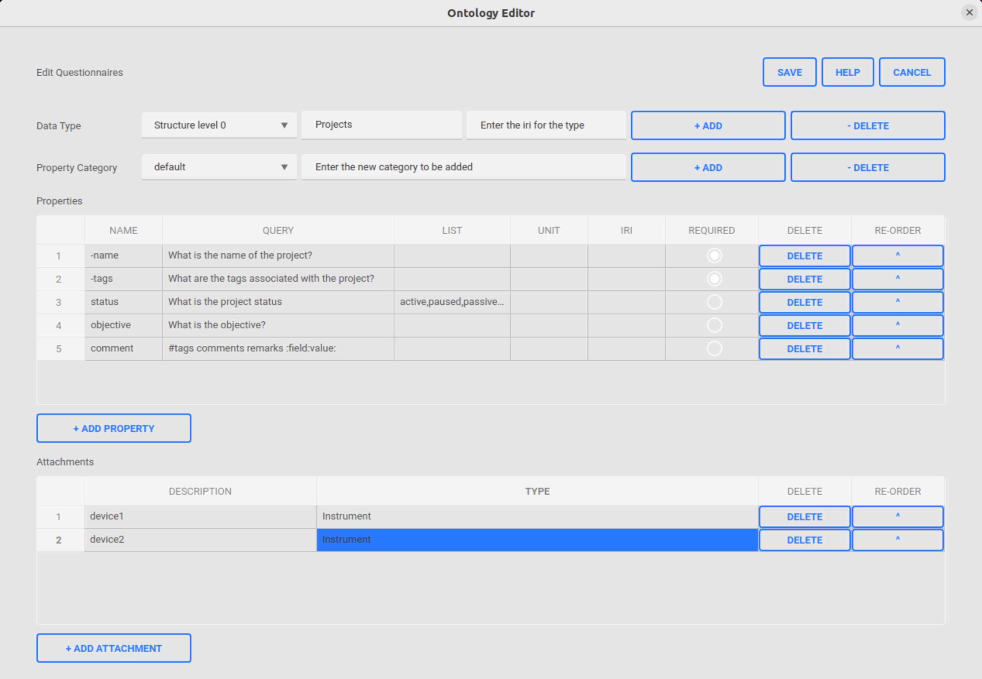
Ontology Editor
Data type attachments
Attachments table which lists all the attachments associated with the selected data type
Description (eg. device name) attribute of the attachment
Type of the attachment, can be any previously defined data types
Delete the attachment from the attachments table
Re-order button to pull up the item to the top of the attachments table
Add a new attachment row to the attachments table
1
2
3
4
5
6

Slide 9
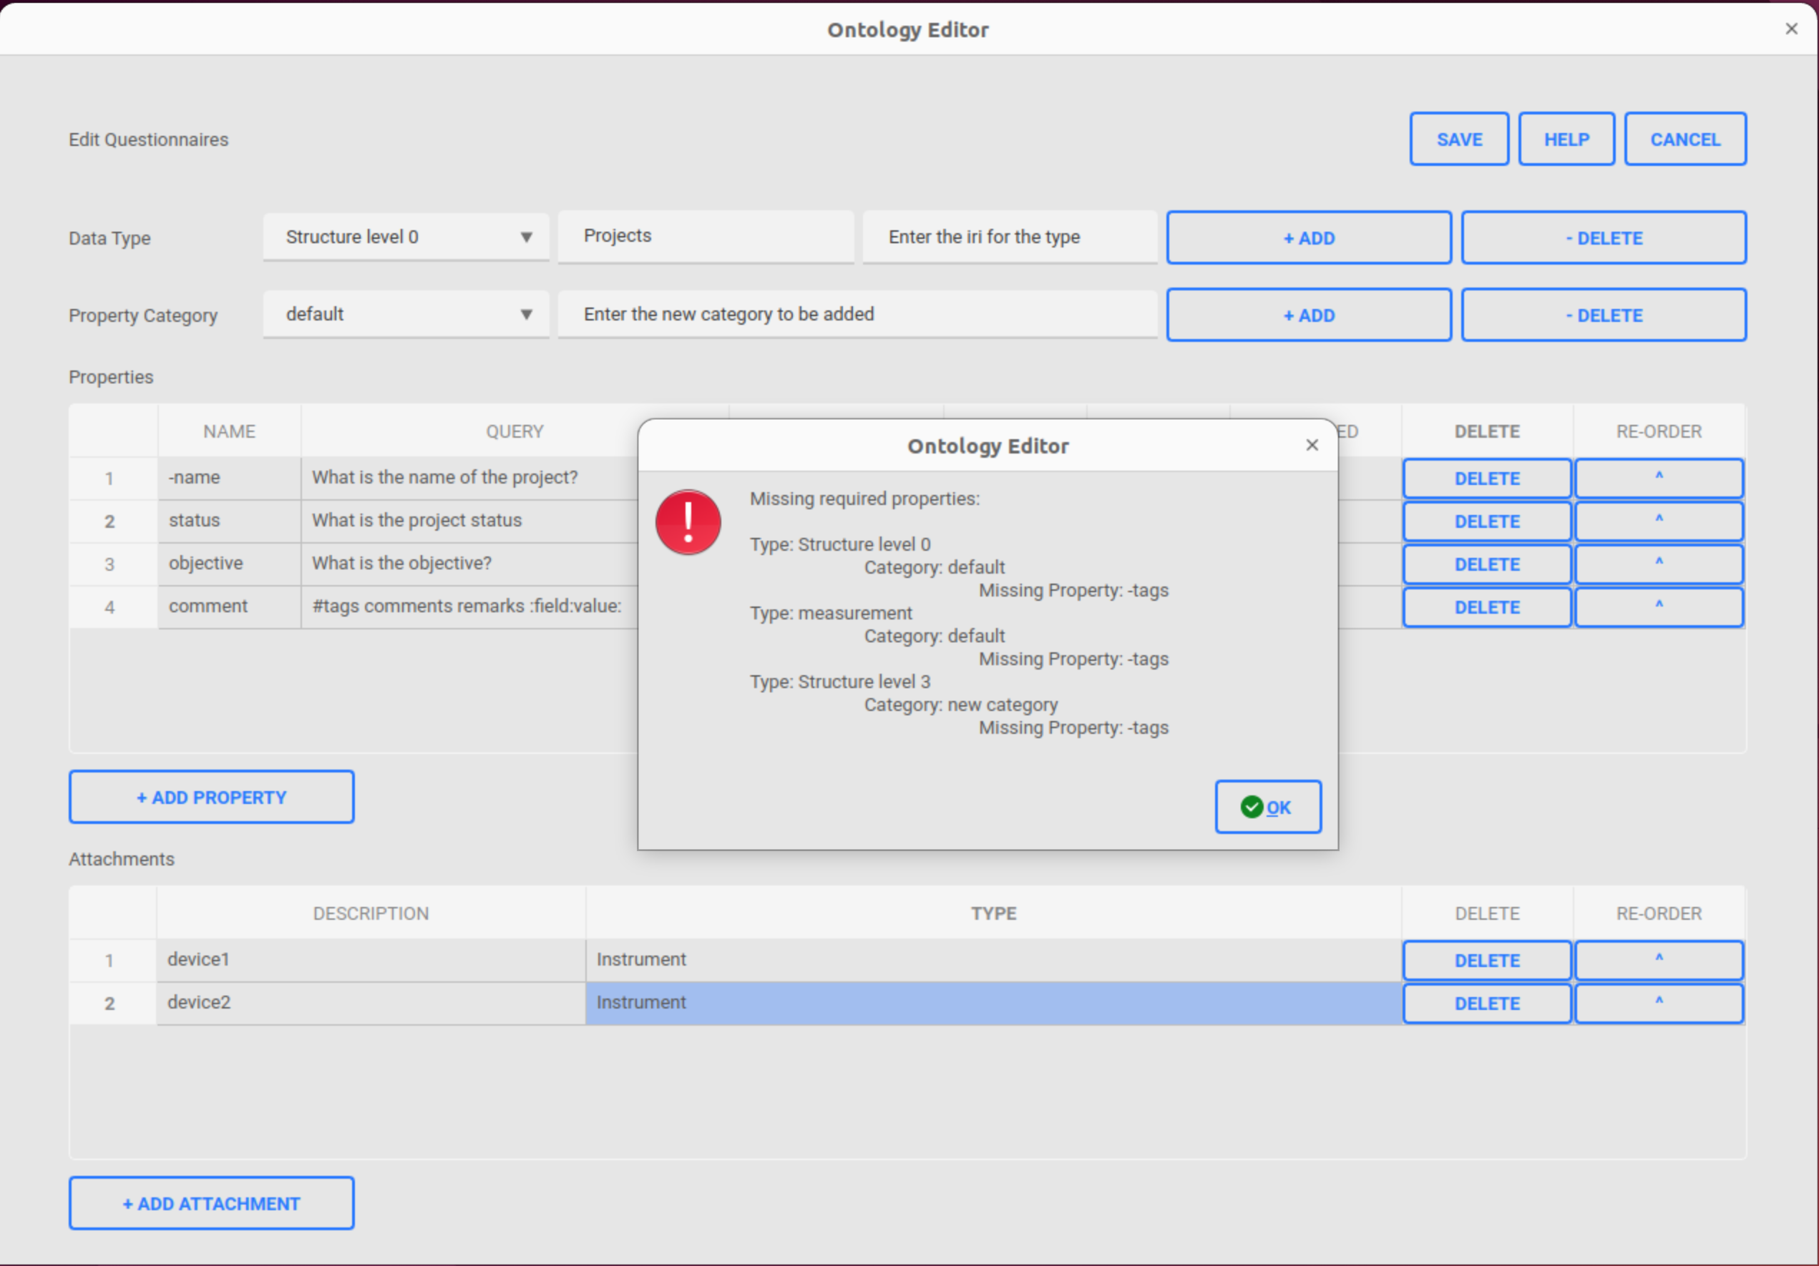
Ontology Editor
Save, help and cancel operations
Save the changes made on the ontology data loaded from database
  Save operation will check within each type, if all the required properties (-name & -tags) are defined by the user for every category
    If all set, then success message will be shown for the save operation
    Otherwise an error will be displayed with the missing required properties for the respective type categories as shown in the picture
Navigate to the help page of the ontology editor
Cancel all the changes done so far on the loaded ontology data and exit the editor
1
2
3

Slide 10
Thanks
jithu murugan

