Slide 1

Data Hierarchy Configuration
Data Hierarchy editor tool
06 november 2023 I jithu murugan

Slide 2
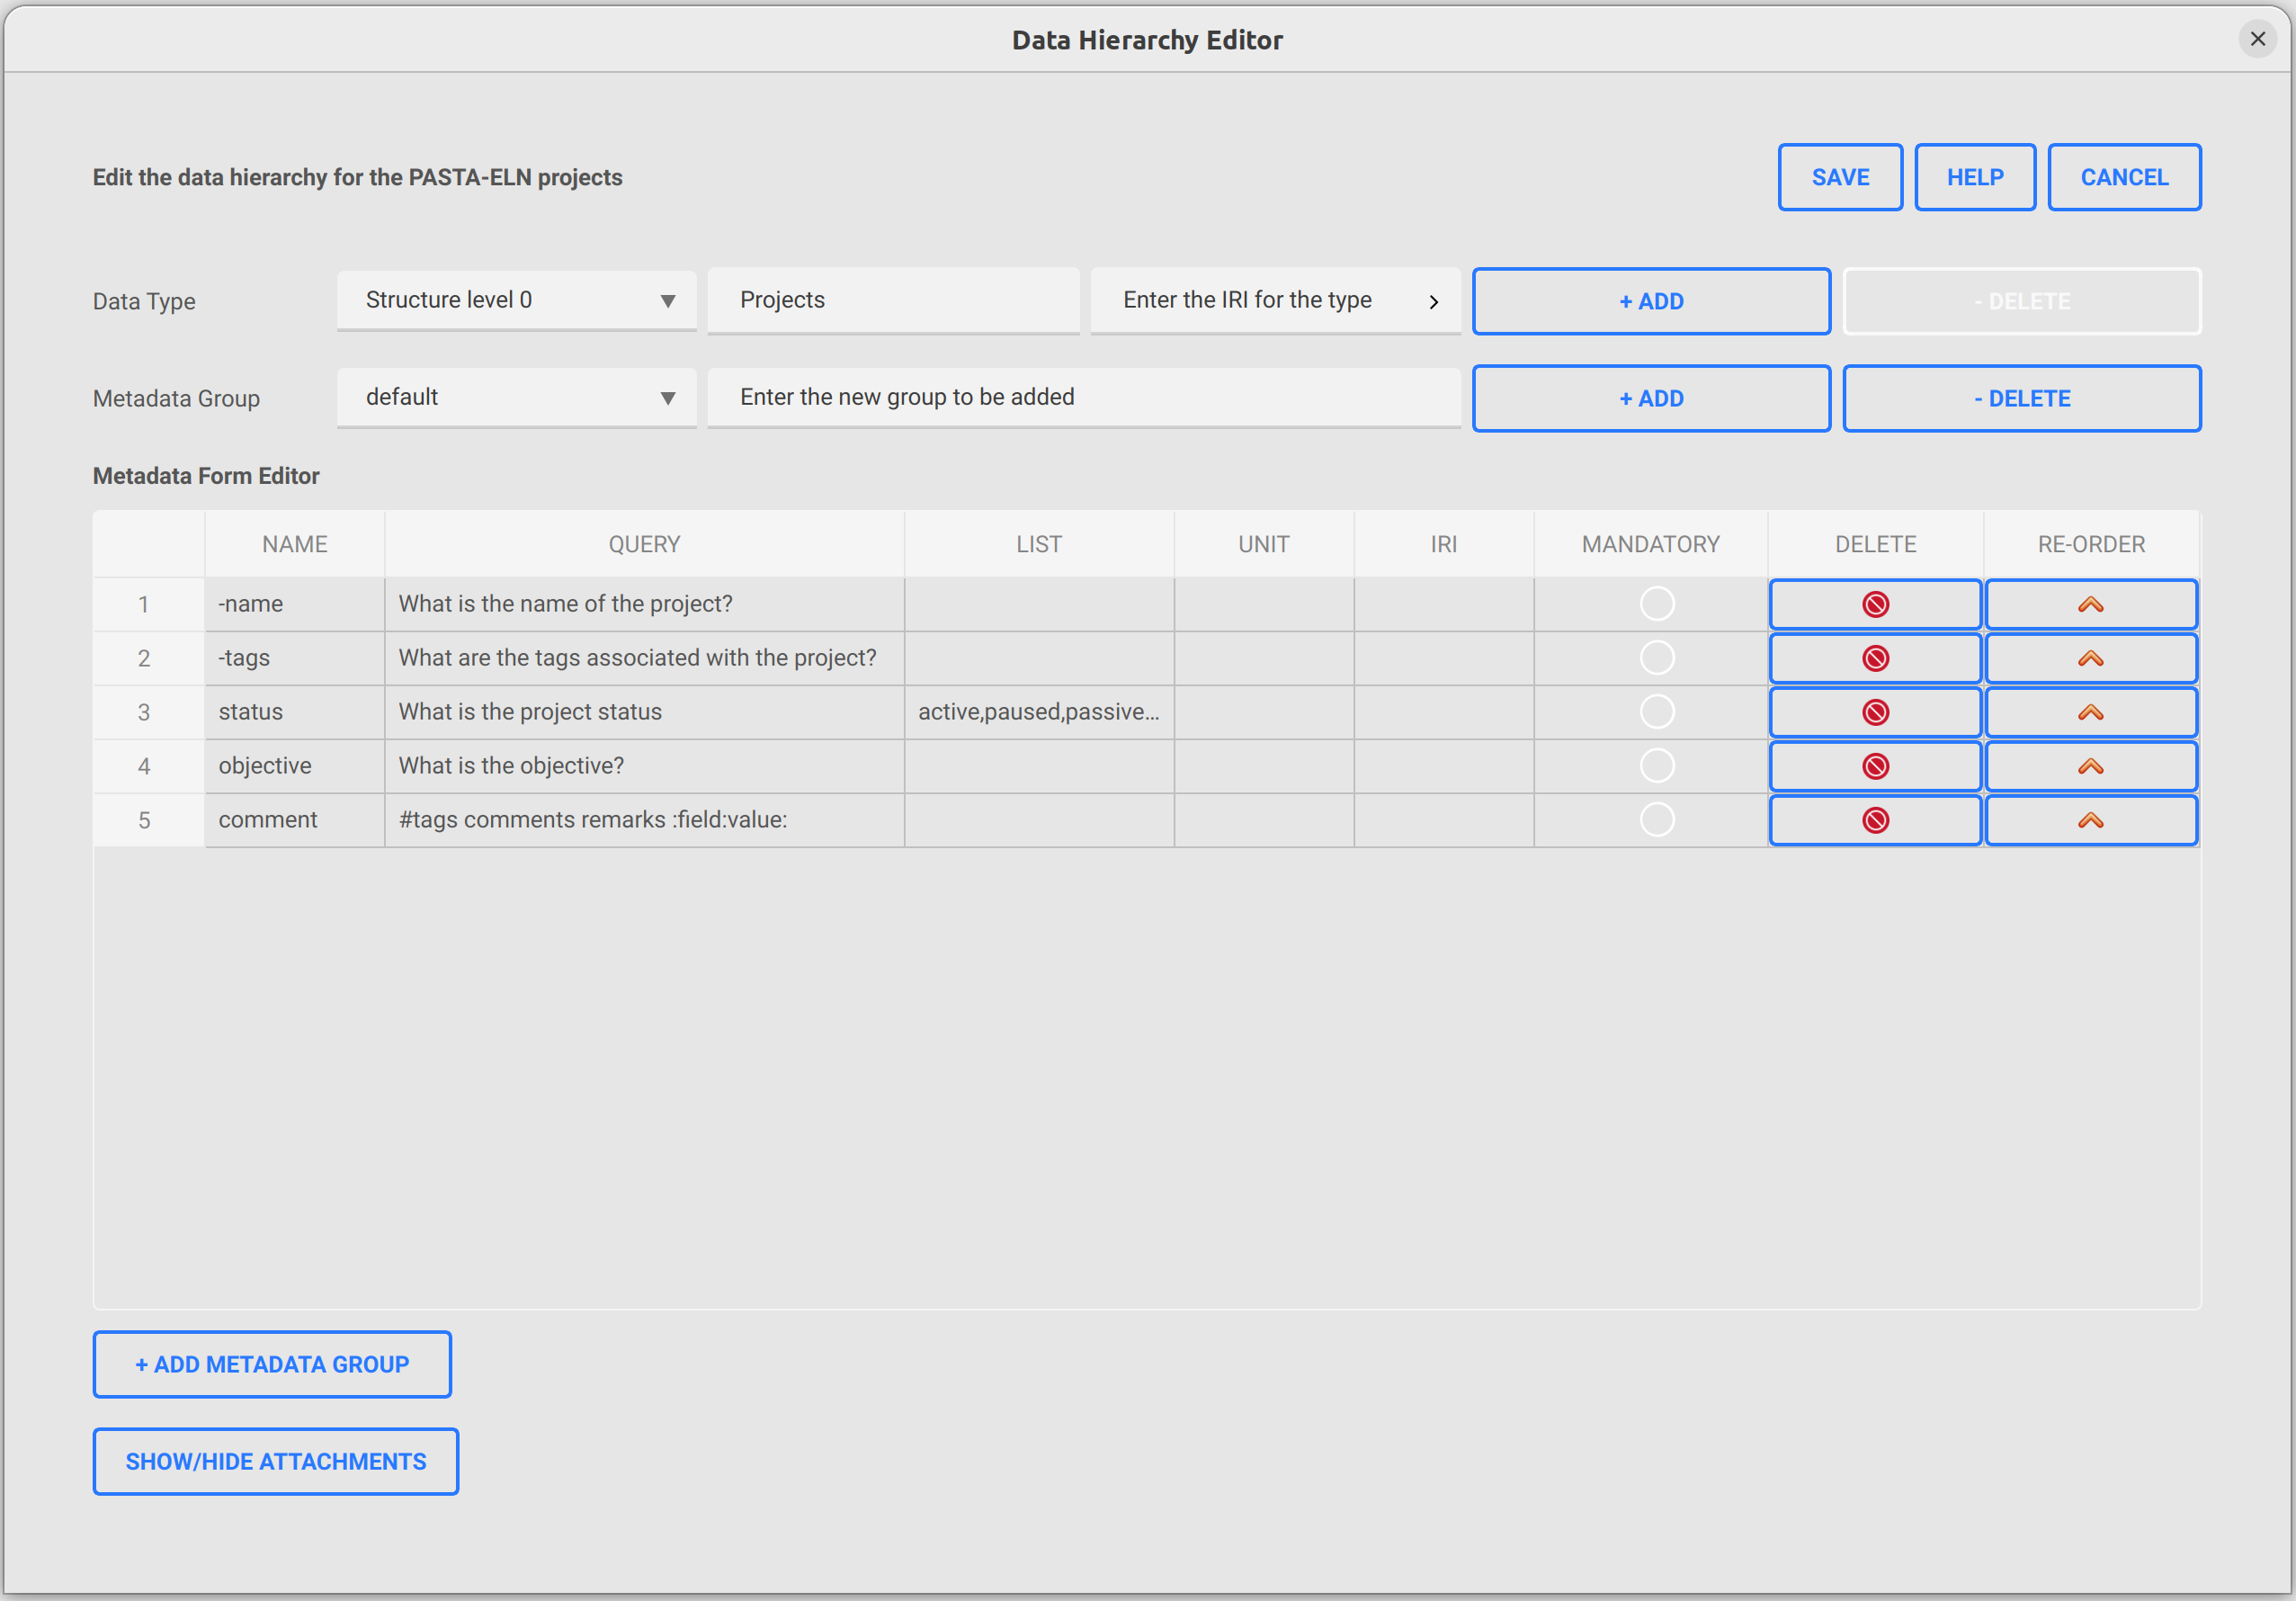
Usage
How to launch the tool
Follow the below given steps to open the tool
Open PASTA Application
Go to System | Data Hierarchy Editor or press F8
The editor tool will be opened with the loaded data from the database as shown in the picture

Slide 3
Data Hierarchy Editor
Data type tools
1
2
3
4
5
Select the data type to be edited from the combo-box list
Edit the displayed title of the selected type
Edit the Internationalized Resource Identifier (IRI) associated with the selected type
Add a new type to the list
Delete the selected type from the list

Slide 4
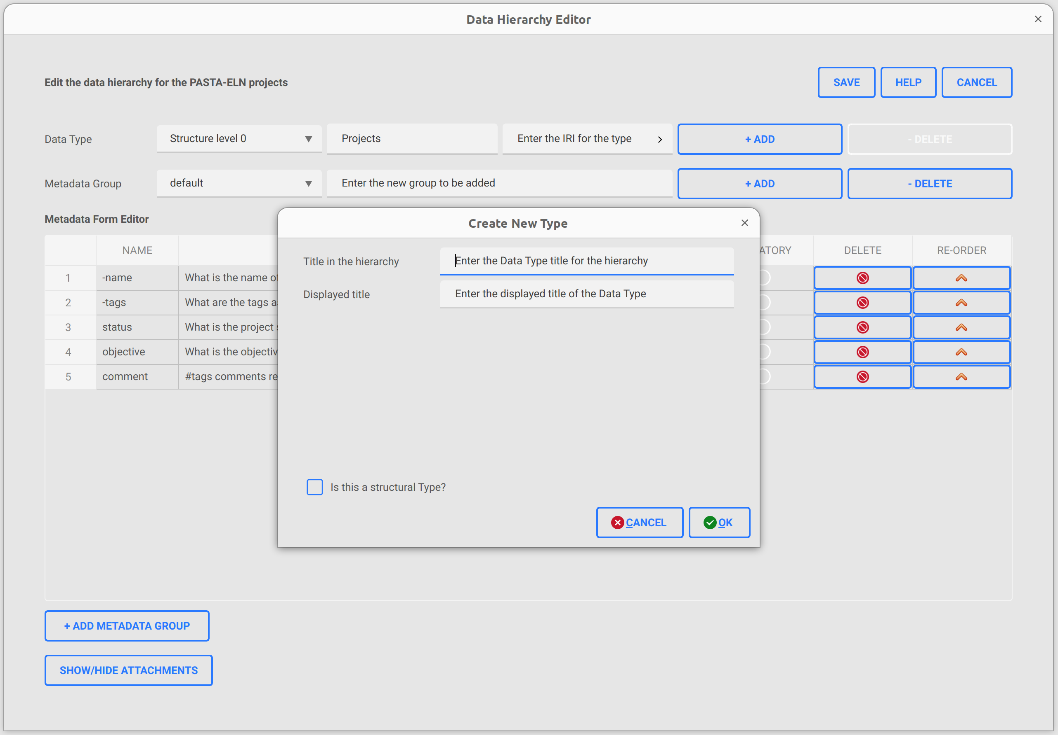
Data Hierarchy Editor
Data type tools: Add new type
Click “+ Add” button to open the “Create New Type” window
Enter the title for the type
Enter the displayed title to be associated with the type
Select the check-box if you need to add a structure level type (x0, x1,...xn)
  If checked, the title will be auto-populated
1
2
3
4

Slide 5
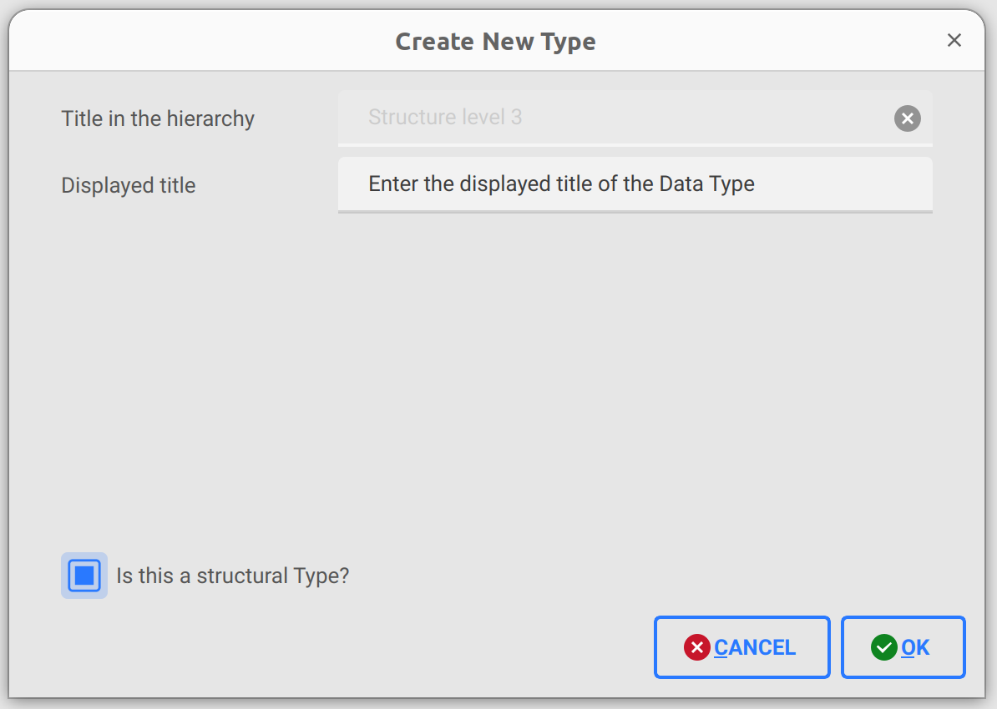
Data Hierarchy Editor
Data type tools: Add new type
1
2
3
4

Slide 6
Data Hierarchy Editor
Data type metadata table with groups
1
2
5
3
4
Select the metadata group from the combo-box associated with the selected type
Enter the new metadata group name to be added
Add a new metadata group
  When a new group is added, the metadata table will be cleared and empty set is associated with the group by default
Delete the selected metadata group
  The selected group will be deleted and the next one in the list will be displayed
Metadata table for the selected group
Add a new row to the metadata table for entering a new metadata to the selected group
6

Slide 7
Data Hierarchy Editor
Metadata attributes
Name of the property
Query associated with the property
List associated with the property
Unit for the property
Internationalized Resource Identifier (IRI)
Mandatory attribute
Delete the property from the table
Re-order button to move up the property in the table
1
2
3
4
5
6
7
8

Slide 8
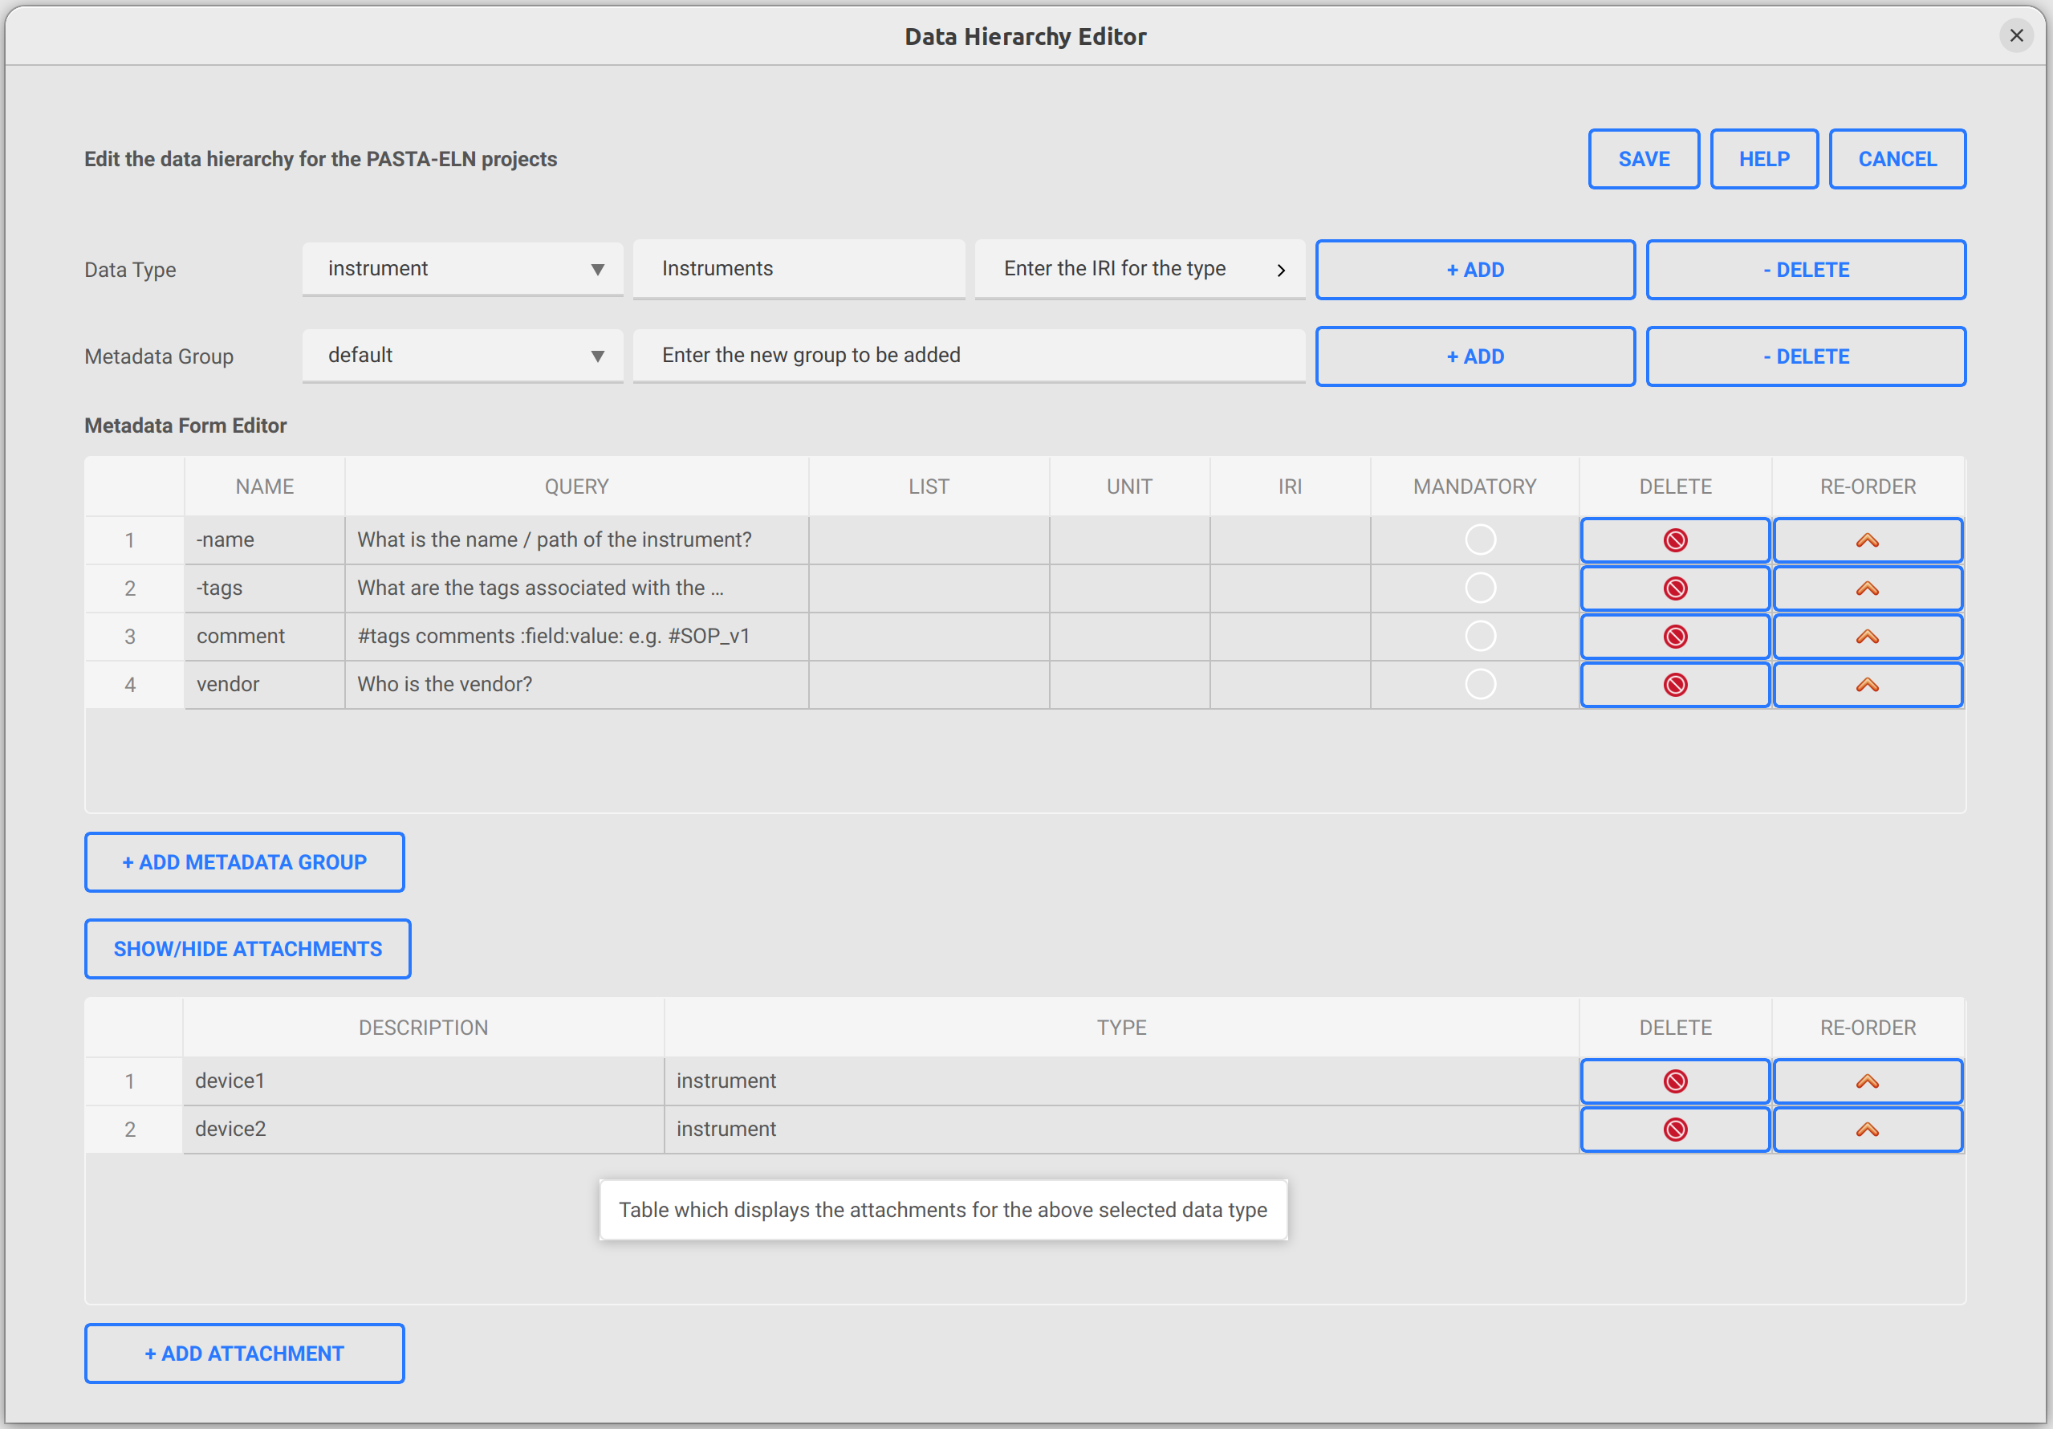
Data Hierarchy Editor
Data type attachments
Attachments table which lists all the attachments associated with the selected data type
Description (eg. device name) attribute of the attachment
Type of the attachment, can be any previously defined data types
Delete the attachment from the attachments table
Re-order button to pull up the item to the top of the attachments table
Add a new attachment row to the attachments table
1
2
3
4
5
6

Slide 9
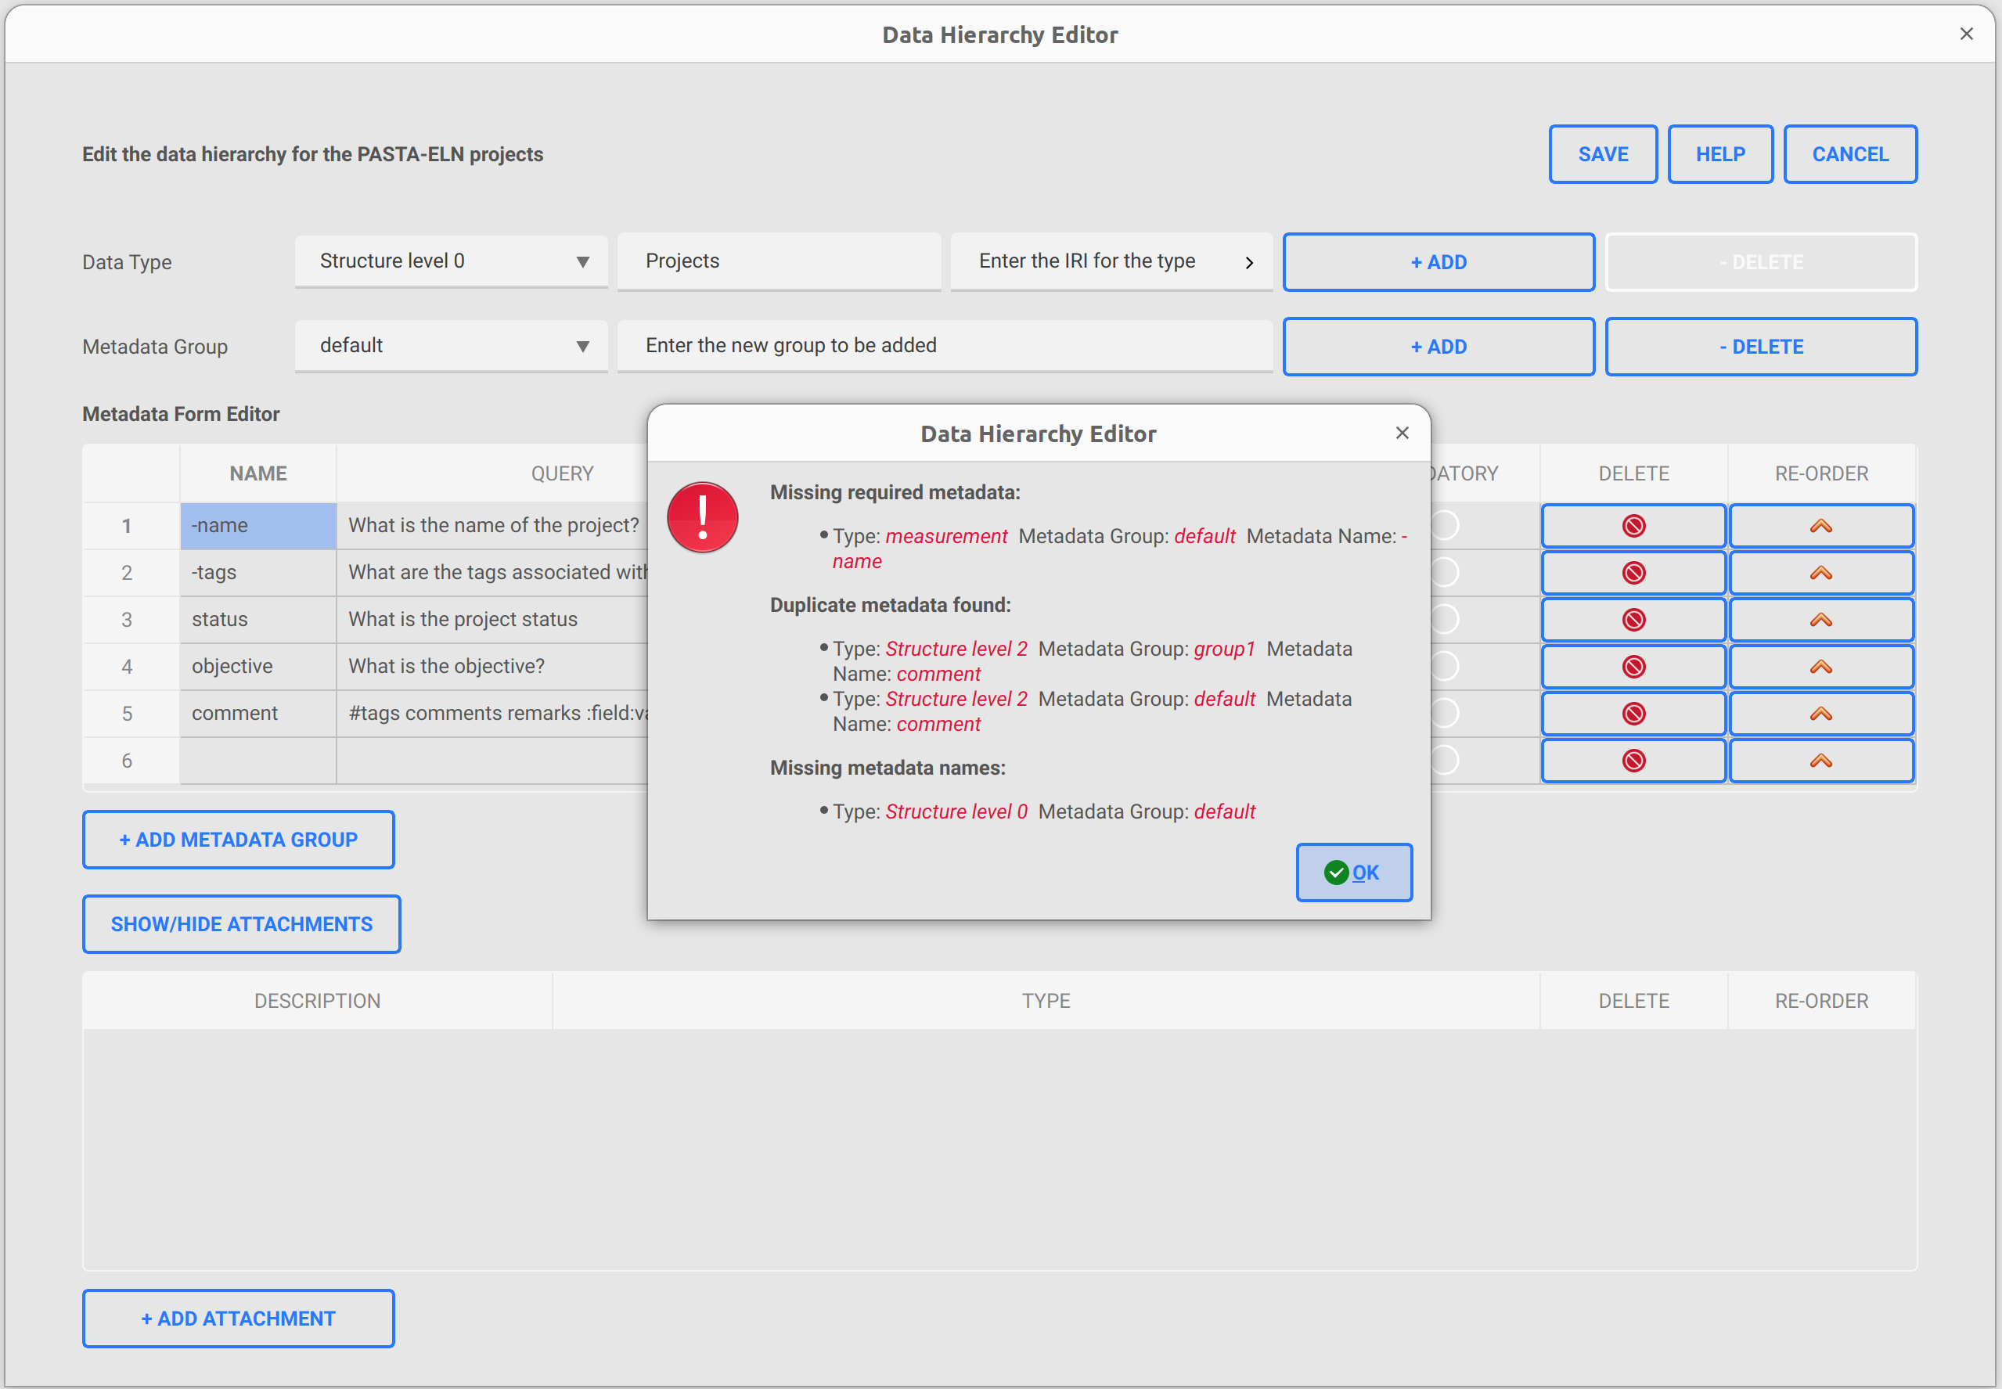
Data Hierarchy Editor
Save, help and cancel operations
Save the changes made on the data loaded from database
  Save operation will check the following within each type:
    if all the required properties (-name & -tags) are defined by the user for default category
      If all set, then success message will be shown for the save operation
      Otherwise an error will be displayed with the missing required properties for the respective type categories as shown in the picture
    If all metadata have a unique name across all groups and within the group
    If all metadata has a non-null valid name
Navigate to the help page of the data hierarchy editor
Cancel all the changes done so far on the loaded data and exit the editor
1
2
3

Slide 10
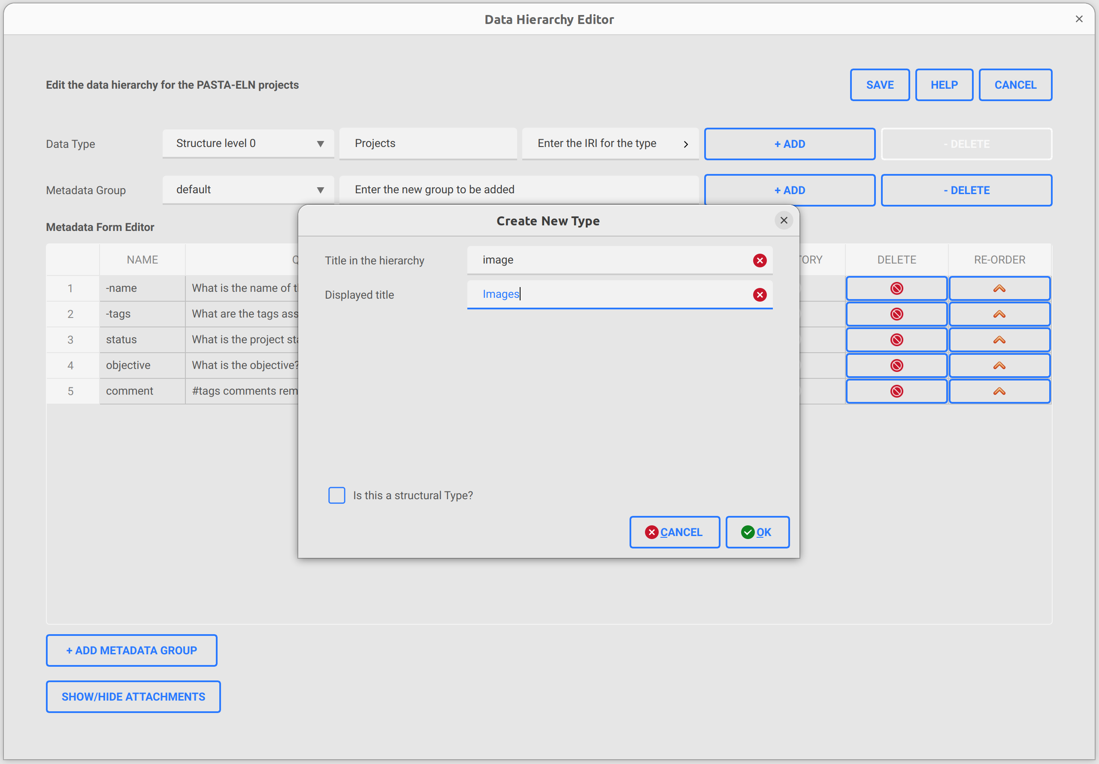
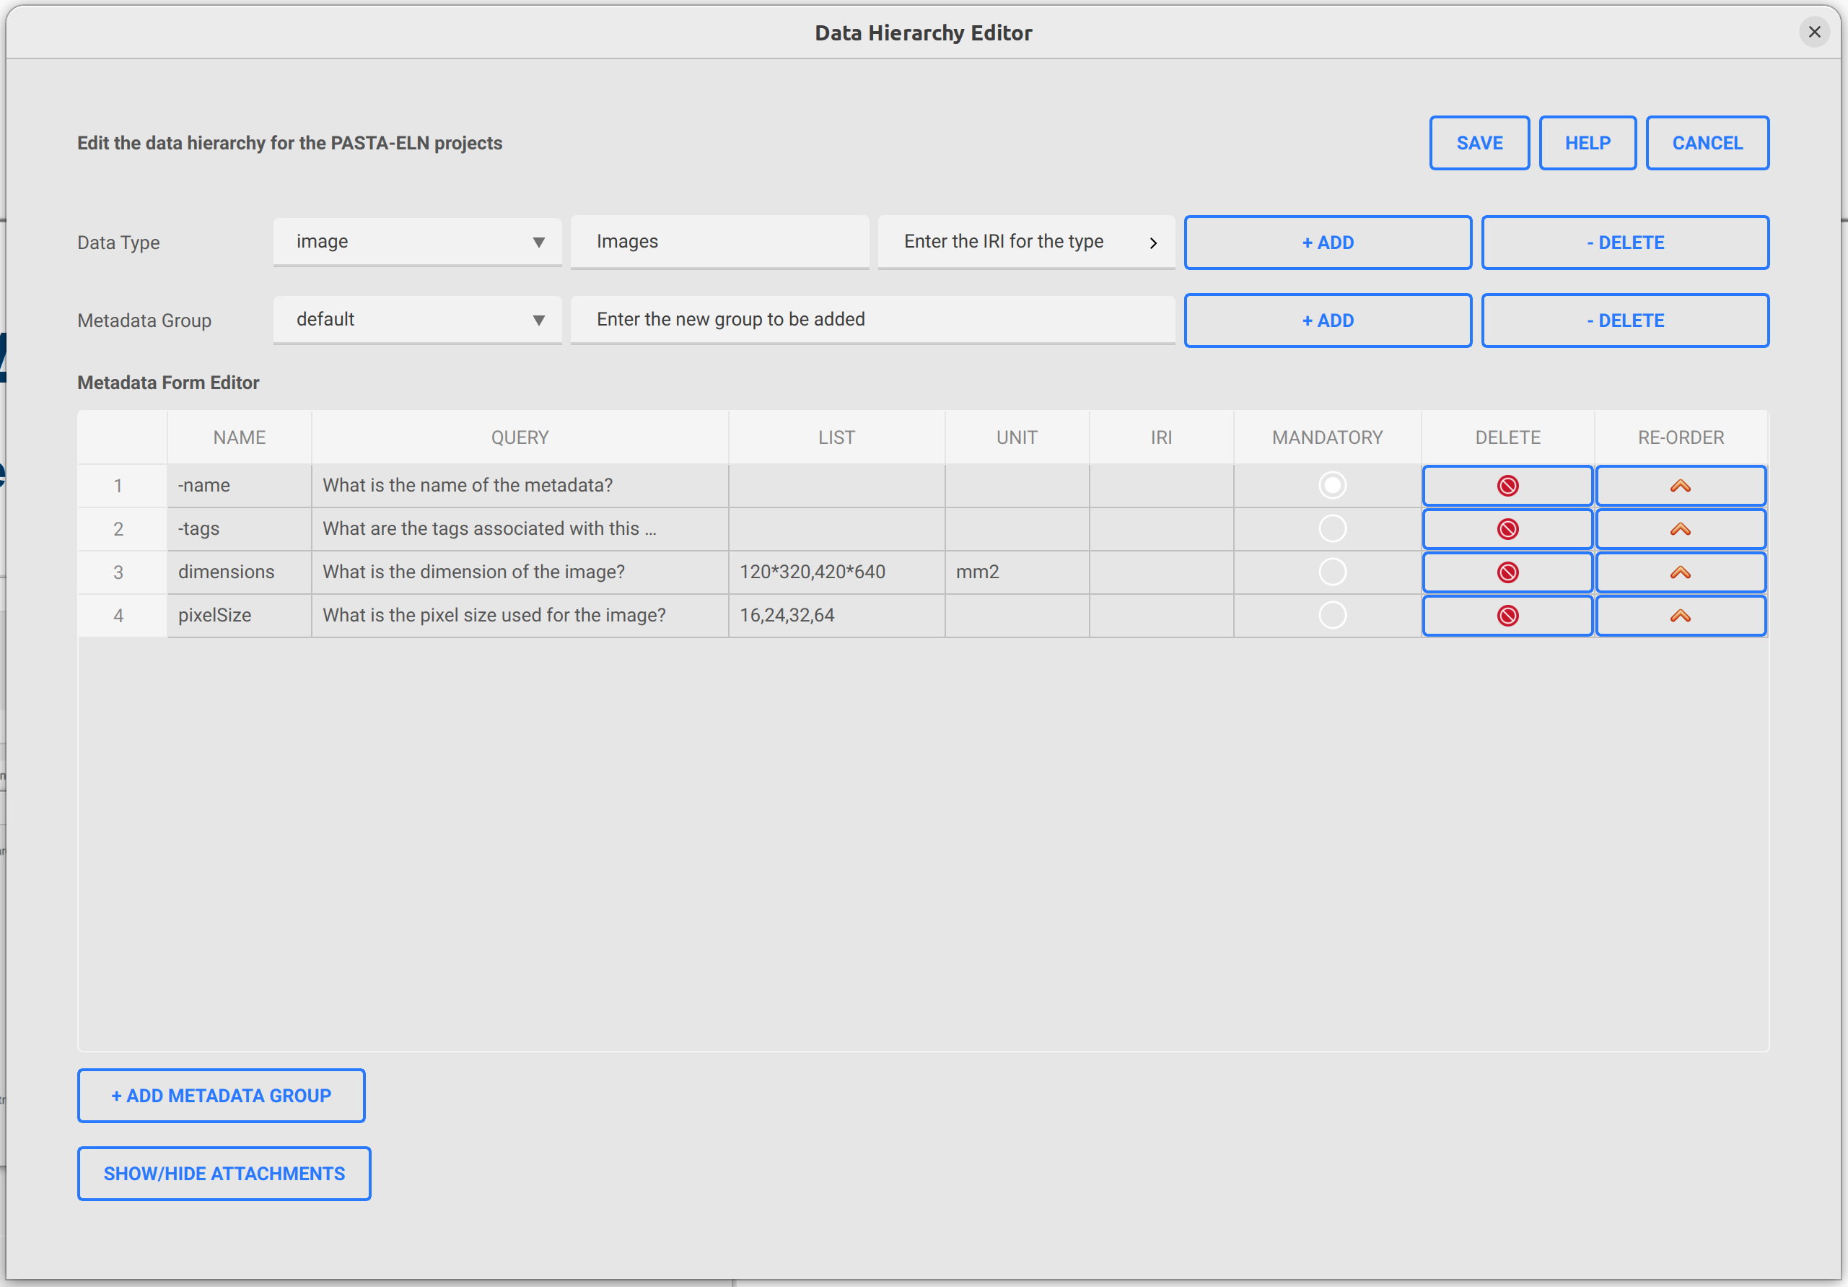
Data Hierarchy Editor
Using modified or newly added type in pasta app
1. Add a new type titled “image”
1. Add metadata (dimension & pixel size) for the
newly added type

Slide 11
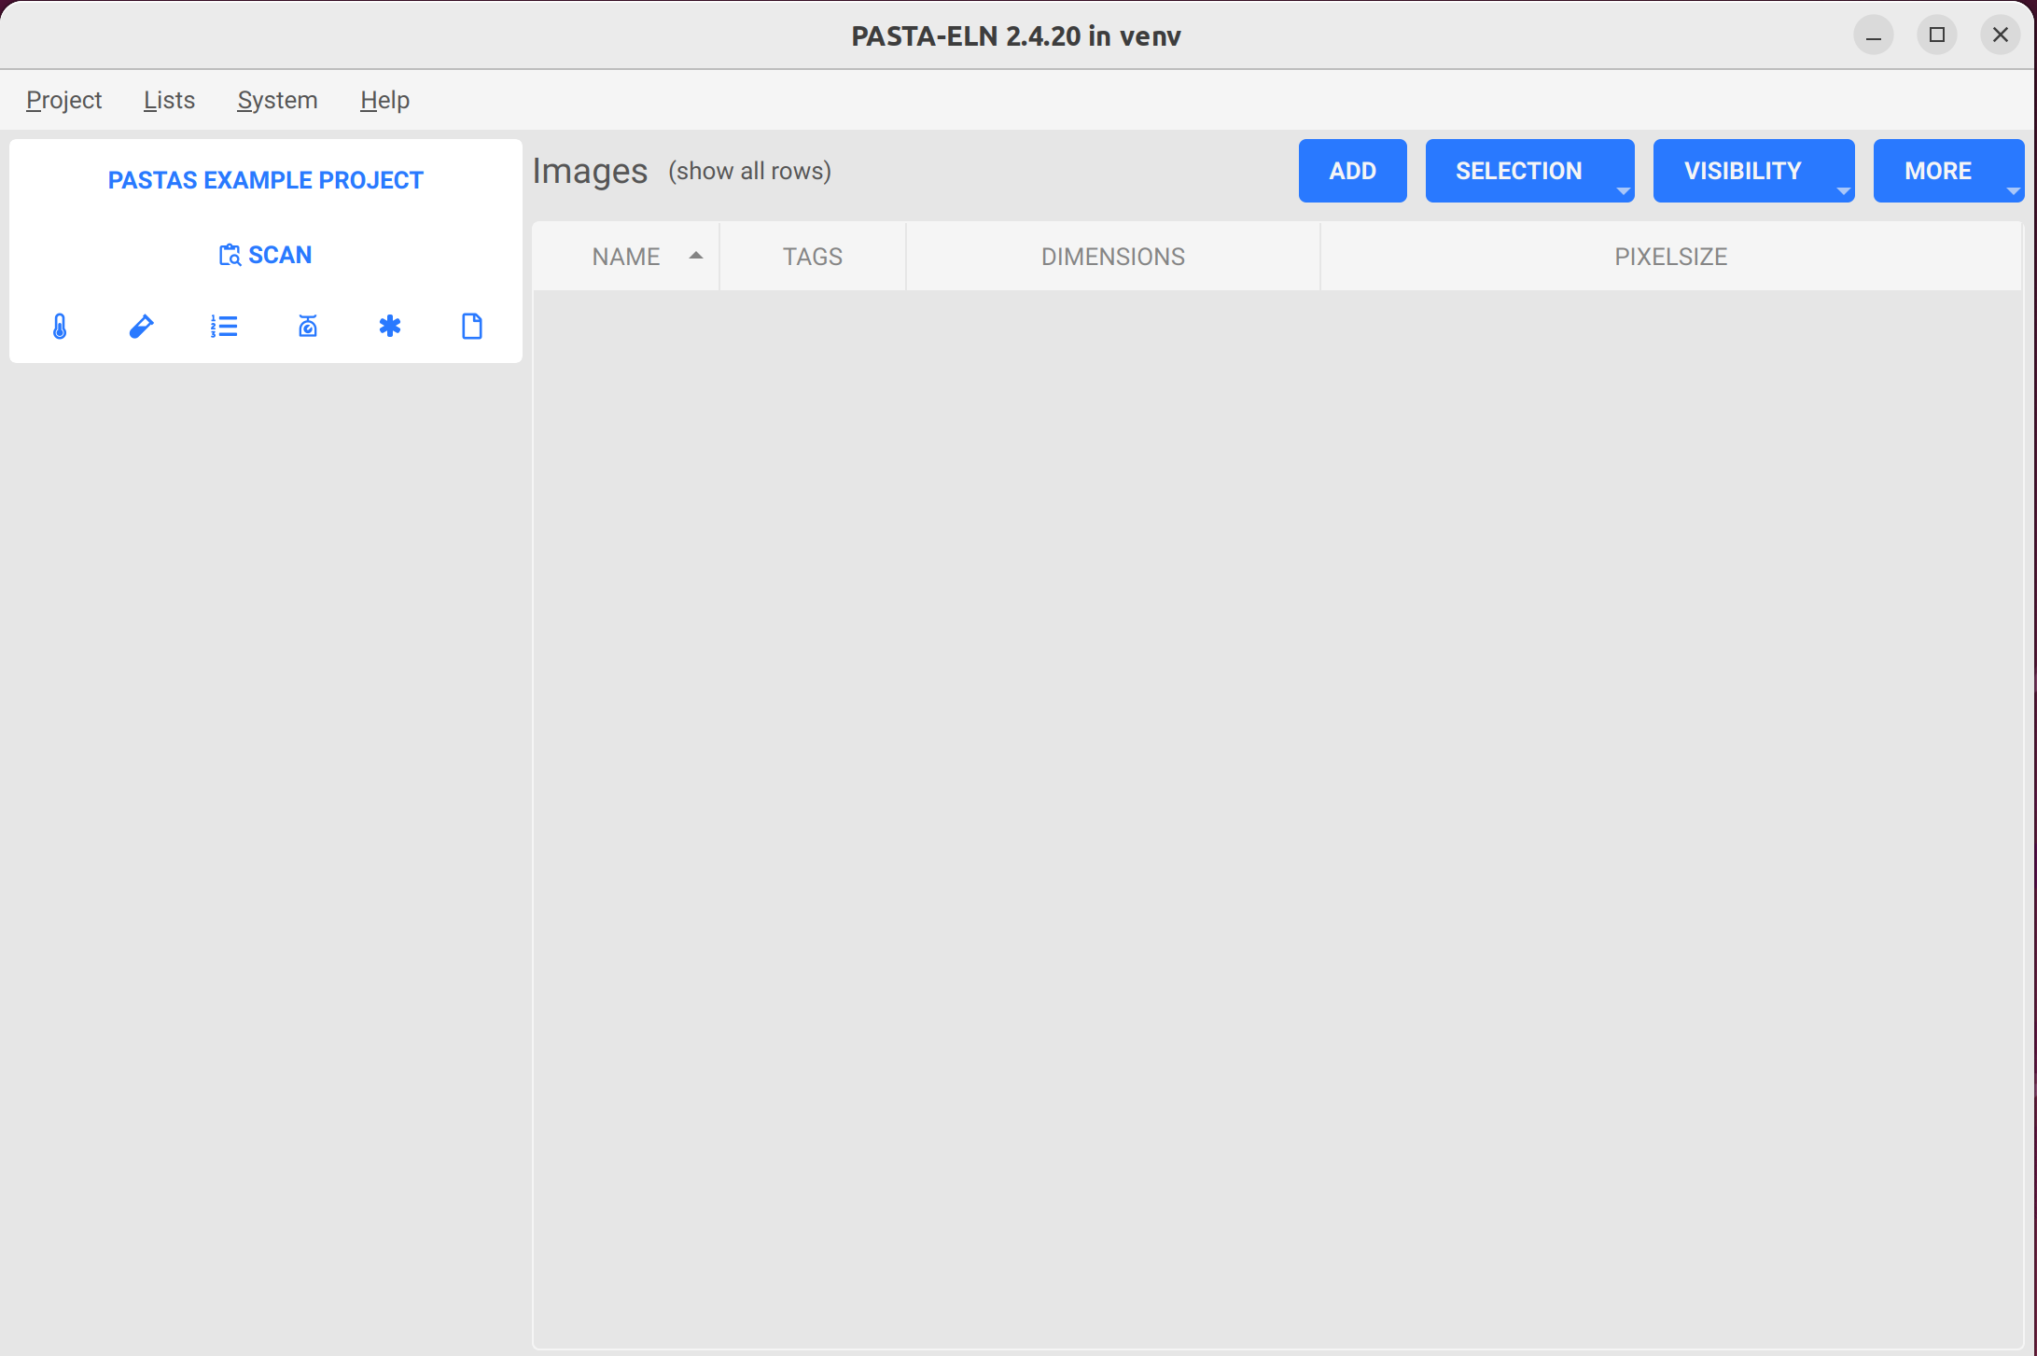
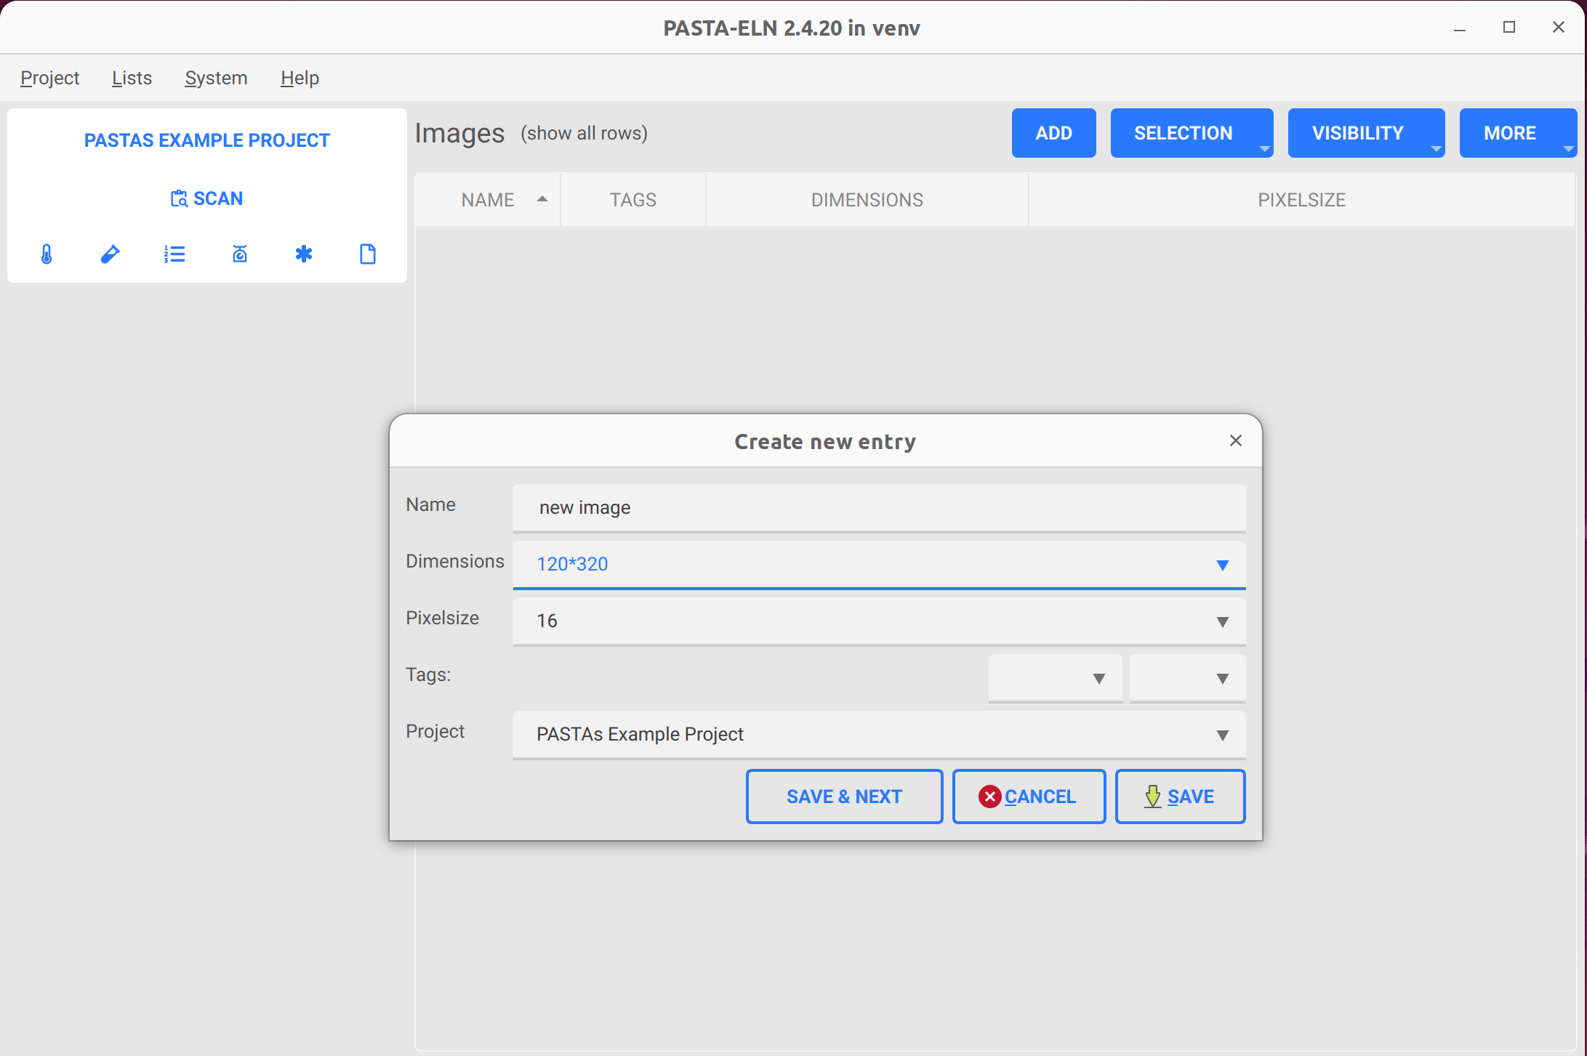
Data Hierarchy Editor
Using modified or newly added type in pasta app
3. In Pasta app, Go to Lists | Images and click on
“Add” button to add a new image type
4. Set the metadata for the new type and save
the newly configured type in database

Slide 12
Thanks
jithu murugan

