Slide 1


HIGO
EMPLOYEE ATTRITION UNDER THE MICROSCOPE

Slide 2
EXECUTIVE SUMMARY
01
Analyzed 1,470 employee records
02
237 employees resigned, including 91 top talent
03
R&D department has the highest attrition with poor environment satisfaction
04
Work-life balance and lack of promotion are major contributors
HIGO

Slide 3
PROBLEM STATEMENT
High employee attrition can have a serious impact on any organization. It leads to higher recruitment costs, the loss of valuable skills and experience, lower morale among remaining staff, and disruptions in daily operations. Understanding why employees choose to leave is essential for creating proactive strategies that help keep top talent on board.

Slide 4
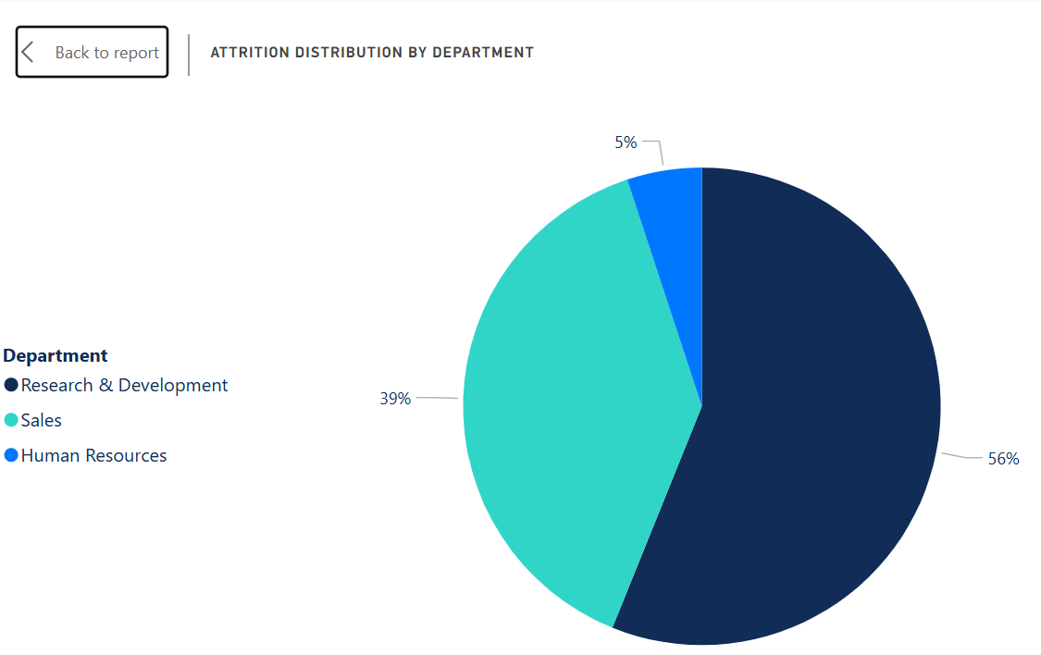
KEY INSIGHT
#1: R&D DEPARTMENT
R&D department has the highest number of resignations
56% of resignations come from R&D
124 employees who left R&D rated the department poorly for work environment and relationships
Indicates serious internal issues that must be investigated further
If unresolved, more employees may resign for similar reasons

Slide 5
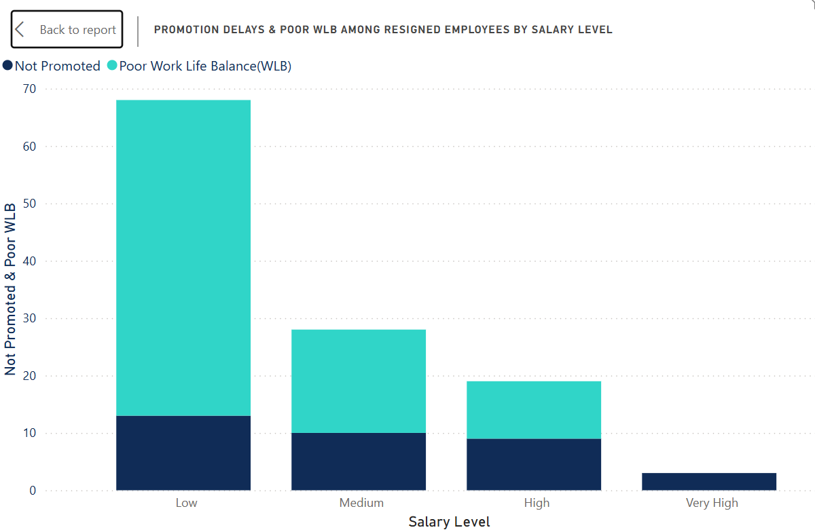
KEY INSIGHT
#2: WORK-LIFE BALANCE & CAREER GROWTH
Poor work-life balance is a major factor causing resignations, even among high-salary employees
Bar charts in the dashboard show salary alone is not enough to retain employees if work-life balance is low
Lack of promotion for over 5 years is another critical factor
Three employees in the “very high” salary bracket resigned, likely due to absence of promotion opportunities
These factors suggest the need for better career development and workload management

Slide 6
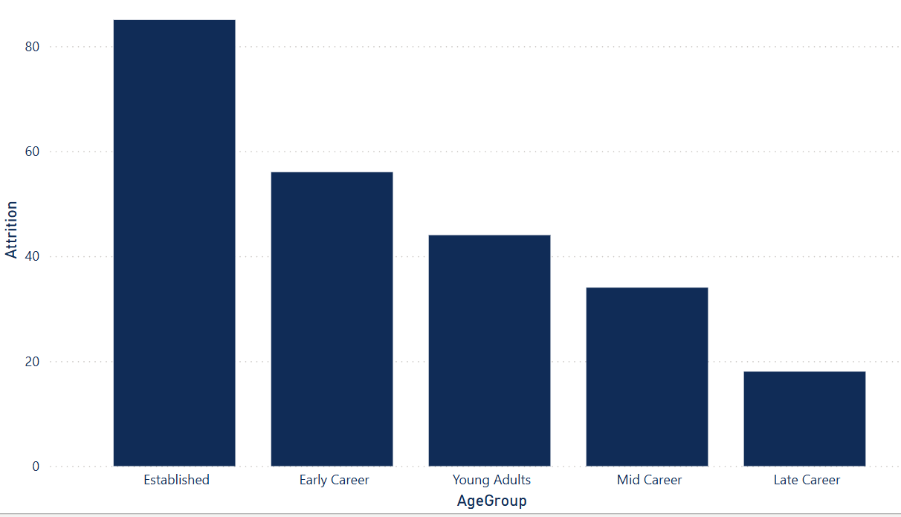
KEY INSIGHT
#3: LIFE STAGE AND FATIGUE
High resignations among employees in Established and Early Career stages
New hires resigning due to poor environment or low relationships
High overtime combined with long commutes causing fatigue
Fatigue from overtime, long travel, and distant commutes is driving some employees to resign
Employees with frequent or occasional business travel are also resigning due to exhaustion from combining travel, overtime, and long commutes

Slide 7
BUSINESS
IMPACT
01
Loss Top Talent
03
Productivity Loss from Work-Life Imbalance
Losing 91 top-performing employees out of 237 resignations leads to a significant loss of skills and productivity. Replacing them is costly and risky, potentially affecting innovation, project timelines, and the company’s competitiveness.
Employees with poor work-life balance face a higher risk of burnout, absenteeism, and eventually resignation—even when earning high salaries. Long hours and lengthy commutes further reduce productivity and can lead to more errors, lower work quality, and missed deadlines.
02
Increased Recruitment and Training Costs
04
Financial Implications
High turnover rates in critical departments like Research & Development increase recruitment costs because of frequent hiring needs. Additionally, new hires need time to onboard and reach full productivity, which can cause delays in strategic projects and product development.
Turnover costs from recruitment, onboarding, lost productivity, and delays can be high. Even conservative estimates show replacing an employee may cost 50% to 200% of their salary, creating significant financial impact when attrition is high.

Slide 8
ACTION PLAN
01
Improve Work Environment in R&D
03
Establish Clear Career Development Paths
To improve R&D, conduct anonymous surveys and focus groups to identify key issues. Provide leadership training for managers and create open channels for employee feedback. Monitor progress through quarterly environment satisfaction reviews.
To support career growth, the company should set clear promotion criteria and communicate them to employees. Regular career discussions, personalized development plans, and targeted training will help staff grow. Publicly recognizing promotions can also boost motivation and engagement.
02
Enhance Work-Life Balance
04
Support Early Career and Established Employees
To enhance work-life balance, the company should introduce flexible hours and remote work where possible, review workloads to reduce overtime, and promote mental health support without stigma. Tracking work-life balance through regular pulse surveys will help monitor progress.
To better support employees, new hires should be paired with mentors to enhance onboarding and integration. It’s important to identify challenges at each career stage and tailor support, ensure workloads are realistic for newer staff, and foster belonging through engagement programs and regular feedback sessions.

Slide 9
CONCLUSION
The analysis reveals that employee attrition in this organization is driven by a complex mix of factors, including issues within specific departments, poor work-life balance, lack of career progression, and physical strain from long commutes and frequent travel. Addressing these challenges requires a comprehensive retention strategy focusing on improving work environments, ensuring fair and transparent promotion opportunities, reducing overtime, and offering support to employees facing long travel distances. By proactively tackling these issues, the company can reduce turnover rates, retain its top talent, and foster a more engaged and sustainable workforce.

Slide 10
HIGO
THANK YOU

