Slide 1

Time Series Analysis

Slide 2
Chapter Topics
Component Factors of the Time-Series Model
Smoothing of Data Series
Moving Averages
Exponential Smoothing
Least Square Trend Fitting and Forecasting
Linear, Quadratic and Exponential Models
Autoregressive Models
Choosing Appropriate Models
Monthly or Quarterly Data

Slide 3

What Is Time-Series
A Quantitative Forecasting Method to Predict Future Values
Numerical Data Obtained at Regular Time Intervals
Projections Based on Past and Present Observations
Example:
Year: 1994 1995 1996 1997 1998
Sales: 75.3 74.2 78.5 79.7 80.2

Slide 4
Time-Series Components
Trend
Cyclical
Time-Series
Seasonal
Random

Slide 5
Trend Component
Overall Upward or Downward Movement
Data Taken Over a Period of Years
Sales
Time

Slide 6
Cyclical Component
Upward or Downward Swings
May Vary in Length
Usually Lasts 2 - 10 Years
Sales
Cycle
Time

Slide 7
Seasonal Component
Upward or Downward Swings
Regular Patterns
Observed Within 1 Year
Winter
Sales
Time (Monthly or Quarterly)

Slide 8
Random or Irregular Component
Erratic, Nonsystematic, Random, ‘Residual’ Fluctuations
Due to Random Variations of
Nature
Accidents
Short Duration and Non-repeating

Slide 9
Multiplicative Time-Series Model
Used Primarily for Forecasting
Observed Value in Time Series is the product of Components
For Annual Data:
For Quarterly or Monthly Data:
T_{i} = Trend
C_{i} = Cyclical
I_{i} = Irregular
S_{i} = Seasonal

Slide 10
Moving Averages
Used for Smoothing
Series of Arithmetic Means Over Time
Result Dependent Upon Choice of L, Length of Period for Computing Means
For Annual Time-Series, L Should be Odd
Example: 3-year Moving Average
First Average:
Second Average:

Slide 11

Moving Average Example
John is a building contractor with a record of a total of 24 single family homes constructed over a 6-year period. Provide John with a Moving Average Graph.
Year Units Moving Ave
1994 2 NA
1995 5 3
1996 2 3
1997 2 3.67
1998 7 5
1999 6 NA

Slide 12

Moving Average Example Solution
Year Response Moving Ave
1994 2 NA
1995 5 3
1996 2 3
1997 2 3.67
1998 7 5
1999 6 NA
Sales
8
6
4
2
0
94 95 96 97 98 99

Slide 13

Exponential Smoothing
Weighted Moving Average
Weights Decline Exponentially
Most Recent Observation Weighted Most
Used for Smoothing and Short-Term Forecasting
Weights Are:
Subjectively Chosen
Ranges from 0 to 1
Close to 0 for Smoothing
Close to 1 for Forecasting

Slide 14
Exponential Weight: Example
Year Response Smoothing Value Forecast (W = .2) 1994 2 2 NA
1995 5 (.2)(5) + (.8)(2) = 2.6 2
1996 2 (.2)(2) + (.8)(2.6) = 2.48 2.6
1997 2 (.2)(2) + (.8)(2.48) = 2.384 2.48
1998 7 (.2)(7) + (.8)(2.384) = 3.307 2.384
1999 6 (.2)(6) + (.8)(3.307) = 3.846 3.307

Slide 15
Exponential Weight: Example Graph
Sales
8
6
4
2
0
Data
Smoothed
94 95 96 97 98 99
Year

Slide 16
The Linear Trend Model
Year Coded Sales
94 0 2
95 1 5
96 2 2
97 3 2
98 4 7
99 5 6
Projected to year 2000
Excel Output

Slide 17

Autogregressive Modeling
Used for Forecasting
Takes Advantage of Autocorrelation
1st order - correlation between consecutive values
2nd order - correlation between values 2 periods apart
Autoregressive Model for p^{th} order:
Random Error

Slide 18
Autoregressive Model: Example
The Office Concept Corp. has acquired a number of office units (in thousands of square feet) over the last 8 years. Develop the 2nd order Autoregressive models.
Year Units
92 4
93 3
94 2
95 3
96 2
97 2
98 4
99 6

Slide 19
Autoregressive Model: Example Solution
Develop the 2nd order table
Use Excel to run a regression model
Year Y_{i} Y_{i-1} Y_{i-2}
92 4 --- ---
93 3 4 ---
94 2 3 4
95 3 2 3
96 2 3 2
97 2 2 3
98 4 2 2
99 6 4 2
Excel Output

Slide 20
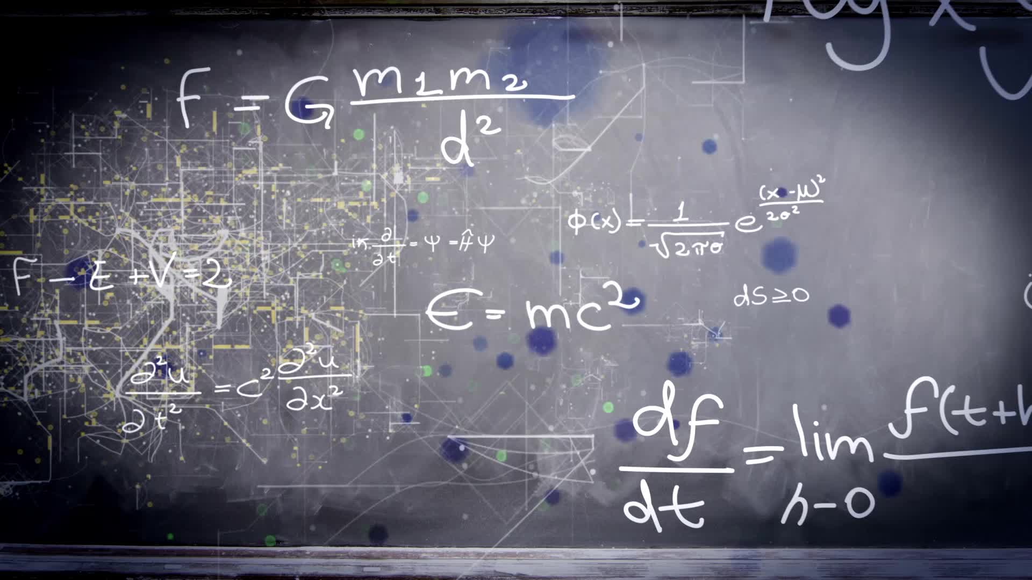
Autoregressive Model Example: Forecasting
Use the 2nd order model to forecast number of units for 2000:

Slide 21

Autoregressive Modeling Steps
1. Choose p: Note that df = n - 2p - 1
1
2. Form a series of “lag predictor” variables
2
Y_{i-1} , Y_{i-2} , … Y_{i-p}
3. Use Excel to run regression model using all p variables
3
4. Test significance of A_{p}
4
If null hypothesis rejected, this model is selected
If null hypothesis not rejected, decrease p by 1 and repeat

Slide 22

Selecting A Forecasting Model
Perform A Residual Analysis
Look for pattern or direction
Measure Sum Square Errors - SSE (residual errors)
Measure Residual Errors Using MAD
Use Simplest Model
Principle of Parsimony

Slide 23

Residual Analysis
e
e
0
0
T
T
Random errors
Cyclical effects
e
e
0
0
T
T
Trend
Seasonal effects

Slide 24

Measuring Errors
Sum Square Error (SSE)
Mean Absolute Deviation (MAD)
Notes:
• Mean Squared Errors (MSE): penalizes large residuals
E.g.: If predicting the inventory level of an expensive product, large error is disastrous.
• Mean absolute deviation (MAD): overlooks isolated severe misses, as long as general tracking is close.

