Slide 1

Telangana Weather / Climate
Data Analysis On Power Bi

Slide 2
About me
Background:
Name: Patil Bharath Sai
University : Kalasalingam Academy of Research and Education, Virudhunagar, Tamil Nadu.
Education : B-tech, Computer and Science Engineering in Artificial Intelligence and Machine Learning.
Why I want to learn Data Science:
I am highly motivated to understand how data-driven insights can solve real-world problems
It has high demand profession and have many career path opportunities
Influencing decision-making and driving innovation
Work Experience: 4 Internship – 3 months Experience in 2 intern
DevTown – Data Science Intern
Bharat Intern – Machine Learning
My Company – Backend Developer
Forage – Accenture Data Analyst
LinkedIn : Patil-bharath-sai-b7065027a/
GitHub : https://github.com/PATIL-BHARATH-SAI

Slide 3
1. Business Problem & Use Case / Domain Understanding
What to include:
Domain: Telangana Weather / Climate Data Analysis.
Business Problem: Weather fluctuations impact agriculture, health, energy, transport. Understanding weather trends helps in policy making, disaster management, and planning.
Use Case Examples:
Agriculture → Crop yield prediction, irrigation planning.
Health → Heatwave/humidity-related illness tracking.
Infrastructure → Flood risk analysis, Transport.
Renewable Energy → Wind/solar forecasting

Slide 4
2. Objective of the Project
Key goals:
To analyze rainfall, temperature, humidity, wind across districts/mandals.
Identify extreme events, anomalies, seasonal & long-term trends.
Compare district-level weather patterns.
Provide actionable insights for agriculture, health, and government planning.

Slide 5
3. Data Importing– Details
Scraped data (Dataset source): Weather Data (Given)
Websites that can be used → IMD (Indian Meteorological Department), Climate Data Online, etc.
Process Followed:
Identify pages (daily/weekly weather reports).
Store into CSV/Excel.
Data Cleaning (remove nulls, fix formats).
Challenges Faced:
Inconsistent formats.
Missing data for some districts.
Handling dynamic websites (needed Selenium).

Slide 6
4. Summary of the Data
Columns: District, Mandal, Date, Rain (mm), Min Temp, Max Temp, Min Humidity, Max Humidity, Min Wind Speed, Max Wind Speed.
Size: Rows = 6,51,366; Columns = 9.
Date Range: 2010–2024.
Granularity: Daily records → aggregated to monthly/seasonal/yearly.
Issues: Missing values, outliers, inconsistent spellings (fixed during cleaning).

Slide 7
Exploratory Data Analysis:
Data Cleaning → Remove errors & prepare reliable dataset.
Data Manipulation → Create new features & restructure data.
Univariate Analysis → Study each variable individually.
Bivariate Analysis → Study relationships between two variables.

Slide 8
Data Cleaning Steps The goal is to make raw data usable and reliable.
Remove duplicates
Drop rows with same District + Date (or unique ID).
Drop duplicates : Remove Duplicates in Power BI/Excel.
Handle missing values (Nulls)
Rainfall → Replace null with 0.
Temperature, Humidity, Wind → Fill using interpolation/forward-fill or mean.
If too many nulls → drop column/rows.
Fix data types
Dates → Convert to Date format.
Numeric values → Convert to integer/float.
Categorical → Ensure text format.
Standardize column names
Example: Rain (mm) → Rain_mm.
Outlier detection & treatment
Use boxplots or IQR method.
Cap extreme values (Winsorization is a data transformation technique used to limit extreme values (outliers) in a dataset to reduce the effect of possible spurious outliers) or keep if meaningful.
Consistency check
Units (°C, mm, kmph).
Negative values in Rainfall, Temp, etc. → should not exist.

Slide 9
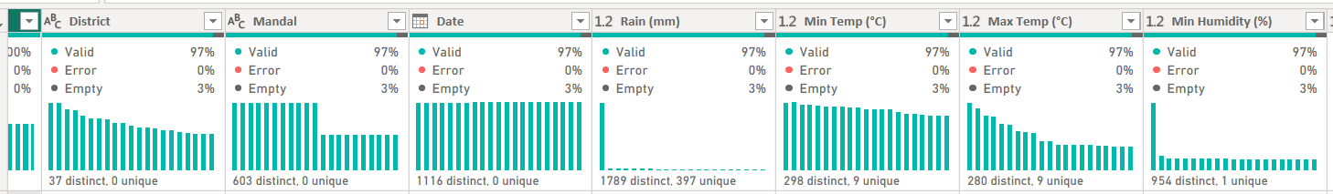
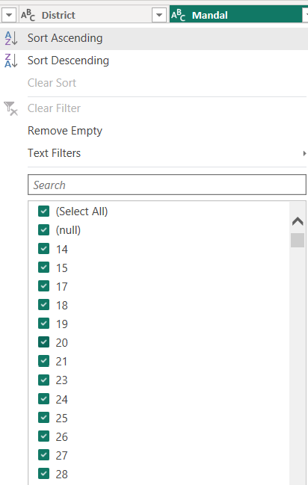
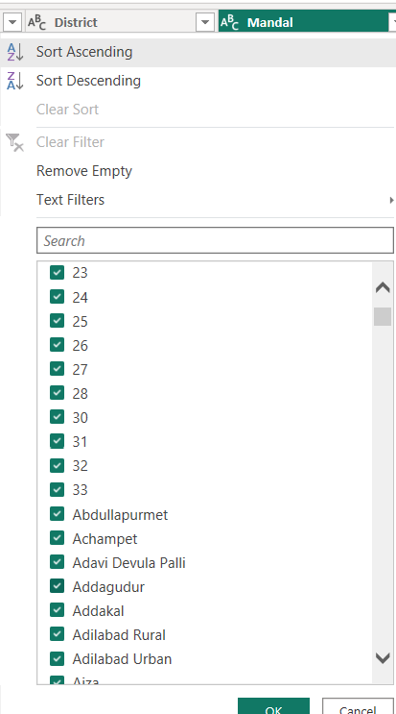
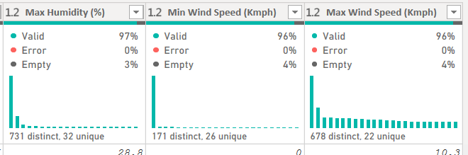
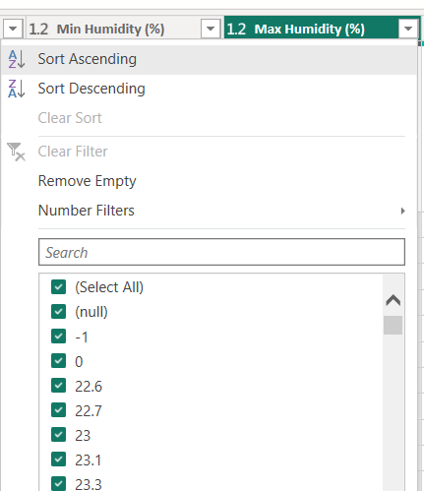

Slide 10
Data Manipulation Steps After cleaning, we transform & enrich data for analysis.
Feature Engineering
Create Temperature Range = Max Temp − Min Temp
Create Humidity Range = Max Humidity − Min Humidity
Create Wind Range = Max Wind Speed − Min Wind Speed
Time Features
Extract Year, Month, Quarter, Season from Date.
Useful for trend/seasonal analysis.
Aggregations
District-level monthly/annual averages.
Example: GroupBy District, Year → Avg Temp, Total Rainfall.
Normalization / Scaling Scale rainfall/temp values for fair comparison.
Encoding categorical variables
Convert District/Mandal into labels.
Joining with external datasets (if any)
E.g., population data, disaster data, crop yield data.

Slide 11
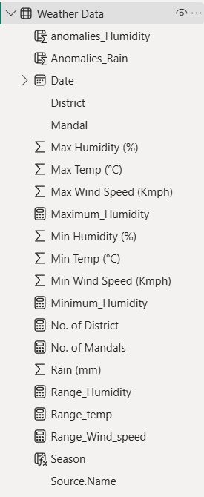
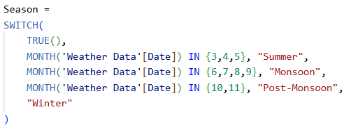

Slide 12
Univariate Analysis Steps
✅ Univariate = Analysing one variable at a time.
Helps understand distribution, central tendency, spread.
Categorical variables (District, Mandal)
Use Bar Charts → frequency/count.
Numerical variables (Rainfall, Temp, Humidity, Wind)
Histogram / Density Plot → distribution.
Scatter chart → outliers & spread.
KPI Cards → mean, min, max.
Summary statistics
Mean, Median, Mode.
Min, Max, Range.
Standard Deviation, Variance.

Slide 13
Bivariate Analysis Steps Analysing two variables together.
Helps find relationships & correlations.
Numerical vs Numerical
Scatter Plot → Rainfall vs Temperature.
Column chart → see relationships among Rain, Temp, Humidity, Wind.
Categorical vs Numerical
Waterfall chart→ Rainfall by District.
Clustered Bar Chart → Avg Temperature by District.
Time-Series Relationships
Line Chart → Rainfall trends over years.
Multiple Line Chart → compare districts.
Seasonal Comparison
Grouped Bar Chart → Quarterly Rainfall by District.
Extreme Events vs Districts
Compare number of anomaly days across districts.
🔍 Example:
High Rainfall days → correlated with High Humidity.
High Temp districts → lower Rainfall.

Slide 14
5. Key Business Questions
Which districts experience highest/lowest rainfall?
What are the seasonal patterns of weather metrics?
How do rainfall, temperature, humidity, and wind correlate?
Which districts face extreme weather events?
Are there year-over-year trends in rainfall and temperature?
Can anomalies (e.g., floods, droughts, heatwaves) be detected?
How do two districts compare in overall weather behavior?

Slide 15

Rainfall Analysis🌧
Telangana_Weather_Climate_Analysis

Slide 16
Temperature Insight🌡
Telangana_Weather_Climate_Analysis

Slide 20
6. Conclusion
Rainfall: Seasonal concentration (70% during monsoon months).
Temperature: Rising yearly trend → possible climate change indicator.
Humidity: Strongly linked with rainfall.
Wind Speed: Extreme events in coastal districts.
Comparative Analysis: District X is better but cooler than District Y.
Overall: Clear evidence of seasonality + anomalies + long-term trends.

Slide 21


Slide 22

THANK YOU

