Slide 1
Stock Price Prediction Using LSTM

Slide 2
Stock Price Prediction Using LSTM
Objective :
In this project we attempt to implement machine learning approach to predict stock prices. Machine learning is effectively implemented in forecasting stock prices. The objective is to predict the stock prices in order to make more informed and accurate investment decisions.
Introduction :
Predicting how the stock market will perform is one of the most difficult things to do. There are so many factors involved in the prediction – physical factors vs. psychological, rational and irrational behavior, etc. All these aspects combine to make share prices volatile and very difficult to predict with a high degree of accuracy.

Slide 3
Stock Price Prediction Using LSTM
Introduction :
Machine learning techniques have the potential to unearth patterns and insights we didn’t see before, and these can be used to make unerringly accurate predictions.
Time Series forecasting & modelling plays an important role in data analysis. The main aim of this project is to predict stock prices using Long short term memory (LSTM).

Slide 4
Stock Price Prediction Using LSTM
Project Approach :
Data Collection :- We will fetch and use the Yahoo Finance dataset and captures the daily information of stocks from the Yahoo Finance. It including dataset from 2017 to till date contain the open,high and lowest price, the closing price, the adjusted closing price and the volume of stock.
Data Cleaning :- We check for null values in the data frame to ensure that there are none. Also check data info and description to check any abnormal values in data.
Data Scaling :- To decrease the computational cost of the data in the table, we will scale the stock values to values between 0 and 1. As a result, all of the data in large numbers is reduced. To perform this we will be using the MinMaxScaler class of the sci-kit-learn library.

Slide 5
Stock Price Prediction Using LSTM
Project Approach :
Data Preparation :- In this we make windows of size “n_steps” starting from the first sample of data and ending at n_steps’th sample (if n_steps=100, then the 100th sample) from the end. for each time step, LSTM will take n_steps-1 samples for training and predict the last sample. Loss calculation is done based on the error in this prediction
Data Splitting :- We have to divide the entire dataset into training and test (training 70% & testing 30%) sets before feeding it into the training model. The Machine Learning LSTM model will be trained on the data in the training set and tested for accuracy and backpropagation on the test set.

Slide 6
Stock Price Prediction Using LSTM
Project Approach :
Model Building :- We’ll build a Sequential Keras model with four LSTM layer. The first LSTM layer has 50 units, second and third LSTM layer has 40 unit, fourth LSTM layer has 10 unit and is followed by one Dense Layer of one neuron. We compile the model using Adam Optimizer and the Mean Squared Error as the loss function. For an LSTM model, this is the most preferred combination. Finally, we use the fit function to train the LSTM model created above on the training data for 200 epochs with a batch size of 100.

Slide 7

Stock Price Prediction Using LSTM
Project Approach :
Model Features :- Long Short Term Memory networks – usually just called LSTM’ are a special kind of RNN, capable of learning long-term dependencies. LSTMs have chain like structure.

Slide 8
Stock Price Prediction Using LSTM
Model Training and Testing Accuracy :
Function | TRAIN | TEST
R^2 | 0.98043 | 0.93885
RMSE | 244.88 | 545.48

Slide 9
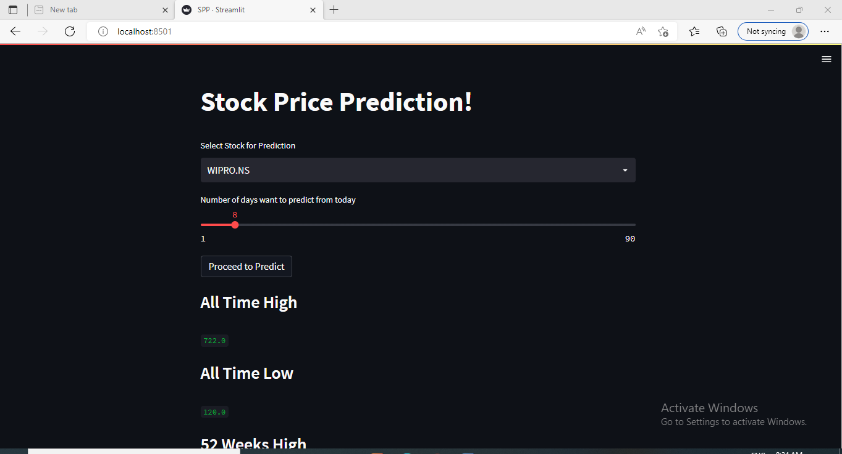
Stock Price Prediction Using LSTM
Project Deploy on Local Host Using Streamlit :

Slide 10
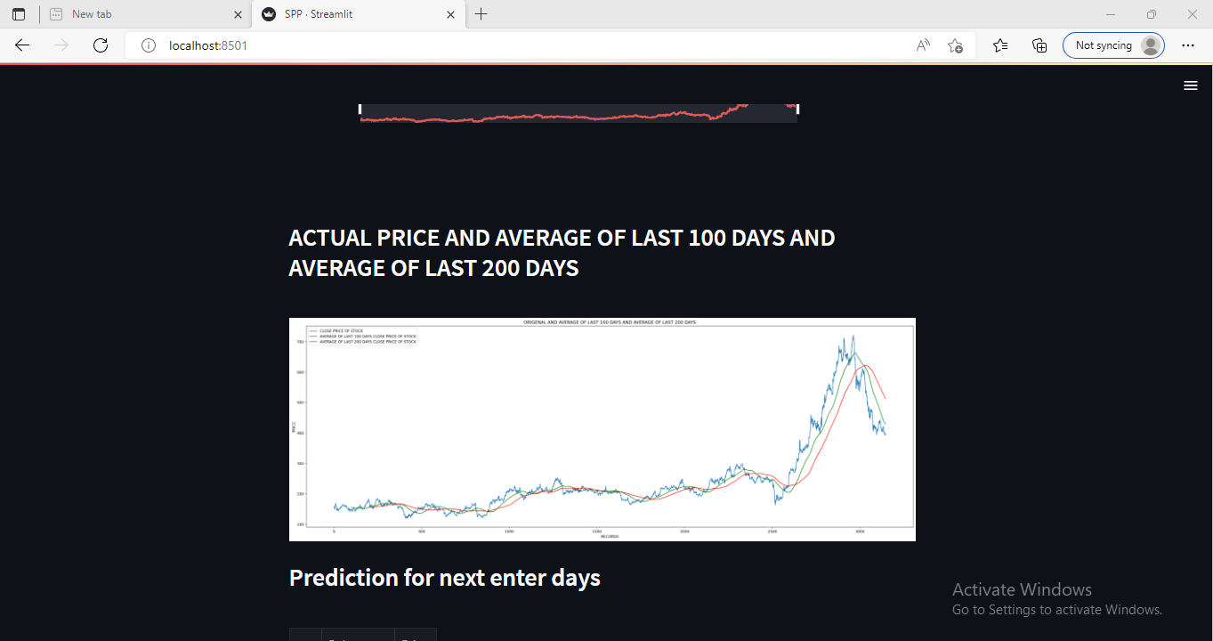
Stock Price Prediction Using LSTM
Project Deploy on Local Host Using Streamlit :

Slide 11
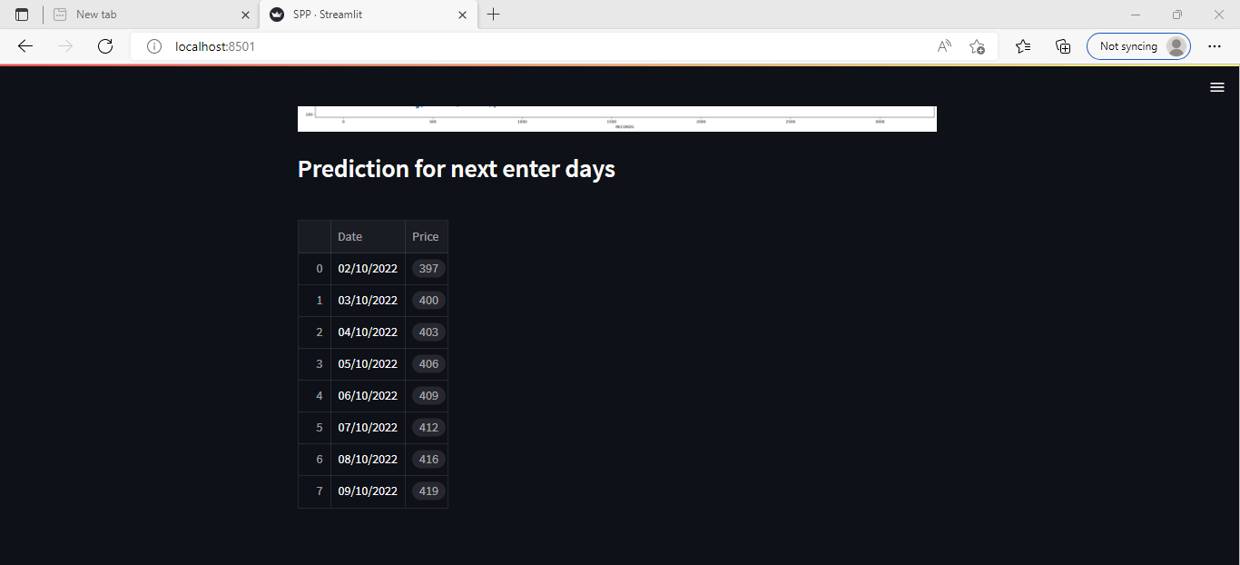
Stock Price Prediction Using LSTM
Project Deploy on Local Host Using Streamlit :

Slide 12
Stock Price Prediction Using LSTM
Conclusion :
In this project, we are predicting closing stock price of wipro organization, we build LSTM model for predicting price. We get N days stock close price. With the help of graph we plot the result.

Slide 13
Thank You

