Slide 1

Alarm Processing System PATMESH S
Tejas Academy

Slide 2
Project
Project Title: Alarm Processing System
Group Name: R&D NMS NMS-SW
Emp. Name: PATMESH SENTHILKUMAR
Mentor Name: Mr. Hanumanthraju R

Slide 3
Project Statement & Objectives
Statement:
Develop an Alarm Processing System for real-time monitoring and management of network devices within a Network Management System (NMS). The system allows administrators to add users, NMS instances, and devices, while users can monitor assigned NMS, resolve device alarms, and track resolved alarms in a history section. Kafka integration ensures real-time alarm notifications for effective device management.
Objectives:
Enable real-time monitoring of network devices with Kafka for alarm notifications.
Allow administrators to manage users, NMS instances, and devices.
Let users view and resolve alarms for their assigned NMS and devices.
Provide a history for tracking and exporting resolved alarms.

Slide 4
System Components Overview
Presentation Layer:
Frontend (React): Provides the user interface for admin and user panels. Users can monitor NMS, view and resolve alarms, and sort alarms based on priority, device, and time.
Business Logic Layer:
Backend (Spring Boot): Manages business logic, user authentication, NMS, devices, and processes alarm data. It interacts with Kafka to handle real-time alarm messaging.
Data Layer:
Database (MySQL & Kafka): MySQL stores user data, NMS configurations, devices, and alarm history. Kafka supports real-time alarm notifications between the backend and frontend.

Slide 5
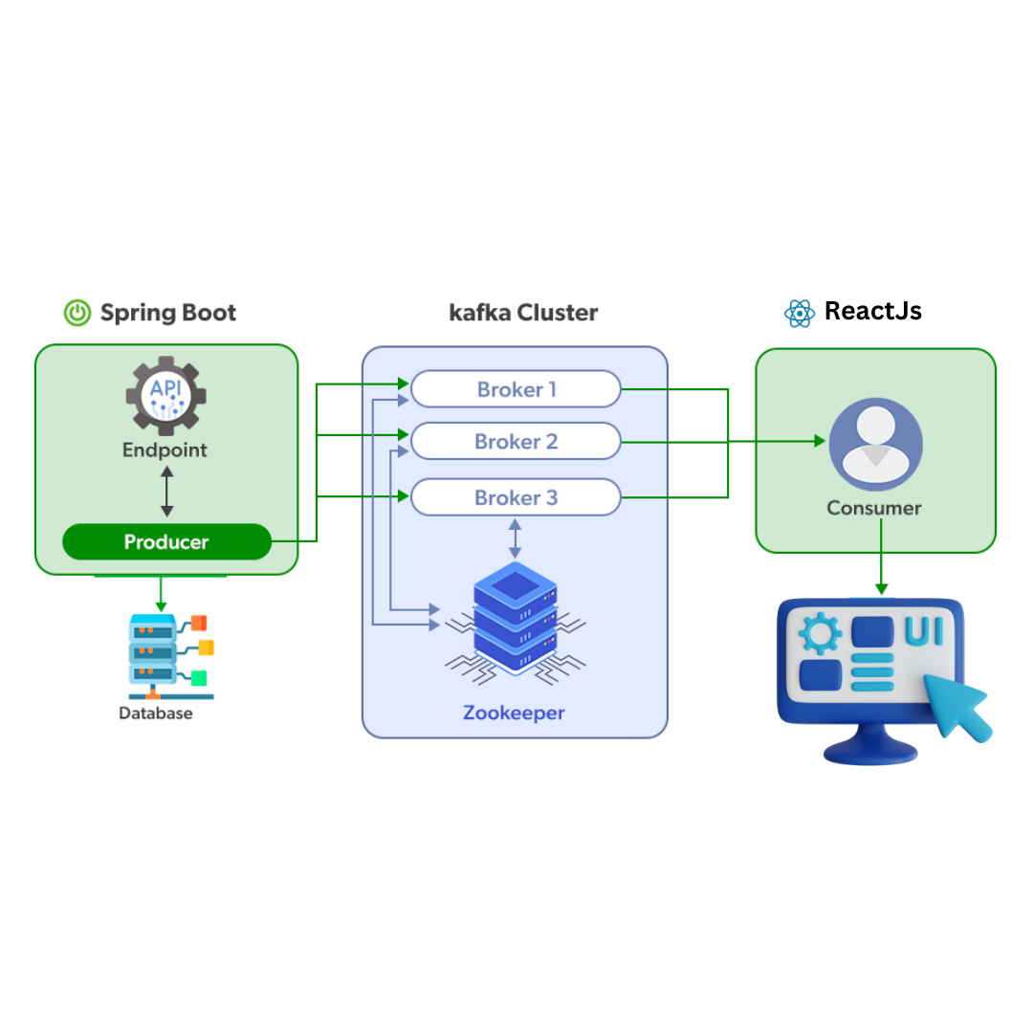
Project Architecture

Slide 6
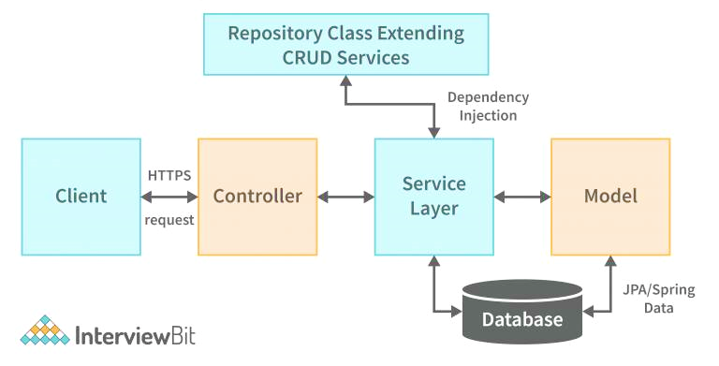

Spring Boot Architecture

Slide 7
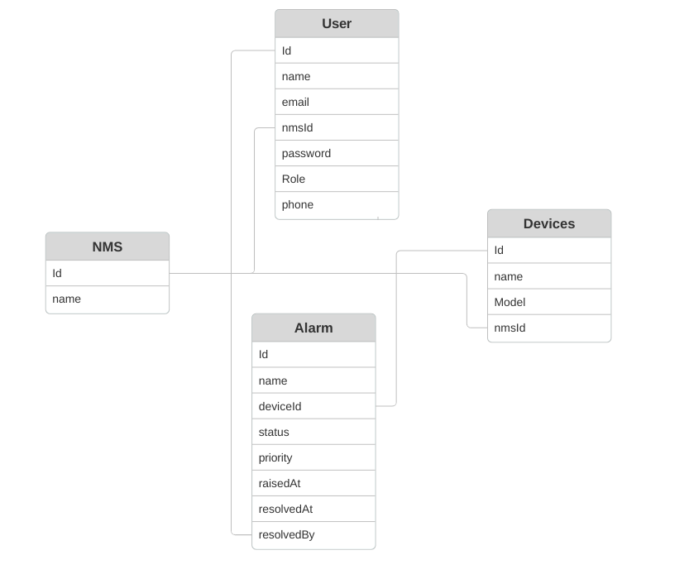
ER Diagram

Slide 8
Technology used
Java
Spring Boot
ReactJs
MySQL
Kafka
Tools used
VS Code
STS(Spring Tool Suit)
Postman(API Testing)
MySQL Workbench
Github

Slide 9
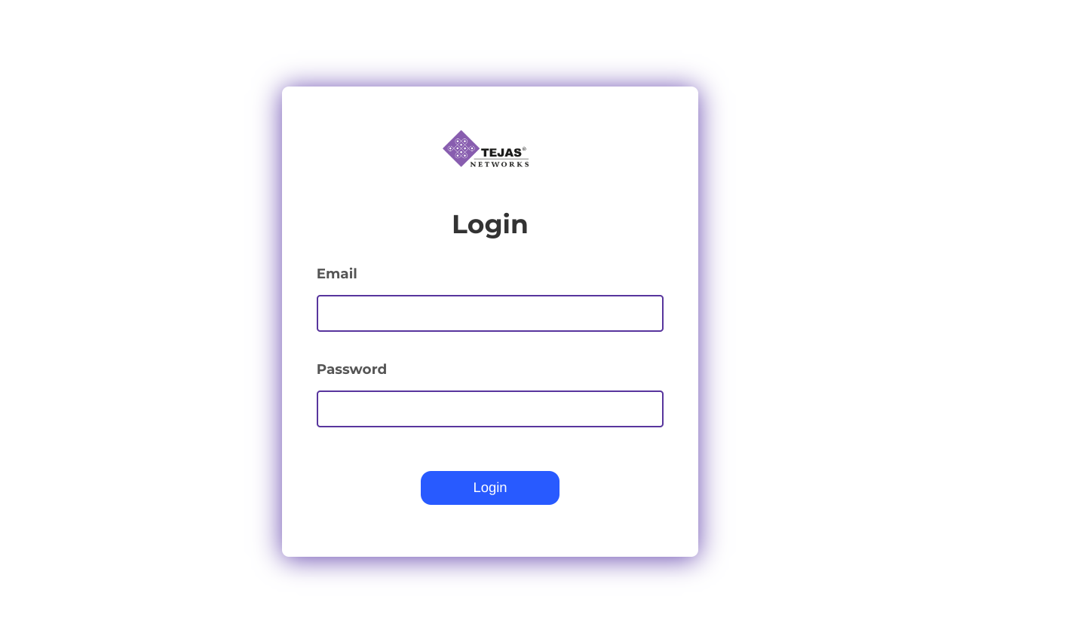
Results

Slide 10
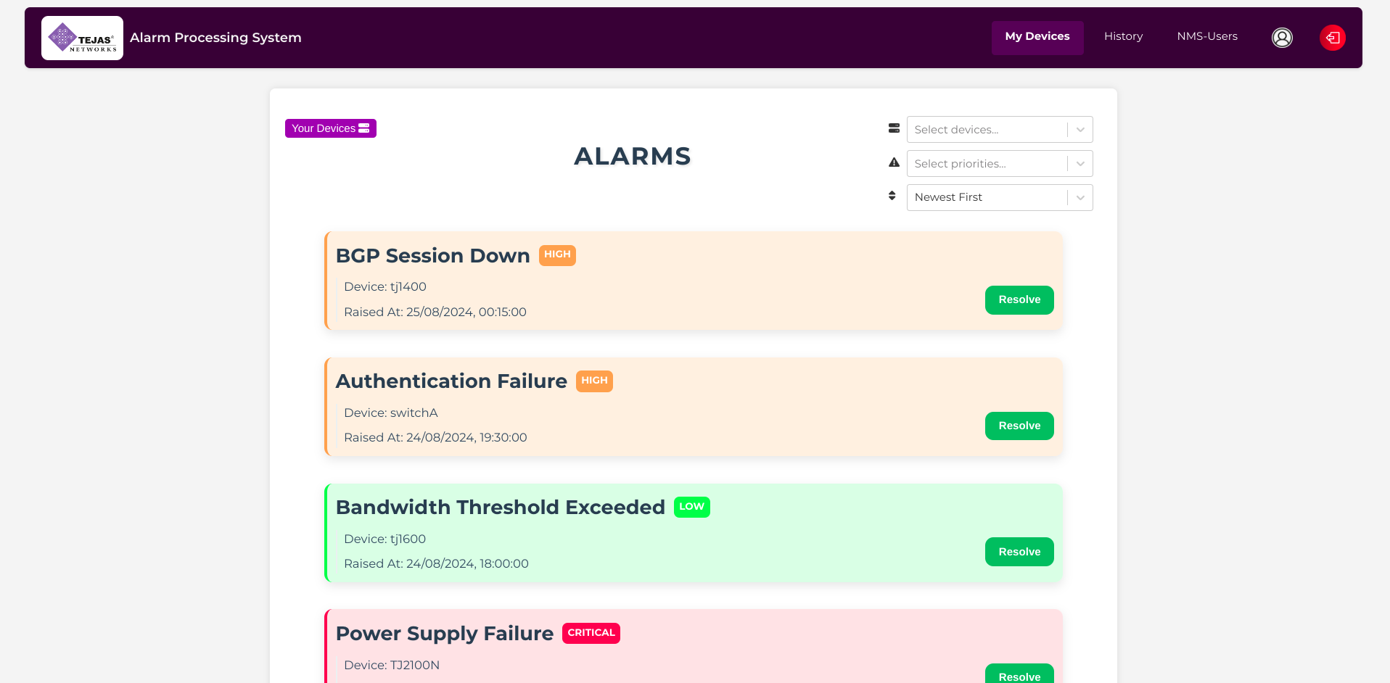

Slide 11
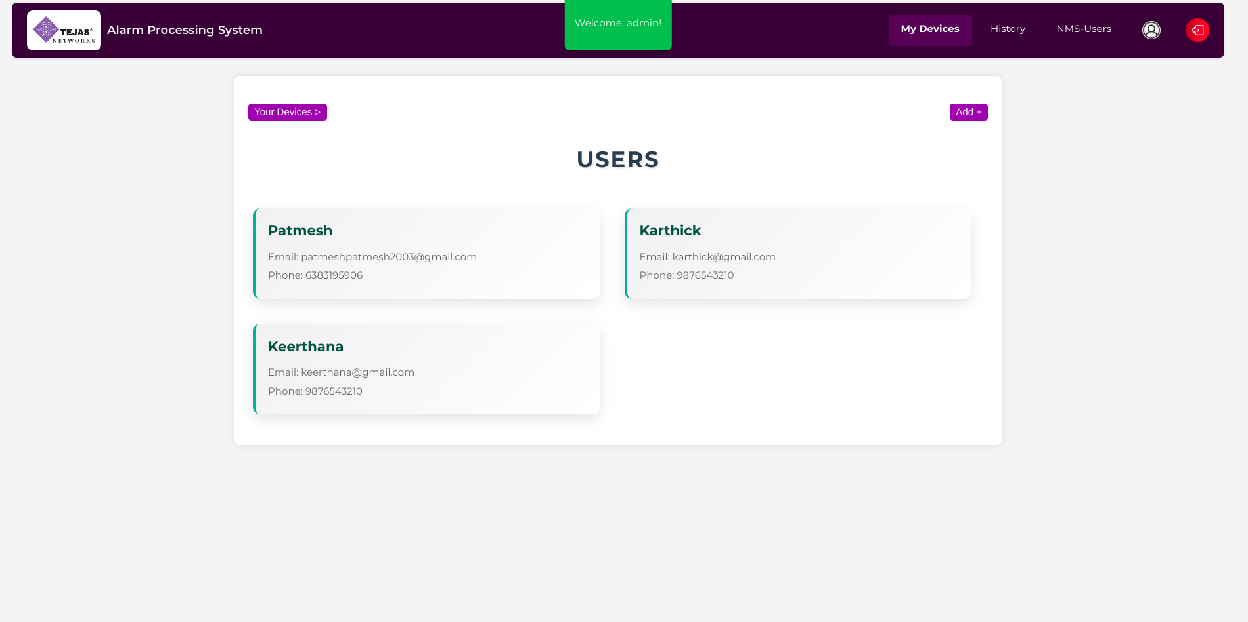

Slide 12
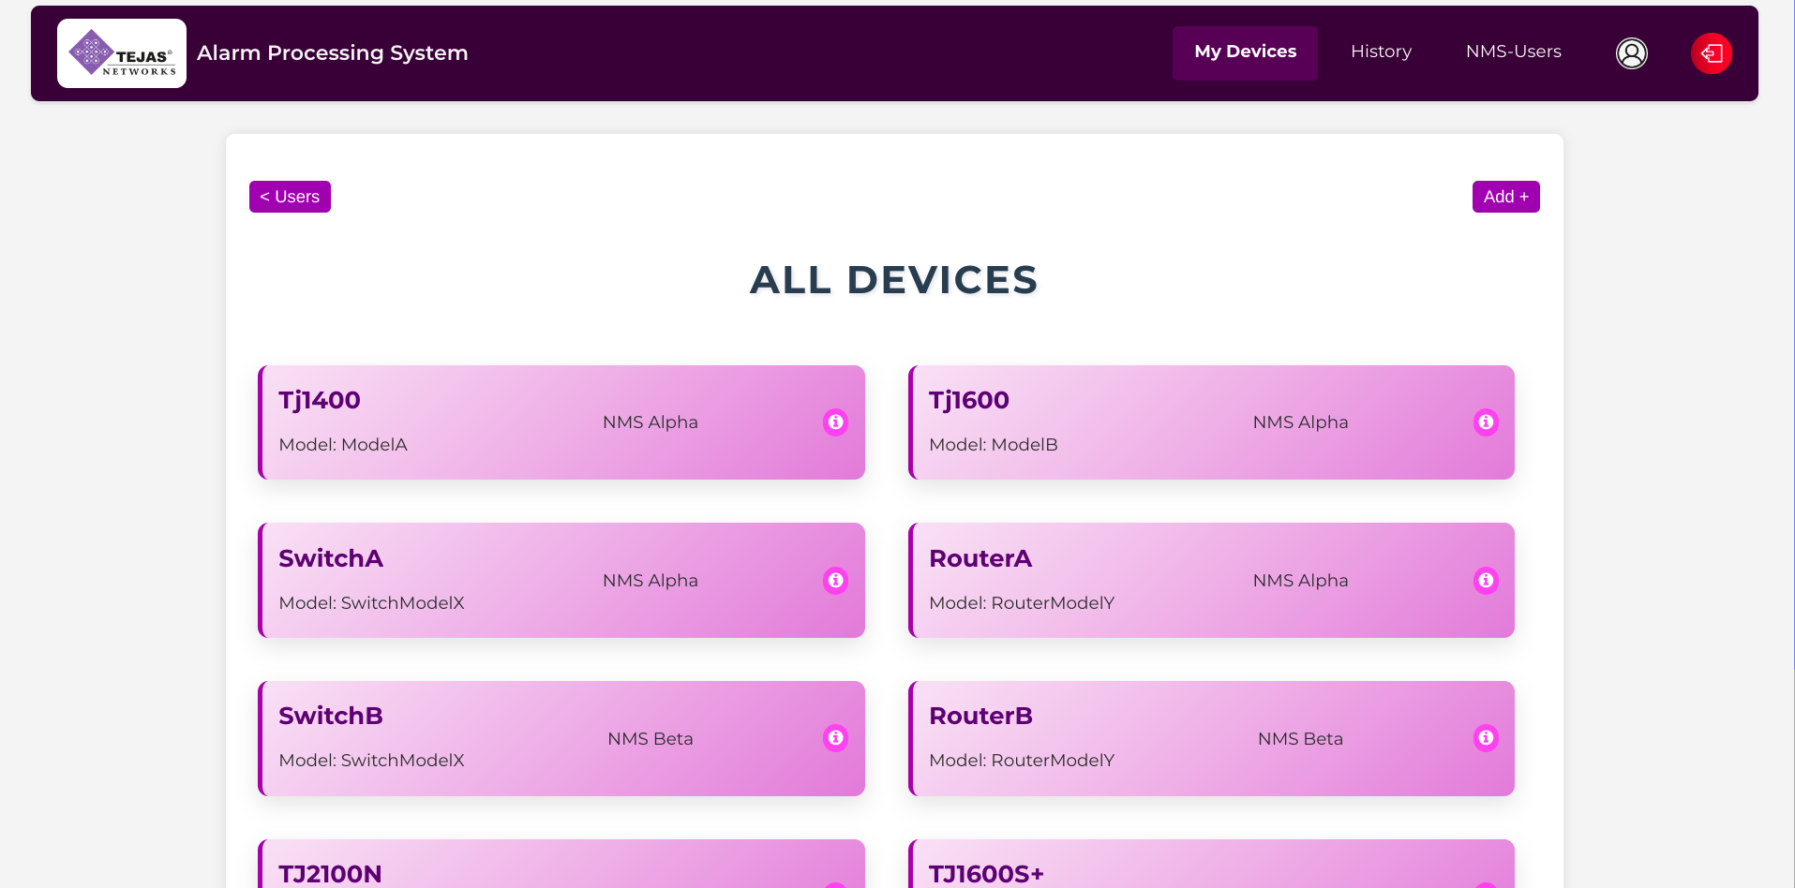

Slide 13
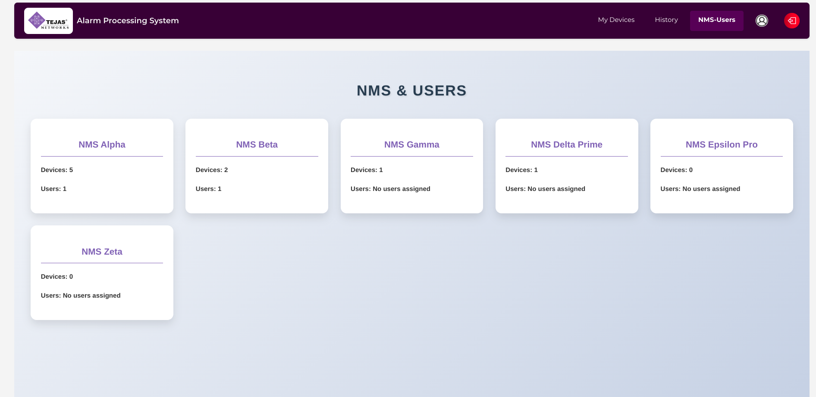

Slide 14
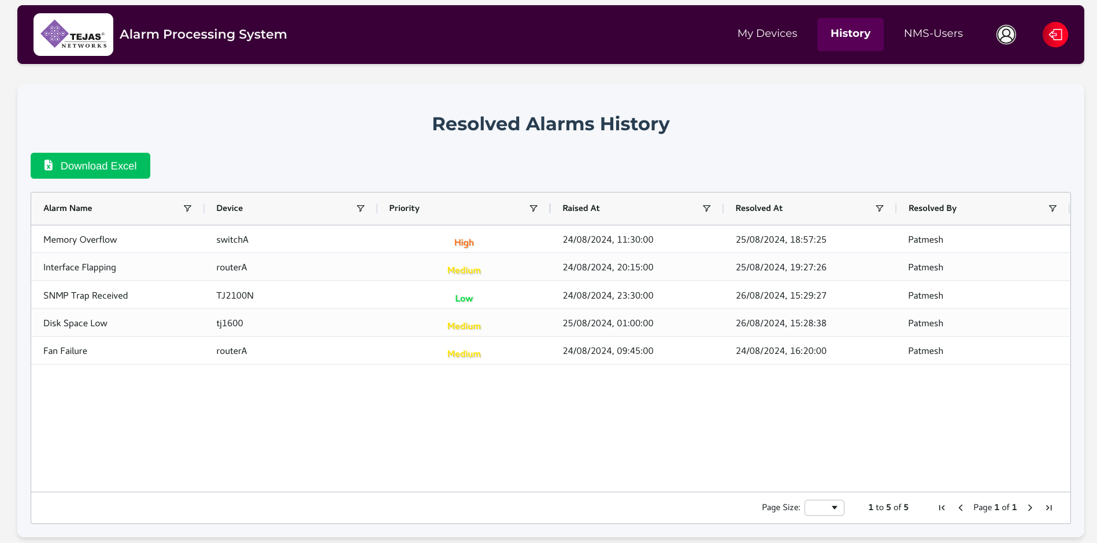

Slide 15
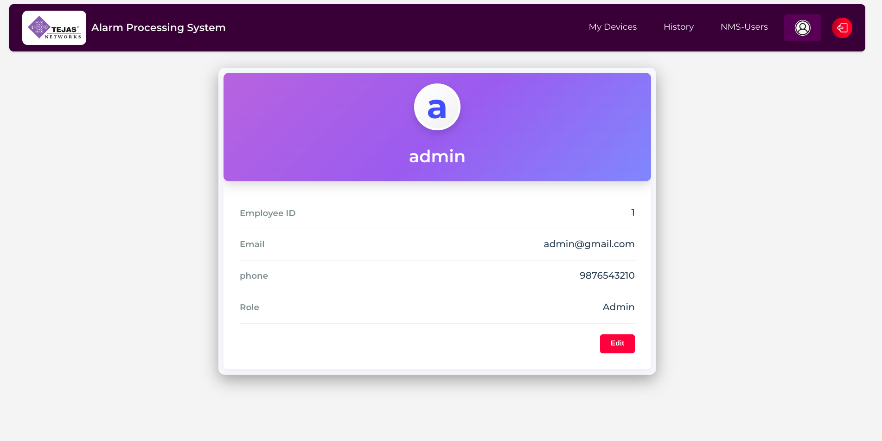

Slide 16
References
https://www.baeldung.com/spring-kafka
https://www.baeldung.com/
https://kafka.apache.org/documentation/
https://medium.com/swlh/spring-boot-and-react-js-fullstack-application-7ad99139e95c

Slide 17
For any queries/clarifications, contact: tejasacademy@tejasnetworks.com

