Slide 1
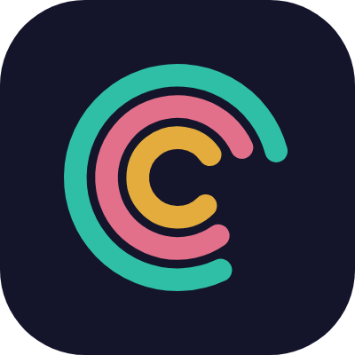
Ownly
خيالي
Every child, the hero of their own story.
FREE PILOT PROGRAM · DUBAI
Personalised bilingual storybooks for nurseries & schools
Notes:
Open warm. Ask what they currently use for values/habits education before pitching anything.

Slide 2



THE PROBLEM
Values lessons don't stick
Nurseries run great values & habits lessons — but worksheets and posters are generic. Every child gets the same lesson, and most forget it by the following week.
One-size-fits-all worksheets
No personal connection
Hard to measure what landed
Every child gets the same generic handout — nothing about it is theirs.
The lesson isn't about them, so it doesn't stick past the classroom door.
No easy way to know which lessons actually worked, or which child needs a repeat.
Ownly — Nursery Pilot Program
2
Notes:
Ask: how do you currently teach values/habits? What do parents ask for most?

Slide 3



THE SOLUTION
Every child becomes the hero
Their own name & avatar
Their own language
One value per story
A cartoon character built to match the child — never a real photo.
Full English or Arabic, right-to-left — not a translation afterthought.
Healthy eating, honesty, hand-washing and more — a focused lesson, not a lecture.
Ownly — Nursery Pilot Program
3
Notes:
Show a sample story here if presenting live — this slide is the pitch in one breath.

Slide 4


HOW IT WORKS
Three steps, a few minutes
1
→
2
→
3
Add your class
Pick a theme
Read or print
Import children once — parents grant consent digitally, on their own phone.
Choose a ready-made value or habit theme, in English or Arabic.
A personalised story is ready in minutes — download, print, or share the PDF.
Ownly — Nursery Pilot Program
4
Notes:
Emphasise "minutes, not an afternoon of lesson planning."

Slide 5



WHY NURSERIES CHOOSE OWNLY
Built for real classrooms
Privacy-first
No real child photos — ever. Illustrated avatars only, by default.
Truly bilingual
English and Arabic, both first-class — not an afterthought translation.
Ready fast
A new personalised story in minutes, not an afternoon of planning.
Monthly, not one-time
A new story every month, not just once at graduation.
Ownly — Nursery Pilot Program
5
Notes:
Lead with privacy-first if the audience is a school (consent-sensitive); lead with fast if it is a busy nursery owner.

Slide 6
CONTENT LIBRARY
A growing library of value & habit themes
Healthy Eating
Honesty
Hand Washing
Brushing Teeth
First Day of School
New Sibling
Saving Money
National Day Gratitude
More themes added regularly — tell us what your curriculum needs and we'll build it.
Ownly — Nursery Pilot Program
6
Notes:
Ask which of these topics is already part of their curriculum.

Slide 7


FREE PILOT PROGRAM
One class. Two weeks. Zero cost.
We set it up together
You pick a theme
You tell us honestly what worked
A short call, your class list, and consent links sent to parents — no technical work on your side.
One value or habit lesson, in English or Arabic, matched to what your class needs right now.
That's the only payment we ask for during the pilot — your real feedback, good or bad.
Ownly — Nursery Pilot Program
7
Notes:
Close here. Ask directly: "Can we start with one class next week?"

Slide 8
Let's start with one class.
Yousef Hawwari
+971 55 599 0694 · yousefhawwari@gmail.com
Every child, the hero of their own story.

