Slide 1
Synthesis Of VHDL Code
RTL Hardware Design
PUE 3141 Advanced Digital Systems Design

Slide 2
Outline
Fundamental limitation of EDA software
Realization of VHDL operator
Realization of VHDL data type
VHDL synthesis flow
Timing consideration
RTL Hardware Design
PUE 3141 Advanced Digital Systems Design

Slide 3
Fundamental limitation of EDA software
Can “C-to-hardware” be done?
EDA tools:
  Core: optimization algorithms
  Shell: wrapping
What does theoretical computer science say?
  Computability
  Computation complexity
RTL Hardware Design
PUE 3141 Advanced Digital Systems Design

Slide 4
Computability
A problem is computable if an algorithm exists.
E.g., “halting problem”:
  can we develop a program that takes any program and its input, and determines whether the computation of that program will eventually halt?
any attempt to examine the “meaning” of a program is uncomputable
RTL Hardware Design
PUE 3141 Advanced Digital Systems Design

Slide 5
Computation complexity
How fast an algorithm can run (or how good an algorithm is)?
“Interferences” in measuring execution time:
  types of CPU, speed of CPU, compiler etc.
RTL Hardware Design
PUE 3141 Advanced Digital Systems Design

Slide 6
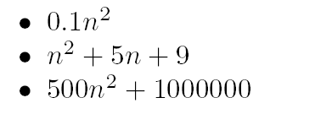
Big-O notation
f(n) is O(g(n)):
if n₀ and c can be found to satisfy:
f(n) < cg(n) for any n, n > n₀
g(n) is simple function: 1, n, log₂n, n², n³, 2^{n}
Following are O(n²):
RTL Hardware Design
PUE 3141 Advanced Digital Systems Design

Slide 7
Interpretation of Big-O
Filter out the “interference”: constants and less important terms
n is the input size of an algorithm
The “scaling factor” of an algorithm:
What happens if the input size increases
RTL Hardware Design
PUE 3141 Advanced Digital Systems Design

Slide 8
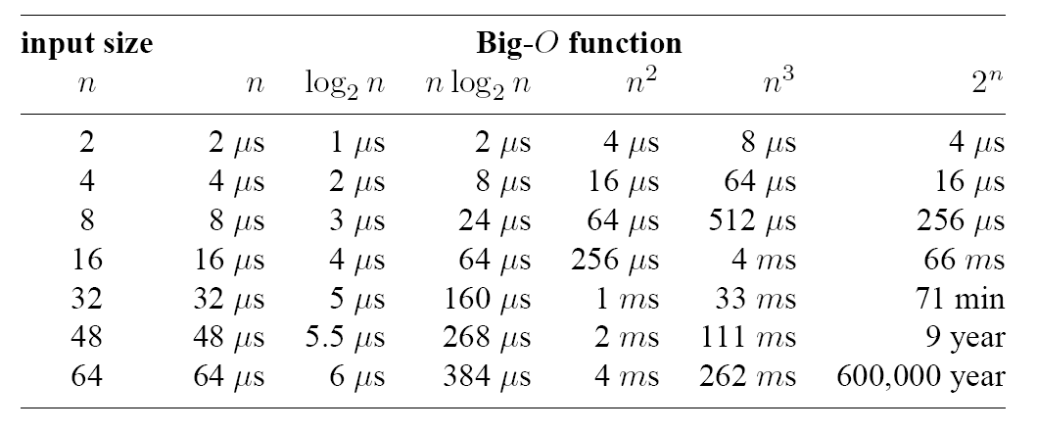
E.g.,
RTL Hardware Design
PUE 3141 Advanced Digital Systems Design

Slide 9
Intractable problems:
  algorithms with O(2^{n})
  Not realistic for a larger n
  Frequently tractable algorithms for sub-optimal solution exist
Many problems encountered in synthesis are intractable
RTL Hardware Design
PUE 3141 Advanced Digital Systems Design

Slide 10
Theoretical limitation
Synthesis software does not know your intention
Synthesis software cannot obtain the optimal solution
Synthesis should be treated as transformation and a “local search” in the “design space”
Good VHDL code provides a good starting point for the local search
RTL Hardware Design
PUE 3141 Advanced Digital Systems Design

Slide 11
What is the fuss about:
  “hardware-software” co-design?
  SystemC, HardwareC, SpecC etc.?
RTL Hardware Design
PUE 3141 Advanced Digital Systems Design

Slide 12
2. Realization of VHDL operator
Logic operator
  Simple, direct mapping
Relational operator
  =, /= fast, simple implementation exists
  >, < etc: more complex implementation, larger delay
Addition operator
Other arith operators: support varies
RTL Hardware Design
PUE 3141 Advanced Digital Systems Design

Slide 13
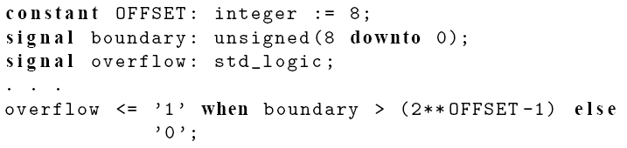
Operator with two constant operands:
  Simplified in preprocessing
  No hardware inferred
  Good for documentation
  E.g.,
RTL Hardware Design
PUE 3141 Advanced Digital Systems Design

Slide 14


Operator with one constant operand:
  Can significantly reduce the hardware complexity
  E.g., adder vs. incrementor
  E.g
  y <= rotate_right(x, y); -- barrel shifter
  y <= rotate_right(x, 3); -- rewiring
  y <= x(2 downto 0) & x(7 downto 3);
  E.g., 4-bit comparator: x=y vs. x=0
RTL Hardware Design
PUE 3141 Advanced Digital Systems Design

Slide 15
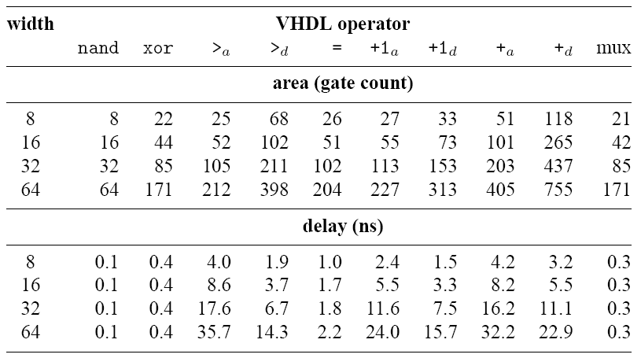
An example 0.55 um standard-cell CMOS implementation
RTL Hardware Design
PUE 3141 Advanced Digital Systems Design

Slide 16
3. Realization of VHDL data type
Use and synthesis of ‘Z’
Use of ‘-’
RTL Hardware Design
PUE 3141 Advanced Digital Systems Design

Slide 17
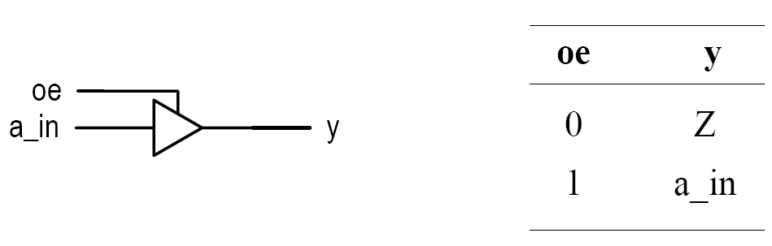
Use and synthesis of ‘Z’
Tri-state buffer:
  Output with “high-impedance”
  Not a value in Boolean algebra
  Need special output circuitry (tri-state buffer)
RTL Hardware Design
PUE 3141 Advanced Digital Systems Design

Slide 18
Major application:
  Bi-directional I/O pins
  Tri-state bus
VHDL description:
  y <= 'Z' when oe='1' else
  a_in;
‘Z’ cannot be used as input or manipulated
  f <= 'Z' and a;
  y <= data_a when in_bus='Z' else
  data_b;
RTL Hardware Design
PUE 3141 Advanced Digital Systems Design

Slide 19
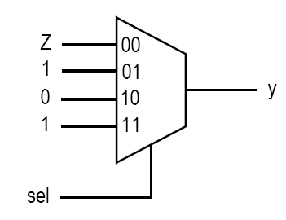
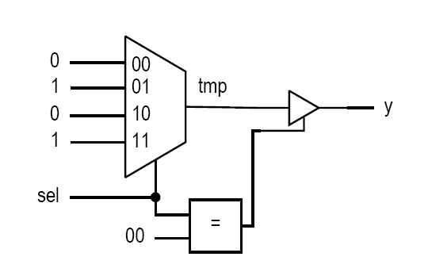
Separate tri-state buffer from regular code:
  Less clear:
  with sel select
  y <= 'Z' when "00",
  '1' when "01"|"11",
  '0' when others;
  better:
  with sel select
  tmp <= '1' when "01"|"11",
  '0' when others;
  y <= 'Z' when sel="00" else
  tmp;
RTL Hardware Design
PUE 3141 Advanced Digital Systems Design

Slide 20
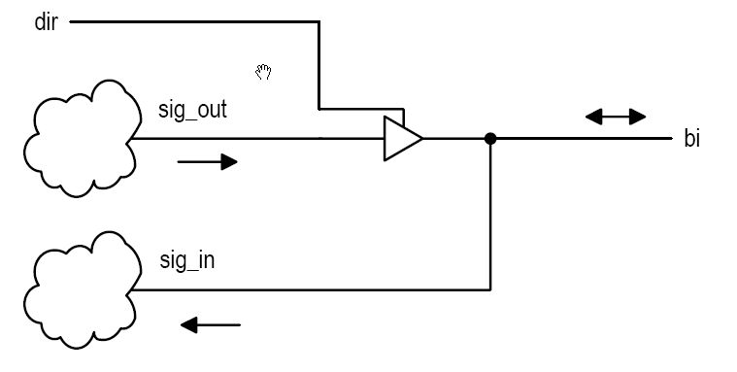
Bi-directional i/o pins
RTL Hardware Design
PUE 3141 Advanced Digital Systems Design

Slide 21
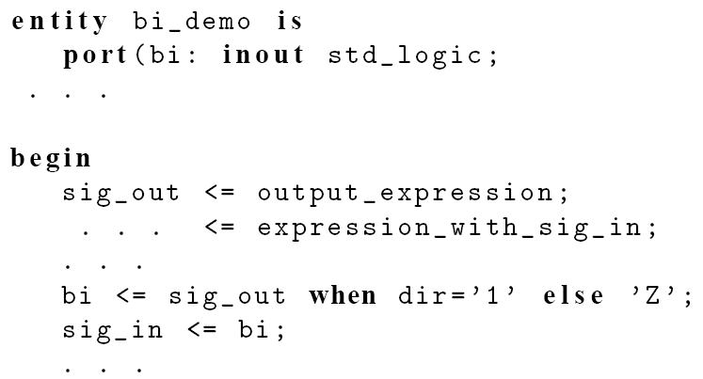
RTL Hardware Design
PUE 3141 Advanced Digital Systems Design

Slide 22
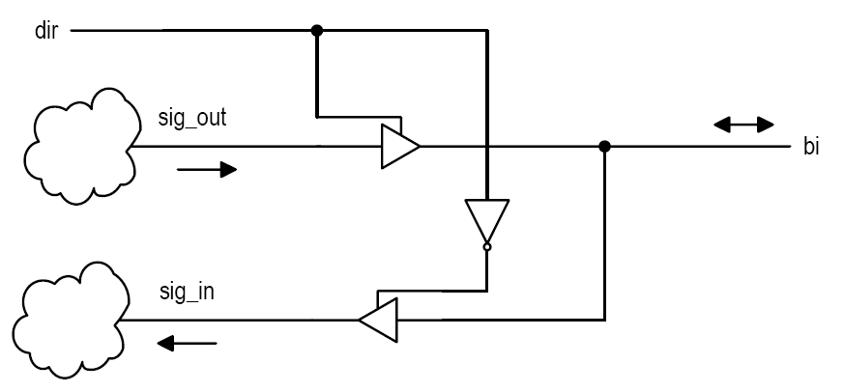
RTL Hardware Design
PUE 3141 Advanced Digital Systems Design

Slide 23
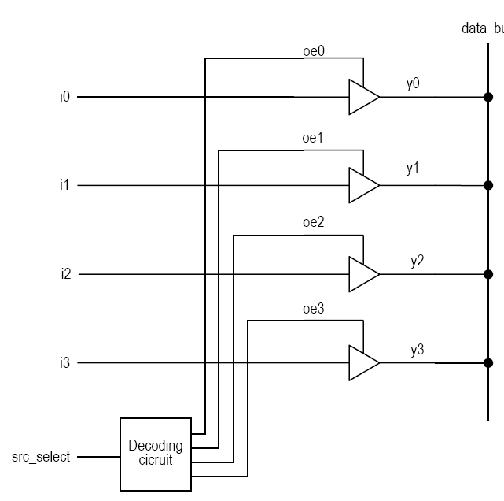
Tri-state bus
RTL Hardware Design
PUE 3141 Advanced Digital Systems Design

Slide 24
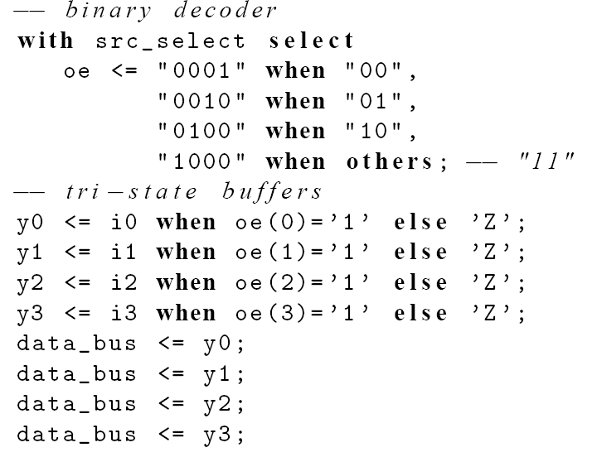
RTL Hardware Design
PUE 3141 Advanced Digital Systems Design

Slide 25
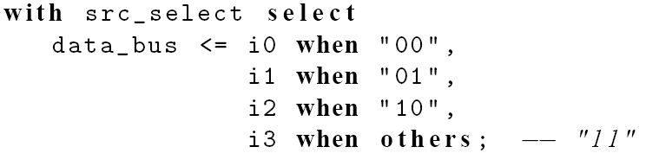
Problem with tri-state bus
  Difficult to optimize, verify and test
  Somewhat difficult to design: “parking”, “fighting”
Alternative to tri-state bus: mux
RTL Hardware Design
PUE 3141 Advanced Digital Systems Design

Slide 26
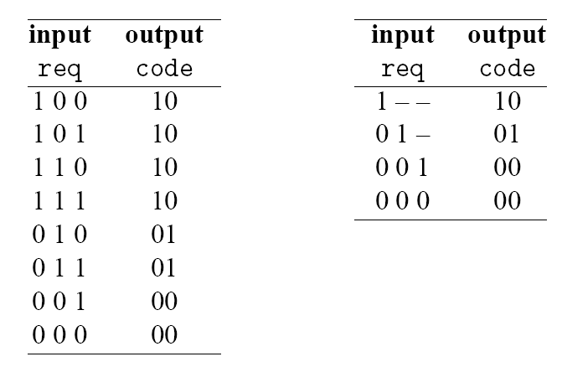
Use of ‘-’
In conventional logic design
  ‘-’ as input value: shorthand to make table compact
  E.g.,
RTL Hardware Design
PUE 3141 Advanced Digital Systems Design

Slide 27
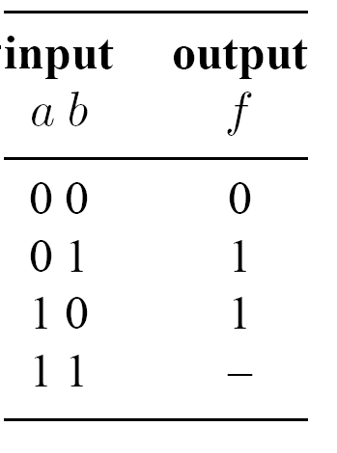
  ‘-’ as output value: help simplification
  E.g.,
  ‘-’ assigned to 1: a + b
  ‘-’ assigned to 0: a’b + ab’
RTL Hardware Design
PUE 3141 Advanced Digital Systems Design

Slide 28
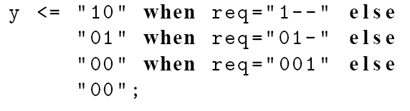
Use ‘-’ in VHDL
As input value (against our intuition):
Wrong:
RTL Hardware Design
PUE 3141 Advanced Digital Systems Design

Slide 29
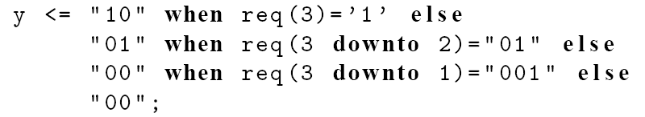
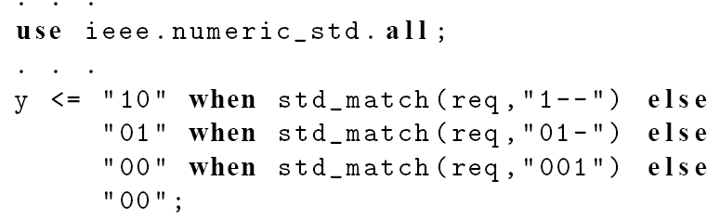
Fix #1:
Fix #2:
RTL Hardware Design
PUE 3141 Advanced Digital Systems Design

Slide 30
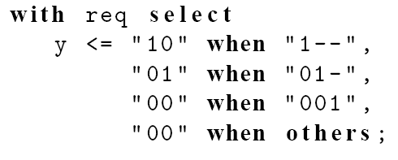
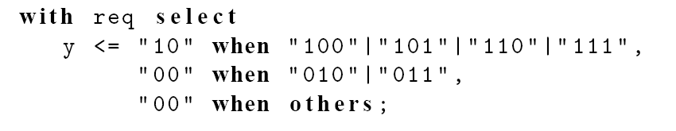
Wrong:
Fix:
RTL Hardware Design
PUE 3141 Advanced Digital Systems Design

Slide 31
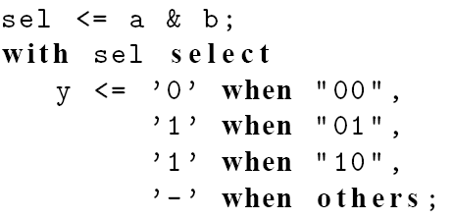
‘-’ as an output value in VHDL
May work with some software
RTL Hardware Design
PUE 3141 Advanced Digital Systems Design

Slide 32
4. VHDL Synthesis Flow
Synthesis:
  Realize VHDL code using logic cells from the device’s library
  a refinement process
Main steps:
  RT level synthesis
  Logic synthesis
  Technology mapping
RTL Hardware Design
PUE 3141 Advanced Digital Systems Design

Slide 33
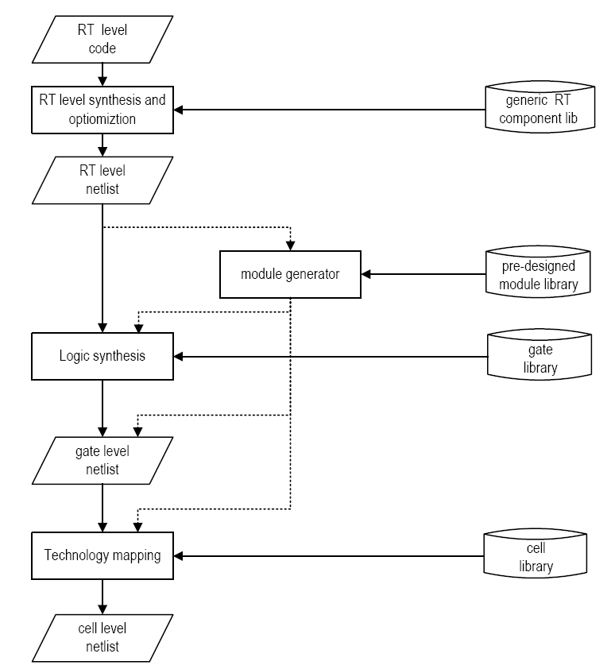
RTL Hardware Design
PUE 3141 Advanced Digital Systems Design

Slide 34
RT level synthesis
Realize VHDL code using RT-level components
Somewhat like the derivation of the conceptual diagram
Limited optimization
Generated netlist includes
  “regular” logic: e.g., adder, comparator
  “random” logic: e.g., truth table description
RTL Hardware Design
PUE 3141 Advanced Digital Systems Design

Slide 35
Module generator
“regular” logic can be replaced by pre-designed module
  Pre-designed module is more efficient
  Module can be generated in different levels of detail
  Reduce the processing time
RTL Hardware Design
PUE 3141 Advanced Digital Systems Design

Slide 36
Logic Synthesis
Realize the circuit with the optimal number of “generic” gate level components
Process the “random” logic
Two categories:
  Two-level synthesis: sum-of-product format
  Multi-level synthesis
RTL Hardware Design
PUE 3141 Advanced Digital Systems Design

Slide 37
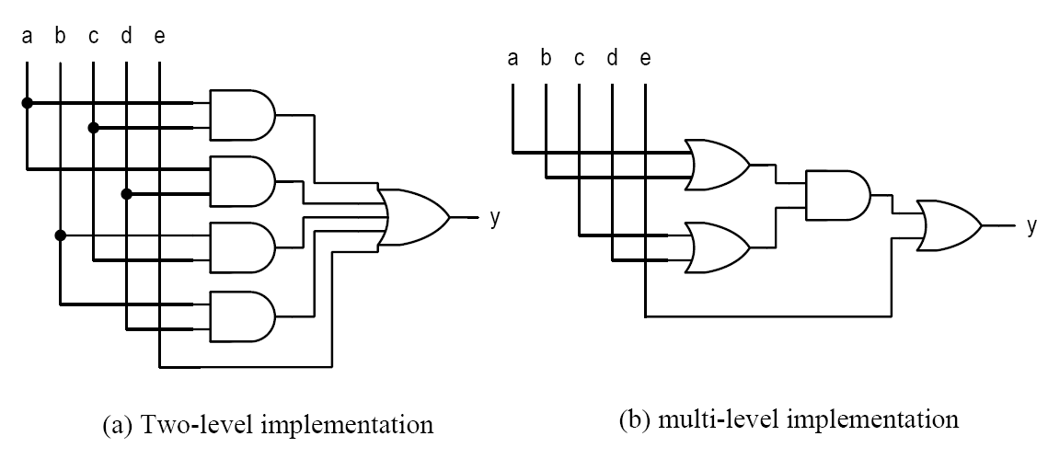
E.g.,
RTL Hardware Design
PUE 3141 Advanced Digital Systems Design

Slide 38
Technology mapping
Map “generic” gates to “device-dependent” logic cells
The technology library is provided by the vendors who manufactured (in FPGA) or will manufacture (in ASIC) the device
RTL Hardware Design
PUE 3141 Advanced Digital Systems Design

Slide 39
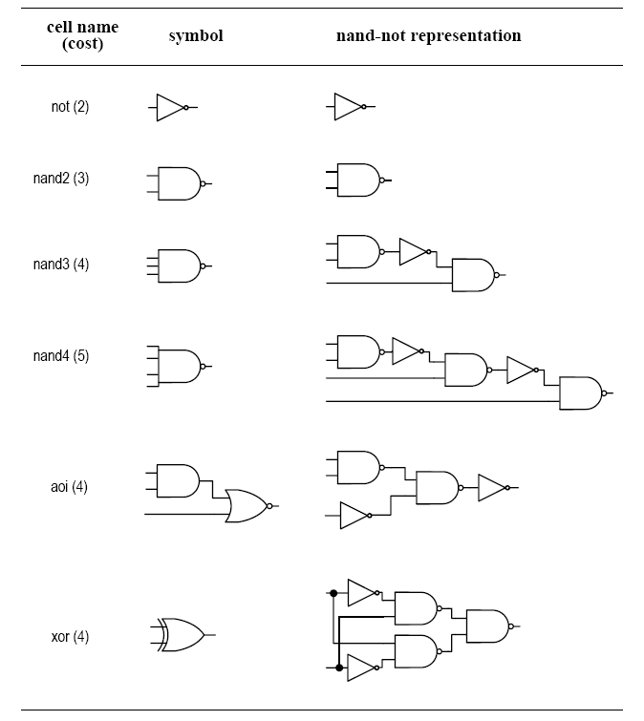
E.g., mapping in standard-cell ASIC
Device
library
RTL Hardware Design
PUE 3141 Advanced Digital Systems Design

Slide 40
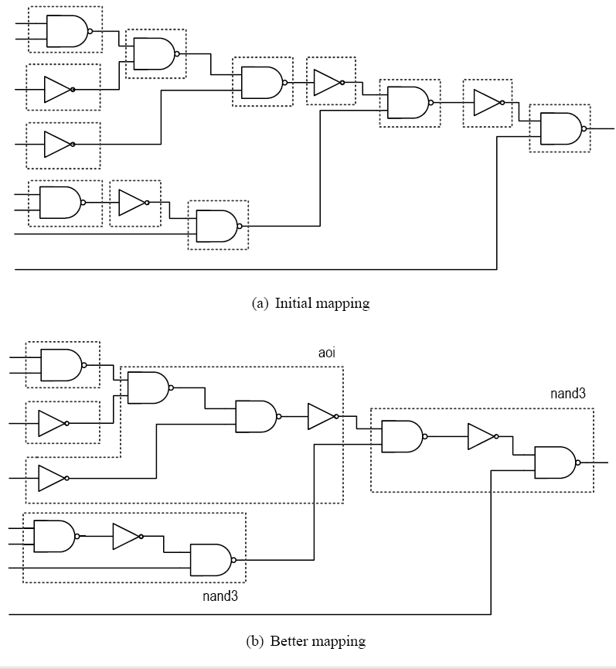
Cost: 31 vs. 17
RTL Hardware Design
PUE 3141 Advanced Digital Systems Design

Slide 41
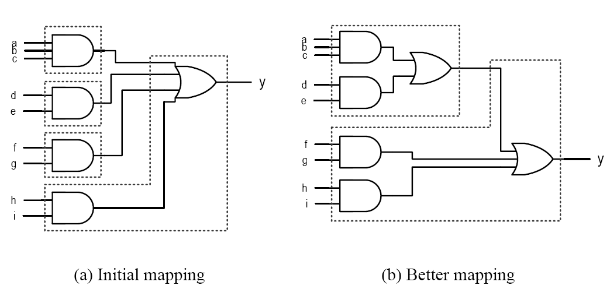
E.g., mapping in FPGA
With 5-input LUT (Look-Up-Table) cells
RTL Hardware Design
PUE 3141 Advanced Digital Systems Design

Slide 42
Effective use of synthesis software
Logic operators: software can do a good job
Relational/Arith operators: manual intervention needed
“layout” and “routing structure”:
  Silicon chip is 2-dimensional square
  “rectangular” or “tree-shaped” circuit is easier to optimize
RTL Hardware Design
PUE 3141 Advanced Digital Systems Design

Slide 43
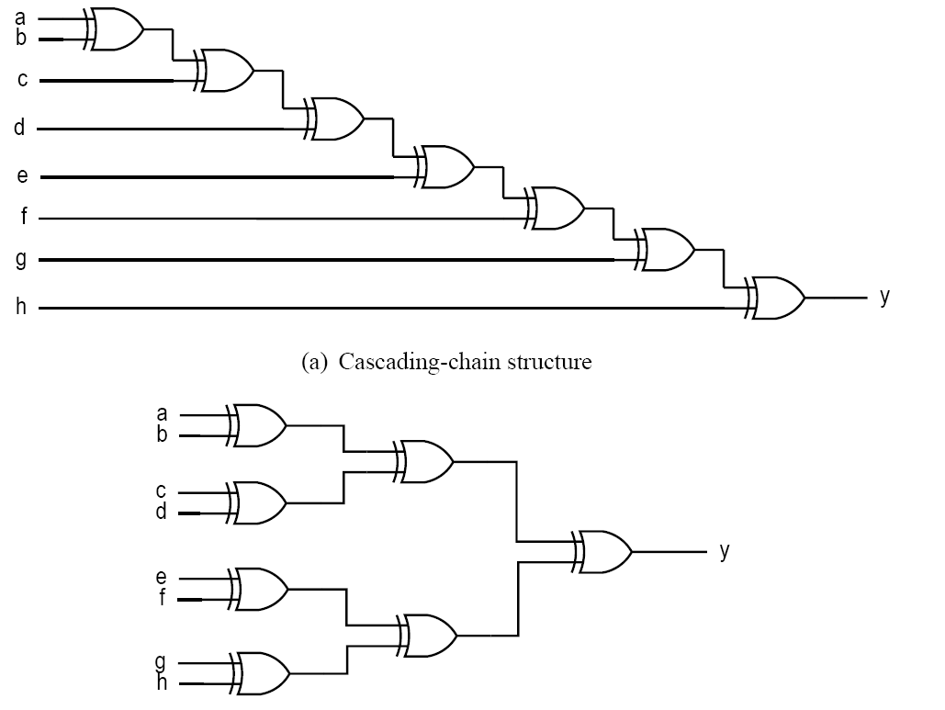
RTL Hardware Design
PUE 3141 Advanced Digital Systems Design

Slide 44
5. Timing consideration
Propagation delay
Synthesis with timing constraint
Hazards
Delay-sensitive design
RTL Hardware Design
PUE 3141 Advanced Digital Systems Design

Slide 45

Propagation delay
Delay: time required to propagate a signal from an input port to a output port
Cell level delay: most accurate
Simplified model:
The impact of wire becomes more dominant
RTL Hardware Design
PUE 3141 Advanced Digital Systems Design

Slide 46
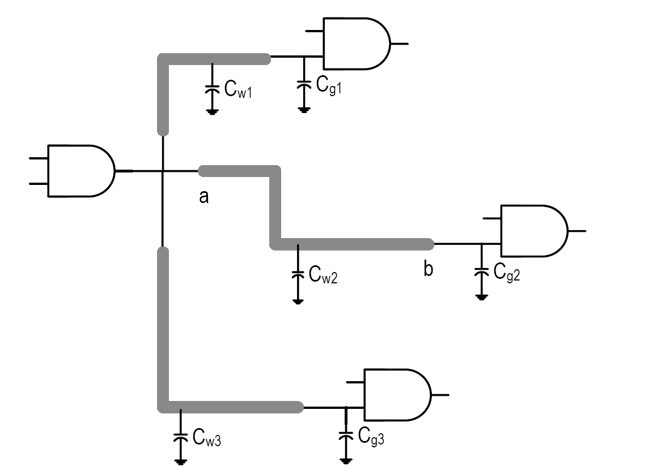
E.g.
RTL Hardware Design
PUE 3141 Advanced Digital Systems Design

Slide 47
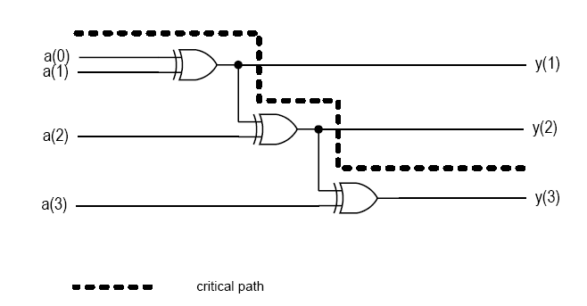
System delay
The longest path (critical path) in the system
The worst input to output delay
E.g.,
RTL Hardware Design
PUE 3141 Advanced Digital Systems Design

Slide 48
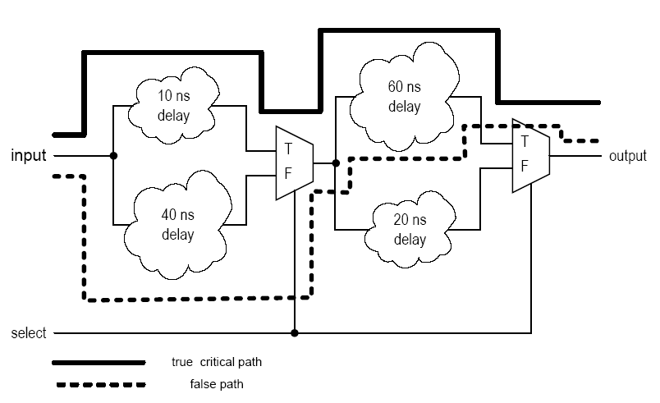
“False path” may exists:
RTL Hardware Design
PUE 3141 Advanced Digital Systems Design

Slide 49
RT level delay estimation:
  Difficult if the design is mainly “random” logic
  Critical path can be identified if many complex operators (such adder) are used in the design.
RTL Hardware Design
PUE 3141 Advanced Digital Systems Design

Slide 50
Synthesis with timing constraint
Multi-level synthesis is flexible
It is possible to reduce by delay by adding extra logic
Synthesis with timing constraint
  Obtain the minimal-area implementation
  Identify the critical path
  Reduce the delay by adding extra logic
  Repeat 2 & 3 until meeting the constraint
RTL Hardware Design
PUE 3141 Advanced Digital Systems Design

Slide 51
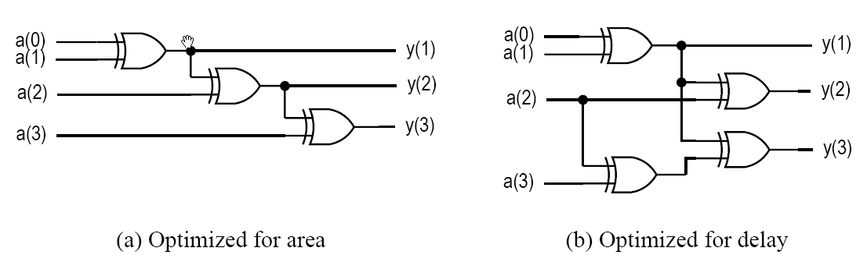
E.g.,
RTL Hardware Design
PUE 3141 Advanced Digital Systems Design

Slide 52
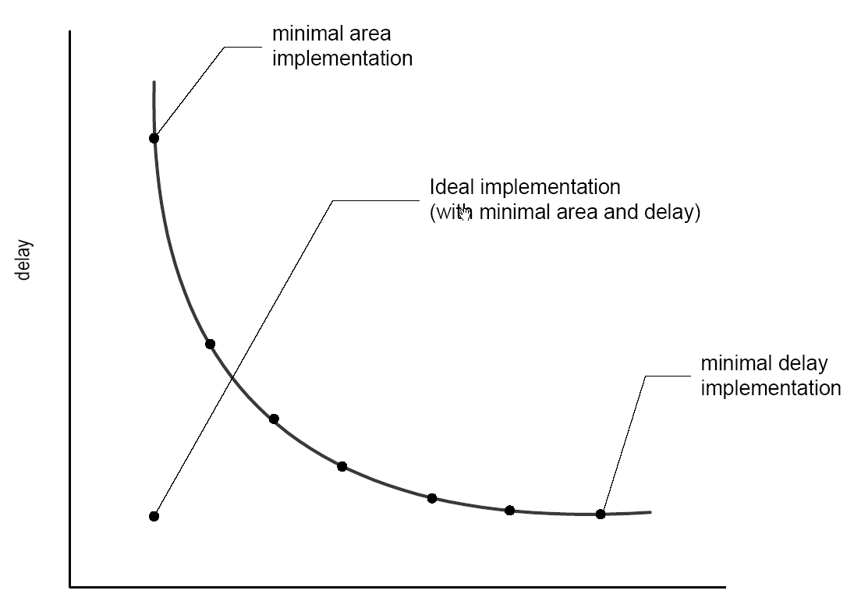
Area-delay trade-off curve
RTL Hardware Design
PUE 3141 Advanced Digital Systems Design

Slide 53
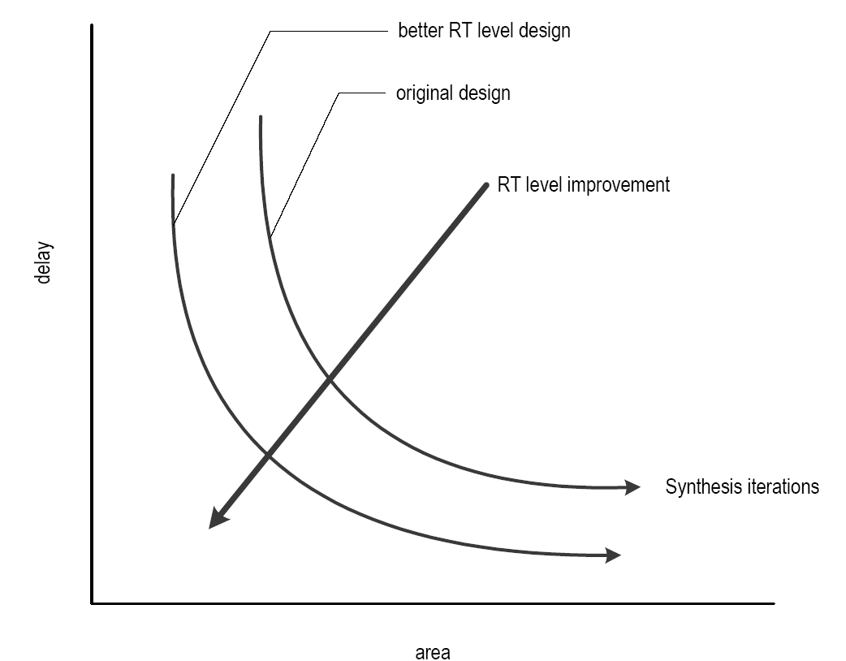
Improvement in “architectural” level design (better VHDL code to start with)
RTL Hardware Design
PUE 3141 Advanced Digital Systems Design

Slide 54
Timing Hazards
Propagation delay: time to obtain a stable output
Hazards: the fluctuation occurring during the transient period
  Static hazard: glitch when the signal should be stable
  Dynamic hazard: a glitch in transition
Due to the multiple converging paths of an output port
RTL Hardware Design
PUE 3141 Advanced Digital Systems Design

Slide 55
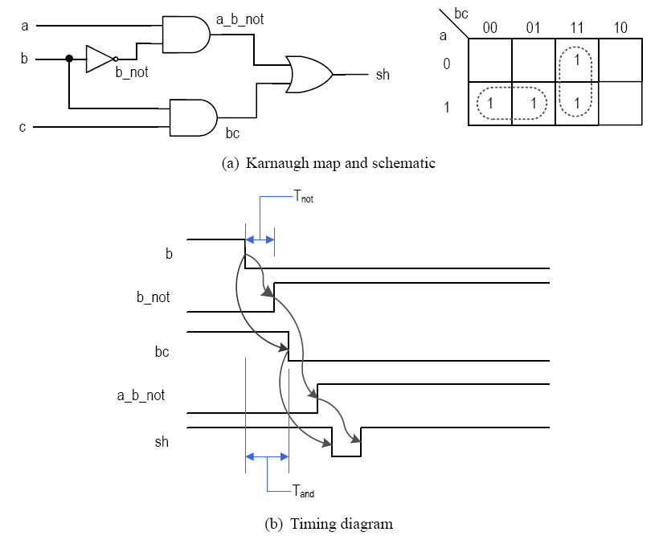
E.g., static-hazard (sh=ab’+bc; a=c=1)
RTL Hardware Design
PUE 3141 Advanced Digital Systems Design

Slide 56
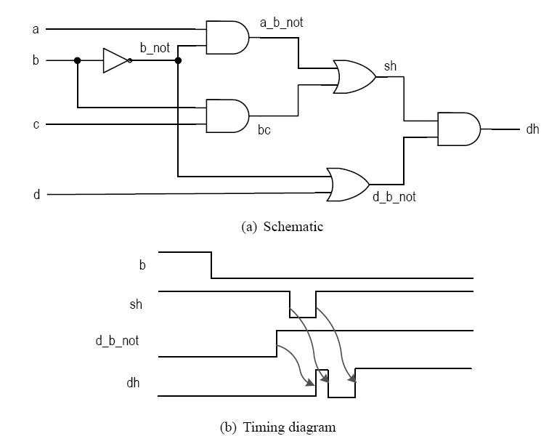
E.g., dynamic hazard (a=c=d=1)
RTL Hardware Design
PUE 3141 Advanced Digital Systems Design

Slide 57
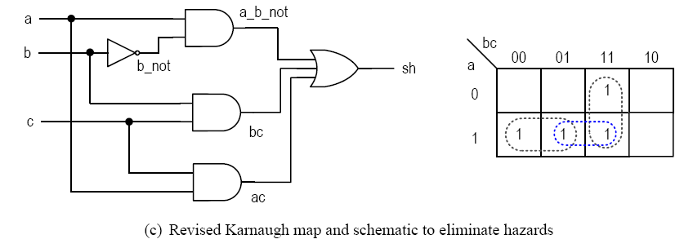
Dealing with hazards
Some hazards can be eliminated in theory
E.g.,
RTL Hardware Design
PUE 3141 Advanced Digital Systems Design

Slide 58
Eliminating glitches is very difficult in reality, and almost impossible for synthesis
Multiple inputs can change simultaneously (e.g., 1111=>0000 in a counter)
How to deal with it?
Ignore glitches in the transient period and retrieve the data after the signal is stabilized
RTL Hardware Design
PUE 3141 Advanced Digital Systems Design

Slide 59
Delay sensitive design and its danger
Boolean algebra
  the theoretical model for digital design and most algorithms used in synthesis process
  algebra deals with the stabilized signals
Delay-sensitive design
  Depend on the transient property (and delay) of the circuit
  Difficult to design and analyze
RTL Hardware Design
PUE 3141 Advanced Digital Systems Design

Slide 60
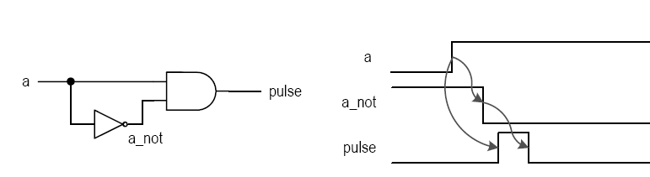
E.g., hazard elimination circuit:
ac term is not needed
E.g., edge detection circuit (pulse=a a’)
RTL Hardware Design
PUE 3141 Advanced Digital Systems Design

Slide 61
What’s can go wrong:
  E.g., pulse <= a and (not a);
  During logic synthesis, the logic expressions will be rearranged and optimized.
  During technology mapping, generic gates will be re-mapped
  During placement & routing, wire delays may change
  It is bad for testing verification
If delay-sensitive design is really needed, it should be done manually, not by synthesis
RTL Hardware Design
PUE 3141 Advanced Digital Systems Design

