Slide 1
Hardware Description Language
Dr. Ahmed Ali
Advanced Digital Systems Design (PUE 3141) - Summer 2022

Slide 2
Reference Book
RTL Hardware Design by P. Chu

Slide 3
Outline
Overview on hardware description language
Basic VHDL Concept via an example
VHDL in development flow

Slide 4
1. Overview on hardware description language

Slide 5
Programming language
Can we use C or Java as HDL?
A computer programming language
  Semantics (“meaning”)
  Syntax (“grammar”)
Develop of a language
  Study the characteristics of the underlying processes
  Develop syntactic constructs and their associated semantics to model and express these characteristics.

Slide 6
Traditional PL
Modeled after a sequential process
  Operations performed in a sequential order
  Help human's thinking process to develop an algorithm step by step
  Resemble the operation of a basic computer model

Slide 7
HDL
Characteristics of digital hardware
  Connections of parts
  Concurrent operations
  Concept of propagation delay and timing
Characteristics cannot be captured by traditional PLs
Require new languages: HDL
RTL Hardware Design by P. Chu
Chapter 2

Slide 8
Use of an HDL program
Formal documentation
Input to a simulator
Input to a synthesizer

Slide 9
Modern HDL
Capture characteristics of a digital circuit:
  entity
  connectivity
  concurrency
  timing
Cover description
  in Gate level and RT level
  In structural view and behavioral view

Slide 10
Highlights of modern HDL:
  Encapsulate the concepts of entity, connectivity, concurrency, and timing
  Incorporate propagation delay and timing information
  Consist of constructs for structural implementation
  Incorporate constructs for behavioral description (sequential execution of traditional PL)
  Describe the operations and structures in gate level and RT level.
  Consist of constructs to support hierarchical design process
RTL Hardware Design by P. Chu
Chapter 2

Slide 11
Two HDLs used today
  VHDL and Verilog
  Syntax and ``appearance'' of the two languages are very different
  Capabilities and scopes are quite similar
  Both are industrial standards and are supported by most software tools
RTL Hardware Design by P. Chu
Chapter 2

Slide 12
VHDL
  VHDL: VHSIC (Very High Speed Integrated Circuit) HDL
  Initially sponsored by DoD as a hardware documentation standard in early 80s
  Transferred to IEEE and ratified it as IEEE standard 1176 in 1987 (known as VHDL-87)
  Major modification in ’93 (known as VHDL-93)
  Revised continuously
RTL Hardware Design by P. Chu
Chapter 2

Slide 13
IEEE Extensions
  IEEE standard 1076.1 Analog and Mixed Signal Extensions (VHDL-AMS)
  IEEE standard 1076.2 VHDL Mathematical Packages
  IEEE standard 1076.3 Synthesis Packages
  IEEE standard 1076.4 VHDL Initiative Towards ASIC Libraries (VITAL)
  IEEE standard 1076.6 VHDL Register Transfer Level (RTL) Synthesis
  IEEE standard 1164 Multivalue Logic System for VHDL Model Interoperability
  IEEE standard 1029 VHDL Waveform and Vector Exchange to Support Design and Test Verification (WAVES)
RTL Hardware Design by P. Chu
Chapter 2

Slide 14
2. Basic VHDL Concept via an example
RTL Hardware Design by P. Chu
Chapter 2

Slide 15
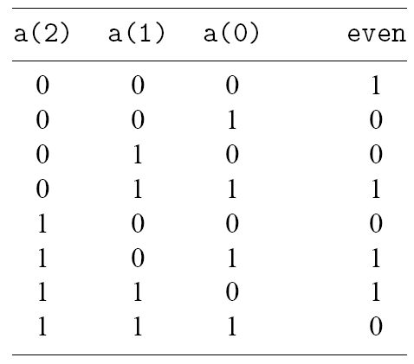
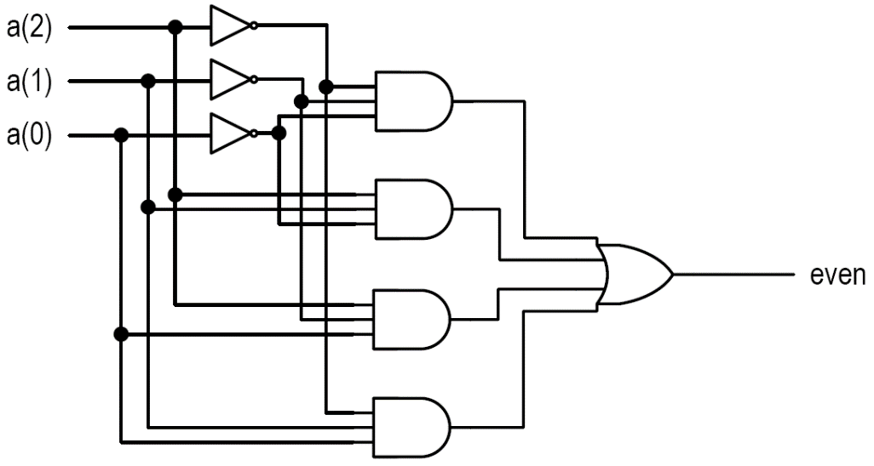
Even parity detection circuit
Input: a(2), a(1), a(0)
output: even
RTL Hardware Design by P. Chu
Chapter 2

Slide 16

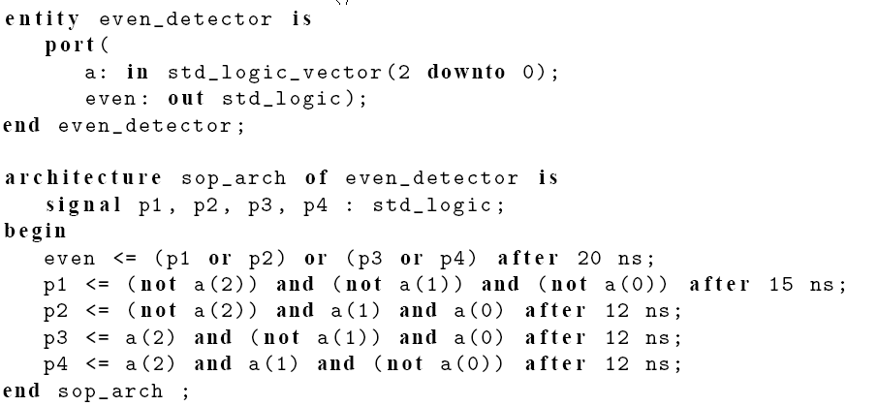
VHDL Listing 2.1
RTL Hardware Design by P. Chu
Chapter 2

Slide 17
Entity declaration
  i/o ports (“outline” of the circuit)
Architecture body
  Signal declaration
  Each concurrent statement
    Can be thought s a circuit part
    Contains timing information
  Arch body can be thought as a “collection of parts”
What’s the difference between this and a C program
RTL Hardware Design by P. Chu
Chapter 2

Slide 18
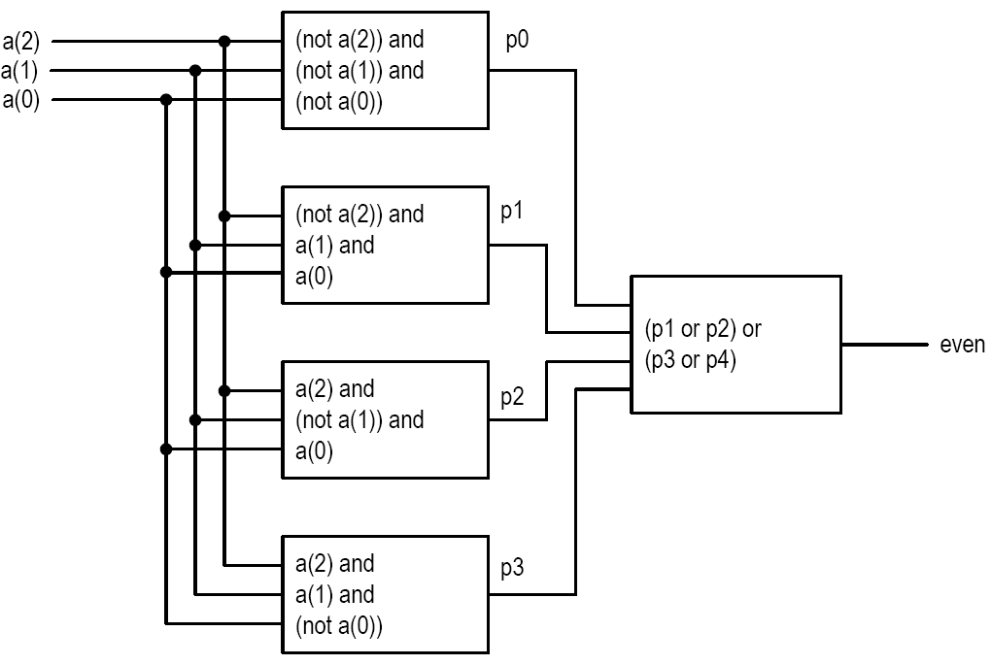
Conceptual interpretation
RTL Hardware Design by P. Chu
Chapter 2

Slide 19
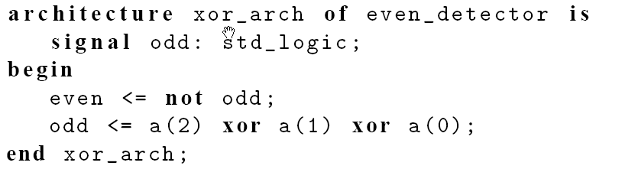
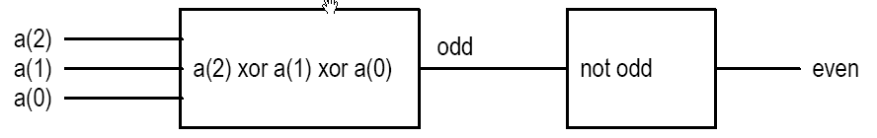
VHDL Listing 2.2
Same entity declaration
Implicit δ-delay (delta delay)
RTL Hardware Design by P. Chu
Chapter 2

Slide 20
Structural description
In structural view, a circuit is constructed by smaller parts.
Structural description specifies the types of parts and connections.
Essentially a textual description of a schematic
Done by using “component” in VHDL
  First declared (make known)
  Then instantiated (used)
RTL Hardware Design by P. Chu
Chapter 2

Slide 21
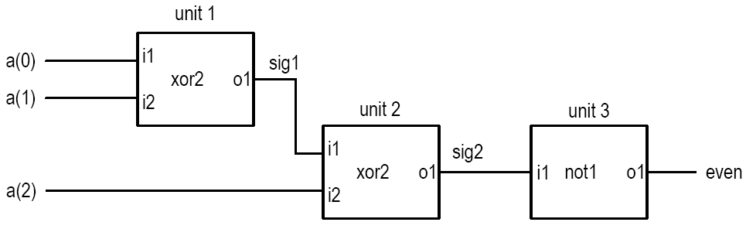
Example
Even detector using previously designed components (xor2 and not1)
RTL Hardware Design by P. Chu
Chapter 2

Slide 22
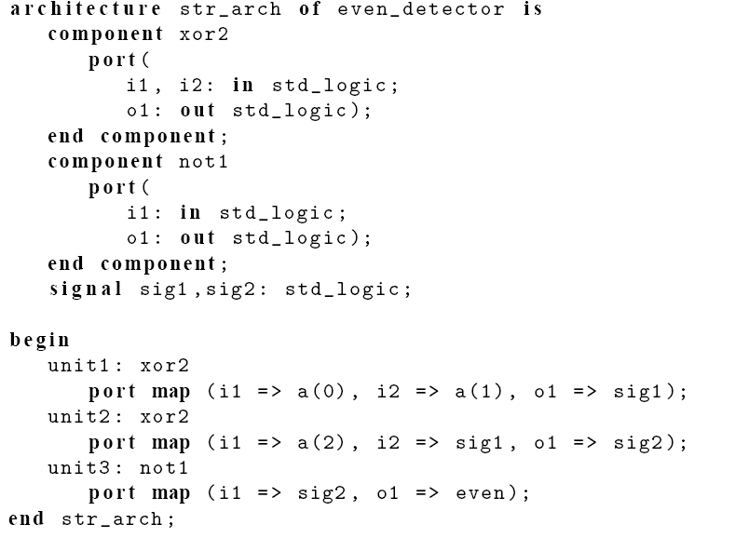
VHDL Listing 2.3
RTL Hardware Design by P. Chu
Chapter 2

Slide 23
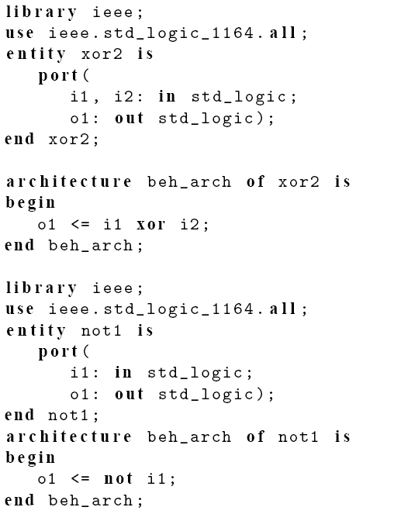
Somewhere in library
RTL Hardware Design by P. Chu
Chapter 2

Slide 24
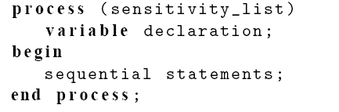
“Behavioral” description
No formal definition on “behavioral” in VHDL
VHDL “process”: a language construct to encapsulate “sequential semantics”
  The entire process is a concurrent statement
  Syntax:
RTL Hardware Design by P. Chu
Chapter 2

Slide 25
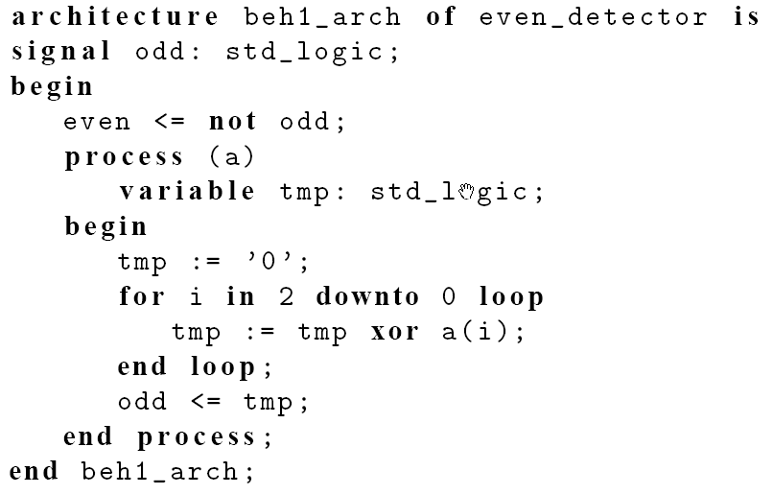
Listing 2.5
RTL Hardware Design by P. Chu
Chapter 2

Slide 26
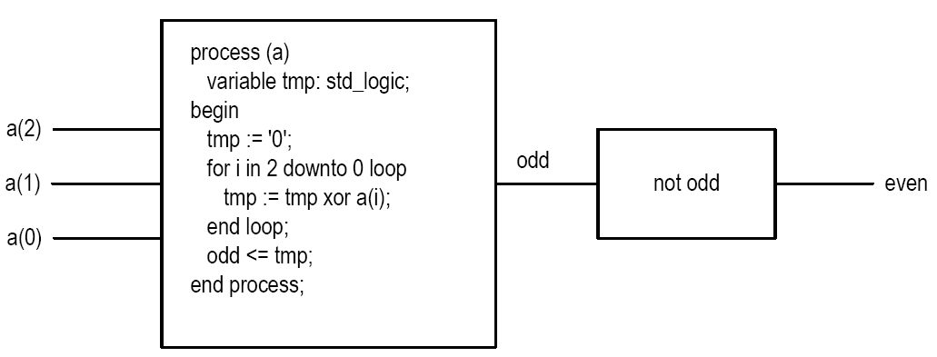
Conceptual interpretation
RTL Hardware Design by P. Chu
Chapter 2

Slide 27
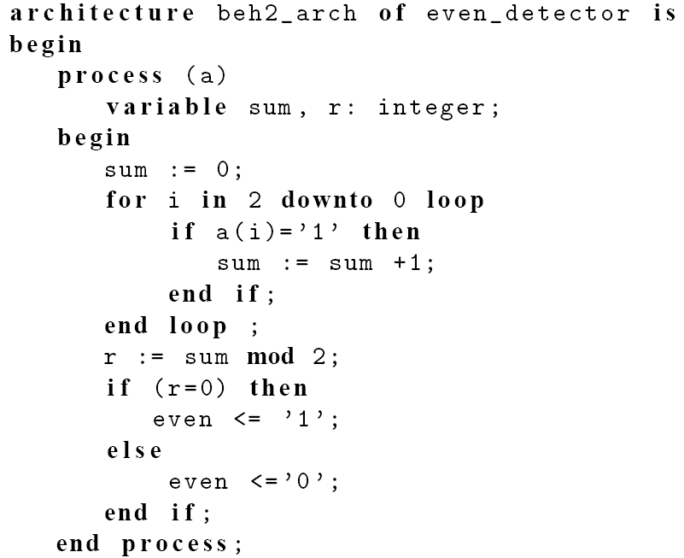
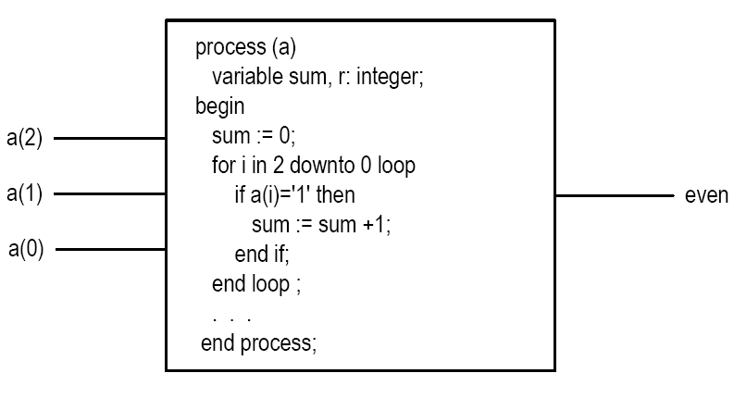
Listing 2.6
RTL Hardware Design by P. Chu
Chapter 2

Slide 28
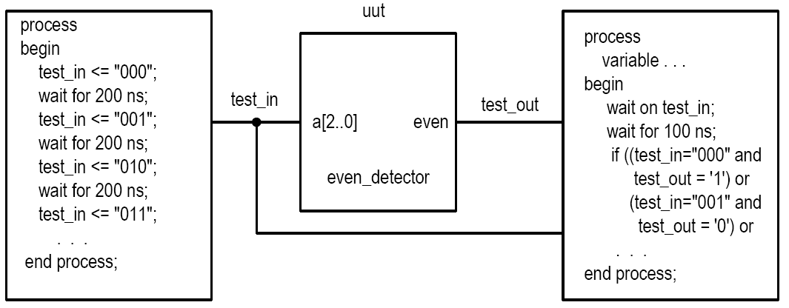
Testbench
a “virtual” experiment table
  Circuit to be tested
  Input stimuli (e.g., function generator)
  Output monitor (e.g., logic analyzer)
e.g.,
RTL Hardware Design by P. Chu
Chapter 2

Slide 29
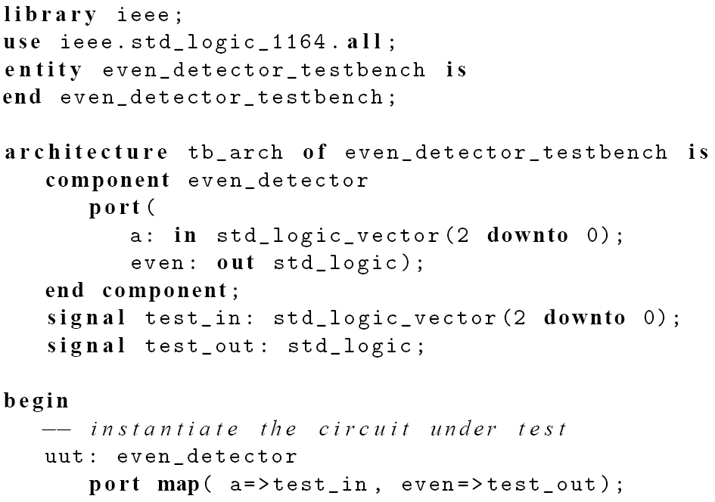
VHDL Listing 2.7
RTL Hardware Design by P. Chu
Chapter 2

Slide 30
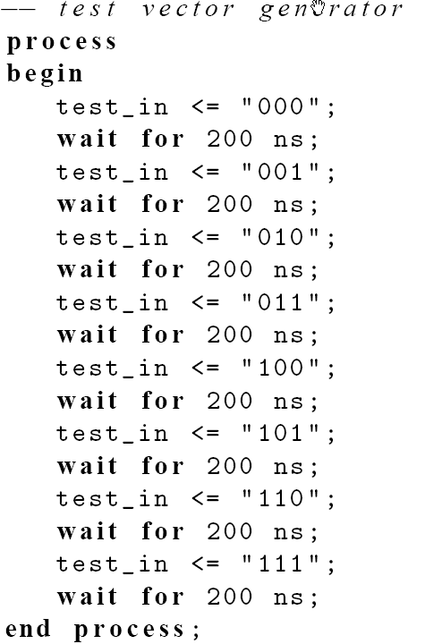
RTL Hardware Design by P. Chu
Chapter 2

Slide 31
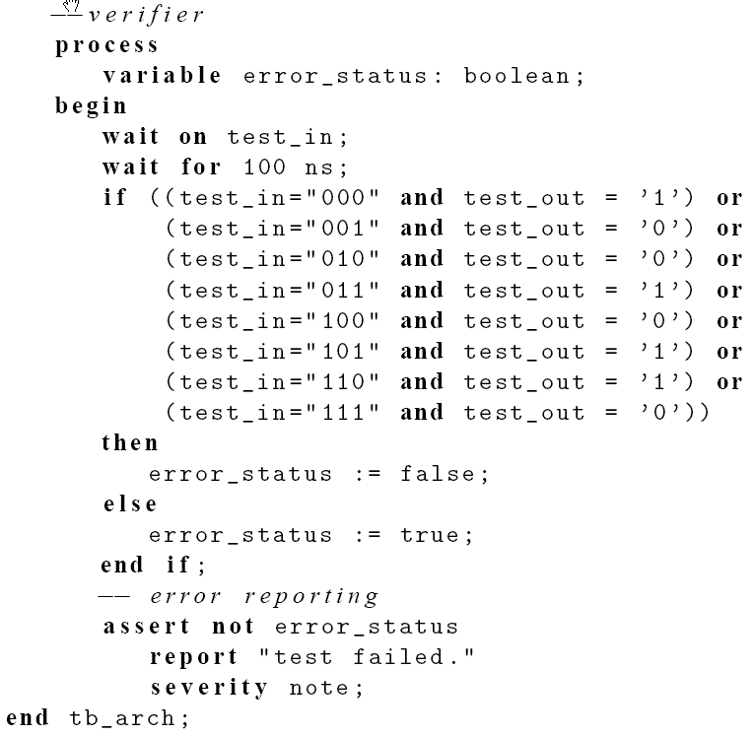
RTL Hardware Design by P. Chu
Chapter 2

Slide 32
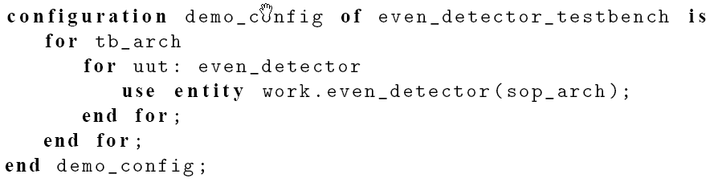
Configuration
Multiple architecture bodies can be associated with an entity declaration
  Like IC chips and sockets
VHDL configuration specifies the binding
E.g.,
RTL Hardware Design by P. Chu
Chapter 2

Slide 33
3. VHDL in development flow
RTL Hardware Design by P. Chu
Chapter 2

Slide 34
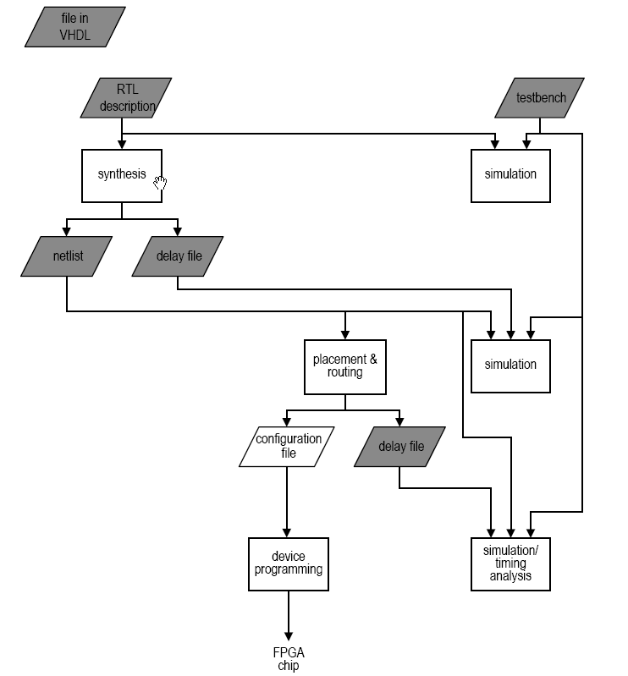
Scope of VHDL
RTL Hardware Design by P. Chu
Chapter 2

Slide 35
Coding for synthesis
“Execution” of VHDL codes
  Simulation:
    Design “realized” in a virtual environment (simulation software)
    All language constructs can be “realized”
    “realized” by a single CPU
RTL Hardware Design by P. Chu
Chapter 2

Slide 36
  “Synthesis
    Design realized by hardware components
    Many VHDL constructs can be synthesized (e,g, file operation, floating-point data type, division)
    Only small subset can be used
    E.g., 10 additions
    Syntactically correct code ≠ Synthesizable code
    Synthesizable code ≠ Efficient code
    Synthesis software only performs transformation and local search
RTL Hardware Design by P. Chu
Chapter 2

Slide 37
The course focuses on hardware, not VHDL (i.e., the “H”, not “L” of HDL)
Emphasis on coding for synthesis:
  Code accurately describing the underlying hardware structure
  Code providing adequate info to guide synthesis software to generate efficient implementation
RTL Hardware Design by P. Chu
Chapter 2

