Slide 1
Basic Language Constructs of VHDL
PUE 3141 Advanced Digital Systems Design

Slide 2
Reference Book
RTL Hardware Design by P. Chu
PUE 3141 Advanced Digital Systems Design

Slide 3
Outline
Basic VHDL program
Lexical elements and program format
Objects
Data type and operators
PUE 3141 Advanced Digital Systems Design

Slide 4
1. Basic VHDL program
PUE 3141 Advanced Digital Systems Design

Slide 5
Design unit
Building blocks in a VHDL program
Each design unit is analyzed and stored independently
Types of design unit:
  entity declaration
  architecture body
  package declaration
  package body
  configuration
PUE 3141 Advanced Digital Systems Design

Slide 6
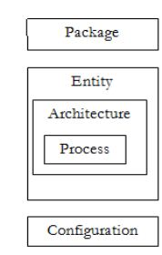
PUE 3141 Advanced Digital Systems Design

Slide 7
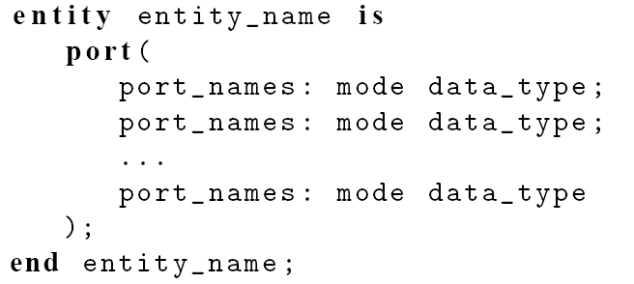
Entity declaration
Simplified syntax
PUE 3141 Advanced Digital Systems Design

Slide 8
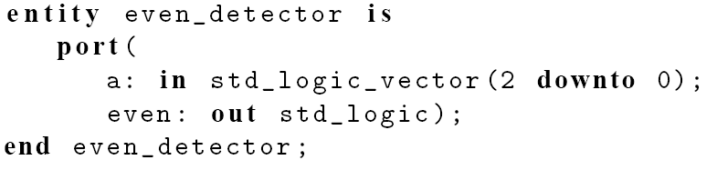
Port declaration: port names, mode, and data types.
mode: the direction of the signal
  in: the signal flows into the circuit
  out: the signal flows out of the circuit
  inout: bi-directional, the signal flows in both direction
E.g.
PUE 3141 Advanced Digital Systems Design

Slide 9
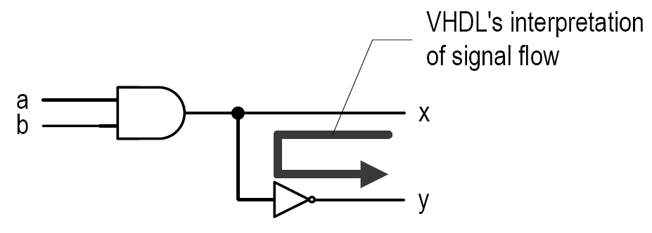
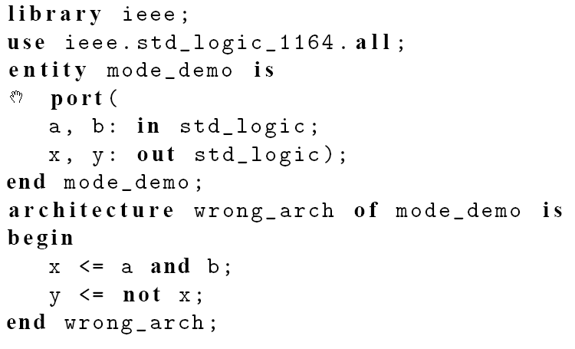
A common mistake with mode
PUE 3141 Advanced Digital Systems Design

Slide 10
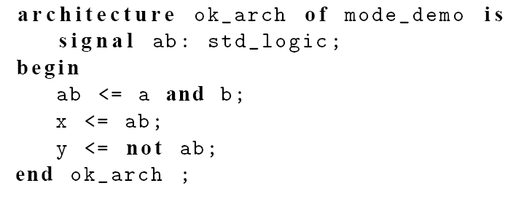
Fix: change the mode of x to be inout, but this is a poor solution.
Fix: use an internal signal
PUE 3141 Advanced Digital Systems Design

Slide 11
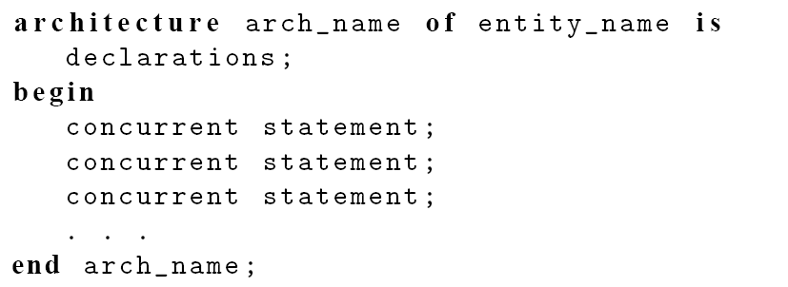
Architecture body
Simplified syntax
An entity declaration can be associated with multiple architecture bodies
PUE 3141 Advanced Digital Systems Design

Slide 12
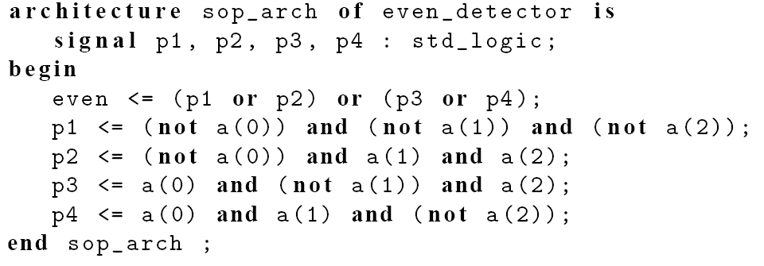
E.g.
PUE 3141 Advanced Digital Systems Design

Slide 13
Other design units
Package declaration/body:
  collection of commonly used items, such as data types, subprograms and components
Configuration:
  specify which architecture body is to be bound with the entity declaration
PUE 3141 Advanced Digital Systems Design

Slide 14
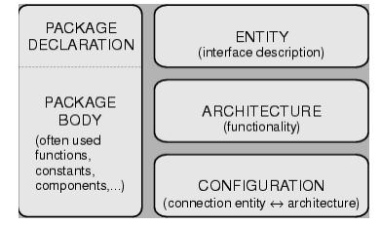
PUE 3141 Advanced Digital Systems Design

Slide 15
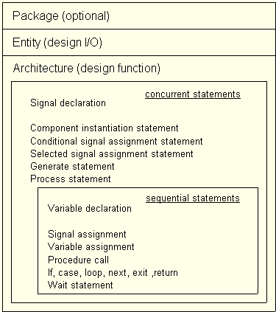
PUE 3141 Advanced Digital Systems Design

Slide 16
VHDL Library
A place to store the analyzed design units
Normally mapped to a directory in host computer
Software define the mapping between the symbolic library and physical location
Default library: “work”
Library “ieee” is used for many ieee packages
PUE 3141 Advanced Digital Systems Design

Slide 17

E.g.
Line 1: invoke a library named ieee
Line 2: makes std_logic_1164 package visible to the subsequent design units
The package is normally needed for the std_logic/std_logic_vector data type
PUE 3141 Advanced Digital Systems Design

Slide 18
Processing of VHDL code
Analysis
  Performed on “design unit” basis
  Check the syntax and translate the unit into an intermediate form
  Store it in a library
Elaboration
  Bind architecture body with entity
  Substitute the instantiated components with architecture description
  Create a “flattened”' description
Execution
  The analyzed and the elaborated description is fed to simulation or synthesis software.
PUE 3141 Advanced Digital Systems Design

Slide 19
2. Lexical elements and program format
PUE 3141 Advanced Digital Systems Design

Slide 20
Lexical elements
Lexical element:
  Basic syntactical units in a VHDL program
Types of Lexical elements:
  Comments
  Identifiers
  Reserved words
  Numbers
  Characters
  Strings
PUE 3141 Advanced Digital Systems Design

Slide 21
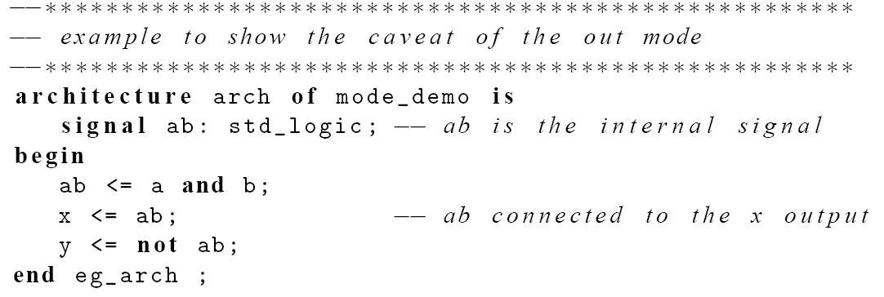
Comments
Starts with - -
Just for clarity
e.g.,
PUE 3141 Advanced Digital Systems Design

Slide 22
Identifier
Identifier is the name of an object
Basic rules:
  Can only contain alphabetic letters, decimal digits and underscore
  The first character must be a letter
  The last character cannot be an underscore
  Two successive underscores are not allowed
PUE 3141 Advanced Digital Systems Design

Slide 23
Valid examples:
  A10, next_state, NextState, mem_addr_enable
Invalid examples:
  sig#3, _X10, 7segment, X10_, hi_ _there
VHDL is case insensitive:
  Following identifiers are the same:
  nextstate, NextState, NEXTSTATE, nEXTsTATE
PUE 3141 Advanced Digital Systems Design

Slide 24
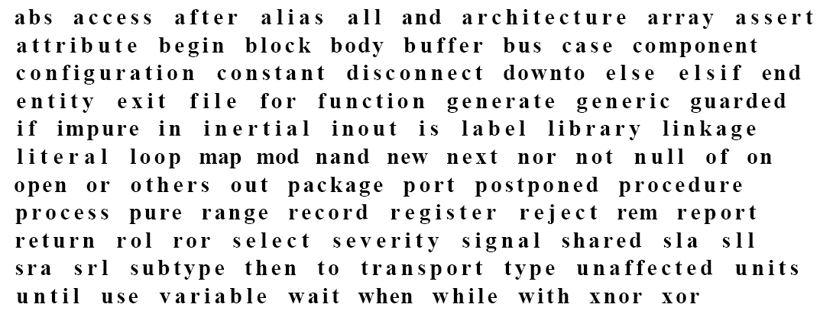
Reserved words
PUE 3141 Advanced Digital Systems Design

Slide 25
Numbers, characters and strings
Number:
  Integer: 0, 1234, 98E7
  Real: 0.0, 1.23456 or 9.87E6
  Base 2: 2#101101#
Character:
  ‘A’, ‘Z’, ‘1’
Strings
  “Hello”, “101101”
Note
  0 and ‘0’ are different
  2#101101# and “101101” are different
PUE 3141 Advanced Digital Systems Design

Slide 26
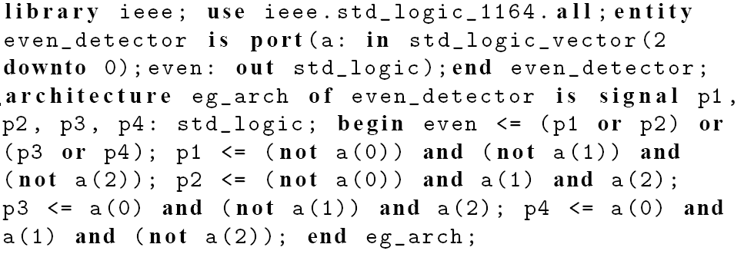
Program format
VHDL is “free-format”: blank space, tab, new-line can be freely inserted
e.g., the following are the same
PUE 3141 Advanced Digital Systems Design

Slide 27
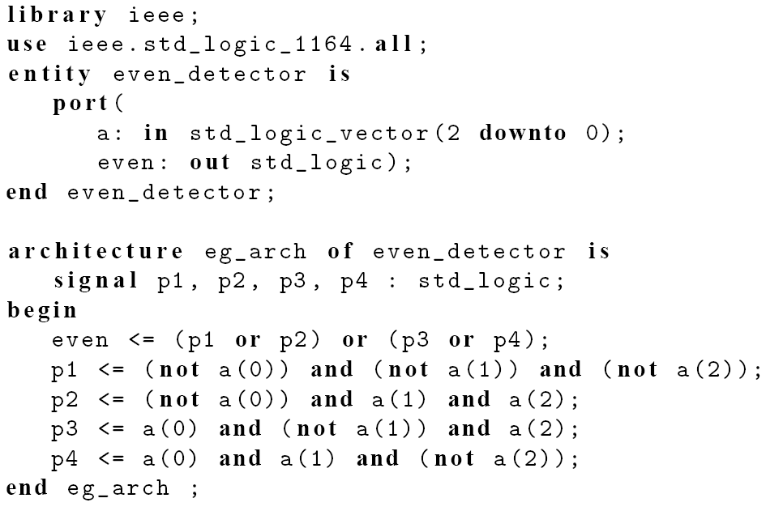
PUE 3141 Advanced Digital Systems Design

Slide 28
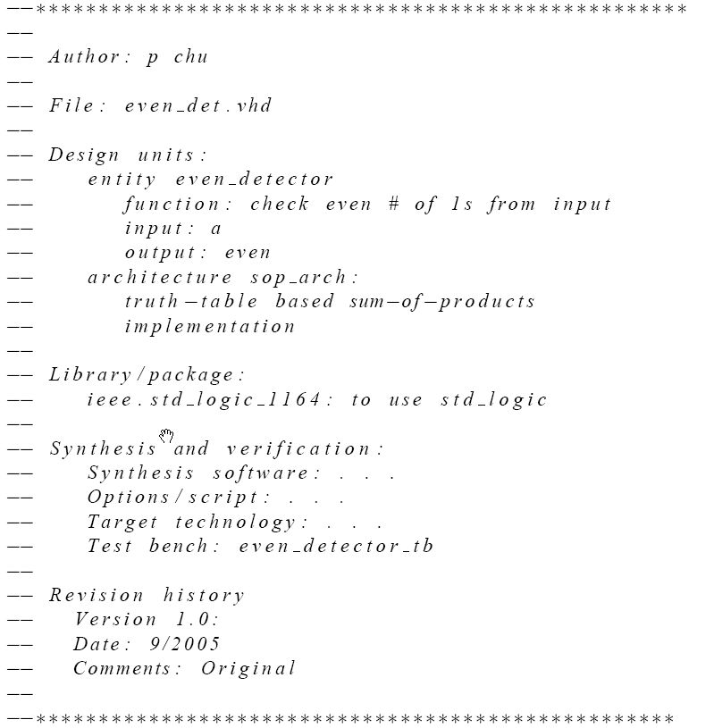
A good “header”
PUE 3141 Advanced Digital Systems Design

Slide 29
3. Objects
PUE 3141
Advanced Digital Systems Design
PUE 3141 Advanced Digital Systems Design

Slide 30
Objects
A named item that hold a value of specific data type
Four kinds of objects
  Signal
  Variable
  Constant
  File (cannot be synthesized)
Related construct
  Alias
PUE 3141 Advanced Digital Systems Design

Slide 31
Signal
Declared in the architecture body's declaration section
Signal declaration:
signal signal_name, signal_name, ... : data_type
Signal assignment:
signal_name <= projected_waveform;
Ports in entity declaration are considered as signals
Can be interpreted as wires or “wires with memory” (i.e., FFs, latches etc.)
PUE 3141 Advanced Digital Systems Design

Slide 32
Variable
Declared and used inside a process
Variable declaration:
variable variable_name, ... : data_type
Variable assignment:
variable_name := value_expression;
Contains no “timing info” (immediate assignment)
Used as in traditional PL: a “symbolic memory location” where a value can be stored and modified
No direct hardware counterpart
PUE 3141 Advanced Digital Systems Design

Slide 33
Constant
Value cannot be changed
Constant declaration:
constant const_name, ... : data_type := value_expression
Used to enhance readability of VHDL code
  E.g.,
PUE 3141 Advanced Digital Systems Design

Slide 34
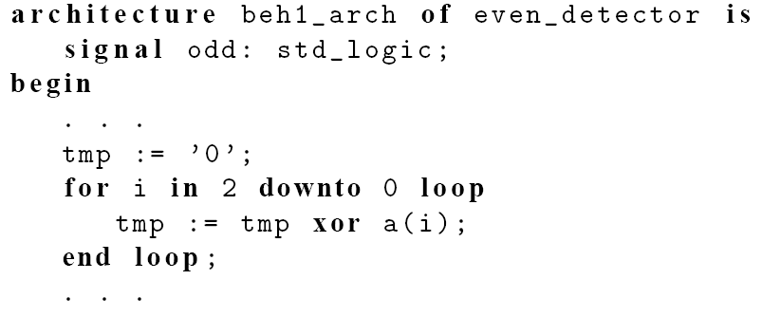
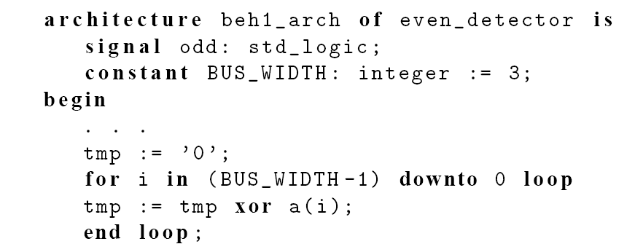
It is a good idea to avoid “hard literals”
PUE 3141 Advanced Digital Systems Design

Slide 35
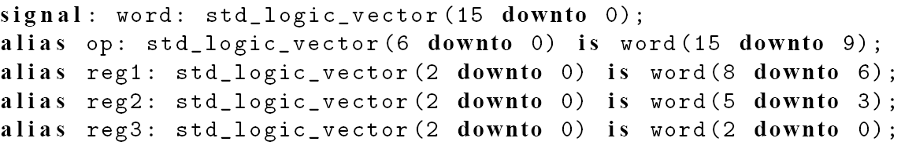
Alias
Not a data object
Alternative name for an object
Used to enhance readability
  E.g.,
PUE 3141 Advanced Digital Systems Design

