Slide 1
Basic Language Constructs of VHDL
PUE 3141 Advanced Digital Systems Design

Slide 2
Reference Book
RTL Hardware Design by P. Chu
PUE 3141 Advanced Digital Systems Design

Slide 3
Outline
Basic VHDL program
Lexical elements and program format
Objects
Data type and operators
PUE 3141 Advanced Digital Systems Design

Slide 4
4. Data type and operators
Standard VHDL
IEEE1164_std_logic package
IEEE numeric_std package
PUE 3141 Advanced Digital Systems Design

Slide 5
Data type
Definition of data type
  A set of values that an object can assume.
  A set of operations that can be performed on objects of this data type.
VHDL is a strongly-typed language
  an object can only be assigned with a value of its type.
  only the operations defined with the data type can be performed on the object.
PUE 3141 Advanced Digital Systems Design

Slide 6
Data types in standard VHDL
integer:
  Minimal range: -(2^31-1) to 2^31-1
  Two subtypes: natural, positive
boolean: (false, true)
bit: ('0', '1')
  Not capable enough
bit_vector: a one-dimensional array of bit
PUE 3141 Advanced Digital Systems Design

Slide 7
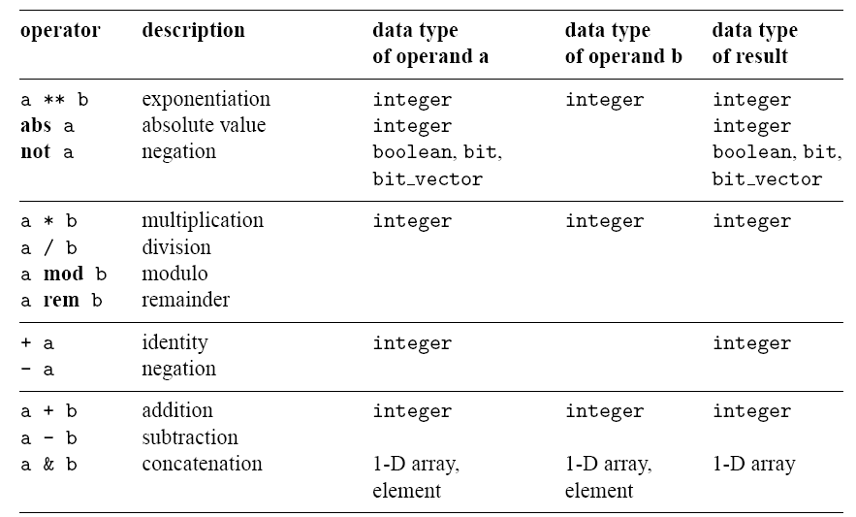
Operators in standard VHDL
PUE 3141 Advanced Digital Systems Design

Slide 8
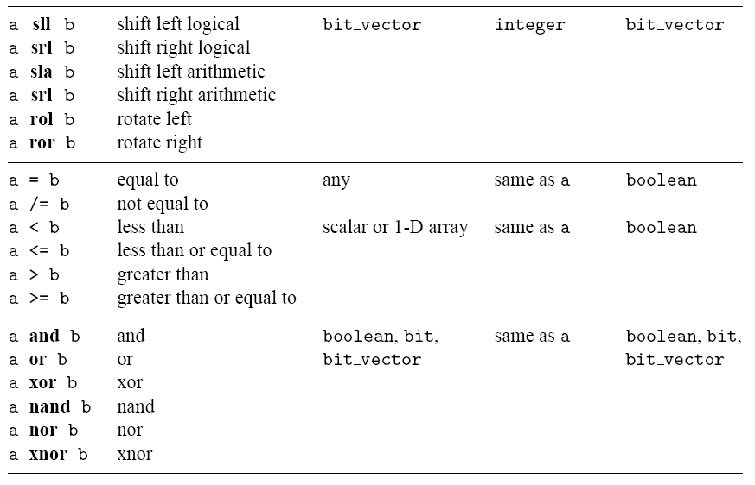
PUE 3141 Advanced Digital Systems Design

Slide 9
IEEE std_logic_1164 package
What’s wrong with bit?
New data type: std_logic, std_logic_vector
std_logic:
  9 values: ('U', 'X', '0', '1', 'Z', 'W', 'L', 'H', '-')
    '0', '1': forcing logic 0' and forcing logic 1
    'Z': high-impedance, as in a tri-state buffer.
    'L' , 'H': weak logic 0 and weak logic 1, as in wired-logic
    'X', 'W': “unknown” and “weak unknown”
    'U': for uninitialized
    '-': don't-care.
PUE 3141 Advanced Digital Systems Design

Slide 10
std_logic_vector
  an array of elements with std_logic data type
  Imply a bus
  E.g.,
  signal a: std_logic_vector(7 downto 0);
  Another form (less desired)
  signal a: std_logic_vector(0 to 7);
Need to invoke package to use the data type:
  library ieee;
  use ieee.std_logic_1164.all;
PUE 3141 Advanced Digital Systems Design

Slide 11
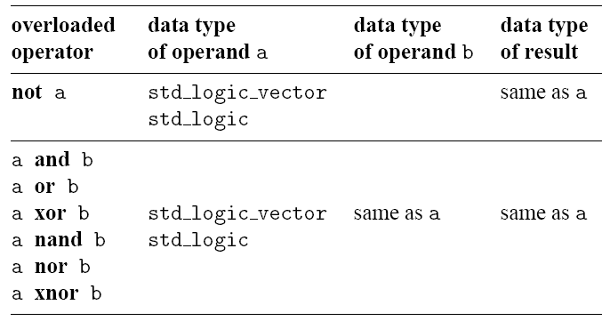
Overloaded operator
IEEE std_logic_1164 package
Which standard VHDL operators can be applied to std_logic and std_logic_vector?
Overloading: same operator of different data types
Overloaded operators in std_logic_1164 package
PUE 3141 Advanced Digital Systems Design

Slide 12
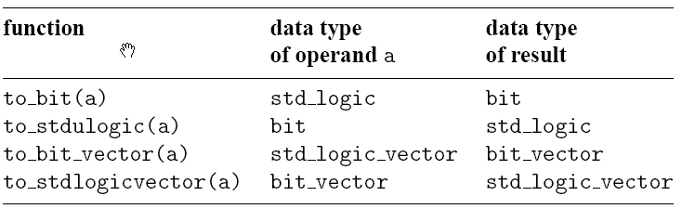
Type conversion function in std_logic_1164 package:
PUE 3141 Advanced Digital Systems Design

Slide 13
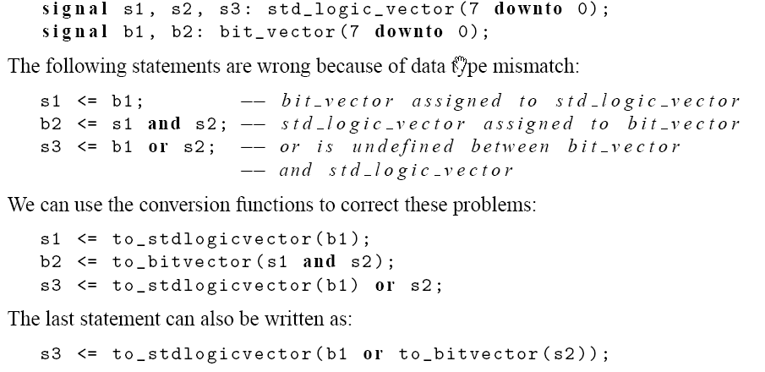
E.g.,
PUE 3141 Advanced Digital Systems Design

Slide 14
Operators over an array data type
Relational operators for array
  operands must have the same element type but their lengths may differ
  Two arrays are compared element by element, form the left most element
  All following returns true
    "011"="011", "011">"010", "011">"00010", "0110">"011"
PUE 3141 Advanced Digital Systems Design

Slide 15
Concatenation operator (&)
e.g.,
  y <= "00" & a(7 downto 2);
  y <= a(7) & a(7) & a(7 downto 2);
  y <= a(1 downto 0) & a(7 downto 2);
PUE 3141 Advanced Digital Systems Design

Slide 16
Array aggregate
Aggregate is a VHDL construct to assign a value to an array-typed object
E.g.,
  a <= "10100000";
  a <= (7=>'1', 6=>'0', 0=>'0', 1=>'0', 5=>'1',
  4=>'0', 3=>'0', 2=>'1');
  a <= (7|5=>'1', 6|4|3|2|1|0=>'0');
  a <= (7|5=>'1', others=>'0');
E.g.,
  a <= "00000000"
  a <= (others=>'0');
PUE 3141 Advanced Digital Systems Design

Slide 17
IEEE numeric_std package
Digital hardware involves logical operations and arithmetic operations.
How to infer arithmetic operators?
In standard VHDL (std_logic_1164 package):
  signal a, b, sum: integer;
  . . .
  sum <= a + b;
What’s wrong with integer data type?
PUE 3141 Advanced Digital Systems Design

Slide 18
IEEE numeric_std package: define integer as a an array of elements of std_logic
Two new data types: unsigned, signed
The array interpreted as an unsigned or signed binary number
E.g.,
  signal x, y: signed(15 downto 0);
Need invoke package to use the data type
  library ieee;
  use ieee.std_logic_1164.all;
  use ieee.numeric_std.all;
The std_logic_vector, unsigned, signed are considered as three independent data types. Ex: “1100”.
PUE 3141 Advanced Digital Systems Design

Slide 19
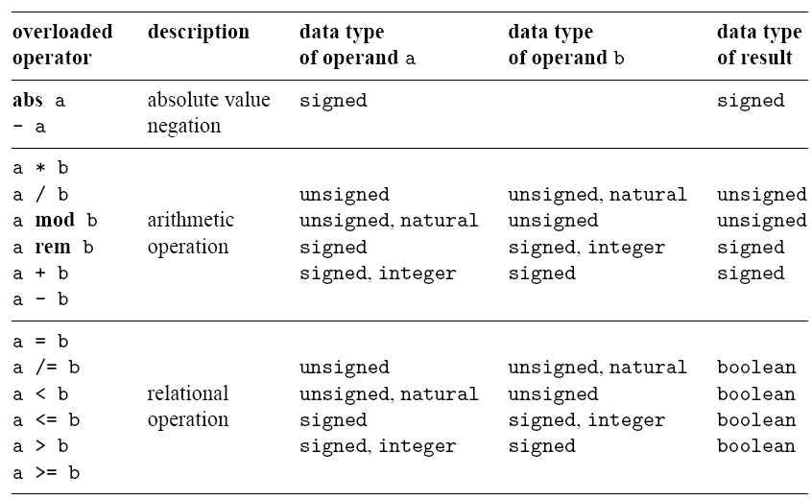
Overloaded operators in
IEEE numeric_std package
PUE 3141 Advanced Digital Systems Design

Slide 20
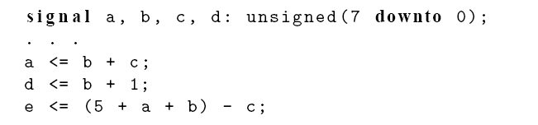
Since unsigned, signed data types are arrays, their declarations are similar to that of std_logic_vector
E.g.,
PUE 3141 Advanced Digital Systems Design

Slide 21
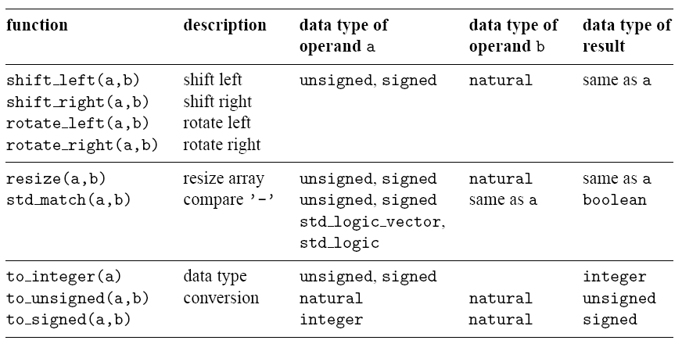
New functions in
IEEE numeric_std package
PUE 3141 Advanced Digital Systems Design

Slide 22
Type conversion
Std_logic_vector, unsigned, signed are defined as an array of element of std_logic
They considered as three different data types in VHDL
Type conversion between data types:
  type conversion function
  Type casting (for “closely related” data types)
PUE 3141 Advanced Digital Systems Design

Slide 23
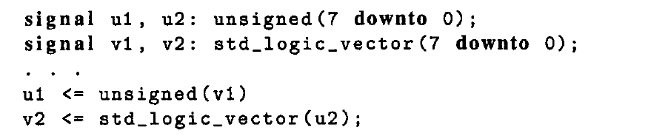
Type casting
Conversion between closely related data types in VHDL is done by a procedure known as type casting.
PUE 3141 Advanced Digital Systems Design

Slide 24
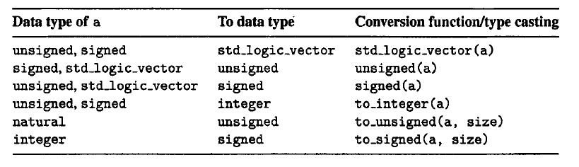
Type conversion between number-related data types
Note: std_logic_vector is not interpreted as a number and thus cannot be directly converted to an integer and vice versa.
PUE 3141 Advanced Digital Systems Design

Slide 25
E.g.
  library ieee;
  use ieee.std_logic_1164.all;
  use ieee.numeric_std.all;
  . . .
  signal s1, s2, s3, s4, s5, s6: std_logic_vector(3 downto 0);
  signal u1, u2, u3, u4, u6, u7: unsigned(3 downto 0);
  signal sg: signed(3 downto 0);
PUE 3141 Advanced Digital Systems Design

Slide 26
  Ok; the + operator is overloaded with the unsigned and natural types.
  u3 <= u2 + u1; --- ok, both operands unsigned
  u4 <= u2 + 1; --- ok, operands unsigned and natural
  Wrong
  u5 <= sg; -- type mismatch
  u6 <= 5; -- type mismatch
  Fix
  u5 <= unsigned(sg); -- type casting
  u6 <= to_unsigned(5,4); -- conversion function
PUE 3141 Advanced Digital Systems Design

Slide 27
  Wrong: the arithmetic operators are not overloaded with the mix data types signed and unsigned:
    u7 <= sg + u1; -- + undefined over the types
  Fix
    u7 <= unsigned(sg) + u1; -- ok, but be careful
  Wrong
    s3 <= u3; -- type mismatch
    s4 <= 5; -- type mismatch
  Fix
    s3 <= std_logic_vector(u3); -- type casting
    s4 <= std_logic_vector(to_unsigned(5,4));
PUE 3141 Advanced Digital Systems Design

Slide 28
  Wrong: arithmetic operations cannot be applied to the std_logic_vector since no overloading is defined for this type.
    s5 <= s2 + s1; + undefined over std_logic_vector
    s6 <= s2 + 1; + undefined
  Fix: convert the operands to the unsigned or signed data type, perform addition, and then convert the result back to the std_logic_vector
    s5 <= std_logic_vector(unsigned(s2) + unsigned(s1));
    s6 <= std_logic_vector(unsigned(s2) + 1);
PUE 3141 Advanced Digital Systems Design

Slide 29
Non-IEEE package
Packagea by Synopsys
std_logic_arith:
  Similar to numeric_std
  New data types: unsigned, signed
  Details are different
std_logic_unsigned/ std_logic_signed
  Treat std_logic_vector as unsigned and signed numbers
  i.e., overload std_logic_vector with arith operations
PUE 3141 Advanced Digital Systems Design

Slide 30
Software vendors frequently store them in ieee library:
E.g.,
  library ieee;
  use ieee.std_logic_1164.all;
  use ieee.std_arith_unsigned.all;
  . . .
  signal s1, s2, s3, s4, s5, s6: std_logic_vector(3 downto 0);
  . . .
  s5 <= s2 + s1; -- ok, + overloaded with std_logic_vector
  s6 <= s2 + 1; -- ok, + overloaded with std_logic_vector
PUE 3141 Advanced Digital Systems Design

Slide 31
Only one of the std_logic_unsigned and std_logic_signed packages can be used
The std_logic_unsigned/std_logic_signed packages beat the motivation behind a strongly-typed language
Numeric_std is preferred
PUE 3141 Advanced Digital Systems Design

