Slide 1
Concurrent Signal Assignment Statements
RTL Hardware Design
PUE 3141 Advanced Digital Systems Design

Slide 2
Outline
Combinational versus sequential circuit
Simple signal assignment statement
Conditional signal assignment statement
Selected signal assignment statement
Conditional vs. selected signal assignment
RTL Hardware Design
PUE 3141 Advanced Digital Systems Design

Slide 3
1. Combinational vs. sequential circuit
Combinational circuit:
  No internal state
  Output is a function of inputs only
  No latches/FFs or closed feedback loop
Sequential circuit:
  With internal state
  Output is a function of inputs and internal state
Sequential circuit to be discussed later
RTL Hardware Design
PUE 3141 Advanced Digital Systems Design

Slide 4
2. Simple signal assignment statement
RTL Hardware Design
PUE 3141 Advanced Digital Systems Design

Slide 5
Simple signal assignment is a special case of conditional signal assignment
Syntax:
signal_name <= projected_waveform;
E.g.,
y <= a + b + 1 after 10 ns;
Timing info ignored in synthesis
and δ-delay is used:
signal_name <= value_expression
RTL Hardware Design
PUE 3141 Advanced Digital Systems Design

Slide 6
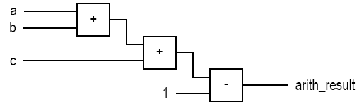
E.g.,
  status <= '1';
  even <= (p1 and p2) or (p3 and p4);
  arith_out <= a + b + c - 1;
Implementation of last statement
RTL Hardware Design
PUE 3141 Advanced Digital Systems Design

Slide 7
Signal assignment statement with a closed feedback loop
a signal appears in both sides of a concurrent assignment statement
E.g.,
q <= ((not q) and (not en)) or (d and en);
Syntactically correct
Form a closed feedback loop
Should be avoided
RTL Hardware Design
PUE 3141 Advanced Digital Systems Design

Slide 8
3. Conditional signal assignment statement
Syntax
Examples
Conceptual implementation
Detailed implementation examples
RTL Hardware Design
PUE 3141 Advanced Digital Systems Design

Slide 9
Syntax
Simplified syntax:
  signal_name
  <= value_expr_1 when boolean_expr_1 else
  value_expr_2 when boolean_expr_2 else
  value_expr_3 when boolean_expr_3 else
  . . .
  value_expr_n
RTL Hardware Design
PUE 3141 Advanced Digital Systems Design

Slide 10
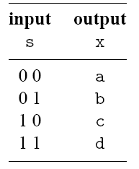
E.g., 4-to-1 mux
Function table:
RTL Hardware Design
PUE 3141 Advanced Digital Systems Design

Slide 11
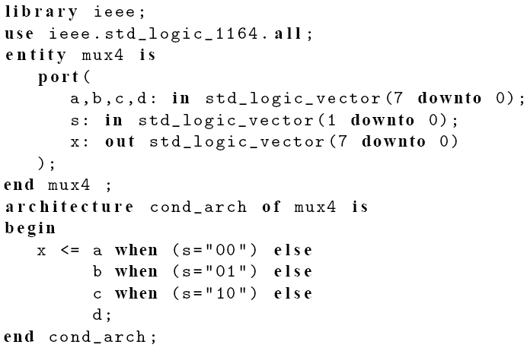
RTL Hardware Design
PUE 3141 Advanced Digital Systems Design

Slide 12
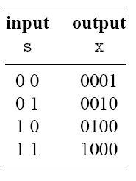
E.g., 2-to-2² binary decoder
Function table:
RTL Hardware Design
PUE 3141 Advanced Digital Systems Design

Slide 13
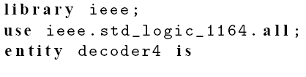
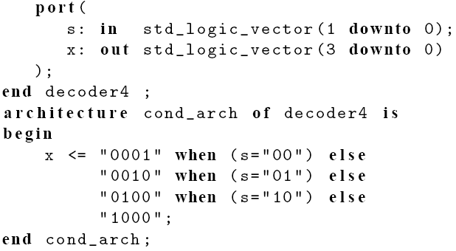
RTL Hardware Design
PUE 3141 Advanced Digital Systems Design

Slide 14
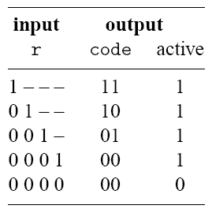
E.g., 4-to-2 priority encoder
Function table:
RTL Hardware Design
PUE 3141 Advanced Digital Systems Design

Slide 15

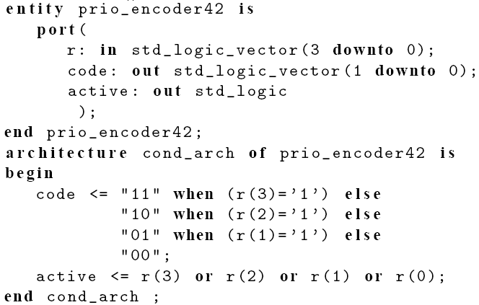
RTL Hardware Design
PUE 3141 Advanced Digital Systems Design

Slide 16
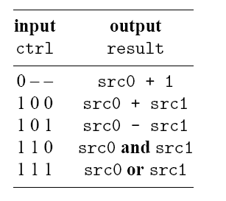
E.g., simple ALU
Function table:
RTL Hardware Design
PUE 3141 Advanced Digital Systems Design

Slide 17
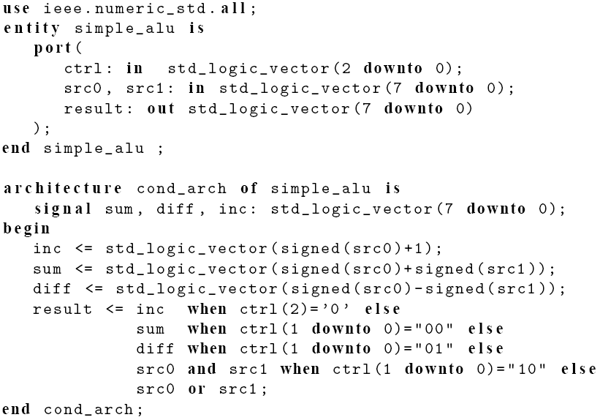
RTL Hardware Design
PUE 3141 Advanced Digital Systems Design

Slide 18
Conceptual implementation
Syntax:
  signal_name
  <= value_expr_1 when boolean_expr_1 else
  value_expr_2 when boolean_expr_2 else
  value_expr_3 when boolean_expr_3 else
  . . .
  value_expr_n;
Evaluation in ascending order
Achieved by “priority-routing network”
Top value expression has a “higher priority”
RTL Hardware Design
PUE 3141 Advanced Digital Systems Design

Slide 19
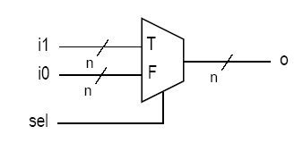
2-to-1 “abstract” mux
sel has a data type of boolean
If sel is true, the input from “T” port is connected to output.
If sel is false, the input from “F” port is connected to output.
RTL Hardware Design
PUE 3141 Advanced Digital Systems Design

Slide 20
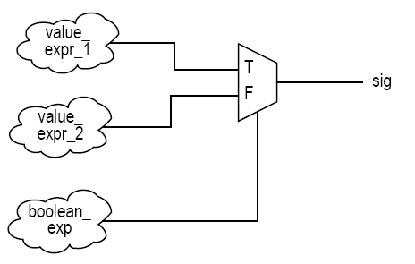
RTL Hardware Design
PUE 3141 Advanced Digital Systems Design

Slide 21
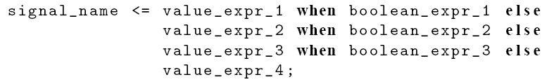
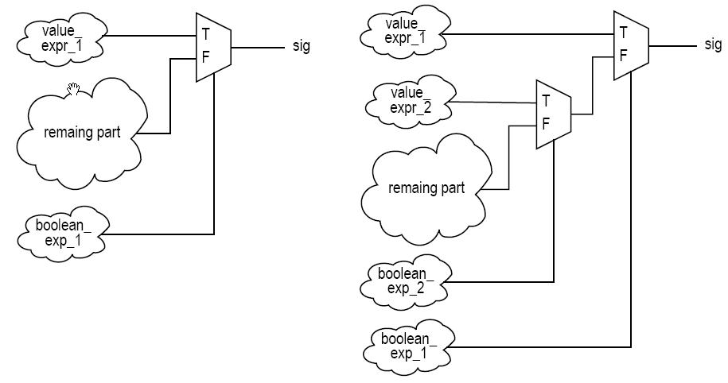
RTL Hardware Design
PUE 3141 Advanced Digital Systems Design

Slide 22
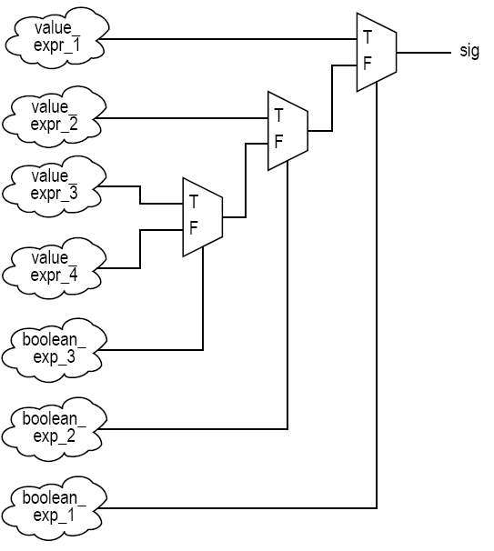
RTL Hardware Design
PUE 3141 Advanced Digital Systems Design

Slide 23
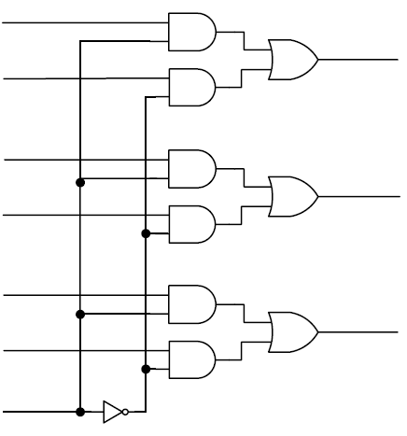
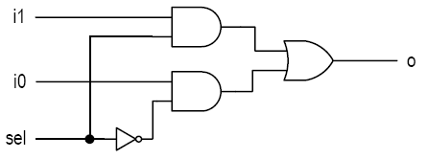
Detailed implementation examples
2-to-1 mux
RTL Hardware Design
PUE 3141 Advanced Digital Systems Design

Slide 24
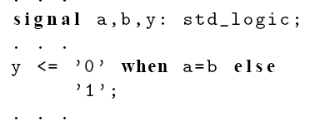
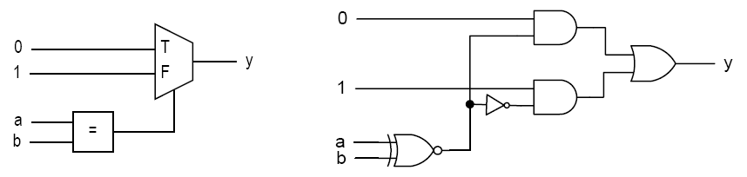
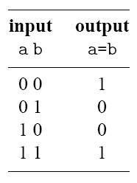
E.g.,
RTL Hardware Design
PUE 3141 Advanced Digital Systems Design

Slide 25
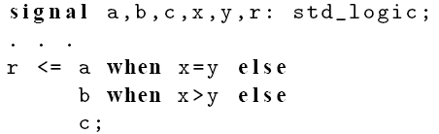
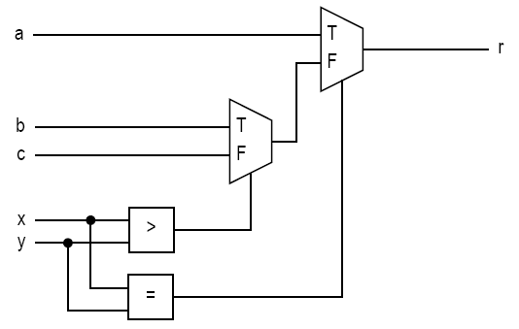
E.g.,
RTL Hardware Design
PUE 3141 Advanced Digital Systems Design

Slide 26
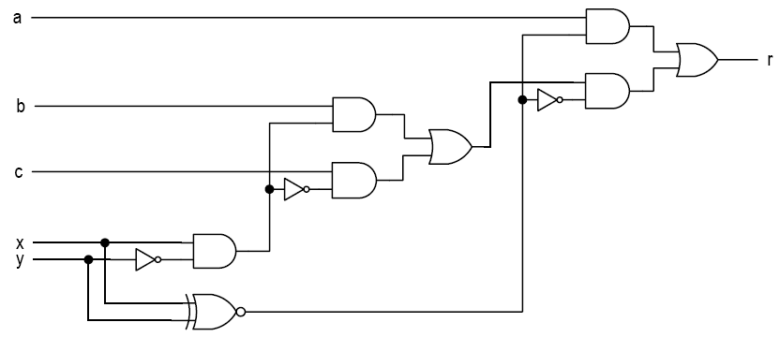
RTL Hardware Design
PUE 3141 Advanced Digital Systems Design

Slide 27
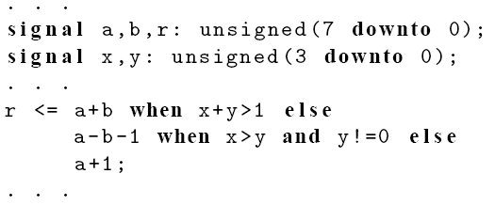
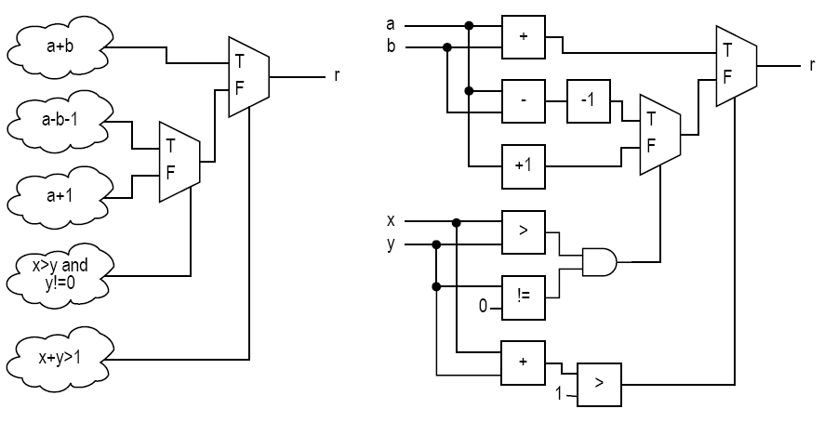
E.g.,
RTL Hardware Design
PUE 3141 Advanced Digital Systems Design

Slide 28
4. Selected signal assignment statement
Syntax
Examples
Conceptual implementation
Detailed implementation examples
RTL Hardware Design
PUE 3141 Advanced Digital Systems Design

Slide 29
Syntax
Simplified syntax:
  with select_expression select
  signal_name <=
  value_expr_1 when choice_1,
  value_expr_2 when choice_2,
  value_expr_3 when choice_3,
  . . .
  value_expr_n when choice_n;
RTL Hardware Design
PUE 3141 Advanced Digital Systems Design

Slide 30
select_expression
  Discrete type or 1-D array
  With finite possible values
choice_i
  A value of the data type
Choices must be
  mutually exclusive
  all inclusive
  others can be used as last choice_i
RTL Hardware Design
PUE 3141 Advanced Digital Systems Design

Slide 31
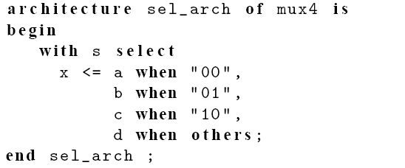
E.g., 4-to-1 mux
RTL Hardware Design
PUE 3141 Advanced Digital Systems Design

Slide 32
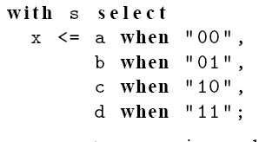
Can “11” be used to replace others?
RTL Hardware Design
PUE 3141 Advanced Digital Systems Design

Slide 33
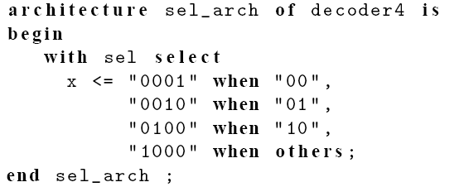
E.g., 2-to-2² binary decoder
RTL Hardware Design
PUE 3141 Advanced Digital Systems Design

Slide 34
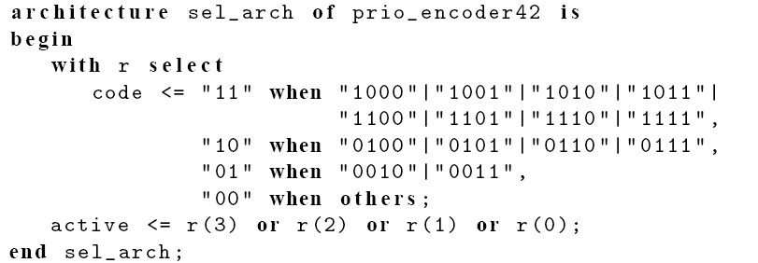
E.g., 4-to-2 priority encoder
RTL Hardware Design
PUE 3141 Advanced Digital Systems Design

Slide 35
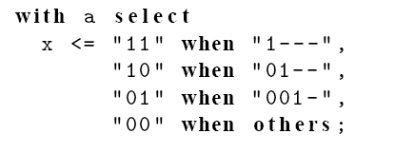
Can we use ‘-’?
RTL Hardware Design
PUE 3141 Advanced Digital Systems Design

Slide 36
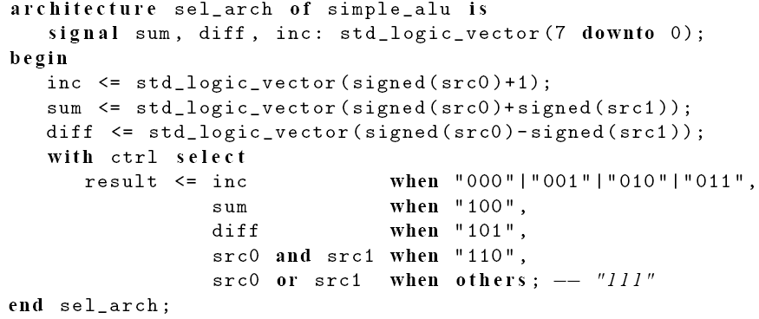
E.g., simple ALU
RTL Hardware Design
PUE 3141 Advanced Digital Systems Design

Slide 37
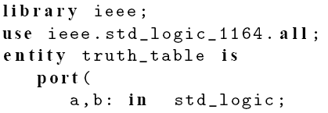
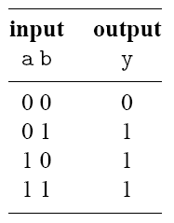
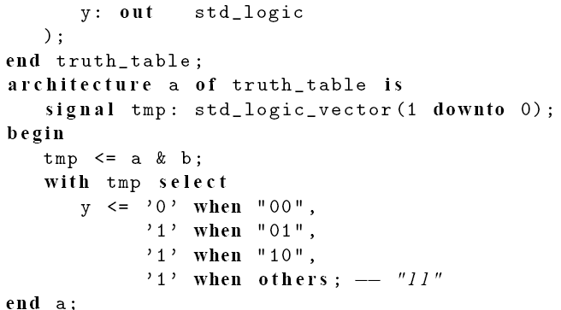
E.g., Truth table
RTL Hardware Design
PUE 3141 Advanced Digital Systems Design

Slide 38
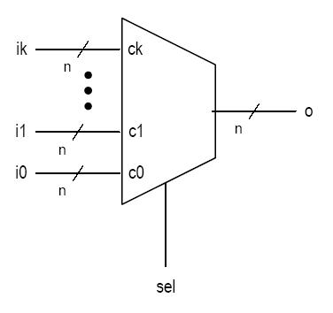
Conceptual implementation
Achieved by a multiplexing circuit
Abstract (k+1)-to-1 multiplexer
  sel is with a data type of (k+1) values:
  c0, c1, c2, . . . , ck
RTL Hardware Design
PUE 3141 Advanced Digital Systems Design

Slide 39
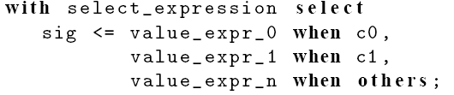
select_expression is with a data type of 5 values: c0, c1, c2, c3, c4
RTL Hardware Design
PUE 3141 Advanced Digital Systems Design

Slide 40
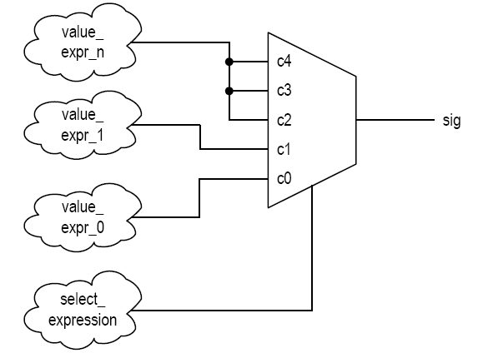
RTL Hardware Design
PUE 3141 Advanced Digital Systems Design

Slide 41
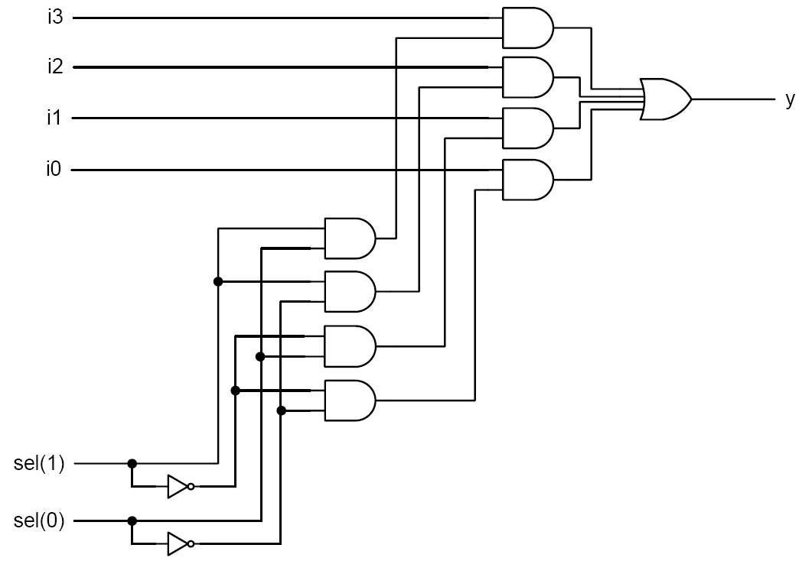
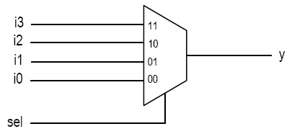
Detailed implementation examples
4-to-1 mux
RTL Hardware Design
PUE 3141 Advanced Digital Systems Design

Slide 42
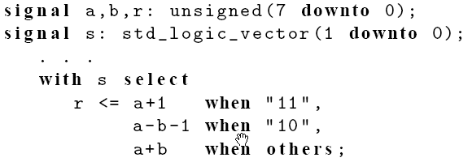
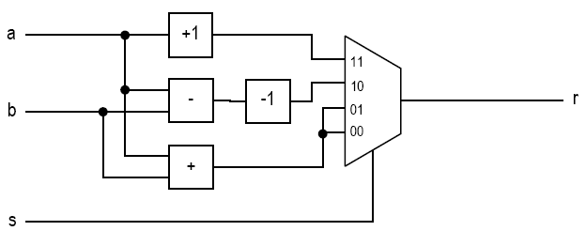
E.g.,
RTL Hardware Design
PUE 3141 Advanced Digital Systems Design

Slide 43
3. Conditional vs. selected signal assignment
Conversion between conditional vs. selected signal assignment
Comparison
RTL Hardware Design
PUE 3141 Advanced Digital Systems Design

Slide 44
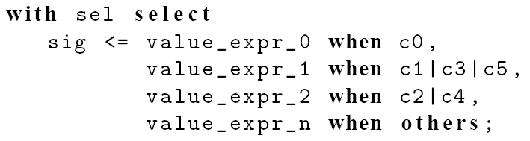
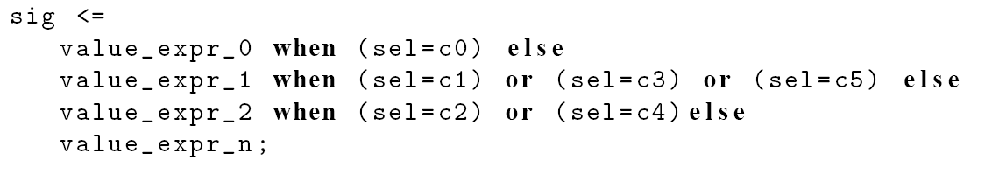
From selected assignment to conditional assignment
RTL Hardware Design
PUE 3141 Advanced Digital Systems Design

Slide 45
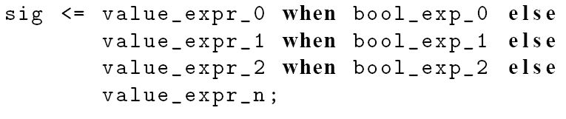
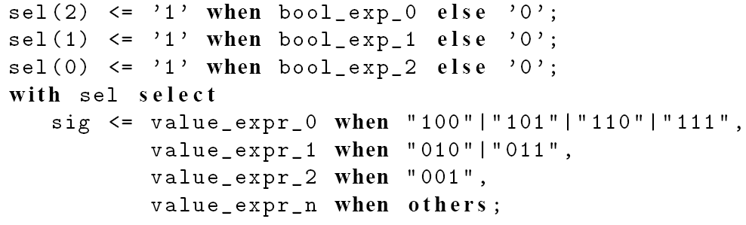
From conditional assignment to selected assignment
RTL Hardware Design
PUE 3141 Advanced Digital Systems Design

Slide 46
Comparison
Selected signal assignment:
  good match for a circuit described by a functional table
  E.g., binary decoder, multiplexer
  Less effective when an input pattern is given a preferential treatment
RTL Hardware Design
PUE 3141 Advanced Digital Systems Design

Slide 47
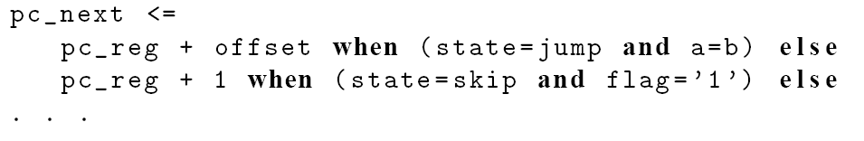
Conditional signal assignment:
  good match for a circuit a circuit that needs to give preferential treatment for certain conditions or to prioritize the operations
  E.g., priority encoder
  Can handle complicated conditions. e.g.,
RTL Hardware Design
PUE 3141 Advanced Digital Systems Design

Slide 48
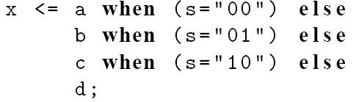
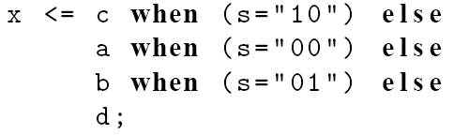
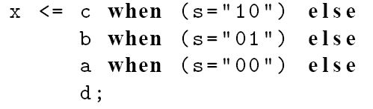
  May “over-specify” for a functional table based circuit.
  E.g., mux
RTL Hardware Design
PUE 3141 Advanced Digital Systems Design

