Slide 1
Basic Language Constructs of VHDL
PUE 3141 Advanced Digital Systems Design

Slide 2
Reference Book
RTL Hardware Design by P. Chu
PUE 3141 Advanced Digital Systems Design

Slide 3
Outline
Basic VHDL program
Lexical elements and program format
Objects
Data type and operators
PUE 3141 Advanced Digital Systems Design

Slide 4
1. Basic VHDL program
PUE 3141 Advanced Digital Systems Design

Slide 5
Design unit
Building blocks in a VHDL program
Each design unit is analyzed and stored independently
Types of design unit:
  entity declaration
  architecture body
  package declaration
  package body
  configuration
PUE 3141 Advanced Digital Systems Design

Slide 6
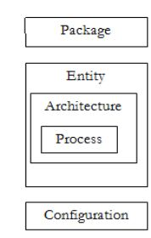
PUE 3141 Advanced Digital Systems Design

Slide 7
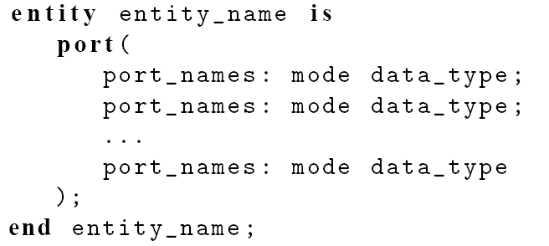
Entity declaration
Simplified syntax
PUE 3141 Advanced Digital Systems Design

Slide 8
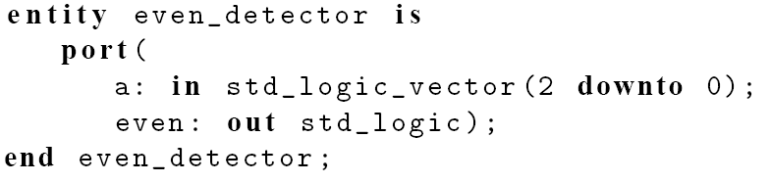
Port declaration: port names, mode, and data types.
mode: the direction of the signal
  in: the signal flows into the circuit
  out: the signal flows out of the circuit
  inout: bi-directional, the signal flows in both direction
E.g.
PUE 3141 Advanced Digital Systems Design

Slide 9
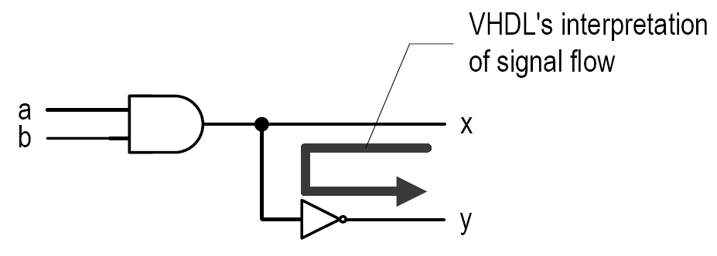
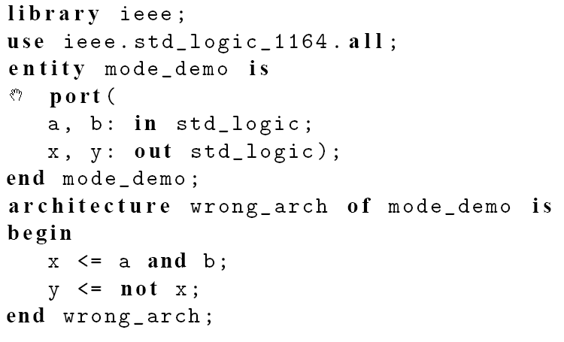
A common mistake with mode
PUE 3141 Advanced Digital Systems Design

Slide 10
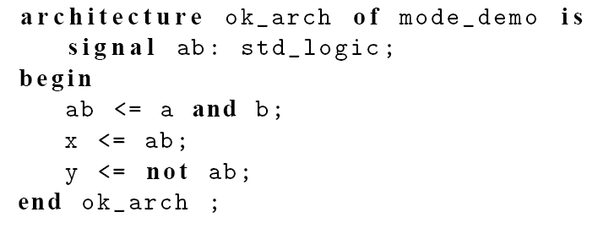
Fix: change the mode of x to be inout, but this is a poor solution.
Fix: use an internal signal
PUE 3141 Advanced Digital Systems Design

Slide 11
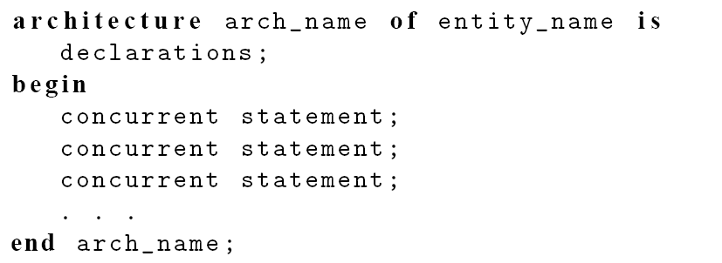
Architecture body
Simplified syntax
An entity declaration can be associated with multiple architecture bodies
PUE 3141 Advanced Digital Systems Design

Slide 12
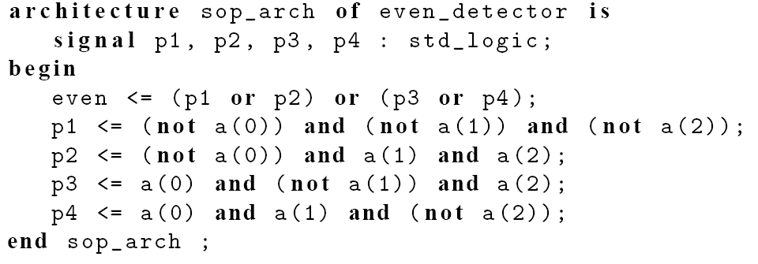
E.g.
PUE 3141 Advanced Digital Systems Design

Slide 13
Other design units
Package declaration/body:
  collection of commonly used items, such as data types, subprograms and components
Configuration:
  specify which architecture body is to be bound with the entity declaration
PUE 3141 Advanced Digital Systems Design

Slide 14
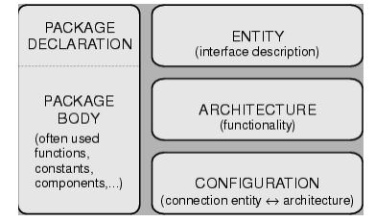
PUE 3141 Advanced Digital Systems Design

Slide 15
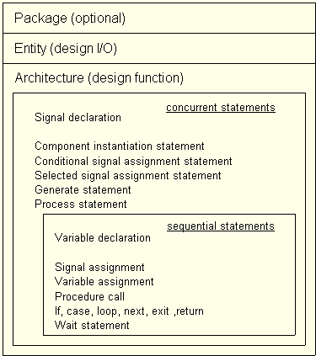
PUE 3141 Advanced Digital Systems Design

Slide 16
VHDL Library
A place to store the analyzed design units
Normally mapped to a directory in host computer
Software define the mapping between the symbolic library and physical location
Default library: “work”
Library “ieee” is used for many ieee packages
PUE 3141 Advanced Digital Systems Design

Slide 17

E.g.
Line 1: invoke a library named ieee
Line 2: makes std_logic_1164 package visible to the subsequent design units
The package is normally needed for the std_logic/std_logic_vector data type
PUE 3141 Advanced Digital Systems Design

Slide 18
Processing of VHDL code
Analysis
  Performed on “design unit” basis
  Check the syntax and translate the unit into an intermediate form
  Store it in a library
Elaboration
  Bind architecture body with entity
  Substitute the instantiated components with architecture description
  Create a “flattened”' description
Execution
  The analyzed and the elaborated description is fed to simulation or synthesis software.
PUE 3141 Advanced Digital Systems Design

Slide 19
2. Lexical elements and program format
PUE 3141 Advanced Digital Systems Design

Slide 20
Lexical elements
Lexical element:
  Basic syntactical units in a VHDL program
Types of Lexical elements:
  Comments
  Identifiers
  Reserved words
  Numbers
  Characters
  Strings
PUE 3141 Advanced Digital Systems Design

Slide 21
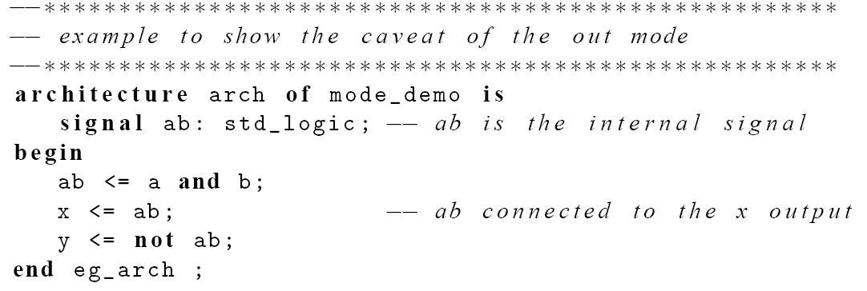
Comments
Starts with - -
Just for clarity
e.g.,
PUE 3141 Advanced Digital Systems Design

Slide 22
Identifier
Identifier is the name of an object
Basic rules:
  Can only contain alphabetic letters, decimal digits and underscore
  The first character must be a letter
  The last character cannot be an underscore
  Two successive underscores are not allowed
PUE 3141 Advanced Digital Systems Design

Slide 23
Valid examples:
  A10, next_state, NextState, mem_addr_enable
Invalid examples:
  sig#3, _X10, 7segment, X10_, hi_ _there
VHDL is case insensitive:
  Following identifiers are the same:
  nextstate, NextState, NEXTSTATE, nEXTsTATE
PUE 3141 Advanced Digital Systems Design

Slide 24
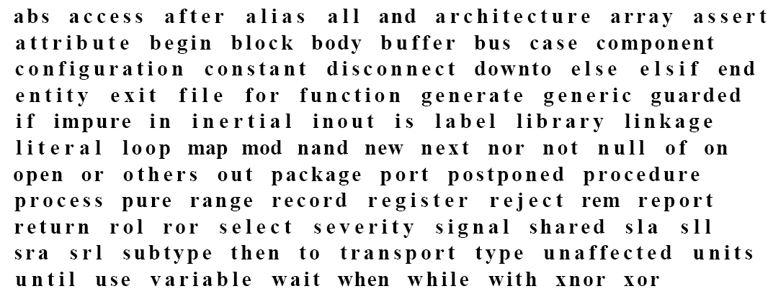
Reserved words
PUE 3141 Advanced Digital Systems Design

Slide 25
Numbers, characters and strings
Number:
  Integer: 0, 1234, 98E7
  Real: 0.0, 1.23456 or 9.87E6
  Base 2: 2#101101#
Character:
  ‘A’, ‘Z’, ‘1’
Strings
  “Hello”, “101101”
Note
  0 and ‘0’ are different
  2#101101# and “101101” are different
PUE 3141 Advanced Digital Systems Design

Slide 26
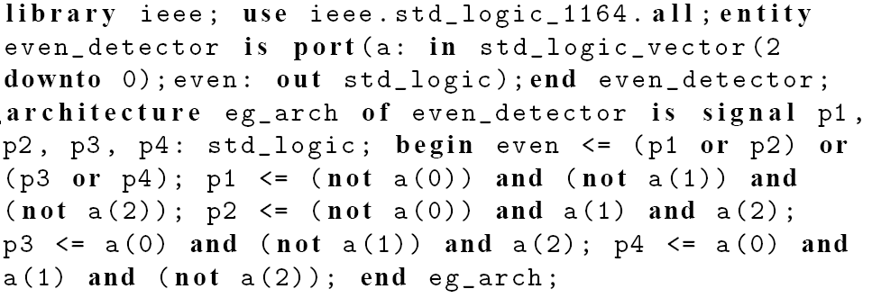
Program format
VHDL is “free-format”: blank space, tab, new-line can be freely inserted
e.g., the following are the same
PUE 3141 Advanced Digital Systems Design

Slide 27
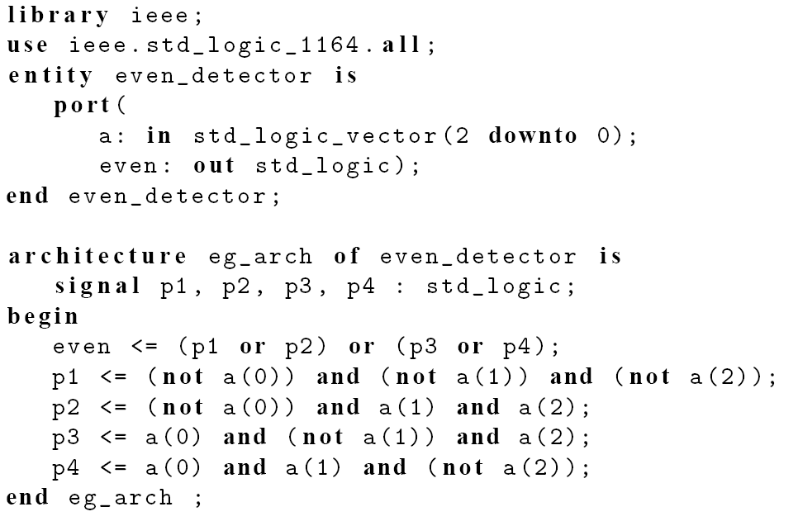
PUE 3141 Advanced Digital Systems Design

Slide 28
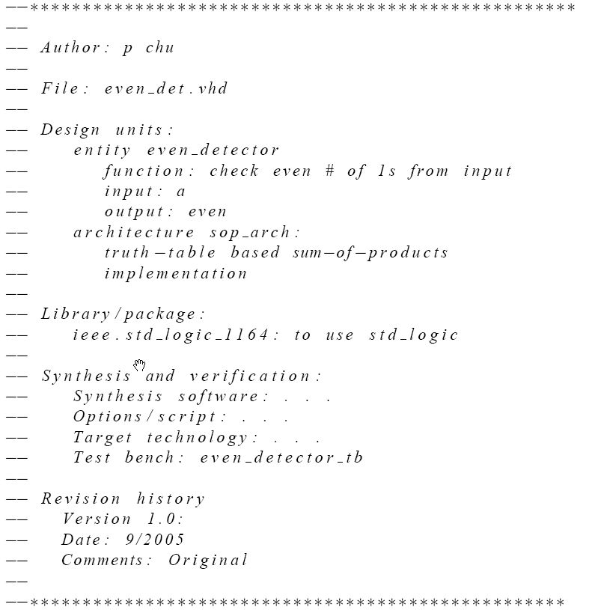
A good “header”
PUE 3141 Advanced Digital Systems Design

Slide 29
3. Objects
PUE 3141
Advanced Digital Systems Design
PUE 3141 Advanced Digital Systems Design

Slide 30
Objects
A named item that hold a value of specific data type
Four kinds of objects
  Signal
  Variable
  Constant
  File (cannot be synthesized)
Related construct
  Alias
PUE 3141 Advanced Digital Systems Design

Slide 31
Signal
Declared in the architecture body's declaration section
Signal declaration:
signal signal_name, signal_name, ... : data_type
Signal assignment:
signal_name <= projected_waveform;
Ports in entity declaration are considered as signals
Can be interpreted as wires or “wires with memory” (i.e., FFs, latches etc.)
PUE 3141 Advanced Digital Systems Design

Slide 32
Variable
Declared and used inside a process
Variable declaration:
variable variable_name, ... : data_type
Variable assignment:
variable_name := value_expression;
Contains no “timing info” (immediate assignment)
Used as in traditional PL: a “symbolic memory location” where a value can be stored and modified
No direct hardware counterpart
PUE 3141 Advanced Digital Systems Design

Slide 33
Constant
Value cannot be changed
Constant declaration:
constant const_name, ... : data_type := value_expression
Used to enhance readability of VHDL code
  E.g.,
PUE 3141 Advanced Digital Systems Design

Slide 34
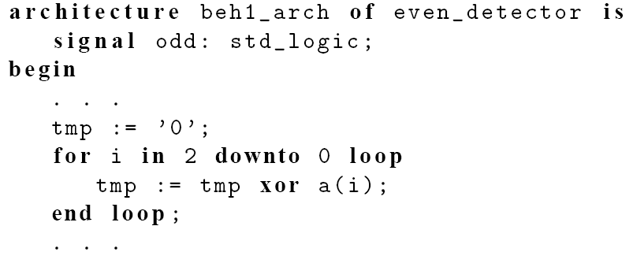
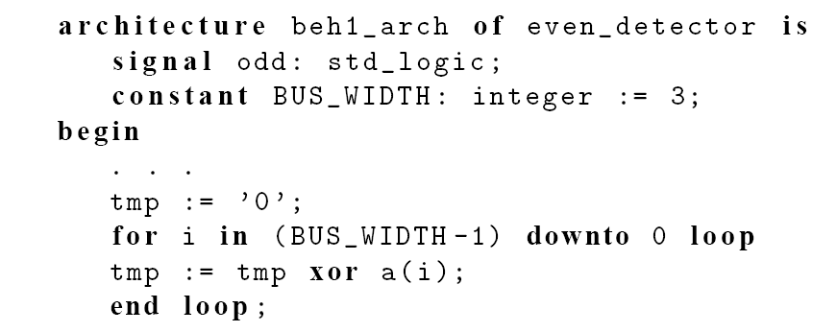
It is a good idea to avoid “hard literals”
PUE 3141 Advanced Digital Systems Design

Slide 35
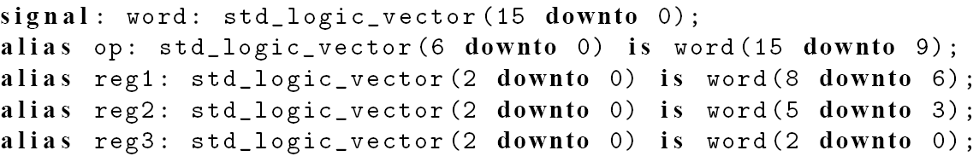
Alias
Not a data object
Alternative name for an object
Used to enhance readability
  E.g.,
PUE 3141 Advanced Digital Systems Design

Slide 36
4. Data type and operators
Standard VHDL
IEEE1164_std_logic package
IEEE numeric_std package
PUE 3141 Advanced Digital Systems Design

Slide 37
Data type
Definition of data type
  A set of values that an object can assume.
  A set of operations that can be performed on objects of this data type.
VHDL is a strongly-typed language
  an object can only be assigned with a value of its type.
  only the operations defined with the data type can be performed on the object.
PUE 3141 Advanced Digital Systems Design

Slide 38
Data types in standard VHDL
integer:
  Minimal range: -(2^31-1) to 2^31-1
  Two subtypes: natural, positive
boolean: (false, true)
bit: ('0', '1')
  Not capable enough
bit_vector: a one-dimensional array of bit
PUE 3141 Advanced Digital Systems Design

Slide 39
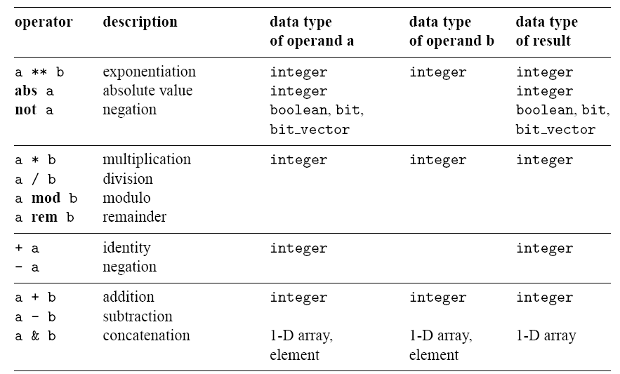
Operators in standard VHDL
PUE 3141 Advanced Digital Systems Design

Slide 40
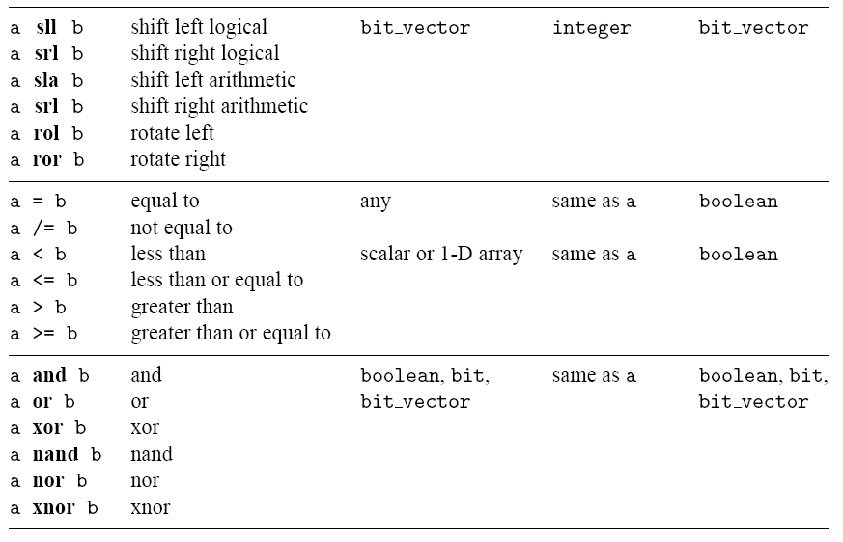
PUE 3141 Advanced Digital Systems Design

Slide 41
IEEE std_logic_1164 package
What’s wrong with bit?
New data type: std_logic, std_logic_vector
std_logic:
  9 values: ('U', 'X', '0', '1', 'Z', 'W', 'L', 'H', '-')
    '0', '1': forcing logic 0' and forcing logic 1
    'Z': high-impedance, as in a tri-state buffer.
    'L' , 'H': weak logic 0 and weak logic 1, as in wired-logic
    'X', 'W': “unknown” and “weak unknown”
    'U': for uninitialized
    '-': don't-care.
PUE 3141 Advanced Digital Systems Design

Slide 42
std_logic_vector
  an array of elements with std_logic data type
  Imply a bus
  E.g.,
  signal a: std_logic_vector(7 downto 0);
  Another form (less desired)
  signal a: std_logic_vector(0 to 7);
Need to invoke package to use the data type:
  library ieee;
  use ieee.std_logic_1164.all;
PUE 3141 Advanced Digital Systems Design

Slide 43
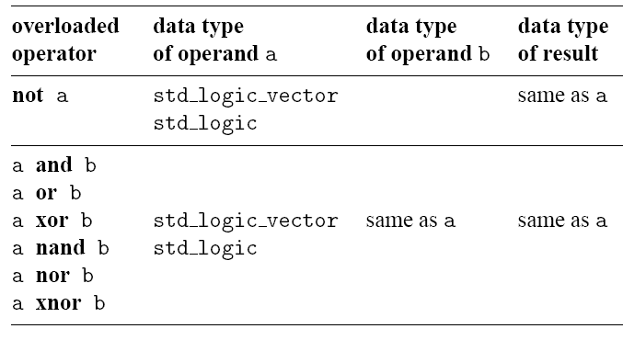
Overloaded operator
IEEE std_logic_1164 package
Which standard VHDL operators can be applied to std_logic and std_logic_vector?
Overloading: same operator of different data types
Overloaded operators in std_logic_1164 package
PUE 3141 Advanced Digital Systems Design

Slide 44
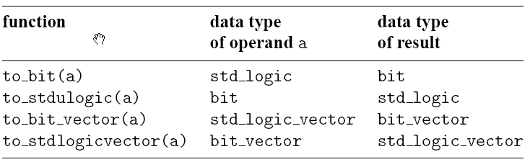
Type conversion function in std_logic_1164 package:
PUE 3141 Advanced Digital Systems Design

Slide 45
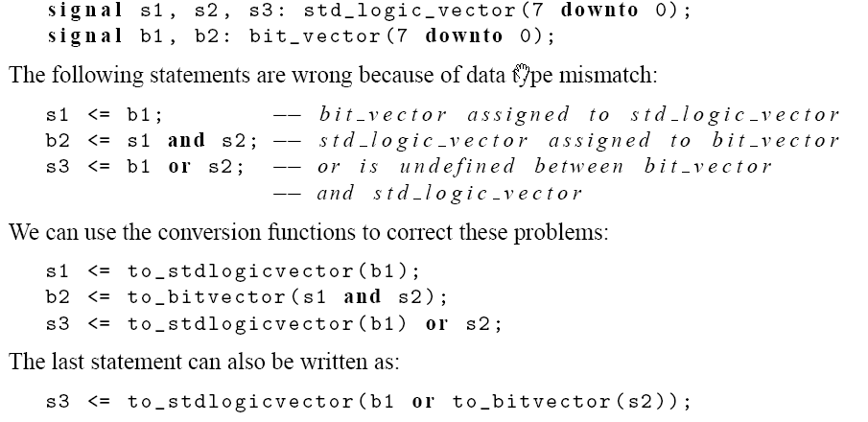
E.g.,
PUE 3141 Advanced Digital Systems Design

Slide 46
Operators over an array data type
Relational operators for array
  operands must have the same element type but their lengths may differ
  Two arrays are compared element by element, form the left most element
  All following returns true
    "011"="011", "011">"010", "011">"00010", "0110">"011"
PUE 3141 Advanced Digital Systems Design

Slide 47
Concatenation operator (&)
e.g.,
  y <= "00" & a(7 downto 2);
  y <= a(7) & a(7) & a(7 downto 2);
  y <= a(1 downto 0) & a(7 downto 2);
PUE 3141 Advanced Digital Systems Design

Slide 48
Array aggregate
Aggregate is a VHDL construct to assign a value to an array-typed object
E.g.,
  a <= "10100000";
  a <= (7=>'1', 6=>'0', 0=>'0', 1=>'0', 5=>'1',
  4=>'0', 3=>'0', 2=>'1');
  a <= (7|5=>'1', 6|4|3|2|1|0=>'0');
  a <= (7|5=>'1', others=>'0');
E.g.,
  a <= "00000000"
  a <= (others=>'0');
PUE 3141 Advanced Digital Systems Design

Slide 49
IEEE numeric_std package
Digital hardware involves logical operations and arithmetic operations.
How to infer arithmetic operators?
In standard VHDL (std_logic_1164 package):
  signal a, b, sum: integer;
  . . .
  sum <= a + b;
What’s wrong with integer data type?
PUE 3141 Advanced Digital Systems Design

Slide 50
IEEE numeric_std package: define integer as a an array of elements of std_logic
Two new data types: unsigned, signed
The array interpreted as an unsigned or signed binary number
E.g.,
  signal x, y: signed(15 downto 0);
Need invoke package to use the data type
  library ieee;
  use ieee.std_logic_1164.all;
  use ieee.numeric_std.all;
The std_logic_vector, unsigned, signed are considered as three independent data types. Ex: “1100”.
PUE 3141 Advanced Digital Systems Design

Slide 51
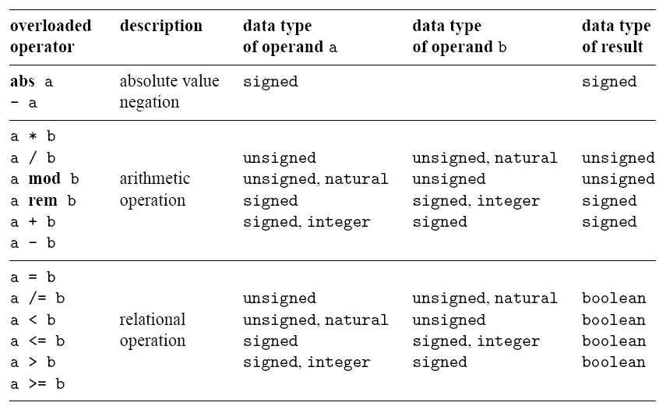
Overloaded operators in
IEEE numeric_std package
PUE 3141 Advanced Digital Systems Design

Slide 52
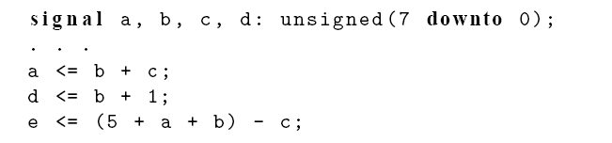
Since unsigned, signed data types are arrays, their declarations are similar to that of std_logic_vector
E.g.,
PUE 3141 Advanced Digital Systems Design

Slide 53
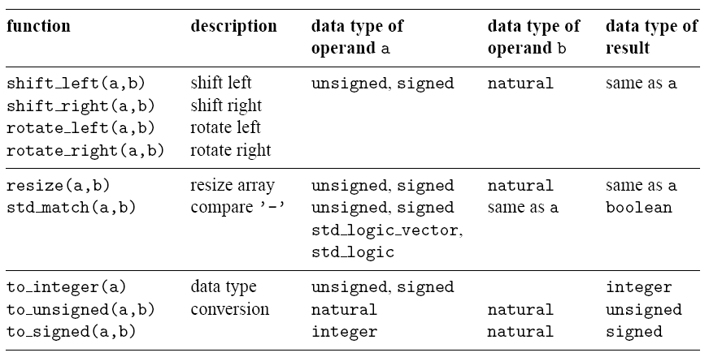
New functions in
IEEE numeric_std package
PUE 3141 Advanced Digital Systems Design

Slide 54
Type conversion
Std_logic_vector, unsigned, signed are defined as an array of element of std_logic
They considered as three different data types in VHDL
Type conversion between data types:
  type conversion function
  Type casting (for “closely related” data types)
PUE 3141 Advanced Digital Systems Design

Slide 55
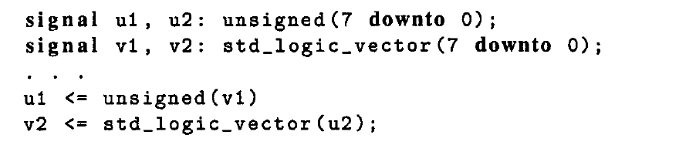
Type casting
Conversion between closely related data types in VHDL is done by a procedure known as type casting.
PUE 3141 Advanced Digital Systems Design

Slide 56
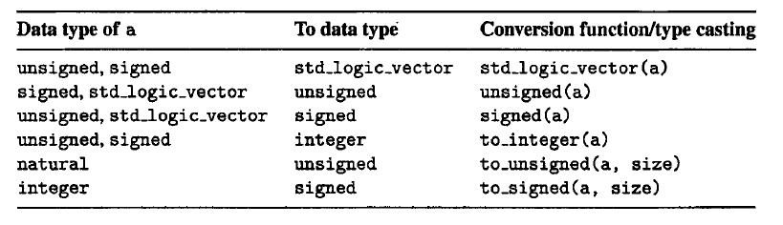
Type conversion between number-related data types
Note: std_logic_vector is not interpreted as a number and thus cannot be directly converted to an integer and vice versa.
PUE 3141 Advanced Digital Systems Design

Slide 57
E.g.
  library ieee;
  use ieee.std_logic_1164.all;
  use ieee.numeric_std.all;
  . . .
  signal s1, s2, s3, s4, s5, s6: std_logic_vector(3 downto 0);
  signal u1, u2, u3, u4, u6, u7: unsigned(3 downto 0);
  signal sg: signed(3 downto 0);
PUE 3141 Advanced Digital Systems Design

Slide 58
  Ok; the + operator is overloaded with the unsigned and natural types.
  u3 <= u2 + u1; --- ok, both operands unsigned
  u4 <= u2 + 1; --- ok, operands unsigned and natural
  Wrong
  u5 <= sg; -- type mismatch
  u6 <= 5; -- type mismatch
  Fix
  u5 <= unsigned(sg); -- type casting
  u6 <= to_unsigned(5,4); -- conversion function
PUE 3141 Advanced Digital Systems Design

Slide 59
  Wrong: the arithmetic operators are not overloaded with the mix data types signed and unsigned:
    u7 <= sg + u1; -- + undefined over the types
  Fix
    u7 <= unsigned(sg) + u1; -- ok, but be careful
  Wrong
    s3 <= u3; -- type mismatch
    s4 <= 5; -- type mismatch
  Fix
    s3 <= std_logic_vector(u3); -- type casting
    s4 <= std_logic_vector(to_unsigned(5,4));
PUE 3141 Advanced Digital Systems Design

Slide 60
  Wrong: arithmetic operations cannot be applied to the std_logic_vector since no overloading is defined for this type.
    s5 <= s2 + s1; + undefined over std_logic_vector
    s6 <= s2 + 1; + undefined
  Fix: convert the operands to the unsigned or signed data type, perform addition, and then convert the result back to the std_logic_vector
    s5 <= std_logic_vector(unsigned(s2) + unsigned(s1));
    s6 <= std_logic_vector(unsigned(s2) + 1);
PUE 3141 Advanced Digital Systems Design

Slide 61
Non-IEEE package
Packagea by Synopsys
std_logic_arith:
  Similar to numeric_std
  New data types: unsigned, signed
  Details are different
std_logic_unsigned/ std_logic_signed
  Treat std_logic_vector as unsigned and signed numbers
  i.e., overload std_logic_vector with arith operations
PUE 3141 Advanced Digital Systems Design

Slide 62
Software vendors frequently store them in ieee library:
E.g.,
  library ieee;
  use ieee.std_logic_1164.all;
  use ieee.std_arith_unsigned.all;
  . . .
  signal s1, s2, s3, s4, s5, s6: std_logic_vector(3 downto 0);
  . . .
  s5 <= s2 + s1; -- ok, + overloaded with std_logic_vector
  s6 <= s2 + 1; -- ok, + overloaded with std_logic_vector
PUE 3141 Advanced Digital Systems Design

Slide 63
Only one of the std_logic_unsigned and std_logic_signed packages can be used
The std_logic_unsigned/std_logic_signed packages beat the motivation behind a strongly-typed language
Numeric_std is preferred
PUE 3141 Advanced Digital Systems Design

