Slide 1
Sequential Statements
PUE 3141 Advanced Digital Systems Design

Slide 2
Reference Book
RTL Hardware Design by P. Chu
PUE 3141 Advanced Digital Systems Design

Slide 3
Outline
VHDL process
Sequential signal assignment statement
Variable assignment statement
If statement
Case statement
Simple for loop statement
PUE 3141 Advanced Digital Systems Design

Slide 4
Conceptual implementation
Same as conditional signal assignment statement if the if statement consists of
  One output signal
  One sequential signal assignment in each branch
Multiple sequential statements can be constructed recursively
PUE 3141 Advanced Digital Systems Design

Slide 5
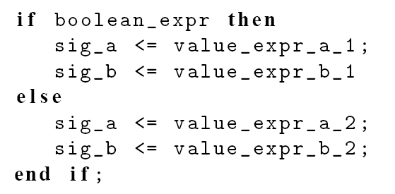
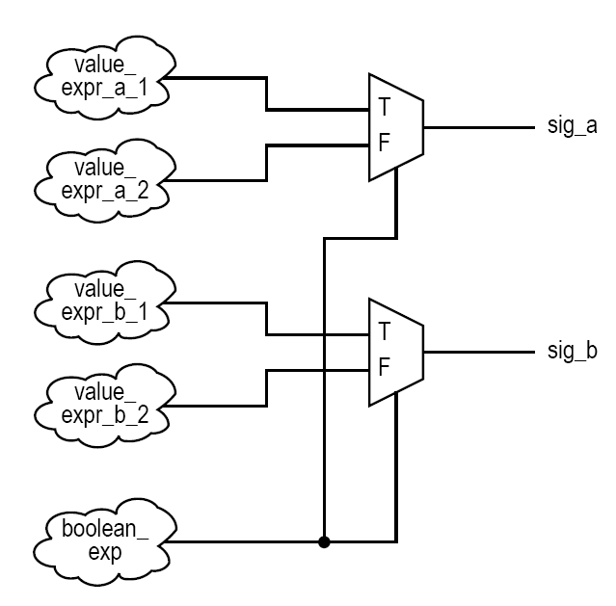
e.g.
PUE 3141 Advanced Digital Systems Design

Slide 6
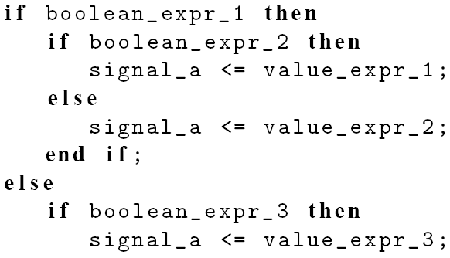
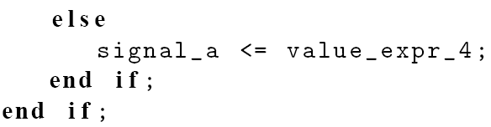
e.g.
PUE 3141 Advanced Digital Systems Design

Slide 7
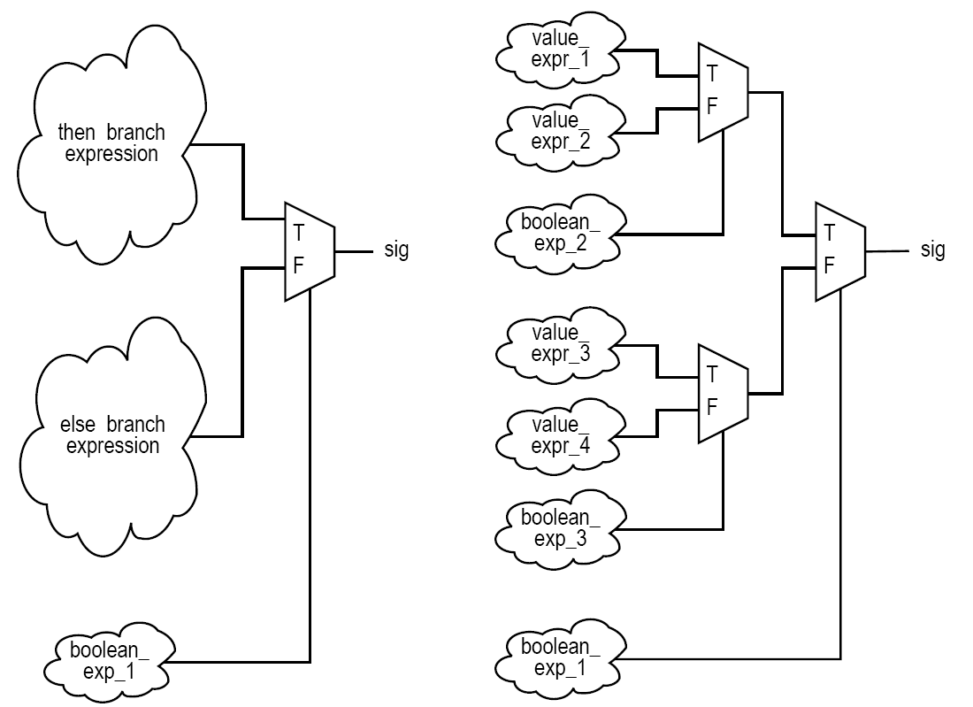
PUE 3141 Advanced Digital Systems Design

Slide 8
5. Case statement
Syntax
Examples
Comparison to selected signal assignment statement
Incomplete signal assignment
Conceptual Implementation
PUE 3141 Advanced Digital Systems Design

Slide 9
Syntax
  case case_expression is
  when choice_1 =>
  sequential statements;
  when choice_2 =>
  sequential statements;
  . . .
  when choice_n =>
  sequential statements;
  end case;
PUE 3141 Advanced Digital Systems Design

Slide 10

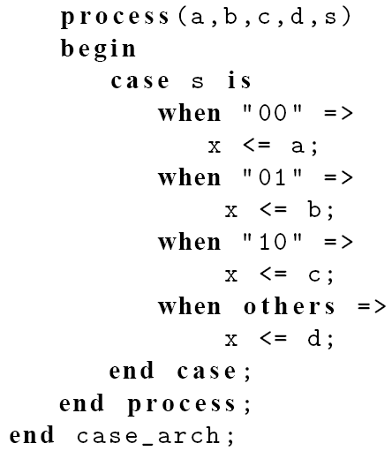
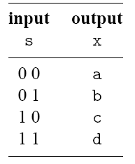
E.g., 4-to-1 mux
PUE 3141 Advanced Digital Systems Design

Slide 11
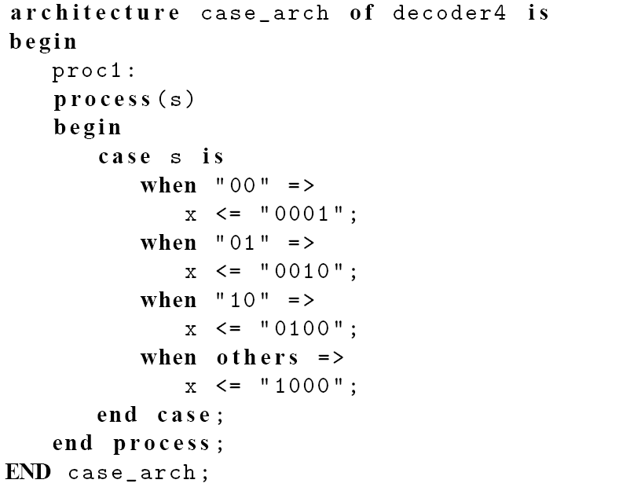
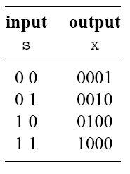
E.g., 2-to-2² binary decoder
PUE 3141 Advanced Digital Systems Design

Slide 12
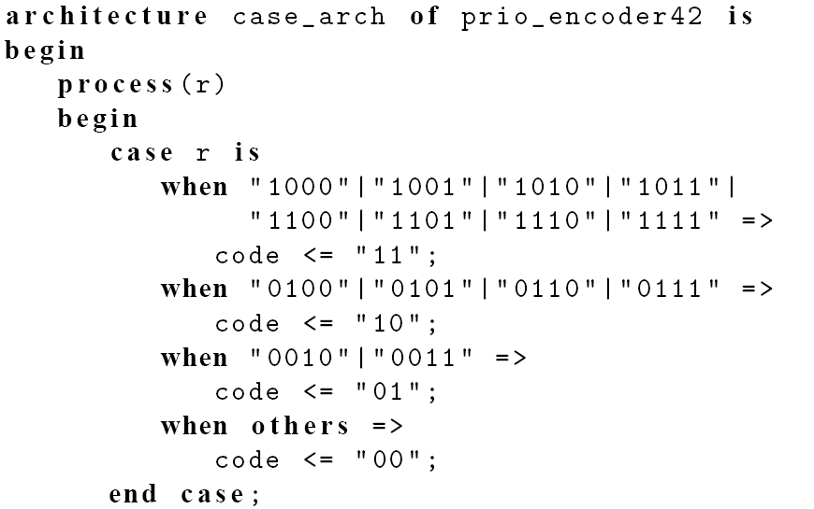
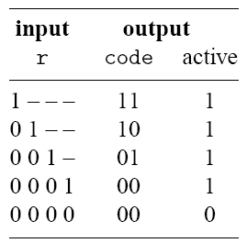
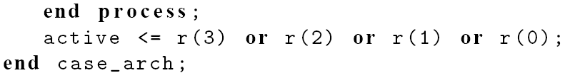
E.g., 4-to-2 priority encoder
PUE 3141 Advanced Digital Systems Design

Slide 13
Comparison to selected signal assignment
Two statements are the same if there is only one output signal in case statement
Case statement is more flexible
Sequential statements can be used in choice branches
PUE 3141 Advanced Digital Systems Design

Slide 14
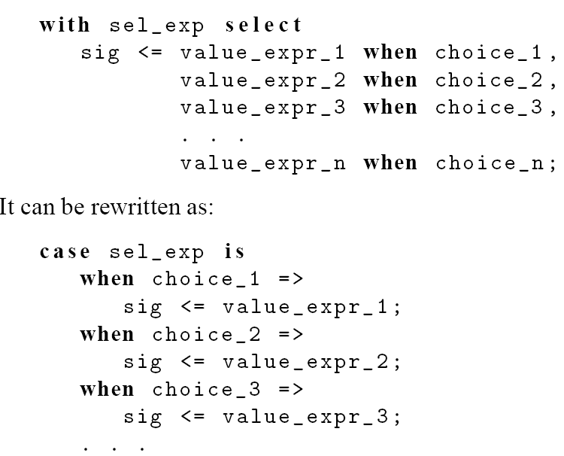
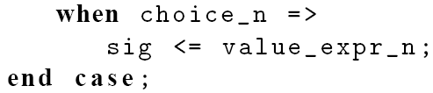
PUE 3141 Advanced Digital Systems Design

Slide 15
Incomplete signal assignment
According to VHDL definition:
  Signals do not need to be assigned in all choice branch
  When a signal is unassigned, it keeps the “previous value” (implying “memory”)
PUE 3141 Advanced Digital Systems Design

Slide 16
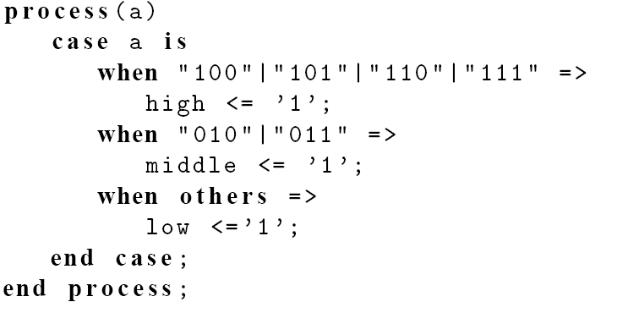
Incomplete signal assignment
E.g.,
PUE 3141 Advanced Digital Systems Design

Slide 17
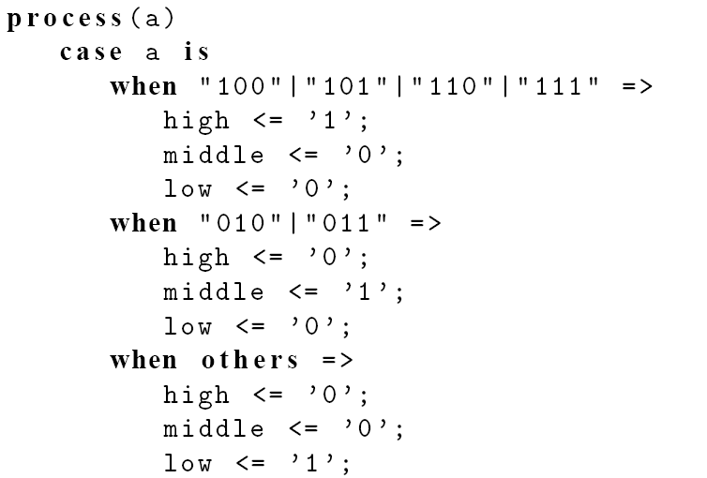

Fix #1:
PUE 3141 Advanced Digital Systems Design

Slide 18
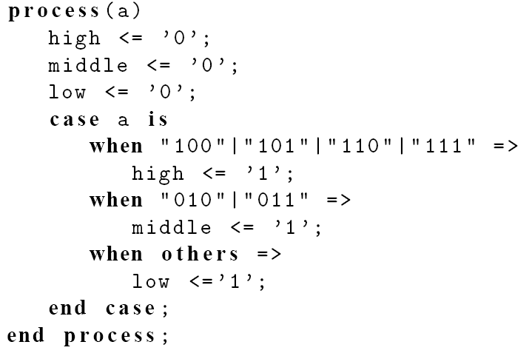
Fix #2:
PUE 3141 Advanced Digital Systems Design

Slide 19
Conceptual implementation
Same as selected signal assignment statement if the case statement consists of
  One output signal
  One sequential signal assignment in each branch
Multiple sequential statements can be constructed recursively
PUE 3141 Advanced Digital Systems Design

Slide 20
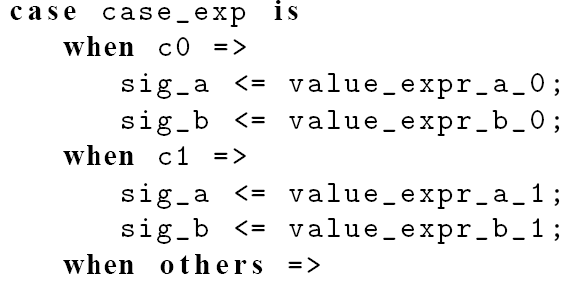
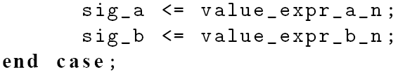
e.g.
PUE 3141 Advanced Digital Systems Design

Slide 21
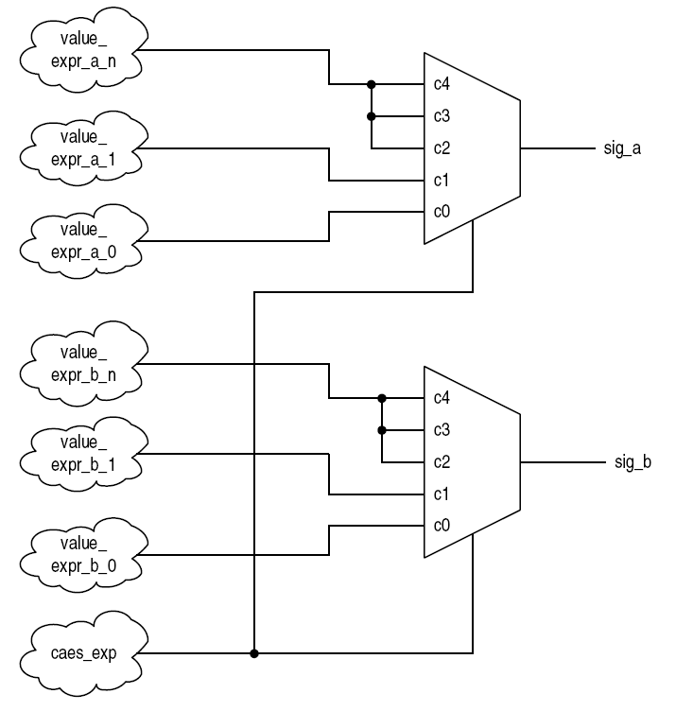
PUE 3141 Advanced Digital Systems Design

Slide 22
6. Simple for loop statement
Syntax
Examples
Conceptual Implementation
PUE 3141 Advanced Digital Systems Design

Slide 23
VHDL provides a variety of loop constructs
Only a restricted form of loop can be synthesized
Syntax of simple for loop:
  for index in loop_range loop
  sequential statements;
  end loop;
loop_range must be static
Index assumes value of loop_range from left to right
PUE 3141 Advanced Digital Systems Design

Slide 24
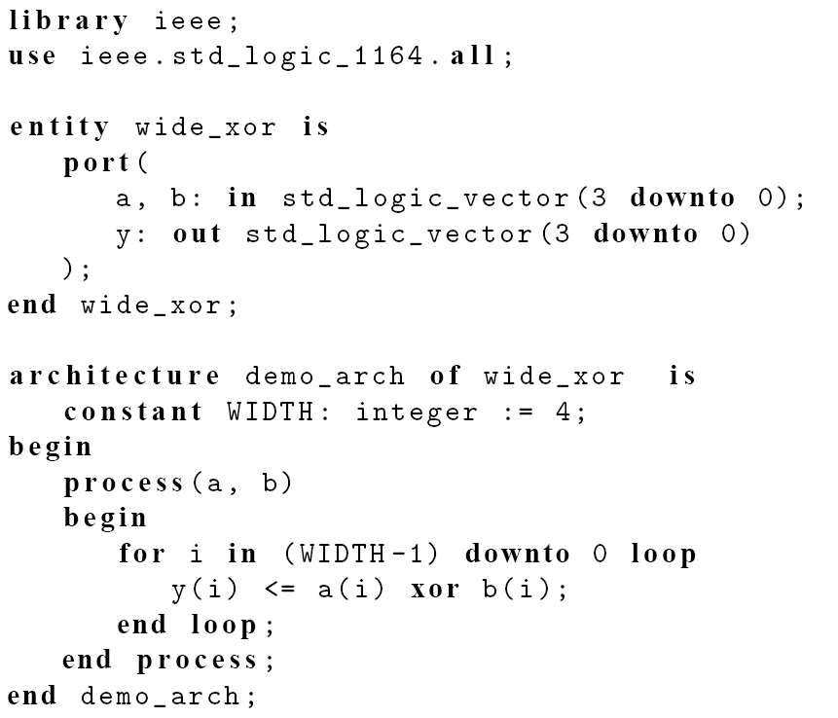
E.g., bit-wide xor
PUE 3141 Advanced Digital Systems Design

Slide 25
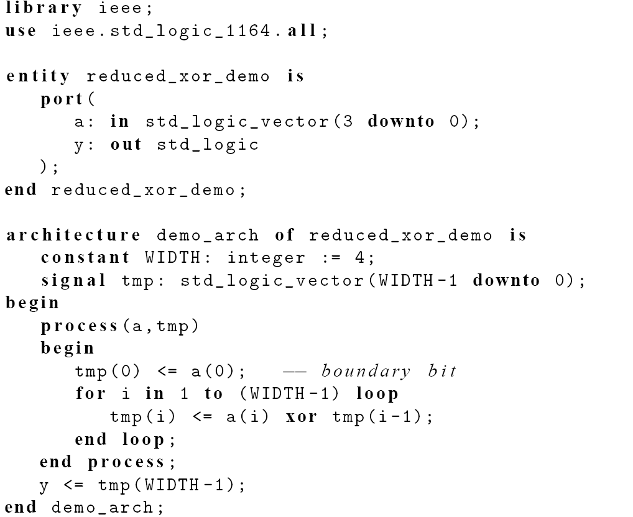
E.g., reduced-xor
PUE 3141 Advanced Digital Systems Design

Slide 26
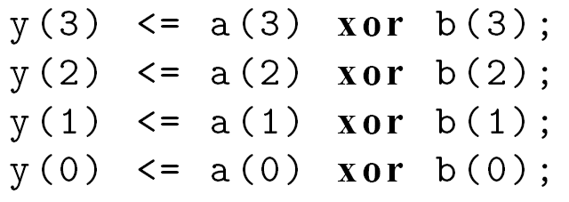
Conceptual implementation
“Unroll” the loop
For loop should be treated as “shorthand” for repetitive statements
E.g., bit-wise xor
PUE 3141 Advanced Digital Systems Design

Slide 27
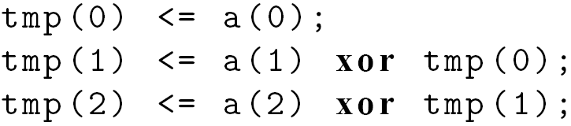
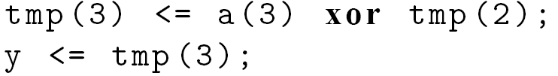
E.g., reduced-xor
PUE 3141 Advanced Digital Systems Design

Slide 28
Synthesis of sequential statements
Concurrent statements
  Modeled after hardware
  Have clear, direct mapping to physical structures
Sequential statements
  Intended to describe “behavior”
  Flexible and versatile
  Can be difficult to be realized in hardware
  Can be easily abused
PUE 3141 Advanced Digital Systems Design

Slide 29
Think hardware
Designing hardware is not converting a C program to a VHDL program
PUE 3141 Advanced Digital Systems Design

