Slide 1

Project Title -Seasonal Agriculture Performance Analysis
Pavan Dipak Mali
Marathwada Mitra Mandal’s College Of Engineering Pune
AICTE STU ID : STU6791db886388e1737612168

Slide 2

PROBLEM STATEMENT
Agricultural performance varies across different seasons.
Environmental conditions, farming practices, resource availability, and market conditions influence agricultural outcomes.
Raw agricultural data does not clearly reveal seasonal patterns and performance differences.
The project aims to analyze agricultural data to identify seasonal patterns, trends, relationships, and variations in agricultural performance.

Slide 3
Project Description
The Seasonal Agriculture Performance Analysis project focuses on understanding how agricultural performance changes across Kharif, Rabi, and Zaid seasons. The project analyzes agricultural, environmental, resource, and economic data after proper data cleaning and preparation. Different statistical and visualization techniques are used to compare yield, production, revenue, profit, cost, rainfall, temperature, water usage, and water efficiency across seasons. Correlation analysis is further used to identify relationships between important variables. The overall analysis helps identify seasonal patterns, differences, and meaningful insights that can support evidence-based agricultural planning.

Slide 4

WHO ARE THE END USERS?
Farmers – to understand seasonal crop performance and resource usage.
Agricultural Planners – to support seasonal planning and decision-making.
Agricultural Researchers – to study seasonal patterns and relationships.
Government & Agricultural Departments – to support data-driven agricultural planning.
Agricultural Analysts – to analyze trends, performance, and seasonal variations.

Slide 5

Technology Used
Python – Data analysis and processing
Pandas – Data cleaning and manipulation
NumPy – Numerical computations
Matplotlib – Data visualization
Seaborn – Statistical visualization
Google Colab – Development and execution environment

Slide 6
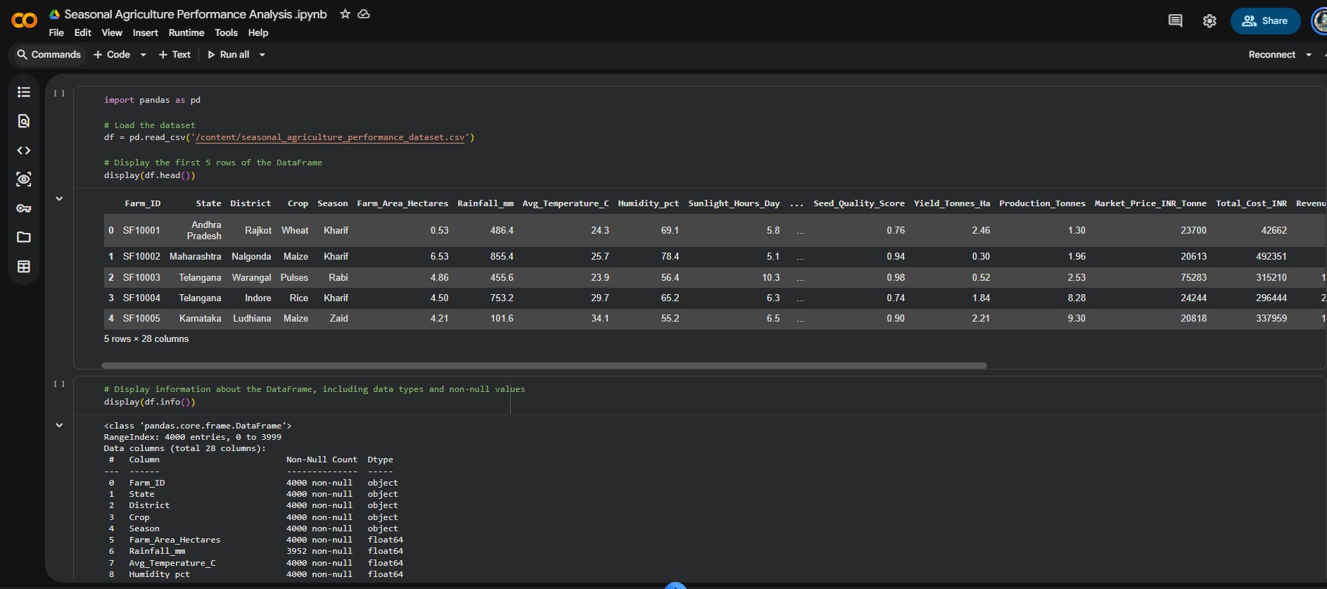
RESULTS

Slide 7
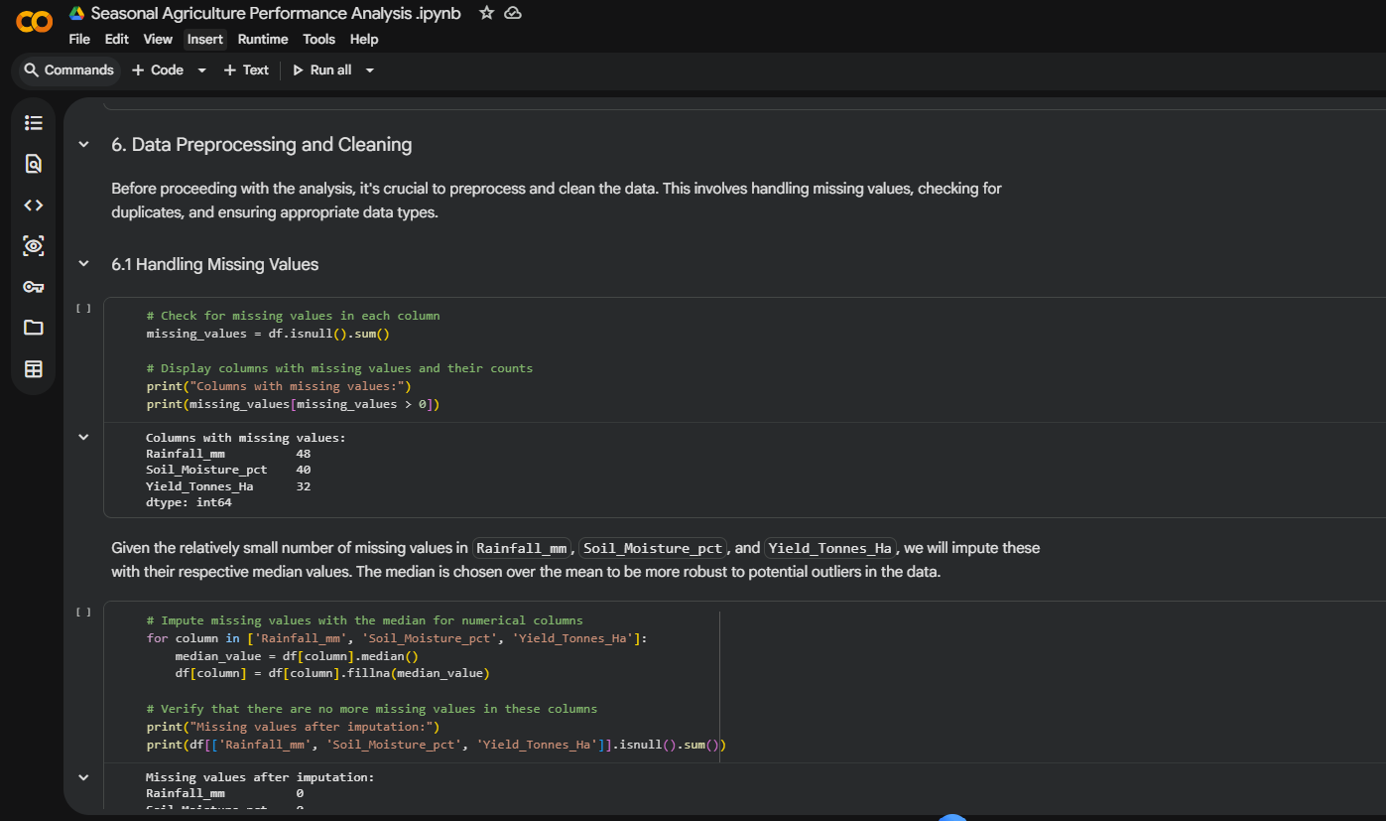
RESULTS

Slide 8
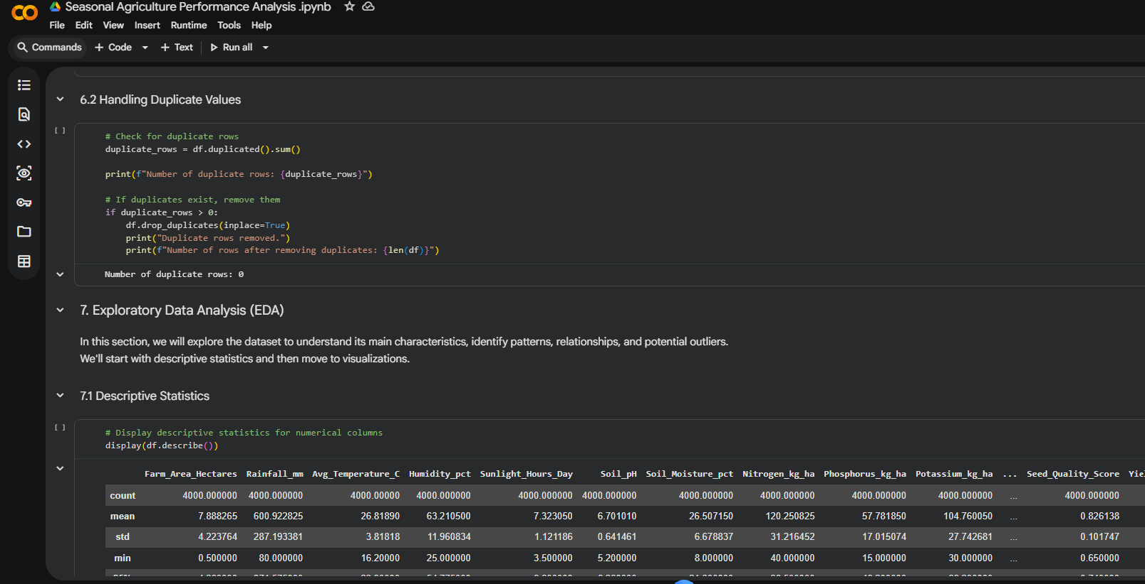
RESULTS

Slide 9
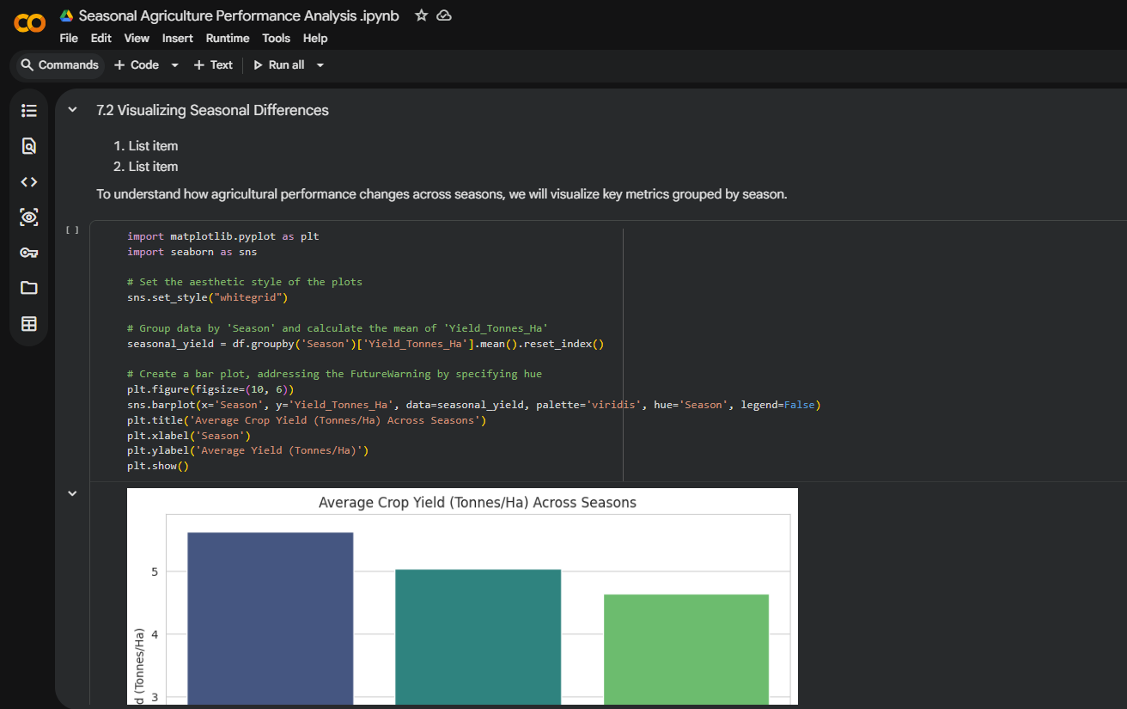
RESULTS

Slide 10
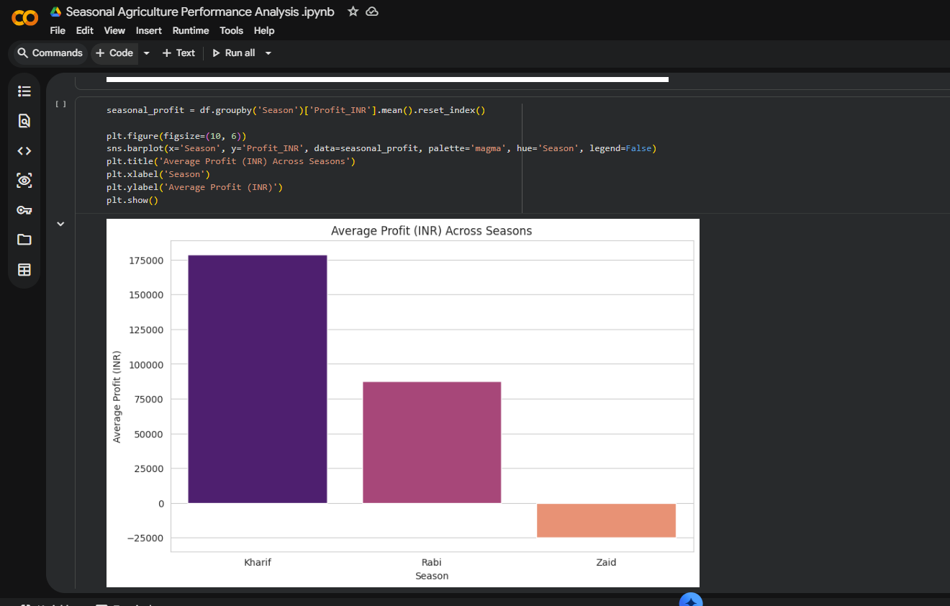
RESULTS

Slide 11
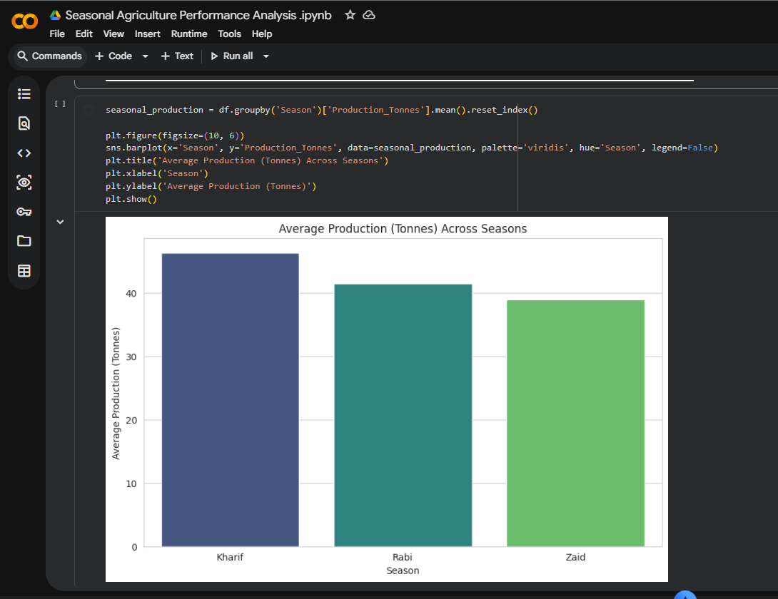
RESULTS

Slide 12
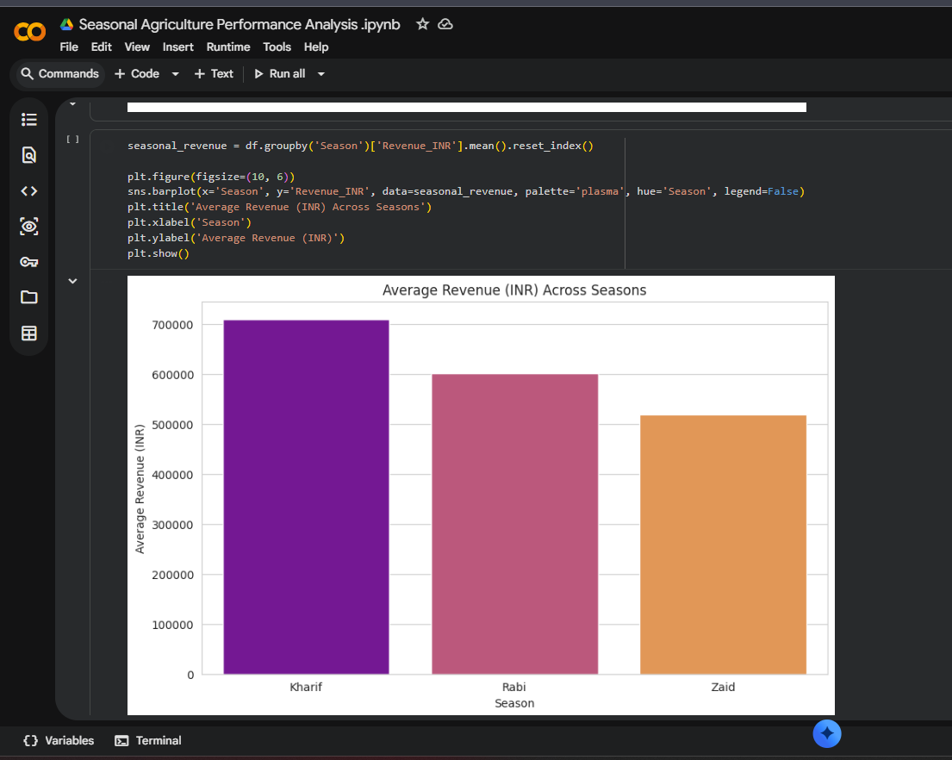
RESULTS

Slide 13
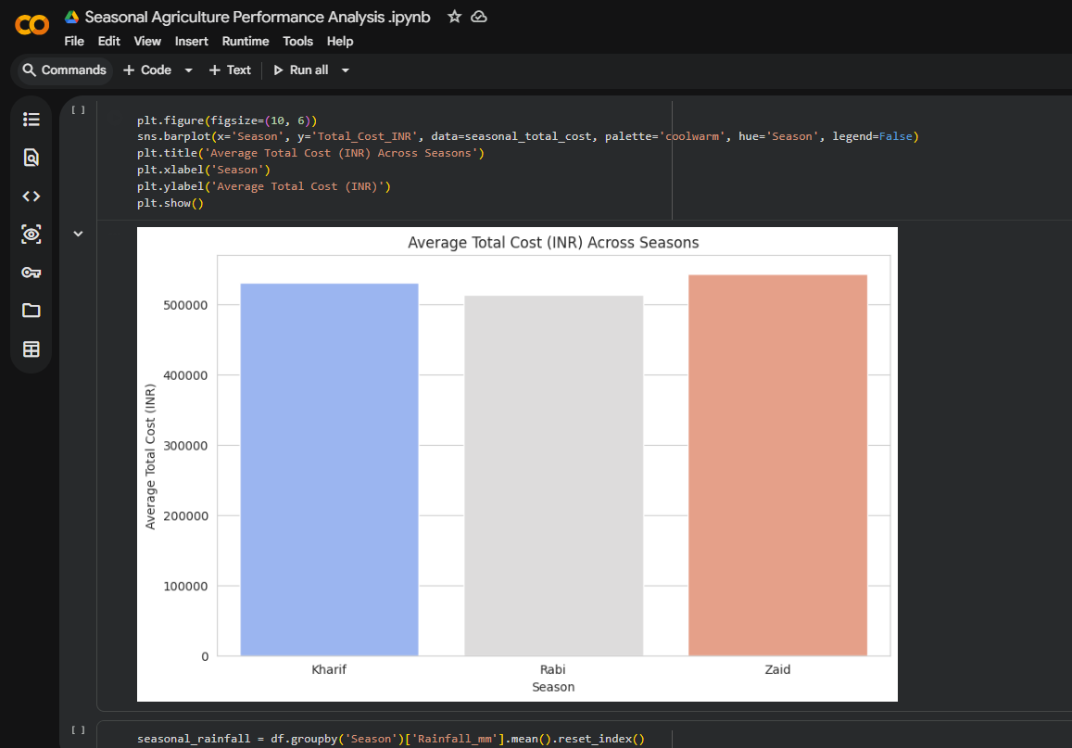
RESULTS

Slide 14
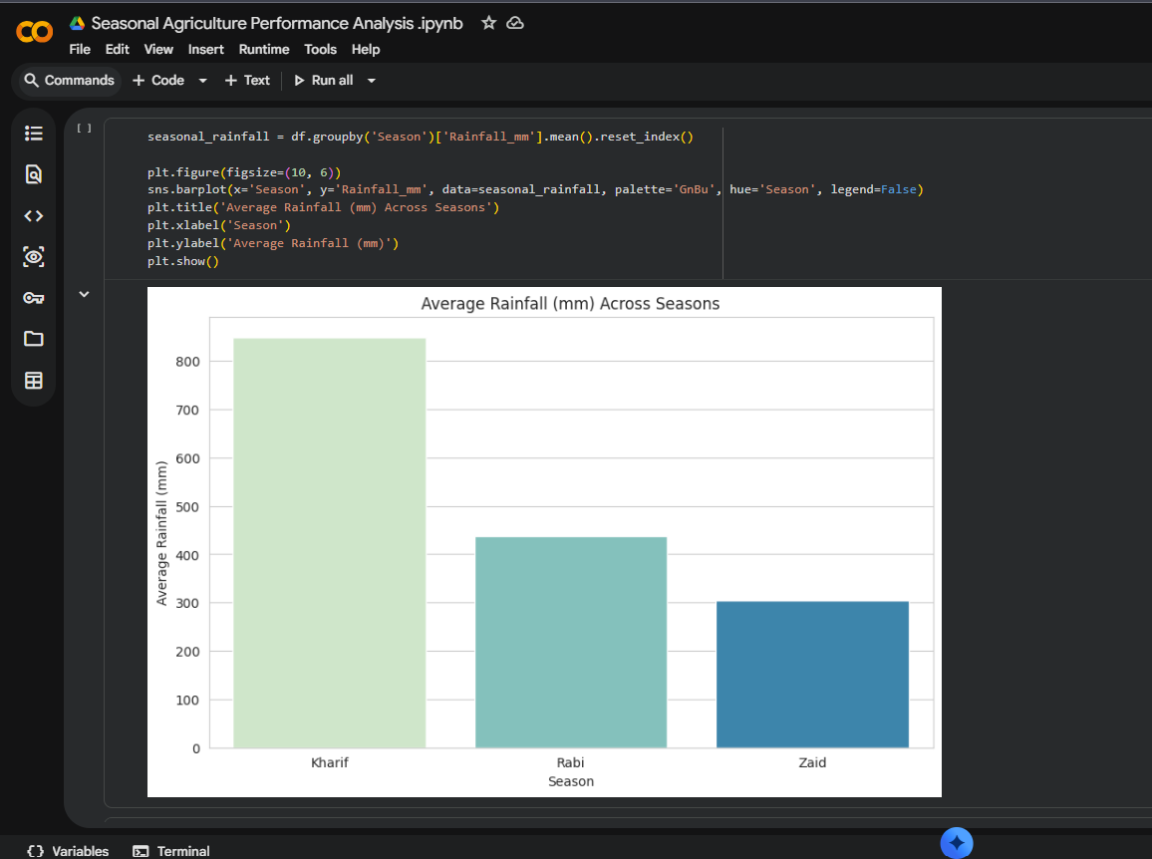
RESULTS

Slide 15
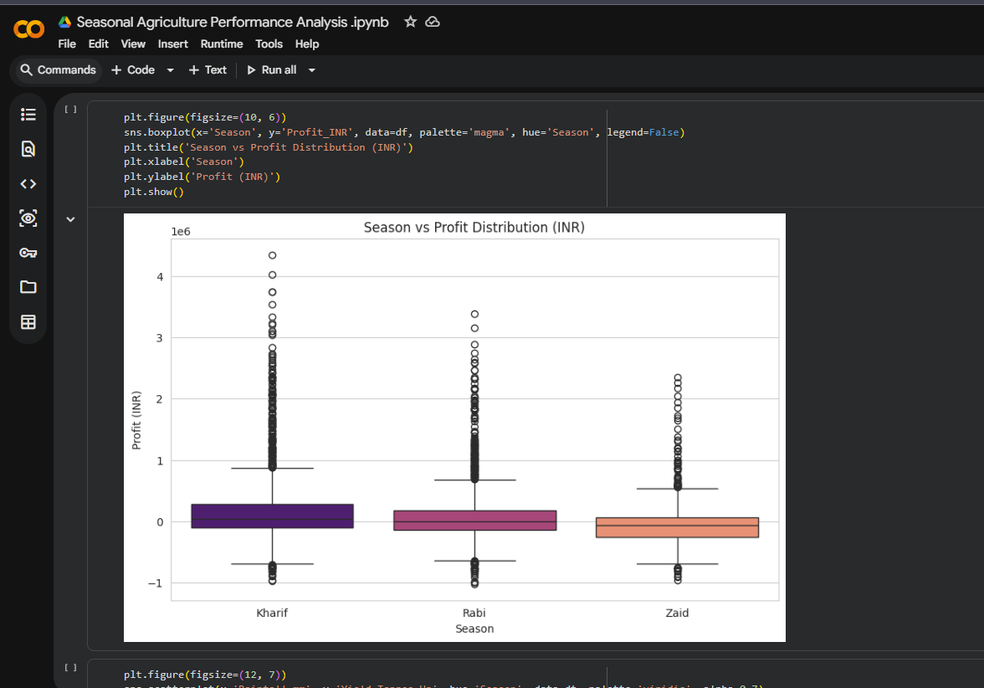
RESULTS
[Add screen shots of your code ]

Slide 16
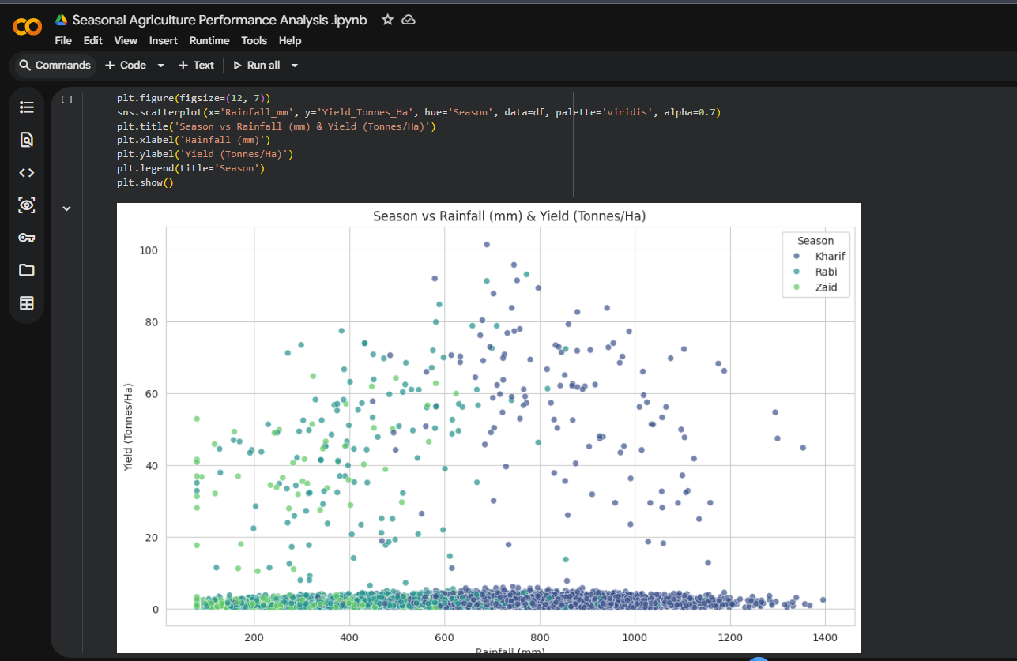
RESULTS
[Add screen shots of your code ]

Slide 17
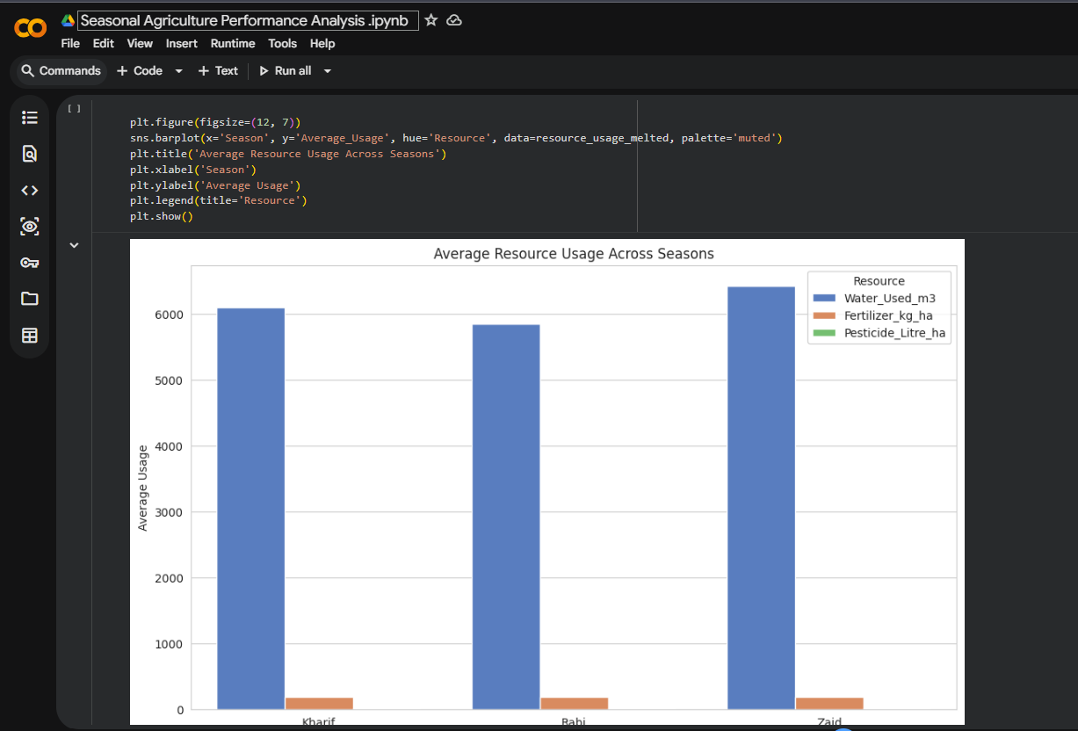
RESULTS
[Add screen shots of your code ]

Slide 18
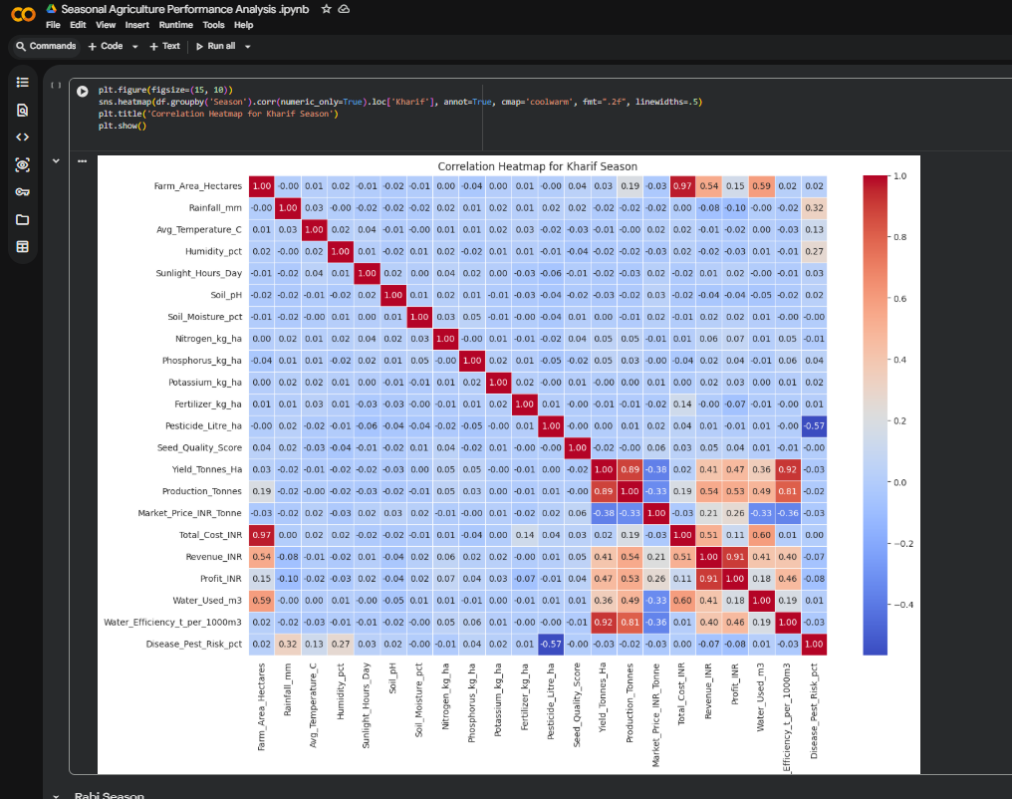
RESULTS
[Add screen shots of your code ]

Slide 19
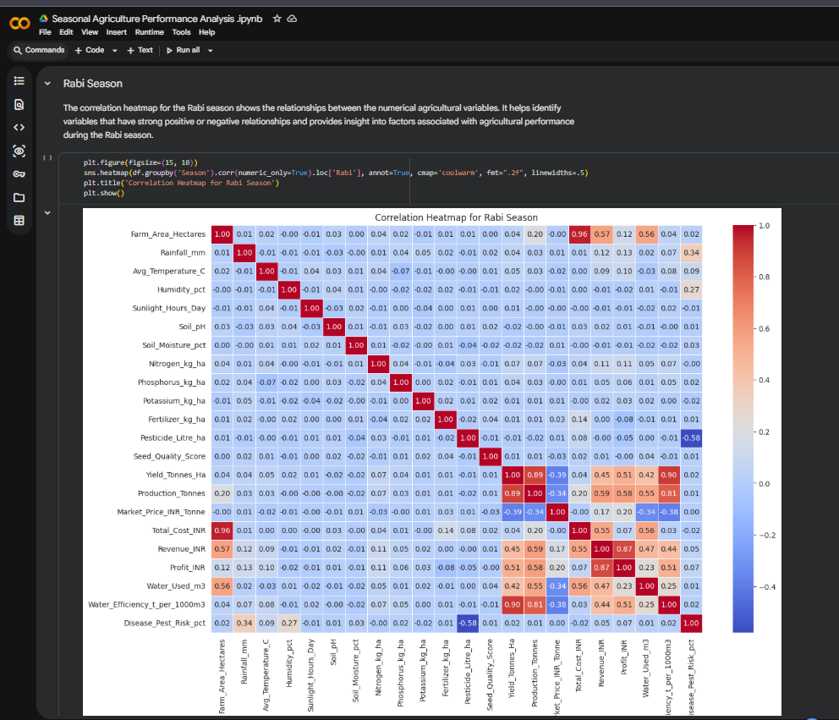
RESULTS
[Add screen shots of your code ]

Slide 20
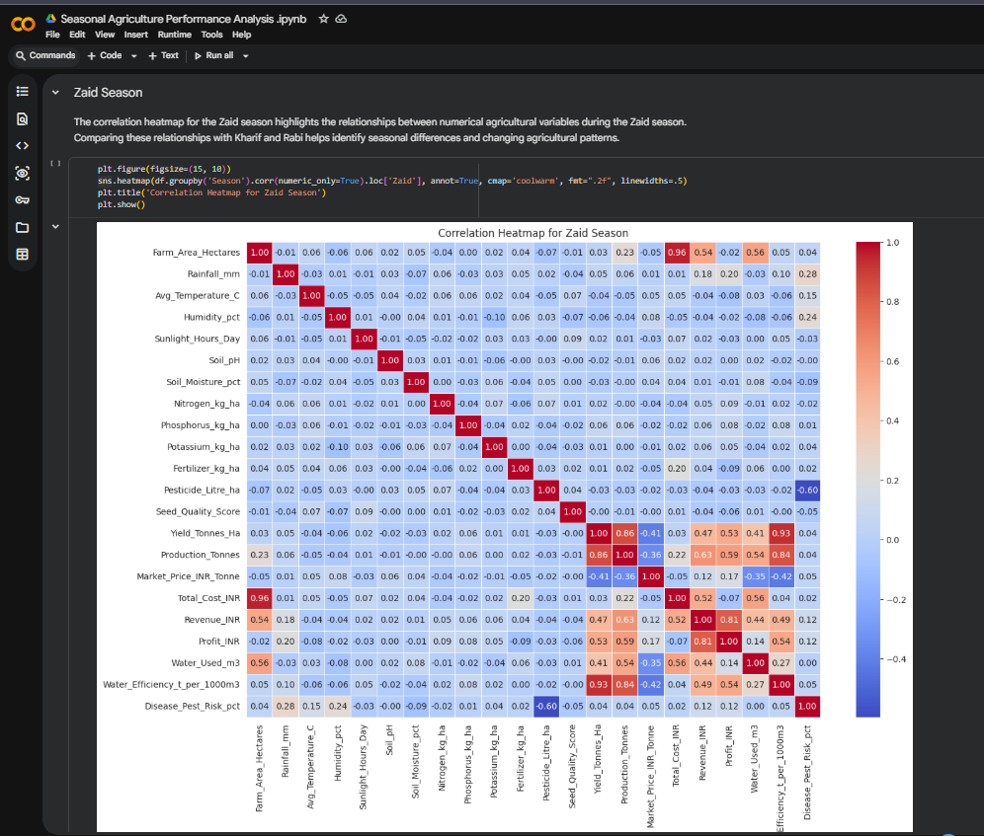
RESULTS
[Add screen shots of your code ]

Slide 21
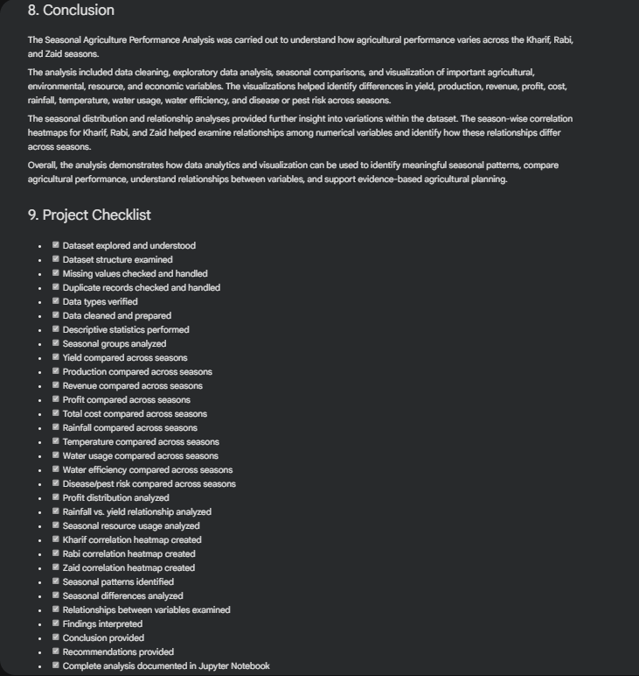
RESULTS
[Add screen shots of your code ]

Slide 22
Future scope
Multi-year analysis – Analyze agricultural performance over multiple years to identify long-term seasonal trends.
Regional analysis – Compare agricultural performance across different geographical regions.
Predictive analysis – Use machine learning to predict crop yield, production, and profit.
Weather integration – Include real-time weather and climate data for better seasonal analysis.
Crop recommendations – Suggest suitable crops based on seasonal and environmental conditions.
Interactive dashboard – Develop a dashboard for farmers and agricultural planners to explore seasonal insights.

Slide 23
GitHub Link
https://github.com/PAVAN2627/Seasonal-Agriculture-Performance-Analysis

Slide 24
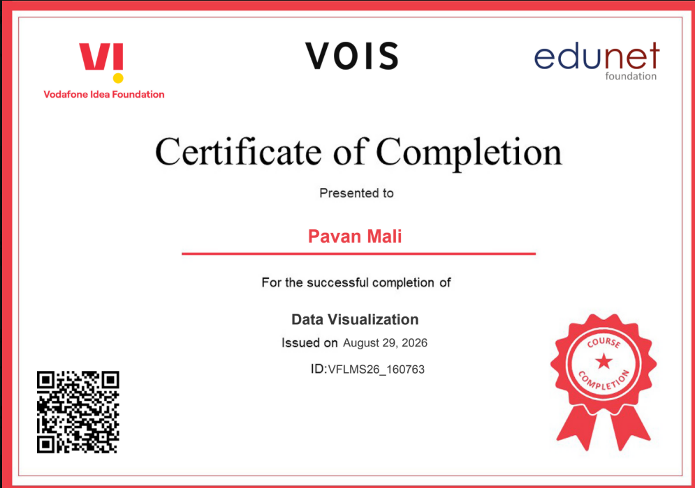
VOIS Course completion certificate - Course name- Data Visualization

Slide 25
Thank you
VOIS AICTE Batch1 2026–2027
.
.

