Slide 1

BUSINESS INTELLIGENCE · RETAIL ANALYTICS
Retail Sales Performance Analysis
Executive Business Intelligence Dashboard · 2014–2017
Prepared by Pavani Mynam
SQL SERVER
POWER BI
DAX
POWER QUERY
DATA MODELING

Slide 2

BUSINESS CONTEXT
Business Challenge & Strategic Objectives
Sales Monitoring
Regional Profitability
Track transactions and trends
Compare margins by region
Retail organisations generate thousands of transactions across products, customers, and regions. Without centralised reporting, executives struggle to monitor performance and identify profitable opportunities.
Customer Behaviour
Product Performance
Understand buying patterns
Measure SKU-level results
Each objective adds a different lens on performance, helping leadership turn fragmented data into a unified view of the business.

Slide 3
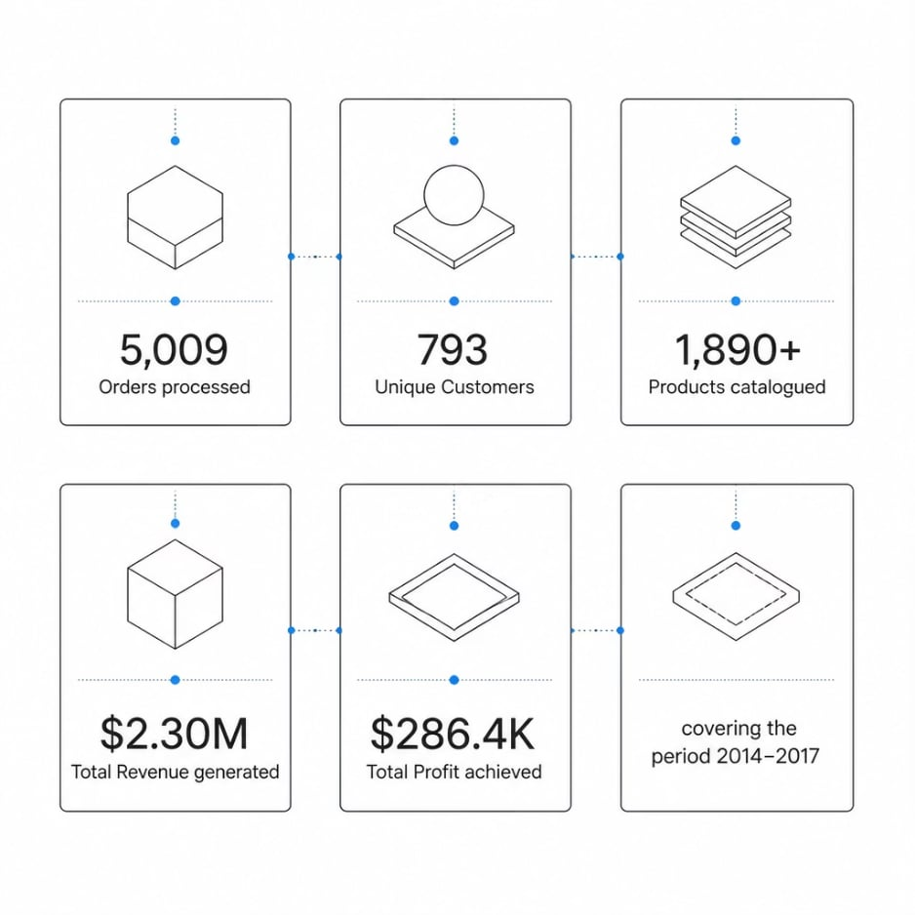
DATA & ARCHITECTURE
Dataset Overview & Solution Architecture
End-to-End Data Pipeline
Raw CSV data was ingested into SQL Server, transformed via Power Query, modelled into a star schema, and surfaced through SQL views — powering interactive Power BI dashboards for executive reporting.
01
02
03
Raw CSV Data
SQL Server Ingestion
Power Query Transformation
Source files
Centralised loading
Cleaned and reshaped
04
05
Star Schema Modeling
Power BI Dashboards
Structured for reporting
Executive reporting output

Slide 4
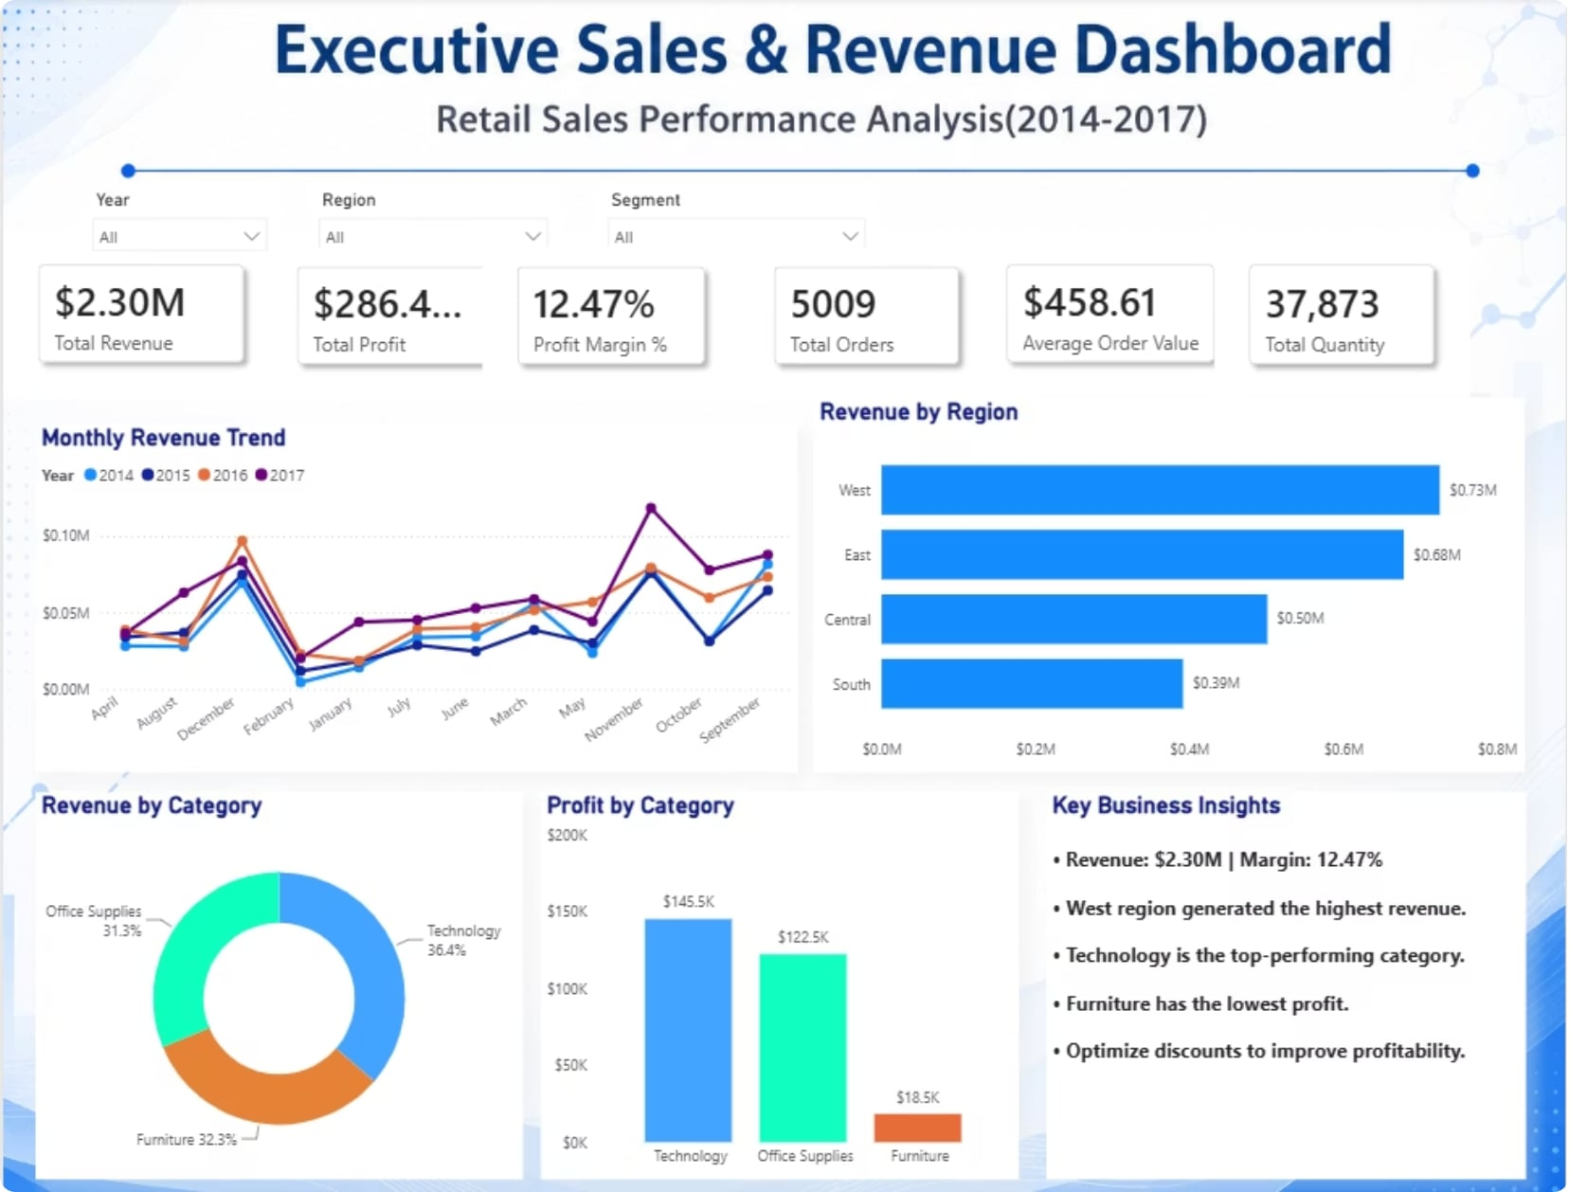

DASHBOARD 1
Executive Overview — Business at a Glance
Total Revenue
Total Profit
$2.30M total sales
$286.4K 12.47% margin
Profit Margin
Total Orders
12.47% of revenue
5,009 orders processed
Average Order Value
Total Quantity
$458.61 per order
37,873 units sold
West led revenue; Technology topped categories at $636K.

Slide 5
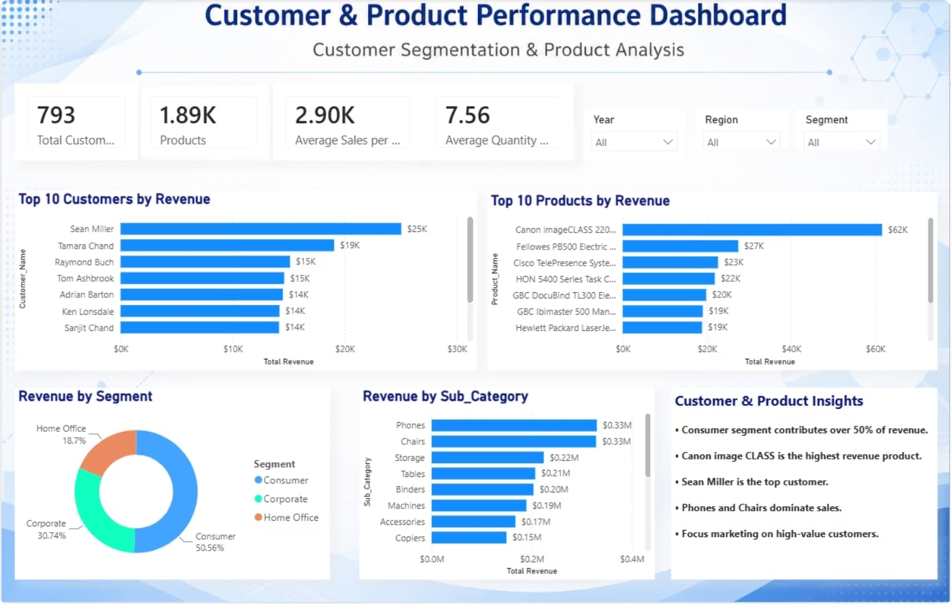

DASHBOARD 2
Customer & Product Analysis
Total Customers 793
Total number of customers in the dashboard dataset.
Total Products 1,890
Total number of products in the dashboard dataset.
Average Order Value $458.61
Average revenue per order across the dashboard.
Average Quantity 7.56
Average units per order across the dashboard.
01
02
03
Revenue by Segment
Corporate
Home Office
Consumer contributes 48.5% of revenue, the largest segment.
Corporate contributes 32.5% of revenue.
Home Office contributes 19% of revenue.
Consumer is the largest revenue driver at 48.5%, replacing the earlier 50%+ estimate. Sean Miller is the top customer, and Canon imageCLASS 2480 is the top product by revenue.

Slide 6
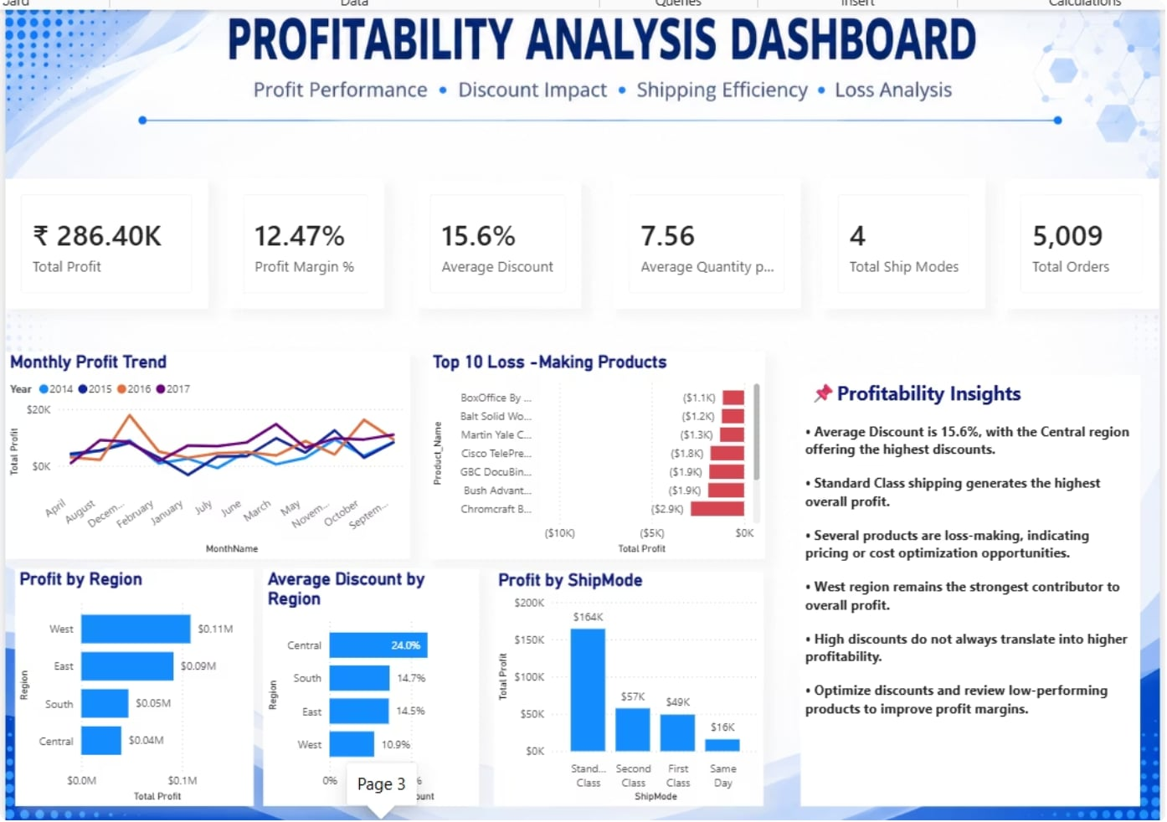


DASHBOARD 3
Profitability Analysis
Total Profit
Profit Margin
Average Discount
$286.4K
12.47%
15.6%
Average Quantity
Total Ship Modes
Total Orders
7.56
4
5009
Key Insights
1
2
3
4
Regional Profit Leader
Shipping Performance
Loss-Making Products
Discount Variation by Region
West leads with $98.1K in profit, followed by East ($87K), South ($67K), and Central ($34K).
Standard Class delivers the strongest profit contribution across shipping modes.
The top 10 loss-making products indicate where pricing and inventory review should be prioritized.
Discount levels vary by region, suggesting uneven margin pressure that should be monitored closely.

Slide 7


EXPLORATORY ANALYSIS
Exploratory Data Analysis — Eight Analytical Lenses
Use these eight lenses as a structured framework to understand performance, identify patterns, and surface opportunities across the business.
1
2
3
4
Monthly Revenue Trend
Profit Trend
Regional Performance
Customer Segmentation
Track how revenue moves over time and spot seasonality, momentum, or sudden shifts.
See whether profitability is improving, flattening, or slipping—and where the pressure is building.
Compare how each region contributes to growth, profit, and overall business health.
Break customers into meaningful groups to uncover different behaviors, needs, and value.
5
6
7
8
Product Performance
Shipping Analysis
Discount Analysis
Loss-Making Products
Identify the products driving results, the laggards, and the biggest opportunities to improve.
Evaluate shipping modes and timelines to find the best balance of speed, cost, and profit.
Understand how discounts affect demand and margins across products, regions, and segments.
Flag products that consistently underperform so pricing, costs, or inventory can be reviewed.

Slide 8












KEY INSIGHTS
Six Executive KPIs — Performance Snapshot
At a glance, these metrics highlight revenue scale, profitability, order activity, customer value, and the strongest-performing segments.
Total Revenue
Profit Margin
$2.30M
12.47%
Across all regions and categories
Net margin on total sales
Best Region
Total Orders
West
5,009
Highest revenue and profit
All completed orders
Total Customers
Average Order Value
793
$458.61
Unique customers served
Average revenue per order

Slide 9
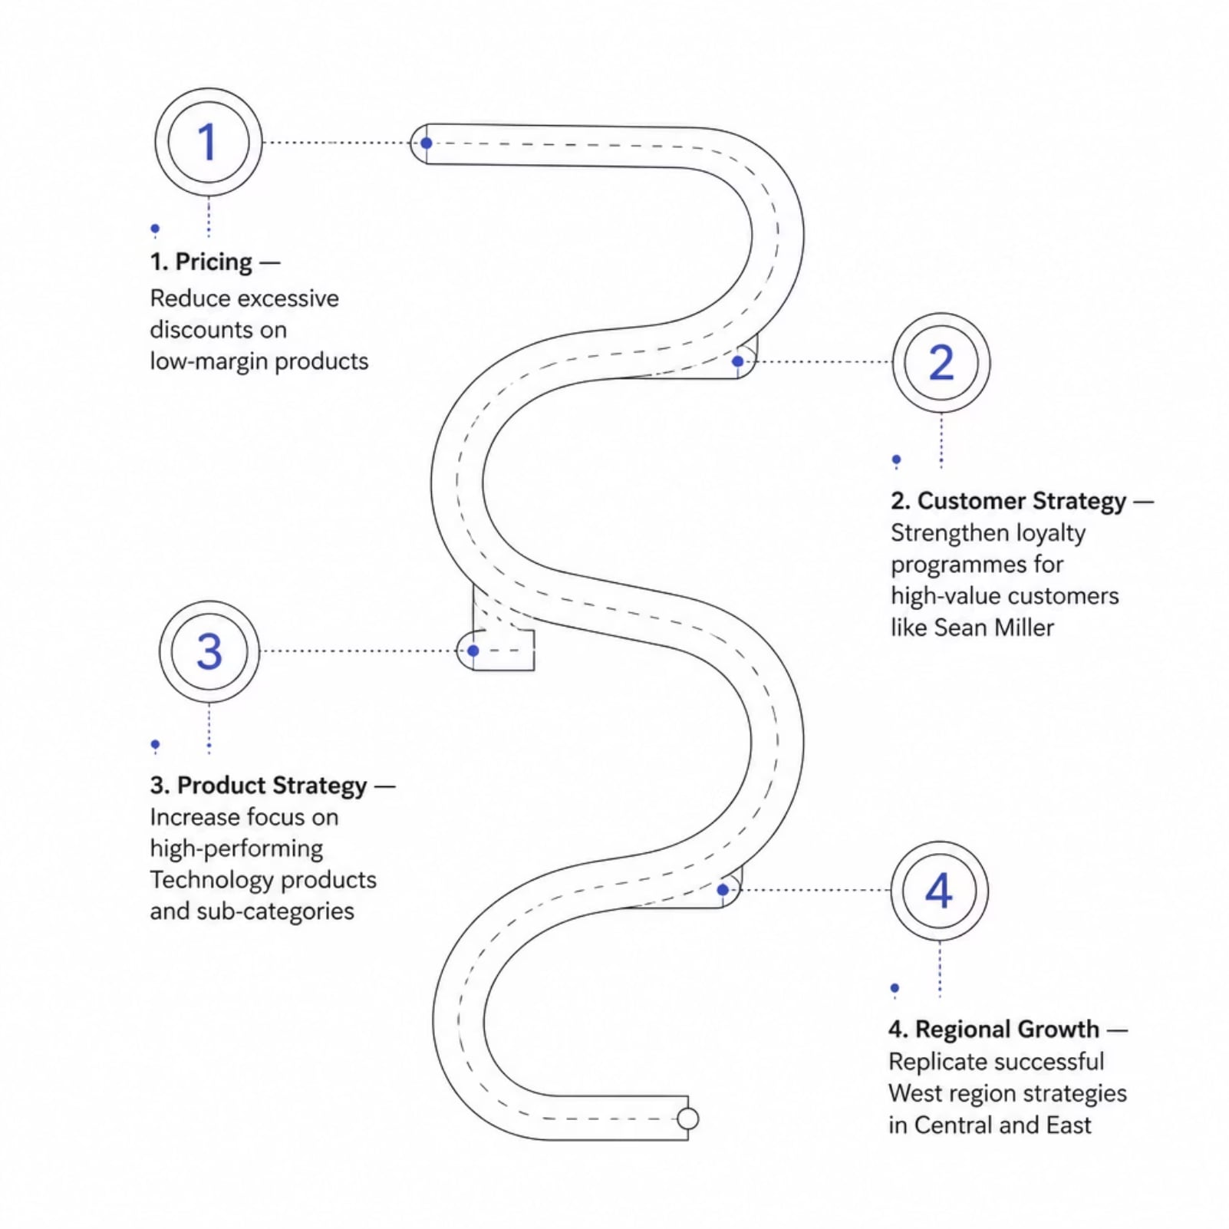
STRATEGIC ROADMAP
Recommendations & Business Impact
Expected Business Impact
Smarter Discounting
Regional Margin Lift
Reduce margin erosion by tightening discount discipline and optimizing pricing by region to protect profitability.
Improve profitability in underperforming regions like Central and East by applying the strongest pricing and sales practices.
Stronger Product Mix
Reduced Losses
Shift demand and sales effort toward high-margin Technology products to raise revenue quality and improve return on effort.
Eliminate or reprice loss-making SKUs to remove unprofitable activity and reduce drag on overall performance.
Improved Profitability
Increase overall profit margin from 12.47% toward target levels through better pricing, mix, and regional execution.

Slide 10
PROJECT SUMMARY
Technical Skills & Project Highlights
Database
Business Intelligence
Analytics
SQL Server · SQL Views
Power BI · Power Query · DAX
Data Modelling · EDA · KPI Development · Dashboard Design
3
15+
1
Interactive Dashboards
Business KPIs
Star Schema
Thank You
Pavani Mynam · LinkedIn · GitHub · Email

