Slide 1
CORRELATION
Saritha

Slide 2
Uni -variate distribution: The distribution involving only one variable.
Example: Marks in statistics ,weight of a person, Height of a person ,prices of commodities etc ,.. are Uni- variate distributions.
Bi-variate distribution: The distribution involving only two variables.
Example: Price and Demand of a commodity, Rainfall and Yield of a crop,… are Bi-variate distributions.

Slide 3
CORRELATION
Definition: The variables are said to be correlated, If the change in one variable effects in a change in the other variable is called correlation.
The relationship between two random variables is called Correlation
Linear correlation : When the amount of change in one variable leads to a constant ratio of change in the other variable.

Slide 4
Non linear correlation : When the amount of change in one variable is not in constant ratio to the change in the other variable. Types of correlation Positive correlation : increase (decrease) in one variable leads to increase ( decrease) in other variable. Example : 1.Heights and Weights of a group of persons. 2.Demand and supply of a commodity Negative correlation: Increase (decrease ) in one variable leads decrease (increase) in other variable Example: 1.Volume and pressure of a gas 2.Supply and price of a commodity

Slide 5
Uncorrelated variables : If there is no relation between two variables are called Uncorrelated variables. Example : Income of father does not depend on the age of son. Scatter diagram: The diagrammatic representation of a bi- variate data (x1,y1)(x2,y2)…………..(xn,yn) is called Scatter diagram .It is a simple graphical representation by plotting values of the random variables X on x- axis and values of the random variable Y on Y- axis

Slide 6
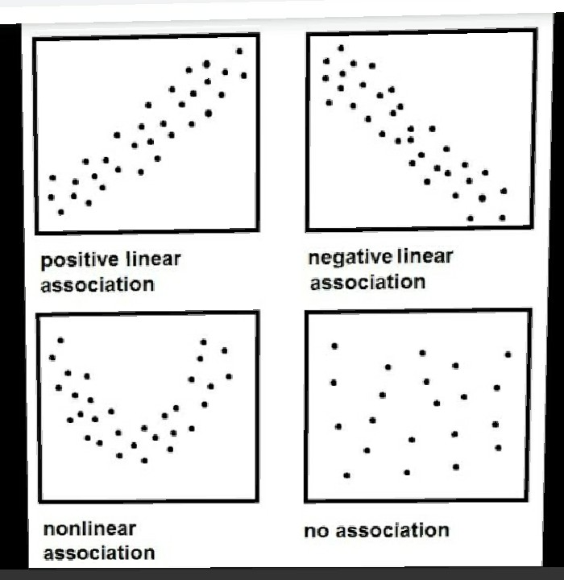

Slide 7
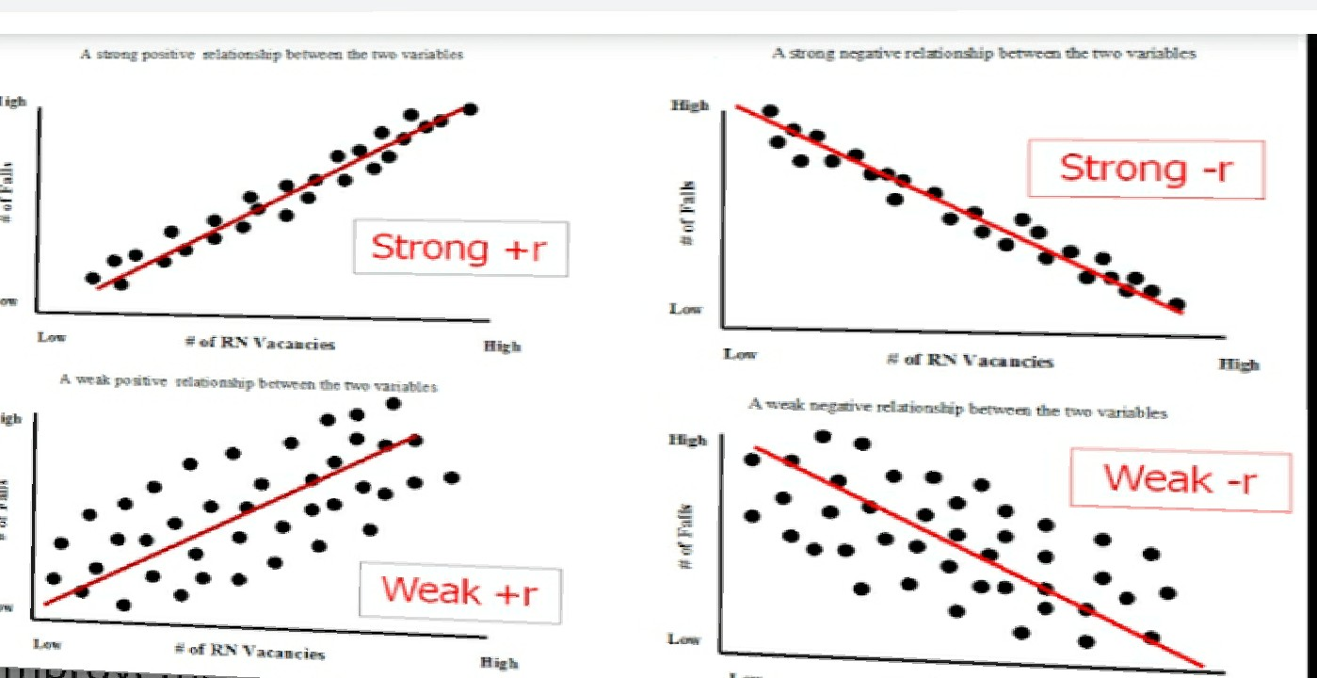

Slide 8
Correlation coefficient: “Prof. karl Pearson” discovered the measure to find the intensity of linear relation ship between two variables
Correlation coefficient is denoted by r (x,y) and defined as

Slide 9
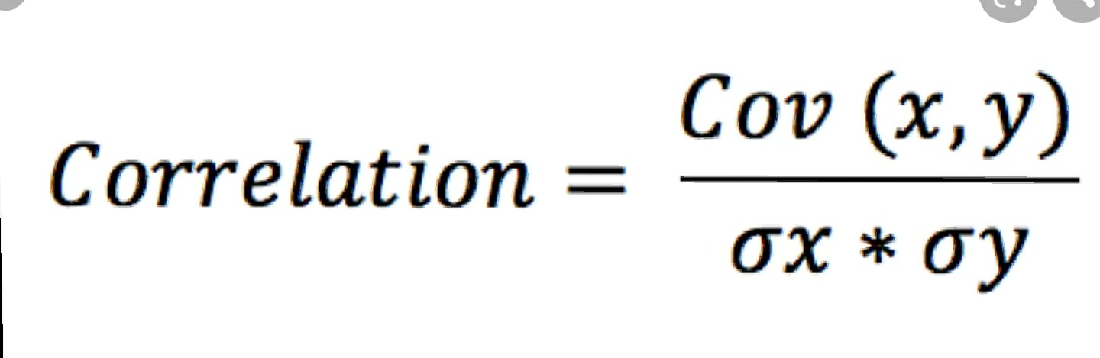

Slide 10
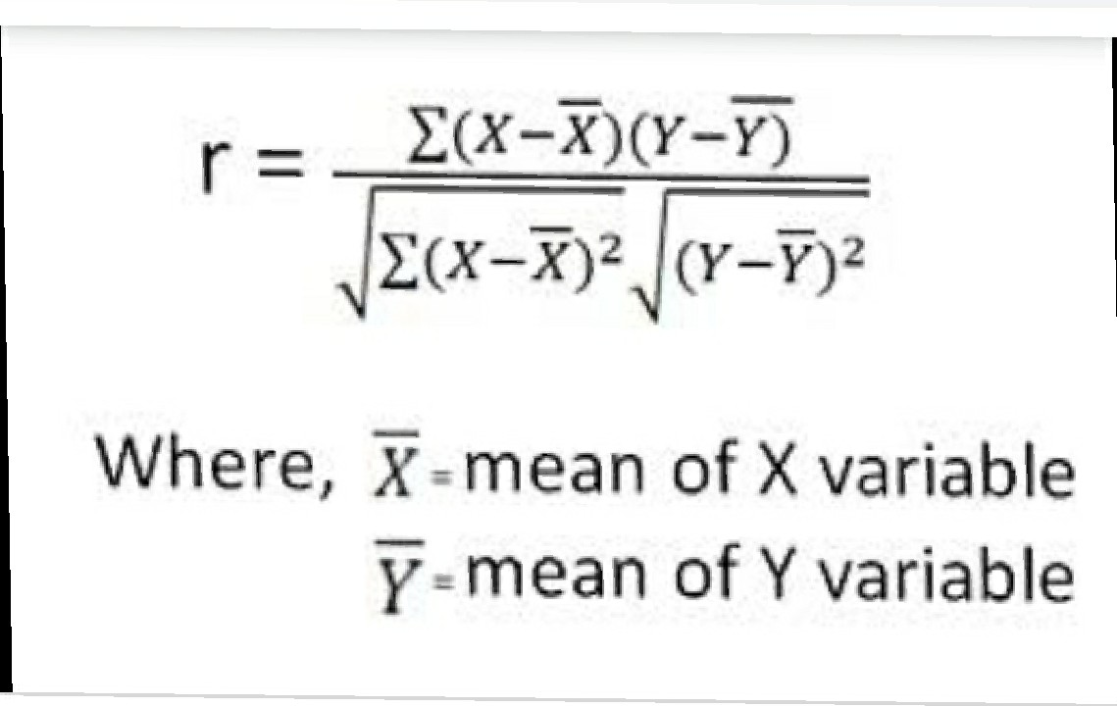

Slide 11
Properties of correlation coefficient: 1.Correlation coefficient is a numerical value or constant and it does not depend on any units of the given data 2. Limits of correlation coefficient lies between -1 and +1

Slide 12
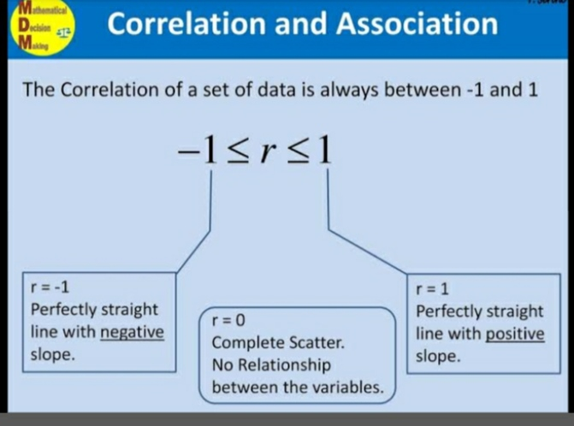

Slide 13
3. Correlation coefficient is independent of shifting origin and scale
4. There is no correlation between any two independent random variable. If X and Y are independent random variables then there is a zero correlation.
Converse of this need not be true i.e, r(x,y)=0, then X and Y need not be independent randaom variables.

Slide 14


Slide 15


Slide 16
The more one works out at the gym,the less body fat one may have.
The more one smokes cigarettes ,the fewer years she will have to lie
If a train increases speed ,the lenght of time to get to the final point decrease s..

Slide 17
Thank you

