Slide 1

CENTRALISED REMOTE CONTROL PUMP IN AGRICULTURE
BY-
TEAM DEVELOPERS
P.MANIKANTESHWAR
R.PAVANI
S.CHIRUDEEP

Slide 2
Introduction
In present scenario, irrigation techniques in India are through the manual control in which the farmers irrigate the land at regular intervals. Manual operation of the routine practices in agriculture requires lot of attention and care. Also it is difficult to perform desired jobs efficiently and precisely. Ultimately this may result in lower crop production, non-uniform growth and poor quality. The introduction of automation in irrigation system will result in increased application efficiency and drastically reduce labor requirement. The proposed system helps to monitor and control the irrigation system using a simple mobile phone.

Slide 3
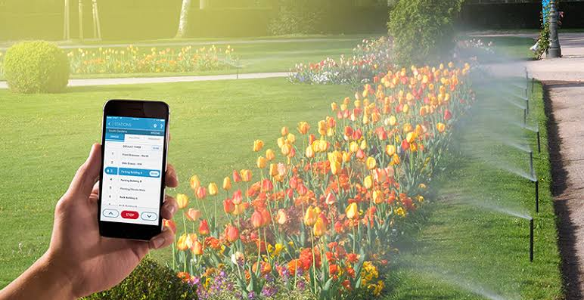
About the project
This project introduces the concept of smart irrigation in agriculture. It simplifies the irrigation system by replacing manual effort with Centralised motor pump that can be remotely controlled using a mobile. The mobile app consists of simple interface, designed to be understandable by anyone.

Slide 4
Components
HARDWARE:
Node-MCU
Water pump
Relays
Connecting wires
SOFTWARE:
Arduino IDE
Node RED
MIT App Inventor

Slide 5
BLOCK DIAGRAM
Power Source
(5V)
Node MCU
2 Channel Relay Module
Pump ON /Pump OFF
Mobile Phone

Slide 6
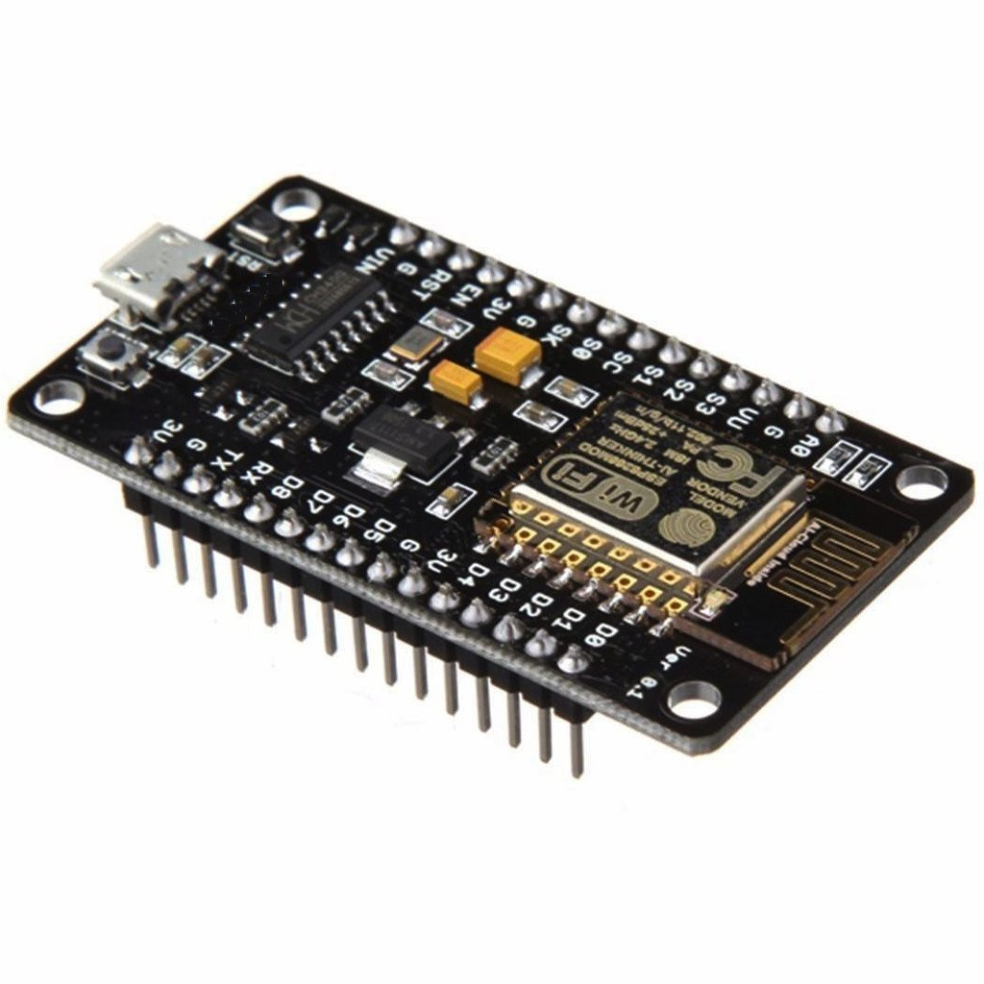
Components
Node MCU:
NodeMCU is an open source IoT platform. It includes firmware which runs on
the ESP8266 Wi-Fi SoC from Espressif Systems, and hardware which is based
on the ESP-12 module. NodeMCU Development board is featured with wi-fi
capability, analog pin, digital pins and serial communication protocols.

Slide 7
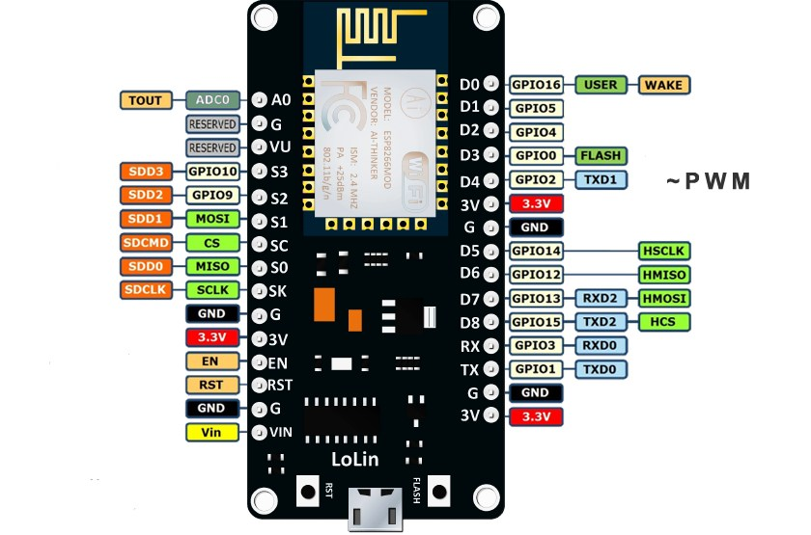
Node MCU

Slide 8
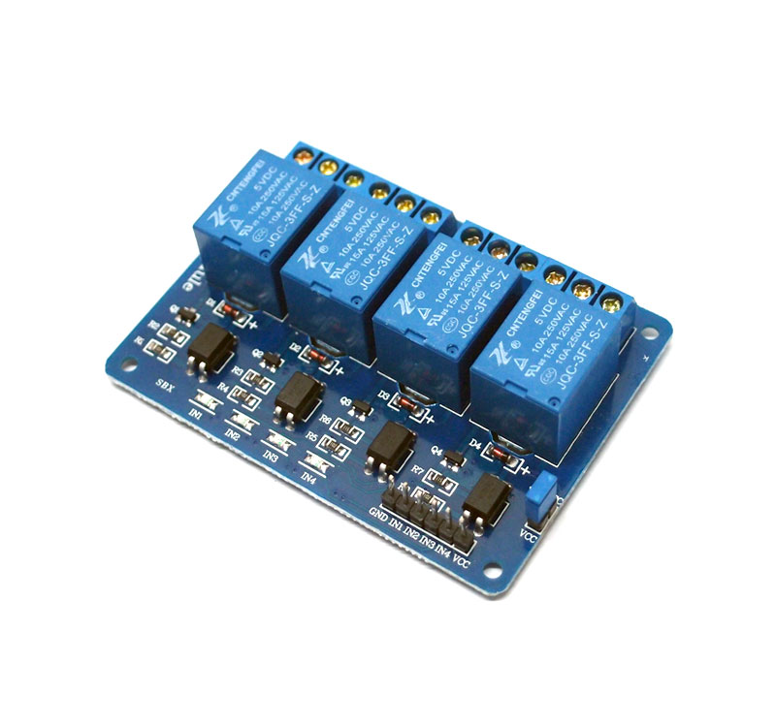
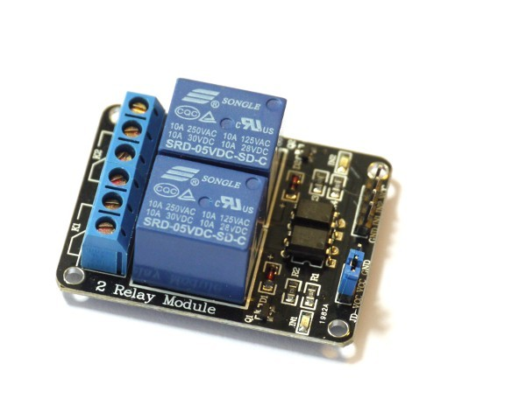
Components
Relay:
Relays are switches that open and close circuits electromechanically or
electronically. Relays control one electrical circuit by opening and closing
contacts in another circuit. As relay diagrams show, when a relay contact is
normally open (NO), there is an open contact when the relay is not energized.
Classification or the types of relays depend on the function for which they are
used.

Slide 9
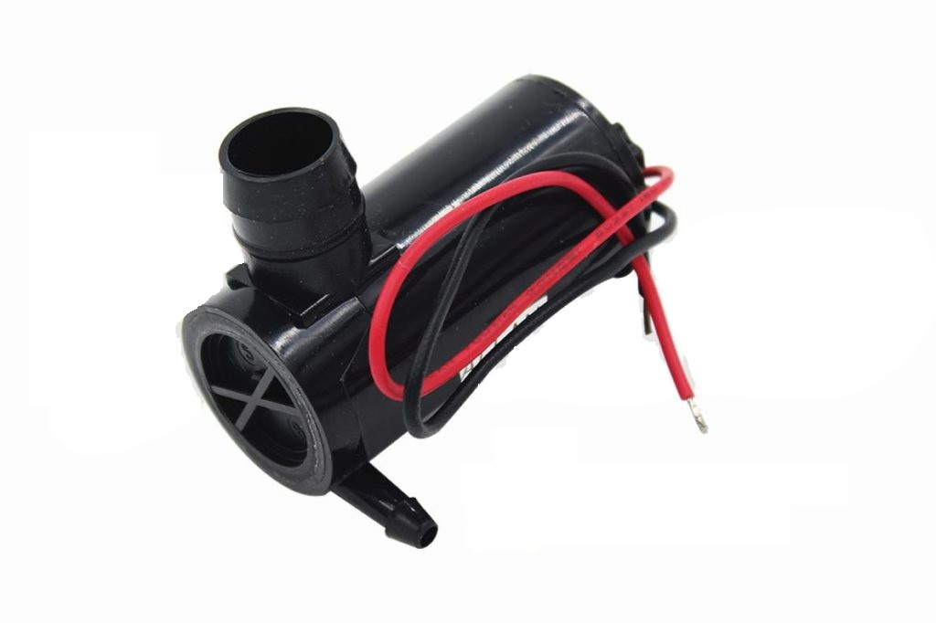
Components
Motor Pump:
A submersible pump (or sub pump, electric submersible pump (ESP)) is a device which has a hermetically sealed motor close-coupled to the pump body. The whole assembly is submerged in the fluid to be pumped. The main advantage of this type of pump is that it prevents pump cavitations’, a problem associated with a high elevation difference between pump and the fluid surface. Small DC Submersible water pumps push fluid to the surface as opposed to jet pumps having to pull fluids. Submersibles are more efficient than jet pumps.

Slide 10
Software
Node RED:
Node-RED is a flow-based development tool for visual programming developed originally by IBM for wiring together hardware devices, APIs and online services as part of the Internet of Things. Node-RED provides a web browser-based flow editor, which can be used to create JavaScript functions. Elements of applications can be saved or shared for re-use. The flows created in Node-RED are stored using JSON.

Slide 11
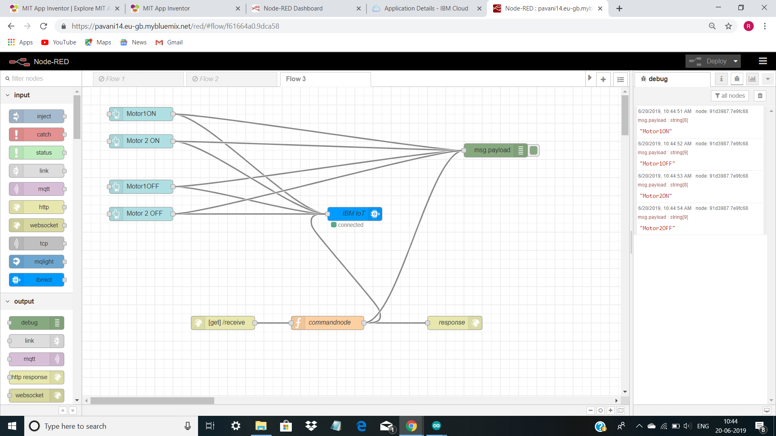

Slide 12
Software
Arduino IDE:
The Arduino integrated development environment (IDE) is a cross-platform application (for Windows, macOS, Linux) that is written in the programming language Java. It is used to write and upload programs to Arduino compatible boards, but also, with the help of 3rd party cores, other vendor development board. The Arduino IDE supports the languages C and C++ using special rules of code structuring

Slide 13
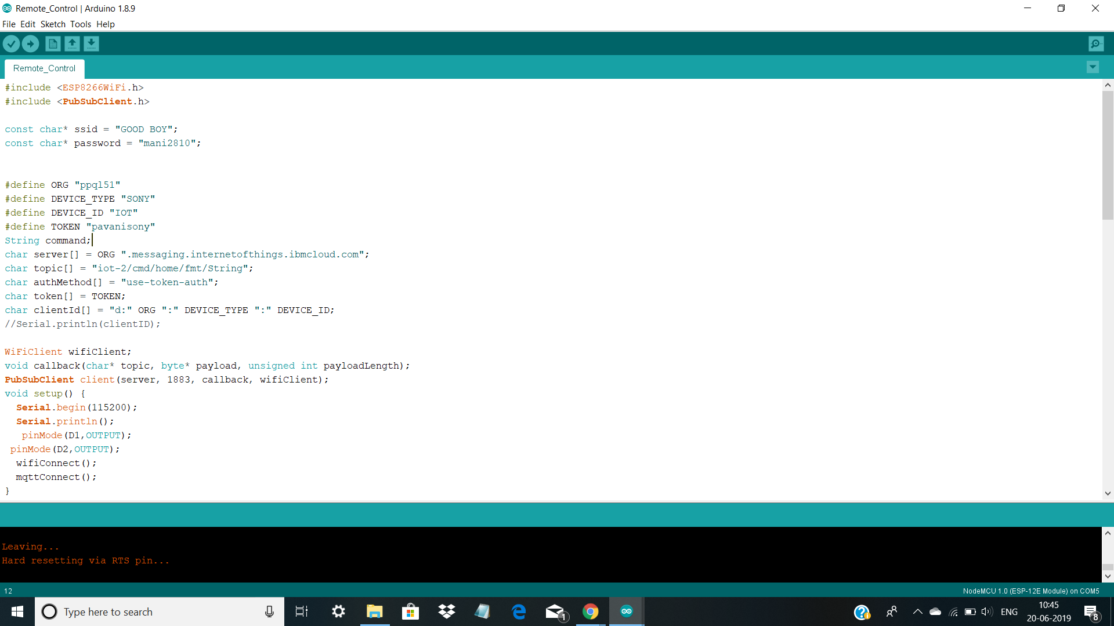
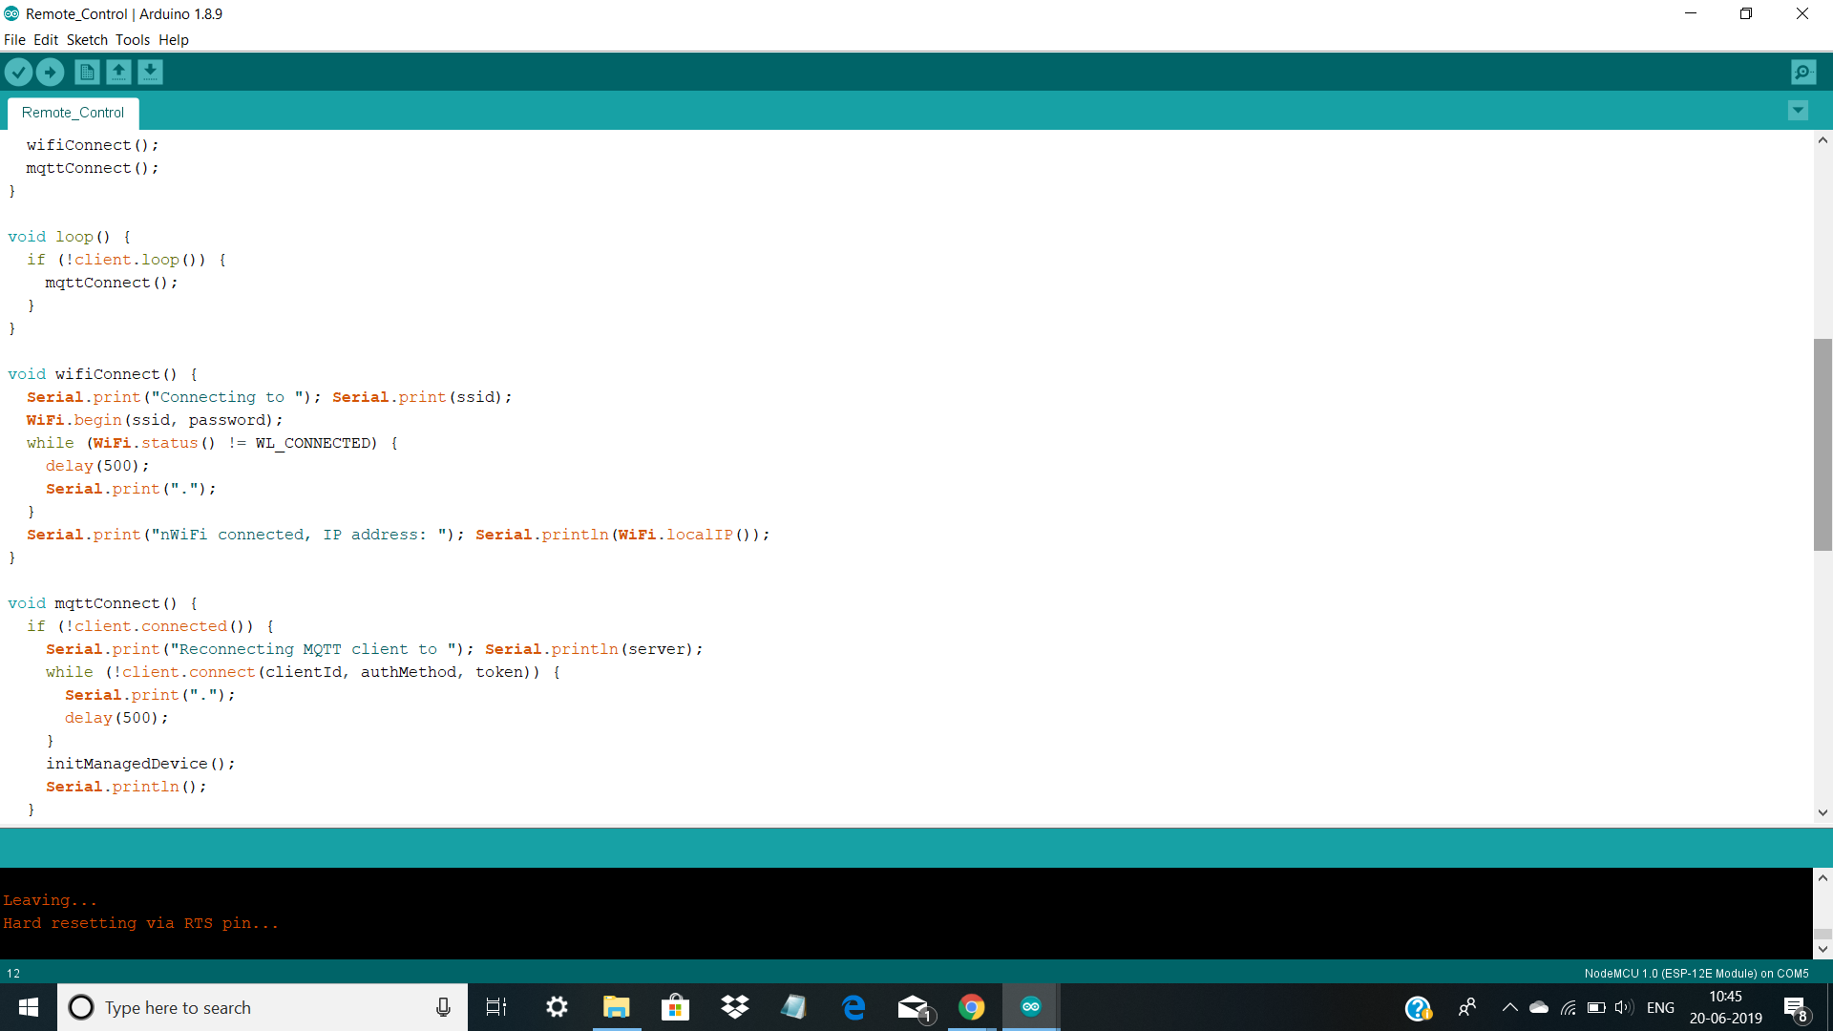

Slide 14
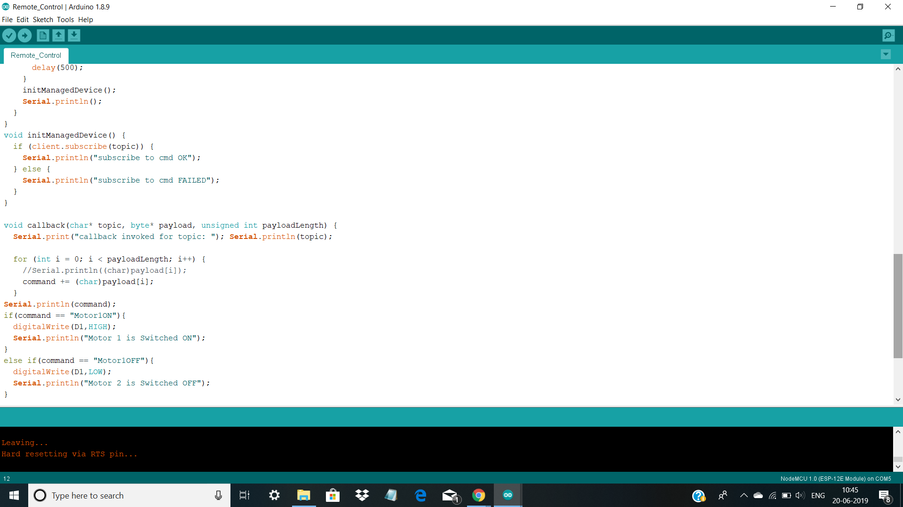
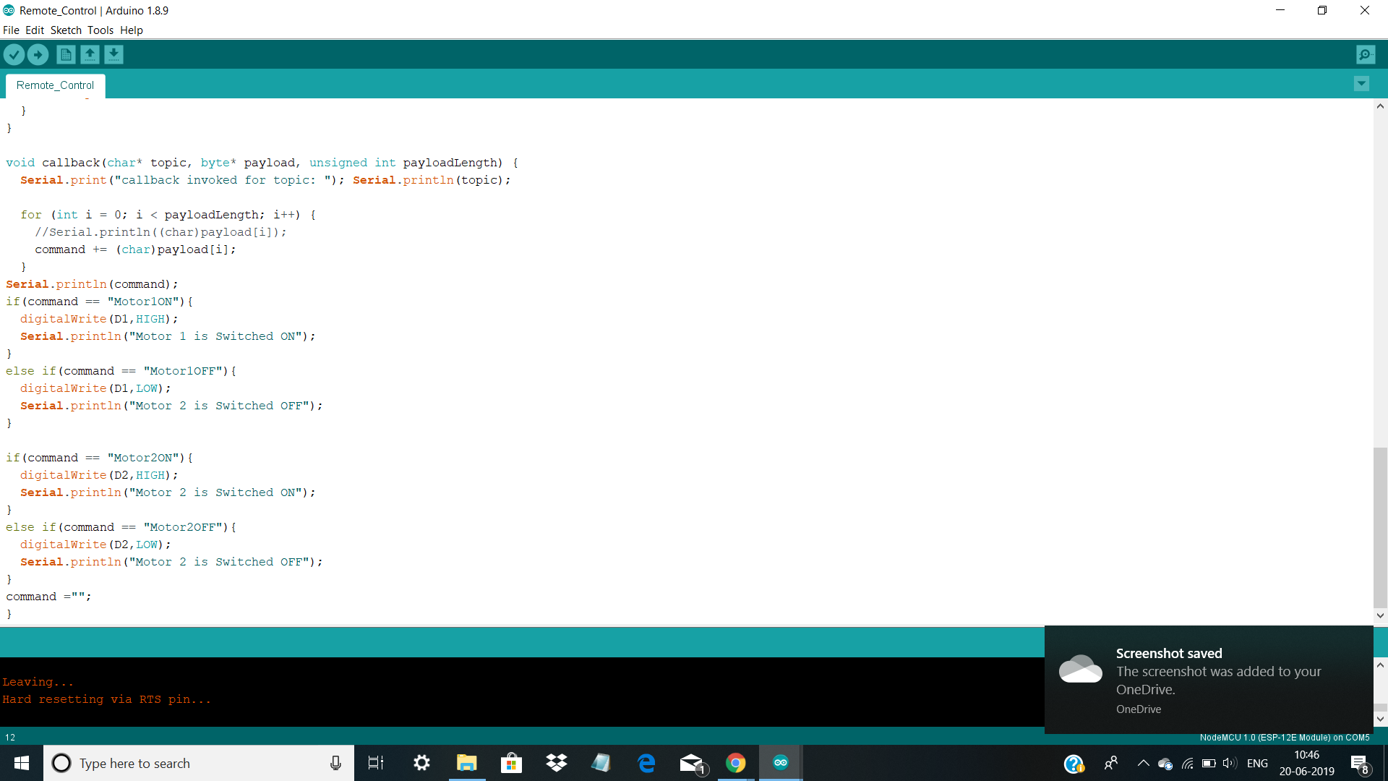

Slide 15
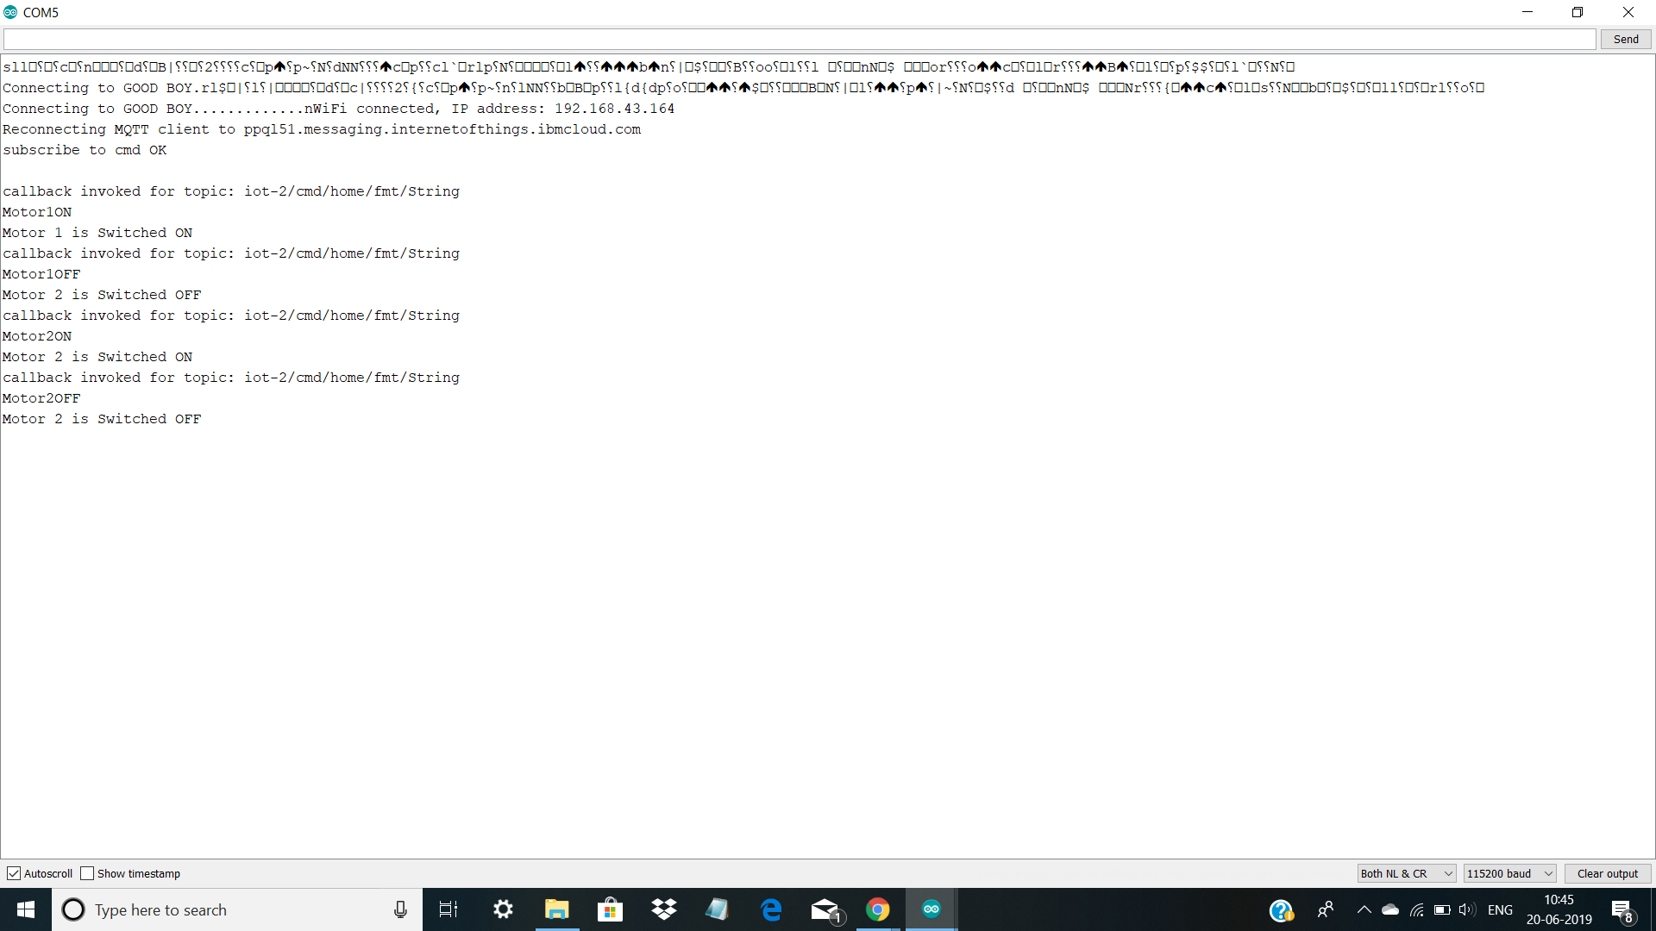
Serial Monitor Output:

Slide 16
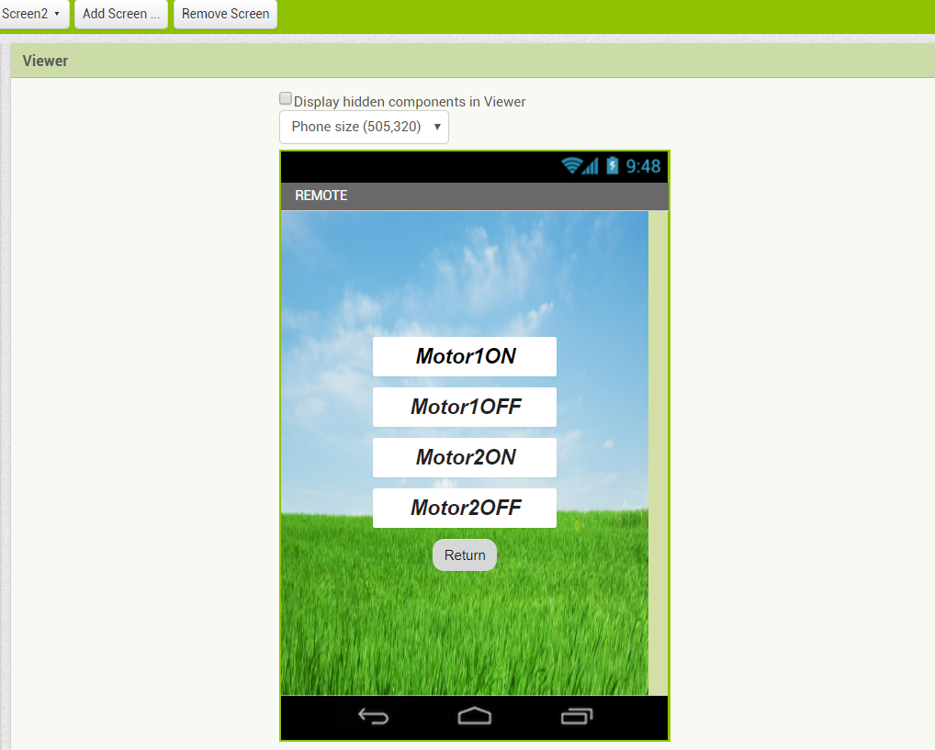
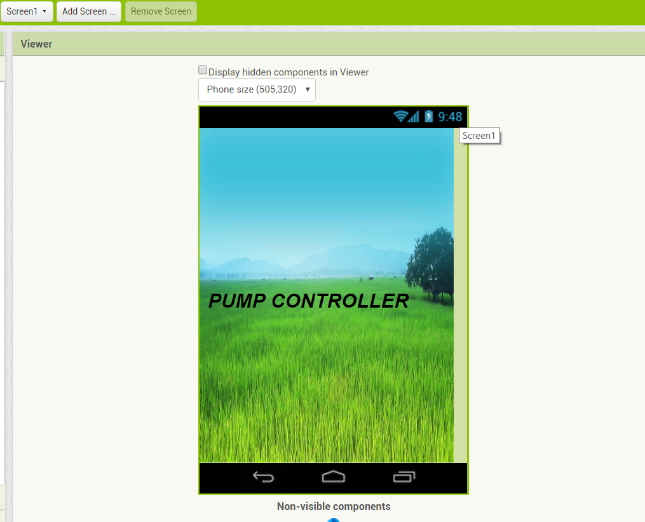
MOBILE APPLICATION
This is application is used as a remote to control the pump.

Slide 17
CONCLUSION
Using our project, we can remotely operate a pump without using the GSM Module. In the market, usage of GSM module in these smart pumps is taking place and this project aims for the much simplified version of these pumps.

Slide 18


