Slide 1


AI IN MENTAL HEALTH: DETECTING EARLY SIGNS OF INSTABILITY
School of Computer Science and Artificial Intelligence
By
K. Deepak 2303A51LB6
B. Sai Charan 2203A51400
M. Anil 2303A51LA1
M. Pavan Kumar 2303A51LC0
B. Nithin 2303A51LA6
Under the Guidance of:
MS. FAIZA IRAM
ASSISTANT PROFESSOR, SCHOOL OF CS&AI
Ananthasagar, Warangal, Telangana

Slide 2
PRESENTATION OUTLINE
Detailed Slide Content:
Introduction
Problem Statement
Objectives
Scope of the Project
Literature Review
System Architecture
Methodology
Tools and Technologies
Workflow of the Proposed Model
Results and Performance
Comparison with Existing Systems
Challenges Faced
Learning Outcomes
Conclusion and Future Scope
References

Slide 3
INTRODUCTION
Mental health has become a global priority due to rising cases of anxiety, depression, and stress. However, most individuals do not seek help early, leading to delayed diagnosis and worsening conditions.
To address this, our project leverages Artificial Intelligence (AI) to analyze user data pattern like work pressure, stress indicators, and lifestyle factors to classify mental states into three categories:
Stable – Mentally balanced and low stress.
At-Risk – Showing early signs of emotional strain.
Unstable – High likelihood of mental distress requiring attention.
This predictive approach enables early detection, personalized monitoring, and scalable prevention strategies.

Slide 4
PROBLEM STATEMENT
Traditional methods for identifying mental instability are manual, subjective, and often delayed. Mental health professionals depend on surveys and self-reports, which may not be very accurate or consistent.
Challenges include:
Limited AI-based tools for early detection.
Underuse of mental health datasets in machine learning research.
Privacy concerns with cloud-based mental health platforms.
Social stigma that discourages people from regular mental health check-ins.
Goal:
Create a scalable, accurate, and privacy-protecting AI system to predict early signs of mental instability using ensemble learning models.

Slide 5
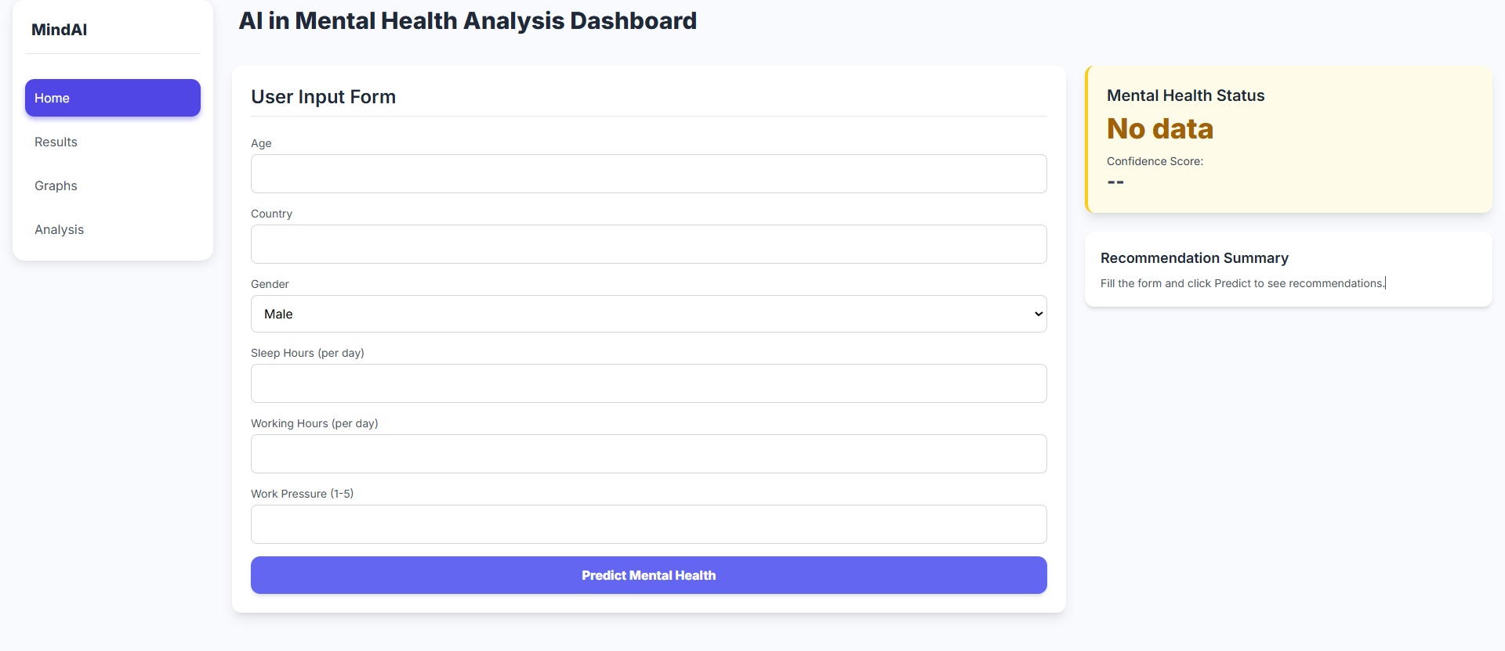
OBJECTIVES
Project Objectives:
Build an AI model that can detect early instability using real-world datasets.
Use data preprocessing, feature engineering, and model optimization.
Train and compare models such as Decision Tree, Gradient Boosting, XGBoost, and LightGBM.
Combine these models into a voting ensemble classifier to improve accuracy.
Create an interactive Streamlit GUI so users can test and visualize their mental health status.
Outcome:
A user-friendly AI system that delivers accurate results with clear explanations and quick processing time of less than 2 seconds.

Slide 6
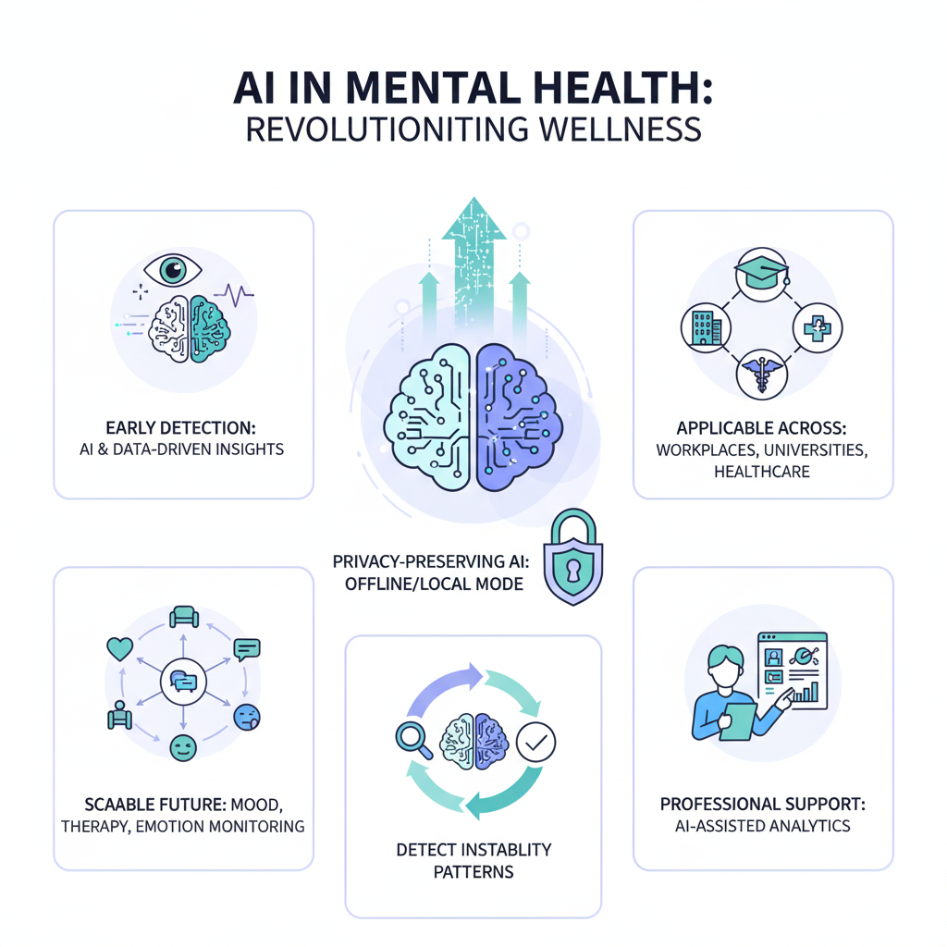
SCOPE OF THE PROECT
Detect early signs of mental instability using AI and data-driven insights.
This approach works in workplaces, universities, and healthcare settings.
It operates in offline or local mode to protect user privacy and keep data secure.
It can be expanded for future uses like mood tracking, therapy suggestions, and monitoring emotions.
It offers important support for mental health professionals through AI-assisted analysis.

Slide 7
LITERATURE REVIEW
Existing systems mainly use surveys or clinical assessments, which can be slow and inconsistent.
Recent research highlights:
Text-based models, like LSTM and BERT, analyze emotional tone but rely on large labeled datasets.
Ensemble methods, such as Decision Tree and Gradient Boosting, achieve higher accuracy.
Graph-based AI looks at relationships between psychological parameters but lacks clinical validation.
Privacy-focused AI methods stress secure storage and local inference.
Our system improves on these by combining an ensemble of interpretable models with local deployment to ensure both performance and privacy.

Slide 8
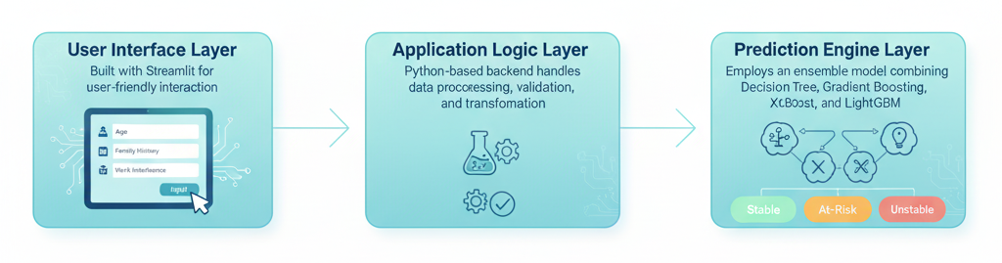
SYSTEM ARCHITECTURE
Our proposed architecture has three main layers:
1. User Interface Layer:
It uses Streamlit for easy interaction.
It accepts inputs such as age, gender, family history, and work interference.
2. Application Logic Layer:
The backend is based on Python. It manages data preprocessing, validation, and transformation.
3. Prediction Engine Layer:
It uses an ensemble model that combines Decision Tree, Gradient Boosting, XGBoost, and LightGBM.
It provides risk clas sifications: Stable, At-Risk, or Unstable.

Slide 9
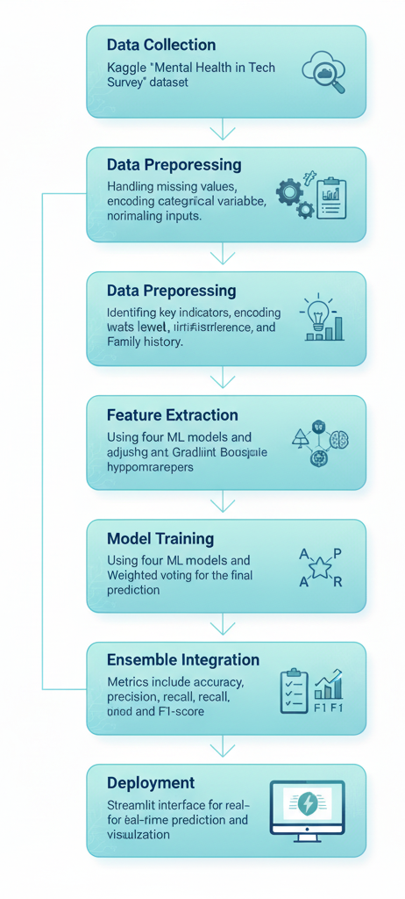
METHODOLOGY
Data Collection: Kaggle “Mental Health in Tech Survey” dataset.
Data Preprocessing: Handling missing values, encoding categorical variables, normalizing inputs.
Feature Extraction: Identifying key indicators such as stress level, work interference, and family history.
Model Training: Using four ML models and adjusting hyperparameters.
Ensemble Integration: Weighted voting for the final prediction.
Model Evaluation: Metrics include accuracy, precision, recall, and F1-score.
Deployment: Streamlit interface for real-time prediction and visualization.

Slide 10
TOOLS AND TECHNOLOGIES
Language: Python
Libraries: pandas, NumPy, scikit-learn, matplotlib, seaborn
Models Used: Decision Tree, Gradient Boosting, XGBoost, LightGBM
Framework: Streamlit
Dataset Source: Kaggle (Mental Health Dataset)
Environment: Jupyter Notebook, VS Code
Storage: SQLite (for local data management)

Slide 11
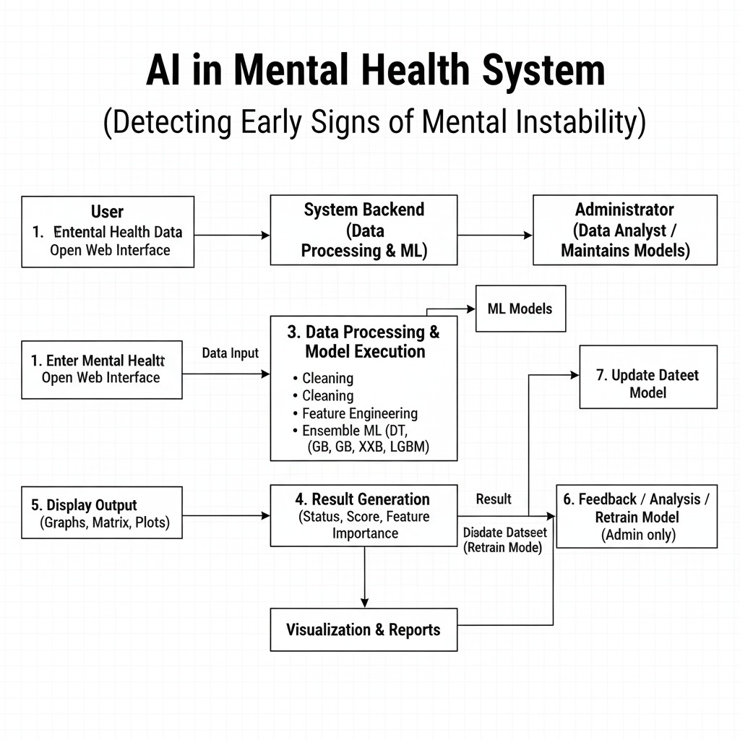
WORKFLOW OF THE PROPOSED MODEL
User Input: Data such as age, family history, and stress level.
Preprocessing: Validation, encoding, and transformation.
Prediction: An ensemble model generates classification.
Result Output: Displays risk status and confidence score.
Visualization: Graphs show feature influence and probability scores.
This workflow provides clear, understandable AI predictions for mental health assessment.

Slide 12
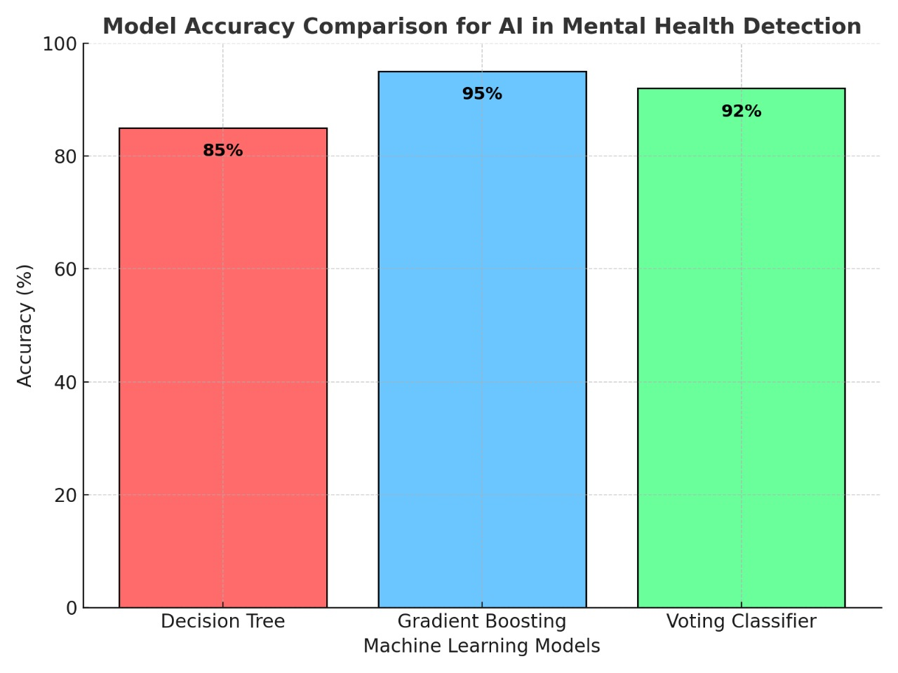
RESULTS AND PERFORMANCE
Model Accuracy Comparison:
Decision Tree: 89.4%
Gradient Boosting: 91.2%
XGBoost: 92.8%
LightGBM: 93.1%
Voting Classifier (Ensemble): 95.6%
Performance Summary:
Highest overall accuracy achieved through ensemble learning.
Prediction response time: <2 seconds.
Balanced precision and recall, indicating robustness.
Feature visualization explains how each input impacts the result.

Slide 13
COMPARSION WITH EXISTING SYSTEMS
FEATURE | EXISTING SYSTEMS | PROPSED MODEL
Accuracy | 80–88% | 95.6%
Interpretability | Low | High (Feature Visualization)
Data Privacy | Cloud-based | Local Offline
Response Time | 3–4 sec | 1–2 sec

Slide 14
CHALLENGES FACED
Data Imbalance: Some categories are underrepresented and need resampling.
Overfitting: We manage it with regularization and cross-validation.
UI Challenges: We optimize the Streamlit layout and responsiveness.
Ethical Constraints: We ensure the responsible use of AI predictions.
Team Coordination: We balance the phases of data, model, and interface development.

Slide 15
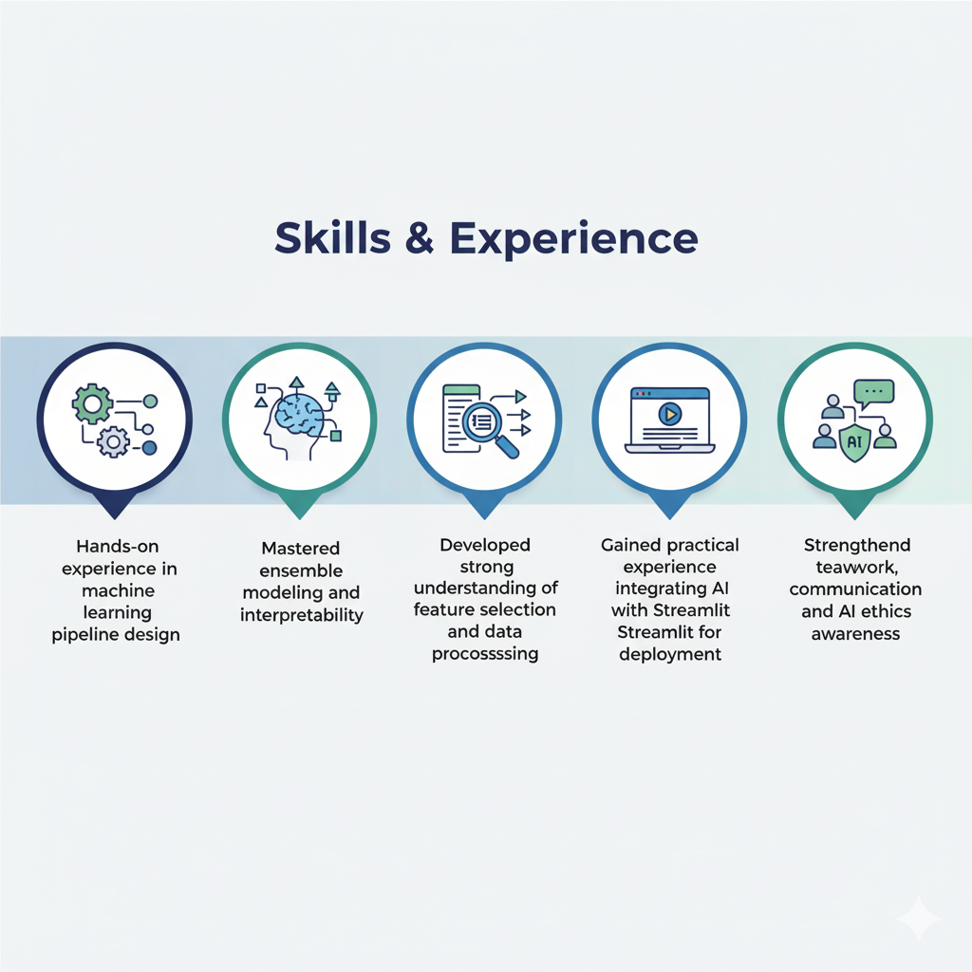
Learning Outcomes
Hands-on experience in designing machine learning pipelines.
Mastered ensemble modeling and how to interpret it.
Developed a solid understanding of feature selection and data preparation.
Gained practical experience using AI with Streamlit for deployment.
Enhanced teamwork, communication, and awareness of AI ethics.

Slide 16
CONCLUSION AND FUTURE SCOPE
Conclusion:
The system detects early signs of mental instability.
Ensemble models improved accuracy by using different algorithms.
The Streamlit GUI provides easy visualization and real-time results.
Future Enhancements:
Deep learning integration (BERT/LSTM).
Mobile app version.
Chatbot and emotional analysis.
Multilingual and dashboard support.

Slide 17
REFERENCES
[1] Chataut R., Naukya M., and Akl R. 2024. 6G networks and the AI revolution—Exploring technologies, applications, and emerging challenges. Sensors, 24(6):1888.
[2] Al-Tameemi I.K.S., Feizi-Derakhshi M.R., Pashazadeh M.R., Pashazadeh S., and Asadpour M. 2024. A comprehensive review of visual–textual sentiment analysis from social media networks. Journal of Computational Social Science, 7(3): 2767–2838.
[3] Alsaif H.F. and Aldossari H.D. 2023. Review of stance detection for rumor verification in social media. Engineering Applications of Artificial Intelligence, 119: 105801.
[4] Duan J., Xiong J., Li Y., and Ding W. 2024. Deep learning based multimodal biomedical data fusion: An overview and comparative review. Information Fusion, 112: 102536.
[5] Ruffo G., Semeraro A., Giacchino A., and Rosso P. 2023. Studying fake news spreading, polarisation dynamics, and manipulation by bots: A tale of networks and language. Computer Science Review, 47: 100531.
[6] Li H., Yang W., Wang W., and Wang H.Q. 2024. Harmfulness metrics in digital twins of social network rumors detection in cloud computing environment. Journal of Cloud Computing, 13(1): 36.
[7] Azevedo B.F., Rocha A.M.A., and Pereira A.I. 2024. Hybrid approaches to optimization and machine learning methods – A systematic literature review. Machine Learning, 113(7): 4055–4097.
[8] Hayawi K., Saha S., Masud M., Mathew S.S., and Kaosar M. 2023. Social media bot detection with deep learning methods: a systematic review. Neural Computing and Applications, 35(2): 8903–8918.
[9] Comito C., Caroprese L., and Zumpano E. 2023. Multimodal fake news detection in social media: A survey of deep learning techniques. Social Network Analysis and Mining, 13(1): 101.
[10] Azri A., Favre C., Harbi N., Darmont J., and Noûs C. 2023. Rumor classification through a multimodal fusion framework and ensemble learning. Information Systems Frontiers, 25(5): 1795–1810.

