Slide 1
EmojAI
Batch-01

Slide 2
Table of content
S.No. | Topic | Pg No.
1 | Team Information | 2
2 | Problem statement | 3
3 | Abstract | 4
4 | Introduction | 5
5 | Existing Solutions | 6, 7
6 | Drawbacks of Existing Solutions | 8
7 | Proposed Solution: EmojAI | 9, 10
8 | Output | 11
1

Slide 3

TEAM INFORMATION
Team Name: Tech T-Rex
Guide : Mrs. Afiya Parveen
Team Members:
Name | Roll No.
WAGMARE SANJANA | 22QM1A6760
RANGDAL PAVANSAI | 22QM1A6748
U. SAI HRUTHVIN | 21N81A67C5
POLUDASU NAGA PRABHAS | 22QM1A6746
2

Slide 4
PROBLEM STATEMENT
In digital communication (messaging apps, social media, emails), users often struggle to quickly and accurately select emojis that reflect the precise emotional tone and intensity of their text messages. Manually searching through extensive emoji libraries or choosing generic options can lead to messages that feel less expressive, are potentially misinterpreted, or simply lack the visual emphasis intended by the sender. There is a need for an automated system that can analyze the sentiment within a given text message and suggest contextually relevant emojis to enhance expressiveness and reduce the effort required from the user.
3

Slide 5
ABSTRACT
The Ultimate Emoji Suggester is a sentiment-driven emoji recommendation tool designed to enhance digital communication. It analyzes the emotional tone of user messages—such as happiness, sadness, excitement, or confusion—using keyword-based sentiment detection with intensity modifiers. Based on this analysis, it intelligently suggests relevant emojis from a curated emoji library categorized by emotion and intensity. Built with Python and Pydantic for data modeling, this system features a user-friendly command-line interface and can be integrated into messaging apps, chatbots, or social media platforms to make conversations more expressive and engaging.
4

Slide 6
INTRODUCTION
Emojis are key to modern communication, adding emotional context and tone to plain text.
Manually choosing the right emoji can be time-consuming or emotionally inaccurate.
This project introduces an intelligent emoji suggester that analyzes the user's message sentiment.
It detects emotional tones like happy, sad, excited, angry, confused, etc., with varying intensity levels.
Based on the sentiment, it recommends the most contextually appropriate emojis.
Built using Python with modular design, it can be easily integrated into messaging apps, chatbots, or support systems.
Aims to make digital conversations more expressive, natural, and emotionally intelligent.
5

Slide 7
EXISTING SOLUTIONS
Gboard (Google Keyboard):
Automatically suggests emojis, GIFs, and stickers based on typed text.
Uses machine learning to predict relevant emojis contextually.
SwiftKey Keyboard (Microsoft):
Offers emoji predictions based on user typing habits and emotional context.
Learns from user behavior over time to improve suggestions.
Messenger & Instagram (Meta):
Suggests emojis and reactions based on chat context.
Includes emoji-reaction shortcuts for fast emotional expression.
6

Slide 8
EXISTING SOLUTIONS
Slack:
Recommends emoji reactions to messages in threads.
Supports custom emoji usage and predictions based on recent behavior.
iOS Predictive Emoji (Apple):
iOS keyboard highlights words that can be replaced with emojis as you type.
Provides emoji recommendations in the predictive text-bar.
7

Slide 9
DRAWBACKS OF EXISTING SOLUTIONS
Feature / Tool | EmojAI | Gboard | SwiftKey | Slack | iOS Predictive Emoji
Sentiment Detection | ✅ Advanced keyword-based with intensity analysis | ❌ | ❌ | ❌ | ❌
Emotion-Based Emoji Suggestion | ✅ Based on emotion category & strength | ✅ | ✅ | ✅(limited) | ✅(based on keywords)
Custom Emoji Library by Intensity | ✅ Supports mild, moderate, and strong levels | ❌ | ❌ | ❌ | ❌
Natural Language Understanding | ✅ With intensity modifiers (e.g., "very sad") | ⚠️ Basic | ⚠️ Basic | ❌ | ❌
Integration Potential | ✅ CLI-ready, extensible to APIs or chatbots | ✅ | ✅ | ✅ | ✅
8

Slide 10
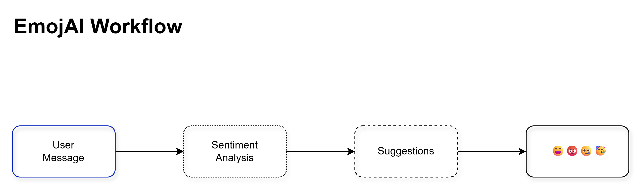
PROPOSED SOLUTION: EmojAI
AI-Powered Emoji Suggestions
EmojAI uses advanced AI (Gemini API) to understand the context, tone, and sentiment of the user’s message to suggest highly relevant emojis.
Sentiment Analysis Integration
Detects emotional tone in user messages using keyword mapping, intensity modifiers, and question-based logic.
Fallback Mechanism
In case the AI fails or encounters issues (like no response, network problems), EmojAI provides a predefined set of fallback emojis to ensure the user always receives suggestions.
Interactive Command-Line Interface (CLI)
EmojAI offers a simple, real-time CLI where users can input their messages and instantly see suggested emojis.
9

Slide 11
PROPOSED SOLUTION: EmojAI
Emotion Categorization:
Classifies messages into emotions like happy, sad, excited, love, confused, angry, etc., with graded intensity (mild, moderate, strong).
Enhanced User Experience
By automating emoji suggestions, EmojAI reduces the effort users need to express themselves better in digital conversations.
Scalable for Future Integrations
Though it starts with CLI, EmojAI is designed to be extended easily into messaging apps, chatbots, or even browser extensions in the future.
Language Flexibility (Future Scope)
The design allows future upgrades to support multiple languages for a broader, global user base.
10

Slide 12
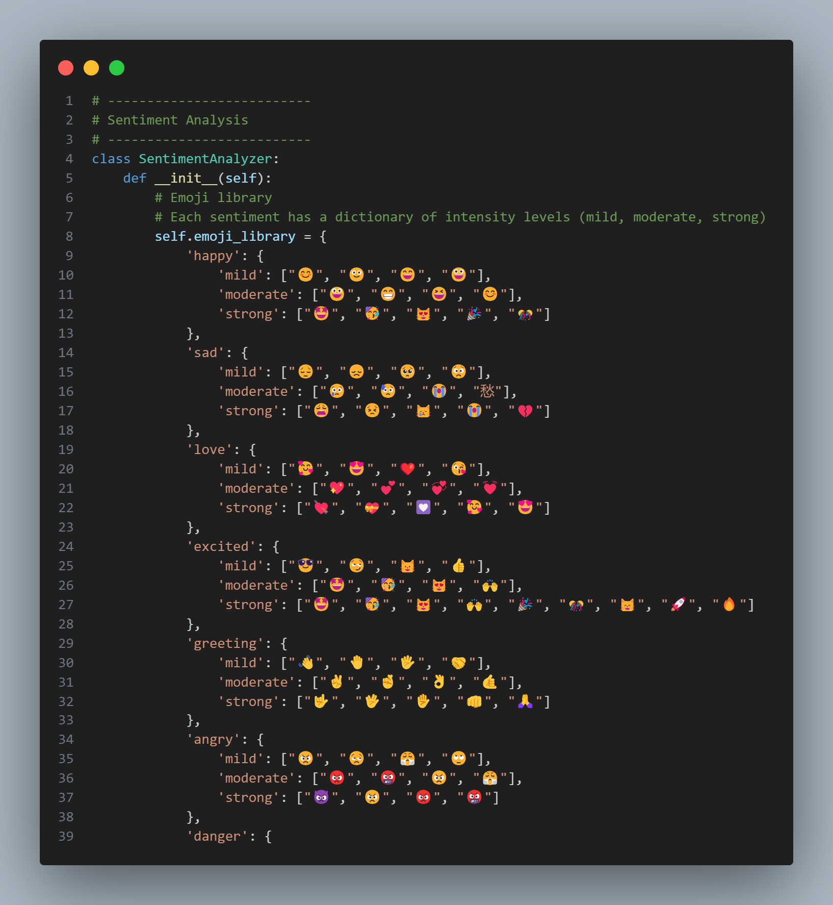
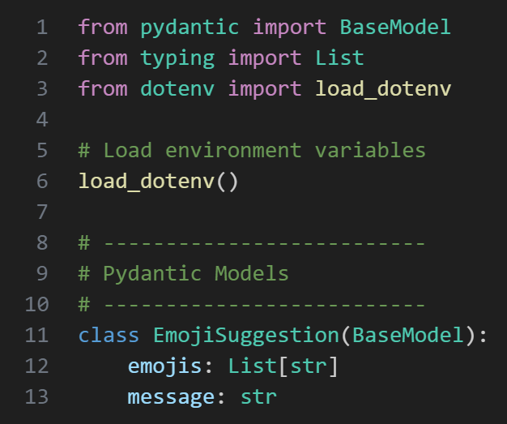
Code: EmojAI
10

Slide 13
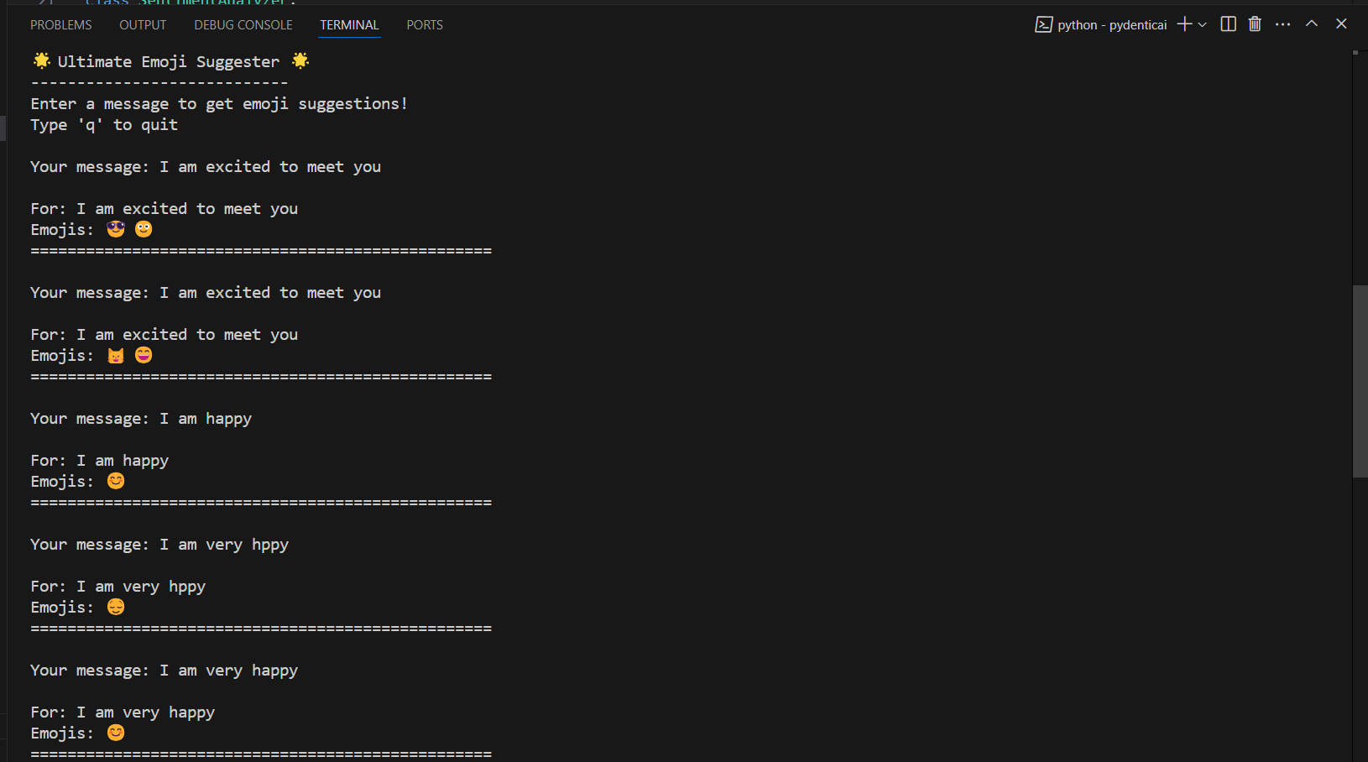
OUTPUT
11

Slide 14
Thank You!

