Slide 1
Crop Production Prediction in Tamil Nadu
Data Analysis and Regression Modeling
K. Pavithra Srinivasan
2nd November 2025

Slide 2
Project Overview
- Agriculture is vital for Tamil Nadu and India.
- Predicting crop production helps farmers and policymakers.
- Goal: Analyze crop production patterns and predict yield using regression models.

Slide 3
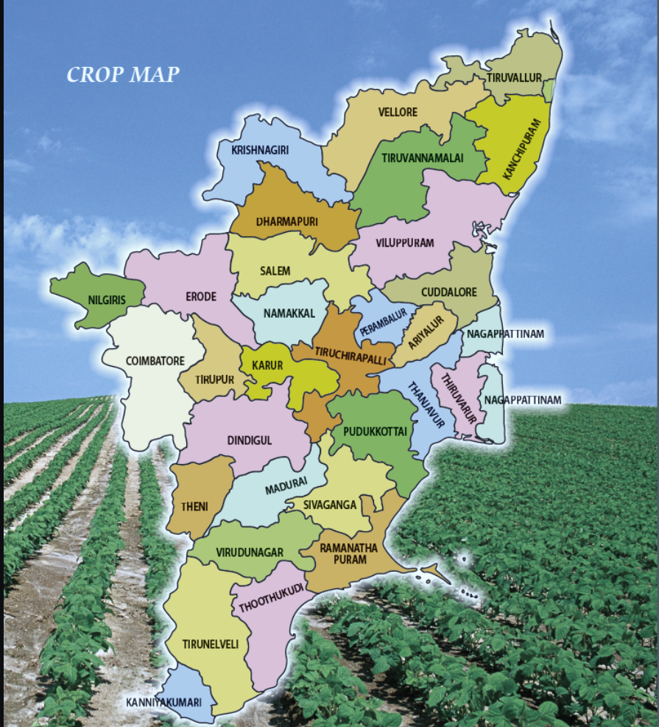

Slide 4
Dataset Preparation
- Started with India crop dataset.
- Filtered only Tamil Nadu records using NumPy.
- Prepared separate Tamil Nadu crop CSV file.
Crop production in India
dataset:
['State_Name’
'District_Name’
'Crop’
'Crop_Year’
'Season’
'Area’
'Production’
'Yield']
Crop production in Tamil Nadu
dataset:
['State_Name’ == Tamil Nadu
'District_Name’
'Crop’
'Crop_Year’
'Season’
'Area’
'Production’
'Yield']

Slide 5
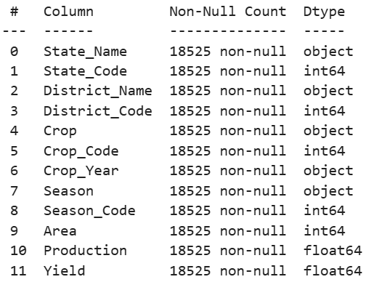
Data Preprocessing
- Loaded Tamil Nadu dataset in Pandas.
- Converted categorical fields to numerical: State_Name, District_Name, Season, Crop.
- Normalized numerical fields.
- Replaced outliers with median values.

Slide 6
Exploratory Data Analysis (EDA)
Performed multiple visual analyses:
- Top 10 crops by production
- Area-wise production by district
- Season-wise rice production
- District-wise rice production
- Rice production over years
- Crop-wise production
- District-wise production heatmap
- Area vs Crop Year
- Least 5 districts in agriculture
- Season-wise crop distribution
- Production over years

Slide 7
Regression Modeling
- SLR: One predictor at a time
- MLR: Multiple predictors (District_Code, Season_Code, Crop_Code)
- Scatter plot shows imperfect predictions
- MLR R² = 0.008

Slide 8
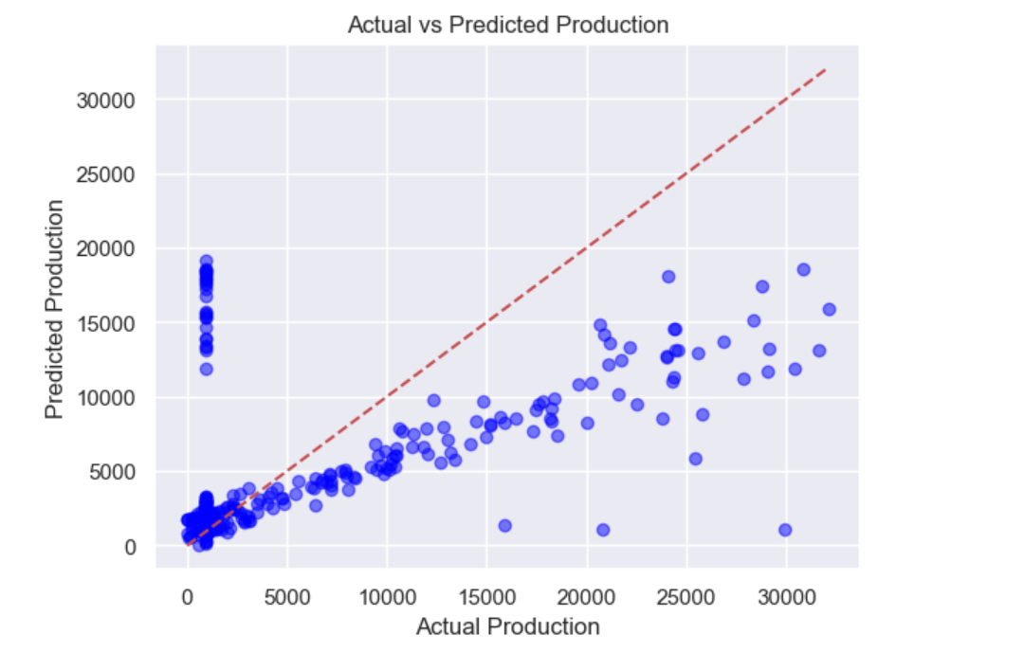

Slide 9
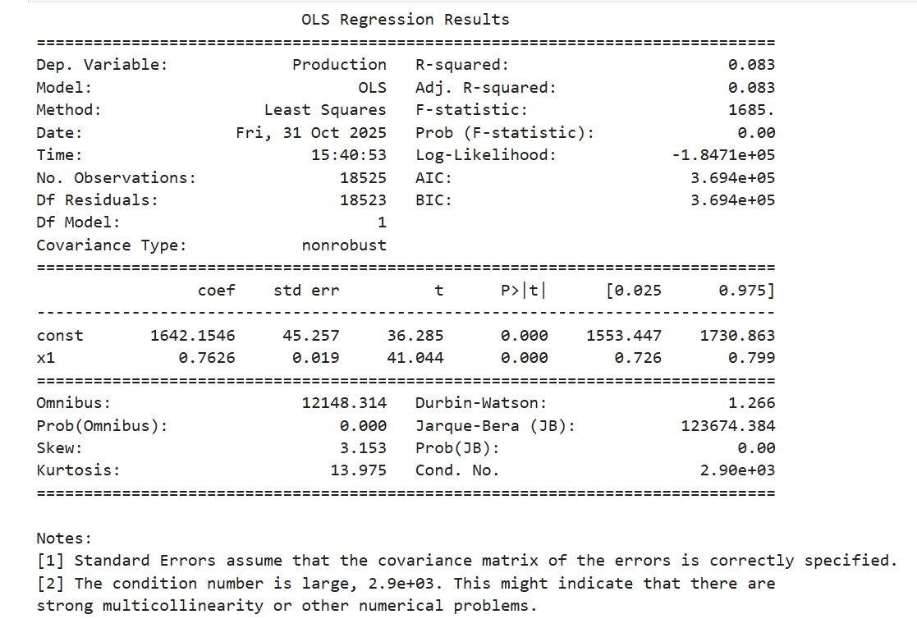
SLR summary
Observation:
"Increasing Area slightly increases Production, and this effect is statistically significant. But since the R² is very low (0.083), Area alone cannot explain most of the variation in Production. Other factors should be included for better prediction."
So, we should move next to a Multiple Linear Regression (MLR) model, including more features like District Code, Crop Code, Season Code and Crop_Year to capture other influences.

Slide 10
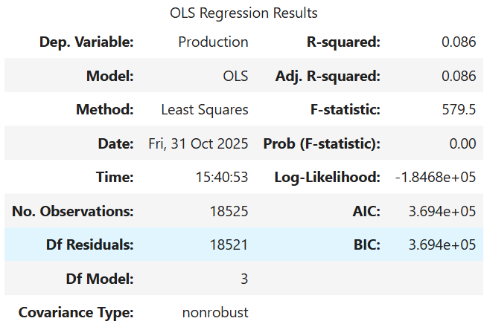
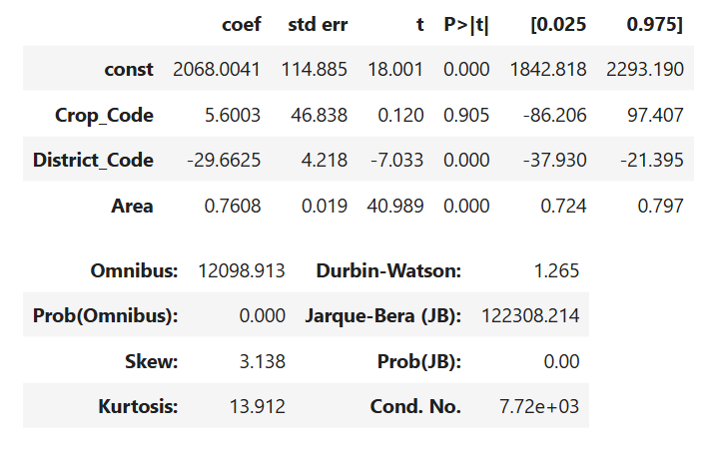
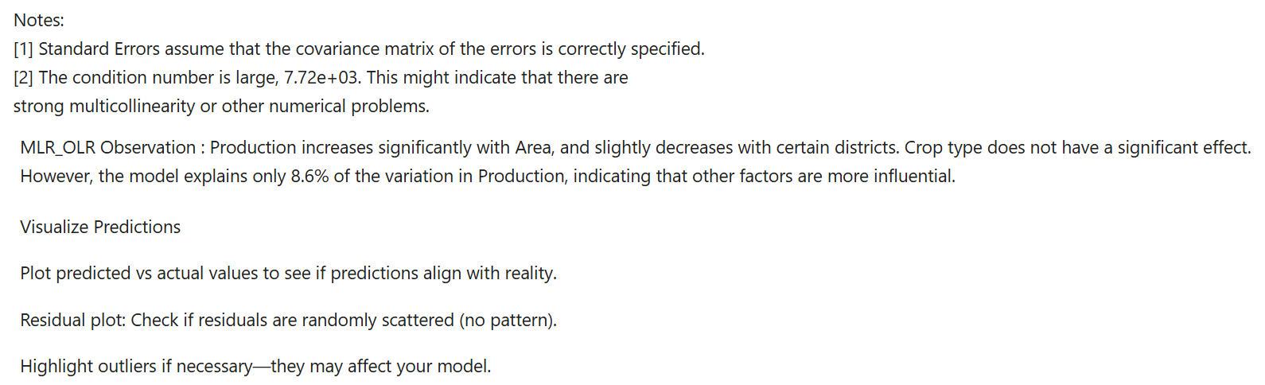
MLR summary

Slide 11
Key Observations
- Data preprocessing and normalization improved dataset quality.
- EDA revealed seasonal, district-wise, and crop-wise production patterns.
- MLR model predictions are limited due to low R² and multicollinearity.
- Larger area does not always guarantee higher production.

Slide 12
Conclusion
- Successfully prepared Tamil Nadu crop dataset from India dataset.
- Preprocessing, normalization, outlier treatment, and EDA done.
- Regression models provided insights but limited predictive accuracy.
- Future improvements: Include rainfall, soil type, fertilizer use, and advanced ML models.

Slide 13
Future Scope
- Extend study to other crops across Tamil Nadu.
- Include additional features for better prediction.
- Apply advanced regression or machine learning models.

Slide 14
Workflow Summary
Data Analysis Workflow:
India Dataset → Filter Tamil Nadu → Dataset Preparation → Preprocessing → EDA → Regression → Evaluation → Conclusion

