Slide 1



DUTY SCHEDULE ALLOTMENT SYSTEM
MICRO PROJECT
Name : Pavithra K
Roll No: 23ADR124
Date : 18/11/2024

Slide 2
PROBLEM STATEMENT
Manual duty allotment scheduling is time-consuming and prone to errors.
Difficulty in managing employee schedules
Inefficient use of resources
Lack of automation

Slide 3
Project Overview
Automated Duty Allotment Schedule System using Java
Creates and manages employee duty schedules
Assigns shifts and tasks to employees
Stores data in MySQL database

Slide 4
System Features
Employee data management
Shift and task assignment
Schedule generation
Database integration
User-friendly interface
Advantages
Efficient duty allotment
Reduced errors
Improved resource utilization
Easy data management

Slide 5
Java Code Overview
Uses Java Scanner for user input
Connects to MySQL database using JDBC
Implements random shift assignment
Stores data in DutySchedule table
Tools Used
MySQL Workbench
Connector/J
Command Prompt
Java IDE

Slide 6
Flow Chart
Date
Get required inputs
Database connection
No. of employees
Add to database
User options
Employee name
Display from database
Work selection
Schedule of the duty
Terminate

Slide 7
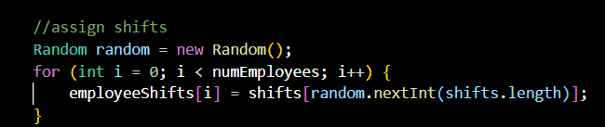
Code Snippets
Shift Assignment :
Assigns shifts to employees randomly using Java's Random class

Slide 8
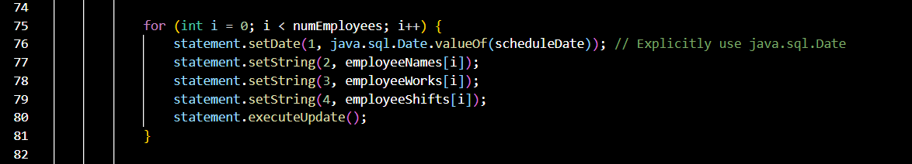
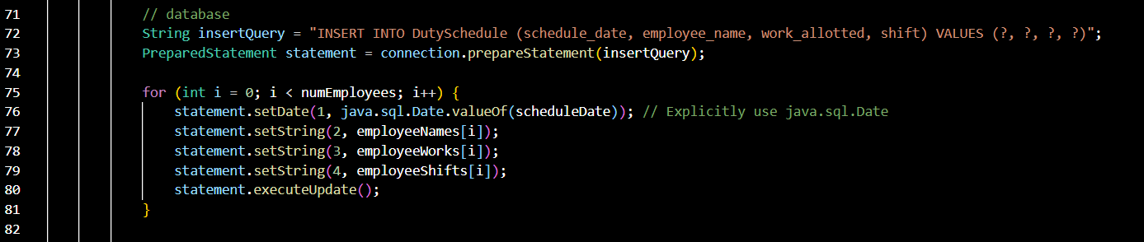
Schedule Generation Algorithm
Generates a schedule for each employee, displaying their name, shift, and work allotted
Database Query
Inserts employee schedule data into the DutySchedule table using a Prepared Statement.

Slide 9
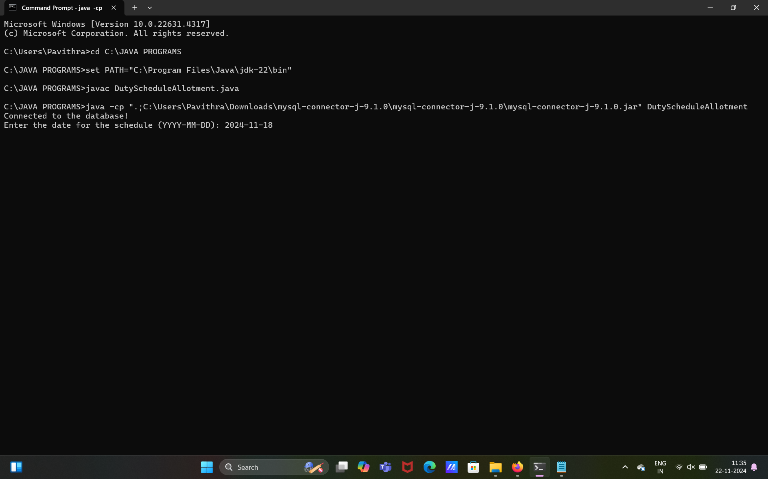
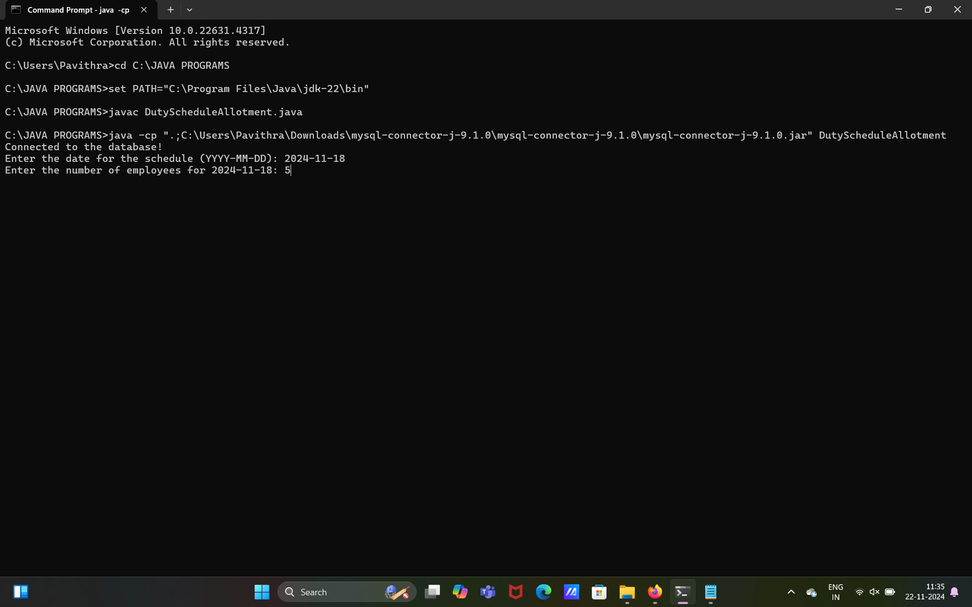
Output Screenshots
Entering the date for the duty allotment
Entering the No. of employees assigned for that date

Slide 10
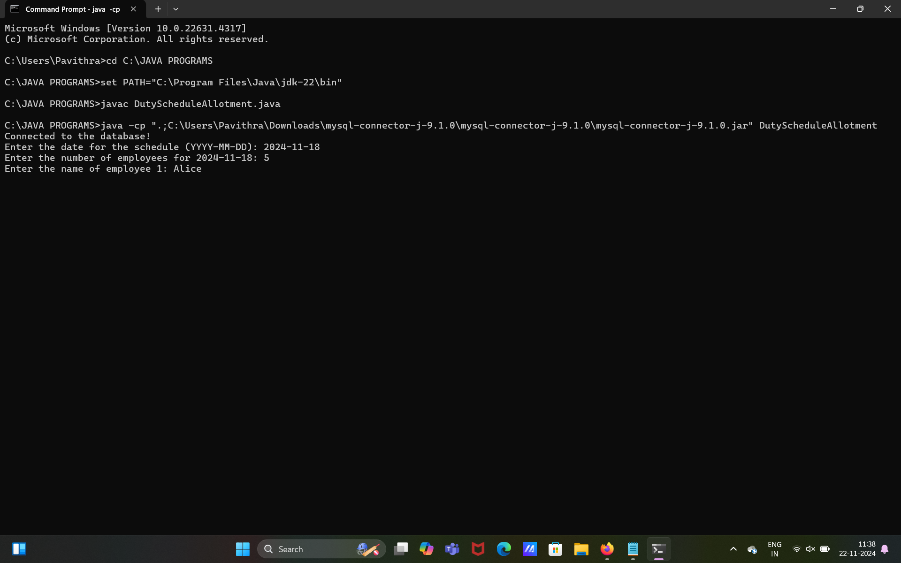
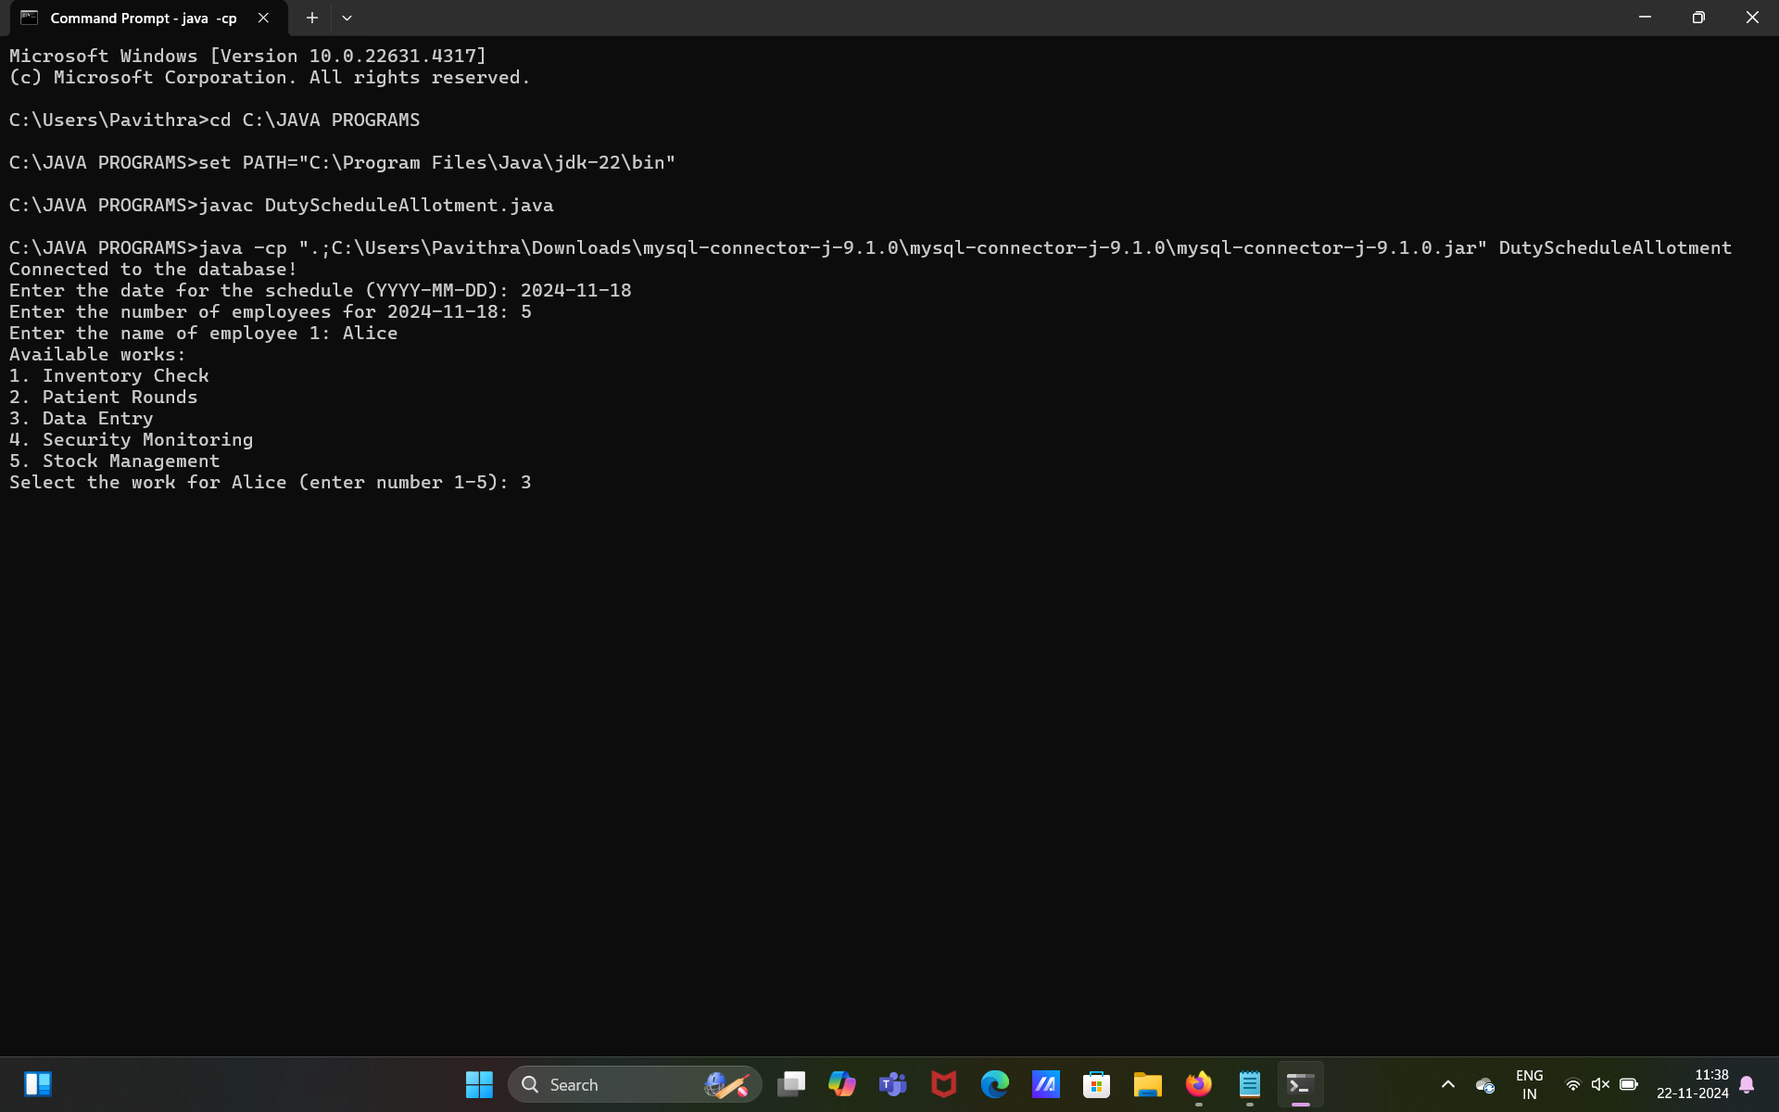
Entering the name of the employee
Selecting the work assigned for that respective employee

Slide 11
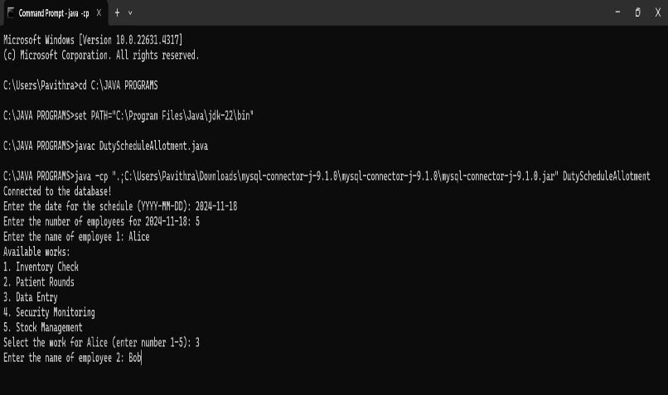
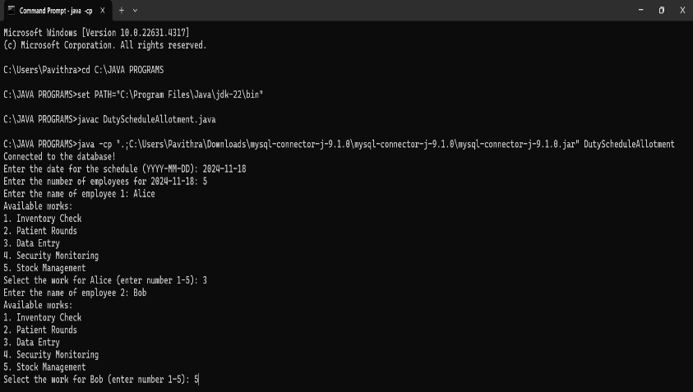
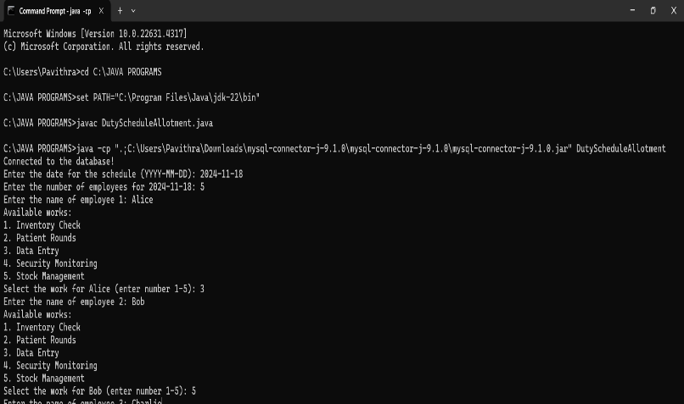
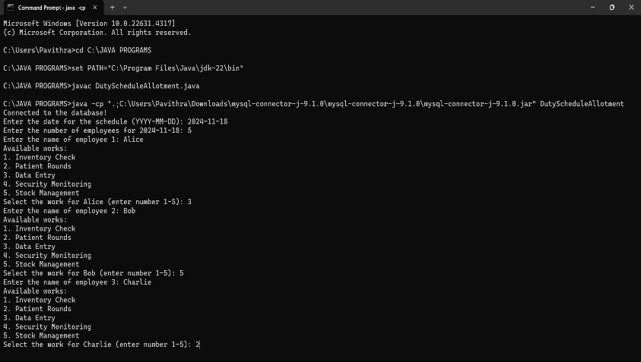
Entering the name for each employee and selecting the work
For employee 2:
For employee 3:

Slide 12
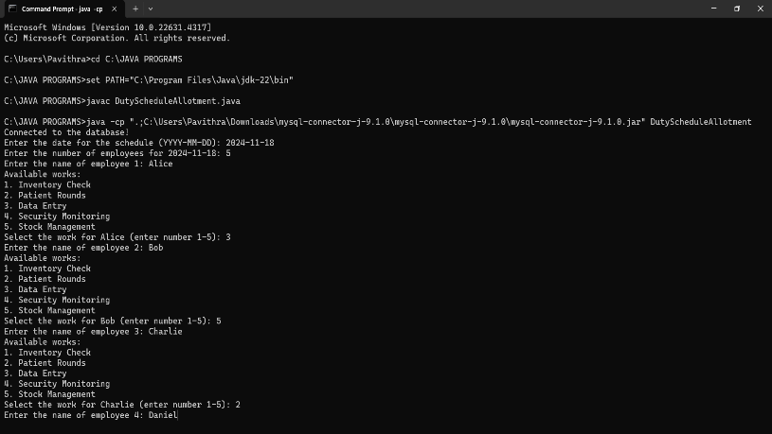
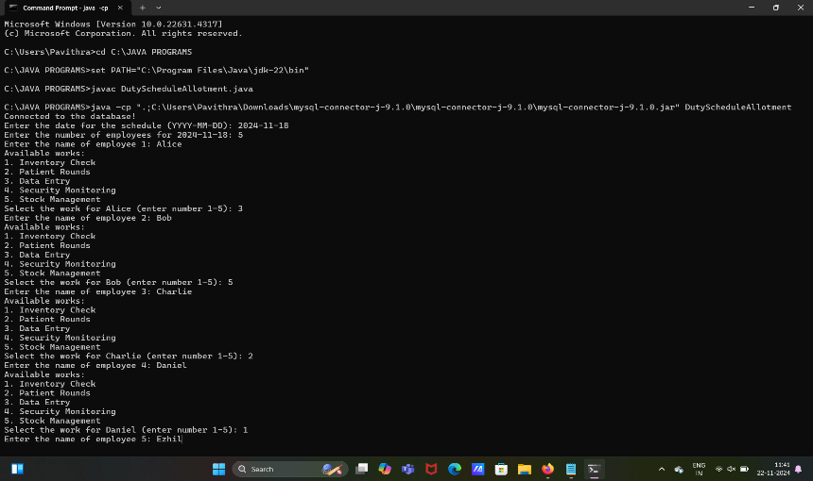
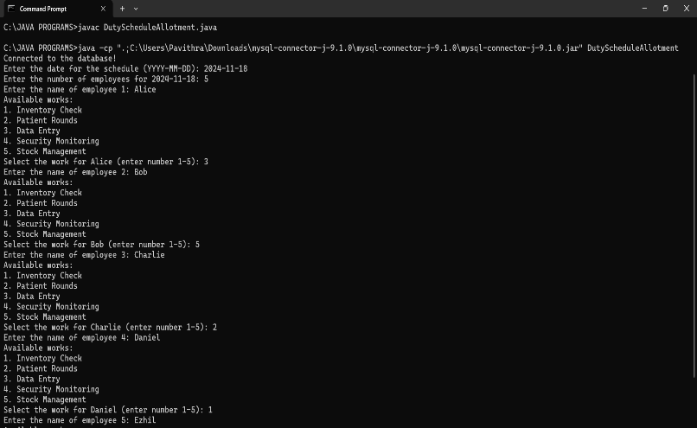

For employee 4:
For employee 5:

Slide 13
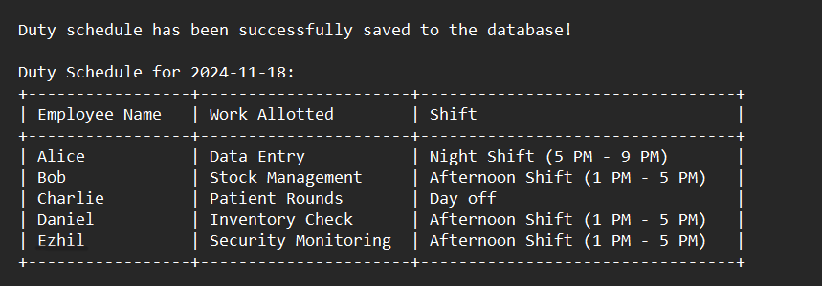
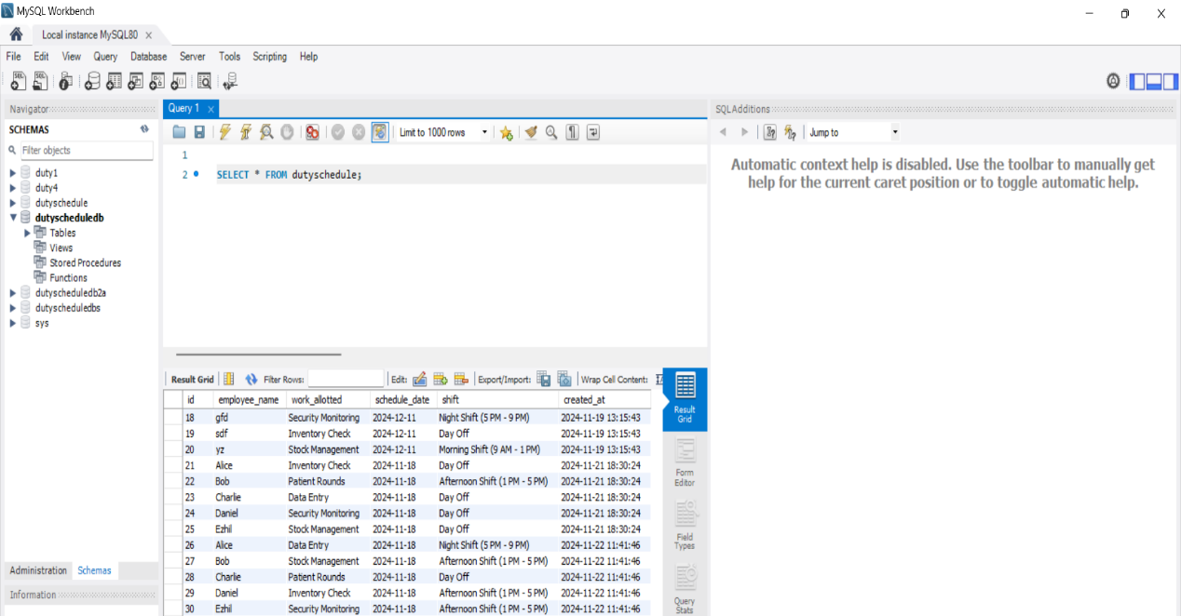
Output of the schedule
Schedule saved in the Database

Slide 14
Conclusion
The Duty Allotment Schedule System successfully automates employee scheduling
Summary:
Efficient automation of employee Scheduling
Reduced manual errors and increased productivity
Improved resource utilization and workforce management

Slide 15
THANK YOU

