Slide 1



BATCH NO : 47 ALCOHOL SENSING ENGINE LOCK WITH GPS
By
Pavithran A V [21BEC145]
Praveen S [21BEC151]
Priyakanth K [21BEC156]
Sabari J [21BEC168]
GUIDE
Mr. T. SIVAKUMAR.

Slide 2
List of Content
ABSTRACT
INTRODUCTION
PROPOSED SYSTEM
LITERATURE SURVEY
METHODOLOGY
FLOWCHART AND EXECTION
RESULT
APPLICATIONS AND ADVANTAGES
CONCLUSION
REFERENCES

Slide 3
ABSTRACT
The design and implementation of an Alcohol Detection with Engine Locking for cars using the Arduino-UNO as the controlling unit is done. The system will continuously monitor the level of alcohol concentration by alcohol detection sensor and thus turn off the engine of the vehicle if the alcohol concentration is above the threshold level. We try to tackle the problem of loss of life and property due to drunken driving. In our project, we have used Arduino Uno microcontroller attached to an alcohol sensor which detects the presence of alcohol by analyzing breath of a person driving the vehicle. Engine of the vehicle is turned off. This model will also send a message to the registered mobile number with the location of the vehicle using the SIM800L.
Key Words: Arduino UNO, Buzzer, LED, SIM800L, MQ-3 Sensor, DC Motor.

Slide 4
INTRODUCTION
One major reason of deaths on Indian roads is accidents due to drunken driving. This happens because of drunk people being able to take control of vehicle even after being drunk.
In our project, we propose to solve this problem by designing a system which automatically switches off the vehicle’s engine whenever alcohol of certain quantity is detected in the driver’s breath.
As soon as the presence of alcohol is detected, the microcontroller stops the engine of the vehicle and a siren is blown to alert nearby people to convey that something is wrong with the vehicle and a message “Alcohol Detected” is flashed on the LCD screen which is installed in the system, so that nearby people can interpret gravity of the situation and inform the concerned authorities to avoid any kind of incident.
This system when implemented in vehicles will not only avoid the deaths and property loss due to drunken driving, but will also help in reducing the total number of accidents which occur due to this.
Moreover, people in other vehicles or pedestrians will be much more safe because of the vehicle being stopped right away.

Slide 5
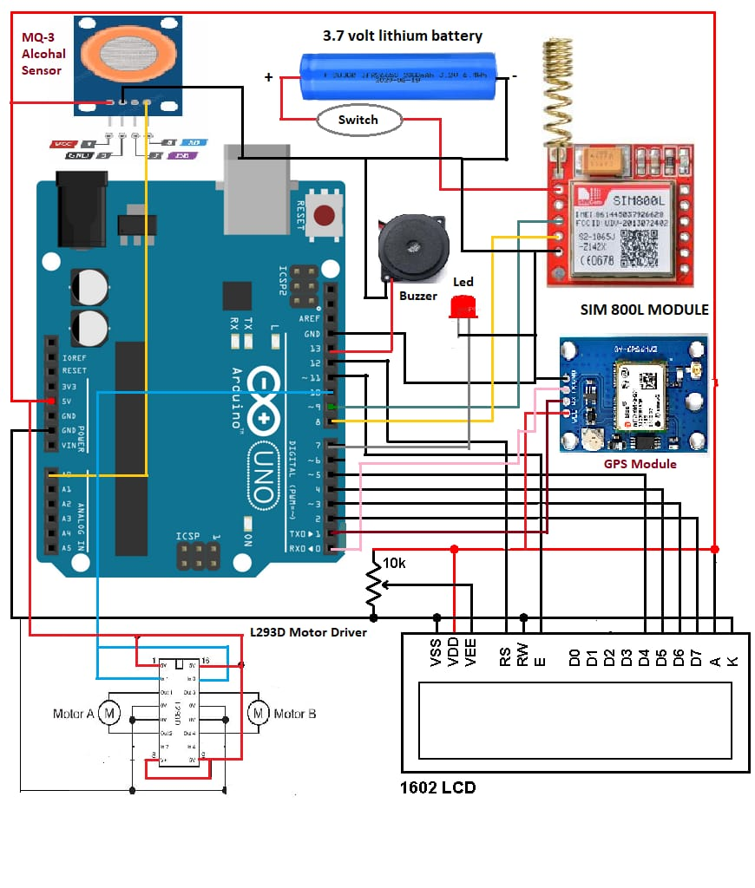
PROPOSED SYSTEM
Using Arduino Uno microcontroller, we propose to design a system consisting of an alcohol sensor, MQ3, to detect the presence of alcohol by analyzing a person’s breath and shutting down the vehicle’s engine when a specific amount of alcohol is detected to prevent any kind of mishap or accident that may occur due to the driver taking control over the vehicle. Hence, drunken driving is controlled, thereby minimizing the loss of life and property.
HARDWARE MODULES

Slide 6
LITERATURE SURVEY
The author has proposed a method to detect alcohol but uses GPS and GSM module which increases the overall cost which could be avoided. In our project, we are using a siren which will be more cost efficient. Use of siren will alert the people nearby and hence any kind of necessary action can be taken. [1]
The authors propose to use a smart helmet to avoid accidents. There are many flaws with their design. A major shortcoming is the limitation of the its application to only vehicles which use helmets, i.e. 2 wheelers which is not a feasible idea while driving, especially for short distances. Another drawback being, the system when implemented makes the helmet too heavy which is not favorable for driving. Also, they have used an expensive microcontroller whereas we are using open source hardware, which is very cheap. [2]

Slide 7
The authors discuss about complex health monitoring systems and infrared sensor to detect the presence of alcohol. A major drawback of this system is the possibility of a false alarm. The system is designed in a manner that even a slight change in some particular condition can result in ringing false alarms even though everything was normal. In our project, we are using only the required technology thereby making the system more reliable and cost effective when implemented. [3]
The authors have proposed a system to prevent the accidents due to drunken driving. Major drawback of this system is that they have used PIC16F877A microcontroller which is not as useful as Arduino Uno microcontroller that we are using. Also, they have used an old design system which is not useful and increases the overall cost of the system which makes it expensive and somewhat unaffordable to certain segments of society thereby limiting its scope to be used. Hence, our system is more cost effective and can be easily afforded. [4]

Slide 8
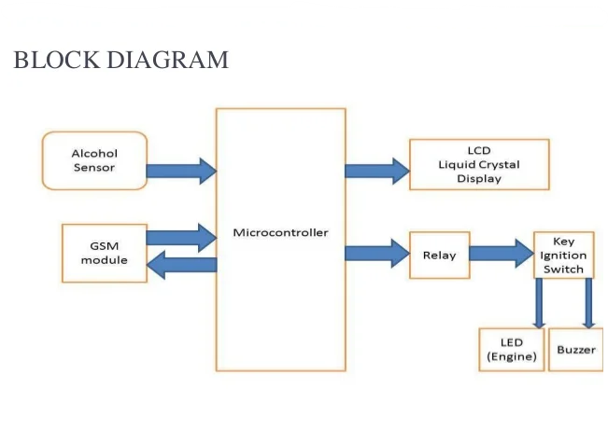
METHODOLOGY
The Alcohol Detection with Engine Locking gadget permits to lessen injuries which are probably taking region because of below the effect of alcohol using. MQ 3 sensor detects the presence of alcohol with inside the environment. The sensor offers output primarily based totally definitely absolutely at the attention of the alcohol if the alcohol hobby is better the conductivity of the MQ-three sensor will growth which in flip offers the studying to ARDUINO. If the studying is more than the brink degree, ARDUINO will save you the DC motor.

Slide 9
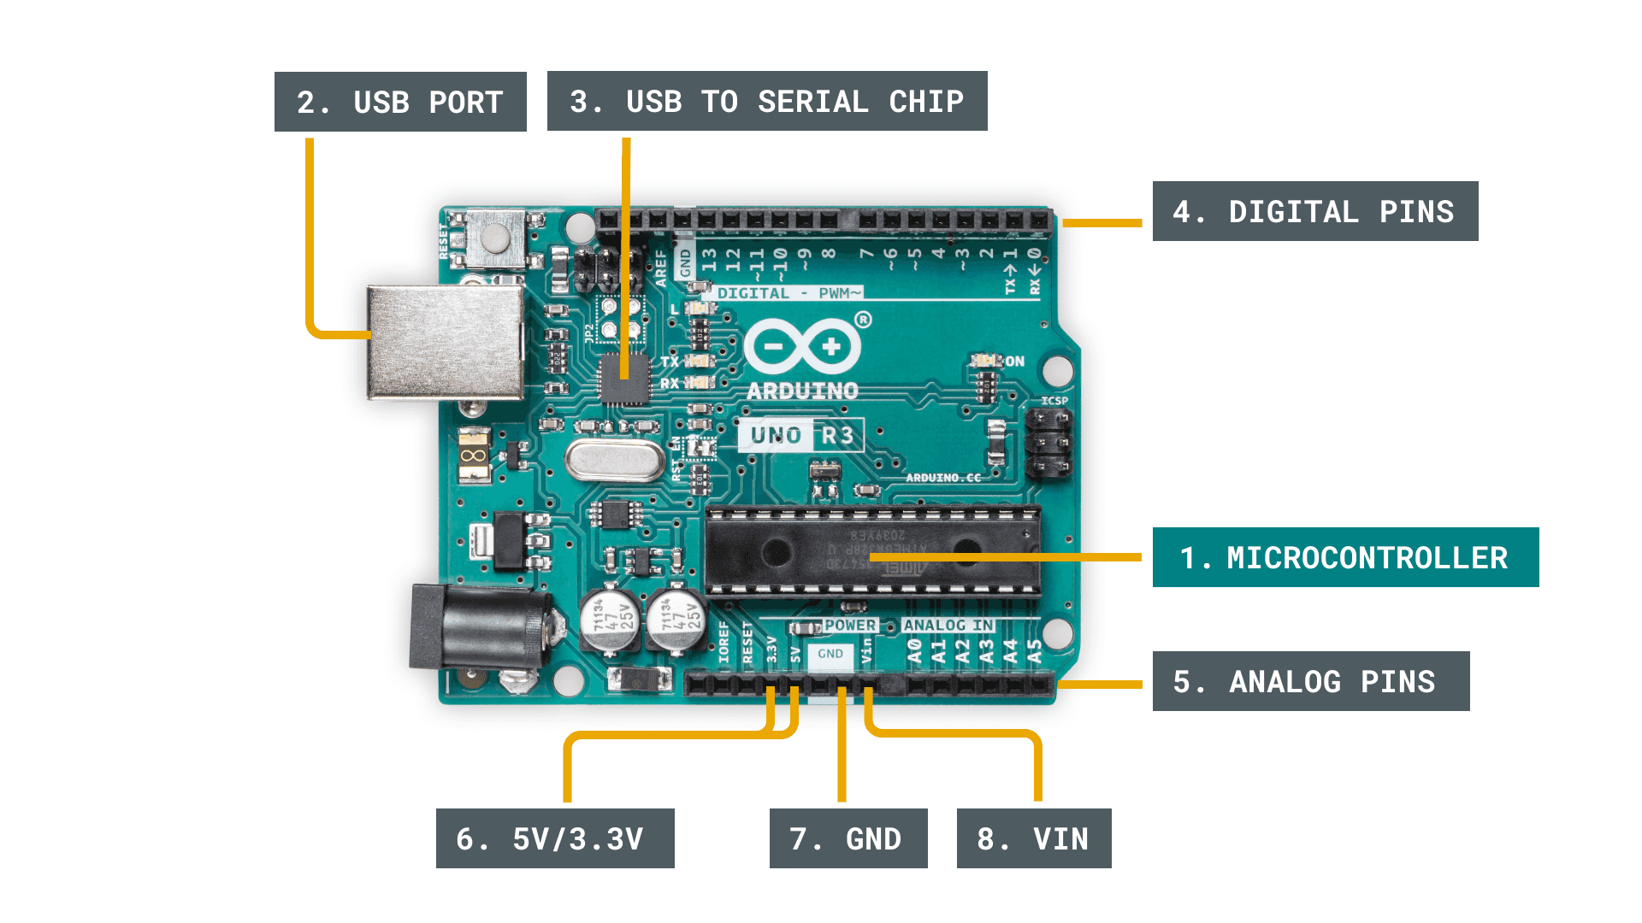
ARDUINO :
Arduino Uno is based on ATmega 328P microcontroller. It consists of 20 pins out of which 14 are digital pins and the rest 6 are PWM. It can be programmed using a computer on Arduino IDE. Arduino being open sourced, has a really good community which makes development very convenient and any kind of problems are taken care of by the community. We are using it because it is open sourced and hence very cheap as compared to conventional microcontrollers. It can handle a large number of operations making it very convenient to use.

Slide 10
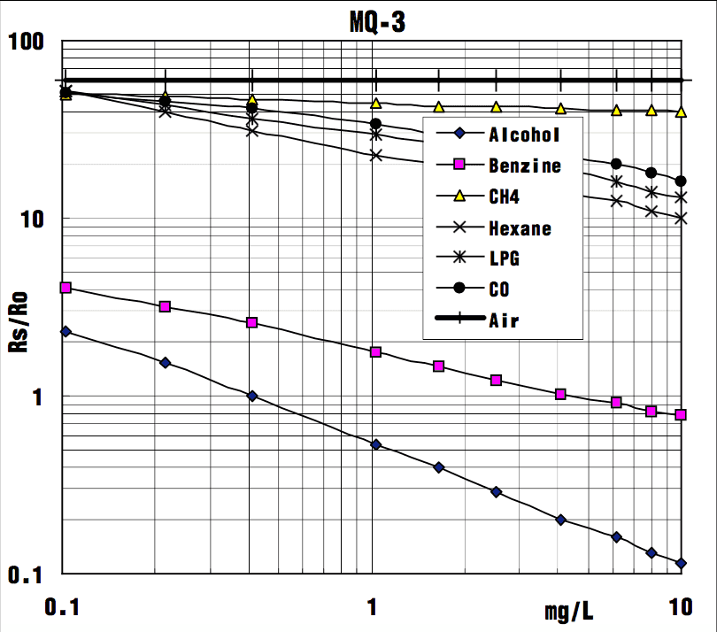
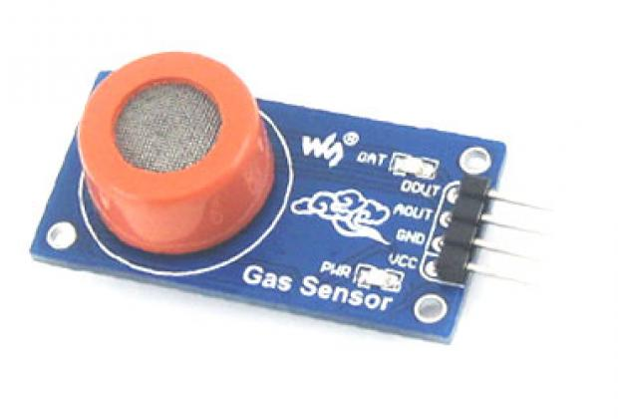
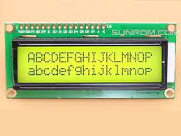
MQ3 SESNSOR :
At pin A0, we connect the MQ3 alcohol sensor. It is one of the most accurate and mostly used alcohol sensor. This sensor can detect the presence of alcohol up to a range of 2 meters thereby making the detection process much accurate. Also, the sensitivity can be adjusted according to needs, making the sensor more versatile.
LCD DISPLAY:
A 16X2 LCD is a device which is used for displaying any message in the form of text and numbers. They can be easily programmed and can be used with different microcontrollers. They are preferred over seven segment display due to the ease of their use and convenience

Slide 11
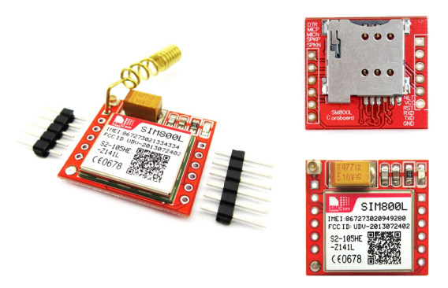
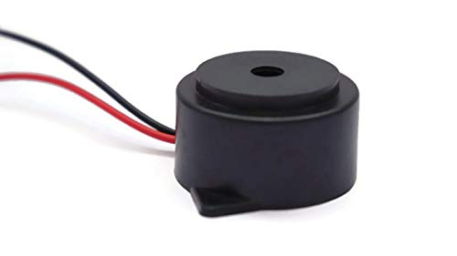
SIM800L :
This is a smaller and solid remote module structure. The SIM800L is an entire group Dual-band GSM/GPRS strategy in a SMT module which can be installed in the client applications. The SIM is embedded in the SIM800L module and the message will individual that the vehicle is not safe be sent to the cops or any specific .
BUZZER:
The alarm unit used is a buzzer which indicates when alcohol is detected. The buzzer is activated when an oscillating signal is passed through the coil of the buzzer and it fluctuates the disk present in the buzzer at a particular frequency which is equal to the driving signal. The buzzer indicates that vehicle in front of us is unsafe.

Slide 12
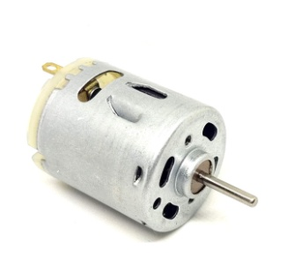
MOTOR :
The DC motor is connected to the L293D which in turn is connected to Arduino and is given 5V supply. DC motor works on the principle of Lorentz Law. When an electric current is passed through the motor, the coil carrying the current produces magnetic field which in turn rotates the coil with the force experienced.
SOFTWARE REQUIREMENT :
Arduino IDE Downloading Arduino IDE software and then power up Arduino Board. and Launching Arduino IDE.
The Arduino integrated development environment is a cross platform Application, that is written in Java programming language and C/C++.

Slide 13
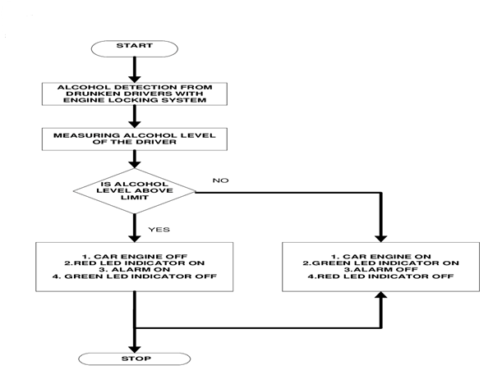
FLOWCHAT AND EXECUTION
• STEP 1: Power on the system
• STEP 2: checks for alcohol concentration
• STEP 3: if alcohol is detected
• STEP 3.1: turn off vehicle engine
• STEP 4: Else
• STEP 5: vehicle engine running

Slide 14
RESULT
If an alcoholic character attempts commanding the automobile the alcoholic sensor determines the lifestyles of alcohol content material cloth material and close to down the automobile engine and the buzzer will alarm. We can keep away from any type of lack of lifestyles with the beneficial aid of using this gadget. All gadgets is examined and related as required thereby giving us the masses-favored give up quit end result five.
The Alcohol detection with a motor locking gadget may be achieved in any 2 or four-wheelers.
Alcohol detection with motor locking can assist save you injuries because of the effect of alcohol using.
Alcohol detection with a motor locking gadget may be very useful for the police.
The Alcohol detection with motor locking gadget proves an automated protection gadget for cars and wonderful motors
APPLICATIONS AND ADVANTAGES:

Slide 15
CONCLUSION
We have provided a totally powerful method to extend a wise gadget for motors for alcohol detection whose center is Arduino.
Since the sensor has a nice sensitivity fashion of around 2 meters, it is able to healthful in any automobile. The entire gadget has furthermore the gain of small amount and similarly reliability.
As the developing public belief is that automobile protection is more important, advances in public protection are gaining recognition than with inside the past. • The destiny scope of this gadget is to govern the reasons of the twist of fate because of alcohol intake.
This gadget improves the protection of people and as a quit end result supplying powerful improvement within side the car corporation concerning reducing the injuries induced because of alcohol.

Slide 16
REFERENCES
Lea Angelica Navarro, Mark Anthony Diño, Exechiel Joson, Rommel Anacan, Roberto Dela Cruz Electronics Engineering Department, Technological Institute of the PhilippinesManila [2016, 7th International Conference on Intelligent Systems, Modelling and Simulation] - “Design of Alcohol Detection System for Car Users thru Iris Recognition Pattern”.
Mugila J., Muthulakshmi.M, Santhiya K, Prof.Dhivya. P [International Journal of Innovative Research in Science Engineering and Technology (IJIRTSE) ISSN: 2395-5619, Volume – 2, Issue – 7. July 2016] - “Smart helmet system using alcohol detection for vehicle protection” .
Dhivya M and Kathiravan S, Dept. of ECE, Kalaignar Karunanidhi Institute of Technology [Smart Computing Review, vol. 5, no. 1, February 2015] - “Driver Authentication and Accident Avoidance System for Vehicles”
Nimmy James, Aparna C, Tenna P John, International Journal of Research in Computer and Communication Technology, Vol 3, Issue 1, January- 2014 – “Alcohol Detection System”.

Slide 17


