Slide 1


Sales Domain Using SQL
PRESENTED BY
PAVITHRAN K M

Slide 2
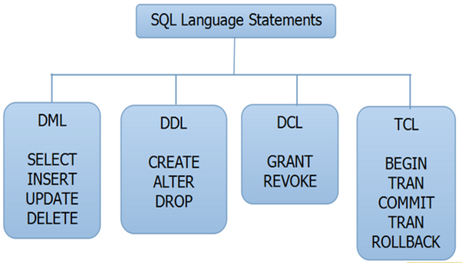
SQL

Slide 3
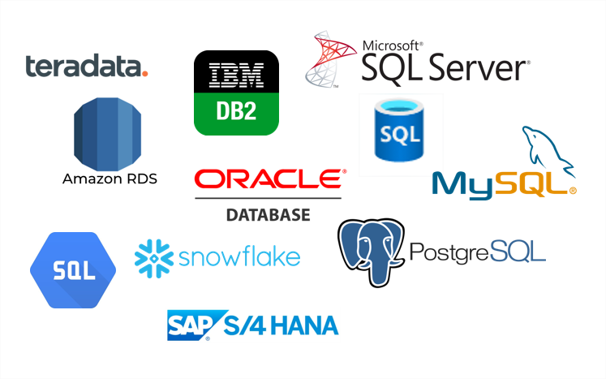
SQL DATABASES

Slide 4
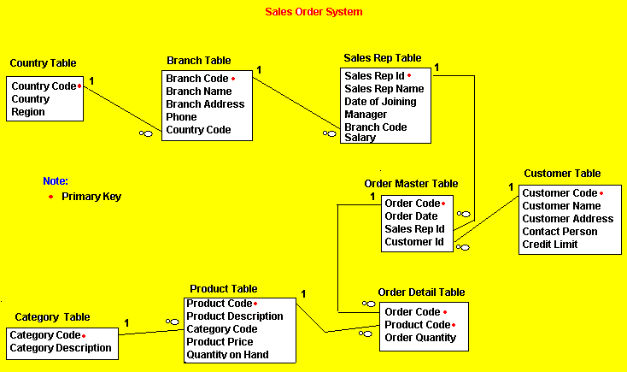
Sales Domain E-R Diagram

Slide 5
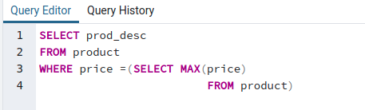
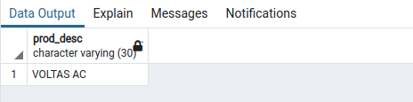
MAX AND MIN
Which product has Maximum price

Slide 6
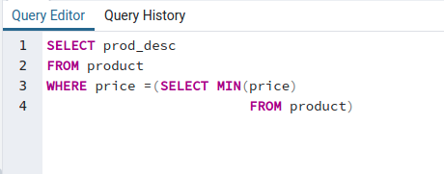
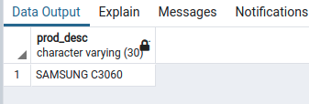
Which product has Minimum price

Slide 7


COUNT,ASC,DESC,LIMIT
Count total products

Slide 8
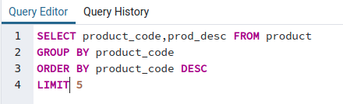
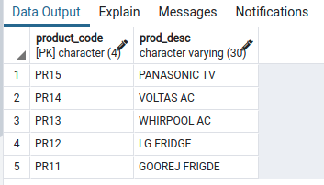
Display five products in descending order

Slide 9
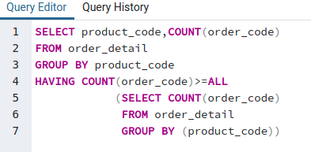

GROUP BY,HAVING
Which is the frequently ordered product

Slide 10
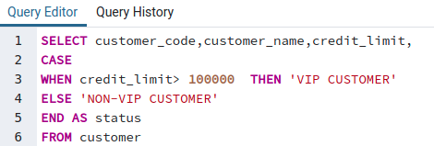
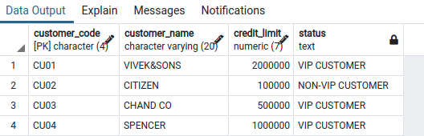
CASE STATEMENT
Display customer status as VIP and NON-VIP using CASE

Slide 11
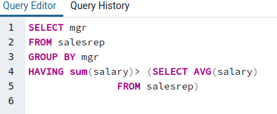
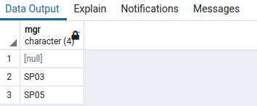
SUBQUERY
Display the manager who earns more than average salary
of the sales rep working under them

Slide 12
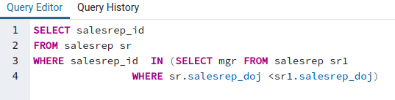
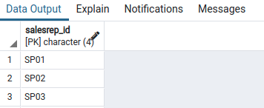
CORRELATED SUBQUERY
Display the sales rep that who has joined before their manager

Slide 13

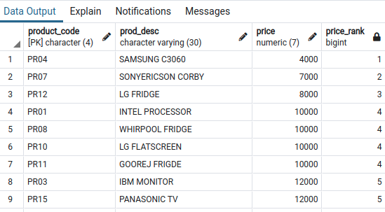
DENSE_RANK vs RANK
Rank the products in product table pricewise

Slide 14
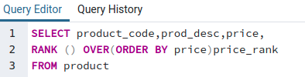
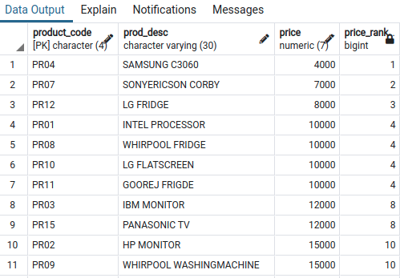
RANK

Slide 15
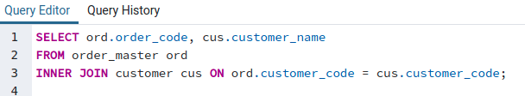
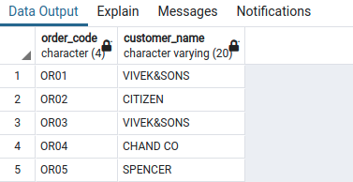
JOINS
Inner Join
Display customers who placed orders

Slide 16
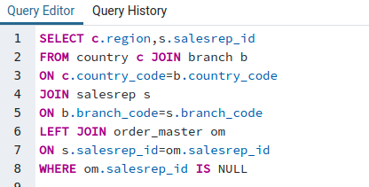

LEFT JOIN
Which region is having inactive sales reprensative?

Slide 17
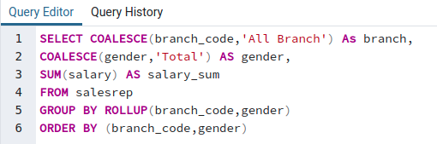
ROLLUP AND CUBE
ROLLUP
Sum up the category wise using ROLLUP

Slide 18
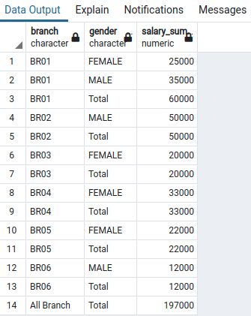
OUTPUT

Slide 19
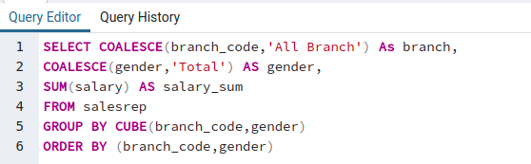
CUBE
Sum up the salary by branch wise and gender wise

Slide 20
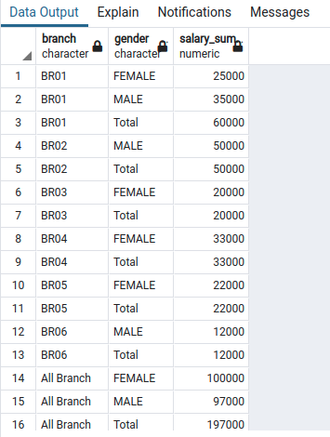
OUTPUT

Slide 21
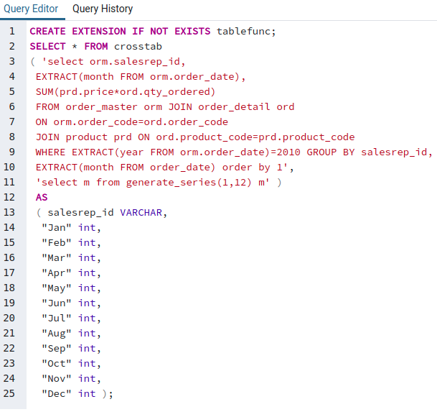
CROSSTAB
Display the total sales processed by salesrep in calender year 2010

Slide 22
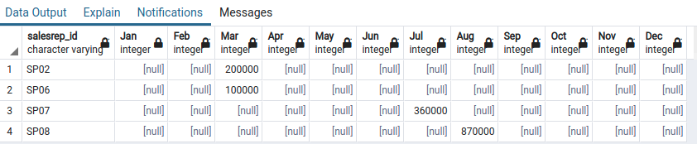
OUTPUT

Slide 23



Thank you
Reimagine technology to
accelerate your business
www.htcinc.com
www.caretech.com
www.ciber.com

