Slide 1

LOAD OPERATION
PRESENTED BY
K.SARATH

Slide 2
Load operation
The load operation is done to load data from a file to table.
The data read from the file should be validated before getting loaded into the table

Slide 3
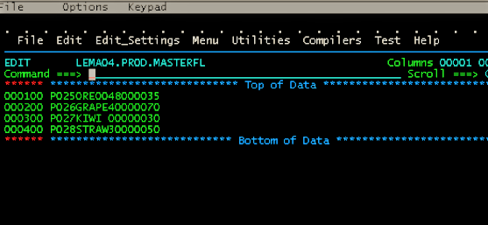
INPUT FILE:

Slide 4
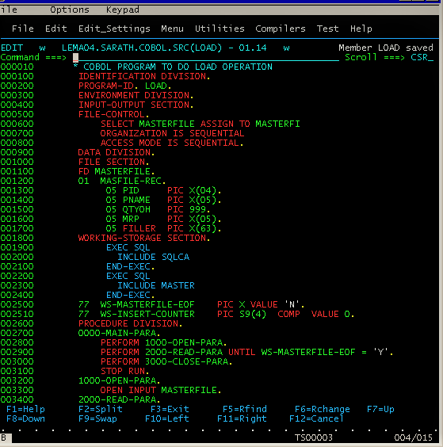
SOURCE CODE:

Slide 5
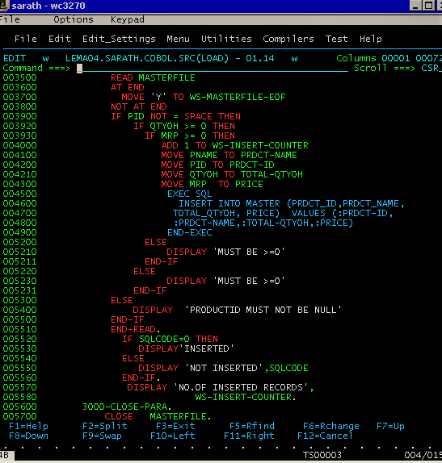

Slide 6
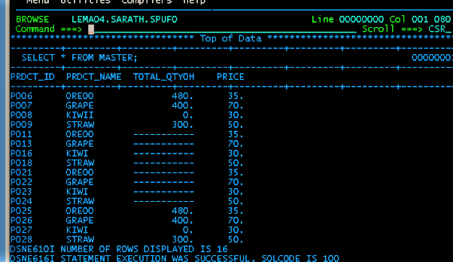
Inserted values into master table:

Slide 7



Thank you
Reimagine technology to
accelerate your business
www.htcinc.com
www.caretech.com
www.ciber.com

