Slide 1


FAMOUS SQL CODES
By
G.Mohanakrishnan
26860

Slide 2

SQLCODE
SQLCODE (which is declared in SQLCA)contains SQL return code indicating the success or failure of last SQL statement executed.
We code a statement immediately after every SQL statement to check the value of the SQLCODE.
The error diagnostic containing the SQL Return Code is held in the field SQLCODE within the DB2 SQLCA block.

Slide 3

Why SQLCODE is needed?
An important feature of DB2 programs is the error processing.
SQL Codes are used on a day-to-day basis for the diagnosis of programming failures as a result of SQL calls by DB2 computer programs.

Slide 4

INDICATIONS
0 means that the execution was successful.
Negative values indicate an unsuccessful execution with an error.
For example -305 , for which Null indicator is needed.
Positive value mean a successful execution with a warning.
For example +100, which means that no matching rows were found or that the cursor has reached the end of the table.

Slide 5

SQLCODE 0
If SQLCODE = 0, execution was successful.
for example, in a SELECT statement, this usually means the successful retrieval of data from a table.

Slide 6
SQLCODE 100
IF SQLCODE=100 indicates that the SQL operation was successful, but found no data to act upon.
for example, in a SELECT these include: the specified table contains no data; the table contains no data that satisfies the query criteria; or row retrieval has reached the final row of the table

Slide 7
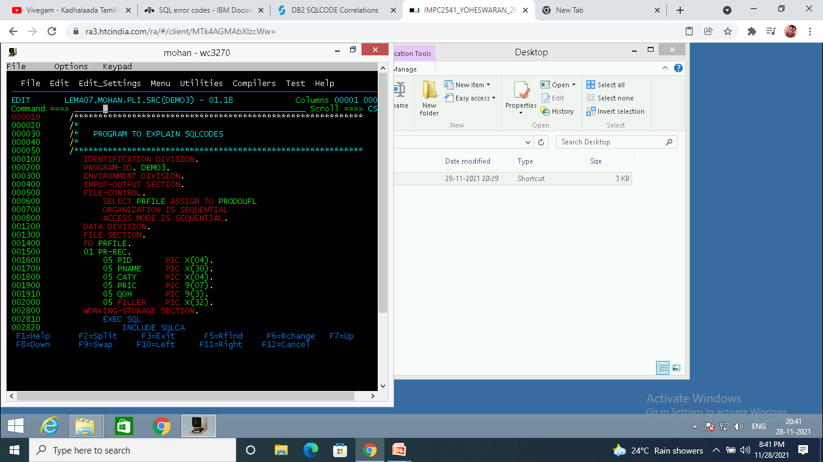
PROGRAM TO FETCH THE DATA

Slide 8
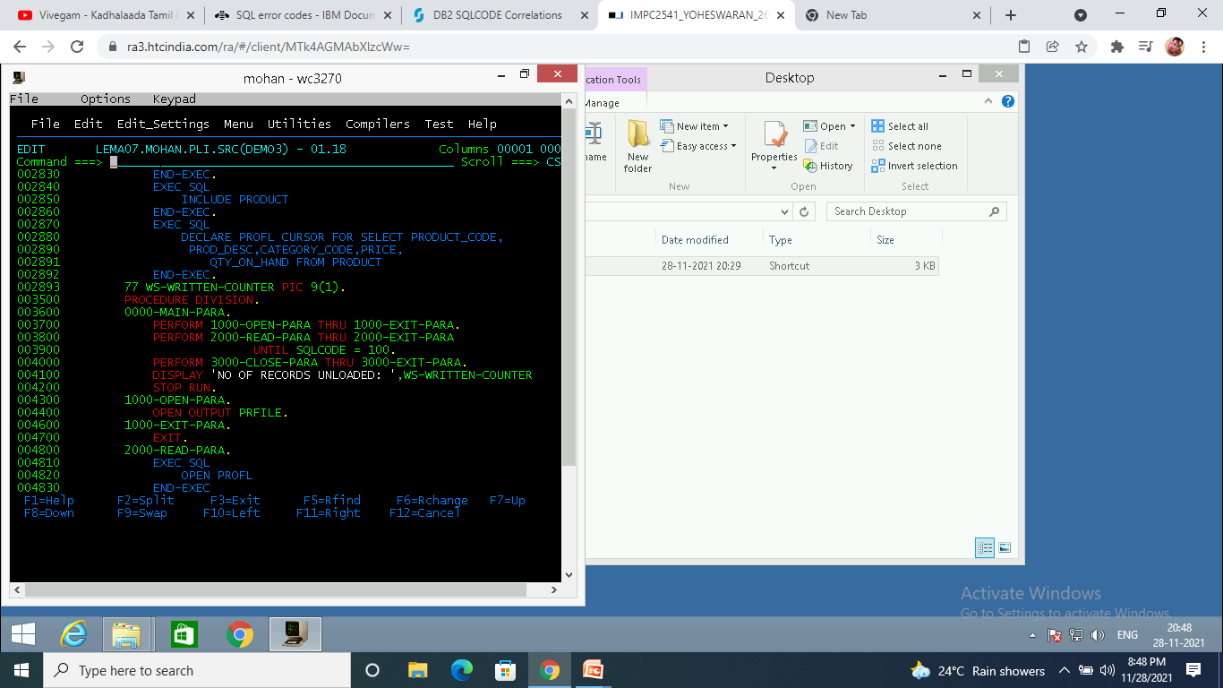
PROGRAM TO FETCH THE DATA

Slide 9
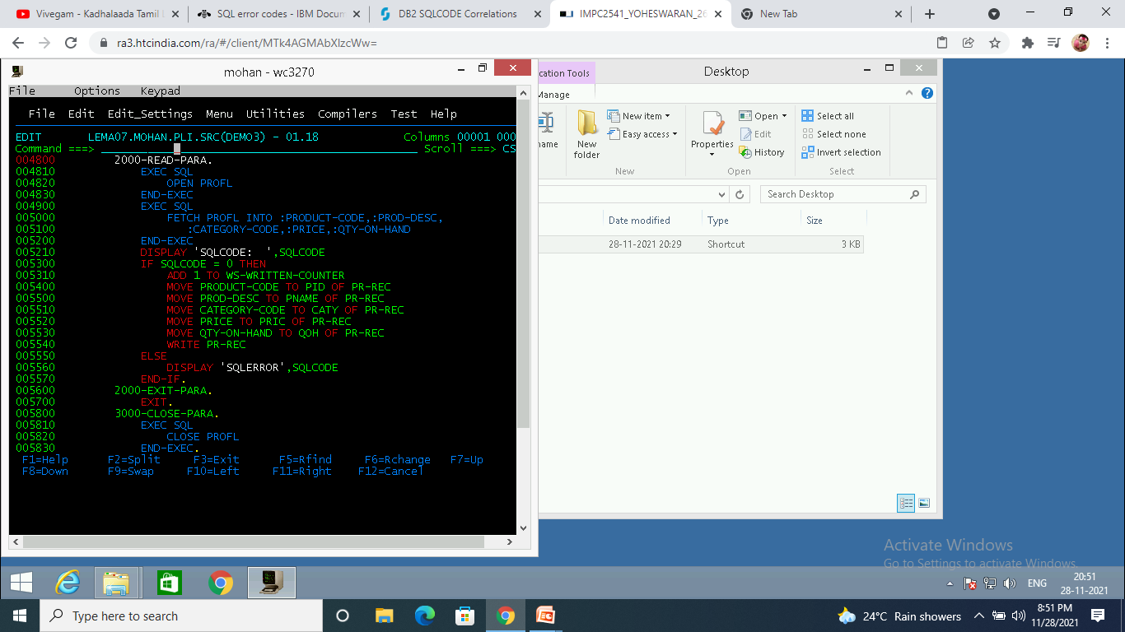
PROGRAM TO FETCH THE DATA

Slide 10
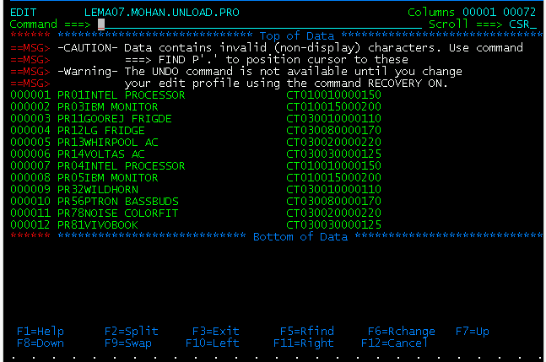
OUPUT FILE

Slide 11
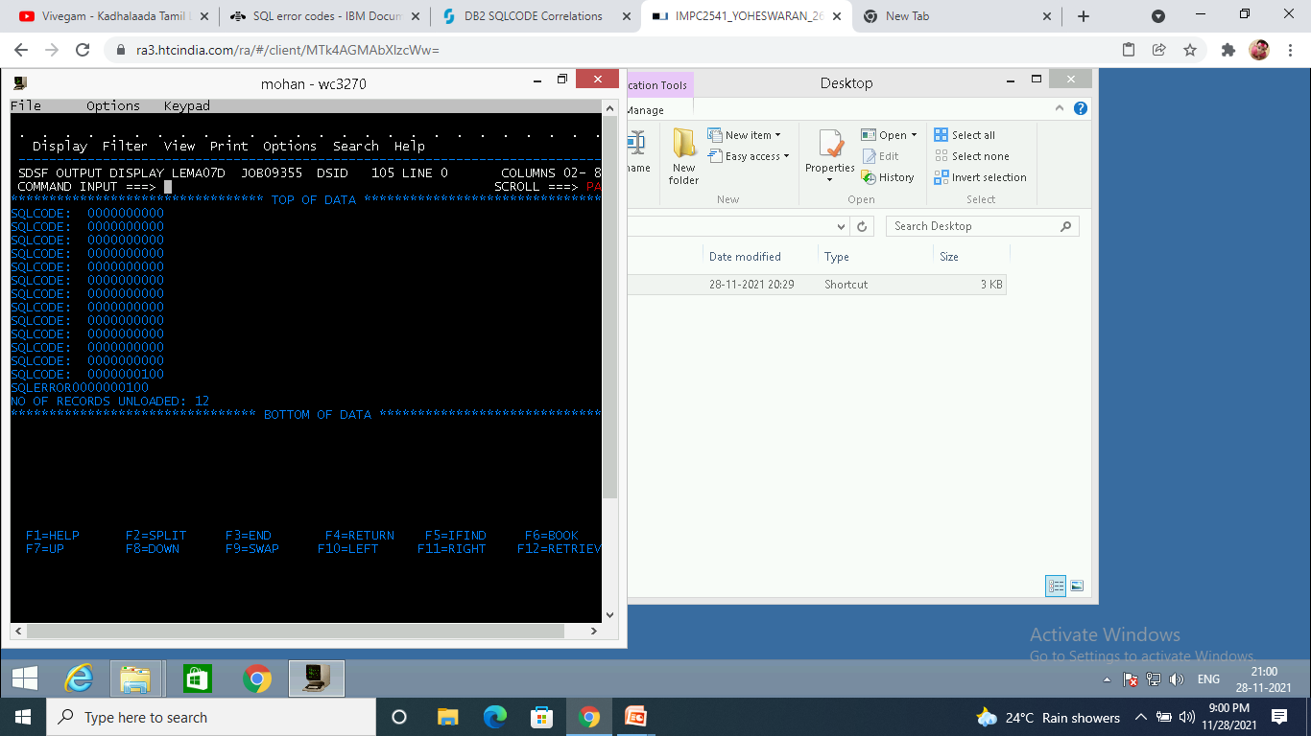
CONSOLE OUTPUT

Slide 12
SQLCODE ‘-501’
The CURSOR identified in a fetch or close statement is not open.

Slide 13

SQLCODE ‘-502’
The CURSOR identified in an open statement is already open.
There must be proper logical flow of process
1.declare a cursor
2. open cursor
3. fetch cursor data
4. close cursor

Slide 14

SQLCODE ‘-507’
The CURSOR identified in the UPDATE or DELETE statement is not open.
This happens when we try to execute the fetch cursor statement without opening the cursor.

Slide 15
SQLCODE ‘-504’
CURSOR NAME cursor-name is not declared

Slide 16

SQLCODE ‘-305’
The null value cannot be assigned to output
Host variable and retrieved.
This happens when we try to retrieve a null value.
To avoid this error, we must use null indicator in our code.

Slide 17
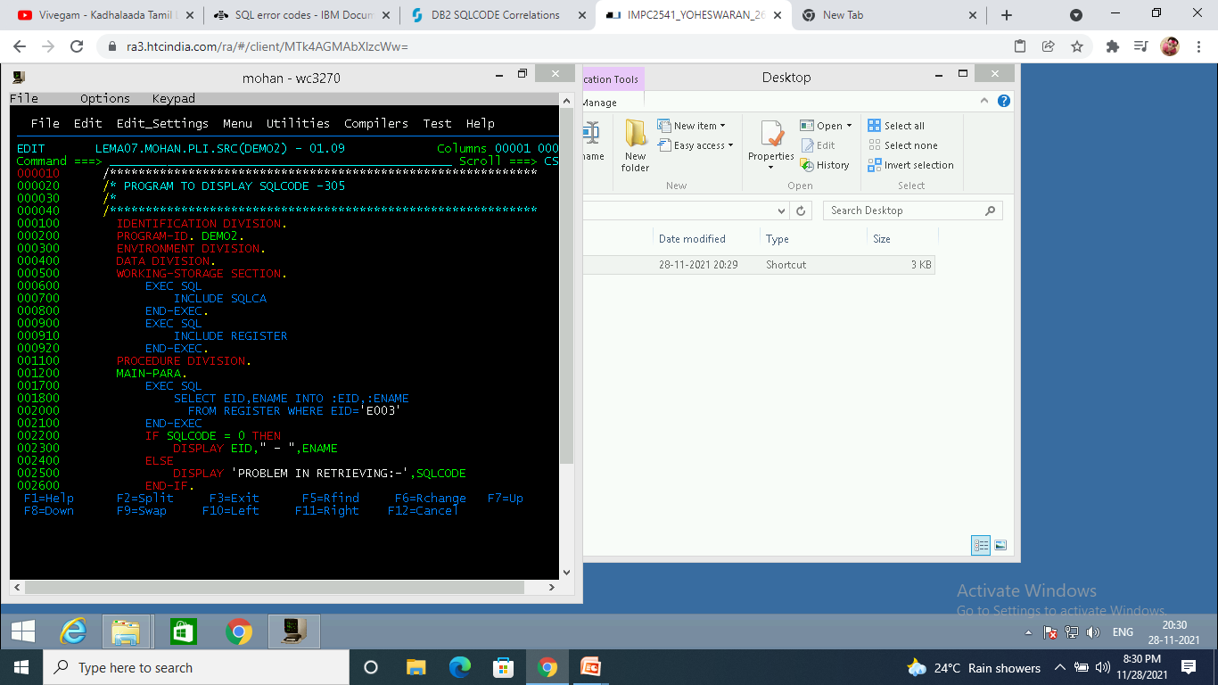
PROGRAM TO RETRIEVE NULL VALUE

Slide 18


CONSOLE OUTPUT

Slide 19

SQLCODE ‘-314’
The statement contains an ambiguous host variable reference.
The host variable declared must be rechecked.

Slide 20

SQLCODE ‘-410’
A numeric value is too long, or it has a value that is not within the range of its data type
This happens when we try to use long as a numeric a data type.

Slide 21

SQLCODE ‘-803’
An inserted or updated value is invalid because the index in index space constrains columns of the table so no two rows can contain duplicate values in those columns.
No duplication can be done in primary key value.

Slide 22

SQLCODE ‘-530’
The insert or update value of foreign key constraint-name is invalid
When a row is inserted or updated into a dependent table, the value of a foreign key must be equal to the value of the parent key of some row of the parent table in the associated relationship.

Slide 23

Thank you
Reimagine technology to
accelerate your business

