Slide 1

ORDER MANAGEMENT SYSTEM
PRESENTED BY
PRAVEENKUMAR S

Slide 2
What is Order Management System?
Order management starts when a customer places an order and ends once they receive their package or service. It allows a business to coordinate the entire fulfillment process
The customer places the order through an automated form. A sales team member checks the details and confirms the order.

Slide 3
Explanation:
Master And Transaction File As Input
Master Layout: Transaction Layout:
Product Id Transaction Id
Product Name Product Id
Quantity in Hand Quantity Required
Price
Pending File And Shiping File As Output

Slide 4
Product Availability:
If Product is Available - Calculate the Bill and move to Shipping file.
If Product is Not Available – Update Status as ‘NA’ and move to Pending File.
If Quantity is Not Sufficient - Update Status as ‘NS’ and move to Pending File.

Slide 5
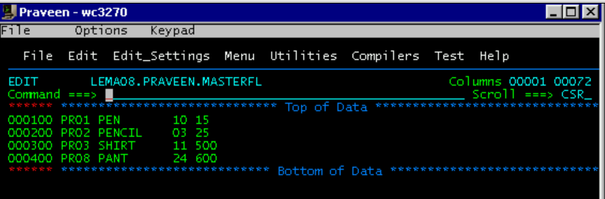
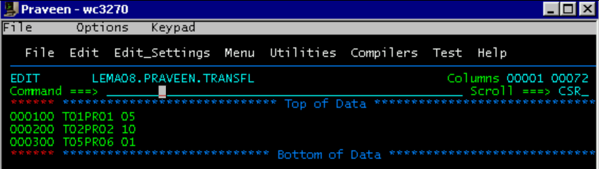
MASTER FILE:
TRANSACTION FILE:

Slide 6
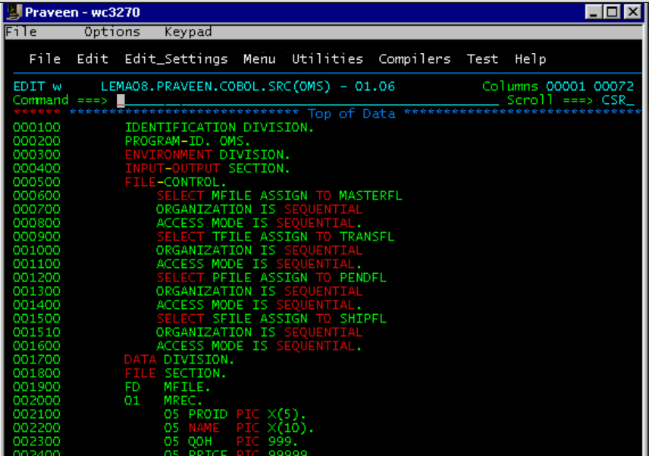
SOURCE CODE:

Slide 7
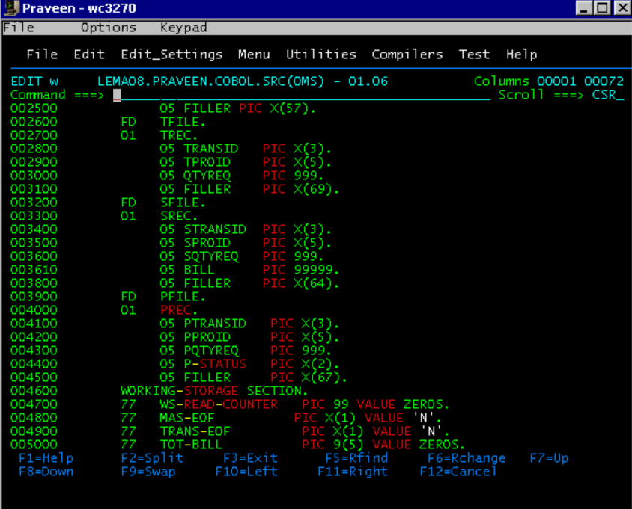

Slide 8
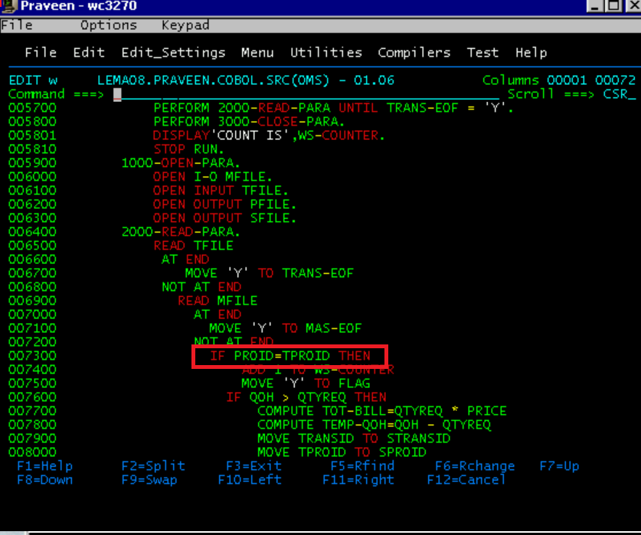

Slide 9
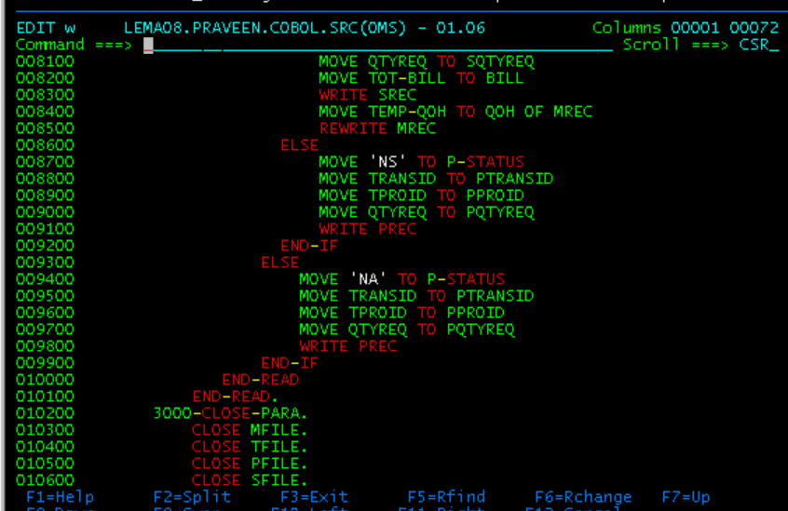

Slide 10
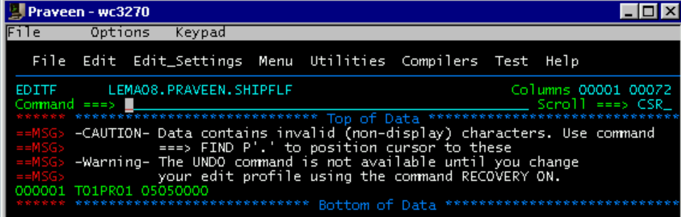
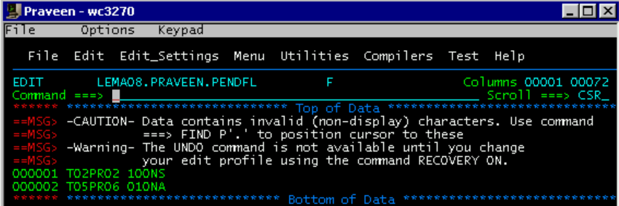
SHIP FILE:
PEND FILE:

Slide 11
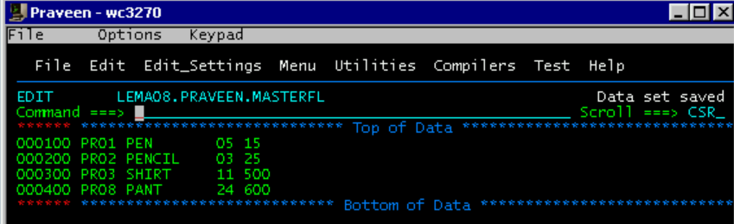
UPDATED MASTER FILE:

Slide 12



Thank you
Reimagine technology to
accelerate your business
www.htcinc.com
www.caretech.com
www.ciber.com

