Slide 1

UNLOAD UTILITY
PRESENTED BY
D.VENKATESH

Slide 2
What is unload utility?
The Unload utility is used to unload data from a table to a sequential data set.
To use the Unload utility, the definitions of the table space and tables must be available on the system.
Table reorganization involves saving the table data into a file and then storing the data from the file back into the table. This process for saving table data in a file is called unloading a table

Slide 3
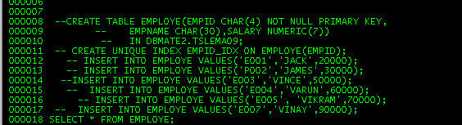
EXPLANATION:
For this Unload program I have created one empty employee
File and also I have created employee table for unload the data into an employee file.

Slide 4
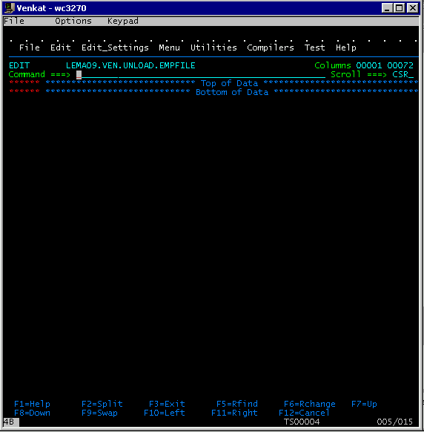
EMPTY FILE:

Slide 5
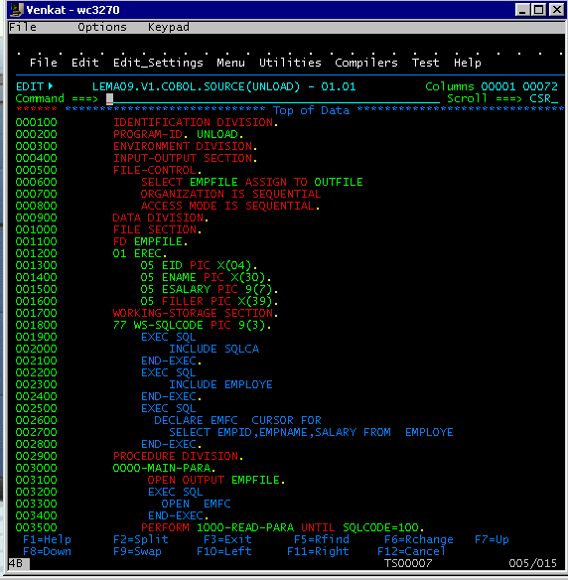
SOURCE CODE:

Slide 6
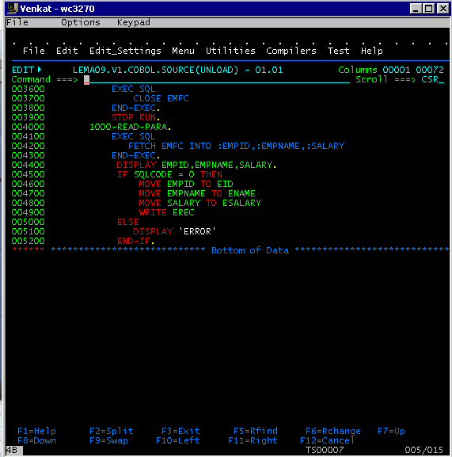

Slide 7
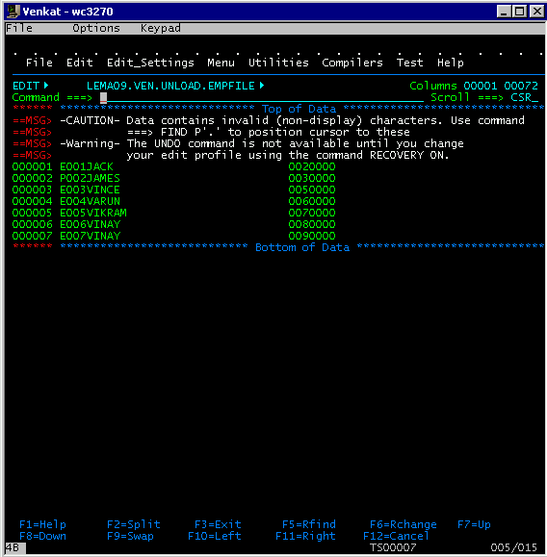
Inserted values into Employee file

Slide 8



Thank you
Reimagine technology to
accelerate your business
www.htcinc.com
www.caretech.com
www.ciber.com

