Slide 1
FLOOD MONITORING AND EARLY WARNING SYSTEM
NAME : PAVITHRASELVI A
COLLEGE CODE : 9530
COLLEGE NAME : ST .MOTHER THERESA ENGINEERING COLLEGE

Slide 2
PROBLEM SOLUTION
Floods are the natural disasters that cause catastrophic destruction and devastation of natural life , agriculture ,property and infrastructure every year .The objective of this project is to monitor the flood situation and send alert in case of danger in the form of text message .The main objective of this project is to detect rising water level in a river at a reasonable distance from the rail track/roadways and intimate that to the respective authorities through SMS ,to take appropriate action .Our project solves problem by implementing an early flood detection mechanism .In this project we will connect water level sensors at different water levels.

Slide 3
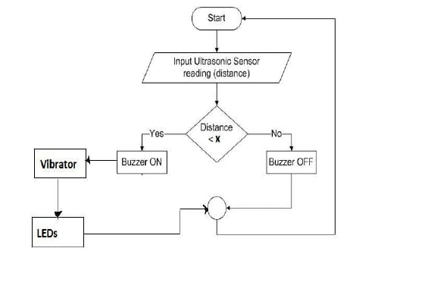
METHODOLOGY USED WITH FLOWCHART

