Slide 1
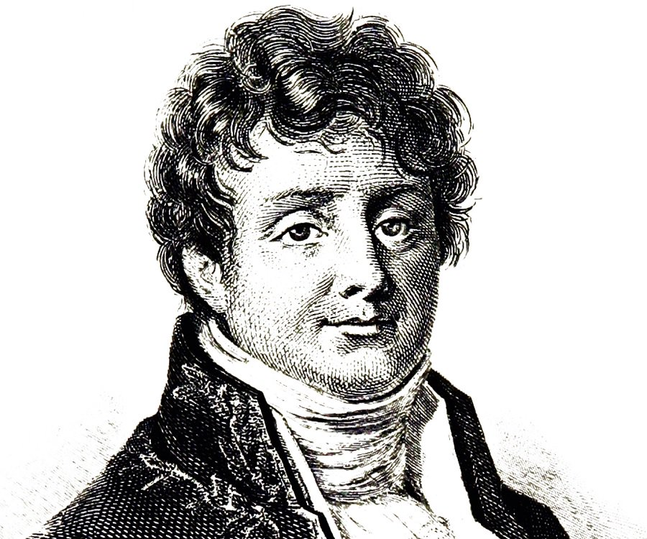


2 Fast 2 Fourier!!
how to Fast Fourier Transform and analyse the spacial and temporal patterns of road accidents in the UK

Slide 2
The Problem

Slide 3
Data Analysis of Temporal Patterns

Slide 4
Data Analysis of Spacial Patterns

Slide 5
Conclusion

