Slide 1
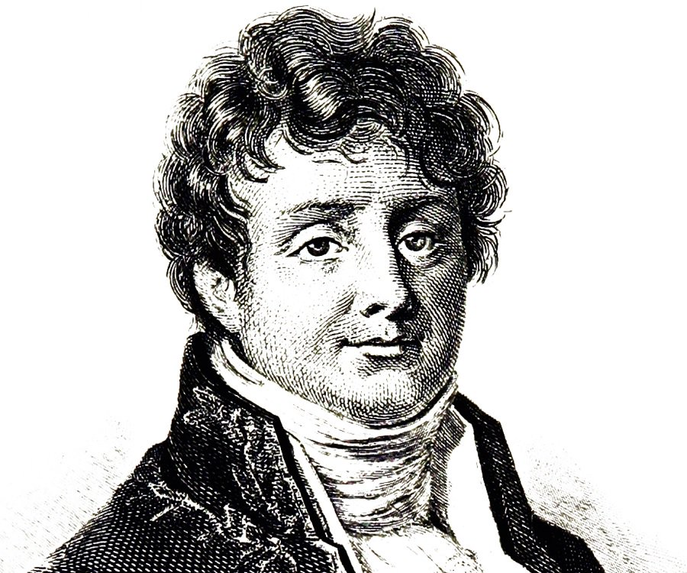


2 Fast 2 Fourier!!
patterns of road accidents in the UK

Slide 2
Methodology
1. Dealt with messy data indices
2. Proceeded to do a seasonal analysis
3. Proposed a forecast model

Slide 3
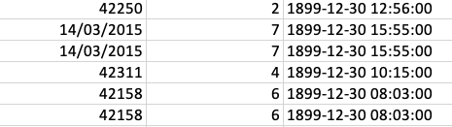
1. Dealing with messy indices

Slide 4
Data Analysis of Spatial Patterns
One of the most interesting, and most challenging, aspects of this data is the spatial problem
Each car crash (discounting those that needed cleaning) had an associated latitude and longitude, demarking where the incident took place.
Hence, we believed there could be a lot gained from plotting the data on a map.

Slide 5
Mapping the Data
Deciding a more general approach would be the most worthwhile use of time, we created a function which mapped the data by a given variable to the plot…
A map of maps, if you will.
For instance, our if we wish to visualise car crashes on a Monday we would take mapofmaps(7, 2, RA, ”day_of_week”, “latitude”, “longitude”).

Slide 6
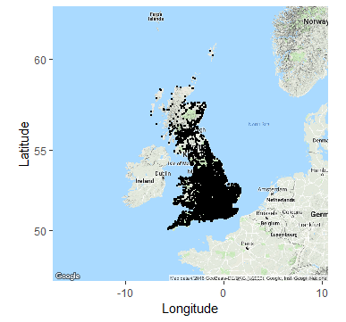
Creating Charts
This gives:
Clearly, the utility of this information is limited.
What we really want is some way of introducing time to our spatial analysis.

Slide 7
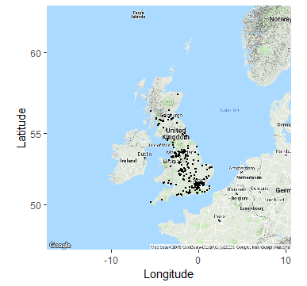
Adding Time
After some rearrangement, we were able to form adjusted versions of the function that take time (either in days or months) as one of their arguments. This allows us to examine data like all car crashes of severity 3 that took place on the 5th of March, 2015. See below:

Slide 8
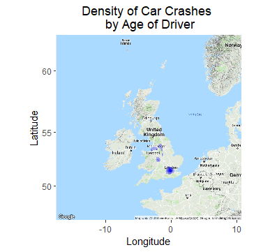
Heat Maps
Another way to look at the data through maps, is by through the medium of heat maps.
We also charted some of these:

Slide 9
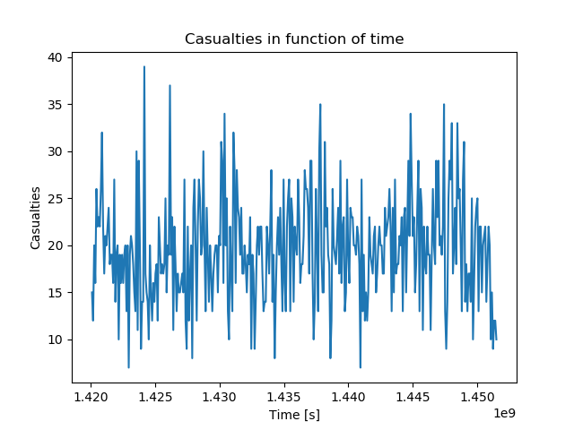
3. Seasonal analysis a) CMA

Slide 10
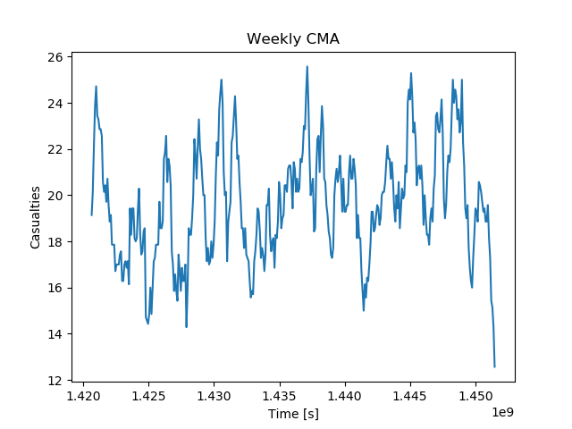

Slide 11
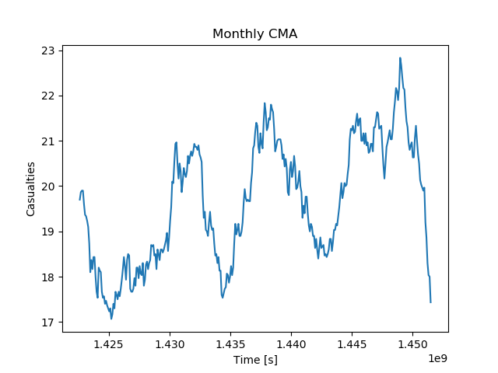

Slide 12
3. Seasonal analysis b) Fourier analysis

Slide 13
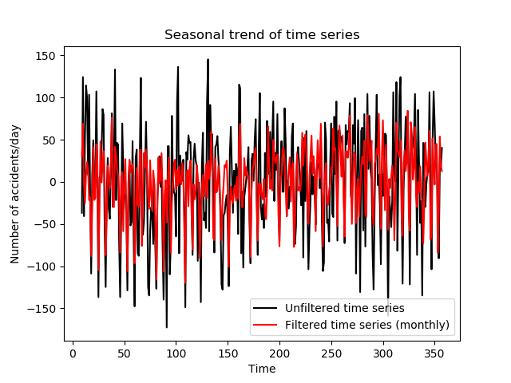

Slide 14
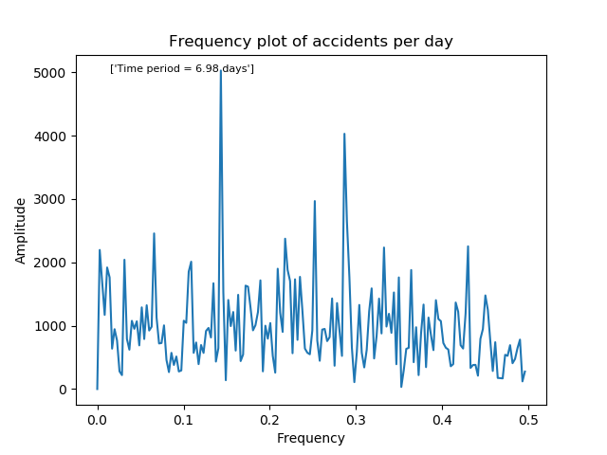

Slide 16
4. Forecasting model

