Slide 1

EVENTEASE
Student Event Discovery & Registration Platform
Customer Experience Design & Programming
Course Code: CUCS1012
SUBMITTED BY
GUIDED BY
Payal Priyadarshini Jena
Registration No.: 240301120103
B.Tech Computer Science & Engineering
Centurion University of Technology and Management
Perween Rumana
Centurion University of Technology and Management
Semester V | Academic Year 2026–27
Notes:
Good [morning/afternoon]. I'm Payal Priyadarshini Jena, registration number 240301120103, B.Tech Computer Science and Engineering. My project for Customer Experience Design and Programming (CUCS1012), guided by Perween Rumana, is EventEase: a student event discovery and registration platform for CUTM.
This is a Customer Experience Design case study, so I won't start with features. I'll walk through the process I followed: the problem, the user research, the insights, a persona and journey map, the design opportunity, the user flow and information architecture, and finally the prototype, which I'll demonstrate live near the end.

Slide 2
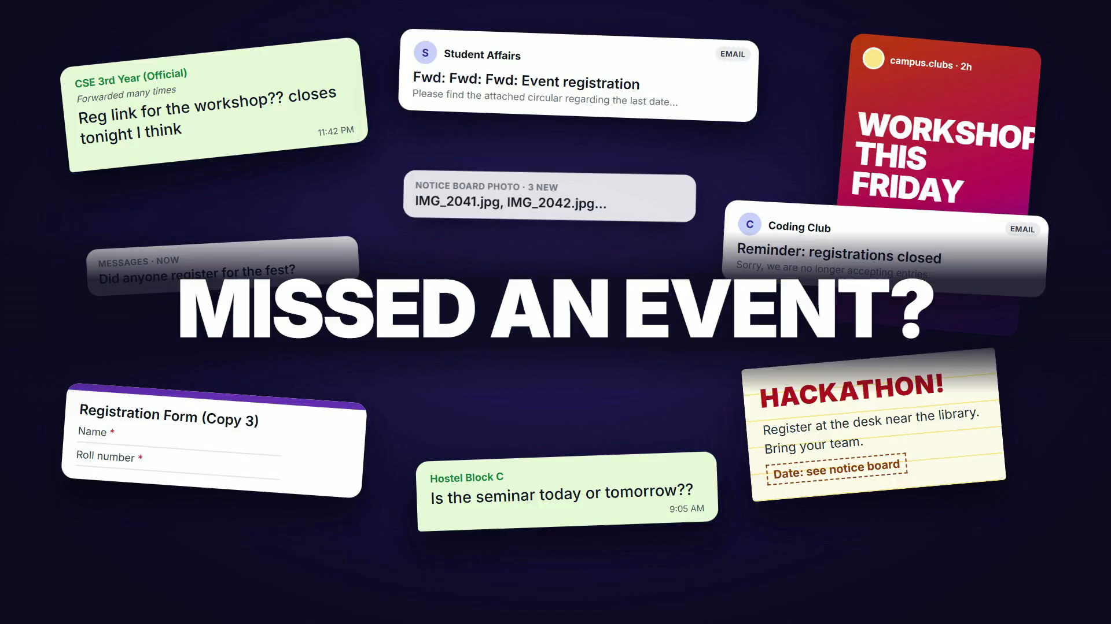

Slide 3






We Started with the Students
01 · RESEARCH METHODOLOGY
We conducted an exploratory student survey with 22 responses, primarily from second-year students.
01
02
03
04
05
06
Identify the problem
Create Google Form
Share with students
22 responses
Analyze responses
Extract CX insights
RESEARCH SCOPE
WHAT WE ASKED
9 questions on the Google Form
Method
Google Forms survey
Q1
How students find out about events
Q6
Ease of tracking after registering (1–5)
Participants
22 students
Q2
How easy event information is to find (1–5)
Q7
Information hardest to locate
Sample
Primarily second-year students
Q3
Missed an event for not knowing in time?
Q8
Would you use one central platform?
Focus
Event discovery
Event information
Q4
Biggest difficulty when registering
Q9
Most useful features
Registration
Post-registration tracking
Q5
Searching WhatsApp / other platforms
Notes:
Before designing anything, I started with the students.
The research followed six steps: identify the problem, create a Google Form, share it with students, collect the 22 responses, analyze them, and extract customer-experience insights.
The scope: a Google Forms survey with 22 participants, mostly second-year students. So this is an exploratory survey, not a statistically representative one.
It focused on four parts of the experience: how students discover events, how they find event information, how they register, and how they keep track of events afterwards.
On the right are the nine questions I asked. The results come on the next slide.

Slide 4
What Did the Students Tell Us?
02 · RESEARCH FINDINGS
FINDING 1
FINDING 2
FINDING 3
FINDING 4
63.6%
68.2%
27.3%
45.5%
14 / 22 students
15 / 22 students
6 / 22 students
10 / 22 students
had missed an event because they didn’t know about it in time.
frequently or sometimes searched WhatsApp or other platforms for event information or links.
said finding complete event information was their biggest registration difficulty.
selected complete event details as one of the most useful features.
TOP REQUESTED FEATURES
Q9 · multi-select
Complete event details
45.5%
Event calendar
45.5%
Event reminders
36.4%
The research indicated a need for a more centralized and structured event experience.
Each dot is one of the 22 respondents. Source: exploratory student survey (Google Forms), primarily second-year students.
Notes:
Here's what the students told us, in four findings.
First: 14 of 22 students, 63.6%, had missed an event because they didn't know about it in time.
Second: 15 of 22, 68.2%, frequently or sometimes searched WhatsApp or other platforms for event information or registration links.
Third: 6 of 22, 27.3%, said finding complete event information was their biggest difficulty when registering — the most common single answer.
Fourth: 10 of 22, 45.5%, chose complete event details as one of the most useful features. Each dot in the row represents one respondent.
The strip below shows the top requested features: complete event details and an event calendar at 45.5% each, and event reminders at 36.4%. That question allowed several answers.
Together, this points to a need for a more centralized, structured event experience.

Slide 5






Who Are We Designing For?
03 · USER PERSONA
AK
GOALS
PAIN POINTS
Aarav Kumar
Discover relevant events
Find complete information
Register quickly
Track registrations
Avoid missing deadlines
Fragmented information
Late discovery
Hard-to-find registration links
Unclear deadlines
Difficult tracking
20 | CSE | CUTM Undergraduate
I want to know what’s happening on campus without having to search everywhere.
BEHAVIOUR
Uses smartphone + laptop
Comfortable with digital platforms
Discovers events through multiple channels
Representative persona synthesized from survey findings.
Notes:
From the findings I synthesized a representative persona: Aarav Kumar, a 20-year-old CSE undergraduate at CUTM.
Aarav is a design persona, not one of the 22 respondents. He brings together the patterns from the survey so the design has a clear person to serve.
His goals: discover relevant events, find complete information, register quickly, track his registrations and avoid missing deadlines.
His pain points: fragmented information, finding out too late, hard-to-find registration links, unclear deadlines and difficult tracking.
He uses a smartphone and a laptop, is comfortable with digital platforms, and hears about events through several channels.
In his words: "I want to know what's happening on campus without having to search everywhere."

Slide 6



Mapping the Current Customer Journey
04 · CUSTOMER JOURNEY MAP
1 DISCOVER
2 SEARCH INFORMATION
3 FIND REGISTRATION
4 REGISTER
5 TRACK EVENT
6 ATTEND
TOUCHPOINT
WhatsApp, Instagram, friends, posters
Chat history, posters, college portal
Forwarded links and social posts
Online registration form
Chats, screenshots, memory
Venue on the day
USER ACTION
Hears about an event
Scrolls through messages for details
Hunts for the link and the deadline
Fills in the form
Re-finds date, venue and requirements
Turns up and takes part
PAIN POINT
Fragmented / late discovery
Searching through messages
Link and deadline hard to locate
Unsure the registration worked
Re-finding details after registering
Unclear event requirements
EMOTION
Engaged
Curious but unsure
Relieved, but unsure
Frustrated
Anxious
Stressed
The journey revealed friction across discovery, information retrieval, registration and post-registration tracking.
Emotions are the team’s interpretation of the journey.
Notes:
Now from who, to what Aarav's experience actually looks like today.
The current journey has six stages: discover, search for information, find the registration, register, track the event, and attend. For each one I mapped the touchpoint, what he does, the pain point, and how he feels.
He hears about an event through WhatsApp, Instagram, friends or a poster — curious, but unsure of the details. He then scrolls through messages looking for information and gets frustrated. Finding the link and the deadline makes him anxious. He fills in a form, relieved but not sure it worked. Afterwards he has to re-find the date, venue and requirements, which is stressful. Only at the event itself does the experience turn positive.
The evidence for these pain points is on the previous slide; this slide shows the experience. The friction runs right across the journey: discovery, finding information, registration, and tracking afterwards.

Slide 7

From Pain Points to Design Opportunity
05 · DESIGN OPPORTUNITY
CURRENT EXPERIENCE
Discover
Search multiple channels
Find information
Find registration link
Register
Search again
Track manually
Research need
EventEase response
Complete details
Event Details
DESIGNED EXPERIENCE
Calendar
Calendar
Discover
View complete details
Register
Confirmation
Save / My Events
Reminder
Attend
Feedback
Reminders
Notifications
DESIGN GOAL
Registered events
My Events
Create a centralized, low-friction experience for discovering, registering for and managing campus events.
Event pass
QR Pass
We didn’t just add features: each CX finding became a design requirement.
Notes:
This is the key transition: from pain points to a design opportunity.
Top: the current experience — discover, search multiple channels, find the information, find the registration link, register, then search again and track everything manually.
Below: the experience I designed — discover, view complete details in one place, register, get a confirmation, save it to My Events, get a reminder, attend, and give feedback.
The design goal: create a centralized, low-friction experience for discovering, registering for and managing campus events.
On the right, each research need maps to an EventEase response: complete details became the Event Details page; the calendar became Calendar; reminders became notifications; registered events became My Events; and the event pass became the QR pass.
So this isn't a feature list — every element traces back to a CX finding.

Slide 8






Translating the CX Journey into the Product
06 · FROM CX TO UX
USER FLOW
INFORMATION ARCHITECTURE
Home
Discover
EventEase
Discover
One place to find campus events, with search and filters.
Home
Recommendations, upcoming events
Search / Filter
Explore
Search, category filters, event details
Event Details
Understand & register
Complete details, then a clear confirmation.
Calendar
All events by month
Register
Confirmation
Clubs
Club pages, follow
My Events
Manage & reflect
Opportunities
Internships, scholarships, competitions
Reminder / Attend
Registrations, reminders and feedback in one place.
My Events
Upcoming, past, saved, passes
Feedback
Profile
Interests, notification settings
The future-state CX journey was translated into the platform’s interaction flow and information architecture.
Notes:
Next, how the future-state journey became an actual interface.
On the left is the user flow: Home, discover, search or filter, open Event Details, register, see the confirmation, find it in My Events, get a reminder and attend, then give feedback. The flow falls into three parts: discovering events in one place; understanding the event and registering with a clear confirmation; and managing everything afterwards.
On the right is the information architecture — the seven top-level areas: Home, Explore, Calendar, Clubs, Opportunities, My Events and Profile.
So the CX journey directly shaped both the interaction flow and the structure of the platform.

Slide 9





From CX Problem to Digital Experience
07 · CONCLUSION & FUTURE SCOPE
We used student research to transform a fragmented campus-event experience into a centralized digital journey.
Research
CX insights
User-centered design
Functional prototype
Understand student needs
Identify key pain points
Define solutions
EventEase platform
FUTURE SCOPE
01
02
03
04
Production authentication
Event operations
Student ecosystem
Intelligence & integration
University-approved SSO for secure and seamless access.
Approvals, check-in, attendance and event management tools for organizers.
Integration with clubs, teams, competitions and certificates in one platform.
Analytics, personalization and integration with institutional systems.
Current status: Functional academic prototype — not deployed at CUTM.
EventEase turns “Where did I find that event?” into “Everything I need is here.”
EVENTEASE
Your campus. Your opportunities. One place.
Notes:
To conclude: I used student research to turn a fragmented campus-event experience into a centralized digital journey — from research, to CX insights, to user-centered design, to a functional prototype.
Looking ahead, four areas would take EventEase toward a real product:
1. Production authentication — university-approved single sign-on.
2. Event operations — approvals, check-in, attendance and event-management tools for organizers.
3. The student ecosystem — clubs, teams, competitions and certificates in one platform.
4. Intelligence and integration — analytics, personalization and integration with institutional systems.
Several of these are explored in the prototype with development stand-ins; making them real would need the university's approval and infrastructure. Its current status: a functional academic prototype, not deployed at CUTM.
In one line: EventEase turns "Where did I find that event?" into "Everything I need is here." Your campus. Your opportunities. One place. Thank you.

Slide 10
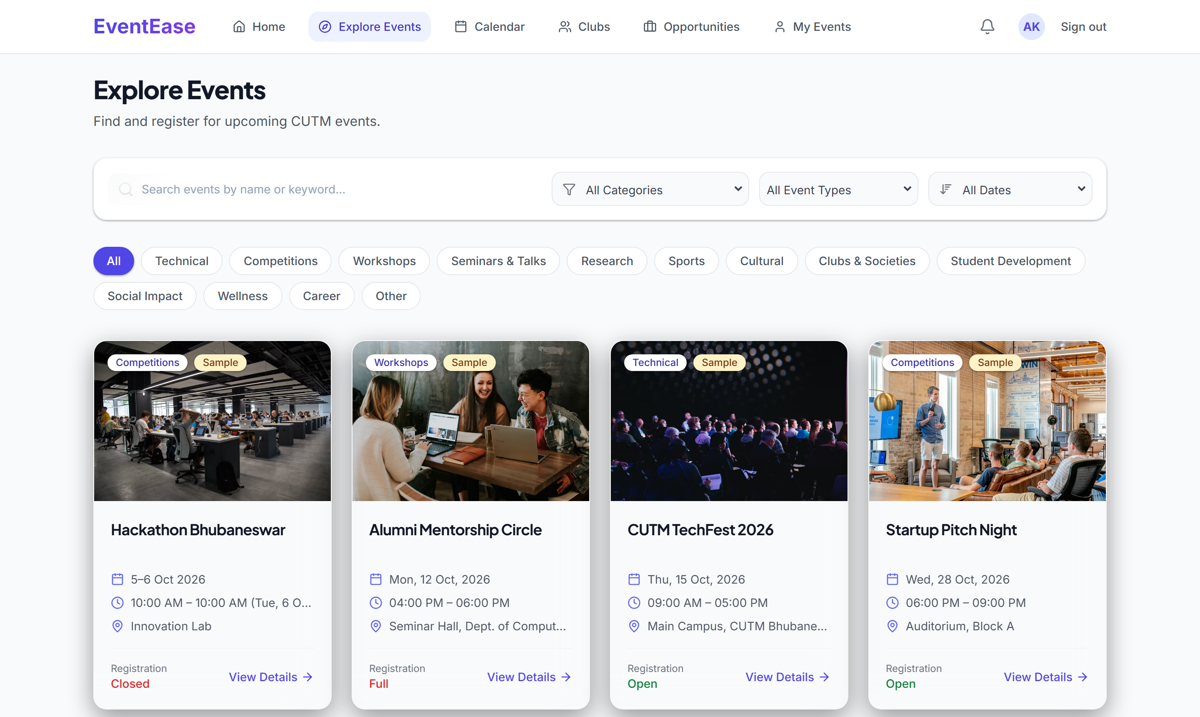
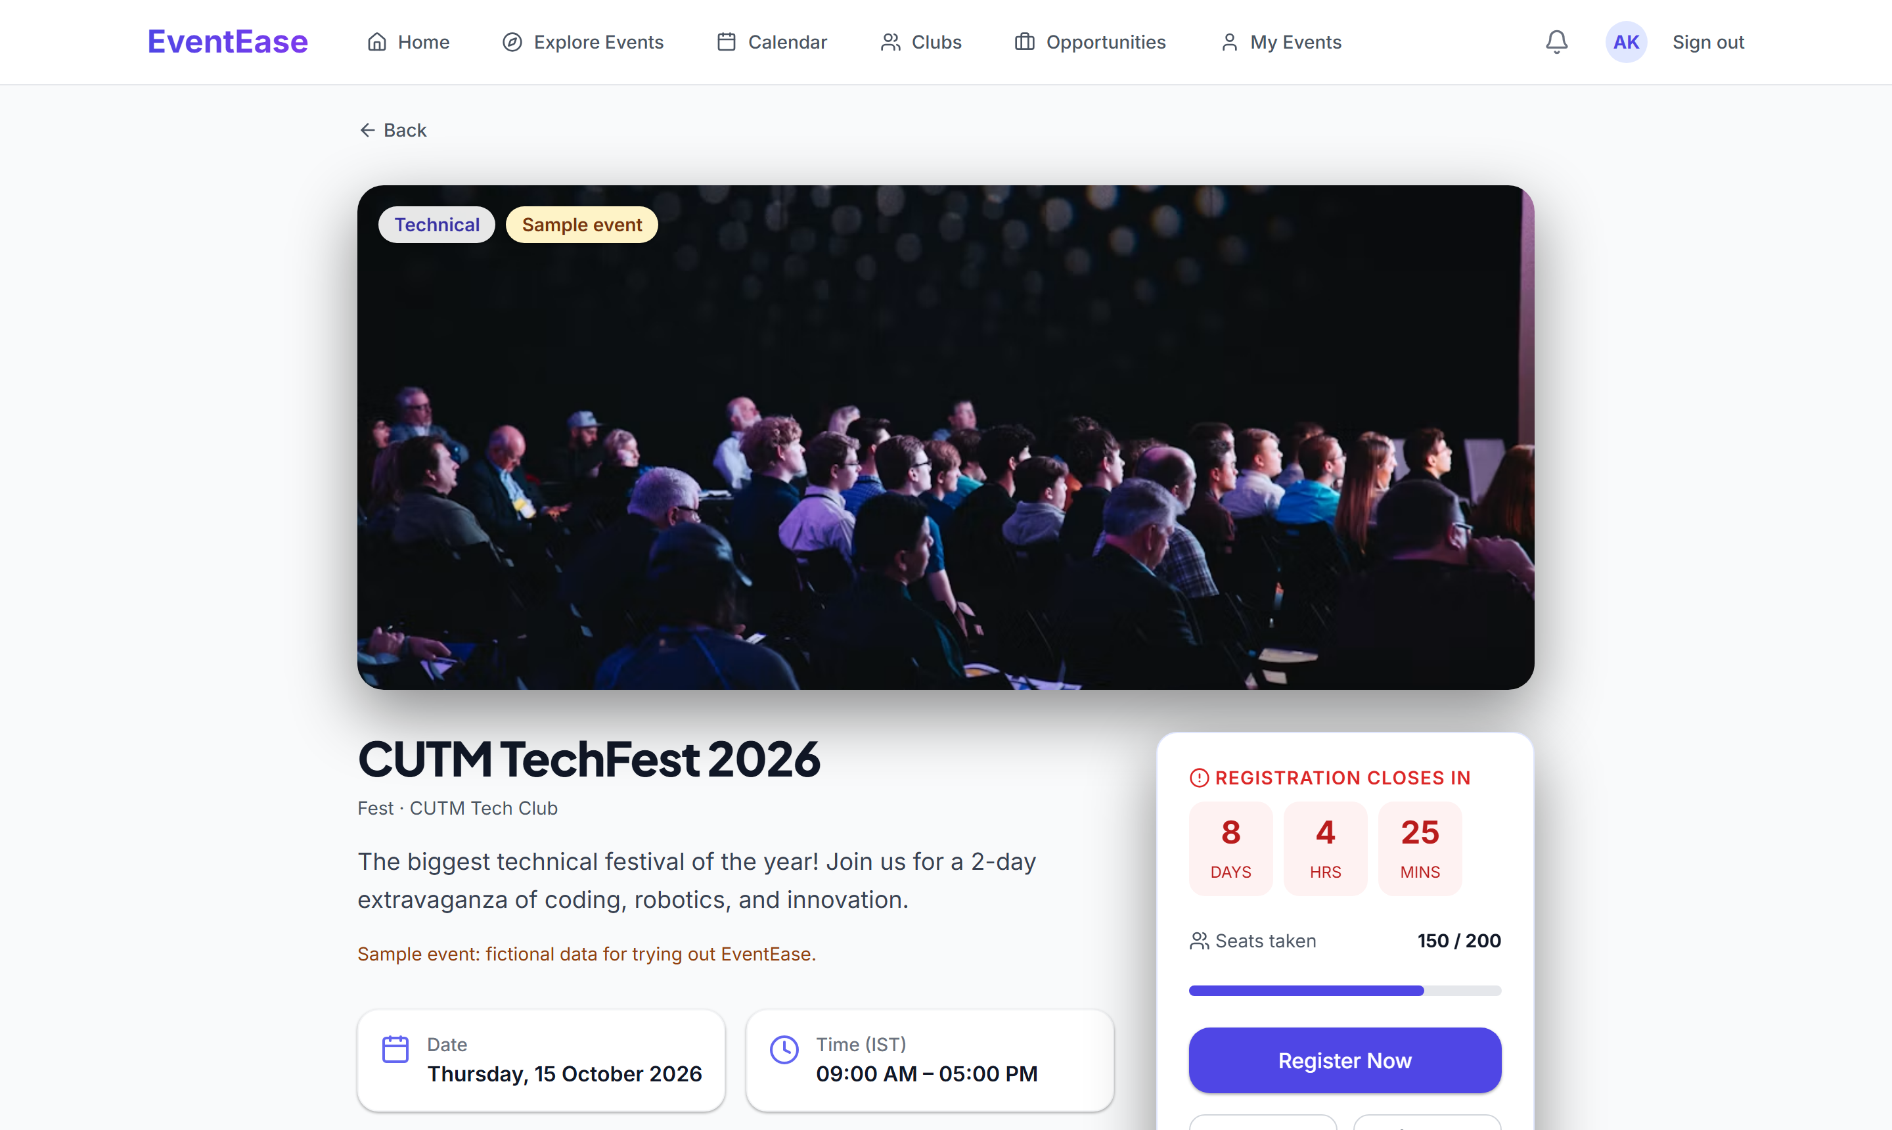
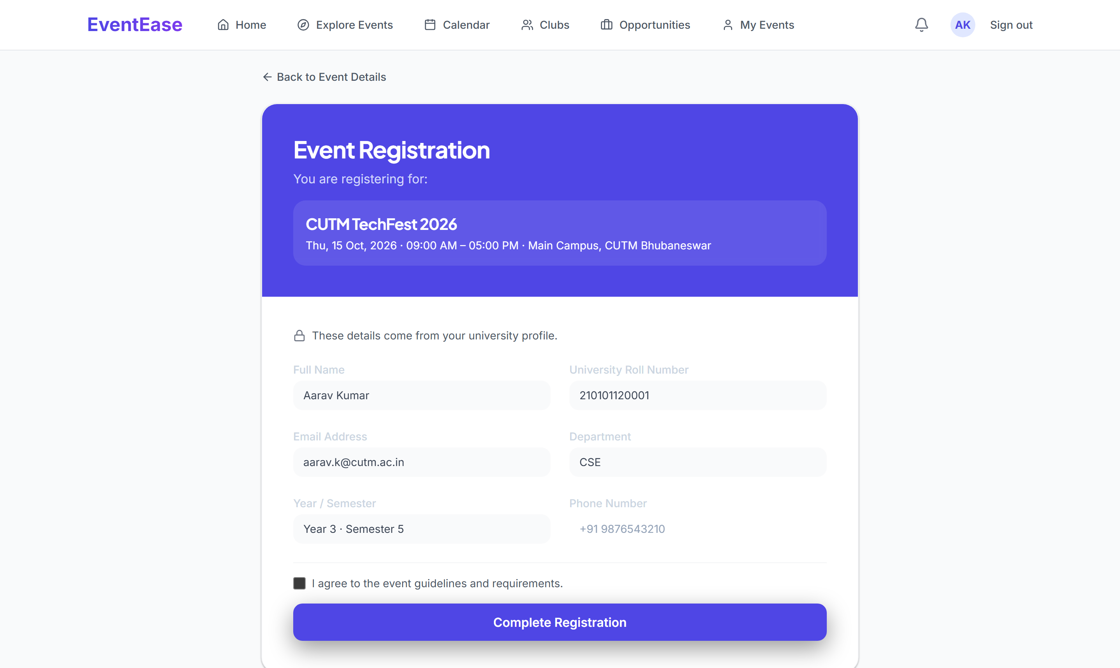
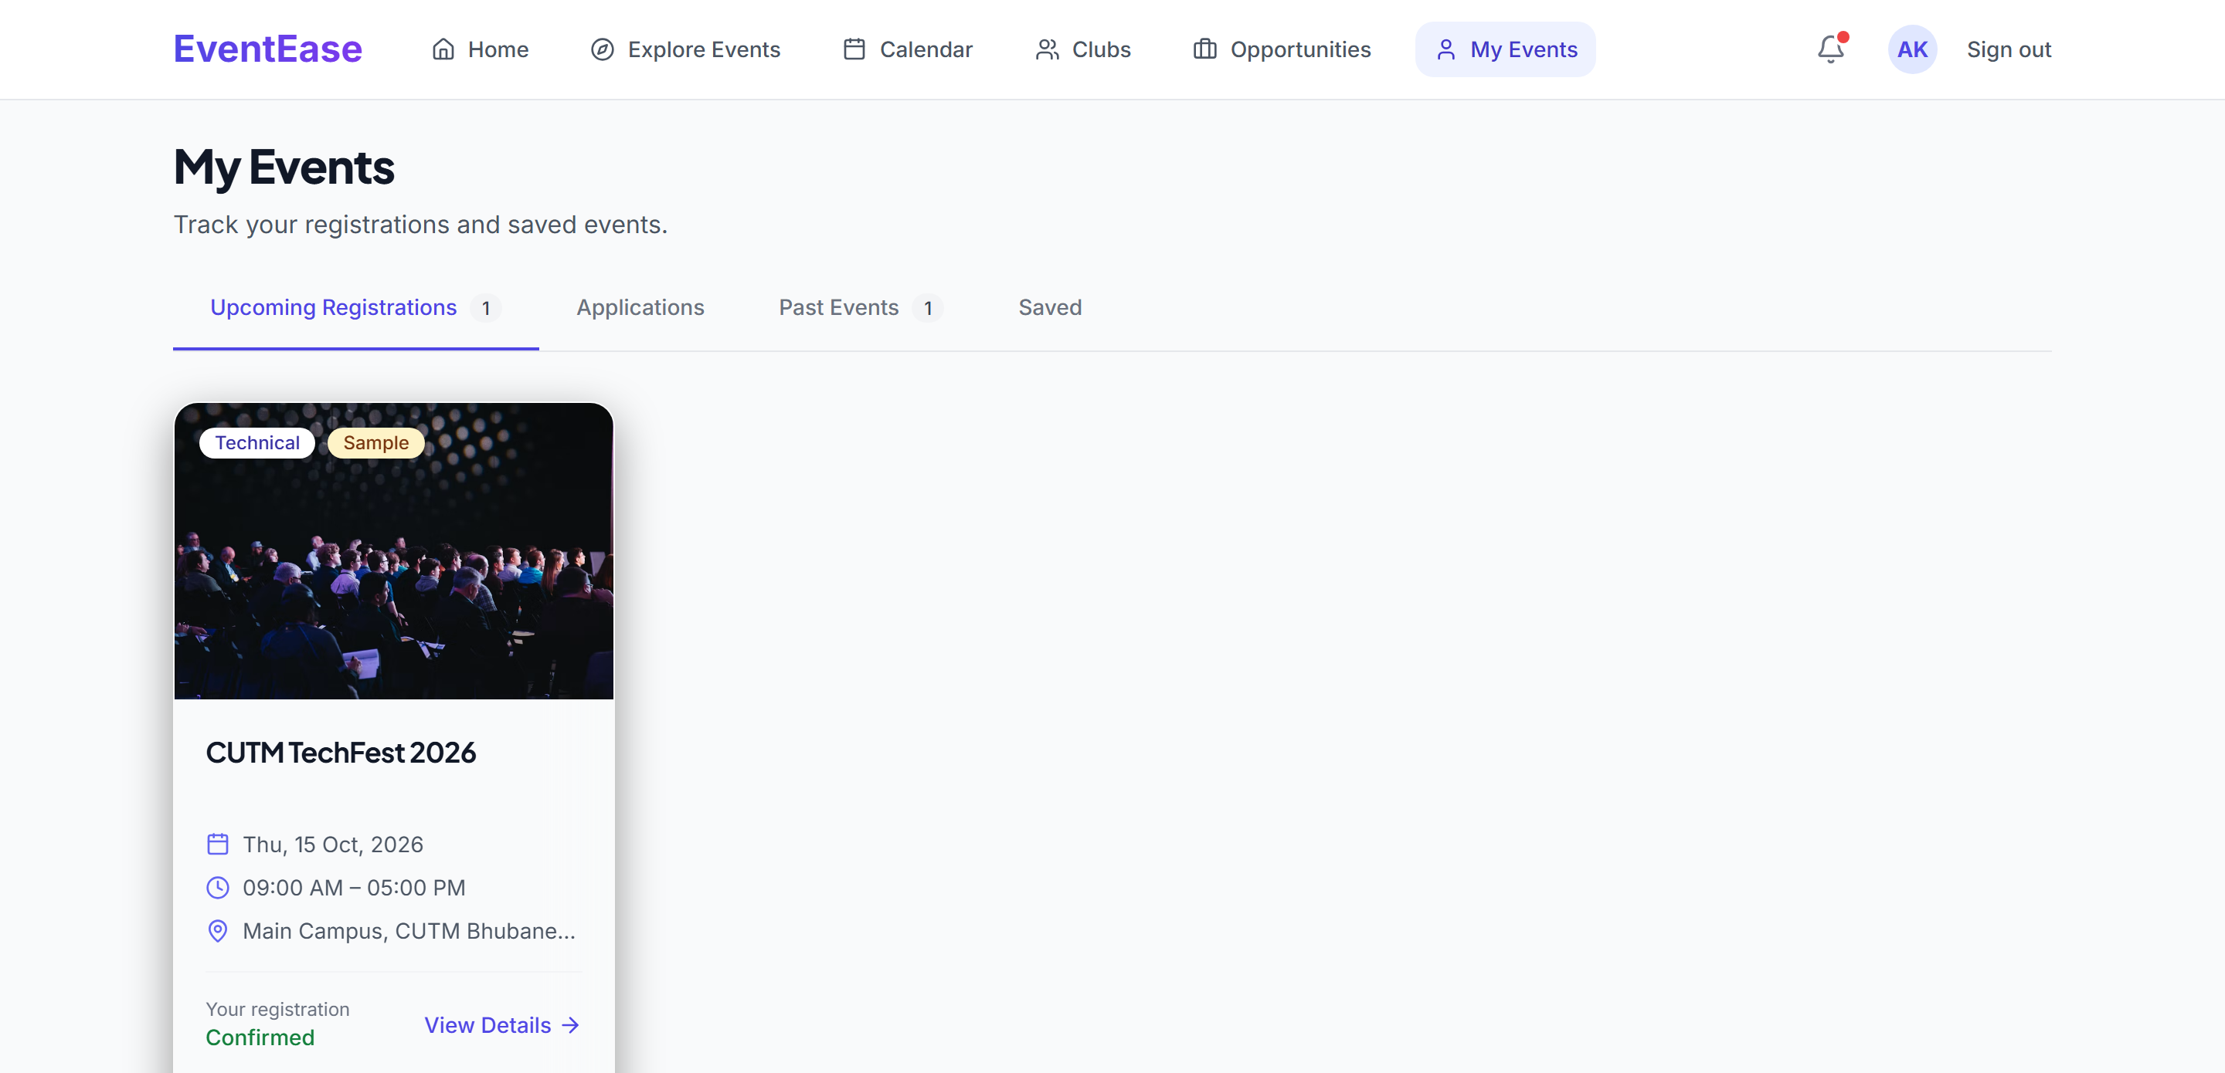

Let’s Experience the Designed Journey
08 · LIVE PROTOTYPE
1
Discover
2
Event Details
3
Register
4
My Events
LIVE PROTOTYPE
“Let’s imagine Aarav has just heard about an event.”
Discover
Explore & search
Understand
Event details
Register
Registration
Confirm
Confirmation & QR
Save & manage
My Events
Track
Calendar
Reflect
Feedback
Notes:
Now let's leave the slides and use the real thing. [Open the running EventEase website.]
I'll follow one user story: let's imagine Aarav has just heard about an event.
1. Discover — he opens Explore and searches or filters for it.
2. Understand — the Event Details page gives him everything in one place: date, venue, eligibility, deadline and seats.
3. Register — the form is short, because his details come from his university profile.
4. Confirm — he gets a clear confirmation and a QR event pass.
5. Save and manage — the event appears in My Events.
6. Track — it shows on the Calendar.
7. Reflect — after the event he can give feedback.
(The events used for registration in this demo are sample events created for the prototype.)

