Slide 1



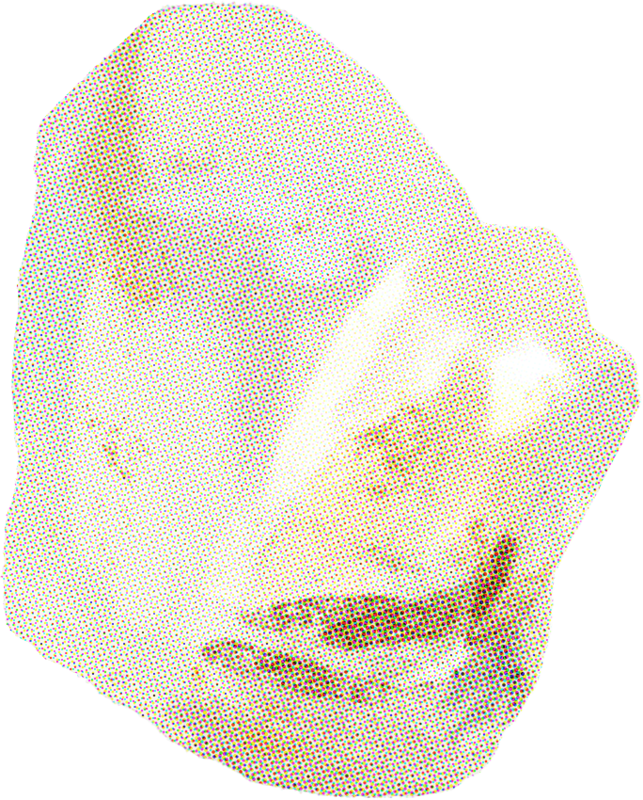


THE ULTIMATE CIRCULAR ECONOMY
PLARICK
Aarav Jain , Aarav Jain, Shreshtha

Slide 2
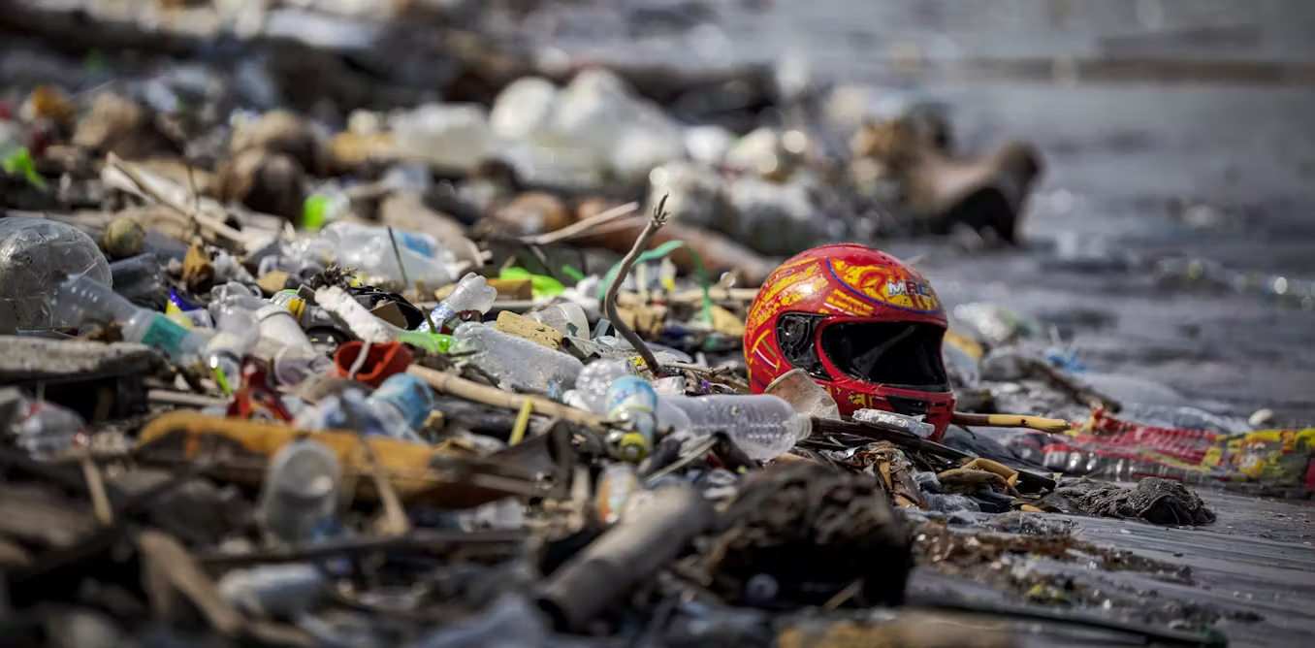
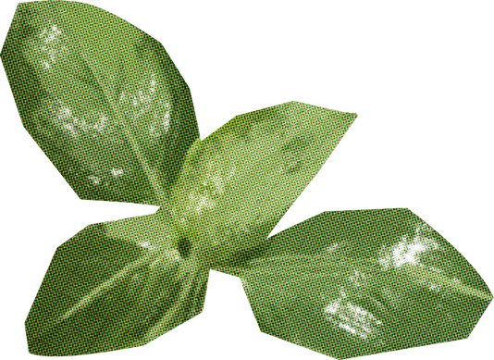

WHAT IS
THE PROBLEM?
PLASTIC WASTE

Slide 3



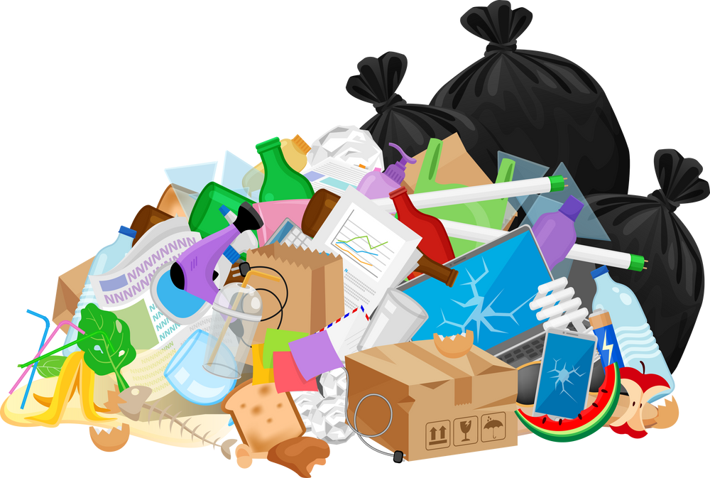







THE PROBLEM

Slide 4






Slide 5


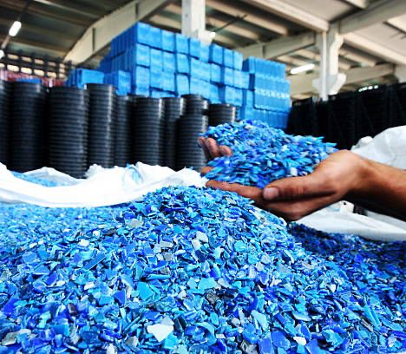

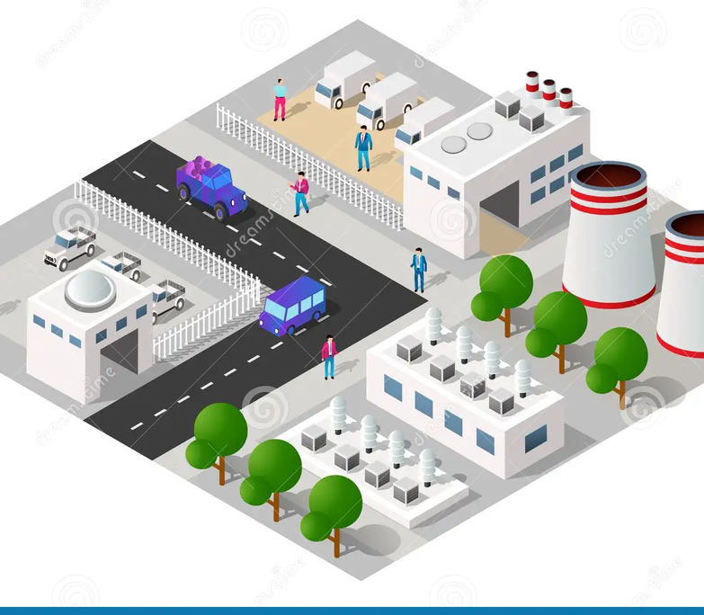
COLLECTION
PRIMARY COLLECTION: Industrial Sites
SECONDARY COLLECTION: Companies segregating plastic wastage from landfills
OF PLASTIC
INDUSTRIAL WASTE
CSR & GOVERNMENT SCHEMES
LOCATED NEAR INDUSTRIAL AREAS

Slide 6

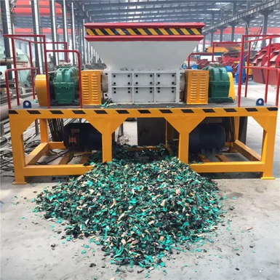
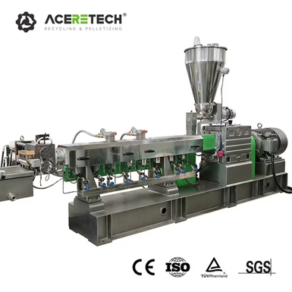
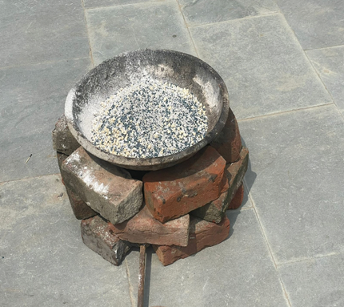
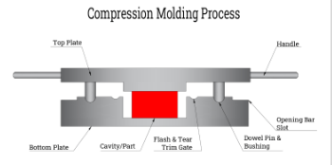
SHREDDED PLASTIC → BRICK
Obtain Plastic Wastage
Compounder (Melting)
Shredding Plastic
Mix With Other RM
250 Celcius
HDPE
PET
PP
CALCIUM
SAND
LIMESTONE
PHOSPOROUS
Compression Moulding
Transportation
Packaging

Slide 7

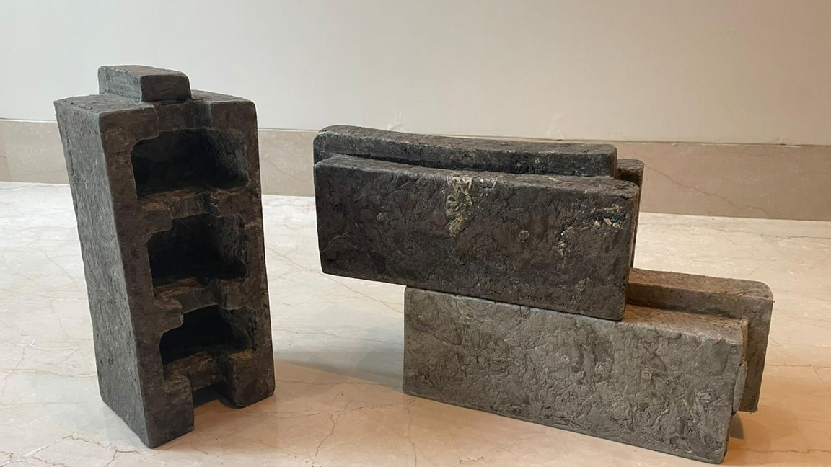
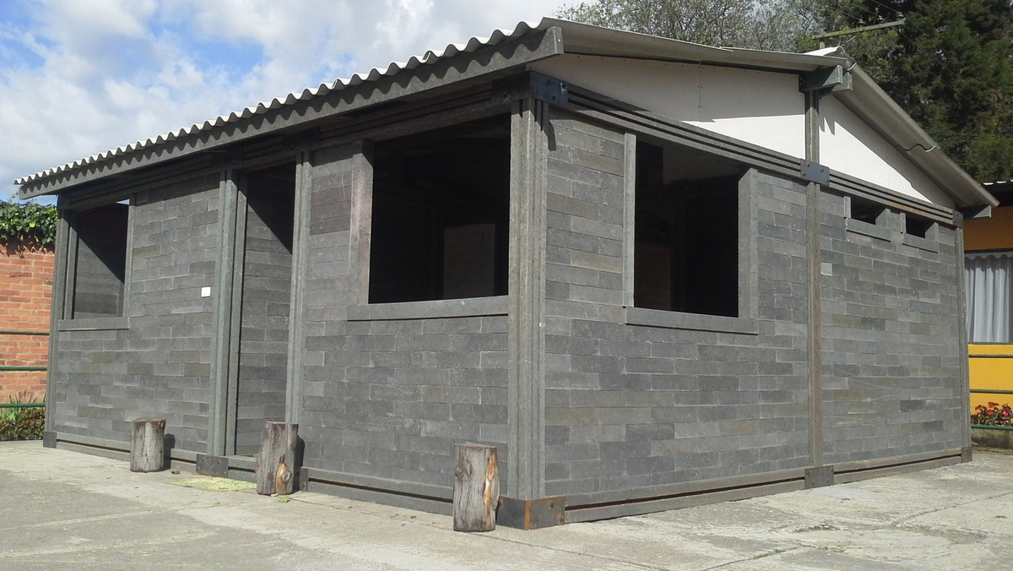

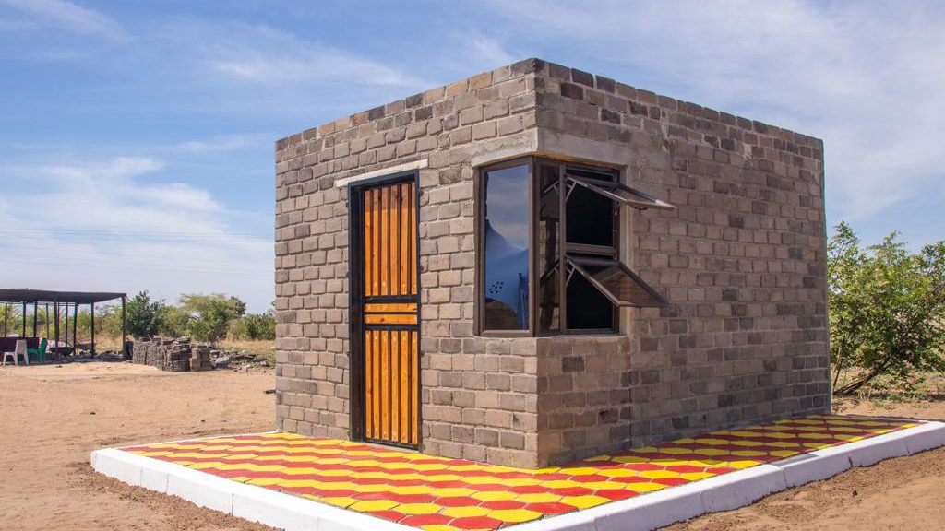
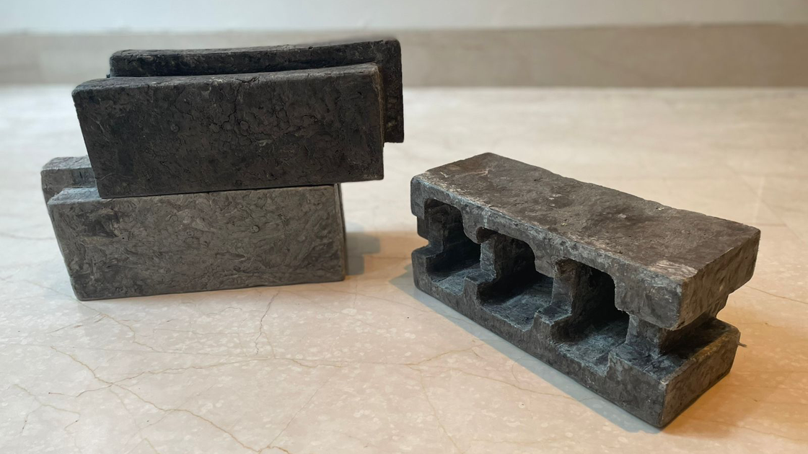
PLASTIC BRICK
TEMPORARY HOUSING
CIRCULAR
ECONOMY

Slide 8


REDUCED PLASTIC WASTAGE
SUSTIANABLE PRODUCTION
We will be able to process plastic waste generated by 50,000 people every year
Comparatively sustainable production method than conventional clay bricks.
REUSE, REDUCE & RECYCLE
ENVIRONMENTAL
SUSTAINABILITY
We aim to solve the challenge of UV degradation, microplastics and flammability through a TEFLON or Phosphorous coating

Slide 9




IMPROVED SEEPAGE PROTECTION
INCREASED DURABILITY
Plastic: 131.8 N/mm2
Concrete: 17.1N/mm2
ALMOST 0 SEEPAGE
LOW MAINTAINANCE COST
SOCIAL
SUSTAINABILITY
IMPROVED HEALTH
THERMAL INSULATION
Primarily in regions of extreme temperatures
Reduced effects of plastic wastage, toxins and fumes
Reduces Energy needed for temperature regulation

Slide 10



EMPLOYMENT
IMPROVED WORKING CONDITIONS
Manafacturing Process: Closed System
hollow bricks reduce transport costs and labour
Segregation, Operations and Transportation
ECONOMIC
SUSTAINABILITY
COST EFFICIENCY
CEMENT BRICKS: $0.7
PLARICK: $0.5

Slide 11


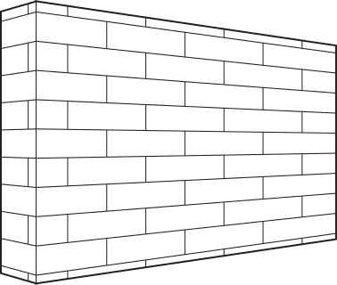

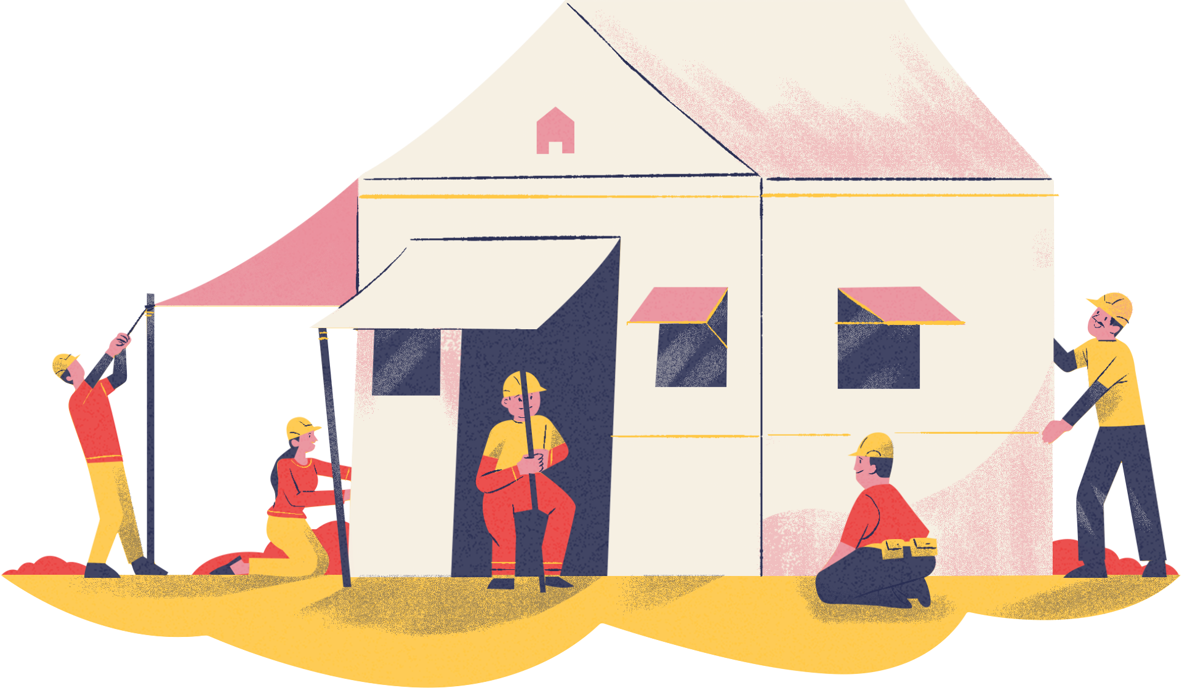
TARGET MARKET
No cement requirement
Interlocking design
TEMPORARY
HOUSING
GLOBAL ANNUAL MARKET: $47 Billion
EXPECTED: $65 Billion by 2030

Slide 12
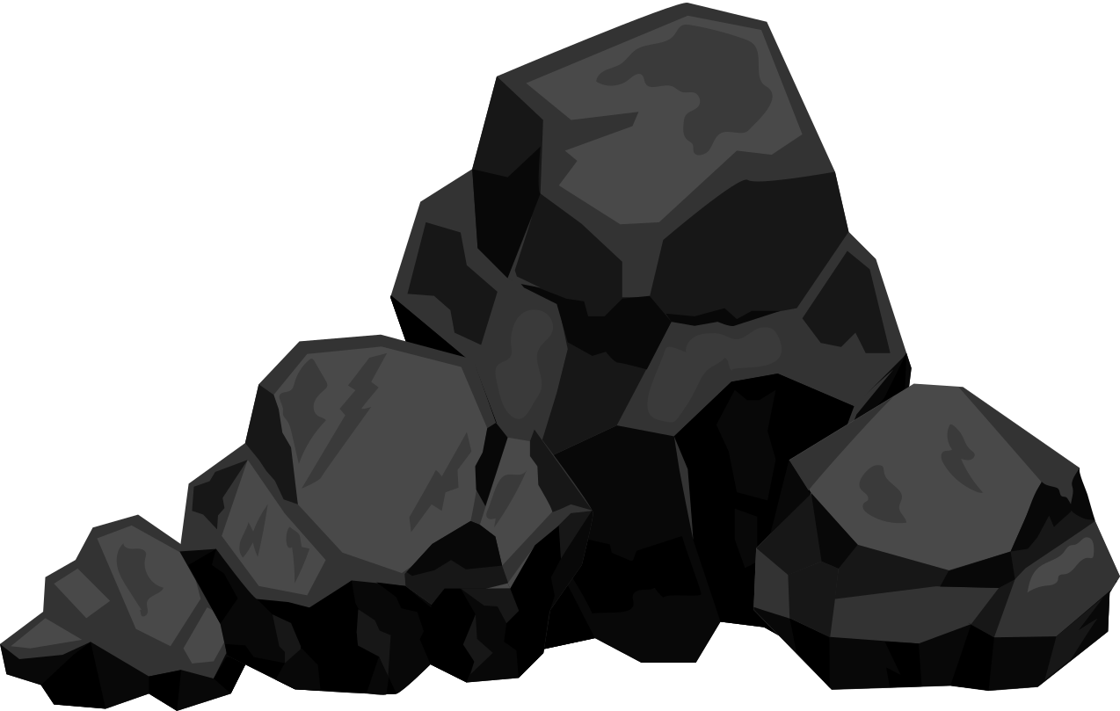


ENERGY & RESORUCES
Energy-efficient systems.
Coal used to manafacture Traditional Clay and Cement Bricks
Solar energy is the primary source of power.
SOLAR PANELS

Slide 13
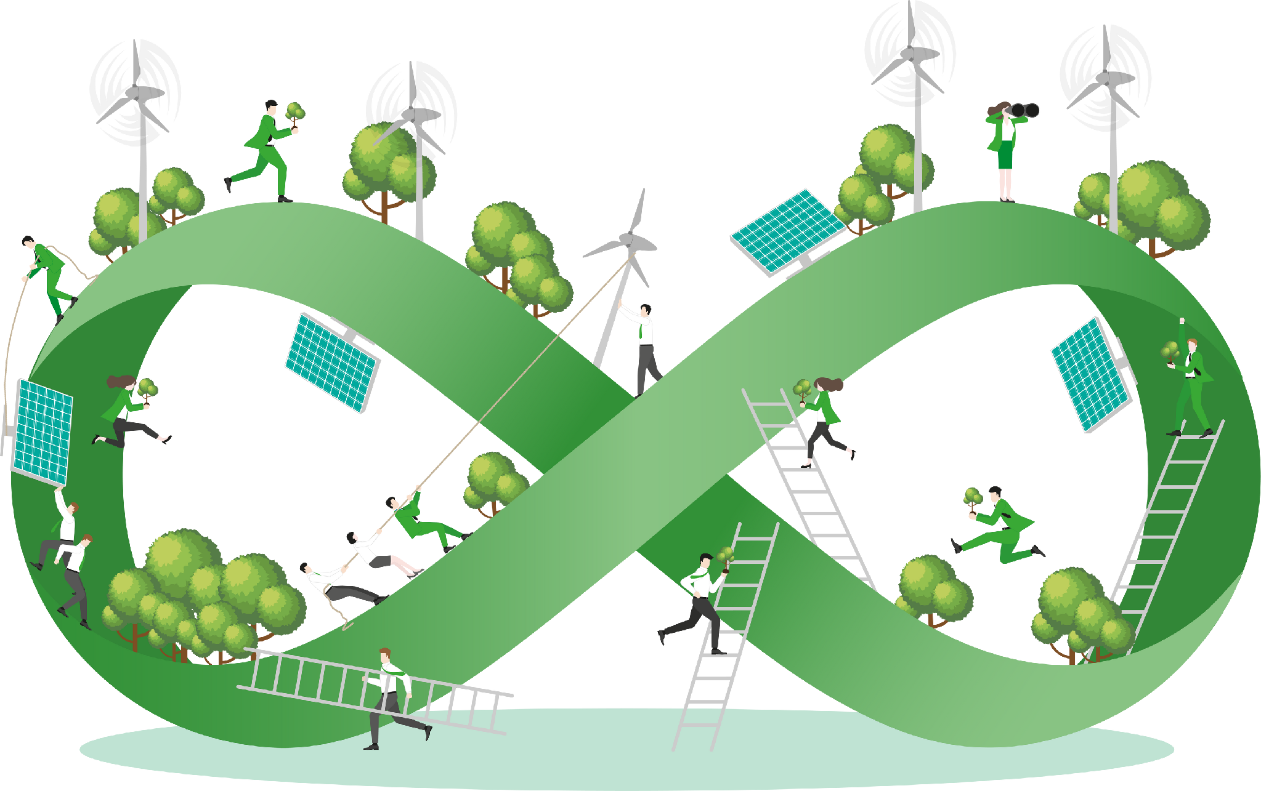

HELP US TRANSFORM WASTE
INTO DURABLE SPACE

