Slide 1

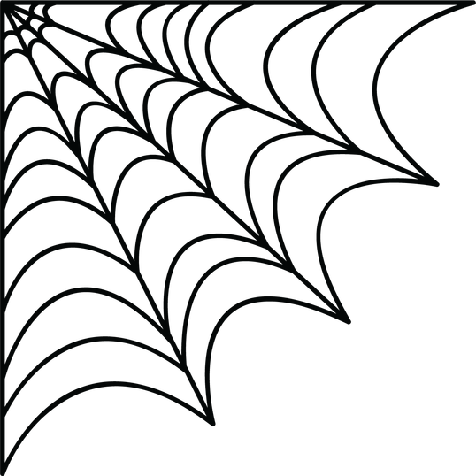





arch presents
2nd edition of
10hr hackathon
GhostTrace
Autonomous Financial Crime Investigation

Slide 2
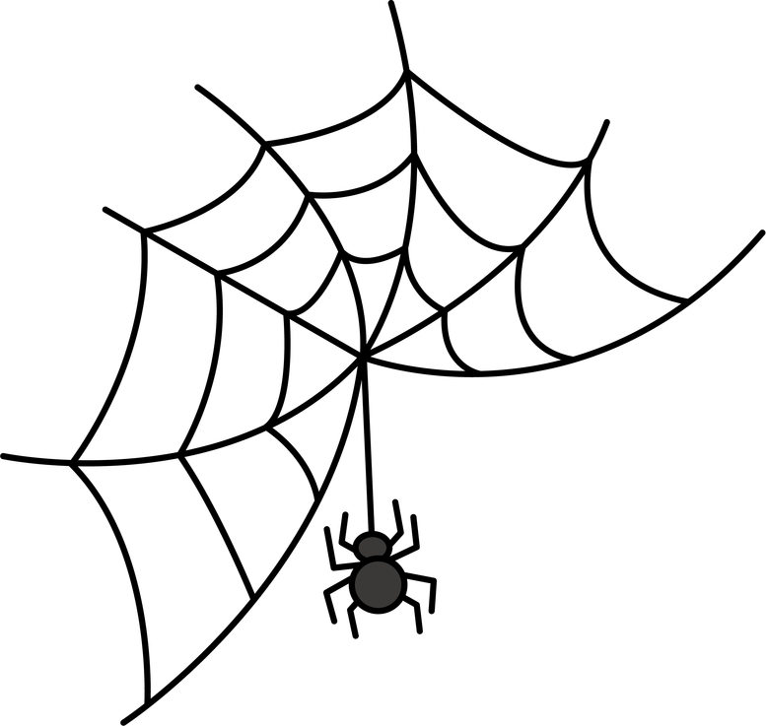



Team Name: Aapthamitra Audits
Track Selected: The Vampire’s Ledger
Name | SRN/PRN | Email ID | Phone Number
Pooja Avadhani | PES1UG24CS323 | Poojaavadhani71@gmail.com | 6362639882
Parinitha Ramesh | PES1UG24CS317 | parinitharamesh2006@gmail.com | 9743741204
Kartik Naik | PES1UG24CS219 | kartikmnaik222@gmail.com | 6362143267
Pallavi Rajkumar | PES1UG24CS314 | bubanalepallavi@gmail.com | 6363578463

Slide 3
Problem Statement
Money mule rings launder illicit funds by hopping them across hundreds of dummy accounts. Legacy fraud engines judge one transaction at a time, so the ring itself stays invisible.
1
Single-Event Bias
2
Distributed Smurfing
3
Manual Investigation
Isolated transactions slip past filters that score one event at a time.
Mule networks split balances across hundreds of dummy hops.
Compliance officers spend days drafting each regulatory filing.
Result: rings stay hidden, and every SAR (Suspicious Activity Report) arrives late.

Slide 4
Novelty
1) How is it different from existing ideas?
Benchmarked vs a baseline on varied rings and legit look-alike loops
Every alert is explained: cycle path, amounts, time gaps between hops
The graph engine computes the evidence; agents interpret it, never invent it
One explainable workflow: graph evidence, entity profiling, draft SAR
2) How does it solve the problem?
Graph engine finds cycles, velocity spikes and shared devices from the data
Profiler interprets deterministic checks on device IDs, geolocation and dormancy
Compliance agent drafts a SAR and freeze recommendation citing that evidence
Output is a draft for human review; nothing is filed or frozen
Our contribution is the integrated, evidence-grounded workflow. Graph fraud detection and agents are established techniques on their own.

Slide 5
Brief about the idea
GhostTrace is an explainable investigation workflow. A graph engine computes the evidence, three agents interpret it, and the output is a draft SAR that cites every claim.
1
Detective Agent
2
Entity Profiler
3
Compliance Officer
Reads graph-engine results: cycles, hop amounts, time gaps and velocity spikes.
Interprets deterministic checks: shared device IDs, location changes, dormant accounts.
Drafts a SAR and freeze recommendation, citing the computed evidence.
~30 sec target, timed live: investigation start to draft SAR export

Slide 6
Proposed Solution
1
2
3
4
5
Ingest
Compute
Interpret
Report
Visualize
Synthetic ledger with legit traffic, injected rings and device IDs
Graph engine computes cycles, hop amounts, time gaps and device matches
Detective and Profiler read that evidence; they never invent accounts
Compliance agent drafts the SAR and freeze advice, citing evidence
PyVis canvas lights the ring in red; a demo timer shows total time
BENCHMARK
Same ledger, several ring patterns and speeds, plus legit loops; honest results
EVIDENCE
Every claim in the report links back to a computed graph fact
OUTPUT
Red-flagged ring plus a draft SAR for human review

Slide 7
Technologies Used
LAYER
TOOL / FRAMEWORK
ROLE IN THE SOLUTION
Graph Engine
NetworkX (Python)
Computes cycles, amounts, time gaps and device matches
Agent Runtime
CrewAI / LangGraph
Agents interpret the evidence and prepare the report
LLM Inference
Gemini API / Groq
Fast reasoning and grounded SAR drafting
Frontend UI
Streamlit + PyVis
Interactive network exploration, zero custom CSS
Data
Python + synthetic generator
Several ring patterns, legit loops, synthetic device IDs

Slide 8
Wireframes / Mock Diagrams
GhostTrace | Investigation Console
Interactive Graph Canvas
Flagged mule ring
Live Investigation Trace
> cycle detected: 4 hops
> time gaps computed: 41m
> device match verified: D17
> SAR draft generated
$9.8k | 12m
$9.4k | 9m
$9.7k | 9m
Instant SAR Dossier
Draft SAR and freeze recommendation, every claim cited to evidence
$9.5k | 11m
Export Draft SAR

Slide 9
Thank You!
GhostTrace | The Vampire’s Ledger
Unmasking mule rings and generating
evidence-backed SAR drafts in seconds.

