Slide 1
JSW ONE TMT
Price Positioning Dashboard
Brand-wise TMT Steel Prices — Distributor & Dealer Level
Gap Severity Legend
As on 9th March 2026
Competitive: Gap ≤ ₹2,000
Watch: Gap ₹2,001 – ₹4,000
Markets Covered
Action Needed: Gap > ₹4,000
Delhi • Haryana • Jaipur (Rajasthan) • Kanpur (UP E+C) • Chandigarh • Ludhiana (Punjab) • Dehradun (Uttarakhand) • Shimla (H.P.) • Jammu (J&K)
JSW ONE TMT | Price Positioning | 9th Mar '26 | 0/10

Slide 2
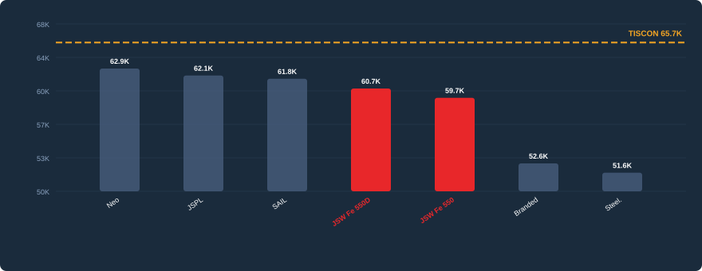
JSW ONE TMT Price Positioning
As on 9th Mar '26
Delhi
1 / 10
DEALER LEVEL PRICES
Dealer Level Price Comparison
Brand
Distr. (₹)
Dealer (₹)
Gap vs TSL
TISCON (TSL)
₹60,000
₹65,650
BENCHMARK
Neo
₹59,150
₹62,850
▼ ₹2,800
JSPL
₹58,500
₹62,100
▼ ₹3,550
SAIL
₹59,500
₹61,750
▼ ₹3,900
JSW One Fe 550D
₹58,400
₹60,700
▼ ₹4,950
JSW One Fe 550
₹57,400
₹59,700
▼ ₹5,950
Branded Prem Sec.
₹52,400
₹52,650
▼ ₹13,000
Steelmint
₹51,650
₹51,650
▼ ₹14,000
JSW Fe 550D (Project Grade)
JSW Fe 550 (Standard Retail)
Distr.
Dealer
Distr.
Dealer
▼ ₹4,950
₹58,400
₹60,700
▼ ₹5,950
₹57,400
₹59,700
ACTION NEEDED
TISCON: ₹65,650
ACTION NEEDED
TISCON: ₹65,650
JSW ONE TMT | Price Positioning | 9th Mar '26 | 1/10

Slide 3
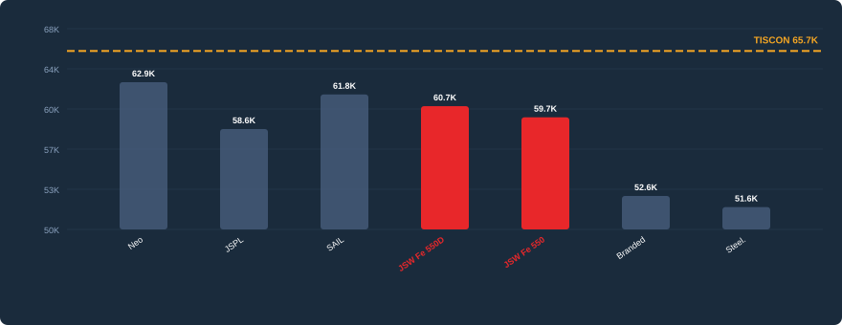
JSW ONE TMT Price Positioning
As on 9th Mar '26
Haryana
2 / 10
DEALER LEVEL PRICES
Dealer Level Price Comparison
Brand
Distr. (₹)
Dealer (₹)
Gap vs TSL
TISCON (TSL)
₹60,000
₹65,650
BENCHMARK
Neo
₹59,150
₹62,850
▼ ₹2,800
JSPL
N/A
₹58,650
▼ ₹7,000
SAIL
₹59,500
₹61,750
▼ ₹3,900
JSW One Fe 550D
₹58,400
₹60,700
▼ ₹4,950
JSW One Fe 550
₹57,400
₹59,700
▼ ₹5,950
Branded Prem Sec.
₹52,400
₹52,650
▼ ₹13,000
Steelmint
₹51,650
₹51,650
▼ ₹14,000
JSW Fe 550D (Project Grade)
JSW Fe 550 (Standard Retail)
Distr.
Dealer
Distr.
Dealer
▼ ₹4,950
₹58,400
₹60,700
▼ ₹5,950
₹57,400
₹59,700
ACTION NEEDED
TISCON: ₹65,650
ACTION NEEDED
TISCON: ₹65,650
JSW ONE TMT | Price Positioning | 9th Mar '26 | 2/10

Slide 4
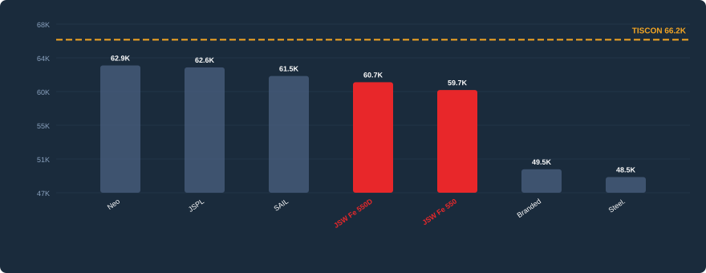
JSW ONE TMT Price Positioning
As on 9th Mar '26
Jaipur (Rajasthan)
3 / 10
DEALER LEVEL PRICES
Dealer Level Price Comparison
Brand
Distr. (₹)
Dealer (₹)
Gap vs TSL
TISCON (TSL)
₹60,500
₹66,150
BENCHMARK
Neo
₹59,150
₹62,850
▼ ₹3,300
JSPL
₹58,750
₹62,600
▼ ₹3,550
SAIL
₹59,250
₹61,500
▼ ₹4,650
JSW One Fe 550D
₹58,400
₹60,700
▼ ₹5,450
JSW One Fe 550
₹57,400
₹59,700
▼ ₹6,450
Branded Prem Sec.
₹52,400
₹49,550
▼ ₹16,600
Steelmint
₹48,550
₹48,550
▼ ₹17,600
JSW Fe 550D (Project Grade)
JSW Fe 550 (Standard Retail)
Distr.
Dealer
Distr.
Dealer
▼ ₹5,450
₹58,400
₹60,700
▼ ₹6,450
₹57,400
₹59,700
ACTION NEEDED
TISCON: ₹66,150
ACTION NEEDED
TISCON: ₹66,150
JSW ONE TMT | Price Positioning | 9th Mar '26 | 3/10

Slide 5
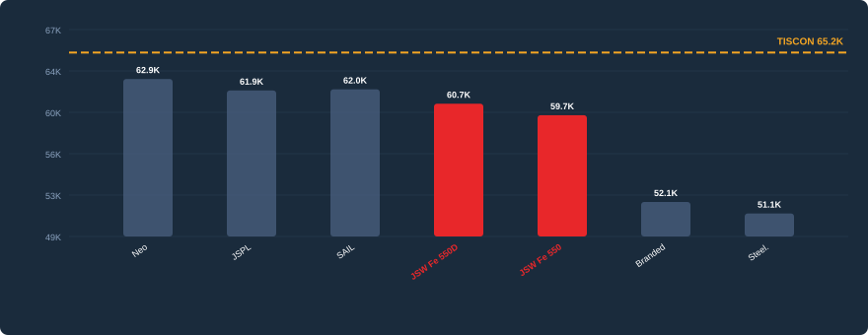
JSW ONE TMT Price Positioning
As on 9th Mar '26
Kanpur (UP E+C)
4 / 10
DEALER LEVEL PRICES
Dealer Level Price Comparison
Brand
Distr. (₹)
Dealer (₹)
Gap vs TSL
TISCON (TSL)
₹59,500
₹65,150
BENCHMARK
Neo
₹59,150
₹62,850
▼ ₹2,300
JSPL
₹58,600
₹61,850
▼ ₹3,300
SAIL
₹59,500
₹61,950
▼ ₹3,200
JSW One Fe 550D
₹58,400
₹60,700
▼ ₹4,450
JSW One Fe 550
₹57,400
₹59,700
▼ ₹5,450
Branded Prem Sec.
₹51,900
₹52,150
▼ ₹13,000
Steelmint
₹51,150
₹51,150
▼ ₹14,000
JSW Fe 550D (Project Grade)
JSW Fe 550 (Standard Retail)
Distr.
Dealer
Distr.
Dealer
▼ ₹4,450
₹58,400
₹60,700
▼ ₹5,450
₹57,400
₹59,700
ACTION NEEDED
TISCON: ₹65,150
ACTION NEEDED
TISCON: ₹65,150
JSW ONE TMT | Price Positioning | 9th Mar '26 | 4/10

Slide 6
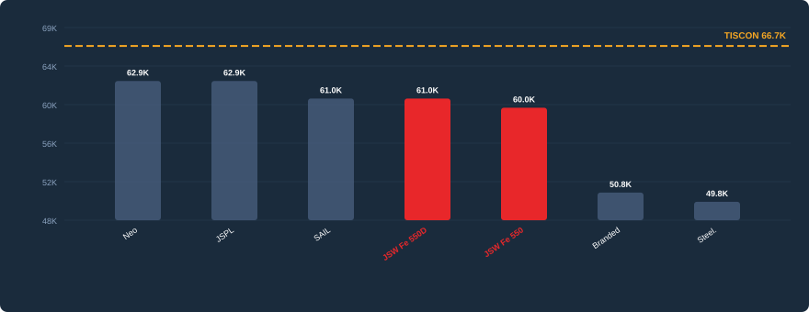
JSW ONE TMT Price Positioning
As on 9th Mar '26
Chandigarh
5 / 10
DEALER LEVEL PRICES
Dealer Level Price Comparison
Brand
Distr. (₹)
Dealer (₹)
Gap vs TSL
TISCON (TSL)
₹61,000
₹66,650
BENCHMARK
Neo
₹59,150
₹62,850
▼ ₹3,800
JSPL
₹59,000
₹62,850
▼ ₹3,800
SAIL
₹58,650
₹60,950
▼ ₹5,700
JSW One Fe 550D
₹58,650
₹60,950
▼ ₹5,700
JSW One Fe 550
₹57,650
₹59,950
▼ ₹6,700
Branded Prem Sec.
₹50,500
₹50,750
▼ ₹15,900
Steelmint
₹49,750
₹49,750
JSW Fe 550D (Project Grade)
JSW Fe 550 (Standard Retail)
Distr.
Dealer
Distr.
Dealer
▼ ₹5,700
₹58,650
₹60,950
▼ ₹6,700
₹57,650
₹59,950
ACTION NEEDED
TISCON: ₹66,650
ACTION NEEDED
TISCON: ₹66,650
JSW ONE TMT | Price Positioning | 9th Mar '26 | 5/10

Slide 7
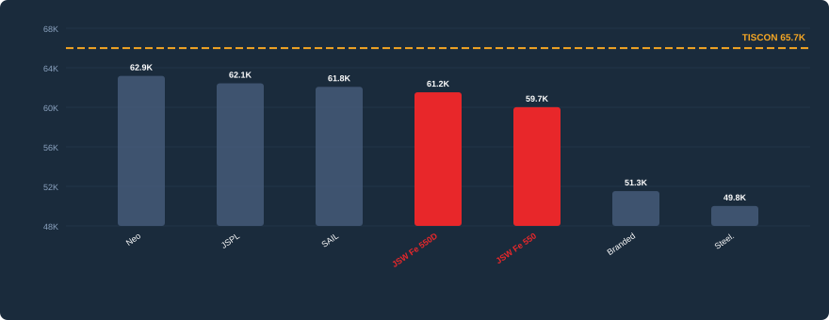
JSW ONE TMT Price Positioning
As on 9th Mar '26
Ludhiana (Punjab)
6 / 10
DEALER LEVEL PRICES
Dealer Level Price Comparison
Brand
Distr. (₹)
Dealer (₹)
Gap vs TSL
TISCON (TSL)
₹60,500
₹65,650
BENCHMARK
Neo
₹59,650
₹62,850
▼ ₹2,800
JSPL
₹58,750
₹62,100
▼ ₹3,550
SAIL
₹60,000
₹61,750
▼ ₹3,900
JSW One Fe 550D
₹58,900
₹61,200
▼ ₹4,450
JSW One Fe 550
₹57,900
₹59,700
▼ ₹5,950
Branded Prem Sec.
₹51,000
₹51,250
▼ ₹14,400
Steelmint
₹49,750
₹49,750
▼ ₹15,900
JSW Fe 550D (Project Grade)
JSW Fe 550 (Standard Retail)
Distr.
Dealer
Distr.
Dealer
▼ ₹4,450
₹58,900
₹61,200
▼ ₹5,950
₹57,900
₹59,700
ACTION NEEDED
TISCON: ₹65,650
ACTION NEEDED
TISCON: ₹65,650
JSW ONE TMT | Price Positioning | 9th Mar '26 | 6/10

Slide 8
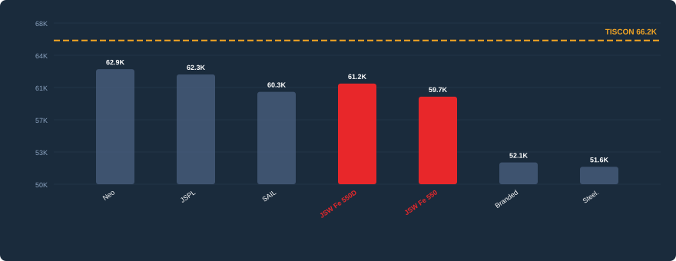
JSW ONE TMT Price Positioning
As on 9th Mar '26
Dehradun (Uttarakhand)
7 / 10
DEALER LEVEL PRICES
Dealer Level Price Comparison
Brand
Distr. (₹)
Dealer (₹)
Gap vs TSL
TISCON (TSL)
₹60,500
₹66,150
BENCHMARK
Neo
₹59,150
₹62,850
▼ ₹3,300
JSPL
₹59,000
₹62,250
▼ ₹3,900
SAIL
₹59,500
₹60,250
▼ ₹5,900
JSW One Fe 550D
₹58,900
₹61,200
▼ ₹4,950
JSW One Fe 550
₹57,400
₹59,700
▼ ₹6,450
Branded Prem Sec.
₹52,150
₹52,150
▼ ₹14,000
Steelmint
₹51,650
₹51,650
▼ ₹14,500
JSW Fe 550D (Project Grade)
JSW Fe 550 (Standard Retail)
Distr.
Dealer
Distr.
Dealer
▼ ₹4,950
₹58,900
₹61,200
▼ ₹6,450
₹57,400
₹59,700
ACTION NEEDED
TISCON: ₹66,150
ACTION NEEDED
TISCON: ₹66,150
JSW ONE TMT | Price Positioning | 9th Mar '26 | 7/10

Slide 9
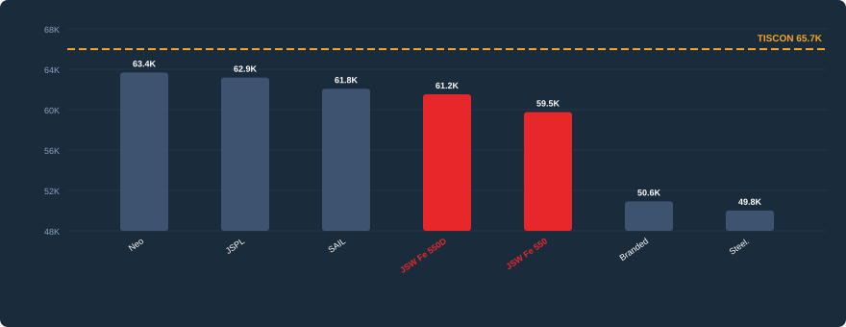
JSW ONE TMT Price Positioning
As on 9th Mar '26
Shimla (H.P.)
8 / 10
DEALER LEVEL PRICES
Dealer Level Price Comparison
Brand
Distr. (₹)
Dealer (₹)
Gap vs TSL
TISCON (TSL)
₹60,000
₹65,650
BENCHMARK
Neo
₹59,650
₹63,350
▼ ₹2,300
JSPL
₹59,600
₹62,850
▼ ₹2,800
SAIL
₹60,500
₹61,750
▼ ₹3,900
JSW One Fe 550D
₹59,450
₹61,200
▼ ₹4,450
JSW One Fe 550
₹57,900
₹59,450
▼ ₹6,200
Branded Prem Sec.
₹50,500
₹50,650
▼ ₹15,000
Steelmint
₹49,750
₹49,750
▼ ₹15,900
JSW Fe 550D (Project Grade)
JSW Fe 550 (Standard Retail)
Distr.
Dealer
Distr.
Dealer
▼ ₹4,450
₹59,450
₹61,200
▼ ₹6,200
₹57,900
₹59,450
ACTION NEEDED
TISCON: ₹65,650
ACTION NEEDED
TISCON: ₹65,650
JSW ONE TMT | Price Positioning | 9th Mar '26 | 8/10

Slide 10
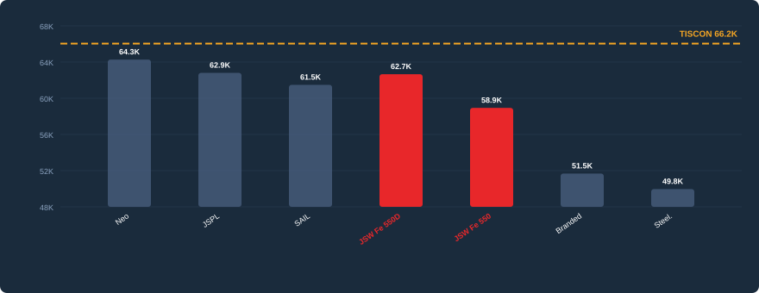
JSW ONE TMT Price Positioning
As on 9th Mar '26
Jammu (J&K)
9 / 10
DEALER LEVEL PRICES
Dealer Level Price Comparison
Brand
Distr. (₹)
Dealer (₹)
Gap vs TSL
TISCON (TSL)
₹60,500
₹66,150
BENCHMARK
Neo
₹60,650
₹64,350
▼ ₹1,800
JSPL
₹59,000
₹62,850
▼ ₹3,300
SAIL
₹59,500
₹61,500
▼ ₹4,650
JSW One Fe 550D
₹60,400
₹62,700
▼ ₹3,450
JSW One Fe 550
₹58,900
₹58,900
▼ ₹7,250
Branded Prem Sec.
₹51,500
₹51,500
▼ ₹14,650
Steelmint
₹49,750
₹49,750
▼ ₹16,400
JSW Fe 550D (Project Grade)
JSW Fe 550 (Standard Retail)
Distr.
Dealer
Distr.
Dealer
▼ ₹3,450
₹60,400
₹62,700
▼ ₹7,250
₹58,900
₹58,900
WATCH
TISCON: ₹66,150
ACTION NEEDED
TISCON: ₹66,150
JSW ONE TMT | Price Positioning | 9th Mar '26 | 9/10

Slide 11
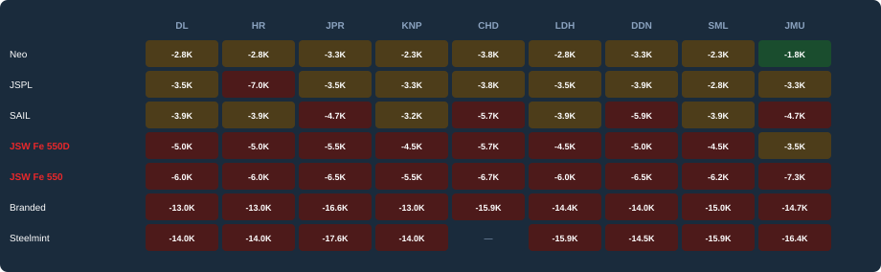
JSW ONE TMT Summary
Market × Brand Gap Heatmap
Dealer Level Gap vs TISCON (in ₹ thousands)
Competitive (≤₹2K)
Watch (₹2K–₹4K)
Action (>₹4K)
MARKETS NEEDING IMMEDIATE REALIGNMENT
MARKETS WHERE JSW IS MOST COMPETITIVE
Delhi, Haryana, Jaipur (Rajasthan), Kanpur (UP E+C), Chandigarh, Ludhiana (Punjab), Dehradun (Uttarakhand), Shimla (H.P.), Jammu (J&K)
Jammu (J&K)
JSW brands with > ₹4,000 gap vs TISCON at dealer level
JSW 550D within ₹4,000 of TISCON at dealer level
JSW ONE TMT | Price Positioning | 9th Mar '26 | 10/10

