Slide 1
Yilan Ji yj2425@columbia.edu
Haoyan Min hm2689@columbia.edu
Ruiqi Zhong rz2383@columbia.edu
COMS 4995 Final Project :
Meta-learning Through
Deep Reinforcement Learning
Do excuse me if I am talking fast
The model and architecture is original
The formulation is sophisticated

Slide 2
A Very Brief Introduction
Increasing demand for data analysts and machine learning
Many works are routine (e.g. model choice, parameter tuning)
Automatically find the “best” model through meta-learning (machine learning for machine learning)

Slide 3
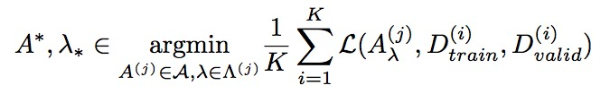
Problem Abstraction
CASH: Combined Algorithm Selection and Hyper-parameter optimization[1]
We want to search the model (within a certain family) that (approximately) minimizes the cross validation error in the shortest time
Non-differentiable
Takes time to compute
Need smart optimization procedure

Slide 4
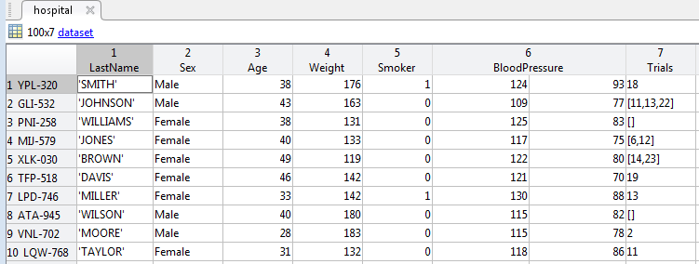
How would data analysts do it? An abstraction of optimization procedure
sparseness
dimensions,
class prior …
A reinforcement Learning Formulation
Calculate metedata
observation
Logistic Regression
loss
accuracy
…
observation
A Data Set
Analyst
Action
Increase regularization
Action
loss
accuracy
…
[2]
observation
policy
…
reward
Interaction with a black box
but simulatable environment

Slide 5
Our Model
Calculate metedata
sparseness
dimensions,
class prior …
observation
Binary classification problem
Simulated Data Sets
100~1000 data points
5~1000 dimensions
Different parameter and noise distribution
Balanced weights
Best accuracy 0.7~0.95
Sklearn primitives
Imputation
qda, Bernoulli nb
PCA
Continuous hyper-parameters
π(s) = argmaxa Q(s,a)
A Data Set
Analyst
train/test loss accuracy
Meta statistics
loss
accuracy
…
observation
Logistic Regression
Action
policy
The improved test accuracy
over all past attempted models
loss
accuracy
…
Increase regularization
Action
observation
reward

Slide 6
A brief Overview
Notation | Translation | Real world | Our model
π(s) | policy | analyst | LSTM Network
a | action | a distribution of model choices | sklearn primitives
o | obseravation | metadata, model performance | metadata, model performance
r | reward | Better prediction | Cv accuracy increase

Slide 7
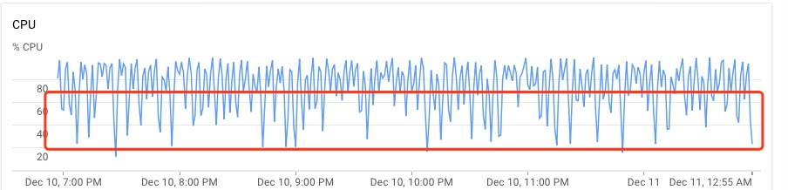
OUR Architecture
Python
Implementation in Keras[3]
32 CPUs for evaluation stage
multiprocess, synchronized
We use an LSTM to model Q(s,a)
Data set
Estimated value Q(s, a)
Model
Performance
Q(s, a)
Model
Performance
argmaxa Q(s,a)
argmaxa Q(s,a)
h0
h1
h2
Meta-statistics
Meta-statistics
Performance
Model choice

Slide 8
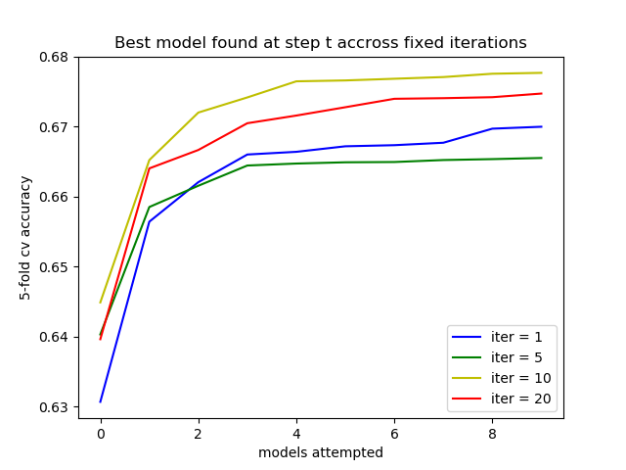
Evaluation Criteria
Find the best cross validation accuracy within 10 choices
Reinforcement learning result starting from completely random (policy evaluation)
Blue curve (random guess)
Analyst (iter 1)
Analyst (iter 2)
8th attempted model
How good is his first attempted model after he sees the data

Slide 9
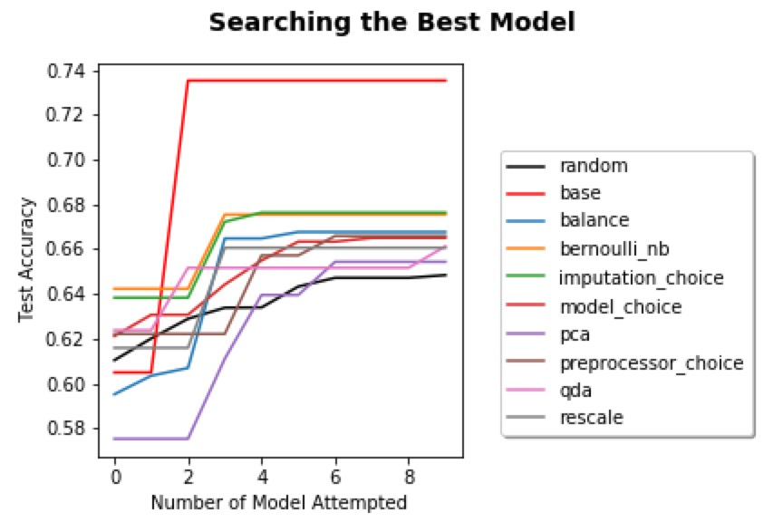
Not a good starting point? Train a policy network First
We use an LSTM to mimic the performance of Bayesian Optimization[4] (e.g. Gaussian Process), implemented by autosklearn[5][6]

Slide 10
Using the pre-trained policy network as a starting point for reinforcement learning
Still training as it takes really a long time…
rz2383@columbia.edu Ruiqi Zhong (Feel free to contact me)
Github: https://github.com/PB12203006/Meta-Learning-with-Deep-Reinforcement-Learning [7]
Due to presentation time limit, we will release more project progress and visualization on github
Or add me on social media!!

Slide 11
Challenges
Text
1. Hard to find a reasonable assumption of real world data set.
2. Training the network is not the most time consuming part. Evaluating the policy is. Each data point is a 5-fold cross validation ~ training a model 5 times.
3. Hard to design a reward function

Slide 12
References
Text
[1] Hessel, Matteo, et al. ”Rainbow: Combining Improvements in Deep Reinforcement Learning.” arXiv preprint arXiv: 1710.02298 (2017).
[2]https://www.mathworks.com/help/stats/manipulate-dataset-arrays-using-the-variable-editor.html
[3]MLA Brochu, Eric, Vlad M. Cora, and Nando De Fre- itas. ”A tutorial on Bayesian optimization of expensive cost functions, with application to active user modeling and hierarchical reinforcement learning.” arXiv preprint arXiv:1012.2599 (2010).
[4] Feurer, Matthias, et al. ”Efficient and robust automated machine learning.” Advances in Neural Information Processing Systems. 2015.
[5]https://github.com/fchollet/keras
[6]https://github.com/automl/auto-sklearn
[7]https://github.com/PB12203006/Meta-Learning-with-Deep-Reinforcement-Learning

Slide 13
Text
Thanks for Watching
Yilan Ji, Haoyan Min, Ruiqi Zhong

