Slide 1
Book4
File created on: 04/06/2021 12.54.37 GMT+02:00

Slide 2
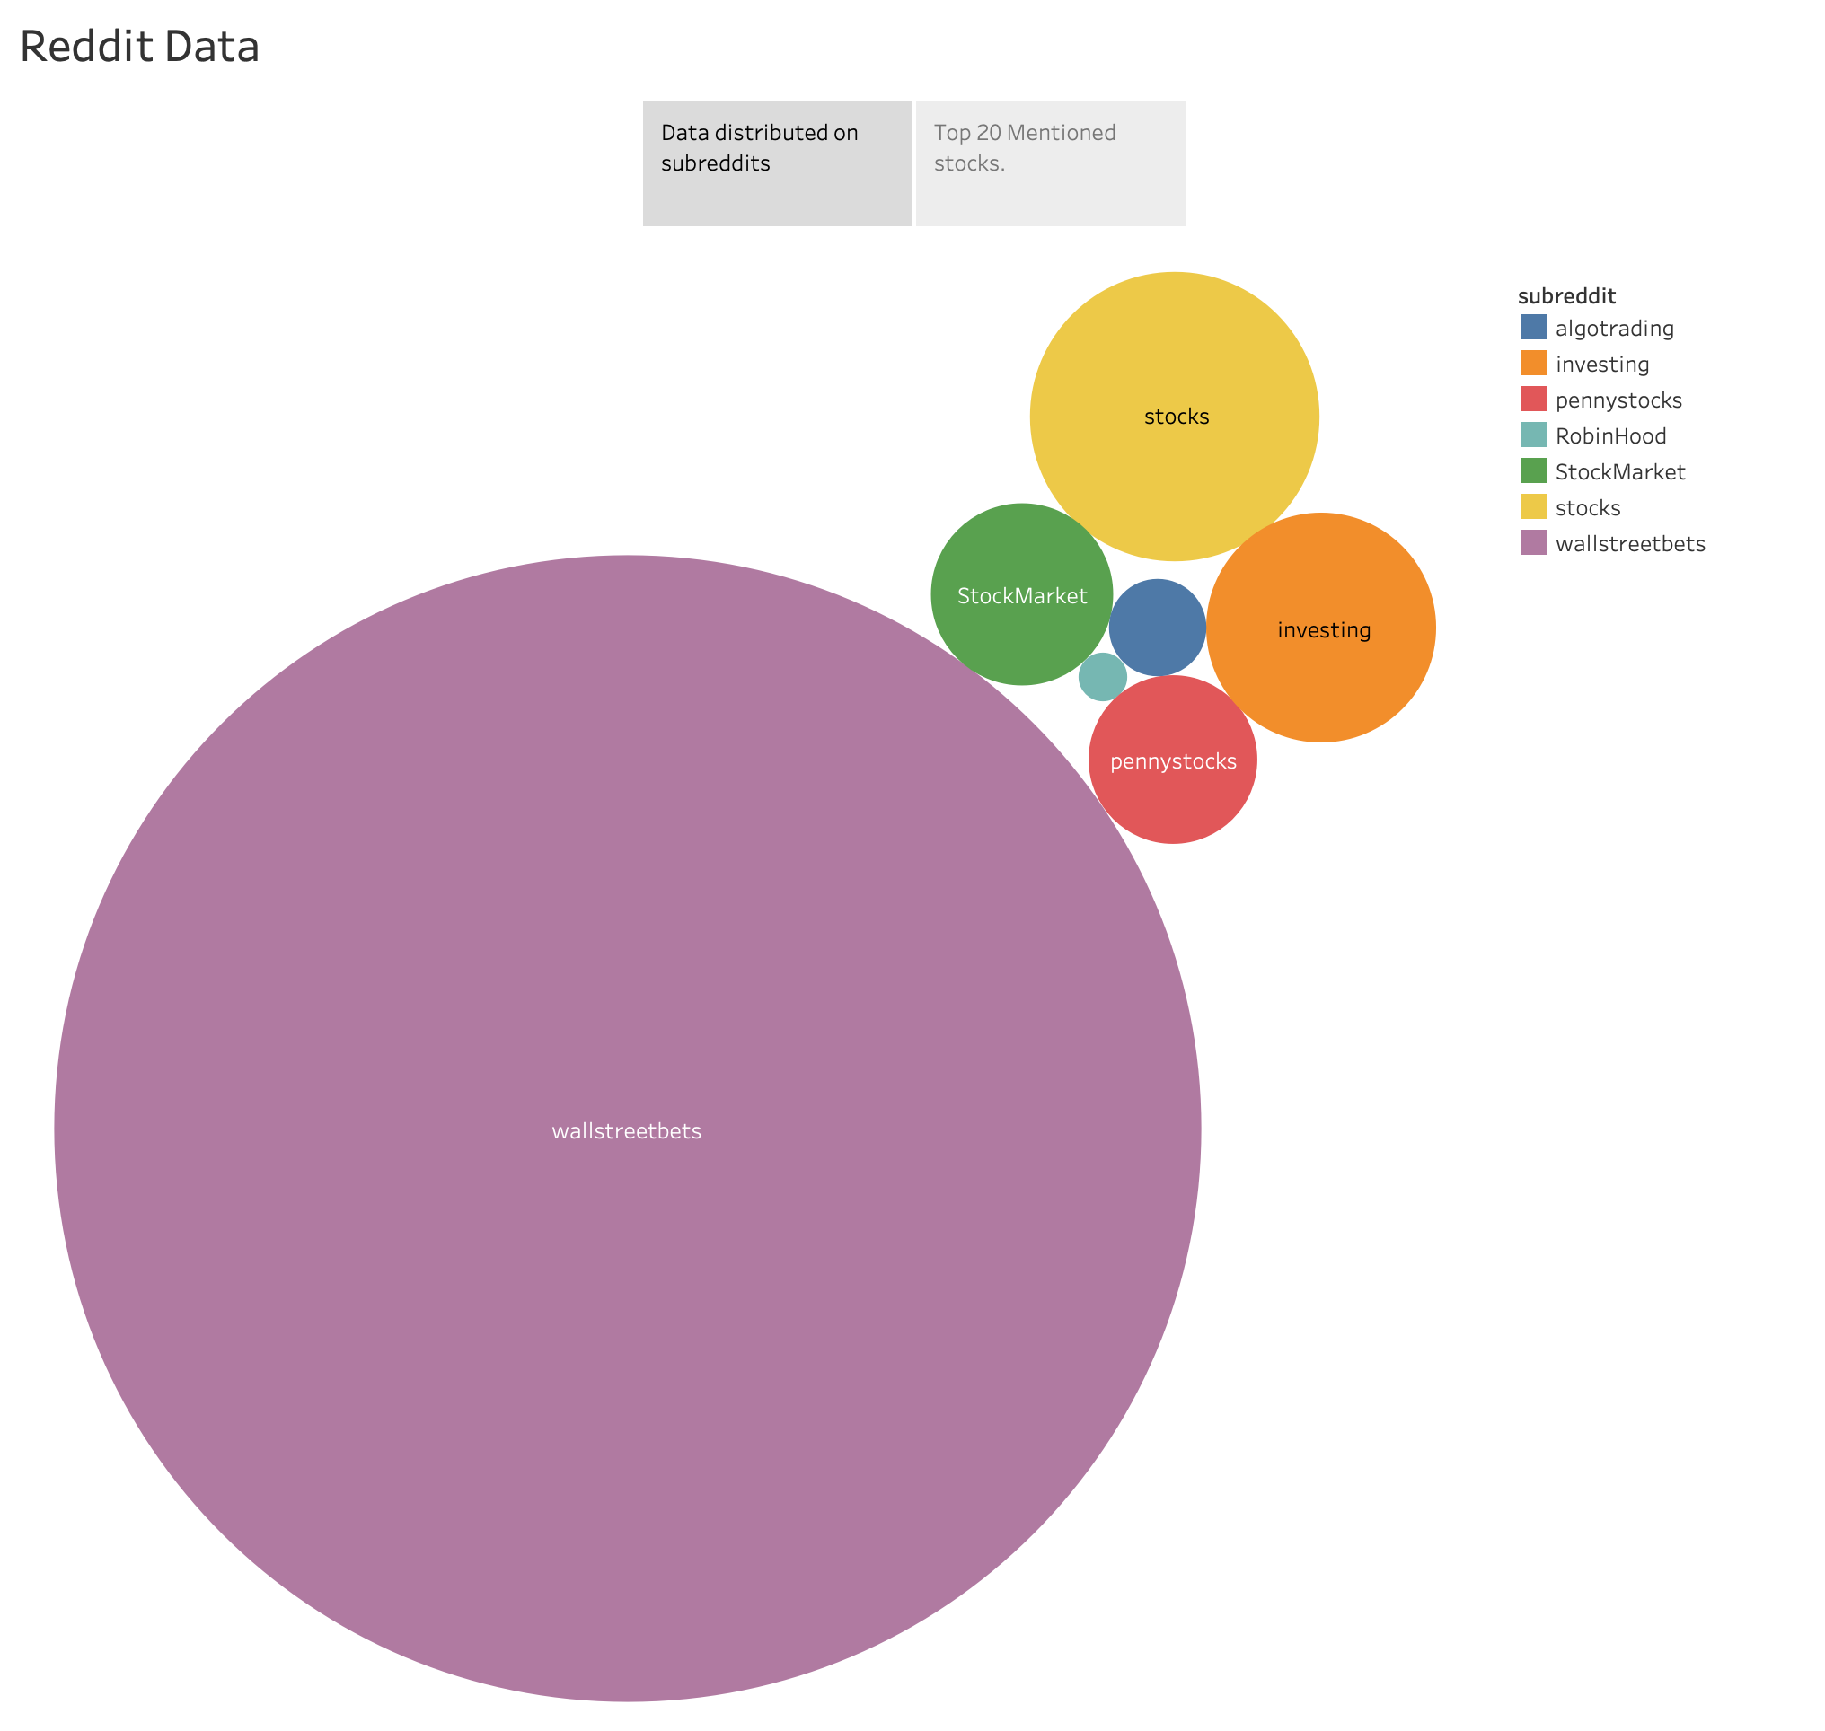

Slide 3
