Slide 1
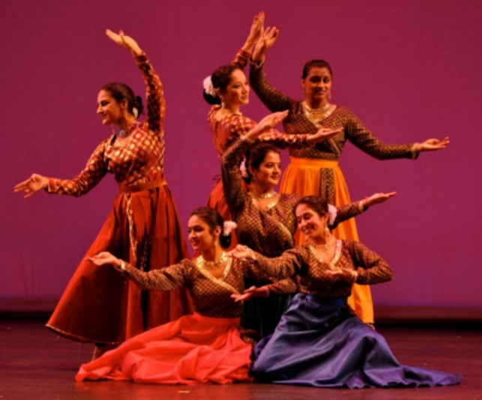
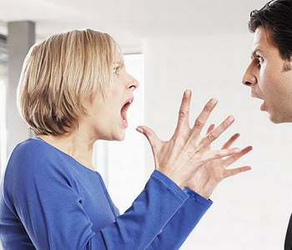
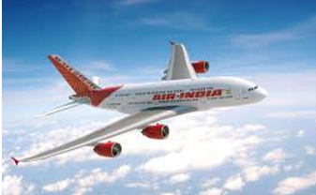
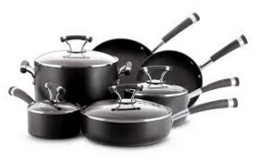
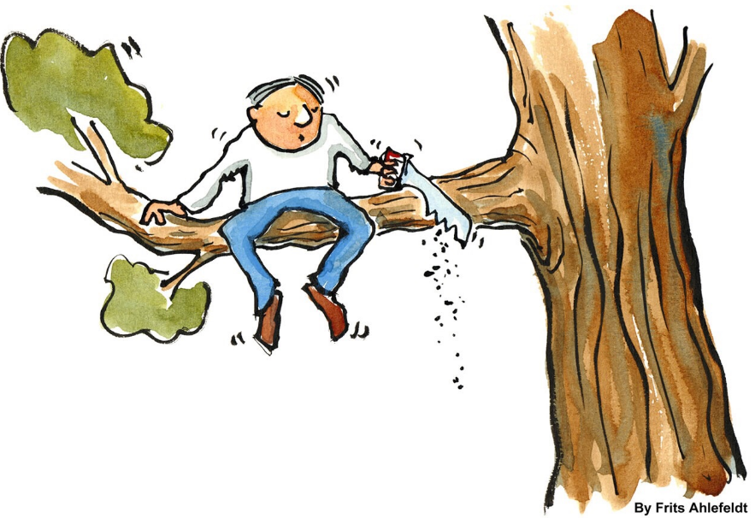
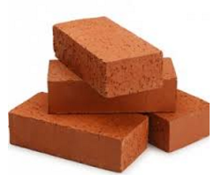

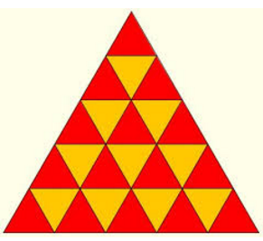
Puzzle #1
4/6
7/17
2/5
4/10
2/4
3/6
2/7
9/9

Slide 2
#1 (4/6) kathak | (7/17) troublesome woman | (2/5) plane | (4/10) bouldering | (2/4) fool | (3/6) bricks | (2/7) student | (9/9) triangles

