Slide 1

PBCore Structure

Slide 2




Slide 3
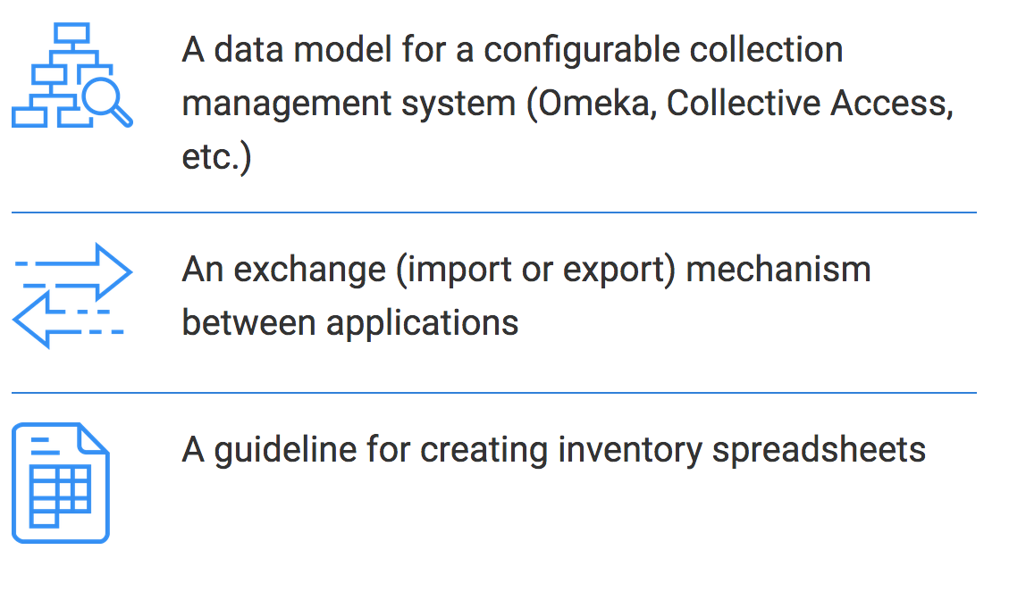
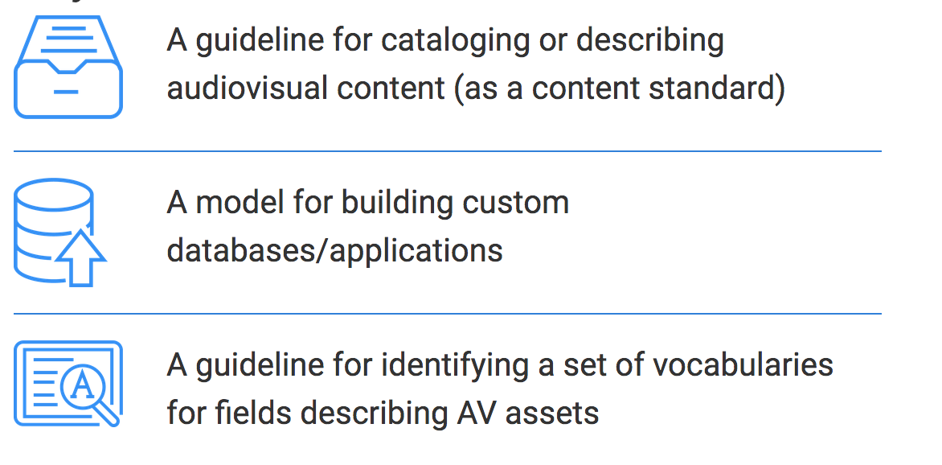
Key Functions of PBCore

Slide 4
1. Types of PBCore records a. Description Documents b. Instantiation Documents c. Collection Documents 2. PBCore Elements a. Asset Elements b. Instantiation Elements c. Attributes
How do you build a PBCore record?

Slide 5
1. Types of PBCore records a. Description Documents b. Instantiation Documents c. Collection Documents
How do you build a PBCore record?

Slide 6
Collection Document
Description Document
Asset Information
Instantiation Document
Instantiation Information
Asset
Instantiation
Instantiation
Essence Track
Instantiation
Essence Track
Essence Track
Asset
Instantiation
Essence Track
Instantiation
Essence Track
Instantiation
Essence Track
Notes:
We’ll talk more about elements and attributes when we look at PBCore vocabularies next week, but for now, let’s jump back to structure. PBCore structures are designed to be flexible. You can use them in a bunch of different ways to describe your material in the way that makes the most sense for your institution.

Slide 7
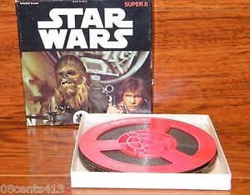
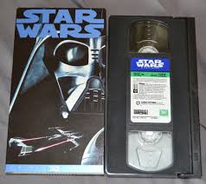
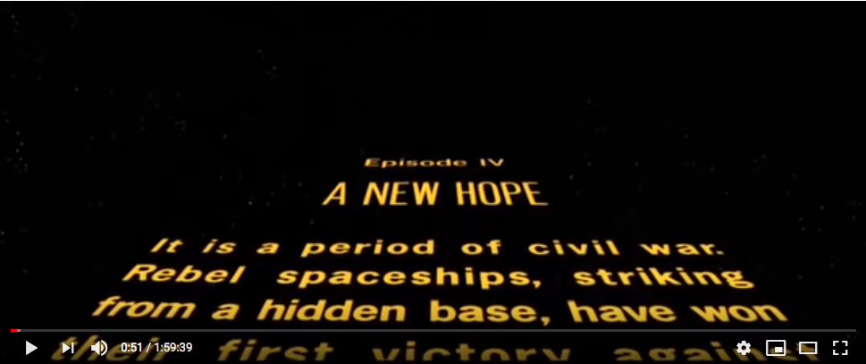
Description Document
Asset Information
Instantiation
Essence Track
Essence Track
Instantiation
Essence Track
Essence Track

Slide 8
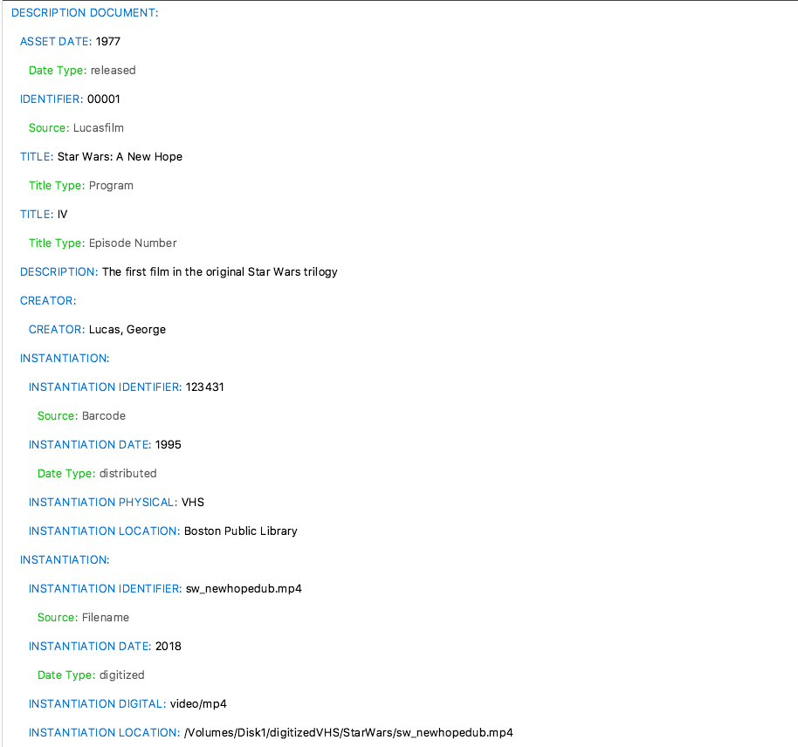
Description Document
Asset Information
Instantiation
Essence Track
Essence Track
Instantiation
Essence Track
Essence Track
Notes:
In blue, you’ll see PBCore elements; the elements are modified by attributes, in green. We’ll talk more about elements and attributes later in this presentation.

Slide 9
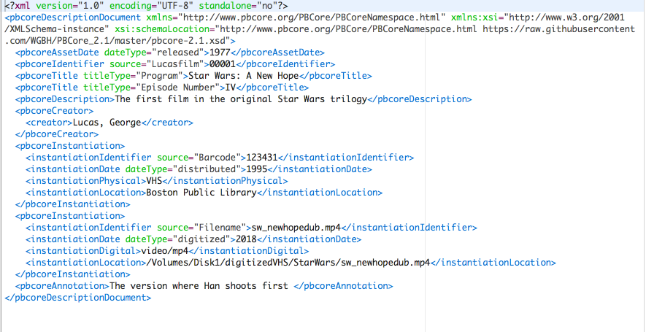
Notes:
This is the same data as on the previous slide, presented in XML.

Slide 10
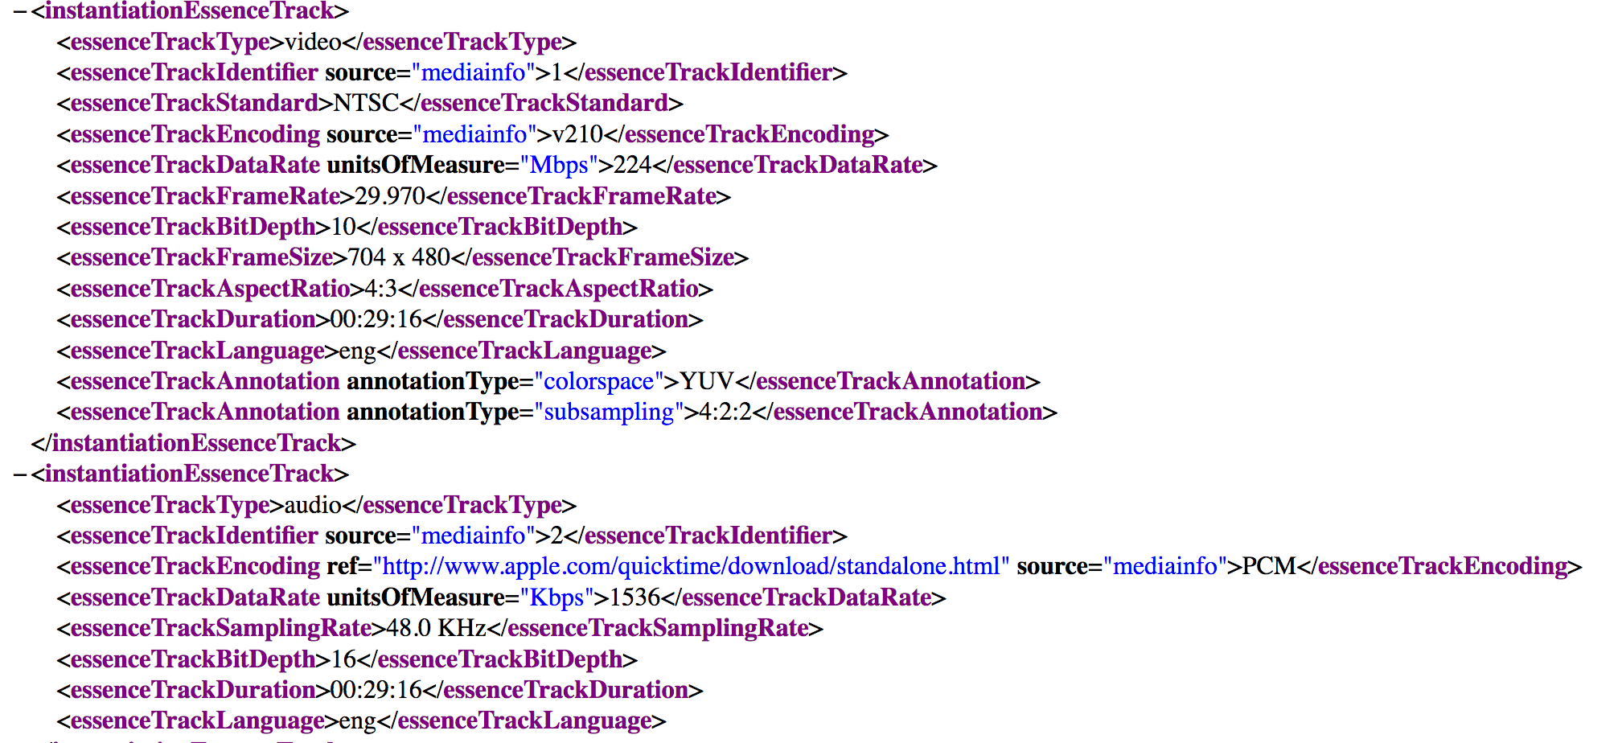
Instantiation Document
Instantiation Information
Essence Track
Essence Track

Slide 11

Collection Document
Asset
Instantiation
Instantiation
Asset
Instantiation
Instantiation
Notes:
'Collection’ is a very XML-y concept – can’t put a lot of descriptive information in a collection document, really just designed to group XML together

Slide 12
2. PBCore Elements a. Asset Elements b. Instantiation Elements c. Attributes
How do you build a PBCore record?

Slide 13
PBCore Asset Elements
pbcoreAssetType
pbcoreAssetDate
pbcoreIdentifier
pbcoreTitle
pbcoreSubject
pbcoreDescription
pbcoreGenre
pbcoreRelation
pbcoreRelationType
pbcoreRelationIdentifer
pbcoreCoverage
coverage
coverageType
pbcoreAudienceLevel
pbcoreAudienceRating
pbcoreCreator
creator
creatorRole
pbcoreContributor
contributor
contributorRole
pbcorePublisher
publisher
publisherRole
pbcoreInstantiation*
pbcoreRightsSummary
rightsSummary
rightsLink
rightsEmbedded
pbcorePart
pbcoreAnnotation
pbcoreExtension
extensionWrap
extensionElement
extensionValue
extensionAuthorityUsed
extensionEmbedded
Notes:
An element is the main building block of data in XML. Many of these may be familiar from Dublin Core or other metadata standards that you’ve used. The elements highlighted in red are required elements [discuss required elements and why Identifier, Title, and Description are considered necessary in PBCore]. I’m not going to walk through the definitions of all these elements, but I’d like to stop here and give everyone the opportunity to ask any questions you may have about any of these specific elements before we move on.

Slide 14
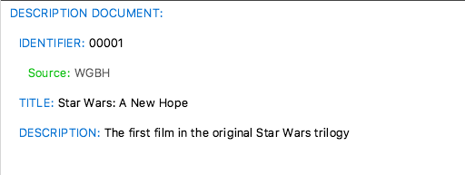
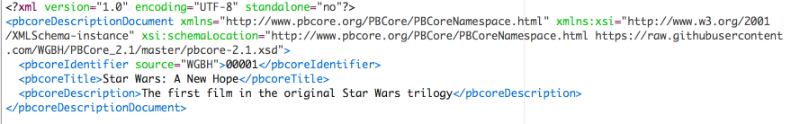
Notes:
This is the most basic PBCore description document you can have and have it still validate in XML – but if your use case doesn’t require valid PBCore XML, you wouldn’t necessarily need to hold to this

Slide 15
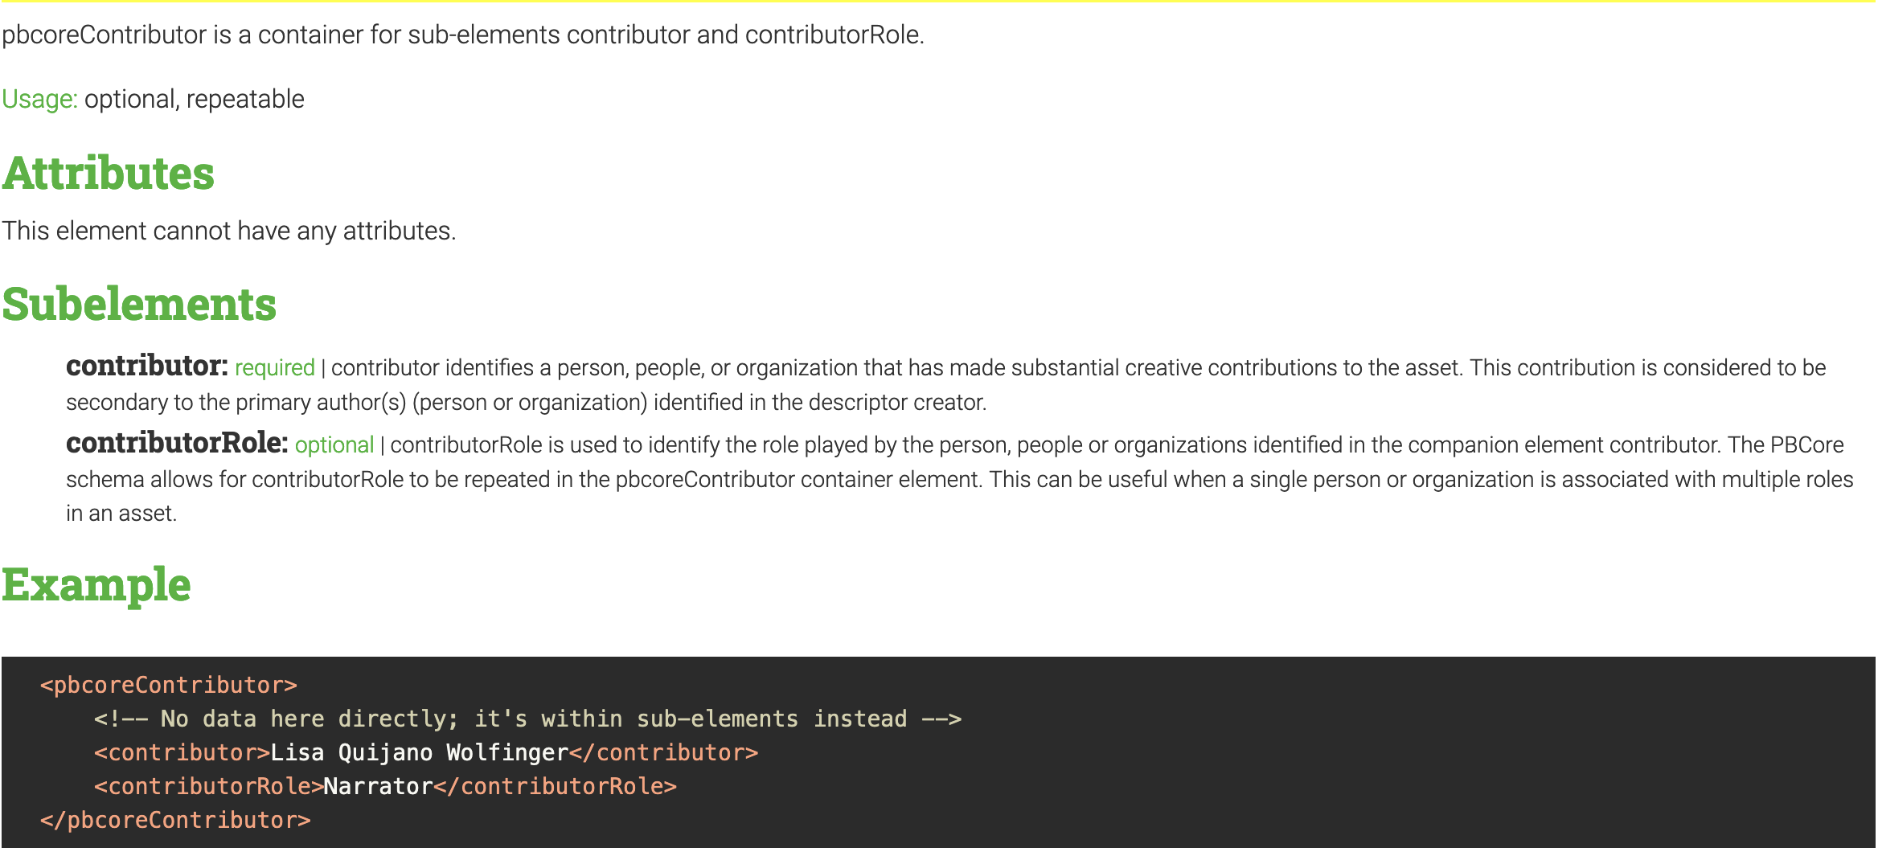
Container Elements
Notes:
Container elements don’t hold any data – they’re a way to group other, related elements together. For example, the element pbcoreContributor is a container for the elements ‘contributor’ and ‘contributorRole’, as in this example, where the creator is Lisa Quijano Wolfinger and the role she plays in the production is as the Narrator. The purpose of grouping the elements is to avoid confusion when there are multiple contributor and contributorRole associated with a production – because the name ‘Lisa Quijano Wolfinger’ and the role ‘Narrator’ are grouped, there’s no way to get them mixed up with another contributor and contributor, as there might be if the data were flat.

Slide 16
PBCore Instantiation Elements
instantiationChannelConfiguration
instantiationLanguage
instantiationAlternativeModes
instantiationEssenceTrack*
instantiationRelation
instantiationRelationType
instantiationRelationIdentifier
instantiationRights
rightsSummary
rightsLink
rightsEmbedded
instantiationAnnotation
instantiationPart
pbcoreExtension
extensionWrap
extensionElement
extensionValue
extensionAuthorityUsed
extensionEmbedded
pbcoreInstantiation
instantiationIdentifier
instantiationDate
instantiationDimensions
instantiationPhysical
instantiationDigital
instantiationStandard
instantiationLocation
instantiationMediaType
instantiationGenerations
instantiationTimeStart
instantiationFileSize
instantiationDuration
instantiationDataRate
instantiationColors
instantiationTracks
*essenceTrackType
essenceTrackIdentifier
essenceTrackStandard
essenceTrackEncoding
essenceTrackDataRate
essenceTrackFrameRate
essenceTrackPlaybackSpeed
essenceTrackSamplingRate
essenceTrackBitDepth
essenceTrackFrameSize
essenceTrackAspectRatio
essenceTrackTimeStart
essenceTrackDuration
essenceTrackLanguage
essenceTrackAnnotation
essenceTrackExtension
extensionWrap
extensionEmbedded
Notes:
A lot of the technical video properties we talked about last time appear here, as Instantiation Elements. [talk about required elements, Identifier and Location; then, talk about Essence Track elements as a way to provide even more specificity.] Again, I’m going to hold here for a minute to give people the opportunity to ask any questions they may have about any specific instantiation elements.

Slide 17
pbcoreIdentifier
instantiationIdentifier
AAPB Asset ID
PBS NOLA Code
EIDR
Barcode
File name
MD5
Notes:
You might wonder why we need two ‘identifier’ elements, one on the asset and one on the instantiation. Wouldn’t that just be the same information? Sometimes, yes, but sometimes an asset has a content identifier that’s distinct from the identifier you’d use for the instantiation. [Some examples are on this slide].

Slide 18
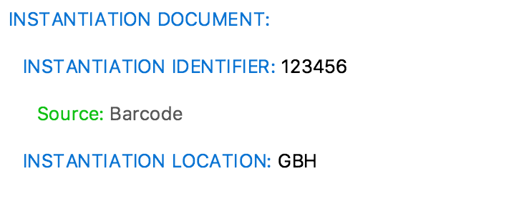
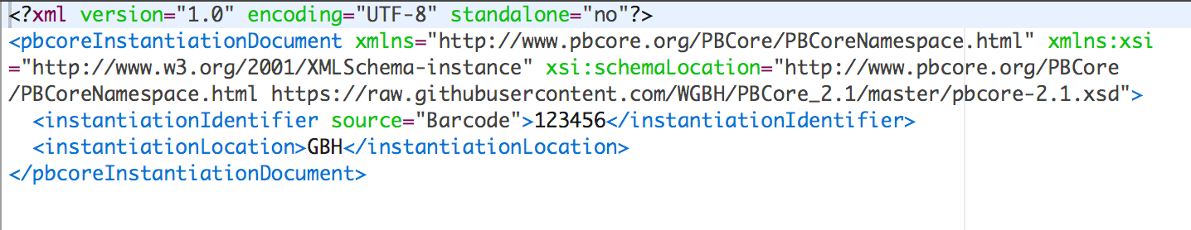
Notes:
This is the most basic PBCore instantiation document you can have and have it still validate in XML. Note again the green ‘source’ for identifier. That’s a PBCore attribute – a way to further modify the data in an element and provide more detail and specificity. ‘Identifier source’ is the only required attribute in PBCore, but there are a lot of optional attributes that provide even more scope and flexibility on how to describe your data.

Slide 19
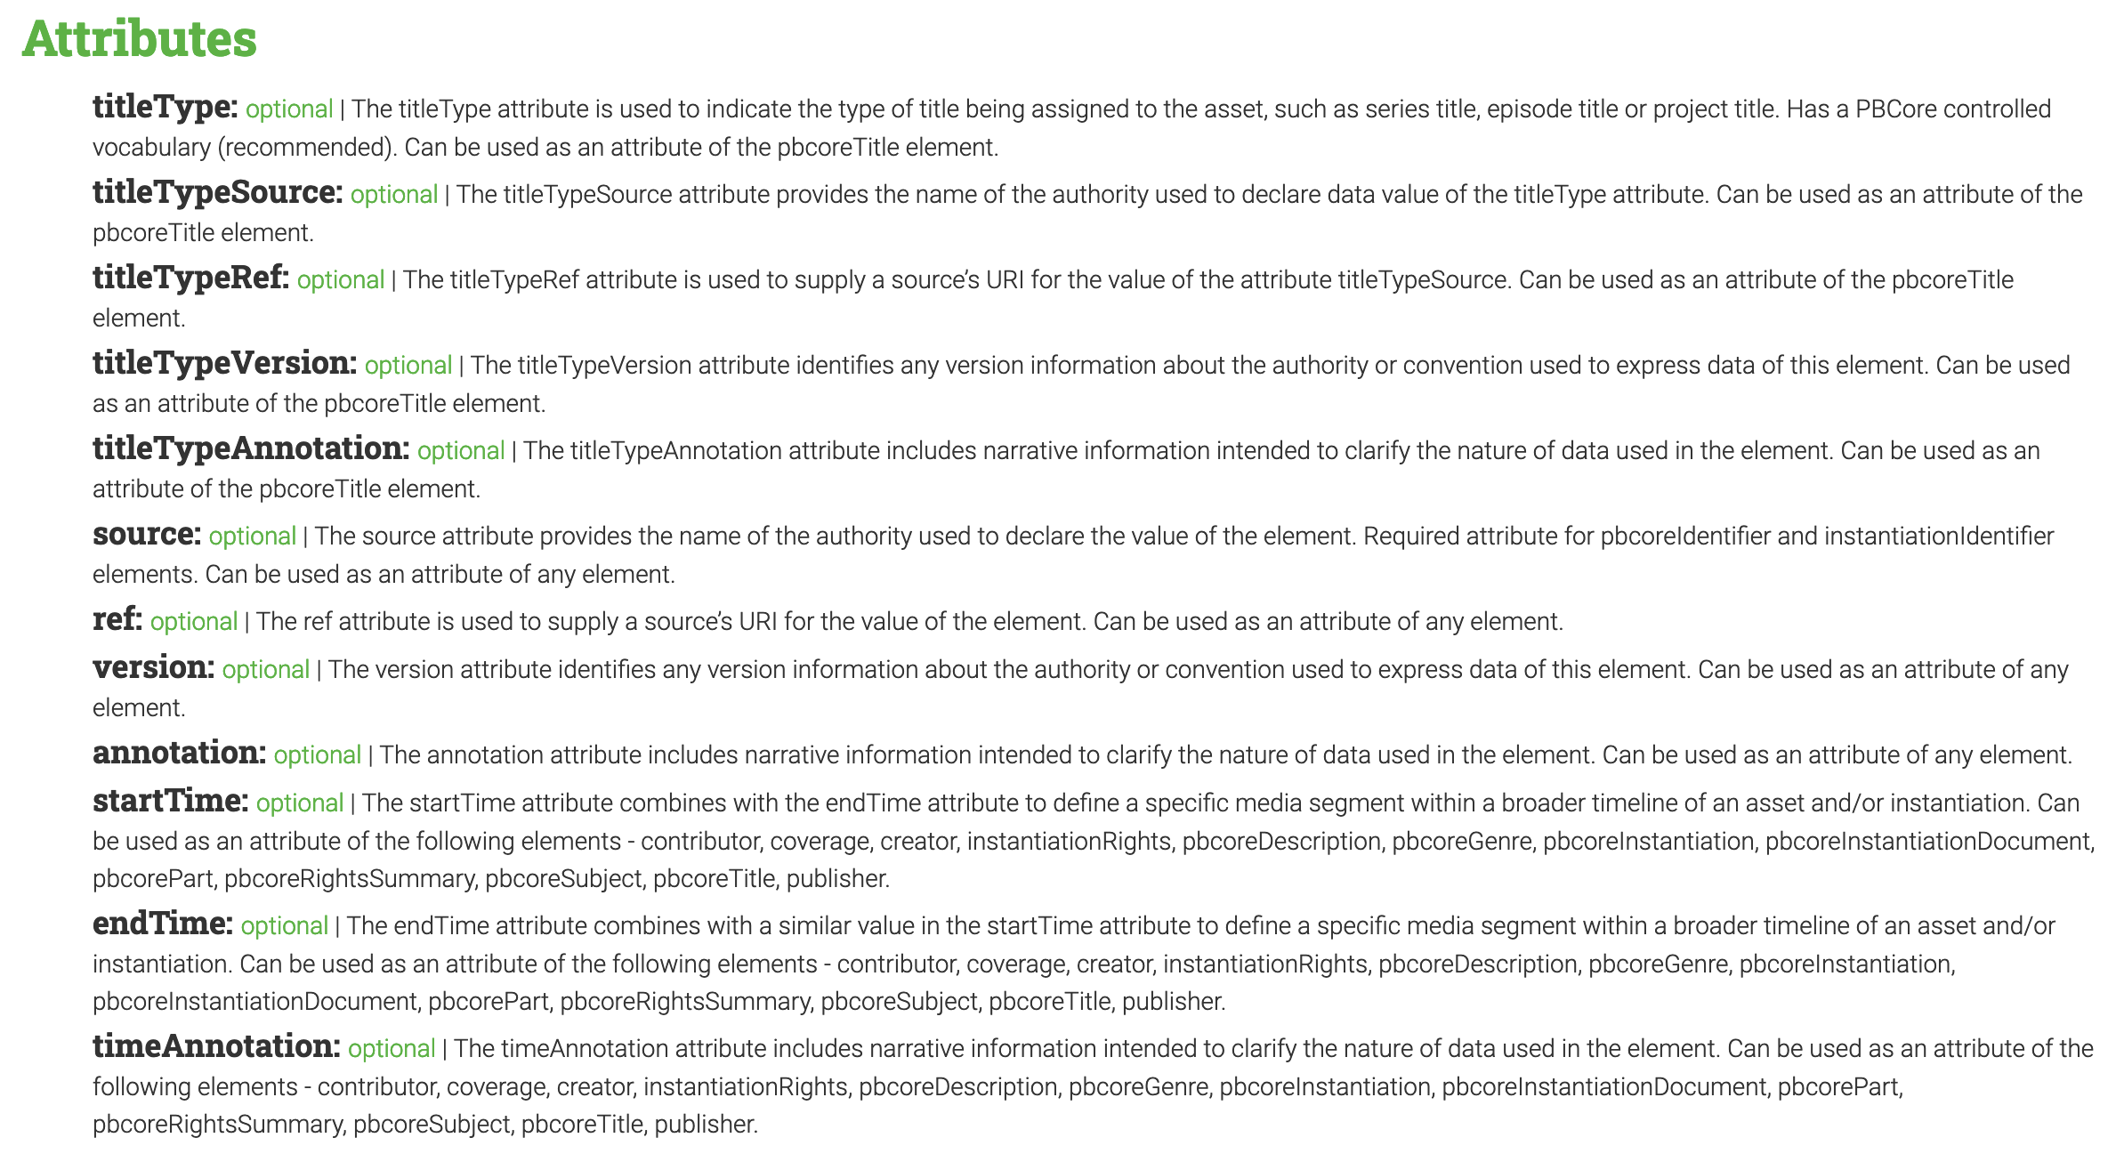
Notes:
As an example, let’s walk through the attributes available for the pbcoreTitle element. Note that all of these attributes are optional.

Slide 20
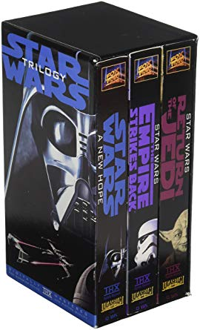
Description Document
Asset Information
Description Document
Asset Information
Description Document
Asset Information
Instantiation
Instantiation
Instantiation
Notes:
Let’s take a box set as an example. This is one way you could describe a box set of all three star Wars movies: three records for three separate films, with the asset information and then the instantiation information about the VHS.

Slide 21
Description Document
Asset Information
PBCore Part
Sub-Asset Information
Instantiation
PBCore Part
Sub-Asset Information
Instantiation
PBCore Part
Sub-Asset Information
Instantiation
Notes:
However, you could also use the pbcorePart element to structure this box set as one record, with three sub-assets. This would allow you to describe each program individually.

Slide 22
Description Document
Asset Information
Instantiation
InstantiationPart
InstantiationPart
InstantiationPart
Notes:
Or, if you wanted to consider the entire box set a single instantiation, you could also use Instantiation Part to describe the individual VHS tapes.

Slide 23
Exercise
Follow along with the class as we use the simple PBCore form to catalog an example item.
Pick one of the other example items available in the class folder, then take ten minutes to catalog it in the PBCore form. If you feel comfortable, when you’re done, email me your work at rebecca_fraimow@wgbh.org
Notes:
Talking points about the PBCore form: for simplicity, do not worry about duplicating elements such as Creator or Contributor – just pick one. Do not put data in container elements.

Slide 24
rebecca_fraimow@wgbh.org
Join us for our next webinar!
PBCore Controlled
Vocabularies
Wednesday
October 6
12:30 PM ET
OPTIONAL HOMEWORK
Complete a PBCore cataloging form and email it to me for review
Send me a case study from your organization for the final class on metadata modeling!

