Slide 1

PBCore Controlled Vocabularies

Slide 2




Slide 3
1. Review PBCore Elements 2. Restricted Values in PBCore 3. PBCore Controlled Vocabularies 4. Recommended External Vocabularies
How do you populate data in PBCore?

Slide 4
PBCore Asset Elements
pbcoreAssetType
pbcoreAssetDate
pbcoreIdentifier
pbcoreTitle
pbcoreSubject
pbcoreDescription
pbcoreGenre
pbcoreRelation
pbcoreRelationType
pbcoreRelationIdentifer
pbcoreCoverage
coverage
coverageType
pbcoreAudienceLevel
pbcoreAudienceRating
pbcoreCreator
creator
creatorRole
pbcoreContributor
contributor
contributorRole
pbcorePublisher
publisher
publisherRole
pbcoreInstantiation*
pbcoreRightsSummary
rightsSummary
rightsLink
rightsEmbedded
pbcorePart
pbcoreAnnotation
pbcoreExtension
extensionWrap
extensionElement
extensionValue
extensionAuthorityUsed
extensionEmbedded
Notes:
Let’s begin with a review of PBCore asset elements. After trying to fill out the PBCore forms last week, does anyone have new questions about any of the Asset elements?

Slide 5
PBCore Instantiation Elements
instantiationChannelConfiguration
instantiationLanguage
instantiationAlternativeModes
instantiationEssenceTrack*
instantiationRelation
instantiationRelationType
instantiationRelationIdentifier
instantiationRights
rightsSummary
rightsLink
rightsEmbedded
instantiationAnnotation
instantiationPart
pbcoreExtension
extensionWrap
extensionElement
extensionValue
extensionAuthorityUsed
extensionEmbedded
pbcoreInstantiation
instantiationIdentifer
instantiationDate
instantiationDimensions
instantiationPhysical
instantiationDigital
instantiationStandard
instantiationLocation
instantiationMediaType
instantiationGenerations
instantiationTimeStart
instantiationFileSize
instantiationDuration
instantiationDataRate
instantiationColors
instantiationTracks
*essenceTrackType
essenceTrackIdentifier
essenceTrackStandard
essenceTrackEncoding
essenceTrackDataRate
essenceTrackFrameRate
essenceTrackPlaybackSpeed
essenceTrackSamplingRate
essenceTrackBitDepth
essenceTrackFrameSize
essenceTrackAspectRatio
essenceTrackTimeStart
essenceTrackDuration
essenceTrackLanguage
essenceTrackAnnotation
essenceTrackExtension
extensionWrap
extensionEmbedded
Notes:
How about the Instantiation elements? Any new questions there?

Slide 6
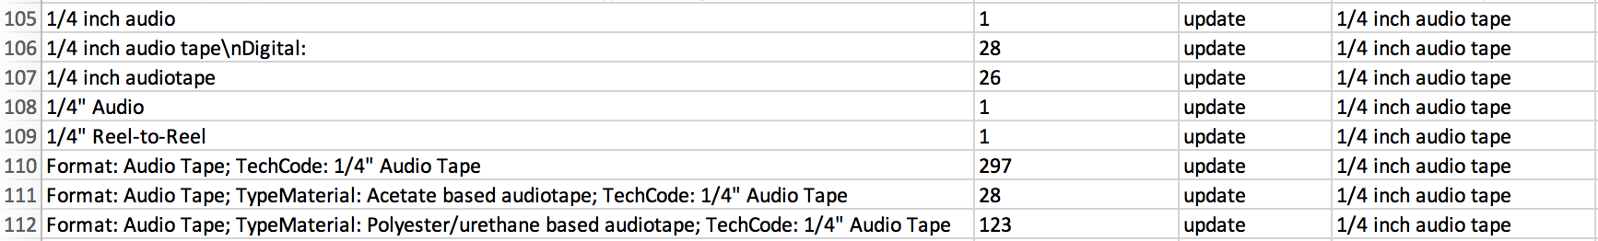
Why are controlled vocabularies important?
Notes:
Here’s an example of unrestricted data from the initial survey conducted by the American Archive of Public Broadcasting to find out what kind of tapes were being held at public media stations around the country. We let people enter the data however they wanted, instead of providing a drop-down or restricted list. That created a challenge. Here’s some examples of entries that were all recognizably the same kind of format – ¼” open reel audio tape – being described in different ways …

Slide 7
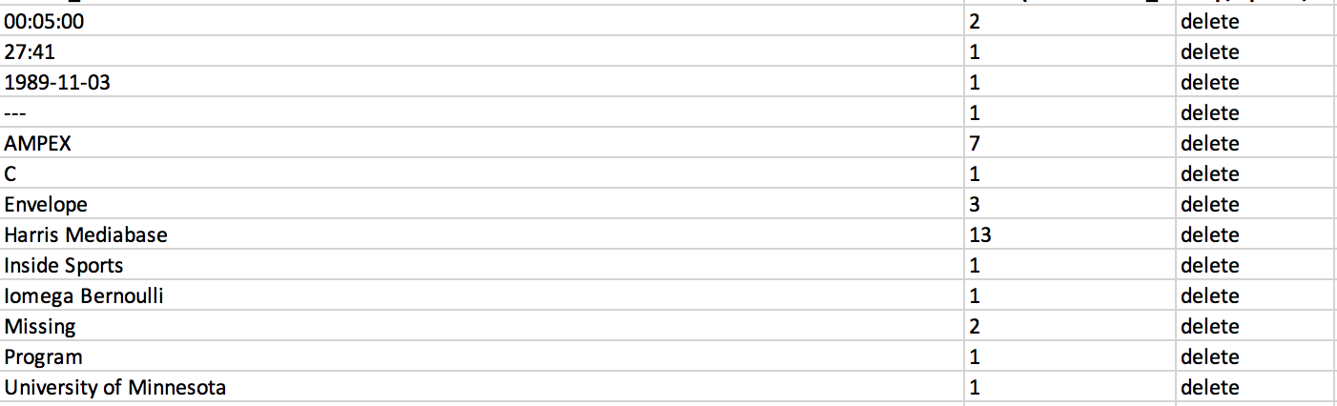
Why are controlled vocabularies important?
Notes:
… and here are some format values that people put in that didn’t seem to correspond to a recognizable media format at all.

Slide 8
1. Review PBCore Elements 2. Restricted Values in PBCore 3. PBCore Controlled Vocabularies 4. Recommended External Vocabularies
How do you populate data in PBCore?

Slide 9
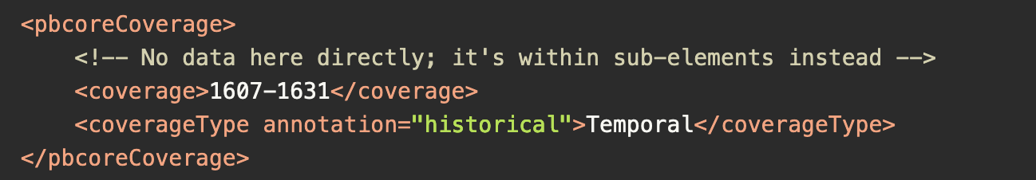
PBCore Elements with Restricted Values
coverageType: must be Spatial or Temporal

Slide 10
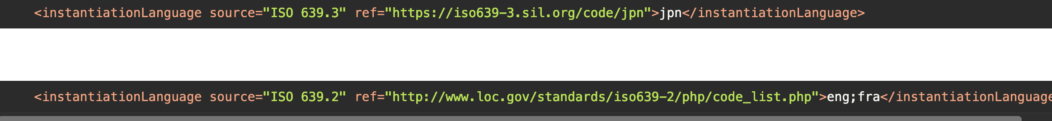
PBCore Elements with Restricted Values
instantiationLanguage: must be indicated using 3-letter codes from ISO 639 (eng, spa, jpn, etc.)

Slide 11
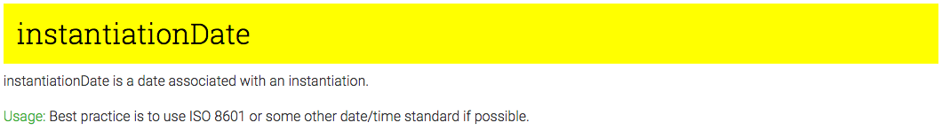
Notes:
ISO 8601 = yyyy/mm/dd

Slide 12
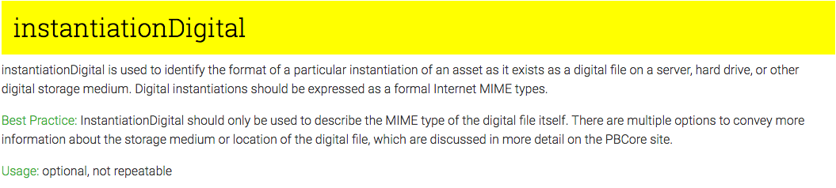

Slide 13
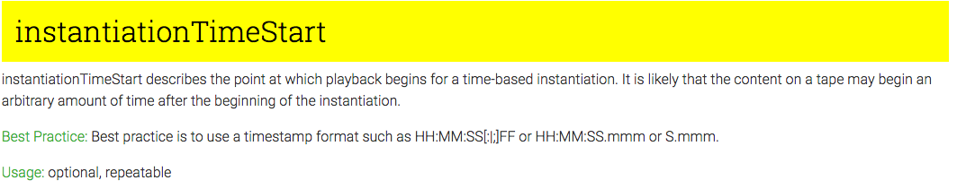
Notes:
ISO 8601 = yyyy/mm/dd

Slide 14
1. Review PBCore Elements 2. Restricted Values in PBCore 3. PBCore Controlled Vocabularies 4. Recommended External Vocabularies
How do you populate data in PBCore?

Slide 15
PBCore Controlled Vocabularies
pbcoreAssetType
@dateType
@titleType
@descriptionType
pbcoreRelationType
instantiationRelationType
creator/contributorRole
publisherRole
instantiationPhysical
instantiationMediaType
instantiationGenerations
Notes:
Walk through each of the vocabularies on the website, highlight unique features, ask for questions about any of the terminology.

Slide 16

Title: Nova
@titleType: Series
Title: Black Hole Apocalypse
@titleType: Episode
Title: 4501
@titleType: Episode Number
Notes:
Here’s an example of how to use the titleType attribute with controlled vocabularies to provide a more complete description of an item.

Slide 17

Notes:
Exercise – what tiles and title types for this film?

Slide 18
Title: Star Wars
@titleType: Original
Title: Star Wars: A New Hope
@titleType: Revised
Title: A New Hope
@titleType: Alternate
Title: Star Wars
@titleType: Series
Title: A New Hope
@titleType: Episode
Title: IV
@titleType: Episode Number
Notes:
Exercise – what tiles and title types for this film?

Slide 19
1. Review PBCore Elements 2. Restricted Values in PBCore 3. PBCore Controlled Vocabularies 4. Recommended External Vocabularies
How do you populate data in PBCore?

Slide 20
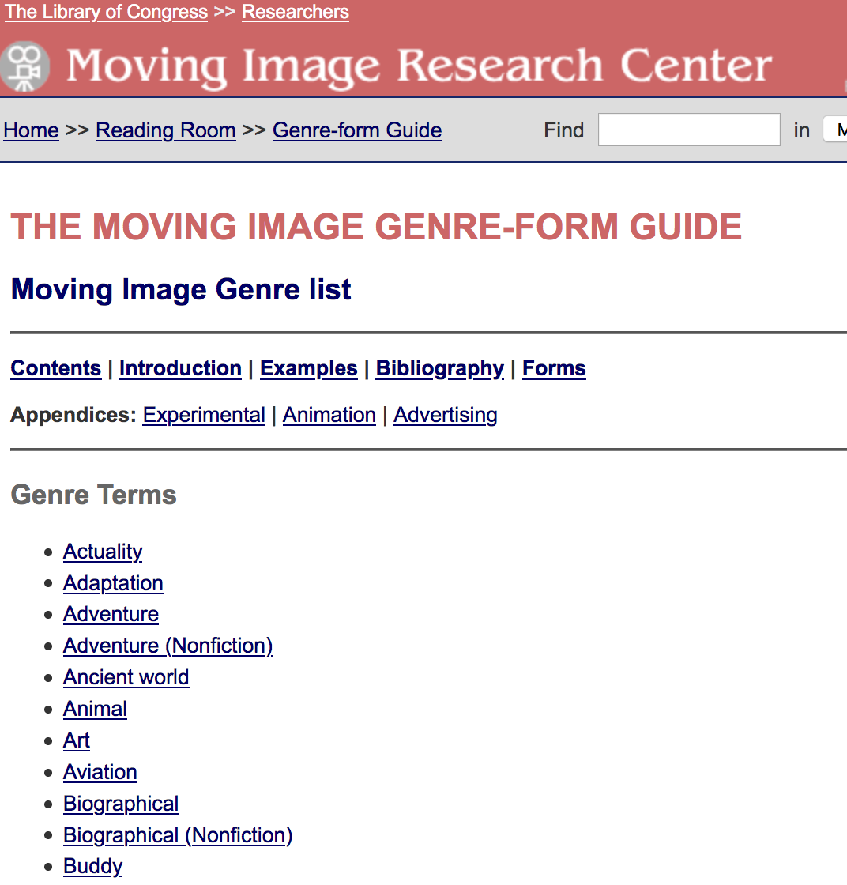
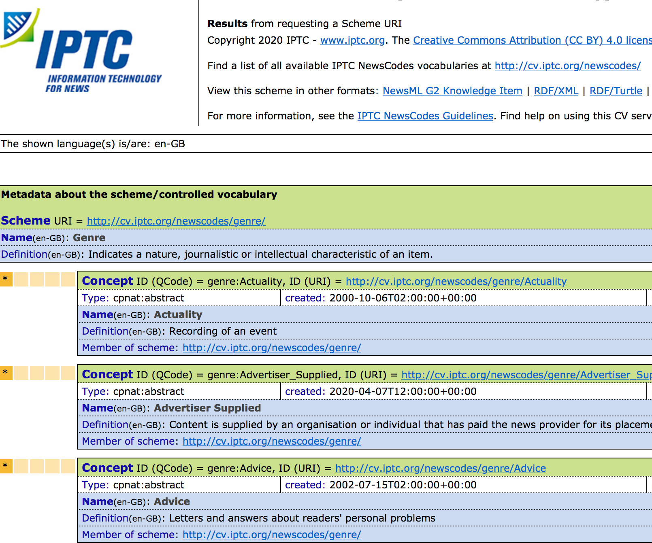
Notes:
There are a number of vocabularies that PBCore doesn’t support, because other authorities are already doing it better. On the PBCore website, we’ll often recommend existing vocabularies for users that want to adopt a controlled vocabulary for that element, or organizations can come up with their own.

Slide 21
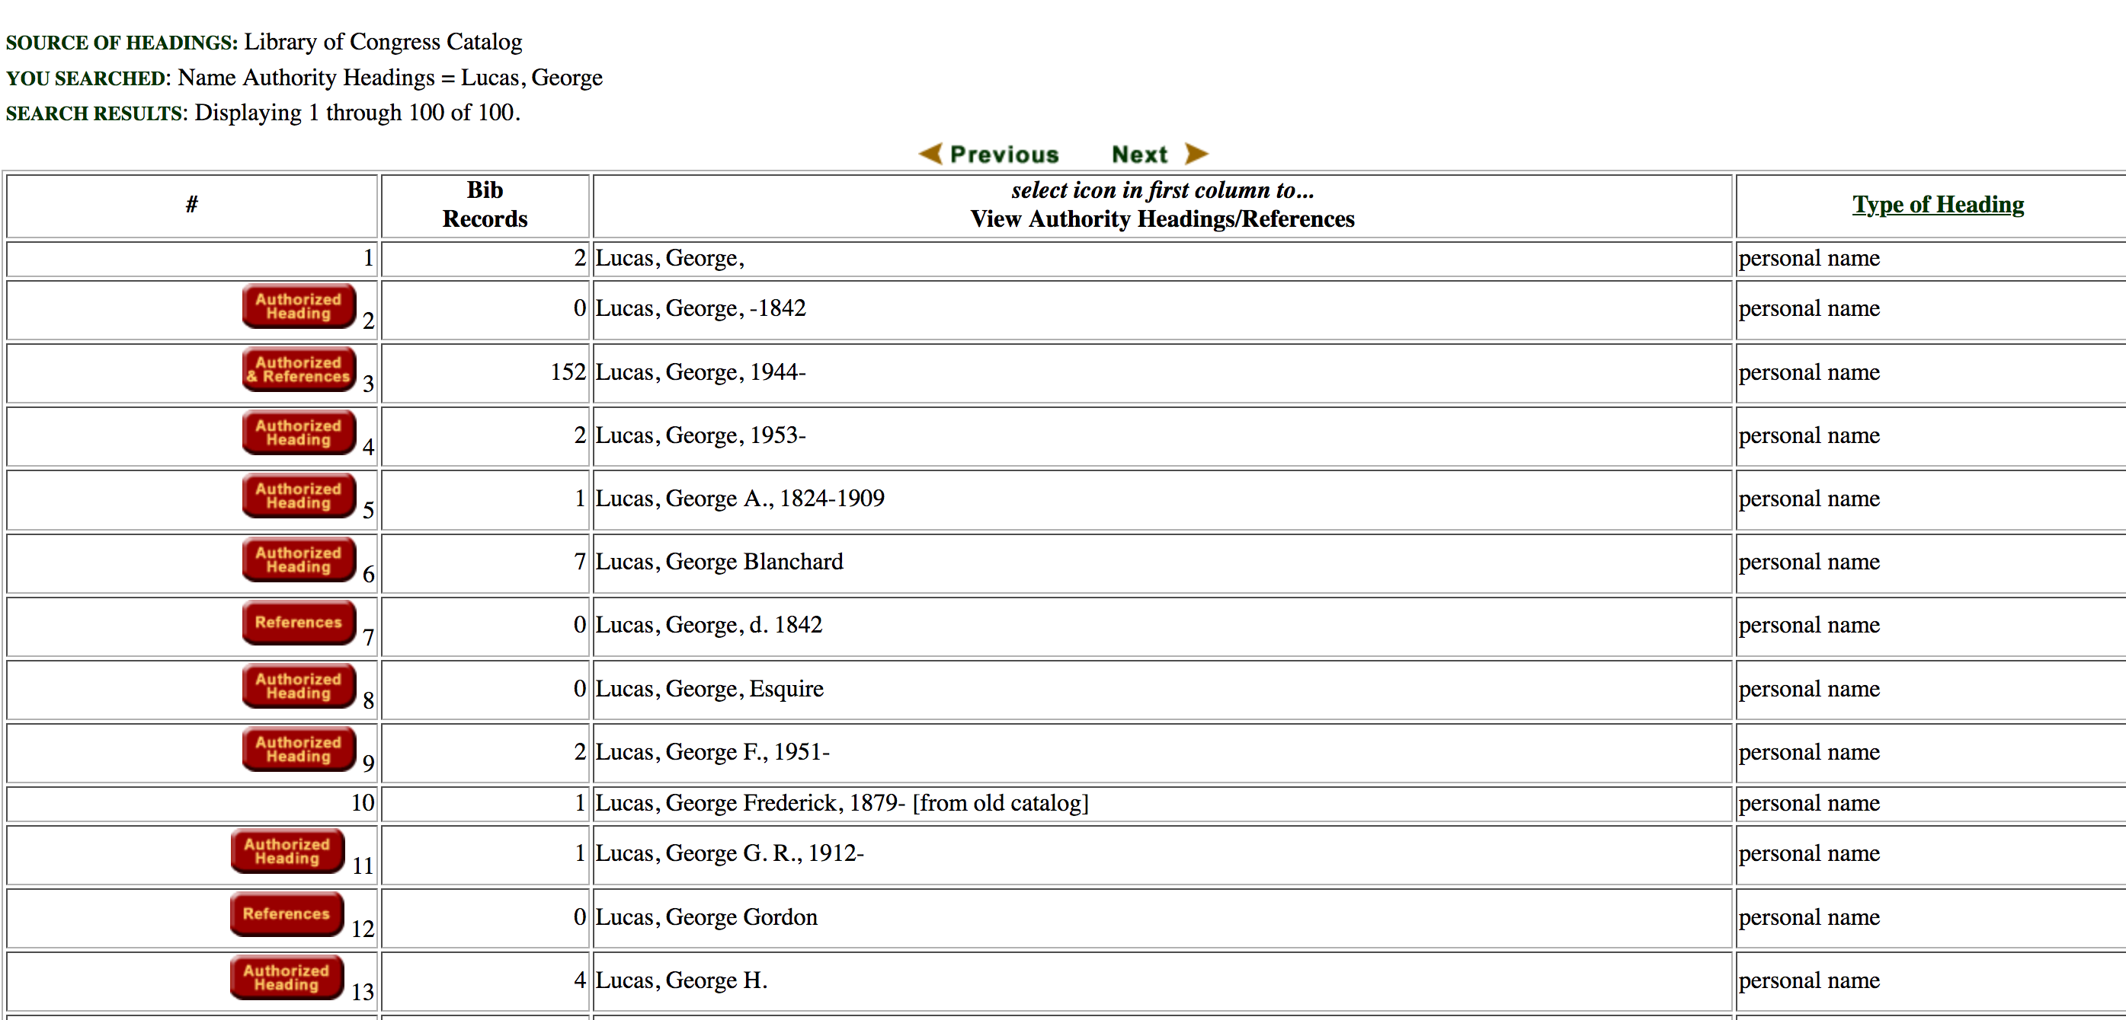

Slide 22
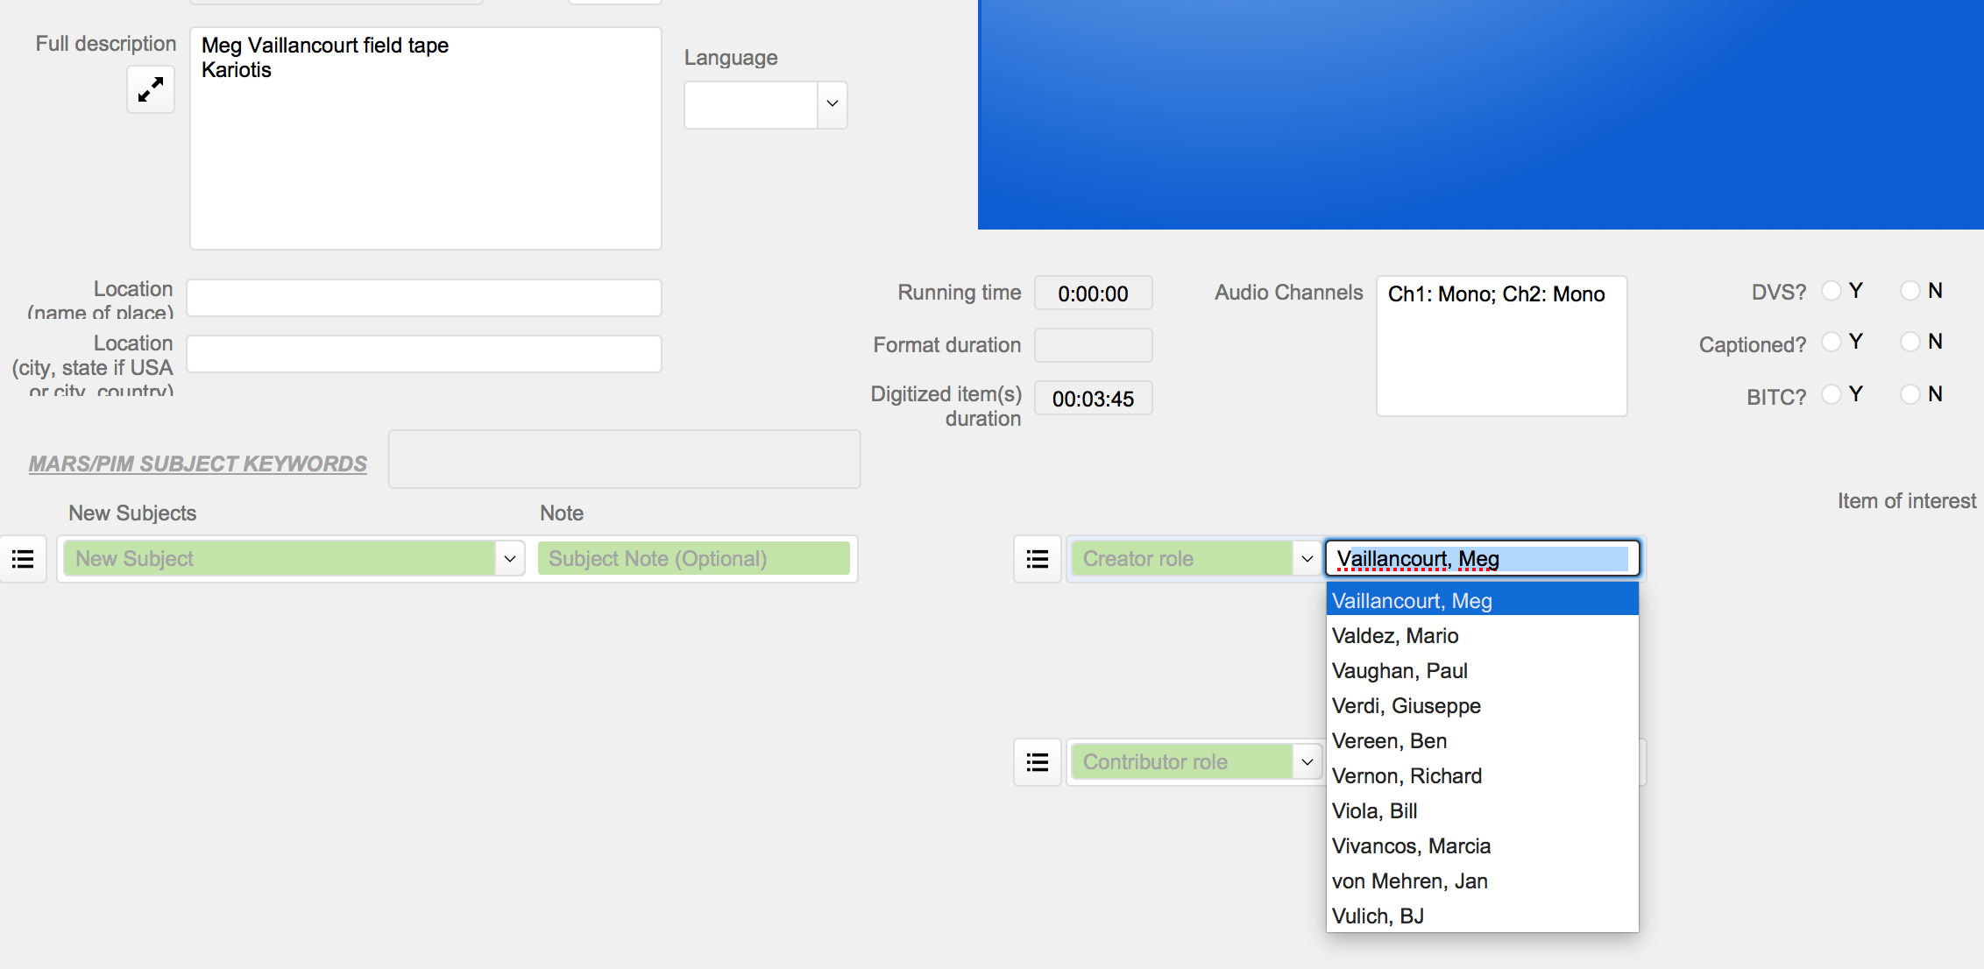
Notes:
Sometimes, even if you don’t want to use a controlled vocabulary list because there are too many potential values, you want to ensure that values are utilized consistently in every record. Our cataloging database at GBH tracks creators and contributors that have been entered into previous records so that catalogers can see whether a name has already been used with an established spelling.

Slide 23
Exercise
Review the example item linked in your breakout group.
Using the attached PBCore form, take five minutes to catalog your item as thoroughly as you can in the available time on your own. Do not refer to the controlled vocabulary lists.
In your breakout groups, compare your PBCore records. Does your terminology match? Check the PBCore controlled vocabulary lists, and, as a group, update your records with a controlled vocabulary term where available.

Slide 24
rebecca_fraimow@wgbh.org
Join us for our next webinar!
Using the PBCore Cataloging Tool
Wednesday
October 13
12:30 PM ET

